Slide 1




The TRAVERSE Sexual Function Substudy

Slide 2


TRAVERSE Sexual Function Substudy: aims
TRAVERSE Sexual Function Substudy
Primary
To evaluate whether TRT for 1 year in men with hypogonadism and low libido improves overall sexual activity more than placebo
Secondary
To determine whether improvements in sexual activity over 1 year are maintained
after 2 years of TRT versus placebo
To determine whether TRT improves hypogonadal symptoms more than placebo
over 1 and 3 years of treatment
To determine whether TRT improves sexual desire and erectile function more than placebo over 1 year
To determine whether the improvements in sexual desire and erectile function
over 1 year are maintained after 2 years
TRT, testosterone replacement therapy.

Slide 3

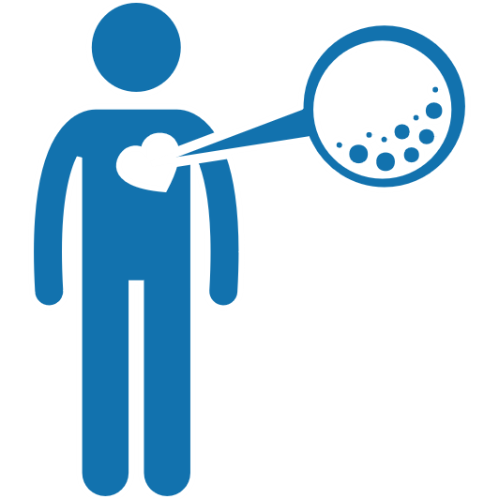
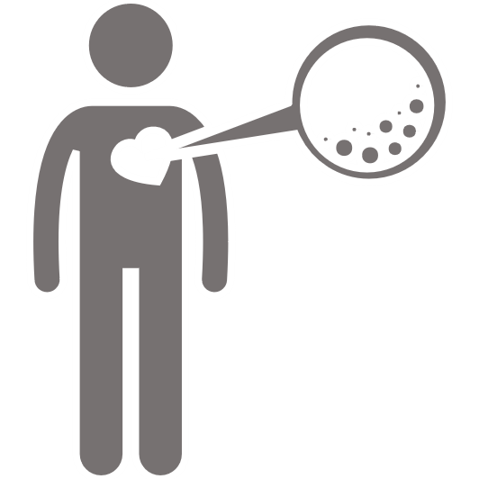
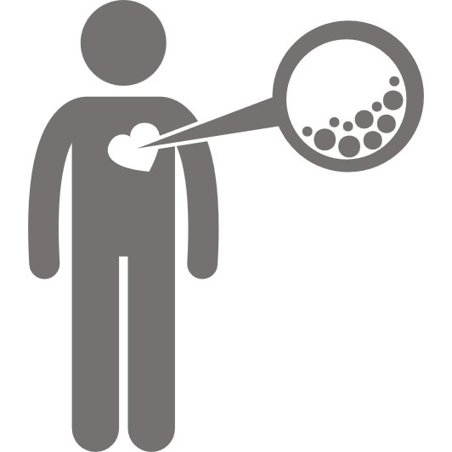
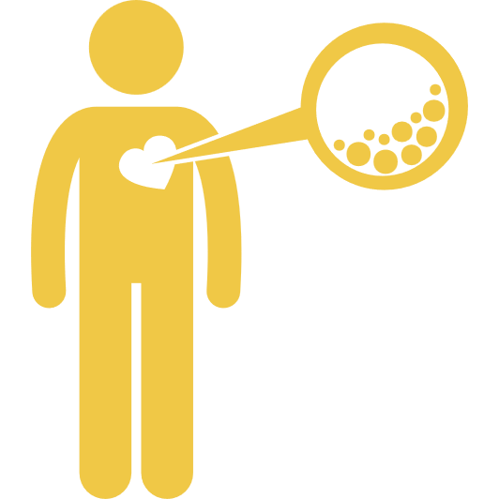
TRAVERSE Sexual Function Substudy: results
Baseline characteristics, CVD and risk factors
 | Testosterone (n=587) | Placebo (n=574)
Mean (SD) age, years Age ≥65 years, n (%) of patients | 64.0 ± 7.5 299 (50.9) | 63.3 ± 7.8 279 (48.6)
Race/ethnicity, n (%) of patients White Black or African American Other | 488 (83.1) 82 (14.0) 17 (2.9) | 475 (82.8) 75 (13.1) 24 (4.2)
Prior testosterone use, n (%) of patients | 2 (0.3) | 2 (0.3)
Prior CVD, n (%) of patients | 289 (49.2) | 294 (51.2)
At risk for CVD, n (%) of patients | 298 (50.8) | 280 (48.8)
Dyslipidaemia, n (%) of patients | 542 (92.3) | 527 (91.8)
Hypertension, n (%) of patients | 559 (95.2) | 529 (92.2)
CVD, cardiovascular disease; SD, standard deviation.

Slide 4
TRAVERSE Sexual Function Substudy: results
Baseline hypogonadism and sexual function
 | Testosterone (n=587) | Placebo (n=574)
Sexual activity: PDQ-4 score Mean (SD) PDQ-4 score per day Not sexually active (PDQ-4 score = 0), n (%) of patients | 1.8 (1.7) 70 (11.9) | 1.8 (1.8) 59 (10.3)
Mean (SD) HIS-Q composite total score | 46.9 (11.5) [n=563] | 46.8 (12.0) [n=550]
Mean (SD) HIS-Q sexual function domain score | 63.1 (19.0) [n=565] | 63.4 (19.7) [n=553]
Mean (SD) HIS-Q libido subdomain score | 65.4 (16.8) [n=567] | 65.8 (17.1) [n=553]
Mean (SD) DISF – Desire score* | 12.0 (5.3) | 12.0 (5.2)
Mean (SD) IIEF total score | 13.0 (5.7) [n=328] | 12.8 (5.7) [n=325]
Using a PDE-5 inhibitor, n (%) of patients | 51 (8.7) | 56 (9.8)
*A DISF – Desire score <20 was an inclusion criterion of the TRAVERSE Sexual Function Substudy.
DISF, DeRogatis Interview for Sexual Functioning; HIS-Q, Hypogonadism Impact of Symptoms Questionnaire; IIEF, International Index of Erectile Function;
PDE-5, phosphodiesterase type 5; PDQ-4, Psychosexual Daily Diary Question 4; SD, standard deviation.

Slide 5


TRAVERSE Sexual Function Substudy: results
Effect of testosterone or placebo on sexual activity
Hypogonadal men with low libido at baseline
PDQ-4 to evaluate sexual activity
The PDQ is a daily self-reported questionnaire
PDQ-4 score is calculated as the average
of the weekly values for all items (+1 for every yes and 0 for every no) at 6, 12 or 24 months
since baseline
Estimated mean (95% CI) between-group difference
in acts per day; omnibus test p=0.011
2.0
Testosterone
Placebo
0.48
(-0.01, 0.96)
Q4. For all the items below, select yes if you have experienced
(or are experiencing) today, otherwise select no
Sexual daydreams
Anticipation of sex
Sexual interactions with partner
Flirting (by you)
Orgasm
Flirting (by others toward you)
Ejaculation
1.5
0.49
(0.19, 0.79)
0.47
(0.11, 0.83)
N
Intercourse
Masturbation
Night spontaneous
erection
Day spontaneous
erection
Erection in response
to sexual activity
Y
Y
N
Change from baseline in PDQ-4 score
Y
N
Y
N
1.0
Y
N
Y
N
Y
N
0.5
Y
N
Y
N
Y
N
Y
N
Y
N
0
0
6
12
24
Months since randomisation
Patients, n
Testosterone
Placebo
587 260 170 106
574 259 171 95
Lee KK et al. J Androl 2003;24:688–98.
CI, confidence interval; PDQ-4, Psychosexual Daily Diary Question 4.

Slide 6



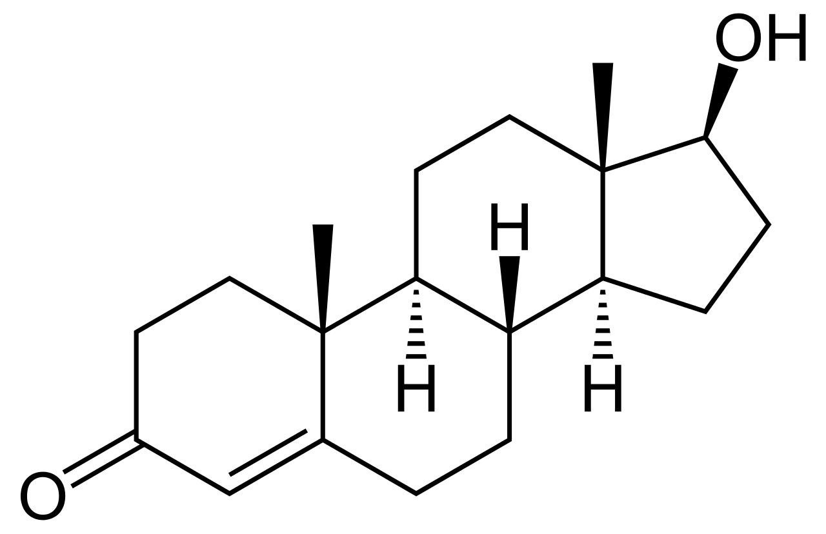


TRAVERSE Sexual Function Substudy: results
Prespecified analyses: effect on sexual activity by PDQ-4 score
The observed significant improvements in PDQ-4 score with testosterone versus placebo were irrespective of the following:
Subgroup |  |  | p value for interaction
 | Age | <65 years | 0.338
 |  | ≥65 years
 | Prior CVD | Yes | 0.421
 |  | No
 | Baseline testosterone level | <250 ng/dL (<8.7 nmol/L) | >0.05
 |  | ≥250 ng/dL (≥8.7 nmol/L)
 | Race/ethnicity | Black | >0.05
 |  | White
PDQ-4, Psychosexual Daily Diary Question 4.

Slide 7
TRAVERSE Sexual Function Substudy: results
Effects on symptoms of hypogonadism evaluated using the HIS-Q
Sexual Function substudy
Full Analysis set
Estimated mean (95% CI) between-group difference; omnibus test p=0.001
Estimated mean (95% CI) between-group difference; omnibus test p<0.001
5
Testosterone
Placebo
5
Testosterone
Placebo
0
-2.3
(-3.6, -1.0)
-2.7
(-4.3, -1.0)
0
-1.6
(-2.2, -0.9)
-1.5
(-2.3, -0.7)
Change from baseline in HIS-Q composite
-2.5
(-3.9, -1.1)
Change from baseline in HIS-Q composite
-1.7
(-2.3, -1.0)
-5
-5
-10
-10
0
6
12
24
0
6
12
24
Months since randomisation
Months since randomisation
Patients, n
Testosterone
Placebo
587 476 384 305 2601 2054 1694 1267
574 464 388 285 2603 2019 1679 1206
CI, confidence interval; HIS-Q, Hypogonadism Impact of Symptoms Questionnaire.

Slide 8
TRAVERSE Sexual Function Substudy: results
Effects on sexual symptoms evaluated using the HIS-Q
Sexual Function substudy
Full Analysis set
Estimated mean (95% CI) between-group difference; omnibus test p=0.019
Estimated mean (95% CI) between-group difference; omnibus test p=0.001
5
Testosterone
Placebo
5
Testosterone
Placebo
-2.7
(-5.1, -0.3)
-4.0
(-6.8, -1.3)
-3.4
(-6.4, -0.3)
0
0
Change from baseline in HIS-Q sexual function
Change from baseline in HIS-Q sexual function
-5
-5
-10
-10
0
6
12
24
0
6
12
24
Months since randomisation
Months since randomisation
Patients, n
Testosterone
Placebo
587 481 388 307 2601 2077 1714 1289
574 471 394 288 2603 2042 1703 1218
CI, confidence interval; HIS-Q, Hypogonadism Impact of Symptoms Questionnaire.

Slide 9
TRAVERSE Sexual Function Substudy: results
Effects on sexual desire evaluated using the HIS-Q
Sexual Function substudy
Full Analysis set
Estimated mean (95% CI) between-group difference; omnibus test p=0.001
Estimated mean (95% CI) between-group difference; omnibus test p<0.001
5
Testosterone
Placebo
5
Testosterone
Placebo
0
-3.9
(-5.8, -1.9)
-3.4
(-5.9, -0.9)
0
Change from baseline in HIS-Q libido
-3.3
(-5.5, -1.1)
Change from baseline in HIS-Q libido
-5
-5
-10
-10
0
6
12
24
0
6
12
24
Months since randomisation
Months since randomisation
Patients, n
Testosterone
Placebo
587 484 390 308 2601 2082 1715 1287
574 473 394 288 2603 2042 1711 1224
CI, confidence interval; HIS-Q, Hypogonadism Impact of Symptoms Questionnaire.

Slide 10
TRAVERSE Sexual Function Substudy: results
Effects on erectile function evaluated using the IIEF-5
Sexual Function substudy
Estimated mean (95% CI) between-group difference; omnibus test p=0.443
5
Testosterone
Placebo
4
3
Change from baseline in IIEF-5 score
2
1
0
0
12
24
Months since randomisation
Patients, n
Testosterone
Placebo
587 181 58
574 161 50
CI, confidence interval; IIEF-5, International Index of Erectile Function.

Slide 11

TRAVERSE Sexual Function Substudy
Conclusions
In middle-aged and older men with hypogonadism and established CVD or multiple risk factors for incident cardiac events, who also reported low libido:
  Testosterone was significantly more efficacious than placebo
  at improving overall sexual activity, hypogonadal symptoms
  and sexual desire, but not erectile function
  The improvements in sexual activity over 1 year were maintained
  for up to 2 years of treatment
CVD, cardiovascular disease.

Slide 12
The TRAVERSE Trial
Overall synthesis
TRAVERSE, the largest RCT of TRT to date, has provided important data on the
CV and prostate safety of TRT and its effects on several efficacy endpoints
The findings apply only to middle-aged and older men with a confirmed diagnosis of hypogonadism, and should not be extended to men who do not have hypogonadism or to longer treatment durations
Rates of loss-to-follow-up and study drug discontinuation were high, but not dissimilar to those in RCTs in other symptomatic conditions; non-retention rates were similar
The trial’s findings will facilitate a more informed consideration of the potential benefits and risks of TRT and treatment decisions in middle-aged and older men with hypogonadism
CV, cardiovascular; RCT, randomised controlled trial; TRT, testosterone replacement therapy.

