Slide 1
The TRAVERSE Diabetes Substudy

Slide 2
Background and gaps in knowledge
?
Background
Gaps in knowledge
Nearly 35% of the US population has prediabetes
Diabetes is a major public health problem globally
Low T levels are associated with an increased risk of diabetes
Severe T deficiency is associated with increased fat mass, insulin resistance, and increased risk of diabetes
TTh reduces whole body and visceral fat, and improves muscle mass and insulin sensitivity in men with hypogonadism
Uncontrolled registry study: decrease in HbA_{1c} and lower rate of progression from prediabetes to diabetes in men on TTh vs men not receiving TTh
The efficacy of TTh in preventing progression from prediabetes to diabetes has not been evaluated
No large RCT has evaluated the effects of TTh on glycaemic remission in men with hypogonadism and diabetes
HbA_{1c}, glycated haemoglobin; RCT, randomised controlled trial; T, testosterone; TTh, testosterone therapy.
Bullard KM et al. Diabetes Care 2013;36:2286–93; Ding EL et al. JAMA 2006;295:1288–99; Jones TH et al. Diabetes Care 2011;34:828–37; Yialamas MA et al. J Clin Endocrinol Metab 2007;92:4254–9.

Slide 3
TRAVERSE Diabetes substudy: aims
TRAVERSE Diabetes substudy
Primary
To evaluate the efficacy of TTh versus placebo in preventing progression from prediabetes to diabetes in middle-aged and older men with hypogonadism and prediabetes
Secondary
To evaluate the effects of TTh versus placebo on the incidence of glycaemic remission in middle-aged and older men with hypogonadism and diabetes
To evaluate the effects of TTh versus placebo on changes in fasting glucose and HbA_{1c} in men with hypogonadism and prediabetes or diabetes
HbA_{1c}, glycated haemoglobin; TTh, testosterone therapy.
Bhasin S et al. JAMA Intern Med 2024; doi: 10.1001/jamainternmed.2023.7862.

Slide 4
TRAVERSE Diabetes substudy
Eligibility criteria and analytical approach
Analytic sample for progression from prediabetes to diabetes
Included all randomised participants who had prediabetes (HbA_{1c} between 5.7% and 6.4%, and ≥1 fasting glucose measurement between 100 and 125 mg/dL
Excluded men with a known diagnosis of diabetes or using a diabetes medication
Analytic sample for glycaemic remission
Included all randomised participants who had diabetes at baseline (HbA_{1c} >6.5%; fasting glucose >125 mg/dL; current diagnosis of diabetes; current use of diabetes medication)
HbA_{1c}, glycated haemoglobin.
Bhasin S et al. JAMA Intern Med 2024; doi: 10.1001/jamainternmed.2023.7862.

Slide 5
TRAVERSE Diabetes substudy: results
Rates of progression to diabetes in men with prediabetes
RR (95% CI) Testosterone Placebo
n=607, n/N (%) n=568, n/N (%)
Month 6
0.47 (0.14–1.55) 4/598 (0.7) 8/562 (1.4)
Month 12
0.76 (0.52–1.10) 45/575 (7.8) 57/533 (10.7)
Month 24
0.73 (0.52–1.02) 50/494 (10.1) 67/460 (14.6)
Month 36
0.78 (0.55–1.11) 46/359 (12.8) 52/330 (15.8)
Month 48
0.74 (0.46–1.16) 22/164 (13.4) 19/121 (15.7)
0.4
0.5
0.6
0.7
0.8
0.9
1
2
Omnibus test p=0.49
Lower with testosterone
Higher with testosterone
Proportionate risk
CI, confidence interval; RR, risk ratio. Bhasin S et al. JAMA Intern Med 2024; doi: 10.1001/jamainternmed.2023.7862.

Slide 6
TRAVERSE Diabetes substudy: results
Risk of glycaemic remission in men with diabetes at baseline
RR (95% CI) Testosterone Placebo
n=1917, n/N (%) n=1963, n/N (%)
Month 6
1.44 (0.46–4.53) 7/1898 (0.4) 5/1942 (0.3)
Month 12
1.10 (0.80–1.49) 78/1808 (4.3) 74/1858 (4.0)
Month 24
1.13 (0.84–1.52) 82/1619 (5.1) 70/1617 (4.3)
Month 36
1.08 (0.80–1.46) 64/1251 (5.1) 61/1254 (4.9)
Month 48
1.13 (0.82–1.55) 24/517 (4.6) 23/501 (4.6)
0.7
0.8
0.9
1
2
Omnibus test p=0.95
Lower with testosterone
Higher with testosterone
Proportionate risk
CI, confidence interval; RR, risk ratio. Bhasin S et al. JAMA Intern Med 2024; doi: 10.1001/jamainternmed.2023.7862.

Slide 7
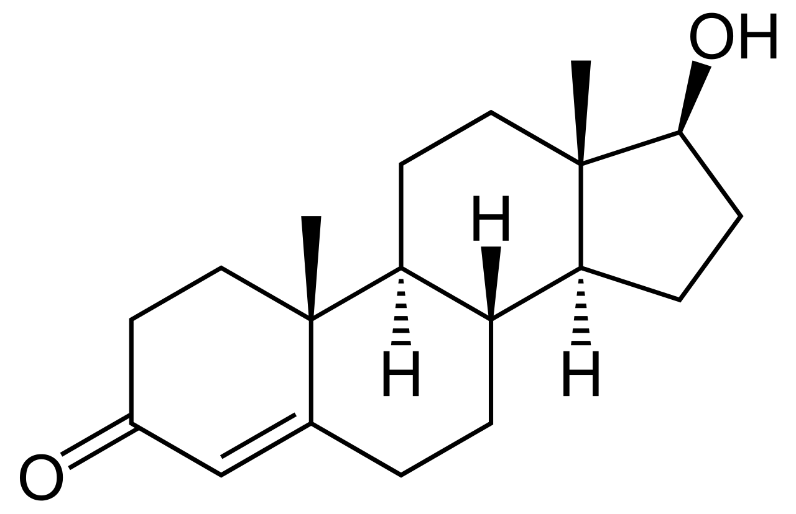
TRAVERSE Diabetes substudy: results
Prespecified analyses
The observed lack of a significant difference between testosterone versus placebo groups for either progression to diabetes in men with prediabetes at baseline, or glycaemic remission in men with diabetes at baseline, was irrespective of the following:
Baseline
testosterone
level
<250 or ≥250 ng/dL (<8.7 or ≥8.7 nmol/L)
Age
<65 or ≥65 years
Black/ African-American or White
Prior CVD
<250 or ≥250 ng/dL (<8.7 or ≥8.7 nmol/L)
Race/
ethnicity
CVD, cardiovascular disease.
Bhasin S et al. JAMA Intern Med 2024; doi: 10.1001/jamainternmed.2023.7862.

Slide 8
TRAVERSE Diabetes substudy: results
Effect of testosterone versus placebo on fasting glucose
Men with prediabetes at baseline
Men with diabetes at baseline
10
Testosterone
Placebo
10
Testosterone
Placebo
5
5
0
0
Change in fasting glucose level (mg/dL)
-5
-5
-10
Omnibus test p=0.31
-10
Omnibus test p=0.32
-15
-15
0
12
24
36
48
0
12
24
36
48
Months since randomisation
Months since randomisation
Patients, n
Testosterone
Placebo
607 437 308 203 73 1917 1450 1048 724 222
568 424 305 184 45 1963 1457 999 701 205
Bhasin S et al. JAMA Intern Med 2024; doi: 10.1001/jamainternmed.2023.7862.

Slide 9
TRAVERSE Diabetes substudy: results
Effect of testosterone versus placebo on HbA_{1c}
Men with prediabetes at baseline
Men with diabetes at baseline
0.32
Testosterone
Placebo
0.32
Testosterone
Placebo
0.16
0.16
Change in HbA_{1c} level (%)
0
0
-0.16
-0.16
Omnibus test p=0.06
Omnibus test p=0.16
-0.32
-0.32
0
12
24
36
48
0
12
24
36
48
Months since randomisation
Months since randomisation
Patients, n
Testosterone
Placebo
607 445 315 207 76 1917 1480 1085 753 230
568 431 315 198 48 1963 1501 1031 717 214
HbA_{1c}, glycated haemoglobin. Bhasin S et al. JAMA Intern Med 2024; doi: 10.1001/jamainternmed.2023.7862.

Slide 10
TRAVERSE Diabetes substudy
Summary and conclusions
In middle-aged and older men with hypogonadism and prediabetes, the rate of progression from prediabetes to diabetes did not differ significantly between testosterone and placebo groups
Testosterone did not improve glycaemic control in men with hypogonadism and diabetes, and rates of glycaemic remission did not differ significantly between testosterone and placebo groups
Bhasin S et al. JAMA Intern Med 2024; doi: 10.1001/jamainternmed.2023.7862.

