Slide 1
Wang, C et al. Long-Term Testosterone Gel Treatment Maintains Beneficial Effects on Sexual Function and Mood, Lean and Fat Mass, and Bone Mineral Density in Hypogonadal Men J Clin Endocrinol Metab, May 2004, 89(5):2085–2098.
Besins Healthcare
Global Medical Affairs
March 2021

Slide 2
3 Year AndroGel® 1% Open Label Trial
Long term open-label efficacy, outcome and safety follow up study of Swerdloff, RS et al 2000
Study design | 36-month open-label follow-up study of the RCT by Swerdloff, RS et al 2000 (42 months total). To evaluate the long term efficacy of T Gel
Study treatment | All patients were treated with T Gel at a dose of either 5g, 7.5g or 10g of gel daily (50mg, 75mg or 100mg testosterone respectively) All subjects previously on the T patch were assigned to 5g AndroGel Men previously on T gel 5g/day with levels <10.4nmol/L (or T gel 10g/day with levels >34.7nmol/L) were assigned to 7.5g/day gel group. Due to the long duration of the study, the study design allowed dose adjustment in increments of 2.5g/day (range min: 2.5g/day max: 10g/day) throughout the study period, depending on clinical symptoms and serum T levels.
Study population | A total of 163 subjects (aged 19-68 years) participated in the long-term study and were included in the safety analysis 123 subjects were included in the efficacy analysis n=49 (primary hypogonadism), n=27 (secondary hypogonadism), n=47 (age-related/adult-onset hypogonadism)
Notes:
Design:
Subjects were permitted entry into a long-term efficacy study of 24 months (total exposure 30 months), which was further extended for up to 36 months (total exposure 42 months)
40 subjects were excluded from the efficacy analysis:
- If there was an interval of ≥90days between the end of the 6-month study and the long-term study in which the subjects could have received some other treatment (20 subjects)
If the subjects participated for <3 months in the long-term study (9 subjects), or
If the subjects were enrolled in this study without having completed the 6-month study (11 subjects)
In the initial 6-month study, patients randomised to testosterone gel had a single, preapplication serum testosterone measurement on Day 60; if levels were within the normal range (10.4 –34.7 nmol/litre; 300-1000 ng/dl), they remained on their original dose.

Slide 3
3 Year AndroGel® 1% Open Label Trial
Assessment Every 6 Months
Physical exam, AE assessment, skin irritation every 6 months
Blood samples every 6 months
Total T, Free T, DHT, E2, LH, FSH, SHBG, bone turnover markers
Safety blood chemistry and PSA
Questionnaire for sexual function and mood every 6 months
Body Composition and BMD at baseline, 6, 18 and 30 months
Muscle strength every 6 months
Wang C, Cunningham G et al. J Clin Endo Metab 2004; 89:2085-98.
Notes:
Questionnaire for sexual function and mood every 6 months.
Sexual motivation: sexual day dreams, anticipation of sex, flirting, sexual interaction.
Sexual performance: orgasm, erection, masturbation, ejaculation, intercourse.
Positive mood: alert, friendly, full of energy, well/good feelings.
Negative mood: angry, irritable, sad, tired nervous.
Body composition assessed after 6, 18 and 30 months by DEXA scan.
Muscle strength assessed every 6 months by bench/leg press.
Bone mineral density assessed after 6, 18 and 30 months by DEXA scan.
Bone turnover markers assessed every 6 months by calcium, inorganic phosphorus, parathyroid hormone (PTH), markers of osteoblastic activity and bone resorption markers.
Blood samples every 6 months for total testosterone, free testosterone, DHT, E2, LH, FSH, SHBG, laboratory parameters, PSA and bone turnover markers

Slide 4
Patients Enrolled in the 3 Year AndroGel® 1% Trial
Number of Patients
Months
Wang C, Cunningham G et al. J Clin Endo Metab 2004; 89:2085-98.
Notes:
The number of patients who dropped out of the trial increased as time went on.

Slide 5
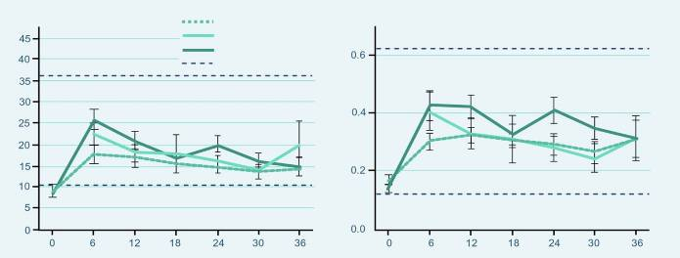
Results of the 3 Year AndroGel® 1% Trial
Testosterone Levels
5 grams
7.5 grams
10 grams
Normal range
Months
Months
At 6 months, the beginning of the long-term study, mean serum T levels were at 14.1, 22.4 and 25.6 nmol/L for the 5g, 7.5g and 10g groups, respectively, which were significantly different between the groups (p = 0.012)
At 12 months the differences in T concentrations between the different dose groups became smaller but remained significant (p= 0.042)
Thereafter with dose adjustment for the subjects, serum T levels were not different between the three groups.
Serum free T followed the same pattern as serum T and also showed no significant differences among the dose groups after 12 months.
Wang C, Cunningham G et al. J Clin Endo Metab 2004; 89:2085-98.
Notes:
At 6 months, which is the beginning of the long-term study, mean serum T levels were at 14.1 ± 1.3, 22.4 ±2.7 and 25.6 ± 2.4 nmol/L which was significantly different for the 5, 7.5 and 10g T gel dose group, respectively (p = 0.012). At 12 months the differences in serum T concentrations between the different dose groups became smaller but remained significant (p = 0.042: T gel 5 g/d 16.9 ± 1.9 nmol/L; 7.5 g/d, 17.9 ± 3.9 nmol/L; and 10 g/d, 20.5 ± 1.5 nmol/L). Thereafter with dose adjustment for the subjects, serum T levels were not different between the three groups.
Serum free T followed the same pattern as serum T and also showed no significant differences among the dose groups after 12 months.

Slide 6
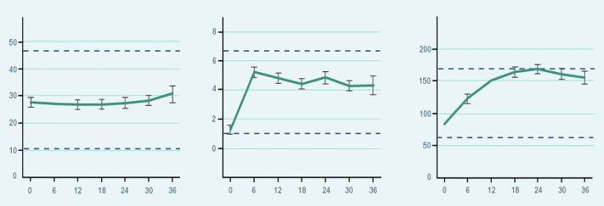
Results of the 3 Year AndroGel® 1% Trial
SHBG: No significant changes
DHT & E2: significantly higher concentrations from baseline
SHBG
DHT
E2
Months
Months
Months
Wang C, Cunningham G et al. J Clin Endo Metab 2004; 89 : 2085-98.
Notes:
Serum SHBG showed no significant change with treatment and remained within the adult male reference range.
Mean serum DHT concentrations were significantly higher after treatment (p=0.0001) and were maintained within the adult male range for the treatment period. Mean serum DHT was different in the three dose groups at 12 (p = 0.0031) and 24 (p = 0.018) months with the levels in the 10 g group higher than the other two. Serum DHT to T ratio was 0.21 at baseline and remained between 0.26 to 0.30 throughout the treatment period without any time effect.
Mean serum E2 levels were significantly different higher after T gel replacement (p =0.0001) and increased progressively until month 18 of treatment while remaining at the upper limit of the male reference range. Serum E2: T ratio increased during treatment from 0.006 at 6 months to 0.013 and 0.016 at 18 and 24 months, respectively (p=0.0001 and 0.0115 respectively). Mean serum E2 concentrations were also significantly different amongst the three groups at 12 (p = 0.009) and 24 (p = 0.005) months where the levels are higher in the 10 g dose group.

Slide 7
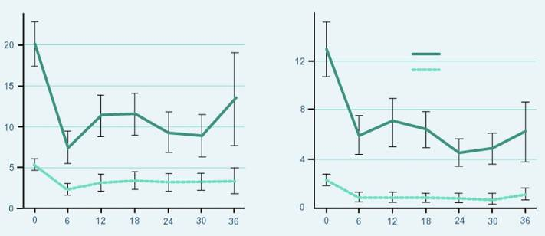
Results of the 3 Year AndroGel® 1% Trial
LH & FSH: Long term suppression maintained from baseline (p<0.0001)
FSH
LH
Primary failure
Other
FSH (IU/L)
Months
Months
Wang C, Cunningham G et al. J Clin Endo Metab 2004; 89:2085-98.
Notes:
Compared with baseline, mean serum LH and FSH concentrations were suppressed significantly with T gel treatment in subjects with primary and secondary hypogonadism as well as in those with low baseline serum T and normal serum gonadotropins (P < 0.0001). This suppression of LH and FSH was maintained throughout the treatment period without further significant changes after 6 months .

Slide 8
Effects on Sexual Function (3 Years)
After treatment with T Gel, Sexual Desire, Sexual Enjoyment and Sexual Activity improved, compared with baseline, and were maintained at the same level from 6 months until the end of the treatment period.
Sexual Desire
Sexual Activity
*
*
Sexual activity (0-7)
Sexual desire (0-7)
Satisfaction with Erection
% Without Erections
*
Satisfaction (0-7)
Subjects without erections (%)
Months
Months
Wang C, Cunningham G et al. J Clin Endo Metab 2004; 89:2085-98.
Notes:
After treatment with T gel, as a group sexual desire (P = 0.0001), enjoyment without partner (P = 0.0001), enjoyment with partner (P= 0.0022), percent full erection (P = 0.0001), and self-assessment of satisfaction with erections (P= 0.0001) improved, compared with baseline, and were maintained at the same level from 6 months until the end of the treatment period. Sexual activity scores were also significantly increased and maintained at the same level from 6 months throughout the treatment period (P = 0.0001). The proportion of subjects with erections increased from a baseline of 64.8% to 81.7% at 6 months without subsequent further significant increases.

Slide 9
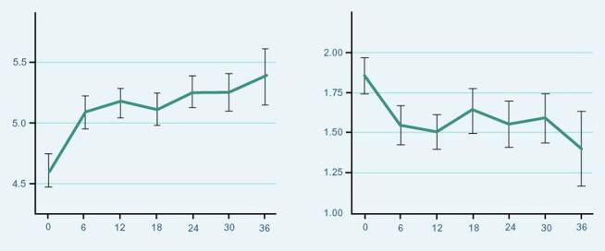
Effects on Mood(3 Years)
Positive mood improved significantly and changes were sustained from baseline
Negative mood parameters were decreased and remained significantly lower (p=0.0013) than baseline without further changes after 6 months of T Gel replacement therapy.
Positive Moods
Negative Moods
Positive moods (0-7)
p = 0.0022
p = 0.0013
Months
Months
Wang C, Cunningham G et al. J Clin Endo Metab 2004; 89:2085-98.
Notes:
Positive mood scores improved with treatment and were sustained (P=0.0022), whereas negative mood parameters were decreased and remained significantly lower (P=0.0013) than baseline without further changes after 6 months of T gel replacement. There was overall improvement in psychosexual function in men over 60 yr, but the changes were smaller, compared with those younger than 60 yr of age (e.g. sexual activity P=0.0129 in older men and P= 0.0001 in younger men).

Slide 10
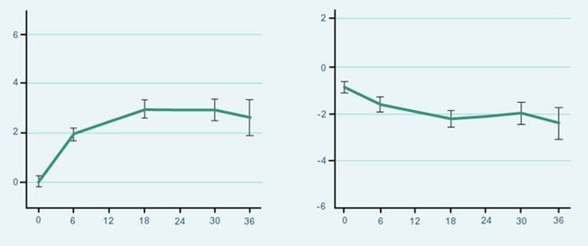
Effects on Body Composition (3 Years)
Lean and fat body mass changed significantly from baseline
Lean Body Mass Change
Fat Body Mass Change
Fat mass change (kg)
*
Lean mass change (kg)
*
* p = 0.0001
* p = 0.0058
Months
Months
Wang C, Cunningham G et al. J Clin Endo Metab 2004; 89:2085-98.
Notes:
Average total body mass increased by 1.2 ± 0.3 kg at 6 months (P=0.0157) and did not significantly change with continued T gel therapy.
Lean body mass increased significantly (P=0.0001) from baseline and remained increased throughout the study period. The change in lean body mass was 1.97 ± 0.24 kg at 6 months and was further increased to 2.93 ± 0.32 kg at 18 months and 2.89 ± 0.41 kg at 30 months (P=0.0065). The differences in the lean body mass between the dose groups and those over and under age 60 yr were not significant.
Fat mass decreased significantly as a group with T gel replacement (P=0.0058). The decrease in fat mass was 0.8 ± 0.3 kg at 6 months and 1.57 ± 0.38 and 1.30 ± 0.51 kg at 18 and 30 months (P= 0.088 when compared with 6 months), respectively, without significant differences among the different dose groups. The decreases in fat mass (P=0.032) and percent fat (P=0.0001) were observed only in the younger subjects but not in older men. The changes in body composition parameters were not related to the change in serum T concentrations during replacement therapy.

Slide 11
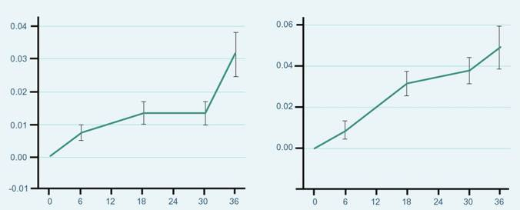
Effects on Body Composition (3 Years)
BMD showed significant gradual and progressive increase from baseline
Change Hip BMD
Change Spine BMD
Change in hip BMD (g/cm²)
Change in spine BMD (g/cm²)
p = 0.0004
p = 0.0001
Months
Months
Wang C, Cunningham G et al. J Clin Endo Metab 2004; 89:2085-98.
Notes:
BMD of the hip (P = 0.0004) and spine (P= 0.0001) showed a gradual and progressive increase with treatment. The increase in the BMD was more marked in the spine than the hip. Spine BMD increased by 0.031± 0.006 (3.1%) and 0.037 ± 0.006 g/cm2 (3.8%) at 18 and 30 months of treatment, respectively, and was significantly higher than that at 6 months (P =0.0001). There were no significant differences in the improvement in BMD among the three dose groups or between the younger and older age groups. The absolute increase in BMD in the hip and spine was not related to the baseline serum T or the change in serum T levels but was significantly related to baseline BMD (P= 0.0001).

Slide 12
Results of the 3 Year AndroGel® 1% Trial
After 36-month treatment | T-gel 5g n = 62 | T-gel 7.5g n = 22 |  | T-gel 10 g n = 39
Mean muscle strength | No statistically significant change over time
Compliance to therapy | 117 % |  | 88.2 % |  | 71.4 %
Mean PSA levels | No further significant increases after 6 months with continued T treatment
Tolerance (skin irritation) [%] | 8.1 % |  | 13.6 % |  | 10.3 %
Wang C, Cunningham G et al. J Clin Endo Metab 2004; 89:2085-98.
Notes:
Muscle strength testing of the upper and lower extremities by the chest and leg press increased, but this did not reach statistical significance over time because of the large variations within and between subjects. The mean chest press increased by 1.7 to 4.1 kg and the leg press by 8.7 to 14.5 kg over the treatment period of up to 36 months. There were no sustained differences among the different dose groups or between subjects who were younger or older than 60 yr.
Overall compliance was 117, 88.2, and 71.4% of the prescribed dose in the 5-, 7.5-, and 10-g groups, respectively. The proportions of patients who were taking less than 80% of their prescribed dose were higher in the 7.5- and 10-g groups, whereas those who were taking more than 120% of their prescribed dose were higher in the 5-g group.
The baseline PSA level was 0.85 0.06 ng/ml. With T replacement there were significant increases in PSA levels over time (P 0.001 in the whole group, P 0.0002 in subjects 60 yr, and P 0.0160 in those 60 yr). Mean serum PSA was 1.11 0.08 ng/ml at month 6 and showed no further significant increases with continued T treatment (P = 0.150).
Application site skin reaction occurred in 12 of 163 subjects (five, three, and four subjects were receiving 5, 7.5, and 10 g T gel/d), 11 had minimal or mild erythema, and one was classified as moderate. Only one subject discontinued from the study after 12 months of 5 g T treatment because of worsening of minimal erythema and punctate rash.

Slide 13
Safety Results During the 3 Year Trial
Prostate
Enlarged prostate 11.7% (n=19) (most were enlarged at baseline)
Prostate cancer 1.2% (n=2)
Urinary symptoms 3.7% (n=6)
nocturia, urinary hesitancy, urinary incontinence, urinary retention, urinary urgency and weak urinary stream
Blood Chemistry
Abnormal laboratory tests AE were reported by 9.3% (n = 15)
↑Hb or Hct
↑AST, ↑ ALT
↑testosterone
↑cholesterol, ↑cholesterol/LDL ratio, ↑ triglycerides, ↑HDL
↑creatinine
Wang C, Cunningham G et al. J Clin Endo Metab 2004; 89:2085-98.
US AndroGel® Prescribing Information. Dec 2007.
Notes:
Urinary symptoms included nocturia, urinary hesitancy, urinary incontinence, urinary retention, urinary urgency and weak urinary stream
Lab test abnormal occurred in fifteen patients with one or more of the following events: elevated aspartate aminotransferase (AST), elevated alanine aminotransferase (ALT), elevated testosterone, elevated hemoglobin or hematocrit, elevated cholesterol, elevated cholesterol/LDL ratio, elevated triglycerides, elevated HDL, or elevated serum creatinine.
Prostate size was not assessed by ultrasound but was assessed during digital rectal examinations. Most of these patients had enlarged prostate at baseline assessment.

Slide 14
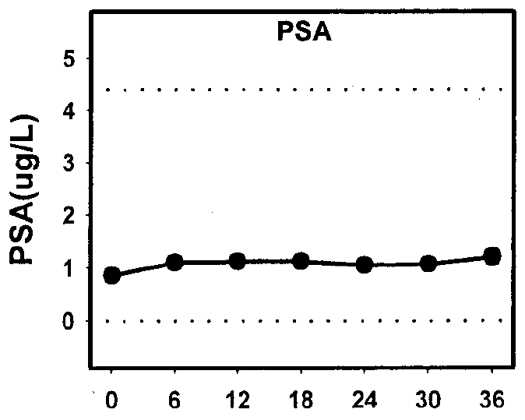
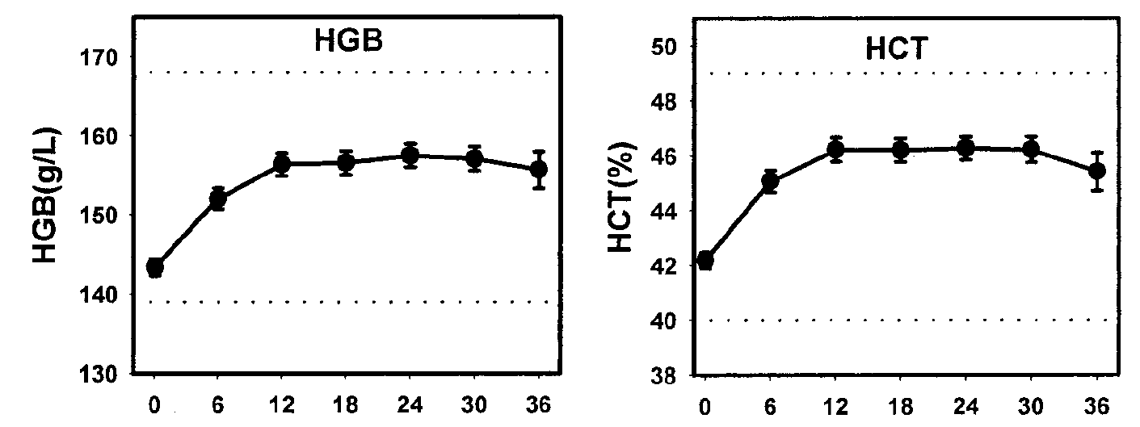
Safety Results During the 3 Year Trial
The effect of long-term T gel application on safety parameters
Safety | Skin Irritation Application site skin reaction occurred in 12/163 subjects (one was classified as moderate). One subject discontinued after 12 months of T Gel (5g) because of worsening erythema and rash. IPSS & PSA Mean IPSS score did not change significantly across time with T gel. None of the individual scores showed any clinically meaningful changes Baseline PSA level was 0.85ng/ml. With T replacement there were significant increases in PSA levels over time. Mean serum PSA was 1.11ng/ml at month 6 and showed no further significant increases with continued T treatment (P = 0.150). 3 subjects (1.8%) aged >63 years whose serum PSA rose above the predetermined critical value of 5.5 ng/dl had T treatment stopped and had confirmed PCa on biopsy Haematocrit Except for the anticipated increase in haematocrit and haemoglobin, there were no clinically significant changes in blood counts or biochemistry.
Figure 1: Haemoglobin (HGB), haematocrit (HCT) and PSA concentrations over time
Figure 1: Adapted from Wang et al.
Notes:
Of the subjects who had elevated PSA during the study, three had confirmed prostate cancer on biopsy. All three subjects were over 63 years old at enrolment in the study.
The incidence of prostate cancer in three of 163 (1.8%) subjects who were enrolled in this study was similar to that reported in older men by Snyder et al. who were treated with scrotal transdermal patches for 3 year (one of 54, 1.8%).
However, if only men over 60 yr enrolled in this study were considered, the incidence would be higher: three of 39 (7.7% over a 3-yr period).
Based on the data from the Surveillance, Epidemiology, and End Result Program of the National Cancer Institute, the anticipated incidence of prostate cancer in the population of men between the ages of 65 and 74 yr is between 973 and 994 cases per 100,000 men [National Cancer Institute, Surveillance, Epidemiology, and
End Result (SEER) Program 2002, www.seer.cancer.gov].
Gynecomastia was observed only in eight more subjects during treatment (4.9%).
Acne was noted in 12 subjects (7.4%). None of these subjects was discontinued because of acne.
Prostate size was not assessed by ultrasound but was assessed during digital rectal examinations and found to be enlarged in 23 subjects (14%) at any time in the study. Most of these patients had enlarged prostate at baseline assessment.

Slide 15
Safety Results During the 3 Year Trial
Additional Side Effects reported by 2 or more subjects in at least 1 treatment group
Acne
Pruritus
Skin dry
Testis disorder
Gynecomastia
Anemia
Wang C, Cunningham G et al. J Clin Endo Metab 2004; 89:2085-98.
US AndroGel® Prescribing Information. Dec 2007.
Notes:
AndroGel® was well tolerated, as evidenced by the low incidence of erythema and absence of discontinuations due to application site reactions.
Adverse events at least possibly related to AndroGel® use reported by or more patients in at least one treatment group at some time the 3 year open label extension study:
Testis disorder occurred in three patients: two patients with a non-palpable testis and one patient with slight right testicular tenderness.
Gynecomastia was observed only in eight more subjects during treatment (4.9%). Breast enlargement was rated as mild in five and moderate in three subjects; all resolved without treatment. Of the eight with breast enlargement with treatment, only one had the diagnosis of Klinefelter’s syndrome.
Acne was noted in 12 subjects (7.4%). None of these subjects was discontinued because of acne.

Slide 16
Summary of the 3 Year AndroGel® 1% Trial
AndroGel®
Normalized testosterone
Restored sexual function
Improved mood
Did NOT Increase muscle strength
Decreased fat mass
Increased bone density
Wang C, Cunningham G et al. J Clin Endo Metab 2004; 89:2085-98.

Slide 17
Summary of the 3 Year AndroGel® 1% Trial
AndroGel is well tolerated and effective when used in the long-term treatment of hypogonadal men.
Conclusions | AndroGel replacement in hypogonadal men led to the restoration of serum T and free T into the adult male range, which was sustained with long term treatment. Long term effects on other hormone assays and improvements in mood, sexual function, and body composition were also sustained with long term treatment. The safety parameters were comparable with other delivery systems. The authors note that the benefits of androgen replacement must be weighed against potential risks. As with all androgen replacement, continuous vigilance is required for the monitoring of serum PSA, haematocrit and haemoglobin.
Wang C, Cunningham G et al. J Clin Endo Metab 2004; 89:2085-98.

