Slide 1
Testosterone Therapy & Monitoring Requirements
Besins Healthcare
Global Medical Affairs
March 2021

Slide 2
Who should be initiating & monitoring TD patients?
“The committee recommends that TTh be initiated
and monitored by the generalist in urology or
family medicine, for most patients, provided that
authoritative clinical guidelines are followed” ¹
Dean J et al. J Sex Med 2015;12:1660-86.

Slide 3
Testosterone Therapy: Prior to Initiation (1/3) General Principles
Confirm Diagnosis
Signs/Symptoms & Biochemical Evidence (x2)
Physical Examination
Consider Aetiology
Primary or Secondary (Check LH/FSH)
Reversible (Opioids, Glucocorticoids, Anti-Psychotics)
Consider Contraindications & Cautions*
Prostate Cancer, Abnormal DRE, Breast Cancer
Fertility requirement, Haematocrit <54%
*Please consult the Summary of Product Characteristics or Prescribing Information for a full list of cautions and contraindications
Hackett, G; Kirby, M et al J Sex Med 2017;14:1504-1523

Slide 4
Testosterone Therapy – Prior to Initiation (2/3)
BSSM Guidelines (2017)
Perform cardiovascular (CV), prostate, breast and haematologic assessment before start of treatment
Offer T therapy to symptomatic men with TD syndrome for treated localised low-risk prostate cancer*, not starting before 1 year of follow-up and without evidence of active disease
Assess CV risk factors before commencing T therapy and optimise secondary prevention in men with established disease
Endocrine Society Guidelines (2018)
T therapy is recommended to induce and maintain secondary sex characteristics and correct symptoms of TD
T Therapy is not recommended in men planning fertility in the near term or men with breast or prostate cancer, a palpable prostate nodule or induration, a PSA level >4 ng/mL, a PSA level >3 ng/mL combined with a high risk of prostate cancer (without further urological evaluation), elevated haematocrit, untreated severe obstructive sleep apnoea, severe lower urinary tract symptoms, uncontrolled heart failure, MI or stroke within the last 6 months, or thrombophilia
Men 55-69 years old being considered for T therapy with a life expectancy >10 years: discuss the potential benefits and risks of evaluating prostate cancer risk and prostate monitoring and engage the patient in shared decision making regarding monitoring. If monitoring is chosen, assess risk before starting treatment then 3-12 months after treatment initiation. Men 40-69 with increased risk, discuss risk and monitoring options
Bhasin S, et al. J Clin Endocrinol Metab 2018;103(5):1715-44.
* (Gleason score <8, stages 1-2, preoperative PSA level <10 ng/mL
Hackett G, et al. J Sex Med 2017;14:1504-23.

Slide 5
Testosterone Therapy – Prior to Initiation (3/3)
AUA Guidelines (2018)
Clinicians should inform testosterone deficient patients that low testosterone is a risk factor for CV disease
In patients with low testosterone, clinicians should measure serum luteinizing hormone levels.
Serum prolactin levels should be measured in patients with low testosterone levels combined with low or low/normal luteinizing hormone levels.
Patients with persistently high prolactin levels of unknown aetiology should undergo evaluation for endocrine disorders.
Serum oestradiol should be measured in testosterone deficient patients who present with breast symptoms or gynecomastia prior to the commencement of testosterone therapy.
Men with testosterone deficiency who are interested in fertility should have a reproductive health evaluation performed prior to treatment.
Prior to offering testosterone therapy, clinicians should measure haemoglobin and haematocrit and inform patients regarding the increased risk of polycythemia.
PSA should be measured in men over 40 years of age prior to commencement of testosterone therapy to exclude a prostate cancer diagnosis.
1. Mulhall JP, et al. American Urological Association 2018.

Slide 6
Testosterone Therapy (TTh)
The Major Goal of TTh:
To achieve & maintain normal physiological testosterone levels to relieve symptoms of androgen deficiency, such as loss of libido, erectile dysfunction, changes in body composition and psychological impairment
EMA/716062/2014 Pharmacovigilance Risk Assessment Committee (PRAC)
Notes:
Papers postulate that once symptoms improve people become less adherent to treatment.
Should this statement be updated to reinforce the benefits of long-term therapy…..?

Slide 7
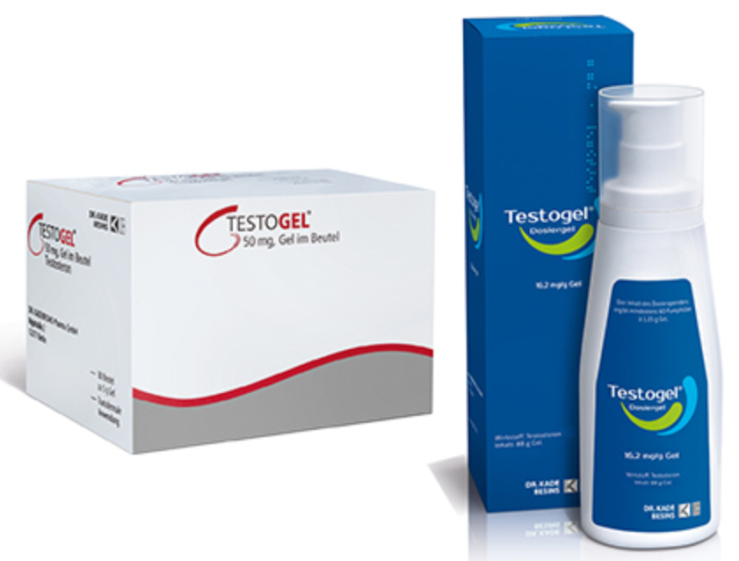
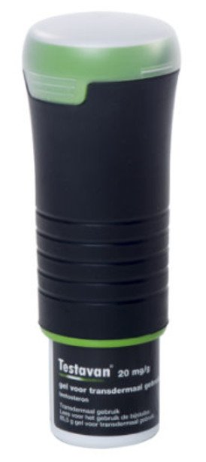
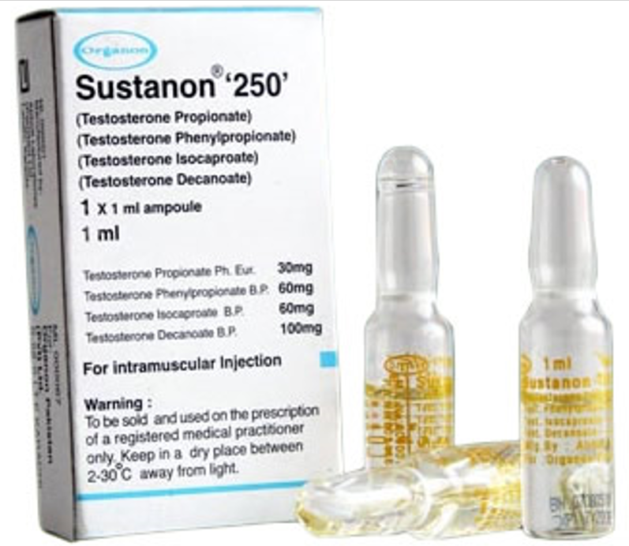
Testosterone Therapy (TTh) – UK ¹
Preparations differ:
Route of delivery
Ease of use
Pharmacokinetics
Cost
Compliance is crucial
Must advise re: all options, including not treating i.e. lifestyle advice
MIMS Online: Accessed Feb 2021

Slide 8
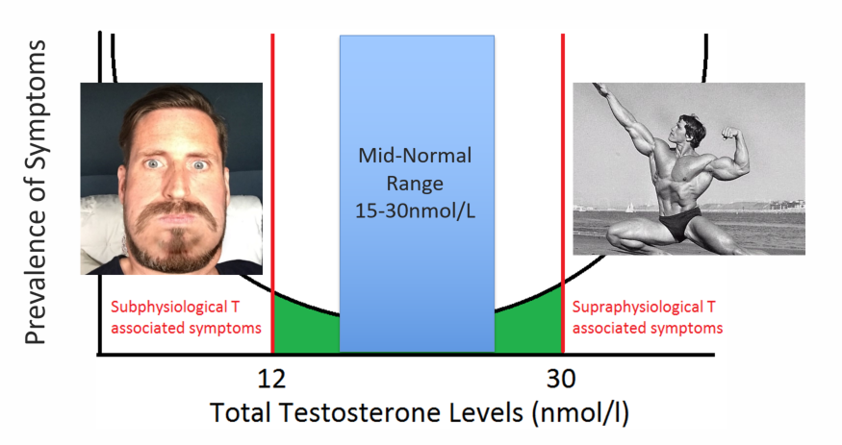
TTh - ‘U’ Shaped Curve
12
35
Hackett, G; Kirby, M et al J Sex Med 2017;14:1504-1523
Notes:
The target range for patients once commenced on therapy is 15-30nmol/L as recommended by the BSSM. Having too much or too little testosterone are both detrimental and should be avoided.

Slide 9
Time to Onset of TD Symptom Improvement
Time-dependent and symptom-specific onset of effects of TTh
Sexual Parameters
Saad et al. European Journal of Endocrinology (2011) 675-685

Slide 10
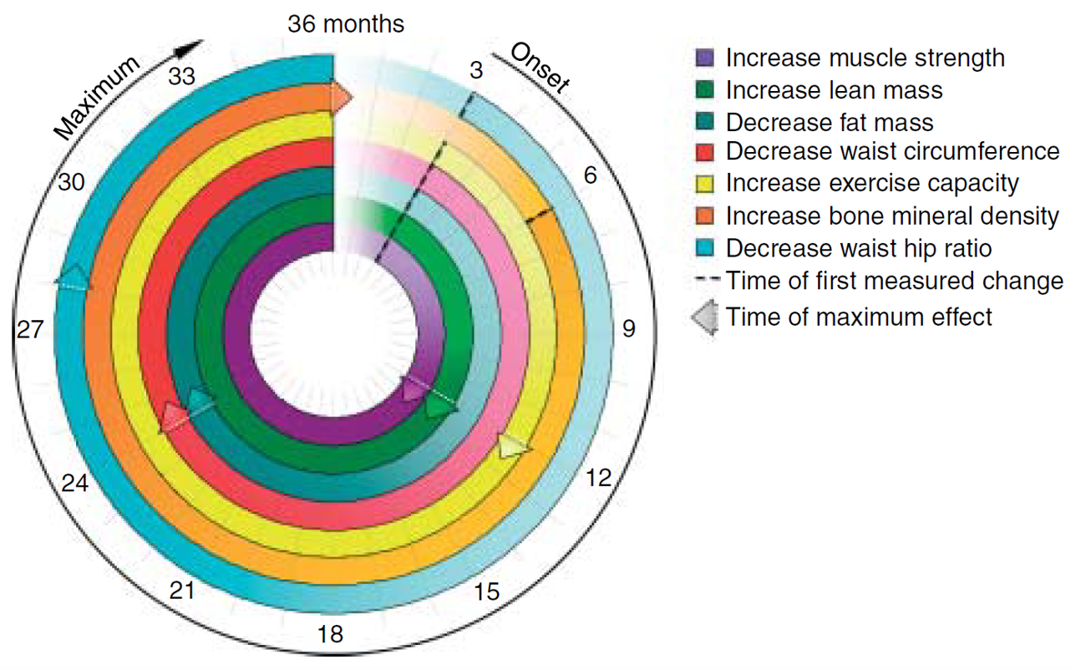
Time to Onset of TD Symptom Improvement
Time-dependent and symptom-specific onset of effects of TTh
Body Composition
Saad et al. European Journal of Endocrinology (2011) 675-685

Slide 11
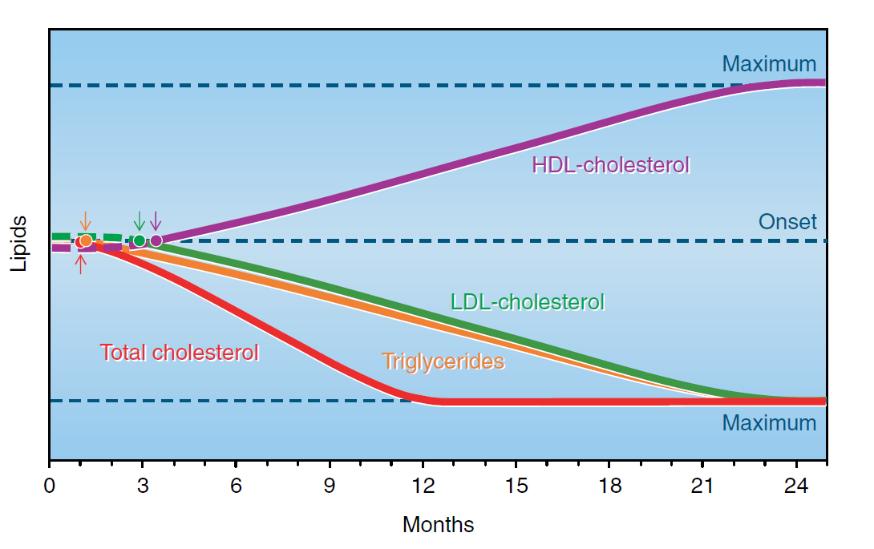
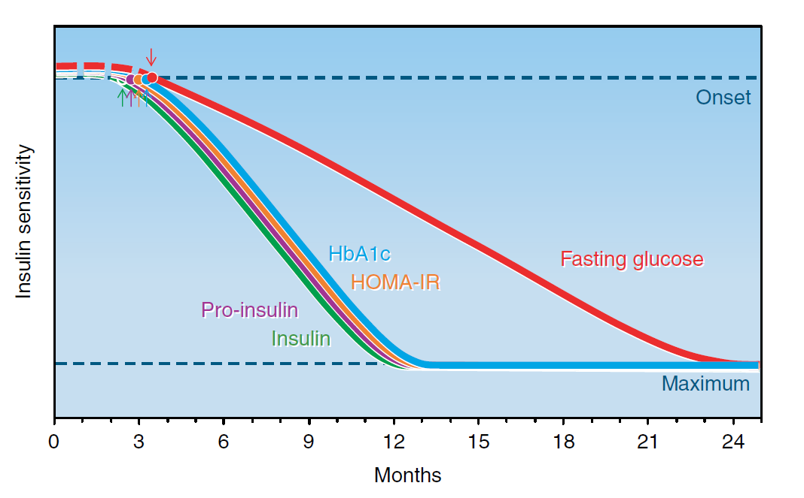
Time to Onset of TD Symptom Improvement
Time-dependent and symptom-specific onset of effects of TTh
Lipids, Glucose & Insulin
Saad et al. European Journal of Endocrinology (2011) 675-685
Notes:
Although the optimal duration of therapy is unknown, continuous therapy over a longer period is necessary to derive the benefits of TRT, with different symptoms improving or resolving at different times.
In a review of the literature, Saad et al. found rapid improvement in sexual interest, quality of life, and change in lipids, showing improvement beginning in 3 to 4 weeks. Changes in erection or ejaculation, erythropoiesis, glycemic control, body morphology (including fat mass, lean body mass, and muscle strength), and bone mass take longer to occur, ranging from 3 to 6 months, often achieving steady state at 1 year. Thus, patients who discontinue therapy after short duration may not experience the benefits of TRT

Slide 12
TTh: For how long?
Hypogonadism is a chronic disease which requires long-term treatment, not unlike diabetes.
Important to realise that TTh is considered lifelong therapy¹
In patients who have a positive response to TTh, treatment should continue in accordance with a standardised monitoring plan²
Patient & HCP expectations need to be managed from the outset. Signs & symptoms of TD don’t appear overnight and they don’t disappear overnight either.
HCPs should ensure that their patients are compliant with therapy and that they optimise the dose of therapy for their patients early on to achieve better compliance
1. Chakrabarty A. Androl Gynecol: Curr Res 2013, 1:3
2. Bhasin S, et al. J Clin Endocrinol Metab 2010; 95: 2536-2559.

Slide 13
Potential adverse effects linked to TTh
Erythrocytosis
Growth of metastatic prostate cancer
Detection of subclinical prostate cancer
Leg oedema and worsening of heart failure
Reduced sperm production and infertility
Acne, oiliness of skin
Breast tenderness
Induction/worsening of obstructive sleep apnoea
Gynaecomastia
Growth of breast cancer
Male pattern balding
Formulation-specific effects
Thrombotic events in patients with thrombophilia, or those with risk factors for VTE
Increases in blood pressure
Weak evidence of association with TTh
Consult Summary of Product characteristics for a full list of adverse events
Bhasin S, Basaria S. Best Pract Res Clin Endocrinol Metab 2011; 25: 251–270.
Bhasin S, et al. J Clin Endocrinol Metab 2010; 95: 2536–2559.
Testogel 16.2mg/g SmPC https://www.medicines.org.uk/emc/product/8919/smpc Last Accessed Sept 2020

Slide 14
Monitoring of Testosterone Levels
Optimum time to measure serum T whilst on TTh ¹
Short-acting T injection
Midway in treatment cycle
Long-acting T undecanoate injection
Just prior to the next injection
Transdermal T gels*
Within 24 hours of precedent application, 2–8 hours after application
*Guidance on monitoring with T gels varies between the different products. Refer to individual product SmPC for full details. Please note that the guidance for AndroGel in the product summaries states that the dose should be titrated based on the pre-dose morning testosterone blood levels
Buvat et al J Sex Med 2013;10:245–284

Slide 15
Recommendations for Follow Up (1/3)
BSSM Guidelines (2017)
Assess response to therapy at 3, 6, and 12 months and every 12 months thereafter
Aim for a target TT level of 15-30 nmol/L to achieve optimal response
Monitor haematocrit before treatment, at 3-6 months, and every 12 months thereafter; decrease dosage, or switch preparation, if haematocrit is >0.54; if haematocrit remains high, consider stopping and reintroduce at a lower dose
Assess prostate health by PSA and DRE before commencing TTh followed by a PSA at 3-6 months, 12 months, and every 12 months thereafter
Assess CV risk before TTh is initiated and monitor CV risk factors throughout therapy
T: testosterone, BMI: body mass index, TD: testosterone deficiency, TTh: testosterone therapy, TT: total testosterone, PSA: prostate-specific antigen, DRE: digital rectal examination, CV: cardiovascular
1. Hackett G, et al. J Sex Med 2017;14:1504-23

Slide 16
Recommendations for Follow Up (2/3)
Endocrine Guidelines (2018)
In men with TD who have started T therapy, evaluate after treatment initiation to assess response, any AEs and compliance to treatment
A urological consultation is recommended for men receiving TTh if during the first 12 months there is a confirmed increase in PSA concentration >1.4 ng/mL above baseline, confirmed PSA >4.0 ng/mL, or a prostatic abnormality detected on DRE. After 1 year, prostate monitoring should conform to standard guidelines for screening based on race and age of patient
Explain the potential benefits and risks of monitoring for prostate cancer and engage the patient in shared decision making regarding the prostate monitoring plan
Evaluate the patient at 3–12 months after treatment initiation and then annually to assess whether symptoms have responded to treatment and whether the patient is suffering from any adverse effects
Monitor T concentrations 3–6 months after initiation of T therapy
Check haematocrit at baseline, 3–6 months after starting treatment, and then annually. If haematocrit is >54%, stop therapy until haematocrit decreases to a safe level; evaluate the patient for hypoxia and sleep apnea; reinitiate therapy with a reduced dose
Measure BMD of lumbar spine and/or femoral neck after 1–2 years of T therapy in hypogonadal men with osteoporosis, consistent with regional standard of care
For men 55–69 years and 40–69 years at increased risk for prostate cancer who choose prostate monitoring, perform DRE and check PSA level before initiating treatment; check PSA and perform digital rectal examination 3–12 months after initiating T treatment, and then in accordance with guidelines for prostate cancer screening depending on the age and race of the patient
Evaluate formulation-specific adverse effects at each visit
TTh: testosterone therapy, T: testosterone, AE: adverse effect, PSA: prostate-specific antigen, DRE: digital rectal examination
1. Bhasin S, et al. J Clin Endocrinol Metab 2018;103(5):1715-44.

Slide 17
Recommendations for Follow Up (3/3)
AUA Guidelines (2018)
Clinicians should measure an initial follow-up total testosterone level after an appropriate interval to ensure that target testosterone levels have been achieved.
Testosterone levels should be measured every 6-12 months while on testosterone therapy.
Clinicians should discuss the cessation of testosterone therapy three to six months after commencement of treatment in patients who experience normalization of total testosterone levels but fail to achieve symptom or sign improvement.
1. Mulhall JP, et al. American Urological Association 2018.

Slide 18
Therapy & Monitoring Questions:
1. According to the BSSM guidelines from 2017, what is the recommended testosterone level target range for patients once they are initiated on TTh?
8-12nmol/L
>12nmol/L
12-35nmol/L
15-30nmol/L
(choose 1 answer)

Slide 19
Therapy & Monitoring Questions:
2. Which of these is NOT a general principle that HCPs should follow prior to initiating a patient on testosterone therapy?
Consider contraindications & cautions
Consider aetiology
Optimise treatment dose
Confirm diagnosis
(choose 1 answer)

Slide 20
Therapy & Monitoring Questions:
3. Which society guideline recommends that that TTh be initiated and monitored by the generalist in urology or family medicine, for most patients, provided that authoritative clinical guidelines are followed?
ISSM
AUA
Endocrine Society
ISSAM
(choose 1 answer)

Slide 21
Therapy & Monitoring Questions:
4. According to the Saad study from 2011, improvements in fasting glucose can take how many months to achieve maximum reduction in hypogonadal men taking TTh?
12 months
26 months
24 months
36 months
(choose 1 answer)

Slide 22
Therapy & Monitoring Questions:
5. True or False. Sexual symptoms take longer to improve compared to parameters of body composition in hypogonadal men taking TTh?
True
False
(choose 1 answer)

Slide 23
Therapy & Monitoring Questions:
6. Which of the following statements is correct?
Hypogonadism is a chronic disease which requires long-term treatment, not unlike diabetes.
Hypogonadism only requires a short-course of treatment for all symptoms to resolve
Hypogonadism should only be treated in men aged <65 years
Hypogonadism is an acute illness that can be treated with rest and relaxation
(choose 1 answer)

Slide 24
Therapy & Monitoring Questions:
7. When should prostate health be checked in men treated with TTh?
Annually
At 12 months
At baseline
At 3-6 months
All of the above
(choose 1 answer)

Slide 25
Therapy & Monitoring Questions:
8. What options are available to a HCP if a patient of theirs on TTh records a haematocrit >0.54 (54%)
Reduce the dose
Switch preparation
Consider stopping treatment
Ask the patient to donate blood at a blood donation centre to reduce haematocrit
All of the above
(choose 1 answer)

Slide 26
Therapy & Monitoring Questions:
9. What do the AUA guidelines suggest clinicians do if after 3-6 months of TTh in patients who normalise total testosterone levels but fail to achieve symptom or sign improvement.
Tell patient to persevere on existing medication for a further 6 months then re-evaluate
Switch to an oral preparation
Double the dose of patient’s existing treatment
Discuss the cessation of testosterone therapy
(choose 1 answer)

Slide 27
Therapy & Monitoring Questions:
10. According to Buvat et al in 2013, when is the optimum time to measure testosterone levels in patients receiving long-acting injectable therapy?
Just prior to the next injection
2-8 hours after administration of injection
Midway between injections
Whenever, it doesn’t matter
(choose 1 answer)

Slide 28
Therapy & Monitoring Answers:
Q1: 15-30nmol/L
Q2: Optimise treatment dose
Q3: ISSM
Q4: 24 months
Q5: False
Q6: Hypogonadism is a chronic disease which requires long-term treatment, not unlike diabetes.
Q7: All of the above
Q8: All of the above
Q9: Discuss the cessation of testosterone therapy
Q10: Just prior to next injection

