Slide 1
The TRAVERSE study
Rationale and study design
Clinicaltrials.gov identifier NCT03518034

Slide 2
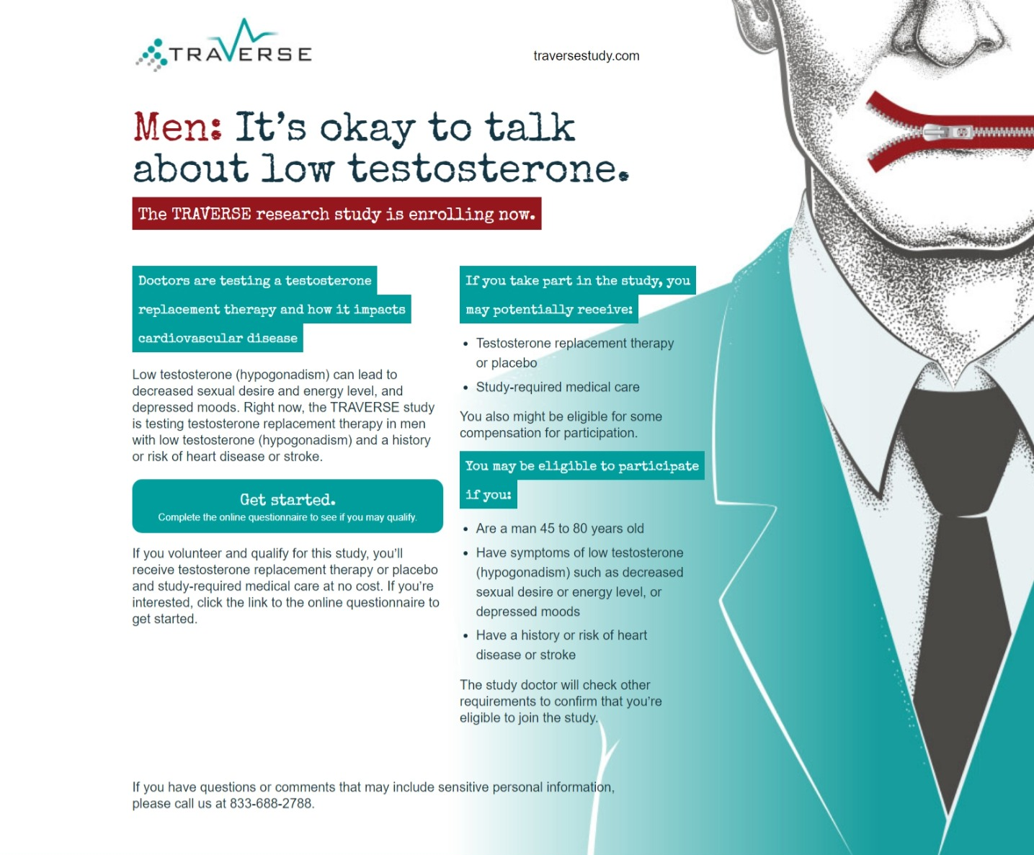
Notes:
The recruitment page for the TRAVERSE study is at http://traversestudy.com (accessed October 2022).

Slide 3
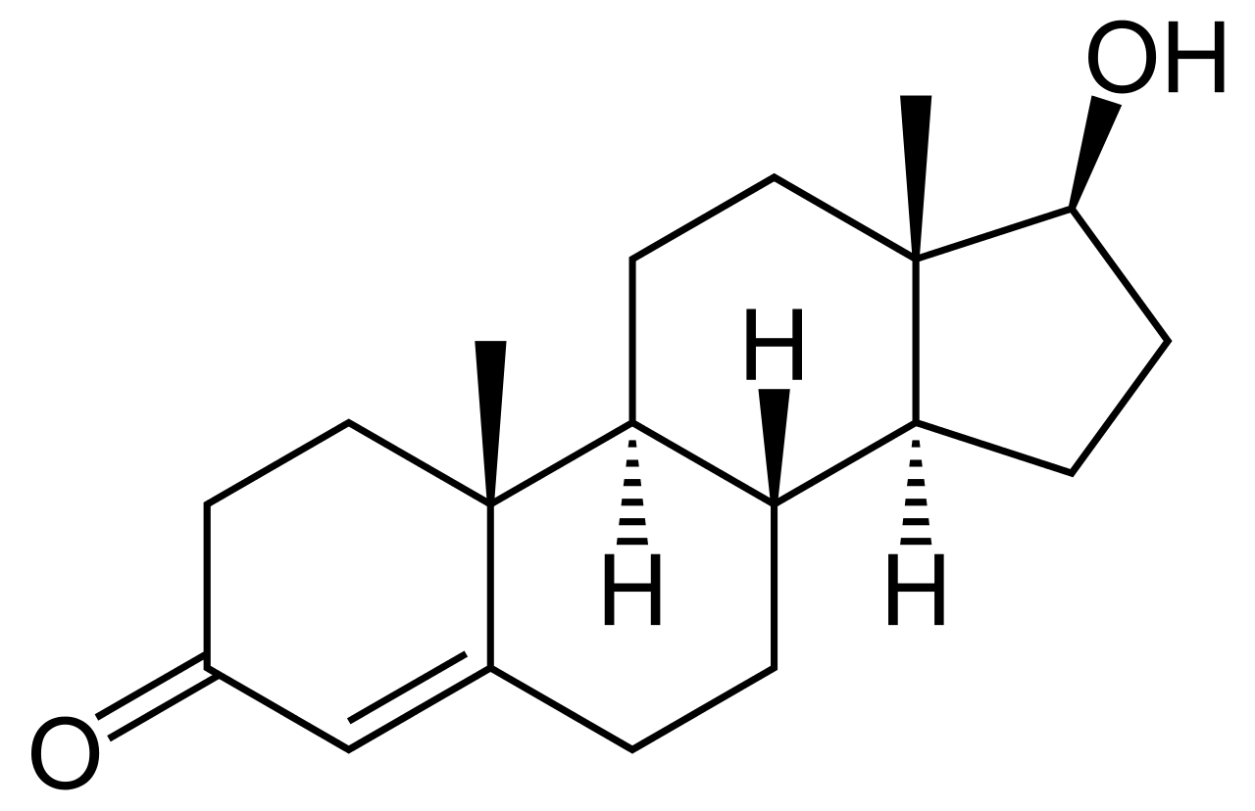
Physiological effects of testosterone and TTh on the cardiovascular system
Testosterone/TTh
Potentially positive effects on the CV system
Potentially negative effects on the CV system
Inhibits L-type calcium channels, leading to coronary vasodilation and increased coronary blood flow
Improves endothelial function
Reduces vascular reactivity
Prolongs time to ST segment depression in men with CAD
Shortens QTc interval
Promotes whole body, subcutaneous and intra-abdominal fat loss
Reduces plasma HDL-C levels
Induces platelet aggregation
Promotes sodium and water retention, which can contribute to oedema and worsen pre-existing heart failure
Increases haematocrit
Older men experience greater increases than younger men
CAD, coronary artery disease; CV, cardiovascular; HDL-C, high-density lipoprotein cholesterol; TTh, testosterone therapy.
Bhasin S et al. Am Heart J 2022;245:41–50.
Notes:
Physiologic effects of testosterone on the CV system
Testosterone exerts diverse effects on CV physiology, some of which may theoretically increase the risk of CV events, while others could be considered potentially beneficial.
Potential benefits on the CV system
Testosterone inhibits L-type calcium channels, resulting in coronary vasodilatation and increased coronary blood flow.
Testosterone improves endothelial function, reduces vascular reactivity, prolongs time to ST segment depression in men with known CAD, and shortens QTc interval.
TTh administration also decreases whole body, subcutaneous and intra-abdominal fat.
Potential drawbacks on the CV system
TTh administration reduces plasma HDL-C by a magnitude that is related to the administered dose, the route of administration, and the extent to which it can be aromatised.
Testosterone induces platelet aggregation by stimulating thromboxane A2 and promotes sodium and water retention, which can contribute to oedema and may worsen pre-existing heart failure.
Testosterone increases haematocrit by stimulating iron-dependent erythropoiesis through suppressing hepcidin, increasing erythropoietin, and by direct effects on the bone marrow that increase haematopoietic progenitors.
Older men experience greater increases in haematocrit than younger men.
CAD, coronary artery disease; CV, cardiovascular; HDL-C, high-density lipoprotein cholesterol; TTh, testosterone therapy.
Reference
Bhasin S et al. Am Heart J 2022;245:41–50.

Slide 4
Data are lacking on the long-term efficacy and safety of TTh use in men with hypogonadism
There are no data from adequately powered randomised trials on the long-term efficacy and safety of TTh use in middle-aged and older men who have an age-related decline in T levels^{1,2}
No randomised trial in men with hypogonadism has been of sufficient size or duration to determine the effects of TTh on MACE or prostate outcomes, including incidence of prostate cancer, acute urinary retention, or surgery for BPH¹
Retrospective studies of TTh have limitations and show inconsistent findings, precluding robust conclusions being made about TTh use and mortality or CV outcomes^{3–7}
Epidemiological studies, including prospective longitudinal and Mendelian randomisation studies, have not demonstrated a consistent relationship between T levels and incident CV events or CV disease risk^{8–10}
BPH, benign prostatic hyperplasia; CV, cardiovascular; MACE, major adverse cardiovascular events; T, testosterone; TTh, testosterone therapy.
1. Bhasin S et al. Am Heart J 2022;245:41–50; 2. Bhasin S et al. J Clin Endocrinol Metab 2018;103:1715–44; 3. Vigen R et al. JAMA 2013;310:1829–36; 4. Finkle WD et al. PLoS One 2014;9:e85805; 5. Shores MM et al. J Clin Endocrinol Metab 2012;97:2050–8; 6. Muraleedharan V et al. Eur J Endocrinol 2013;169:725–33; 7. Baillargeon J et al. Ann Pharmacother 2014;48:1138–40; 8. Collet TH et al. J Endocr Soc 2020;4:bvaa038; 9. Ohlsson C et al. J Am Coll Cardiol 2011;58:1674–81; 10. Mohammadi-Shemirani P et al. Elife 2020;9:e58914.
Notes:
Data are lacking on the long-term efficacy and safety of TTh use in men with hypogonadism, as shown from the following summary of available key evidence in the field.¹
Randomised trials
There are no data from adequately powered randomised trials on the long-term efficacy and safety of TTh use in middle-aged or older men who have an age-related decline in testosterone levels.^{1,2}
The rate of atherogenesis progression, assessed using the common carotid artery intima media thickness or the coronary calcium scores, did not differ between TTh- or placebo-treated men, either in the Cardiovascular Testosterone Trial of the T Trials³ (in men aged ≥65 years with hypogonadism, for an intervention duration of 1 year) or in the Testosterone Effects on Atherosclerosis in Aging Men (TEAAM) Trial⁴ (in men aged ≥60 years with low or low-normal testosterone levels, for an intervention duration of 3 years).
Neither the TTrials nor any other trial to date was of sufficient size or duration to determine the effects of TTh on MACE in men with hypogonadism, or on prostate outcomes, e.g. incidence of prostate cancer (any grade), acute urinary retention, and invasive or non-invasive surgical procedures for BPH.¹
There is no evidence of a significant association between TTh and increased risk of venous thromboembolic events.⁵
Retrospective analyses of TTh
Retrospective analyses of electronic medical records or Medicare data have reported conflicting findings on the association of TTh with CV events.^{6–10}
Of these five published retrospective studies considered by the FDA in its 2014 guidance, two reported increased risk of CV events, one showed a trend toward decreased risk, and two reported lower risk for all-cause mortality associated with TTh.¹
These studies have many limitations, including heterogeneity of study populations and differences in the duration of intervention and study design, use of variable definitions and varying rigor in ascertainment of CV outcomes, and unclear and differing indications for treatment, treatment regimens and on-treatment testosterone levels. Moreover, there is potential residual confounding with these studies, because participants assigned to TTh differed from comparators in baseline CV risk factors.¹
Because of these limitations and inconsistency of findings, these epidemiologic studies preclude robust conclusions being made about the relationship between TTh and CV outcomes and/or mortality.¹
Epidemiological studies of the association of endogenous testosterone levels with CV disease
Prospective longitudinal studies have not found a consistent relationship between endogenous testosterone levels and incident CV events,^{11,12} although a meta-analysis of epidemiologic studies found lower testosterone levels were associated with increased risk of all-cause mortality, especially CV mortality.¹³
However, epidemiological studies can only show association and cannot prove causality, and testosterone may be a marker of health, thus men at higher risk of dying have lower testosterone levels.¹
Mendelian randomisation studies did not find a significant association between genetically determined total or free testosterone levels and CV disease risk.¹⁴
Other outcomes
No trials have been large enough or long enough to determine the long-term benefits of TTh on clinically important outcomes such as bone fractures; progression from prediabetes to diabetes or induction of glycaemic remission; remission of late-life PDD; and sustained improvement in sexual function and activity in men who rigorously meet the Endocrine Society’s criteria for hypogonadism.¹
BPH, benign prostatic hyperplasia; CV, cardiovascular; MACE, major adverse cardiovascular events; PDD, persistent depressive disorder; TTh, testosterone therapy.
References
1. Bhasin S et al. Am Heart J 2022;245:41–50; 2. Bhasin S et al. J Clin Endocrinol Metab 2018;103:1715–44; 3. Budoff MJ et al. JAMA 2017;317:708–16; 4. Basaria S et al. JAMA 2015;314:570–81; 5. Houghton DE et al. Thromb Res 2018;172:94–103; 6. Vigen R et al. JAMA 2013;310:1829–36; 7. Finkle WD et al. PLoS One 2014;9:e85805; 8. Shores MM et al. J Clin Endocrinol Metab 2012;97:2050–8; 9. Muraleedharan V et al. Eur J Endocrinol 2013;169:725–33; 10. Baillargeon J et al. Ann Pharmacother 2014;48:1138–40; 11. Collet TH et al. J Endocr Soc 2020;4:bvaa038; 12. Ohlsson C et al. J Am Coll Cardiol 2011;58:1674–81; 13. Araujo AB et al. J Clin Endocrinol Metab 2011;96:3007–19; 14. Mohammadi-Shemirani P et al. Elife 2020;9:e58914.

Slide 5
Background to the TRAVERSE study
In 2013, in response to a petition from a citizen’s interest group to add a black box warning about the potential CV dangers of TTh, the FDA extensively reviewed all available information and concluded:
“The studies presented in the petition have significant limitations that weaken their evidentiary value for confirming a causal relationship between T and adverse CV outcomes”
Nevertheless, the FDA mandated that TTh product labelling includes a possible increased risk of CV events
In parallel, the EMA concluded that there is no consistent evidence of an increased risk of coronary heart disease associated with TTh use in men with hypogonadism
CV, cardiovascular; EMA, European Medicines Agency; FDA, US Food and Drug Administration; T, testosterone; TTh, testosterone therapy.
Bhasin S et al. J Clin Endocrinol Metab 2018;103:1715–44; Bhasin S et al. Am Heart J 2022;245:41–50.
Notes:
In 2013, in response to a petition by a citizen’s interest group to add a black box warning about the potential CV dangers of TTh, as well as conflicting reports of CV events from small clinical trials, retrospective analyses of medical records data, and pharmacovigilance studies of TTh-treated men, the FDA conducted an extensive review of the available information.^{1,2}
The FDA concluded that “the studies presented in the petition have significant limitations that weaken their evidentiary value for confirming a causal relationship between testosterone and adverse cardiovascular outcomes.”^{1,2}
Nevertheless, the FDA mandated pharmaceutical companies to add labelling information about a possible increased risk of CV events with the use of TTh.¹
An independent review conducted by the European Medicines Agency also found no consistent evidence of an increased risk of coronary heart disease associated with testosterone treatment of men with hypogonadism.^{1,2}
CV, cardiovascular; FDA, US Food and Drug Administration; MACE, major adverse cardiovascular events; TTh, testosterone therapy.
References
1. Bhasin S et al. J Clin Endocrinol Metab 2018;103:1715–44; 2. Bhasin S et al. Am Heart J 2022;245:41–50.

Slide 6
Background to the TRAVERSE study
In 2015, the guidance from the FDA was updated to state:¹
“HCPs should prescribe TTh only for men with low T levels caused by certain medical conditions and confirmed by laboratory tests”
“The benefit and safety of these medications have not been established for the treatment of low T levels due to aging, even if a man’s symptoms seem related to low T”
“…requiring manufacturers of approved testosterone products to conduct a well-designed clinical trial to more clearly address the question of whether an increased risk of heart attack or stroke exists among users of these products”
In response to this FDA guidance, the Testosterone Replacement therapy for Assessment of long-term Vascular Events and efficacy ResponSE in hypogonadal men (TRAVERSE) study was designed, funded by a consortium of TTh manufacturers led by AbbVie²
CV, cardiovascular; FDA, US Food and Drug Administration; HCP, healthcare professional; MACE, major adverse cardiovascular events; T, testosterone; TTh, testosterone therapy.
1. US Food and Drug Administration. Drug Safety Communication: FDA cautions about using testosterone products for low testosterone due to aging. Available at: https://www.fda.gov/media/91048/download (accessed October 2022); 2. Bhasin S et al. Am Heart J 2022;245:41–50.
Notes:
Given the broad and growing use of TTh among middle-aged and older men with, or who are at risk for, CV disease, the FDA issued updated testosterone labelling inclusive of a limitation of use in men with ‘age-related hypogonadism,’ along with a guidance “…requiring manufacturers of approved testosterone products to conduct a well-designed clinical trial to more clearly address the question of whether an increased risk of heart attack or stroke exists among users of these products.”^{1,2}
The Testosterone Replacement therapy for Assessment of long-term Vascular Events and efficacy ResponSE in hypogonadal men (TRAVERSE) study was designed in response to this FDA guidance to determine the effects of TTh on the incidence of MACE in middle-aged and older men with hypogonadism who have, or are at high risk for, CV disease.¹
Study organisation
The TRAVERSE study is funded by a consortium of testosterone manufacturers led by AbbVie, Inc. (North Chicago, IL, USA), and coordinated by the Cleveland Clinic Coordinating Center for Clinical Research (C5Research, Cleveland, OH, USA).¹
CV, cardiovascular; FDA, US Food and Drug Administration; MACE, major adverse cardiovascular events; TTh, testosterone therapy.
References
1. Bhasin S et al. Am Heart J 2022;245:41–50; 2. US Food and Drug Administration. Drug Safety Communication: FDA cautions about using testosterone products for low testosterone due to aging. Available at: https://www.fda.gov/media/91048/download (accessed October 2022).

Slide 7
TRAVERSE: overview and key safety objectives
Ongoing Phase 4, randomised, double-blind, placebo-controlled, non-inferiority, parallel-group, multicentre trial in middle-aged and older men with hypogonadism who have, or who are at high risk for, CV disease, randomized to daily 1.62% transdermal testosterone gel or matching placebo for up to 5 years
Primary endpoint
CV safety: time from randomisation to first occurrence of any component of the MACE composite of nonfatal MI, nonfatal stroke, or death due to CV causes
Secondary endpoints
CV safety: time to first occurrence of any component of the composite endpoint of nonfatal MI, nonfatal stroke, death due to CV causes, or coronary revascularisation (PCI or CABG)
Prostate safety: incidence of high-grade prostate cancer, defined as a pathologically confirmed prostate cancer with Gleason score 4 + 3 or higher
CABG, coronary artery bypass grafting; CV, cardiovascular; MACE, major adverse cardiovascular events; MI, myocardial infarction; PCI, percutaneous coronary intervention.
Bhasin S et al. Am Heart J 2022;245:41–50.
Notes:
TRAVERSE study overview
TRAVERSE (Clinicaltrials.gov identifier NCT03518034) is a phase 4, randomised, double-blind, placebo-controlled, non-inferiority, parallel-group, multicentre study of transdermal TRT in symptomatic men with hypogonadism who have pre-existing CV disease or increased risk for CV disease.
Participants will be randomised to either 1.62% transdermal testosterone gel or a matching placebo gel daily for an anticipated duration of up to 5 years.
Primary and secondary safety outcomes
The primary CV safety outcome of the study is the time from randomisation to first occurrence of any component of the MACE composite of nonfatal MI, nonfatal stroke, or death due to CV causes.
The secondary CV safety endpoint is the time to first occurrence of any component of the composite endpoint of nonfatal MI, nonfatal stroke, death due to CV causes, or coronary revascularisation (PCI or CABG).
The secondary prostate safety endpoint is the incidence of high-grade prostate cancer, defined as a pathologically confirmed prostate cancer with Gleason score 4 + 3 or higher.
CABG, coronary artery bypass grafting; CV, cardiovascular; MACE, major adverse cardiovascular events; MI, myocardial infarction; PCI, percutaneous coronary intervention.
Reference
Bhasin S et al. Am Heart J 2022;245:41–50.

Slide 8
TRAVERSE: tertiary safety and efficacy endpoints
Tertiary endpoints
CV safety: all-cause mortality; hospitalisation or urgent visit for heart failure; venous thromboembolic events, including DVT, PE and VTE; or peripheral arterial revascularisation
Prostate safety: prostate biopsy; any prostate cancer; acute urinary retention; starting pharmacologic treatment for LUTS; and invasive prostate surgical procedures (e.g. prostatectomy, transurethral prostate resection, brachytherapy or other prostate surgical procedure for BPH)
Using PRO questionnaires, the following prespecified efficacy endpoints across five domains will be analysed as secondary outcomes in specific sub-populations
Improvement in sexual activity in participants with low libido
Correction of anaemia in participants with baseline anaemia; incidence of anaemia in participants without baseline anaemia
Remission of depression in participants with late-onset, low grade PDD
Reduction in progression from pre-diabetes to diabetes in participants with prediabetes at baseline; glycaemic remission in participants with diabetes at baseline
Reduction in incidence of clinical fractures
BPH, benign prostatic hyperplasia; CV, cardiovascular; DVT, deep vein thrombosis; LUTS, lower urinary tract symptoms; PDD, persistent depressive disorder (dysthymia); PE, pulmonary embolism; PRO, patient-reported outcomes; VTE, venous thromboembolism.
Bhasin S et al. Am Heart J 2022;245:41–50.
Notes:
Tertiary safety endpoints
Tertiary safety CV endpoints include all-cause mortality; hospitalisation or urgent visit for heart failure; venous thromboembolic events, including DVT, PE, VTE; or peripheral arterial revascularisation.
Tertiary prostate safety endpoints include prostate biopsy; any prostate cancer; acute urinary retention; starting pharmacologic treatment for LUTS; and invasive prostate surgical procedures (e.g. prostatectomy, transurethral prostate resection, brachytherapy or other prostate surgical procedure for BPH).
Efficacy endpoints
A limited number of pre-specified efficacy endpoints are included as secondary outcomes in five efficacy domains, and will be evaluated in sub-studies or analyses of subpopulations using validated PRO questionnaires:
Sexual function: improvement in sexual activity in hypogonadal men with low libido.
Low-grade PDD (dysthymia): remission of depression in hypogonadal men with late-onset, low grade PDD.
Fracture: reduction in incidence of clinical fractures.
Anaemia: correction of anaemia in subset of participants with baseline anaemia, and incidence of anaemia among randomised subjects who did not have anaemia at baseline.
Diabetes: reduction in progression from pre-diabetes to diabetes in subset of participants with pre-diabetes at baseline, and glycaemic remission in subset of participants with diabetes at baseline.
BPH, benign prostatic hyperplasia; CV, cardiovascular; DVT, deep vein thrombosis; LUTS, lower urinary tract symptoms; PDD, persistent depressive disorder; PE, pulmonary embolism; PRO, patient-reported outcome; TTh, testosterone therapy; VTE, venous thromboembolism.
Reference
Bhasin S et al. Am Heart J 2022;245:41–50.

Slide 9
TRAVERSE: study population
6000
5076
expected to be enrolled; as of July 2021, have been randomised¹
n≈
Trial will continue until 256 primary MACE endpoints have occurred, to assess whether the 95% (2-sided) upper confidence limit for a hazard ratio of 1.5 can be ruled out¹
Inclusion criteria¹
Age 45–80 years
Confirmed low serum testosterone concentrations <10.4 nmol/L (300 ng/dL) and hypogonadal symptoms i.e. adheres to the 2018 Endocrine Society criteria for the diagnosis of hypogonadism²
Evidence of CV disease (secondary prevention) or increased risk for CV disease (primary prevention)*
Exclusion criteria¹
Congenital or acquired hypogonadism making long-term placebo therapy medically inappropriate
Contraindications to TTh
MI, stroke, percutaneous coronary angioplasty, CABG surgery, unstable angina, or procedures to treat critical limb ischaemia within the past 4 months
Use within the past 6 months of TTh, clomiphene, anabolic steroids, androgenic steroid derivatives, DHEA or investigational products that may affect the reproductive hormonal system
*As of 31 May 2019, only participants with pre-existing CV disease (secondary prevention) are being enrolled.
CABG, coronary artery bypass grafting; CV, cardiovascular; DHEA, dehydroepiandrosterone; MACE, major adverse cardiovascular events; MI, myocardial infarction; TTh, testosterone therapy.
1. Bhasin S et al. Am Heart J 2022;245:41–50; 2. Bhasin S et al. J Clin Endocrinol Metab 2018;103:1715–44.
Notes:
TRAVERSE: study population
This consists of men aged 45–80 years with confirmed serum testosterone concentrations <10.4 nmol/L (300 ng/dL) who report hypogonadal symptoms and have evidence of, or are at an increased risk for, CV disease.¹
Inclusion criteria¹
These were designed to enrol middle-aged and older men who met the Endocrine Society’s criteria for the diagnosis of hypogonadism,² defined as the presence of: a) two serum testosterone levels <10.4 nmol/L (300 ng/dL), measured using liquid chromatography tandem mass spectrometry in fasting specimens obtained between 5–11 AM, plus b) self-report of ≥1 of the following symptoms related to testosterone deficiency: decreased sexual desire, decreased spontaneous erections, low energy or fatigue, low or depressed mood; loss of body hair or reduced shaving, or hot flashes. To enrich the study population with those at increased risk of CV events, participants were also required to have evidence of either pre-existing CV disease indicated by clinical or angiographic evidence of CAD, cerebrovascular disease, or peripheral vascular disease or increased CV risk defined by the presence of ≥3 of the following risk factors : hypertension, dyslipidaemia, current smoking, stage 3 kidney disease, diabetes, elevated high sensitivity C-reactive protein, age ≥65 years, documented historical Agatston coronary calcium score >75th percentile for age and race.
The first participant was enrolled in May 2018; in April 2019, blinded data from the first 2669 enrolled participants [of which 1799 (67%) and 870 (33%) were in the primary and secondary prevention strata, respectively] showed a pooled primary event rate in the CV risk factor cohort below the 1.5% per year projection. Therefore, on 31 May 2019, it was decided to cease enrolment of participants who qualified via CV risk factors, and subsequently enrol only those with pre-existing CV disease.
Exclusion criteria¹
The study excludes men with congenital or acquired hypogonadism for whom long-term therapy with placebo would not be medically appropriate [e.g. men with two testosterone measurements <3.5 nmol/L (100 ng/dL)], and men with conditions that constitute a contraindication for TTh, including unstable medical conditions that might compromise their safety or make it difficult or unsafe to apply transdermal testosterone gel. Thus, men are excluded if they had a history of prostate or breast cancer; undiagnosed prostate nodule or prostate induration; severe LUTS (IPSS >19); screening PSA >3 ng/mL (or >1.5 ng/mL if taking a 5-alpha reductase inhibitor); erythrocytosis; thrombophilia, unprovoked DVT or PE; haematocrit >50%; uncontrolled heart failure; untreated severe OSA; severe or end-stage CKD (eGFR <30 mL/min/1.73 m²); or BMI >50 kg/m².
Participants are ineligible within the first 4 months after documented MI, stroke, percutaneous coronary angioplasty, CABG surgery, unstable angina; or procedures to treat critical limb ischaemia.
To avoid confounding due to the use of other medications or conditions that might affect testosterone levels or its action, men were excluded who during the preceding 6 months had received testosterone replacement, clomiphene, anabolic steroids, compounded or over-the-counter androgenic steroid derivatives and DHEA, including investigational products that may affect the reproductive hormonal system.
Planned enrolment and randomisation¹
The study will enrol ~6000 participants and continue until at least 256 adjudicated MACE have occurred, to assess whether the 95% (2-sided) upper confidence limit for a hazard ratio of 1.5 can be ruled out.
As of 1 July 2021, 5076 subjects have been randomised.
BMI, body mass index; CABG, coronary artery bypass graft; CAD, coronary artery disease; CKD, chronic kidney disease; CV, cardiovascular; DHEA, dehydroepiandrosterone; DVT, deep vein thrombosis; eGFR, estimated glomerular filtration rate; IPSS, International Prostate Symptom Score; LUTS, lower urinary tract symptoms; MACE, major adverse cardiovascular events; MI, myocardial infarction; OSA, obstructive sleep apnoea; PE, pulmonary embolism; PSA, prostate-specific antigen; TTh, testosterone therapy.
References
1. Bhasin S et al. Am Heart J 2022;245:41–50; 2. Bhasin S et al. J Clin Endocrinol Metab 2018;103:1715–44.

Slide 10
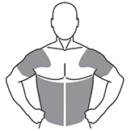
TRAVERSE: intervention and management
Randomised 1:1 to receive either transdermal 1.62% T gel or matching placebo gel
Study drug is provided in metered dose pumps, applied once-daily in the morning to the shoulder(s) or upper arm(s)
For TTh, the starting dose is 40.5 mg (2 pump actuations of 20.25 mg)
TTh dose is titrated to achieve and maintain a serum T concentration of 12.1–26.0 nmol/L (350–750 ng/dL)
Study drug is permanently discontinued in cases of:
Serum T levels >26.0 nmol/L (750 ng/dL) or haematocrit >54%, even after down-titration to lowest dose
New prostate cancer diagnosis
Being deemed at risk for suicide
Participants who discontinue study drug for any other reason may restart at a time deemed medically appropriate by the Investigator
T, testosterone; TTh, testosterone therapy.
Bhasin S et al. Am Heart J 2022;245:41–50.
Notes:
TRAVERSE: intervention and management
Eligible subjects are randomised using an interactive response technology system in a 1:1 ratio to receive either transdermal 1.62% testoterone gel or a matching placebo gel daily.
The study drug is provided in metered dose pumps applied once-daily in the morning to the shoulder(s) or upper arm(s).
All subjects randomised to the TTh group initiate therapy with a 40.5 mg dose (2 pump actuations, each delivering 20.25 mg testosterone) once-daily.
The dose is titrated based on testosterone measurements to achieve and maintain serum levels at a concentration of 12.1–26.0 nmol/L (350–750 ng/dL).
Study drug is permanently discontinued in subjects with confirmed testosterone levels >26.0 nmol/L (750 ng/dL) or haematocrit >54%, even after down-titration to the lowest dose, those with a new prostate cancer diagnosis, or those deemed at risk for suicide, as determined by the Investigator or by response to the Patient Health Questionnaire-9 in the PDD substudy.
Specific criteria are provided for management or referral to a urologist for elevated prostate-specific antigen values.
Otherwise, participants who discontinue study drug for other reasons may be restarted at any time, if deemed medically appropriate by the Investigator.
PDD, persistent depressive disorder; TTh, testosterone therapy.
Reference
Bhasin S et al. Am Heart J 2022;245:41–50.

Slide 11
Outlook and perspective
TRAVERSE is the largest and longest-duration randomised study of TTh ever conducted
It includes a greater number of MACE endpoints than all other randomised trials to date combined; therefore, it will help to address the uncertainty regarding CV safety of TTh among middle-aged or older men who have, or who are at high risk for, CV disease
By virtue of its large sample size and treatment duration, the TRAVERSE study will also allow assessment of prostate safety and provide information regarding the long-term efficacy of TTh in improving sexual function, depressive symptoms and anaemia, and its effect on progression from prediabetes to diabetes or glycaemic remission in men with diabetes, and risk of bone fractures
CV, cardiovascular; MACE, major adverse cardiovascular events; TTh, testosterone therapy.
Bhasin S et al. Am Heart J 2022;245:41–50.

