Slide 1
Effects of testosterone treatment on clinical fractures The TRAVERSE Trial

Slide 2
TRAVERSE Fracture substudy
Rationale for a fracture substudy
Testosterone treatment of severely hypogonadal men improves many parameters of bone density and quality
Testosterone treatment of elderly hypogonadal men also improves many parameters of bone density and quality
No prior trial of testosterone treatment of hypogonadal men has been large enough or long enough to assess its effect on fractures…
…until the Traverse Trial
Snyder PJ et al. N Engl J Med 2024;390:203–11.

Slide 3
TRAVERSE Fracture substudy
Hypothesis
Testosterone treatment of older and middle-aged hypogonadal men will decrease their incidence of clinical fractures
Snyder PJ et al. N Engl J Med 2024;390:203–11.

Slide 4
TRAVERSE Fracture substudy
Assessment of fractures
Every participant was asked at every visit if he had had a fracture
If Yes, then medical records were obtained
Reported fractures were adjudicated at the San Francisco Coordinating Center by Dr. Bauer
Experienced in adjudicating fractures for many prior trials
Trained adjudicator
Reported fracture was adjudicated as confirmed, not confirmed or uncertain
For a confirmed fracture, the anatomic site and degree of trauma were recorded
Snyder PJ et al. N Engl J Med 2024;390:203–11.

Slide 5
TRAVERSE Fracture substudy
Statistical methods
Primary outcome
Time to first clinical fracture (excluding sternum, fingers, toes, skull and facial bones) by time-to-event analysis, using a Cox proportional hazards model
Secondary outcomes
Non-high impact fractures
Fractures in men not taking medication for osteoporosis
Exploratory outcomes
All clinical fractures not excluding fingers, toes, etc.
Major osteoporotic fractures
Snyder PJ et al. N Engl J Med 2024;390:203–11.

Slide 6
TRAVERSE Fracture substudy
Results of adjudication of reported fractures
Adjudication outcome | Testosterone | Placebo
Total fractures reported and adjudicated, n | 186 | 123
Confirmed as a fracture, n (%) | 154 (82.8) | 97 (78.9)
Confirmed as not a fracture, n (%) | 8 (4.3) | 6 (4.9)
Unconfirmed, n (%) | 24 (12.9) | 20 (16.3)
Fracture uncertain | 9 (4.8) | 7 (5.7)
Insufficient documentation | 15 (8.1) | 13 (10.6)
Snyder PJ et al. N Engl J Med 2024;390:203–11.

Slide 7
TRAVERSE Fracture substudy: results
Effect of testosterone on fractures
Testosterone Placebo
n/N (%) n/N (%)
Hazard ratio for fracture (95% CI)
Primary: All clinical fractures
Non-high-impact clinical fractures
Clinical fractures in men not taking osteoporosis medication
Non-high-impact fractures in men not taking osteoporosis medication
Fracture-free survival
All clinical fractures, including those that were excluded
All clinical fractures, including those with uncertain/insufficient documentation
Major osteoporotic fractures: hip, wrist, humerus and clinical spine
Hip fractures
Clinical vertebral fractures
91/2601 (3.50) 64/2603 (2.46)
75/2601 (2.88) 57/2603 (2.19)
1.43 (1.04–1.97)
1.32 (0.94–1.86)
88/2588 (3.40) 63/2592 (2.43)
1.41 (1.02–1.94)
72/2588 (2.78) 56/2592 (2.16)
1.29 (0.91–1.83)
226/2601 (8.69) 198/2603 (7.61)
1.15 (0.95–1.39)
109/2601 (4.19) 72/2603 (2.77)
1.52 (1.13–2.05)
99/2601 (3.81) 75/2603 (2.88)
1.33 (0.98–1.79)
36/2601 (1.38) 30/2603 (1.15)
1.20 (0.74–1.95)
7/2601 (0.27) 6/2603 (0.23)
1.16 (0.39–3.46)
14/2601 (0.54) 11/2603 (0.42)
1.26 (0.57–2.79)
0.3
0.4
0.5
0.6
0.8
1
2
3
4
Testosterone better
Placebo better
CI, confidence interval; n/N, number with fracture/number at risk. Snyder PJ et al. N Engl J Med 2024;390:203–11.

Slide 8
TRAVERSE Fracture substudy: results
Cumulative incidence of clinical fractures
6
5
Hazard ratio 1.43 (95% CI: 1.04 to 1.97)
Testosterone
4
Cumulative incidence of primary endpoint, %
3
2
Placebo
1
0
0
1
2
3
Years
Number at risk
Testosterone
Placebo
2601 2332 1812 1369
2603 2335 1812 1354
CI, confidence interval.
Snyder PJ et al. N Engl J Med 2024;390:203–11.

Slide 9
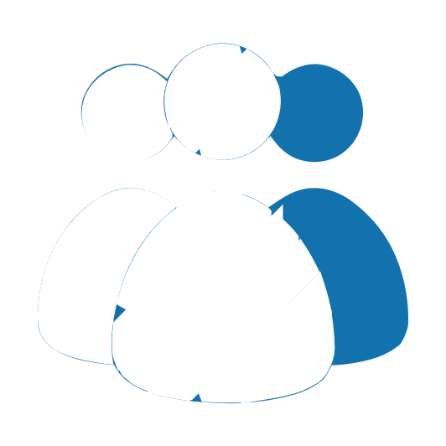
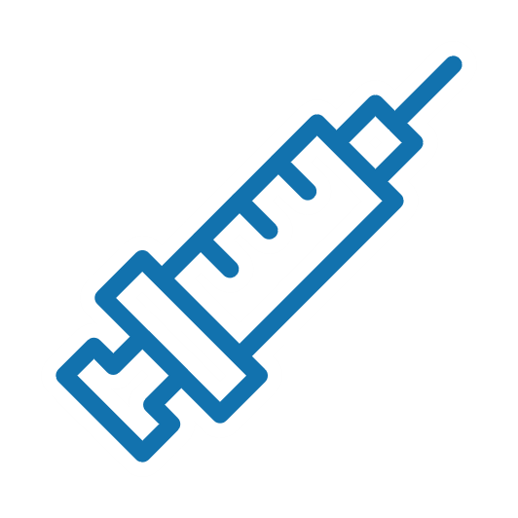
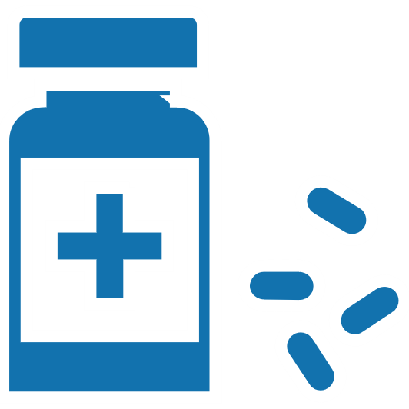
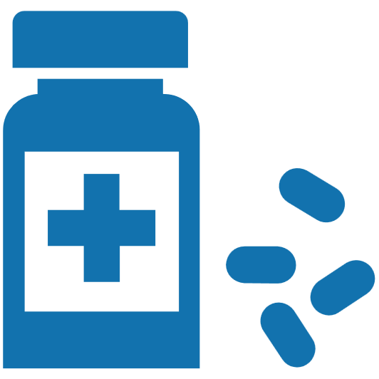
TRAVERSE Fracture substudy: results
Age, race and medications
Subgroup |  |  | Hazard ratio (95% CI) |  | p value for interaction
 | Age | 45–64 years | 1.43 | (0.86-2.39) | 0.98
 |  | ≥65 years | 1.42 | (0.94-2.14)
 | Race | Black | 1.05 | (0.46-2.38) | 0.68
 |  | White | 1.52 | (1.07-2.17)
 | Osteoporosis medication | No | 1.42 | (1.03-1.96) | 0.82
 |  | Yes | 1.76 | (0.16-19.57)
CI, confidence interval.

Slide 10
TRAVERSE Fracture substudy: results
Fractures and trauma
Fracture type, n (%) | Testosterone (n=2601) | Placebo (n=2603)
Primary analysis: all fractures | 91 (3.50) | 64 (2.46)
Fracture associated with trauma | 84 (3.23) | 58 (2.23)
Fall | 58 (2.23) | 43 (1.65)
Non-fall | 25 (0.96) | 15 (0.58)
Fracture not associated with trauma | 6 (0.23) | 6 (0.23)
Undetermined if fracture associated with trauma | 3 (0.12) | 0 (0)
Snyder PJ et al. N Engl J Med 2024;390:203–11.

Slide 11
TRAVERSE Fracture substudy
How can we explain these results?
If testosterone improves bone quality, why does it increase the risk of fracture?
Are the results real? The validity is supported by:
If there was no association between testosterone treatment and fractures, the chance of these results would be only 3%
Testosterone increased the risk of all types of fractures (Forest plot)
Speculation: Testosterone treatment led to an increase in physical activity, which led to an increase in trauma and therefore more fractures

Slide 12
TRAVERSE Fracture substudy
How can we explain these results?
Might TTh increase the risk of osteoporotic fracture by adversely affecting bone structure and strength?
1
Fracture incidence increased immediately at treatment onset – a finding that is too rapid to be due to effects on bone
The rapid divergence between trial groups is more likely related to behavioural changes
TTh may have affected behaviours such as engaging in physical activities associated with fracture risk
There was no substantial between-group difference in the incidence of typical osteoporotic clinical fractures (spine, hip, humerus and wrist) in this substudy
Appears unlikely
2
TTh, testosterone therapy.
Grossmann M, Anawalt BD. N Engl J Med 2024;390:267–8.

Slide 13
TRAVERSE Fracture substudy
Limitations and considerations
No data on bone density or strength were available
We do not know if the groups were matched for BMI at baseline
Because the investigators did not expect these results they did not record what patients were doing at the time of fracture e.g. physical activity
Fracture incidence was lower than estimated in the power calculation
The TTh dose might have been too low to improve bone density and tensile strength
Such effects take time and might have eventually offset or overcome the early increase in fracture risk
SHBG, sex hormone-binding globulin; TTh, testosterone therapy.
Grossmann M, Anawalt BD. N Engl J Med 2024;390:267–8.

Slide 14
TRAVERSE Fracture substudy
Conclusion
Among middle-aged and older men with hypogonadism, established CVD or multiple risk factors for incident cardiac events, TTh treatment did not result in a lower incidence of clinical fracture than placebo
The fracture incidence was numerically higher among men who received TTh than those who received placebo
CVD, cardiovascular disease; TTh, testosterone therapy.
Snyder PJ et al. N Engl J Med 2024;390:203–11.

