Slide 1
The TRAVERSE Anaemia Substudy

Slide 2
Background and gaps in knowledge
?
Background
Gaps in knowledge
Anaemia is:
Highly prevalent in older adults
Associated with fatigue, mobility limitation, poor HRQoL, falls, and increased mortality
T deficiency causes mild normocytic anaemia
Nearly 15% of older adults with T deficiency have anaemia
T increases haemoglobin levels by multiple mechanisms
No large, adequately powered trial has been conducted to evaluate the efficacy of TTh in correcting anaemia in middle-aged and older men with hypogonadism
It is unknown whether TTh can prevent the development of anaemia in middle-aged and older men with hypogonadism
HRQoL, health-related quality of life; T, testosterone; TTh, testosterone therapy.
Guo W et al. Aging Cell 2013;12:280–91; Roy CN et al. JAMA Intern Med 2017;177:480–90; Salive ME et al. J Am Geriatr Soc 1992;40:489–96.

Slide 3
TRAVERSE Anaemia substudy: aims
TRAVERSE Anaemia substudy
Primary
To evaluate the efficacy of TTh versus placebo in correcting anaemia in middle-aged and older men with hypogonadism among randomised TRAVERSE participants who had anaemia at baseline
Secondary included:
To evaluate the effects of TTh versus placebo on the development of anaemia (incidence) in TRAVERSE participants without anaemia at baseline
To evaluate whether changes in haemoglobin levels are associated with changes in energy level
MACE, major adverse cardiovascular events; TTh, testosterone therapy; VTE, venous thromboembolism.
Pencina KM et al. JAMA Netw Open 2023;6:e2340030.

Slide 4
TRAVERSE Anaemia substudy
Eligibility criteria and analytical approach
Analytic sample for anaemia correction
Included all randomised participants who had anaemia at baseline (haemoglobin level <12.7 g/dL, based on established criteria)
Excluded men with a known cause, haematologic malignancy, using ESAs, or missing haemoglobin level measurement
Analytic sample for incident anaemia
Included all randomised participants who did not have anaemia at baseline (haemoglobin level >12.7 g/dL)
ESA, erythropoiesis-stimulating agent.
Pencina KM et al. JAMA Netw Open 2023;6:e2340030.

Slide 5
TRAVERSE Anaemia substudy: results
Baseline characteristics and anaemia parameters
 | Anaemia at baseline |  | No anaemia at baseline
 | Testosterone (n=390) | Placebo (n=425) | Testosterone (n=2203) | Placebo (n=2176)
Mean (SD) age, years Age ≥65 years, n (%) of patients | 64.7 ± 7.7 208 (53.3) | 64.9 ± 7.8 230 (54.1) | 63.1 ± 8.0 1029 (46.7) | 62.9 ± 7.8 980 (45.0)
Race/ethnicity, n (%) of patients White Black or African American Other | 257 (65.9) 119 (30.5) 14 (3.6) | 287 (67.5) 128 (30.1) 10 (2.4) | 1808 (82.1) 325 (14.8) 70 (3.2) | 1795 (82.5) 304 (14.0) 77 (3.5)
Prior CVD, n (%) of patients | 233 (59.7) | 261 (61.4) | 1175 (53.3) | 1175 (54.0)
Mean (SD) haemoglobin level, g/dL | 11.8 (0.8) | 11.8 (0.7) | 14.4 (1.0) | 14.4 (1.0)
Mean (SD) red blood cell count, x 10¹²/L | 4.2 (0.4) | 4.2 (0.4) | 4.8 (0.4) | 4.8 (0.4)
Mean (SD) haematocrit, % | 36.4 (2.4) | 36.3 (2.4) | 42.9 (3.1) | 42.9 (3.0)^{A}
Mean (SD) HIS-Q energy domain score | 50.8 (23.7)^{B} | 48.0 (23.5)^{C} | 50.6 (23.2)^{D} | 50.5 (23.0)^{E}
^{A}n=2174, ^{B}n=363, ^{C}n=388, ^{D}n=2059, ^{E}n=2007. CVD, cardiovascular disease; HIS-Q, Hypogonadism Impact of Symptoms Questionnaire; SD, standard deviation. Pencina KM et al. JAMA Netw Open 2023;6:e2340030.

Slide 6
TRAVERSE Anaemia substudy: results
Correction of anaemia in men with anaemia at baseline
RR (95% CI) Testosterone Placebo
n=390, n/N (%) n=425, n/N (%)
Month 6
1.50 (1.22–1.84) 143/349 (41) 103/375 (27)
Month 12
1.32 (1.10–1.59) 152/338 (45) 122/360 (34)
Month 24
1.37 (1.11–1.70) 124/290 (43) 95/307 (31)
Month 36
1.24 (1.01–1.55) 94/216 (44) 76/229 (33)
Month 48
1.08 (0.81–1.43) 41/92 (45) 38/97 (39)
0.8
0.9
1
2
Omnibus test p=0.002
Lower with testosterone
Higher with testosterone
Relative risk (95% CI)
CI, confidence interval; RR, relative risk.

Slide 7
TRAVERSE Anaemia substudy: results
Achievement of Hb increase >1 g/dL in men with anaemia
RR (95% CI) Testosterone Placebo
n=390, n/N (%) n=425, n/N (%)
Month 6
1.98 (1.51–2.60) 114/349 (33) 62/375 (17)
Month 12
1.54 (1.20–1.98) 110/338 (33) 77/360 (21)
Month 24
1.37 (1.05–1.80) 90/290 (31) 68/307 (22)
Month 36
1.20 (0.91–1.60) 69/216 (32) 51/229 (22)
Month 48
0.96 (0.68–1.37) 31/92 (34) 29/97 (30)
0.6
0.7
0.8
0.9
1
2
3
Omnibus test p<0.001
Lower with testosterone
Higher with testosterone
Relative risk (95% CI)
CI, confidence interval; Hb, haemoglobin level; RR, relative risk; Pencina KM et al. JAMA Netw Open 2023;6:e2340030.

Slide 8
TRAVERSE Anaemia substudy: results
Incidence of anaemia in men not anaemic at baseline
RR (95% CI) Testosterone Placebo
n=390, n/N (%) n=425, n/N (%)
Month 6
0.69 (0.57–0.85) 143/1997 (7) 203/1958 (10)
Month 12
0.78 (0.63–0.97) 137/1934 (7) 171/1894 (9)
Month 24
0.83 (0.69–0.99) 174/1746 (10) 207/1677 (12)
Month 36
0.85 (0.70–1.04) 135/1347 (10) 167/1300 (13)
Month 48
0.86 (0.65–1.13) 51/570 (9) 51/499 (10)
0.5
0.6
0.7
0.8
0.9
1
2
Omnibus test p=0.019
Lower with testosterone
Higher with testosterone
Relative risk (95% CI)
CI, confidence interval; RR, relative risk; Pencina KM et al. JAMA Netw Open 2023;6:e2340030.

Slide 9
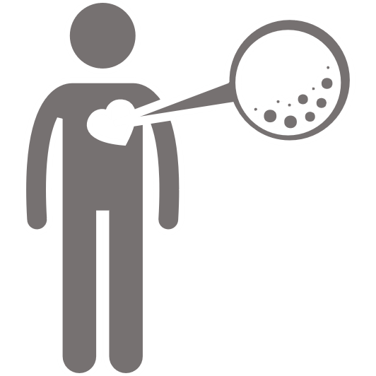
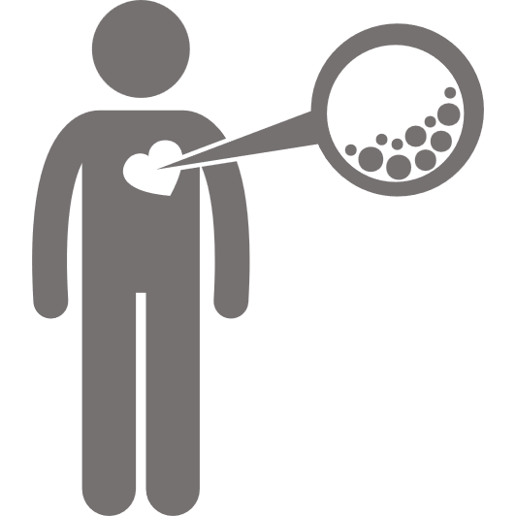
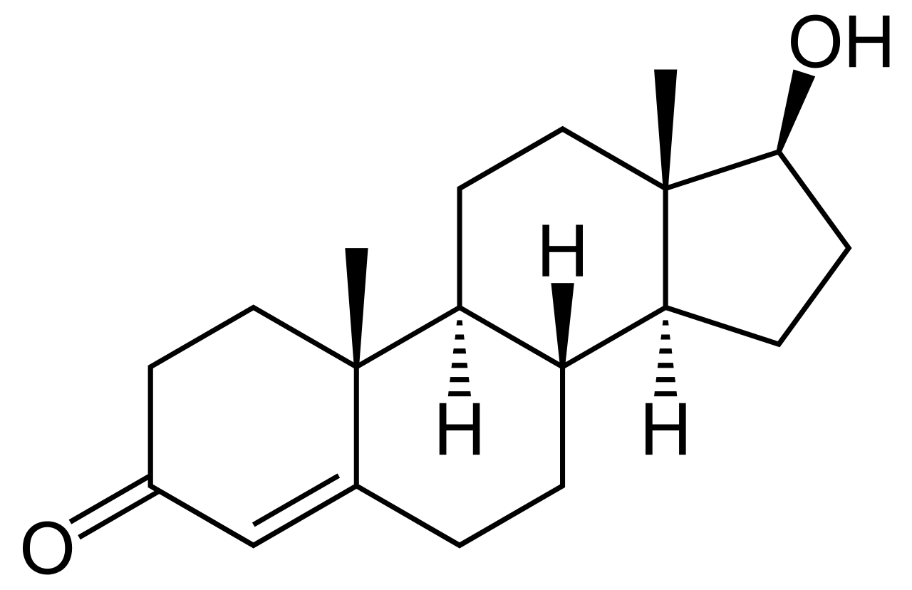
TRAVERSE Anaemia substudy: results
Prespecified analyses: effect on correction of anaemia
The observed significant effect on correction of anaemia with testosterone versus placebo was irrespective of the following:
Subgroup in men with anaemia at baseline |  |  | p value for interaction
 | Age | <65 years | 0.456
 |  | ≥65 years
 | Prior CVD | Yes | 0.628
 |  | No
 | Baseline testosterone level | <250 ng/dL (<8.7 nmol/L) | 0.051
 |  | ≥250 ng/dL (≥8.7 nmol/L)
 | Race/ethnicity | Black/African American | 0.902
 |  | White
CVD, cardiovascular disease; Pencina KM et al. JAMA Netw Open 2023;6:e2340030.

Slide 10
TRAVERSE Anaemia substudy: results
Prespecified analyses: effect on development of anaemia
The observed significantly decreased risk of developing anaemia with testosterone versus placebo was irrespective of the following:
Subgroup in men without anaemia at baseline |  |  | p value for interaction
 | Age | <65 years | 0.329
 |  | ≥65 years
 | Prior CVD | Yes | 0.424
 |  | No
 | Baseline testosterone level | <250 ng/dL (<8.7 nmol/L) | 0.466
 |  | ≥250 ng/dL (≥8.7 nmol/L)
 | Race/ethnicity | Black/African American | 0.445
 |  | White
CVD, cardiovascular disease; Pencina KM et al. JAMA Netw Open 2023;6:e2340030.

Slide 11
TRAVERSE Anaemia substudy: results
Change from baseline in Hb in men with or without anaemia
Men with anaemia at baseline
Men without anaemia at baseline
1.0
Testosterone
Placebo
1.0
Testosterone
Placebo
Omnibus test p<0.001
0.5
0.5
Change from baseline in Hb, g/dL
Change from baseline in Hb, g/dL
0
0
Omnibus test p<0.001
-0.5
-0.5
0
6
12
24
36
48
0
6
12
24
36
48
Months since randomisation
Months since randomisation
Patients, n
Testosterone
Placebo
390 341 271 185 136 53 2203 1934 1573 1131 835 253
425 360 297 179 131 48 2176 1892 1563 1088 811 220
Hb, haemoglobin level; Pencina KM et al. JAMA Netw Open 2023;6:e2340030.

Slide 12
TRAVERSE Anaemia substudy: results
Relation of change in Hb and energy levels in men with anaemia
4
Small but significant improvement in energy
Estimated slope (SE) -0.14 (0.055) p=0.012
3
2
1
Average change from baseline in HIS-Q energy domain score
0
-1
-2
-3
-4
-2
0
2
4
6
8
Average change from baseline in Hb
Hb, haemoglobin level; HIS-Q, Hypogonadism Impact of Symptoms Questionnaire; SE, standard error. Pencina KM et al. JAMA Netw Open 2023;6:e2340030.

Slide 13
TRAVERSE Anaemia substudy
Conclusions
In middle-aged and older men with hypogonadism and anaemia, testosterone treatment was more efficacious than placebo in correcting anemia
Compared to placebo, testosterone treatment was also associated with a lower incidence of anaemia among men without anaemia at baseline
Pencina KM et al. JAMA Netw Open 2023;6:e2340030.

