Slide 1
Cardiovascular safety of testosterone replacement therapy The TRAVERSE Trial

Slide 2
TRAVERSE Trial: objective and design
Determine the effects of testosterone replacement therapy on major adverse cardiac events among middle-aged and older men with hypogonadism who are at high cardiovascular risk
Randomised, double-blind, placebo-controlled trial
Non-inferiority
Event-driven
Multicentre – 316 sites in the United States

Slide 3
TRAVERSE Trial: organisation
Executive Steering Committee
DMC
Steven E. Nissen (Chair) Glenn R. Cunningham
A. Michael Lincoff (Co-PI) Christopher B. Granger
Shalender Bhasin (Co-PI) Mohit Khera
Shehzad Basaria Ian M. Thompson
William E. Boden
John H. Alexander (Chair)
William Bremner
Eric Klein
Darren K. McGuire
Janet Wittes
Academic Research Organisation
Cleveland Clinic Coordinating Center for Clinical Research (C5Research)
Lisa Mitchell Deborah Davey Qiuqing Wang
Kathy Wolski Vidyasagar Kalahasti (CEC)
Sponsors
Consortium led by AbbVie, Inc with additional financial support from Endo Pharmaceuticals, Acerus Pharmaceuticals, Upsher-Smith Laboratories
Panagiotis Flevaris Michael G. Miller
Nader Khan Anna Chan

Slide 4
TRAVERSE Trial: design
Inclusion criteria - hypogonadism
Men, age 45–80 years
Symptoms (1 or more) of hypogonadism:
Decreased sexual desire or libido
Decreased spontaneous erections
Decreased energy or fatigue
Two fasting serum testosterone concentrations <300 ng/dL from blood obtained between 5–11 AM, collected at least 48 hours apart
Low or depressed mood
Loss of axillary or pubic hair or reduced shaving
Hot flashes

Slide 5
TRAVERSE Trial: design
Inclusion criteria - cardiovascular
Pre-existing cardiovascular disease – clinical or angiographic:
Coronary artery disease
Cerebrovascular disease
Peripheral arterial disease
OR
Increased cardiovascular risk (3 or more risk factors):
Hypertension
Dyslipidaemia
Diabetes
Current smoking
Age ≥65 years
CKD stage 3
Elevated hs-CRP
Agatston CAC score >75th percentile
CAC, coronary artery calcium; CKD, chronic kidney disease; hs-CRP, high-sensitivity C-reactive protein.

Slide 6
TRAVERSE Trial: design
Exclusion criteria
Congenital or severe hypogonadism (testosterone <100 ng/dL)
History of prostate cancer or prostate nodules
Elevated PSA >3.0 ng/mL (>1.5 ng/mL if taking 5-α reductase inhibitor)
Thrombophilia, history of unprovoked DVT or pulmonary embolism
Polycythemia
Uncontrolled heart failure, hypertension or diabetes
Uncontrolled major psychiatric disorder or at risk for suicide
ACS, stroke or coronary or peripheral revascularisation in the past 4 months
Testosterone or androgenic steroid treatment in the past 6 months
ACS, acute coronary syndrome; DVT, deep vein thrombosis; PSA, prostate-specific antigen.

Slide 7
TRAVERSE Trial: design
Adjudicated CV endpoints
1
Primary CV endpoint
MACE safety composite
CV mortality, non-fatal MI, non-fatal stroke
2
Secondary CV endpoint
CV safety composite
CV mortality, non-fatal MI, non-fatal stroke, or coronary revascularisation
3
All cause mortality
Heart failure hospitalisation or urgent visit
Peripheral arterial revascularisation
Venous thromboembolic event
Tertiary CV endpoints
CV, cardiovascular; MACE, major adverse cardiovascular events; MI, myocardial infarction.

Slide 8
TRAVERSE Trial: design
Study drug management
Randomised, double-blind, 1:1 ratio
Stratified by pre-existing CVD vs CV risk factors
Testosterone 1.62% gel
Placebo gel
Patients and trial team blinded to post-baseline T levels measured at central lab*
(*Drawn at Weeks 2, 4, 12, 26 and Months 12, 18, 24, 36, 48)
Dose titrations by automated algorithm to maintain T levels 350–750 ng/dL and haematocrit ≤54%
Sham titrations in placebo arm to facilitate blinding
Study drug discontinued if T level >750 ng/dL or haematocrit >54%, despite titration to lowest dose
CV, cardiovascular; CVD, cardiovascular disease; T, testosterone.

Slide 9
TRAVERSE Trial: design
Statistical methods
Noninferiority analysis
Cox proportional-hazards regression model to estimate the hazard ratio of testosterone to placebo for primary MACE endpoint
Rule out a hazard ratio of 1.5 at the 95% (2-sided) upper confidence limit
90% power
Event-driven trial: accrual of 256 first primary composite MACE events
MACE, major adverse cardiovascular events.

Slide 10
TRAVERSE Trial: design
‘On-treatment’ sensitivity analyses for primary MACE
Safety set
All randomised patients who received ≥1 dose of study drug
Primary analysis
Including all events occurring until end of patient follow-up
Principal sensitivity analysis
Censoring events occurring >365 days after last dose of study drug
Additional sensitivity analysis 1
Censoring events occurring >30 days after last dose of study drug
Additional sensitivity analysis 2
Censoring events occurring >30 days after start date of a study drug interruption lasting >3 months
MACE, major adverse cardiovascular events.

Slide 11
TRAVERSE Trial: design
Sample size
Annual placebo event rate estimated as ~1.5%
Protocol allowed trial leadership to cap enrollment in cardiovascular risk factor cohort if pooled event rate fell below projections
Estimated 5400 patients needed to observe the required 256 primary MACE events
To achieve similar power for the principal sensitivity analysis, estimated 6000 patients needed to observe the required 256 primary MACE events
MACE, major adverse cardiovascular events.

Slide 12
TRAVERSE Trial: design
Study timeline
2018
2019
2020
2021
2022
May 23, 2018
First patient enrolled
February 1, 2022
Enrollment terminated based on blinded assessment of pooled MACE accrual rates
April 2019
Blinded data from first 2669 patients showed pooled MACE rate <1.5%
May 31, 2022
End-of-study visits began
May 31, 2019
Further enrollment restricted to patients with pre-existing CVD
January 19, 2023
Last patient end-of-study visit
MACE, major adverse cardiovascular events.

Slide 13
TRAVERSE Trial: patient flow through the trial
5204 patients randomised (with no duplicates)
Testosterone, n=2601
Placebo gel, n=2603
Not treated
n=5
Not treated
n=1
Testosterone-treated, n=2596
Placebo gel-treated, n=2602
Safety set

Slide 14
TRAVERSE Trial: results
Baseline characteristics
 | Testosterone | Placebo
Mean (SD) age, years Age ≥65 years, % of patients | 63.3 ± 7.9 47.7 | 63.3 ± 7.9 46.5
Race/ethnicity, % of patients Black or African American Hispanic or Latino | 17.1 15.7 | 16.6 16.9
Mean (SD) body mass index, kg/m² | 35.0 ± 5.7 | 34.8 ± 6.0
Median (IQR) testosterone level, ng/dL | 227 (189, 258) | 227 (188, 258)
Mean (SD) PSA level, ng/mL | 0.91 ± 0.65 | 0.94 ± 0.68
Haematocrit, % | 42 ± 4 | 42 ± 4
Prior testosterone use, % of patients | 0.2 | 0.4
 | Testosterone | Placebo
Mean (SD) age, years Age ≥65 years, % of patients | 63.3 ± 7.9 47.7 | 63.3 ± 7.9 46.5
Race/ethnicity, % of patients Black or African American Hispanic or Latino | 17.1 15.7 | 16.6 16.9
Mean (SD) body mass index, kg/m² | 35.0 ± 5.7 | 34.8 ± 6.0
Median (IQR) testosterone level, ng/dL | 227 (189, 258) | 227 (188, 258)
Mean (SD) PSA level, ng/mL | 0.91 ± 0.65 | 0.94 ± 0.68
Haematocrit, % | 42 ± 4 | 42 ± 4
Prior testosterone use, % of patients | 0.2 | 0.4
IQR, interquartile range; PSA, prostate-specific antigen; SD, standard deviation.

Slide 15
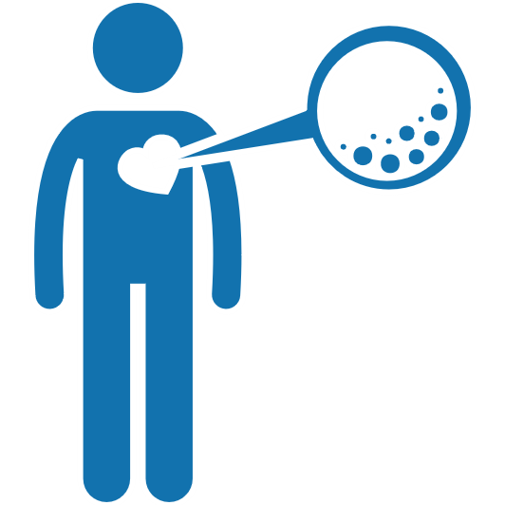
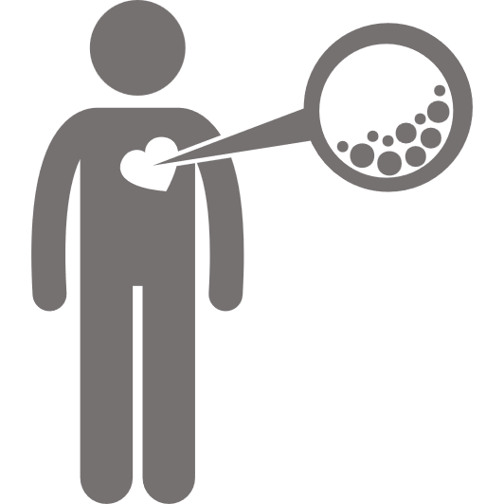
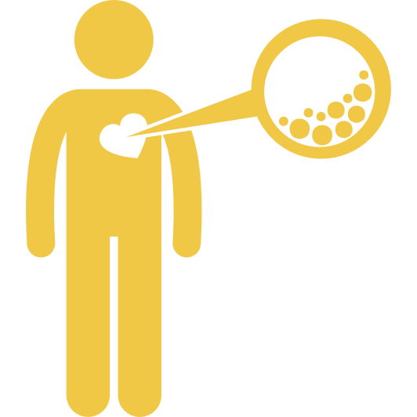
TRAVERSE Trial: results
Cardiovascular disease and risk factors
% of patients | Testosterone | Placebo
CV risk category Pre-existing CVD Increased CV risk | 54.2 45.8 | 55.2 44.8
Coronary artery disease | 44.5 | 44.6
Cerebrovascular disease | 11.7 | 12.2
Peripheral arterial disease | 6.1 | 5.9
Diabetes | 68.7 | 70.8
Hypertension | 93.2 | 92.3
Dyslipidaemia | 90.1 | 89.6
hs-CRP ≥2 mg/dL | 61.8 | 61.0
% of patients | Testosterone | Placebo
CV risk category Pre-existing CVD Increased CV risk | 54.2 45.8 | 55.2 44.8
Coronary artery disease | 44.5 | 44.6
Cerebrovascular disease | 11.7 | 12.2
Peripheral arterial disease | 6.1 | 5.9
Diabetes | 68.7 | 70.8
Hypertension | 93.2 | 92.3
Dyslipidaemia | 90.1 | 89.6
hs-CRP ≥2 mg/dL | 61.8 | 61.0
CV, cardiovascular; CVD, cardiovascular disease; hs-CRP, high-sensitivity C-reactive protein.

Slide 16
TRAVERSE Trial: results
Baseline medications and lipids
 | Testosterone | Placebo
Medications, % of patients Aspirin Lipid-lowering therapy | 60.4 84.0 | 59.5 83.7
Lipids, mg/dL LDL-cholesterol HDL-cholesterol Median (IQR) triglycerides | 80.2 ± 34.0 41.9 ± 11.2 154.6 [108.1, 227.6] | 79.3 ± 33.9 41.7 ± 10.9 157.7 [112.5, 226.7]
HDL, high-density lipoprotein; IQR, interquartile range; LDL, low-density lipoprotein.

Slide 17
TRAVERSE Trial: results
Study drug discontinuation over time
1700
Testosterone
Placebo
Number of discontinued study drug patients
1500
3198 patients
61.5%
1300
1100
900
Patients
700
500
300
End-of-study visits began
100
0
0
6
12
18
24
30
36
42
48
54
Months over the course of the trial

Slide 18
TRAVERSE Trial: patient flow through the trial
5204 patients randomised (with no duplicates)
Testosterone, n=2601
Placebo gel, n=2603
Not treated
n=5
Not treated
n=1
Testosterone-treated, n=2596
Placebo gel-treated, n=2602
Discontinued
study drug
n=1594 (61.4%)
Discontinued
study drug
n=1605 (61.7%)
Completed study drug, n=1003
Safety set
Completed study drug, n=997
21.8 ± 14.2 months
67.5%
Duration of treatment
% time treated
21.6 ± 14.0 months
67.3%

Slide 19
TRAVERSE Trial: results
Patient withdrawal from study over time
1082 patients
20.8%
947 patients
18.2%
1200
Testosterone
Placebo
Number of patients who withdrew from the study
1000
800
Patients
600
400
200
End-of-study visits began
0
0
6
12
18
24
30
36
42
48
54
Months over the course of the trial

Slide 20
TRAVERSE Trial: patient flow through the trial
5204 patients randomised (with no duplicates)
Testosterone, n=2601
Placebo gel, n=2603
Not treated
n=5
Not treated
n=1
Testosterone-treated, n=2596
Placebo gel-treated, n=2602
Discontinued
study drug
n=1594 (61.4%)
Discontinued
study drug
n=1605 (61.7%)
Completed study drug, n=1003
Safety set
Completed study drug, n=997
21.8 ± 14.2 months
67.5%
Duration of treatment
% time treated
21.6 ± 14.0 months
67.3%
Withdrew
from study
n=1007 (38.8%)
Withdrew
from study
n=1023 (39.3%)
Completed study, n=1594
Completed study, n=1580
33.1 ± 12.0 months
82.7%
Duration of follow-up
% possible follow-up
32.9 ± 12.1 months
81.7%

Slide 21
TRAVERSE Trial: results
Testosterone levels
Change in testosterone levels
Median (range) testosterone (ng/dL)
Median (range) change in testosterone (ng/dL)
600
Testosterone
Placebo
350
Testosterone
Placebo
300
500
250
400
200
Cumulative incidence, %
Cumulative incidence, %
150
300
100
200
50
Baseline 227 ng/dL [188, 258]
0
100
-50
0
6
12
18
24
30
36
42
48
0
6
12
18
24
30
36
42
48
Months after randomisation
Months after randomisation
65 ± 22 mg
Testosterone 148 ng/dL [34, 312]
Placebo 14 ng/dL [-21, 56]
Average
daily dose
Change at
12 months
CI, confidence interval; CV, cardiovascular; HR, hazard ratio; MI, myocardial infarction.

Slide 22
TRAVERSE Trial: results
Primary CV safety endpoint
15
Testosterone
Placebo
Primary CV safety endpoint (MACE):
CV death, non-fatal MI, non-fatal stroke
10
Cumulative incidence, %
5
HR 0.96 (95% CI: 0.78–1.17)
Noninferiority p<0.001
Safety set
population
0
0
6
12
18
24
30
36
42
48
Months after randomisation
CI, confidence interval; CV, cardiovascular; HR, hazard ratio; MACE, major adverse cardiovascular events; MI, myocardial infarction.

Slide 23
TRAVERSE Trial: results
Primary and secondary CV safety endpoints
% of patients | Testosterone (n=2596) | Placebo (n=2602) | HR (95% CI)
Primary: CV composite (MACE)* CV death, non-fatal MI, non-fatal stroke | 7.0 | 7.3 | 0.96 (0.78–1.17)
Secondary: CV composite CV death, non-fatal MI, non-fatal stroke, coronary revascularisation | 10.4 | 10.2 | 1.02 (0.86–1.21)
Components of composite endpoints
CV death | 3.4 | 4.0 | 0.84 (0.63–1.12)
Non-fatal MI | 2.6 | 2.4 | 1.10 (0.78–1.56)
Non-fatal stroke | 1.4 | 1.5 | 0.94 (0.60–1.49)
Coronary revascularisation | 5.6 | 4.7 | 1.20 (0.95–1.53)
*p value for non-inferiority <0.001. CI, confidence interval; CV, cardiovascular; HR, hazard ratio; MACE, major adverse cardiovascular events; MI, myocardial infarction.

Slide 24
TRAVERSE Trial: results
Tertiary CV safety endpoints
% of patients | Testosterone (n=2596) | Placebo (n=2602) | HR (95% CI)
All-cause mortality | 5.6 | 5.7 | 0.98 (0.78–1.23)
Heart failure hospitalisation | 2.1 | 1.9 | 1.11 (0.76–1.62)
Peripheral arterial revascularisation | 1.2 | 1.3 | 0.92 (0.56–1.51)
Venous thromboembolic events | 1.7 | 1.2 | 1.46 (0.92–2.32)
Components of venous thromboembolic events
Pulmonary embolism | 0.9 | 0.5
Deep vein thrombosis | 0.6 | 0.5
Other peripheral thrombosis | 0.4 | 0.5
CI, confidence interval; CV, cardiovascular; HR, hazard ratio.

Slide 25
TRAVERSE Trial: results
Principal sensitivity analysis: primary CV safety endpoint
Primary CV safety endpoint:
CV death, non-fatal MI, non-fatal stroke
Censored at 365 days post-last dose of study drug
15
Testosterone
Placebo
10
Cumulative incidence, %
5
HR 1.02 (95% CI: 0.81–1.27)
Noninferiority p<0.001
0
0
6
12
18
24
30
36
42
48
Months after randomisation
CI, confidence interval; CV, cardiovascular; HR, hazard ratio; MI, myocardial infarction.

Slide 26
TRAVERSE Trial: results
‘On-treatment’ sensitivity analyses: primary MACE safety endpoint
HR (95% CI) Testosterone Placebo
n=2596, n (%) n=2602, n (%)
Primary MACE safety endpoint: Safety set
0.96 (0.78–1.17) 182 (7.0) 190 (7.3)
Principal sensitivity analysis
1.02 (0.81–1.27) 154 (5.9) 152 (5.8)
Additional sensitivity
analysis 1
0.99 (0.76–1.29) 110 (4.2) 111 (4.3)
Additional sensitivity
analysis 2
0.99 (0.76–1.29) 107 (4.1) 109 (4.2)
0.7
0.8
0.9
1
2
Favours testosterone
Favours placebo
CI, confidence interval; HR, hazard ratio; MACE, major adverse cardiovascular events.

Slide 27
TRAVERSE Trial: results
Subgroup analyses: primary MACE safety endpoint
HR (95% CI) Testosterone Placebo
n=2596, n/N (%) n=2602, n/N (%)
Age <65 years
≥65 years
Race White
Black
Other
Pre-existing Yes
CVD No
Diabetes Yes
No
0.86 (0.64–1.15) 81/1358 (6.0) 96/1392 (6.9)
1.06 (0.80–1.40) 101/1238 (8.2) 94/1210 (7.8)
0.95 (0.76–1.19) 149/2066 (7.2) 157/2083 (7.5)
0.79 (0.46–1.34) 25/445 (5.6) 30/432 (6.9)
2.52 (0.66–9.58) 8/85 (9.4) 3/87 (3.5)
0.99 (0.77–1.26) 121/1409 (8.6) 125/1437 (8.7)
090 (0.63–1.28) 61/1187 (5.1) 65/1165 (5.6)
1.03 (0.82–1.29) 147/1787 (8.2) 148/1844 (8.0)
0.77 (0.49–1.20) 35/809 (4.3) 42/758 (5.5)
0.4
0.6
0.8
1
2
3
Favours testosterone
Favours placebo
CI, confidence interval; HR, hazard ratio; MACE, major adverse cardiovascular events.

Slide 28
TRAVERSE Trial: results
Investigator-reported adverse events
% of patients | Testosterone | Placebo | p value
Any AE | 45.7 | 44.7 | 0.47
SAE | 27.8 | 26.8 | 0.42
AE leading to study drug discontinuation | 9.4 | 8.7 | 0.37
AEs of special interest | 7.6 | 6.4 | 0.11
Hospitalisation for unstable angina | 1.7 | 2.3 | 0.12
Non-fatal arrhythmia | 5.2 | 3.3 | 0.001
CVD causing syncope | 1.0 | 1.2 | 0.52
Diabetes | 7.3 | 8.2 | 0.22
COVID-19 | 4.7 | 4.5 | 0.78
Atrial fibrillation | 3.5 | 2.4 | 0.02
Acute kidney injury | 2.3 | 1.5 | 0.04
Urinary retention | 1.9 | 1.3 | 0.08
% of patients | Testosterone | Placebo | p value
Any AE | 45.7 | 44.7 | 0.47
SAE | 27.8 | 26.8 | 0.42
AE leading to study drug discontinuation | 9.4 | 8.7 | 0.37
AEs of special interest | 7.6 | 6.4 | 0.11
Hospitalisation for unstable angina | 1.7 | 2.3 | 0.12
Non-fatal arrhythmia | 5.2 | 3.3 | 0.001
CVD causing syncope | 1.0 | 1.2 | 0.52
Diabetes | 7.3 | 8.2 | 0.22
COVID-19 | 4.7 | 4.5 | 0.78
Atrial fibrillation | 3.5 | 2.4 | 0.02
Acute kidney injury | 2.3 | 1.5 | 0.04
Urinary retention | 1.9 | 1.3 | 0.08
% of patients | Testosterone | Placebo | p value
Any AE | 45.7 | 44.7 | 0.47
SAE | 27.8 | 26.8 | 0.42
AE leading to study drug discontinuation | 9.4 | 8.7 | 0.37
AEs of special interest | 7.6 | 6.4 | 0.11
Hospitalisation for unstable angina | 1.7 | 2.3 | 0.12
Non-fatal arrhythmia | 5.2 | 3.3 | 0.001
CVD causing syncope | 1.0 | 1.2 | 0.52
Diabetes | 7.3 | 8.2 | 0.22
COVID-19 | 4.7 | 4.5 | 0.78
Atrial fibrillation | 3.5 | 2.4 | 0.02
Acute kidney injury | 2.3 | 1.5 | 0.04
Urinary retention | 1.9 | 1.3 | 0.08
AE, adverse event; CVD, cardiovascular disease; COVID-19, coronavirus disease 2019; HR, hazard ratio; SAE, serious adverse event.

Slide 29
TRAVERSE Trial
Limitations
Lower rates of study drug adherence and patient retention than in most CV outcome trials
Similar rates seen in other trials of testosterone or other chronic symptomatic conditions (e.g. menopause, obesity, pain)
Reflect challenge in retaining patients with persistent symptoms who choose to change medications or discontinue trial participation
On-treatment sensitivity analyses reinforce non-inferiority conclusions
Patient withdrawal rates similar in both arms, with outcome data available for >80% of potential person-time follow-up
CV, cardiovascular.

Slide 30
TRAVERSE Trial
Summary and interpretation
Among middle-aged or older men with hypogonadism, who had a history of established CVD or who were at high risk for incident CV events, testosterone replacement therapy for a mean duration of 22 months did not increase the risk of MACE
These findings of CV safety should facilitate more informed consideration of the potential benefits and risks of testosterone treatment for middle-aged and older men with hypogonadism
These results apply only to men with hypogonadal symptoms and low testosterone levels and should not be used to justify treatment of broader populations not studied in this trial
CV, cardiovascular; CVD, cardiovascular disease; MACE, major adverse cardiovascular events.

Slide 31
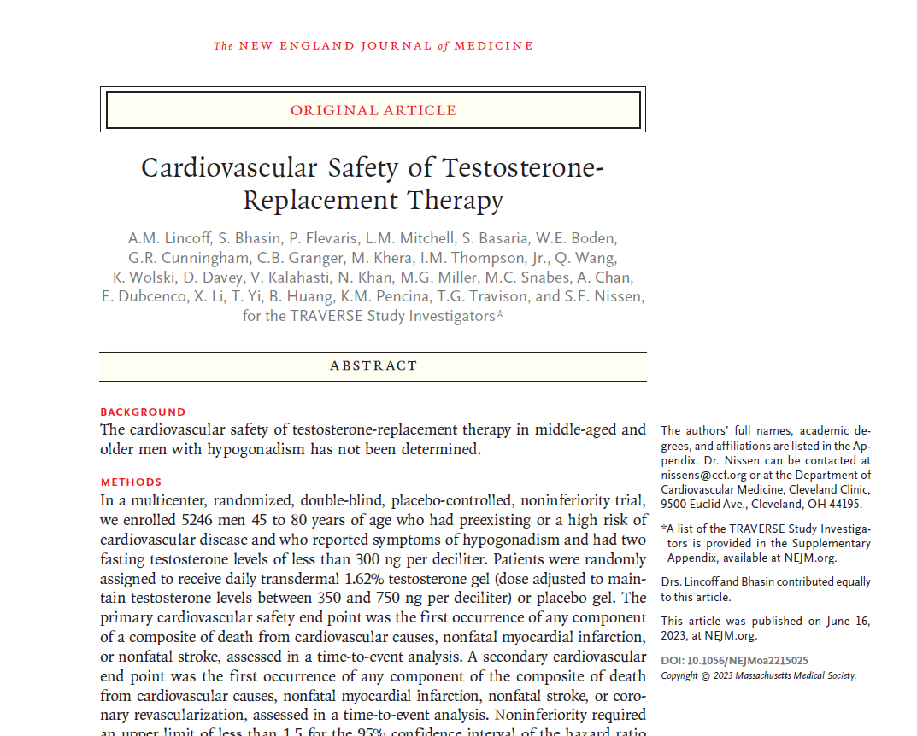
TRAVERSE Trial: CV safety publication
CV, cardiovascular.

