Slide 1
The Testosterone Trials (TTrials)
Besins Healthcare
Global Medical Affairs
March 2021

Slide 2
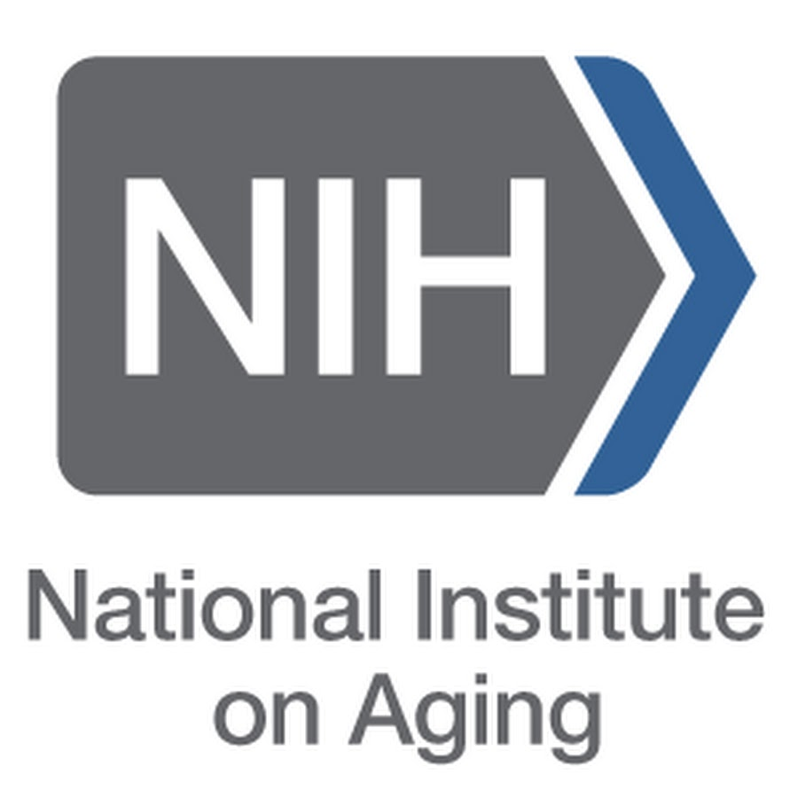
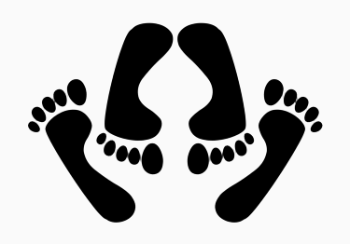
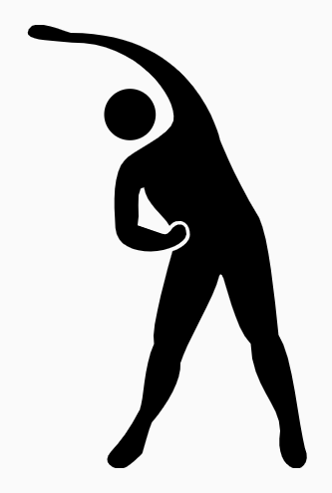
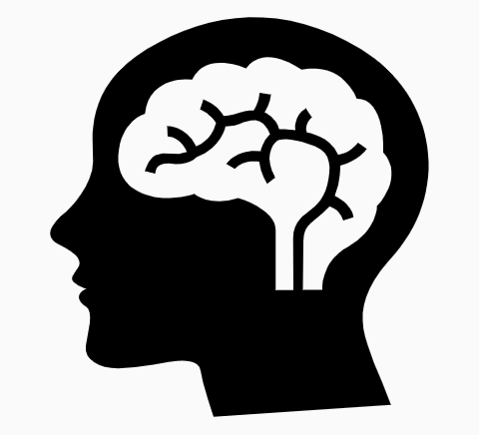
The Testosterone Trials: background
2002
National
Institute
on Aging
NIA and NCI asked the IOM (now the National Academy of Medicine) to assess the evidence on TTh for older men
2003
IOM concluded that the available evidence on TTh was insufficient
IOM recommended that the NIA fund a coordinated set of clinical trials to determine the benefits of TTh in older men with low testosterone
NIA supported the development of the TTrials
2016
to
2017
Key findings of the individual TTrials studies were published
Sexual Function
(2016)
Physical Function (2016)
Cognitive Function (2017)
Vitality (2016)
Anaemia (2017)
Cardiovascular (2017)
Bone (2017)
IOM, Institute of Medicine; NCI, National Cancer Institute; NIA, National Institute on Aging; TTh, testosterone therapy Snyder PJ et al. Endocr Rev 2018;39:369–86.
Notes:
In 2002, the US NIA and NCI requested that the IOM (now the National Academy of Medicine) assess the status of current clinical research on TTh for older men.
In 2003, the IOM committee concluded that the evidence on the effects of TTh in older men with low testosterone was insufficient and recommended that the NIA fund a coordinated set of clinical trials to determine whether TTh has any benefits in this population, and to fund a larger trial to determine the possible risks of TTh, but only if benefits were found.
The NIA followed this advice and supported the development of the TTrials to implement the IOM’s recommendation.
The Testosterone Trials were 7 coordinated clinical trials conducted at 12 US sites to assess the efficacy of TTh for 1 year in older men with hypogonadism [testosterone levels <9.5 nmol/L (<275 ng/dL)]:
Sexual Function, Physical Function and Vitality studies (first key publications in 2016).
Cognitive Function, Anaemia, Cardiovascular and Bone studies (first key publications in 2017).
IOM, Institute of Medicine; NCI, National Cancer Institute; NIA, National Institute on Aging; TTh, testosterone therapy
Reference
Snyder PJ et al. Endocr Rev 2018;39:369–86.

Slide 3
The Testosterone Trials: the impact of TTh on seven clinical outcomes in older men with low testosterone
Shared characteristics of the Testosterone Trials
12 US study sites
TTrials (n=7): Sexual Function, Physical Function, Vitality, Cognitive Function, Anaemia, Cardiovascular, Bone
Non-randomised, double-blinded, placebo-controlled design
Men with average testosterone level <9.5 nmol/L (<275 ng/dL)
Participants received 1% testosterone gel in a pump dispenser (5 g/day, adjusted to maintain normal testosterone levels for a young man) or placebo gel for 12 months
Treatment allocated by minimisation (allows balancing with a larger number of variables than stratified randomisation)
Balancing variables included age ≤ or >75 years, screening testosterone levels ≤ or >6.9 nmol/L (200 ng/dL), use/non-use of antidepressants and use/non-use of PDE-5 inhibitors
PDE-5, phosphodiesterase type 5; TTh, testosterone therapy
Snyder PJ et al. Endocr Rev 2018;39:369–86.
Notes:
The Testosterone Trials were 7 coordinated clinical trials conducted at 12 US sites to assess the efficacy of TTh in older men with hypogonadism [testosterone levels <9.5 nmol/L (<275 ng/dL)]:
Sexual Function.
Physical Function.
Vitality.
Cognitive Function.
Anaemia.
Cardiovascular.
Bone.
Participants were allocated to receive 1% testosterone gel (5 g/day, adjusted to maintain normal testosterone levels for a young man) or placebo gel for 1 year, and efficacy was assessed every 3 months.
Participants were allocated treatment by minimisation, which allows balancing with a larger number of variables than stratified randomisation.
Balancing variables included age < or >75 years, screening testosterone levels < or >6.9 nmol/L (200 ng/dL), use/non-use of antidepressants and use/non-use of PDE-5 inhibitors.
PDE-5, phosphodiesterase type 5; TTh, testosterone therapy
Reference
Snyder PJ et al. Endocr Rev 2018;39:369–86.

Slide 4
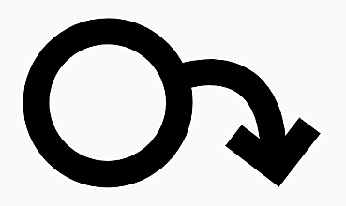
Sexual Function Trial: effect of TTh on sexual activity in older men with low testosterone
To determine if TTh for older men with low testosterone increases sexual activity, assessed by PDQ-Q4
Aim
n=
459
enrolled in the Sexual Function Trial and analysed
n=
771
enrolled in all TTrials and analysed
Selected baseline characteristics and demographics
Mean age
Race
PDE-5 inhibitor use
72.2 years
89% White
8.4%
BMI, body mass index; PDE-5, phosphodiesterase type 5; PDQ-Q4, question 4 of the Psychosexual Daily Questionnaire; TTh, testosterone therapy
Snyder PJ et al. N Engl J Med 2016;374:611–24; Snyder PJ et al. Endocr Rev 2018;39:369–86.
Notes:
The PDQ is a 7-day diary used in multiple trials to evaluate both the frequency and intensity of sexual desire and performance across sexual activities.¹
PDQ-Q4 asks participants to list how many of 12 specified activities (sexual daydreams, anticipation of sex, sexual interactions with partner, flirting by you, flirting toward you, orgasm, ejaculation, intercourse, masturbation, night spontaneous erection, day spontaneous erection, and erection in response to sexual activity) they engaged in each day of the week, and the daily count is averaged over 7 days for a total score ranging from 0–12 (higher scores indicate more activity).^{1,2}
Previous studies show that in hypogonadal men, sexual activity assessed by the PDQ significantly improved after administration of TTh.¹
In the Sexual Function Trial, sexual activity was assessed by PDQ-Q4, administered by interactive voice response daily for 7 days at baseline and 3, 6, 9 and 12 months. An average of the scores for the 7 days at each time point were taken.³
PDQ-Q4 was also administered to all men in the T Trials; however, the primary outcome was determined only for men who were enrolled in the Sexual Function Trial, and analyses of PDQ-Q4 in the overall T Trial population were exploratory only.^{2,3}
PDQ-Q4, question 4 of the Psychosexual Daily Questionnaire (PDQ); TTh, testosterone therapy
References
1. Wang C et al. J Sex Med 2018;15:997–1009; 2. Snyder PJ et al. N Engl J Med 2016;374:611–24; 3. Snyder PJ et al. Endocr Rev 2018;39:369–86.

Slide 5
Sexual Function Trial: TTh significantly improved sexual function versus placebo in older men with low testosterone
Averaged over all follow-up visits, TTh significantly increased sexual activity versus placebo among hypogonadal men enrolled in both the Sexual Function Trial and across all TTrials^{1,2}
TTh also substantially increased libido and, to a lesser degree, erectile function²
Association between TTh and increased sexual activity in men with low testosterone
Effect of TTh on sexual activity, assessed by PDQ-Q4, in older men with low testosterone²
Men enrolled in the Sexual Function Trial (n=459)
All men in the TTrials
(n=771)
1.0
p<0.001
1.0
p<0.001
0.8
0.8
0.6
0.6
0.4
0.4
Change from baseline in response to PDQ-Q4
Change from baseline in response to PDQ-Q4
0.2
0.2
0
0
-0.2
-0.2
-0.5
TTh
Placebo
-0.5
0
3
6
9
12
0
3
6
9
12
No. at risk
TTh
Placebo
Month
No. at risk
TTh
Placebo
Month
230
229
206
201
208
191
205
191
193
194
387
384
348
335
349
317
339
314
328
319
PDQ-Q4, question 4 of the Psychosexual Daily Questionnaire; TTh, testosterone therapy
1. Snyder PJ et al. N Engl J Med 2016;374:611–24; 2. Snyder PJ et al. Endocr Rev 2018;39:369–86.
Notes:
TTh, compared with placebo, substantially increased sexual activity, averaged over all follow-up visits, for men enrolled in the Sexual Function Trial (n=459) and also for all men in the TTrials (n=771). This effect was seen for most types of sexual activity assessed, including sexual daydreams, flirting, sexual intercourse, masturbation and spontaneous erections at night.^{1,2}
The treatment effect (defined as the mean difference in the change from baseline between participants assigned to TTh and those assigned to placebo) was 0.58 and 0.62 for men in the Sexual Function Trial and all men in the TTrials, respectively (both p<0.001).³
The clinical significance of this effect can be judged from the effect size of 0.45, which is close to a ‘moderate’ effect of 0.5, and that TTh increased sexual activity of all types about four times a week.¹
Elevations in plasma testosterone level during TTh were proportional to increases in PDQ-Q4 score (p<0.001 by instrumental variable analysis).³
TTh also substantially increased libido and, to a lesser degree, erectile function.¹
Incremental increases in total and free testosterone and oestradiol levels were substantially associated with greater improvements in sexual activity and libido, but not erectile function.¹
CI, confidence interval; OR, odds ratio; PDQ-Q4, question 4 of the Psychosexual Daily Questionnaire; TTh, testosterone therapy
References
1. Snyder PJ et al. Endocr Rev 2018;39:369–86; 2. Matsumoto AM. Curr Opin Endocr Metab Res 2019;6:34–41; 3. Snyder PJ et al. N Engl J Med 2016;374:611–24.

Slide 6
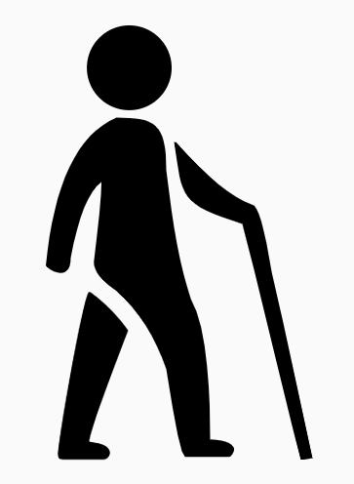
Physical Function Trial: effect of TTh on 6-minute walking distance in older men with low testosterone
To determine if TTh for older men with low testosterone increases 6MWD >50 m beyond the baseline distance
Aim
387
n=
enrolled in the Physical Function Trial and analysed
788
n=
enrolled in all TTrials and analysed
Selected baseline characteristics and demographics
Mean age
Race
Gait speed
72.2 years
89% White
1.1 m/s
6MWD, 6-minute walking distance; TTh, testosterone therapy
Snyder PJ et al. N Engl J Med 2016;374:611–24; Snyder PJ et al. Endocr Rev 2018;39:369–86.
Notes:
For the Physical Function Trial, 6MWD was chosen as the primary efficacy outcome, rather than an outcome based on muscle strength, because of the importance of walking in maintaining independence as men age. It was specifically postulated that TTh, compared with placebo, would increase the fraction of men whose 6MWD increased by >50 m beyond the baseline distance, because enrolled men had reported difficulty walking and/or climbing stairs and because their gait speed was <1.2 m/s.
Great care was taken to standardise the administration of the 6MWD test by using a set test course, timing the walk with a stopwatch, and training the site personnel initially and retraining them annually.
A secondary outcome was self-reported mobility and function, assessed using the physical function domain scale (PF-10) of the SF-36.
6MWD, 6-minute walking distance; SF-36, 36-item Medical Outcomes Short Form Survey; TTh, testosterone therapy
References
Snyder PJ et al. N Engl J Med 2016;374:611–24; Snyder PJ et al. Endocr Rev 2018;39:369–86.

Slide 7
Physical Function Trial: TTh significantly improved walking distance versus placebo in older men with low testosterone
Among men in the Physical Function Trial, TTh did not substantially increase the proportion of men whose 6MWD increased >50 m beyond that at baseline, or the absolute increase in their distance walked, versus placebo
However, TTh significantly improved these two parameters when analysing all men in the TTrials
Effect of TTh on proportion of men achieving a 6MWD >50 m further than baseline in older men with low testosterone
Men enrolled in the Physical Function Trial (n=387)
All men in the TTrials
(n=788)
30
TTh
Placebo
p=0.20
30
p=0.003
20
20
Percent of men who walked ≥50 m further than at baseline
Percent of men who walked ≥50 m further than at baseline
10
10
0
0
0
3
6
9
12
0
3
6
9
12
No. at risk
TTh
Placebo
Month
No. at risk
TTh
Placebo
Month
191
196
179
179
174
171
172
159
172
165
392
389
368
356
358
339
348
320
346
326
6MWD, 6-minute walking distance; TTh, testosterone therapy
Snyder PJ et al. Endocr Rev 2018;39:369–86.
7
Notes:
Among men in the Physical Function Trial, TTh did not substantially increase the proportion of men whose 6MWD increased >50 m beyond that at baseline, or the absolute increase in their distance walked, versus placebo (primary outcome), although the trend was toward greater increases for men assigned to TTh.
However, TTh did substantially improve these two parameters when data from all men in the TTrials were analysed.
The improvement was statistically significant for the men who had not qualified for the Physical Function Trial, demonstrating that this result was not simply a question of increased power.
Importantly, irrespective of study population, men who received TTh were significantly more likely than those who received placebo to perceive that their walking ability had improved since the beginning of the trial (p=0.002), as judged by the PF-10 and a patient global assessment of change question.
There was a significant between-group difference in:
Percentage of men whose 6MWD increased by ≥50 m (OR 1.77; p=0.003).
Change from baseline in 6MWD (mean difference 6.69 m; p=0.007).
Percentage of men whose PF-10 score increased by ≥8 points (OR 1.50; p=0.02).
Change from baseline in PF-10 score (mean difference 3.06 points; p=0.002).
6MWD, 6-minute walking distance; OR, odds ratio; PF-10, physical function domain scale of the SF-36; SF-36, 36-item Medical Outcomes Short Form Survey; TTh, testosterone therapy
References
Snyder PJ et al. N Engl J Med 2016;374:611–24; Snyder PJ et al. Endocr Rev 2018;39:369–86.

Slide 8
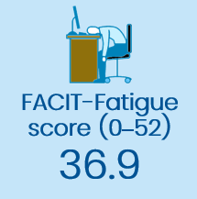
Vitality Trial: effect of TTh on vitality and fatigue in older men with low testosterone
To assess if TTh for older men with low testosterone increases the proportion of men scoring a ≥4-point increase on the FACIT-Fatigue scale
Aim
n=
474
enrolled in the Vitality Trial and analysed
n=
788
enrolled in all TTrials and analysed
Men self-reported low vitality and had a FACIT–Fatigue score <40
Selected baseline characteristics and demographics
Mean age
Race
72.2 years
89% White
FACIT, Functional Assessment of Chronic Illness Therapy; TTh, testosterone therapy
Snyder PJ et al. N Engl J Med 2016;374:611–24; Snyder PJ et al. Endocr Rev 2018;39:369–86.
Notes:
Inclusion in the Vitality Trial required self-reported low vitality/diminished energy and a score of <40 on the FACIT-Fatigue scale (range: 0 to 52, higher scores indicate less fatigue).
The FACIT-Fatigue questionnaire distinguishes between energy at one end of the spectrum and fatigue at the other, and has been validated for assessing energy vs fatigue in many different diseases.
The primary outcome measure of the Vitality Trial was the proportion of men whose score on the FACIT–Fatigue scale increased by ≥4 points.
Secondary outcomes were change from baseline in FACIT–Fatigue score; vitality scale score (range: 0 to 100, higher scores indicate more vitality) of the SF-36; scores on the PANAS scales (range: 5 to 50 for positive and negative effects, higher scores indicate a greater intensity of the effect); and the PHQ-9 depression score (range: 0 to 27, higher scores indicate greater severity of depressive symptoms).
FACIT, Functional Assessment of Chronic Illness Therapy; PANAS, Positive and Negative Affect Schedule; PHQ-9, Patient Health Questionnaire 9; TTh, testosterone therapy
References
Snyder PJ et al. N Engl J Med 2016;374:611–24; Snyder PJ et al. Endocr Rev 2018;39:369–86.

Slide 9
Vitality Trial: TTh significantly improved vitality and fatigue versus placebo in older men with low testosterone
TTh did not increase the proportion of men who demonstrated a FACIT-Fatigue score ≥4 higher than at baseline, versus placebo
However, TTh was associated with a small but significant effect on vitality (assessed using the SF-36 vitality subscale), mood (using PANAS scores) and depressive symptoms (using the PHQ-9)
Association between TTh and improvements in vitality and fatigue in older men with low testosterone
Men enrolled in the Vitality Trial (n=474)
All men in the TTrials
(n=788)
100
TTh
Placebo
p=0.30
100
p=0.22
80
80
60
60
Percent of men who scored ≥4 higher than at baseline on the FACIT-Fatigue scale
Percent of men who scored ≥4 higher than at baseline on the FACIT-Fatigue scale
40
40
20
20
0
0
0
3
6
9
12
0
3
6
9
12
No. at risk
TTh
Placebo
Month
No. at risk
TTh
Placebo
Month
236
238
219
207
217
196
206
188
203
191
394
394
351
337
350
329
337
317
333
316
FACIT, Functional Assessment of Chronic Illness Therapy; PANAS, Positive and Negative Affect Schedule; PHQ-9, Patient Health Questionnaire 9; TTh, testosterone therapy
Matsumoto AM. Curr Opin Endocr Metab Res 2019;6:34–41; Snyder PJ et al. N Engl J Med 2016;374:611–24; Snyder PJ et al. Endocr Rev 2018;39:369–86.
Notes:
Among men enrolled in the Vitality Trial, TTh showed no significant benefit over placebo with respect to vitality, as determined by an increase of ≥4 points in the FACIT–Fatigue score (primary outcome) (OR 1.23; p=0.30).
However, there was a small effect on change from baseline in FACIT–Fatigue score that did not reach significance (mean difference 1.21 points; p=0.06). In addition, a greater increase in testosterone level was associated with a greater increment in FACIT-Fatigue score (p=0.02 by instrumental variable analysis), and the effect of TTh on change from baseline in the score in men in the three core TTrials trials (Sexual Function, Physical Function, Vitality) combined was significant (p=0.006).
There were significant differences between the TTh and placebo groups in SF-36 vitality score (mean difference 2.41 points; p=0.03), PANAS positive affect score (mean difference 0.47 points; p=0.04), PANAS negative affect score (mean difference −0.49 points; p<0.001), and PHQ-9 depression score (mean difference −0.72 points; p=0.004).
Effect sizes (mean between-group differences in outcome divided by the baseline standard deviations) were all <0.20.
Men who received TTh were more likely than men who received placebo to report that their energy was better at the end of the trial (P<0.001).
FACIT, Functional Assessment of Chronic Illness Therapy; OR, odds ratio; PANAS, Positive and Negative Affect Schedule; PHQ-9, Patient Health Questionnaire 9; TTh, testosterone therapy
References
Matsumoto AM. Curr Opin Endocr Metab Res 2019;6:34–41; Snyder PJ et al. N Engl J Med 2016;374:611–24; Snyder PJ et al. Endocr Rev 2018;39:369–86.

Slide 10
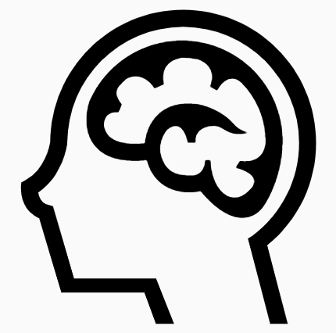
Cognitive Function Trial: effect of TTh on memory & cognition in older men with low testosterone and AAMI
To determine if TTh for older men with low testosterone and AAMI improves verbal memory and other cognitive functions, versus placebo
Aim
493
enrolled in the Cognitive Function Trial and analysed
n=
AAMI defined as both subjective memory complaints and relative impairment on objective tests of memory performance
Selected baseline characteristics and demographics
Mean age
Race
3MSE
72.3 years
87% White
92.7
3MSE, Modified Mini-Mental State Examination; AAMI, age-associated memory impairment; TTh, testosterone therapy
Resnick SM et al. JAMA 2017;317:717–27; Snyder PJ et al. Endocr Rev 2018;39:369–86.
Notes:
Inclusion in the Cognitive Function Trial required men to satisfy AAMI criteria, comprising both subjective memory complaints and relative impairment on objective tests of memory performance.
Subjective memory complaints were indicated by a score of 4 or 5 on ≥1 item of the MAC-Q.
Objective memory impairment was defined by a score >1 SD below the performance for young men (aged 20–24 years), but not >2 SD below the scores of age-matched men on tests of delayed paragraph recall or visual memory.
Men were considered ‘normal for age’ if they did not meet criteria for AAMI and had scores of ≥80 on the 3MSE measure of global cognitive function.
The primary outcome measure was mean change from baseline to Month 6 and Month 12 for delayed paragraph recall (score range: 0 to 50) among men with AAMI.
Secondary outcomes were mean change in visual memory (Benton Visual Retention Test; score range: 0 to −26), executive function (Trail-Making Test B minus A; range: −290 to 290), and spatial ability (Card Rotation Test; score range: −80 to 80) among men with AAMI.
Tests were administered at baseline, Month 6 and Month 12.
3MSE, Modified Mini-Mental State Examination; AAMI, age-associated memory impairment; MAC-Q, Memory Assessment Clinics Questionnaire; TTh, testosterone therapy
References
Resnick SM et al. JAMA 2017;317:717–27; Snyder PJ et al. Endocr Rev 2018;39:369–86.

Slide 11
Cognitive Function Trial: TTh did not improve memory or other cognitive functions in older men with low testosterone
Association between TTh and memory, executive function and spatial ability in older men with low testosterone
3
Verbal memory (primary outcome)
2.0
Visual memory
TTh
Placebo
1.5
Change in Delayed Paragraph Recall Test score (Logical Memory II)
1.0
2
0.5
Change in Benton Visual Retention Test score
0
1
-0.5
-1.0
-1.5
0
-2.0
0
3
6
9
12
0
3
6
9
12
No. of participants
TTh
Placebo
Month
No. of participants
TTh
Placebo
Month
247
246
225
214
221
213
246
246
224
214
219
213
15
Executive function
4
Spatial ability
10
3
5
Change in Trail-Making Test B minus A (s)
2
0
Change in Card Rotation Test score
-5
1
-10
0
-15
-20
-1
0
3
6
9
12
0
3
6
9
12
No. of participants
TTh
Placebo
Month
No. of participants
TTh
Placebo
Month
245
245
223
212
219
211
245
243
223
208
217
210
TTh, testosterone therapy
Resnick SM et al. JAMA 2017;317:717–27.
Notes:
No significant mean changes from baseline to Months 6 and 12 in delayed paragraph recall score were observed among men with AAMI in the TTh and placebo groups [adjusted estimated difference −0.07 (95% CI: −0.92 to 0.79); p=0.88].
Mean scores for delayed paragraph recall were 14.0 at baseline, 16.0 at Month 6 and 16.2 at Month 12 in the TTh group and 14.4 at baseline, 16.0 at Month 6 and 16.5 at Month 12 in the placebo group.
TTh was also not associated with significant differences in visual memory [−0.28 (95%CI: −0.76 to 0.19); p=0.24], executive function [−5.51 (95% CI: −12.91 to 1.88); p=0.14] or spatial ability [−0.12 (95% CI: −1.89 to 1.65); p=0.89].
AAMI, age-associated memory impairment; CI, confidence interval; TTh, testosterone therapy
Reference
Resnick SM et al. JAMA 2017;317:717–27.

Slide 12
Anaemia Trial: relationship between testosterone levels and anaemia, and impact of TTh in older men
To determine if TTh for older men with low testosterone increases haemoglobin concentration and can correct anaemia
Aim
788
n=
n=126 with anaemia (n=62 with unexplained anaemia)
enrolled
Selected baseline characteristics and demographics
Mean age
Race
Mean BMI
74.8 years
85% White
30.7 kg/m²
*Haemoglobin concentration <12.7 g/dL; BMI, body mass index; TTh, testosterone therapy; vBMD, volumetric bone mineral density
Roy CN et al. JAMA Intern Med 2017;177:480–90; Snyder PJ et al. Endocr Rev 2018;39:369–86.
Notes:
For the Anaemia Trial, men had baseline haemoglobin levels ≤12.7 g/dL and were classified using family history and blood/laboratory testing into cohorts with either unexplained anaemia (n=62, 49.2%) or anaemia of known cause (n=64, 50.8%):
Myelodysplasia, n=8 (6.3%).
Iron deficiency, n=42 (33.3%).
Vitamin B12 deficiency, n=3 (2.4%).
Anaemia of inflammation/chronic disease, n=10 (7.9%).
Plasma cell dyscrasia, n=1 (0.8%).
No cases of renal insufficiency, folate deficiency, haemolytic anaemia or monoclonal gammopathy.
TTh, testosterone therapy
Reference
Roy CN et al. JAMA Intern Med 2017;177:480–90.

Slide 13
TTh significantly increased Hb levels in older men with low testosterone and unexplained anaemia
Significantly more men with anaemia of unknown cause had an increase in Hb level ≥1 g/dL from baseline at Month 12 with TTh (54%) than placebo (15%)
Adjusted OR 31.5, 95% CI: 3.7–277.8; p=0.002
More men were not anaemic at Month 12 with TTh (58.3%) than placebo (22.2%)
Adjusted OR 17.0, 95% CI: 2.8–104.0; p=0.002
Association between TTh and Hb concentration in men with unexplained anaemia
Unexplained anaemia at baseline
Change in haemoglobin levels for unexplained anaemia from baseline
80
Testosterone
Placebo
p=0.002
1.5
p=0.02
60
1.0
Percent of men whose haemoglobin levels increased ≥1 from baseline
Change in haemoglobin levels from baseline
40
0.5
20
0
0
-0.5
0
3
6
9
12
0
3
6
9
12
No. at risk
Testosterone
Placebo
Month
No. at risk
Testosterone
Placebo
Month
27
35
24
32
22
27
24
28
24
27
27
35
24
32
22
27
24
28
24
27
CI, confidence interval; Hb, haemoglobin; OR, odds ratio; TTh, testosterone therapy
Roy CN et al. JAMA Intern Med 2017;177:480–90.
Notes:
In cases of unexplained anaemia, more men receiving TTh achieved improvements in haemoglobin concentration ≥1.0 g/dL at Month 12 versus baseline, compared with placebo treatment (adjusted OR 31.5, 95% CI: 3.7–277.8; p=0.02) (primary outcome).
In total, 54% of TTh-treated men and 15% of placebo-treated men had increases of ≥1.0 g/dL versus baseline.
TTh also increased haemoglobin concentrations by continuous analysis in men with unexplained anaemia (secondary outcome):
Adjusted mean difference 0.83 g/dL, 95% CI: 0.48–1.39; p<0.001.
At Month 12, 58.3% (n=14/24) of TTh-treated men with unexplained anaemia at baseline were no longer anaemic, compared with 22.2% (n=6/27) of placebo-treated men (OR 17.0, 95% CI: 2.8–104.0; p=0.002).
CI, confidence interval; OR, odds ratio; TTh, testosterone therapy
Reference
Roy CN et al. JAMA Intern Med 2017;177:480–90.

Slide 14
TTh significantly increased Hb levels in older men with low testosterone and anaemia of known cause
Significantly more men with anaemia of known cause had an increase in Hb level ≥1 g/dL from baseline at Month 12 with TTh (52%) than placebo (19%)
Adjusted OR 8.2, 95% CI: 2.1–31.9; p=0.003
Association between TTh and Hb concentration in men with anaemia of known cause
Anaemia of known cause at baseline
Change in haemoglobin levels for anaemia of known cause from baseline
80
Testosterone
Placebo
p=0.003
1.5
p=0.02
60
1.0
Percent of men whose haemoglobin levels increased ≥1 from baseline
Change in haemoglobin levels from baseline
40
0.5
20
0
0
-0.5
0
3
6
9
12
0
3
6
9
12
No. at risk
Testosterone
Placebo
Month
No. at risk
Testosterone
Placebo
Month
29
35
25
31
26
25
25
26
25
27
29
35
25
31
26
25
25
26
25
27
CI, confidence interval; Hb, haemoglobin; OR, odds ratio; TTh, testosterone therapy
Roy CN et al. JAMA Intern Med 2017;177:480–90.
Notes:
In cases of anaemia of known cause, more men receiving TTh achieved improvements in haemoglobin concentration ≥1.0 g/dL at Month 12 versus baseline, compared with placebo treatment (adjusted OR 8.2, 95% CI: 2.1–31.9; p=0.003).
In total, 52% of TTh-treated men and 19% of placebo-treated men had increases of ≥1.0 g/dL versus baseline.
TTh also increased haemoglobin concentrations by continuous analysis in men with anaemia of known cause:
Adjusted mean difference 0.64 g/dL, 95% CI: 0.12–1.17; p=0.02.
At Month 12, 60.0% (n=15/25) of TTh-treated men with anaemia of known cause at baseline were no longer anaemic, compared with 14.8% (n=4/27) of placebo-treated men (OR 9.4, 95% CI: 1.4–60.5; p=0.02).
CI, confidence interval; OR, odds ratio; TTh, testosterone therapy
Reference
Roy CN et al. JAMA Intern Med 2017;177:480–90.

Slide 15
TTh significantly increased Hb levels in older men with low testosterone without anaemia
Administration of TTh resulted in an Hb concentration of >17.5 g/dL in 6 older, hypogonadal men without anaemia
Association between TTh and Hb concentration in men without anaemia
No anaemia at baseline
Change in haemoglobin levels for no anaemia from baseline
80
Testosterone
Placebo
p<0.001
1.5
p<0.001
60
1.0
Percent of men whose haemoglobin levels increased ≥1 from baseline
Change in haemoglobin levels from baseline
40
0.5
20
0
0
-0.5
0
3
6
9
12
0
3
6
9
12
No. at risk
Testosterone
Placebo
Month
No. at risk
Testosterone
Placebo
Month
336
321
323
304
314
298
309
284
305
285
336
321
323
304
314 298
309 284
305
285
CI, confidence interval; Hb, haemoglobin; OR, odds ratio; TTh, testosterone therapy
Roy CN et al. JAMA Intern Med 2017;177:480–90.
Notes:
More men without anaemia receiving TTh achieved improvements in haemoglobin concentration ≥1.0 g/dL at Month 12 versus baseline, compared with those receiving placebo (adjusted OR 20.7, 95% CI: 12.9–33.3; p<0.001).
In total, 38% of TTh-treated men and 4% of placebo-treated men had increases of ≥1.0 g/dL versus baseline.
TTh also increased haemoglobin concentrations by continuous analysis in men without anaemia:
Adjusted mean difference 0.90 g/dL, 95% CI: 0.78–1.03; p<0.001.
Administration of TTh resulted in a haemoglobin concentration of >17.5 g/dL in 6 men who were not anaemic at baseline.
CI, confidence interval; OR, odds ratio; TTh, testosterone therapy
Reference
Roy CN et al. JAMA Intern Med 2017;177:480–90.

Slide 16
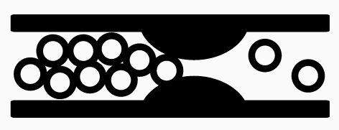
Cardiovascular Trial: effect of TTh on coronary artery plaque volume in older men with low testosterone
To test whether TTh slows the progression of non-calcified coronary artery plaque volume, determined by CTA
Aim
170
n=
n=138 completed the trial
enrolled
Selected baseline characteristics and demographics of study completers
Mean age
Race
Severe atherosclerosis
71.2 years
81% White
50.7%
CTA, computed tomographic angiography; TTh, testosterone therapy
Budoff MJ et al. JAMA 2017;317:708–16; Snyder PJ et al. Endocr Rev 2018;39:369–86.
Notes:
Because the number of men in the TTrials was insufficient to determine clinical cardiovascular risk, it was decided that the Cardiovascular Trial would test whether TTh improves a surrogate outcome, non-calcified coronary artery plaque volume, as determined by CTA.
This outcome has apparent clinical relevance and good reproducibility, making it desirable for a longitudinal study.
Of 170 men enrolled in the Cardiovascular Trial, 138 completed the study. At baseline, 70 of these completers (50.7%) had a coronary artery calcification score >300 Agatston units, reflecting the presence of severe atherosclerosis.
The primary efficacy outcome was non-calcified coronary artery plaque volume, as determined by CTA.
Secondary outcomes included total coronary artery plaque volume and coronary artery calcium score (range: 0 to >400 Agatston units, with higher values indicating more severe atherosclerosis).
CTA, computed tomographic angiography; TTh, testosterone therapy
References
Budoff MJ et al. JAMA 2017;317:708–16; Snyder PJ et al. Endocr Rev 2018;39:369–86.

Slide 17
Cardiovascular Trial: TTh significantly increased non-calcified coronary artery plaque volume versus placebo in older men with low testosterone
In older men with low testosterone, TTh was associated with a significant increase in non-calcified coronary artery plaque volume of 41 mm³ more than placebo (p=0.003)
An increase in non-calcified plaque volume has been associated with subsequent cardiovascular adverse events in other studies, and any compromise of the coronary artery lumen could be deleterious
However, the clinical implications of these findings need to be confirmed in larger studies
Effect of TTh on cardiovascular outcomes in older men with low testosterone
Non-calcified plaque volume, mm³
41 (14 to 67)
p=0.003
Total plaque volume, mm³
47 (13 to 80)
p=0.006
Estimated difference (95% CI)*
*Least squares mean difference in change from baseline to Month 12 for men assigned to TTh vs those assigned to placebo, with adjustment for balancing factors: baseline total testosterone level (6.94 or >6.94 nmol/L (200 or >200 ng/dL), age (75 or >75 years), trial site, participation in the main trials, use or nonuse of antidepressants, use or non-use of PDE-5 inhibitors, and baseline value of the outcome variable; CI, confidence interval; PDE-5, phosphodiesterase type 5; TTh, testosterone therapy
Budoff MJ et al. JAMA 2017;317:708–16; Snyder PJ et al. Endocr Rev 2018;39:369–86.
Notes:
For the primary outcome, TTh compared with placebo was associated with a significantly greater increase in non-calcified plaque volume from baseline to Month 12 [from a median value of 204 to 232 mm³ vs 317 to 325 mm³, respectively; estimated difference 41 mm³; (95% CI: 14 to 67 mm³); p=0.003].¹
For the secondary outcomes, the median total plaque volume increased from baseline to Month 12 from 272 to 318 mm³ in the TTh group vs from 499 to 541 mm³ in the placebo group [estimated difference 47 mm³; (95% CI: 13 to 80 mm³); p=0.006], and the median coronary artery calcification score changed from 255 to 244 Agatston units in the TTh group vs 494 to 503 Agatston units in the placebo group [estimated difference −27 Agatston units; (95% CI: −80 to 26 Agatston units).¹
The increase in non-calcified plaque volume in men treated with TTh compared with men treated with placebo is concerning, because it has been associated with subsequent cardiovascular adverse events in other studies, and any decrease in the coronary artery lumen could be considered deleterious. Whether this effect on the surrogate outcome of plaque volume also increases clinical cardiovascular risk can only be determined by a larger trial of longer duration.^{2,3}
CI, confidence interval; TTh, testosterone therapy
References
1. Budoff MJ et al. JAMA 2017;317:708–16; 2. Snyder PJ et al. Endocr Rev 2018;39:369–86; 3. Matsumoto AM. Curr Opin Endocr Metab Res 2019;6:34–41.

Slide 18
Bone Trial: effect of TTh on bone mineral density and strength in older men with low testosterone
To determine if TTh of older men with low testosterone increases vBMD, assessed using quantitative computed tomography
Aim
211
n=
Osteoporosis was not an entry criterion
enrolled
Selected baseline characteristics and demographics
Mean age
Race
Mean BMI
72.3 years
86% White
31.2 kg/m²
BMI, body mass index; TTh, testosterone therapy; vBMD, volumetric bone mineral density
Snyder PJ et al. JAMA Intern Med 2017;177:471–9; Snyder PJ et al. Endocr Rev 2018;39:369–86.
Notes:
For the Bone Trial, men were excluded if they were taking a medication known to affect bone, except for calcium and over-the-counter vitamin D preparations; if they did not have ≥1 evaluable lumbar vertebra; and/or if they had a DEXA T-score at any site of less than −3.0.
Osteoporosis was not an entry criterion for the study.
The primary efficacy outcome was percent change from baseline in vBMD of trabecular bone in the lumbar spine, assessed by QCT.
Volumetric BMD was chosen as the main method of assessment rather than aBMD by DEXA because it is not artifactually influenced by osteophytes and aortic calcification, and because it can distinguish between trabecular bone, which testosterone primarily affects, and cortical bone.
Secondary outcomes were vBMD of peripheral bone and whole bone of the lumbar spine and trabecular, peripheral and whole bone of the hip; estimated strength of the same sites by finite element analysis from computed tomographic data; and aBMD of the spine and hip by DEXA.
aBMD, areal bone mineral density; DEXA, dual-energy x-ray absorptiometry; QCT, quantitative computed tomography; TTh, testosterone therapy; vBMD, volumetric bone mineral density
References
Snyder PJ et al. JAMA Intern Med 2017;177:471–9; Snyder PJ et al. Endocr Rev 2018;39:369–86.

Slide 19
Bone Trial: TTh significantly increased vBMD and bone strength versus placebo in older men with low testosterone
In older men with low testosterone, TTh significantly increased vBMD and estimated bone strength, especially in trabecular bone and the spine, but also in peripheral bone and the hip
TTh increased mean lumbar spine trabecular vBMD by an additional 6.8% (95% CI: 4.8 to 8.7%; p<0.001, r² 0.26) and estimated spine trabecular bone strength by an additional 8.5% (95% CI: 6.0 to 10.9%; p<0.001) versus placebo
Effect of TTh on vBMD and estimated bone strength in older men with low testosterone
vBMD
Estimated bone strength
12
*
16
*
TTh
Placebo
10
14
*
8
*
12
10
*
6
*
8
Change from baseline (%)
Change from baseline (%)
4
*
*
*
6
**
2
4
*
*
0
2
0
-2
-2
Trabecular
Peripheral
Whole
Trabecular
Peripheral
Whole
Trabecular
Peripheral
Whole
Trabecular
Peripheral
Whole
Spine
Hip
Spine
Hip
*p<0.001, **p<0.005 vs placebo; CI, confidence interval; TTh, testosterone therapy; vBMD, volumetric bone mineral density
Snyder PJ et al. JAMA Intern Med 2017;177:471–9.
Notes:
TTh was associated with significantly greater increases versus placebo in mean spine trabecular vBMD [7.5% (95% CI: 4.8% to 10.3%) vs 0.8% (95% CI: −1.9% to 3.4%); treatment effect 6.8% (95% CI: 4.8% to 8.7%; p<0.001)], spine peripheral vBMD, and hip trabecular and peripheral vBMD.
TTh was also associated with significantly greater increases in mean estimated strength of spine trabecular bone [10.8% (95% CI: 7.4% to 14.3%) vs 2.4% (95% CI: −1.0% to 5.7%); treatment effect 8.5% (95% CI: 6.0% to 10.9%; p<0.001)], spine peripheral bone, and hip trabecular and peripheral bone.
The estimated strength increases were greater in trabecular than peripheral bone and greater in the spine than the hip.
CI, confidence interval; TTh, testosterone therapy; vBMD, volumetric bone mineral density
Reference
Snyder PJ et al. JAMA Intern Med 2017;177:471–9.

Slide 20
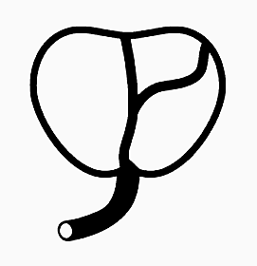
TTrials: similar safety profiles for men receiving TTh or placebo
Adverse event, n (%)
Placebo group
(n=394)
TTh group
(n=394)
Prostate events PSA increase ≥10 ng/mL PCa IPSS >19 Haemoglobin ≥175 g/dL | 8 0 26 0 | (2.0) (0) (6.6) (0) | 23 1 27 7 | (5.8) (<1) (6.9) (1.8)
CV events MI (definite/probable) Stroke (definite/probable) CV death Total (MI, stroke, CV death) | 1 5 1 7 | (<1) (1.3) (<1) (1.8) | 2 5 0 7 | (<1) (1.3) (0) (1.8)
Serious adverse events Death Hospitalisation Other* | 7 78 6 | (1.8) (19.8) (1.5) | 3 68 7 | (<1) (17.3) (1.8)
In the TTrials, compared with placebo, TTh was:
Associated with an increased risk of erythrocytosis (although the overall incidence was low)
Not associated with substantially more diagnoses of PCa
Not associated with a higher incidence of MACE
*Congenital anomaly, disability or important medical or life-threatening event; CV, cardiovascular; IPSS, International Prostate Symptom Score; MACE, major adverse cardiovascular events; MI, myocardial infarction; PCa, prostate cancer; PSA, prostate-specific antigen; TTh, testosterone therapy
Snyder PJ et al. Endocr Rev 2018;39:369–86.
Notes:
The findings of the TTrials confirm that TTh increases the risk of erythrocytosis, although the relatively low incidence compared with that in previous trials suggests that careful monitoring of haemoglobin concentration and reduction of TTh dose (when appropriate) should minimise this risk.
In the TTrials, compared with placebo, TTh was not associated with substantially more PCa diagnoses.
This result might have been influenced by the relatively small number of prostate biopsies, although a much larger number of men were referred for consideration of biopsy because of an increase in PSA. The low percentage of men who underwent biopsy likely reflects the judgment of the site urologists.
TTh was also not associated with a higher incidence of MACE, versus placebo.
Only a trial enrolling a much larger number of older men with low testosterone who are then treated and followed up for a much longer period would be able to determine whether TTh increases the risk of PCa and lower urinary tract symptoms, and/or increases cardiovascular risk.
MACE, major adverse cardiovascular events; PCa, prostate cancer; PSA, prostate-specific antigen; TTh, testosterone therapy
Reference
Snyder PJ et al. Endocr Rev 2018;39:369–86.

Slide 21
Summary
In the TTrials, TTh in the form of a gel given for 1 year to older men with low testosterone:
Improved all aspects of sexual function
Improved walking distance by a small amount
Improved haemoglobin levels and corrected mild to moderate anaemia
Markedly increased vBMD and estimated bone strength
Did not improve vitality, but slightly improved mood and depressive symptoms
Did not improve memory or cognitive function
Increased coronary artery plaque volume
Was not associated with more CV or prostate adverse events; however, the number of men and treatment duration were insufficient to draw definitive conclusions about the risks of TTh in this regard
CV, cardiovascular; TD, testosterone deficiency; TTh, testosterone therapy; vBMD, volumetric bone mineral density
Snyder PJ et al. Endocr Rev 2018;39:369–86.

