Slide 1
Swerdloff, RS et al. Long-Term Pharmacokinetics of Transdermal Testosterone Gel in Hypogonadal Men J Clin Endocrinol Metab, 2000 Vol. 85 No. 12
Besins Healthcare
Global Medical Affairs
March 2021

Slide 2
AndroGel® 1% Clinical Trials
Major Trials
6 month (180 day) clinical trial
First 90 days, randomized, double blind to AndroGel dose, parallel groups
Second 90 days, open label
T- patch and T-gel groups
3-year follow-up clinical trial (extension of above)
Open label trial
T-gel groups only as T-patch patients were switched to T-gel
Wang C, Swerdloff RS et al. J Clin Endocrinol Metab 2000; 85: 2839-2853.
Wang C, Cunningham G et al. J Clin Endocrinol Metab 2004; 89: 2085-2098.
Notes:
Solvay (Unimed) initially performed one clinical trial. As it was approaching completion, it was decided to extend it and this became the long term trial.

Slide 3
AndroGel® - Main Clinical Trials
Type of Trial | Publications
6-month trial 90-day randomized, double blind, parallel groups + 90-day open label extension 180 days = 6 month | Swerdloff RS, Wang C et al. Long-term pharmacokinetics of transdermal testosterone gel in hypogonadal men. J Clin Endo Metab 2000; 85: 4500-10. (Pharmacokinetics) Wang C, Swerdloff RS et al. Transdermal testosterone gel improves sexual function, mood, muscle strength, and body composition parameters in hypogonadal men. J Clin Endo Metab. 2000 ;85: 2839-53. (Clinical Features) Wang C, Swerdloff RS et al. Effects of transdermal testosterone gel on bone turnover markers and bone mineral density in hypogonadal men. Clin Endocrinol 2001; 54: 739-50. (Clinical Features)
3-year trial 36-month extension of trial above | Wang C, Cunningham G et al. Long-term testosterone gel (AndroGel) treatment maintains beneficial effects on sexual function and mood, lean and fat mass, and bone mineral density in hypogonadal men. J Clin Endo Metab 2004; 89: 2085-98. (Clinical Features)
Notes:
Swerdloff RS, Wang C, Cunningham G, Dobs A, Iranmanesh A, Matsumoto AM, Snyder PJ, Weber T, Longstreth J, Berman N. Long-term pharmacokinetics of transdermal testosterone gel in hypogonadal men. J Clin Endocrinol Metab. 2000 Dec;85(12):4500-10.
Wang C, Swerdloff RS, Iranmanesh A, Dobs A, Snyder PJ, Cunningham G, Matsumoto AM, Weber T, Berman N; Testosterone Gel Study Group. Transdermal testosterone gel improves sexual function, mood, muscle strength, and body composition parameters in hypogonadal men. J Clin Endocrinol Metab. 2000;85(8):2839-53.
Wang C, Swerdloff RS, Iranmanesh A, Dobs A, Snyder PJ, Cunningham G, Matsumoto AM, Weber T, Berman N. Effects of transdermal testosterone gel on bone turnover markers and bone mineral density in hypogonadal men.Clin Endocrinol (Oxf). 2001;54(6):739-50.
Wang C, Cunningham G, Dobs A, Iranmanesh A, Matsumoto AM, Snyder PJ, Weber T,Berman N, Hull L, Swerdloff RS. Long-term testosterone gel (AndroGel) treatment maintains beneficial effects on sexual function and mood, lean and fat mass, and bone mineral density in hypogonadal men. J Clin Endocrinol Metab. 2004;89(5):2085-98.

Slide 4
6 Month (180 Day) AndroGel® 1% Trial
Study Design
Prospective, randomized, multicenter, parallel study, 3 groups
1% T-gel 50 mg / day (n=73)
1% T-gel 100 mg / day (n=78)
T-patch 5 mg / day (n=76)
Double blinded until day 90 with respect to T- gel groups
Open label from day 90 -180 with additional group created to accommodate T-gel dose titration
1% T-gel 75 mg / day
Swerdloff RS, Wang C et al. J Clin Endo Metab 2000; 85:4500-10.
Notes:
The study is a randomized, multicenter (16 centers), parallel study including 2 doses of T gel and a single dose of T patches. A placebo group was not included because 6-month placebo treatment of hypogonadal men was not believed to be justifiable, as untreated hypogonadism will result in impaired libido, decreased strength, bone mineral loss, and other clinical defects. The study was double blinded until day 90 with respect to the T gel groups and open label for the T patch group. For the first 3 months of the study (days 1–90), the subjects were randomized to receive 50 mg/day T gel (in 5 g gel delivering about 5mg T/day), 100 mg/day T gel (in 10 g gel delivering about 10 mg T/day), or 2 patches delivering 5 mg T/day (T patch). In the following 3 months (days 91–180), the subjects were administered 1 of the following treatments: 50 mg/day T gel, 100 mg/day T gel, 75 mg/day T gel, or 5.0 mg/day T patch. Patients who were applying T gel had a single, preapplication serum T measurement made on day 60; if the levels were within the normal range (10.4 –34.7 nmol/L; 300-1000 ng/dL), they remained on their original dose. Men with T levels at 60 days of treatment less than 10.4 nmol/L and who were applying 50 mg T gel and those with T levels more than 34.7 nmol/L who had received 100 mg T gel were then assigned to the 75 mg/day T gel group for days 91–180. No changes in dose were made to subjects randomized to T patch. On days 0, 1, 30, 90, and 180 subjects had multiple blood.

Slide 5
6 Month (180 Day) AndroGel® 1% Trial
Efficacy End Points
Blood Samples
Pharmacokinetics of TT, FT
Concentrations of DHT, E2, LH, FSH
Questionnaire
Sexual Function
Mood
Efficacy End Points
Body composition
Total body mass
Lean mass
Fat mass
Muscle strength
Bone mineral density
Bone turnover markers
Swerdloff RS, Wang C et al. J Clin Endo Metab 2000; 85:4500-10.
Wang C, Swerdloff RS et al. J Clin Endocrinol Metab. 2000; 85:2839-53.
Wang C, Swerdloff RS et al. Clin Endocrinol (Oxf). 2001; 54:739-50.
Notes:
Blood samples for testosterone and free testosterone on Days 0, 1, 30, 90, and 180 at 30, 15 and 0 minutes before and 2, 4, 8, 12, 16 and 24 hours after patch/gel application.
Blood samples for DHT, E2, LH and FSH on Days 0, 30, 60, 90, 120, 150 and 180 before patch/gel application.
Questionnaire completed for 7 consecutive days before clinic visits at baseline and Days 30, 60, 90, 120, 150, 180.
Sexual motivation: sexual day dreams, anticipation of sex, flirting, sexual interaction.
Sexual performance: orgasm, erection, masturbation, ejaculation, intercourse.
Positive mood: alert, friendly, full of energy, well/good feelings.
Negative mood: angry, irritable, sad, tired nervous.
Body composition: Assessed Days 0, 90, 180 via DEXA scan.
Muscle strength: Assessed Days 0, 90, 180 via bench/leg press.
Bone mineral density: Assessed Days 0 and 180 via DEXA scan.
Bone turnover markers: Assessed Days 0, 30, 90, 120, 180 via calcium, inorganic phosphorus, parathyroid hormone (PTH), markers of ossteoblastic activity and bone resorption markers.

Slide 6
6 Month (180 Day) AndroGel® 1% Trial
Safety Assessment
Prostate
PSA
International Prostate Symptom Score (1 - 35 with 35 being the most problematic obstruction symptoms)
Skin Irritation
Scale from 0 - 4
Safety Assessment
Blood Chemistry
Complete blood count
Liver function tests
Lipid profile
Adverse Events
Swerdloff RS, Wang C et al. J Clin Endo Metab 2000; 85:4500-10.
Notes:
Skin irritation assessment were measured at every clinic visit using the following scale:
0 = no erythema, 1 = minimal erythema, 2 = moderate erythema with sharply defined borders, 3 = intense erythema with or without edema, and 4 = intense erythema with edema and blistering/erosion.
When subjects developed skin irritation, pretreatment with corticosteroid cream was advised.
The Prostate Symptom Score were assessed on days 0, 30, and 90 using the International Prostate Symptom Score (I-PSS). The maximum score for I-PSS is 35.
Complete blood counts, serum clinical chemistry, and serum PSA levels were measured at each center’s laboratory.
Adverse events were noted at every clinic visit.

Slide 7
6 Month (180 Day) AndroGel® 1% Trial
Inclusion Criteria
Single morning T ≤ 300 ng/dL (10.4 nmol/dL)
No history of chronic medical illness or alcohol or drug abuse
Normal DRE, PSA < 4 ng/mL, urine flow rate >12 mL/s
227 healthy hypogonadal males (19-68 yrs)
Swerdloff RS, Wang C et al. J Clin Endo Metab 2000; 85:4500-10.
Notes:
Two hundred and twenty-seven hypogonadal men were recruited, randomized, and studied in 16 centers in the United States. About one third of the subjects were randomized into each treatment group. The patients were between 19–68 yr of age and had single morning serum T levels at screening of 10.4 nmol/L (300 ng/dL) or less. The screening serum T concentrations were measured at each center’s clinical laboratory. Previously treated hypogonadal men were withdrawn from T ester injection for at least 6 weeks and from oral or transdermal androgens for 4 weeks before the screening visit. Aside from the hypogonadism, the subjects were in good health, as evidenced by medical history, physical examination, complete blood count, urinalysis, and serum biochemistry. If the subjects were taking lipid- lowering agents or tranquilizers, the doses were stabilized for at least 3 months before enrollment. The subjects had no history of chronic medical illness or alcohol or drug abuse. The subjects had a normal rectal examination, a prostate-specific antigen level of less than 4 ng/mL, and a urine flow rate of more than 12 mL/s before enrollment to the study.

Slide 8
6 Month (180 Day) AndroGel® 1% Trial
Exclusion Criteria
Generalized skin disease that might affect T absorption
Prior history of skin irritability with the non-scrotal T patch
Body weight < 80% or > 140% of ideal body weight
On medications known to alter the cytochrome P450 enzyme
Swerdloff RS, Wang C et al. J Clin Endo Metab 2000; 85:4500-10.
Notes:
Subjects were excluded if they had a generalized skin disease that might affect T absorption or a prior history of skin irritability with the non-scrotal T patch (Androderm). Subjects with body weight of less than 80 or more than 140% of ideal body weight and subjects taking medications known to alter the cytochrome P450 enzyme systems were also excluded from this study.

Slide 9
6 Month (180 Day) AndroGel® 1% Trial
Assessment During Trial:
Physical exam, AE assessment, skin irritation, hormone levels
Multiple blood samples on Day 0, 1,30, 90 and 180
Total T (normal range: 298-1,043 ng/dL, 10.33-36.17 nmol/L)
Free T (normal range: 3.48-17.9 ng/dL, 121-620 pmol/L)
Single blood sample on Day 0, 30, 60, 90, 120, 150 and 180
DHT, E2, LH, FSH, SHBG
Tests for various efficacy endpoints
Swerdloff RS, Wang C et al. J Clin Endo Metab 2000; 85:4500-10.
Notes:
On days 0, 1, 30, 90, and 180 subjects had multiple blood samples for T and free T measurements at 30, 15, and 0 min before and 2, 4, 8, 12, 16, and 24 h after T gel or patch application. Brief history and physical examinations were performed, and any complaints or adverse events were documented in the subject’s records. In addition, subjects returned to each study center on days 60, 120, and 150 for a single blood sampling before application of the gel or patch. Serum DHT, estradiol (E2), FSH, LH, and sex hormone-binding globulin (SHBG) were measured in samples collected before gel or patch application on days 0, 30, 60, 90, 120, 150, and 180. Sera for hormones were stored frozen at 220 C until assay. All samples for a patient for each hormone were measured in the same assay whenever possible. In addition, the subjects were examined for any adverse effects and skin irritation.

Slide 10
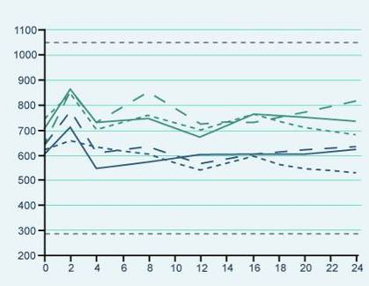
Results of the 6 Month AndroGel® 1% Trial
Pharmacokinetics
T levels were restored & were generally maintained within the normal range
T levels were very similar on Day 30, 90 and 180
Pharmacokinetics are not altered by chronic therapy
Day 30
Day 90
Day 180
AndroGel® 10 g
Testosterone concentration (ng/dL)
AndroGel® 5 g
Time (hours) after application
Swerdloff RS, Wang C et al. J Clin Endo Metab 2000; 85:4500-10.
Notes:
The testosterone concentration-time profiles were similar on Day 30, Day 90 and Day 180, indicating that the pharmacokinetics are not altered by chronic therapy, and the concentrations were generally maintained within the eugonadal range. AndroGel® also maintained mean trough levels in the normal range.

Slide 11
Results of the 6 Month AndroGel® 1% Trial
Testosterone levels returned to the normal range with all transdermal testosterone formulations
PK Results (T Levels) | Effect on Serum T levels (Figure 1) At Day 0 (baseline), average serum T concentrations over 24hours were below the normal adult range for all three groups (range 8.22-8.60nmol/L) On Days 30 and 90, after gel application, the Cav in the T Gel 100mg/day group was 27.46nmol/L, 1.4-fold higher than the T Gel 50mg/day group (Cav = 19.62nmol/L and 19.17nmol/L for Days 30 and 90, respectively), and 1.9-fold higher than the T patch group (14.62nmol/L and 14.46nmol/L for Days 30 and 90, respectively) (p=0.0001) On Day 180, the serum T concentrations achieved and the pharmacokinetic parameters were similar to those on Days 30 and 90, for patients who continued in their original randomised treatment groups Effect on Serum Free T levels Similar to the total T results, the free T Cav achieved by the T gel 100mg group was 1.4- and 1.7-fold higher than those in the T gel 50mg and T patch groups, respectively (P = 0.001).
PK – Pharmacokinetic; Cav - average serum testosterone level (0-24h); T – Testosterone
Notes:
For patients who switched from T Gel 100mg/day or T Gel 50mg/day to T Gel 75mg/day, their Cav on Day 180 was 20.84nmol/L, midway between the two original groups. However these results were not homogenous, with the Cav for patients who had swapped from T Gel 100mg/day to 75mg/day (n=20) being 1.7-fold higher than the Cav for patients who had swapped from T Gel 50mg/day to 75mg/day (n=20).

Slide 12
Results of the 6 Month AndroGel® 1% Trial
Average serum hormone assays Day 180 compared to baseline | T-gel 5g n = 73 | T-gel 10 g n = 78 | T-patch n = 76
Percent free-T / T | No significant alteration
SHBG | Small decrease across 3 groups
DHT [fold increase] | 3.6 | 4.8 | 1.3
Estradiol [% increase] | 30.9 | 45.5 | 9.2
LH suppression [%] | 55 - 60 | 80 - 85 | 30 - 40
Swerdloff RS, Wang C et al. J Clin Endo Metab 2000; 85:4500-10.
Notes:
The results of the hormone assays are presented in the table.

Slide 13
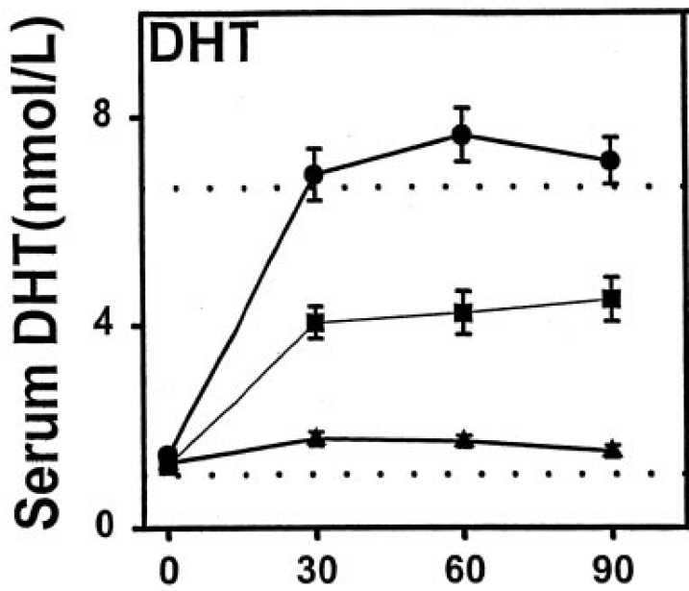
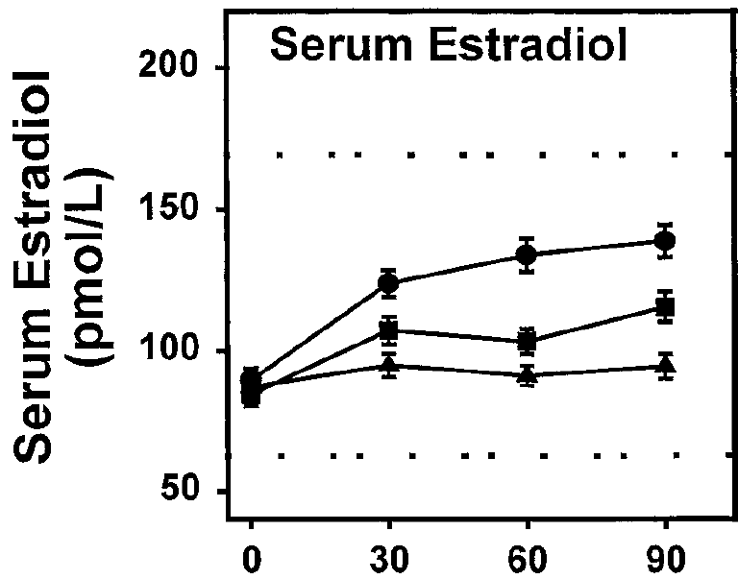
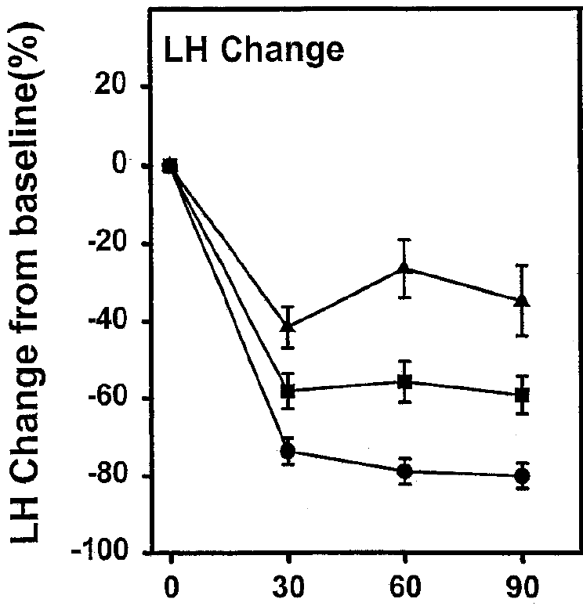
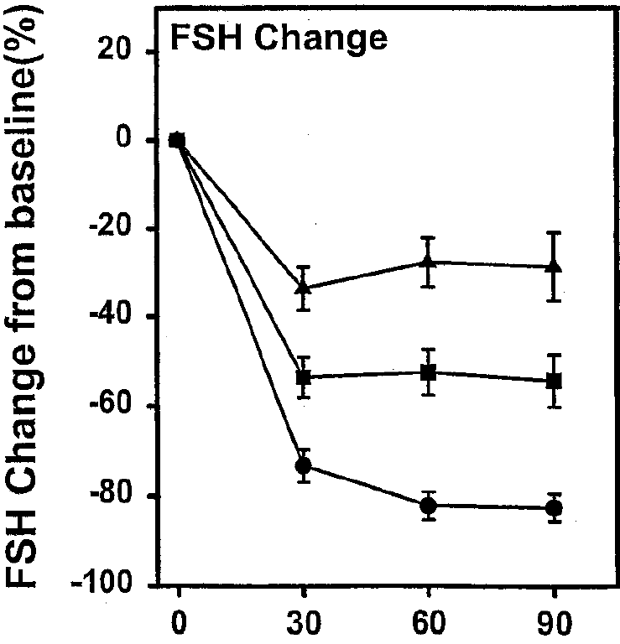
Results of the 6 Month AndroGel® 1% Trial
Concentration of T metabolites increase & gonadotropins decrease following T application
PK Results (Other) | Mean serum DHT* levels increased above the baseline after application of 50mg and 100mg gel Mean serum E2* increased to stable levels. LH* and FSH* levels were suppressed in proportion to serum T levels. Small decreases in SHBG* were seen in all three groups, indicating that when T is administered by the transdermal route, the lack of first pass effect results in minor, if any, decreases in SHBG.
Figure 2: Preapplication serum concentrations of DHT and E2 during daily transdermal T treatment from Days 1-90
Figures 2 & 3
Labels
Figure 3: Percent change in serum LH and FSH from baseline values after transdermal T replacement therapy from days 1–90
50mg T gel
100mg T gel
5mg T patch
Notes:
Results:
*The authors note that these decreases in SHBG are probably not clinically significant (though they may be statistically significant). Serum DHT/T ratios were raised after T gel applications but these ratios remained within the normal range.
Relevance of DHT in TD
Testosterone gets converted to DHT via the enzyme 5-alpha reductase. DHT is the critical factor of prostate growth. 5-alpha reductase is localised mainly in the prostate and therefore circulating testosterone gets converted into DHT in the prostate. The DHT binds to the androgen receptors in the prostate causing it to grow. Drugs that are prescribed to counteract this prostate growth by inhibiting DHT synthesis in the prostate are knows as 5-alpha-reductase inhibitors and include products such as dutasteride and finasteride.
Relevance of Oestradiol in TD
Testosterone also gets converted to oestradiol via the enzyme aromatase. Oestradiol is important in men for bone mineral density (BMD) so a man with low testosterone will consequently have low levels of oestradiol and therefore may have reduced BMD. With testosterone administration, higher levels of testosterone can lead to increased aromatisation of testosterone to oestradiol and therefore potential improvements in BMD.
Why LH and FSH are suppressed with TTh (Fig 3)
The previously described hypothalamic-pituitary-testicular (HPT) axis from module 1 explained that LH binds to the Leydig cells in the testes and through a cascade of events produces testosterone. If testosterone is applied exogenously and if the body is therefore receiving adequate levels of testosterone, then the feedback mechanism will mean that the hypothalamus will reduce the production of GnRH which in turn will reduce the production of LH which is what we see in Figure 3.
Similarly, if testosterone is applied exogenously and if the body is therefore receiving adequate levels of testosterone, then the feedback mechanism will mean that the hypothalamus will reduce the production of GnRH which in turn will also reduce the production of FSH (see Figure 3). FSH binds to the Sertoli cells in the testes which produce sperm. So less FSH production means less sperm production. This explains why men who wish to maintain fertility are not generally candidates for T therapy.

Slide 14
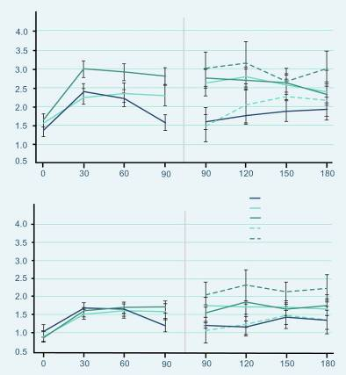
Effects on Sexual Function (6 Months)
Similar scores at baseline
Significant improvement compared to baseline in:
Sexual motivation
Sexual performance
Sexual desire
Satisfaction with erection
For parameters (p=0.0001)
Motivation (0-7)
T patch
50 mg/day T gel
100 mg/day T gel
50-75 mg/day T gel
100-75 mg/day T gel
Performance (0-7)
Wang C, Swerdloff RS et al. J Clin Endocrinol Metab. 2000; 85:2839-53.
Day
Notes:
At baseline, the sexual motivation and performance scores were similar across groups.
After treatment – all subjects as a group showed significant improvement (p=0.0001).
A significant improvement in sexual function, as assessed by patient-completed questionnaires, was observed during 180 days of treatment with AndroGel® 5 g and 10 g. Patients with a dose adjustment to 7.5 mg at Day 90 had a very similar response to those remaining on their initial dose. Improvements were seen in sexual motivation (sexual day dreams, anticipation of sex, flirting and sexual interaction), sexual performance (orgasm, erection, masturbation, ejaculation and intercourse), sexual desire, sexual enjoyment with and without a partner, satisfaction with erection and the percentage of full erection achieved. These improvements occurred within 30 days and were sustained with continued therapy.

Slide 15
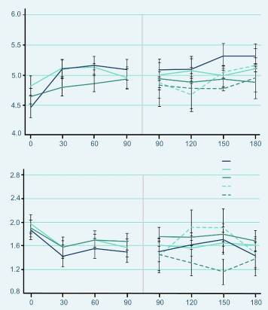
Effects on Mood (6 Months)
Similar scores at baseline
Positive Mood
showed significant improvement (p=0.0001)
Negative Mood
showed significant decreases (p=0.0001)
Positive moods (0-7)
T patch
50 mg/day T gel
100 mg/day T gel
50-75 mg/day T gel
100-75 mg/day T gel
Negative moods (0-7)
Wang C, Swerdloff RS et al. J Clin Endocrinol Metab. 2000; 85:2839-53.
Day
Notes:
Parameters of mood were assessed by using questionnaires that the patients answered daily for 7 consecutive days before clinic visits on day 0 and on days 30, 60, 90, 120, 150, and 180 days during gel and patch application.
This chart shows the positive and negative mood summary responses to T replacement therapy.
All three treatment groups had similar scores at baseline, and all subjects as a group showed improvement in positive mood (P=0.0001).
Positive mood parameters included being alert, friendly, full of energy and well/good feelings.
The negative mood summary scores were also similar in the three groups at baseline.
Negative mood parameters were anger, irritable, sad, tired and nervousness.
The responses to transdermal T applications showed significant decreases (P=0.0001) without showing between-group differences.

Slide 16
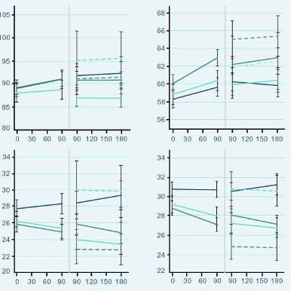
Effects on Body Composition (6 Months)
Similar scores at baseline
Increase in body mass
due to the increase in lean body mass
positively correlated with the increase in serum T from baseline
Fat mass and percent body fat significantly decreased with T gel
T patch
50 mg/day T gel
100 mg/day T gel
50-75 mg/day T gel
100-75 mg/day T gel
Total Body Mass
Lean Mass
Total Body Mass (Kg)
Fat Mass
% Fat
Fat Mass (Kg)
Day
Day
Wang C, Swerdloff RS et al. J Clin Endocrinol Metab. 2000; 85:2839-53.
Notes:
Body composition (total body mass, lean body mass, fat mass, and percent fat) was measured by dual x-ray absorptiometry on days 0, 90, and 180.
At baseline there were no significant differences in these body composition parameters in the three treatment groups.
The increase in body mass was mainly due to the increases in lean body mass.
The percent body fat and fat mass decreased in all treatment groups.
AndroGel® 5 g and 10 g treatment for 180 days resulted in statistically significant increases in total body mass and total lean body mass, whereas the total body fat mass and percentage body fat decreased significantly. The changes to lean body mass and total fat mass were significant by Day 90. The total fat mass remained significantly lower until Day 180. Similar changes were seen in patients titrated to the 7.5 g dose. At the end of 180 days of treatment, the increase in lean body mass was positively correlated with the increase in serum testosterone concentrations from baseline.

Slide 17
Effects on Muscle Strength (6 Months)
Increase in arm and leg muscle strength Day 90 compared to baseline | T-gel 5g n = 73 | T-gel 10 g n = 78 | T-patch n = 76
Leg muscle strength with leg press exercises | 13.7 ± 3.4 kg (p=0.0003) | 12.7 ± 2.7 kg (p=0.0001) | 11.6 ± 2-5 kg (p=0.0001)
Arm/chest muscle strength | 2.6 ± 0.7 kg (p=0.0009) | 2.9 ± 0.8 kg (p=0.0004) | 1.5 ± 0.8 kg (p=0.08)
Wang C, Swerdloff RS et al. J Clin Endocrinol Metab. 2000; 85:2839-53.
Notes:
There was an increase in muscle strength in the legs and arm/chest. After 90 days of treatment, the muscle strength in leg press exercises had increased by 13.7 ± 3.4 kg (p=0.0003) and 12.7 ± 2.7 kg (p=0.0001) with 5 g and 10 g AndroGel®, respectively. Somewhat smaller increases were seen in arm/chest muscle strength: 2.6 ± 0.7 kg (p=0.0009) with 5 g and 2.9 ± 0.8 kg (p=0.0004) with 10 g.

Slide 18
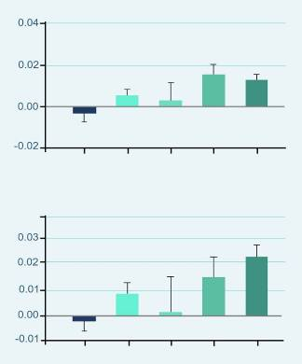
Effects on Bone Mineral Density (6 Months)
BMD increased with T gel in a dose dependent fashion
Significant increase in BMD with the 10 g dose at both
Hip (* p=0.0001)
Spine (* p=0.0001)
Significant increase in hip BMD with patients titrated down to 7.5 g after Day 90
Hip (**p=0.016)
**
*
Change in hip BMD (g/cm²)
Patch
50 mg
50- 75 mg
100- 75 mg
100 mg
T Gel
*
Change in spine BMD (g/cm²)
Patch
50 mg
50- 75 mg
100- 75 mg
100 mg
T Gel
Wang C, Swerdloff RS et al. Clin Endocrinol (Oxf). 2001;54:739-50.
Notes:
Bone mineral density in the hip and spine, as measured by DEXA, increased after 180 days of treatment with 5 g or 10 g AndroGel®. The effect was statistically significant with the 10 g dose. Patients titrated down to 7.5 g after Day 90 also showed a significant increase in hip bone mineral density (p=0.016), whilst no significant change was seen in those titrated up to 7.5 g.
There were also positive changes in urinary markers of bone catabolism. The N-telopeptide:creatine ratio declined within 30 days of treatment with both the 5 g and 10g doses of AndroGel®, and remained below baseline at Day 180.

Slide 19
Compliance During the 6 Month Trial
Compliance | T-gel 5g n = 73 | T-gel 10 g n = 78 | T-patch n = 76
Day 1 - 90 | 93.1% | 96.0% | 89.8%
Day 1 - 180 | 93.3% | 96.5% | 86.3%
Compliance with AndroGel was much better than with the patch
After completion of day 90, the discontinuation rate (21/76, 27.6%) in the T patch group was higher (P=0.0002) than those in the T gel groups (50 mg: 6/73, 8.2%; 100 mg: 5/78, 6.4%).
Most of the discontinuation in the T patch group was due to adverse skin reaction. 3 patients who were receiving the T patch until day 90 were switched to T gel 50 from days 91–180 because of skin irritation from the patches
Swerdloff RS, Wang C et al. J Clin Endo Metab 2000; 85:4500-10.
Notes:
Compliance rates were higher with AndroGel® than with the testosterone patch. During the first 3 months of use (Day 1–90), the mean treatment compliance rates were 93.1% and 96.0% for AndroGel® 5 g and 10 g in comparison with 89.8% for the testosterone patch. During the whole 6-month study period (Day 1–180), the mean compliance rate continued to remain over 90% for AndroGel®, 93.3% and 96.5% for the 5 g and 10 g doses, whereas it fell to 86.3% for the testosterone patch.

Slide 20
Safety Results During the 6 Month Trial
Prostate
AE were reported by 3%, 3% and 5% of patients for doses of 5, 7.5 and 10 g
Enlarged prostate (n=5)
BPH (n=1)
Elevated PSA (n=1)
No prostate cancer cases were diagnosed. However, 2 cases were diagnosed in the 3-year long term study
Blood Chemistry
Abnormal laboratory tests AE were reported by 6%, 5% and 3% of patients for doses of 5, 7.5 and 10 g (n = 9)
↑Hb or Hct
hyperlipidemia, ↓HDL cholesterol, ↑triglycerides
hypokalemia, ↑glucose,
↑creatinine, ↑total bilirubin
Wang C, Swerdloff RS et al. J Clin Endocrinol Metab. 2000; 85:2839-53.
Wang C, Cunningham G et al. J Clin Endo Metab 2004; 89:2085-98.
US AndroGel® Prescribing Information. Dec 2007.
Notes:
Prostate adverse events were reported by 3%, 3% and 5% of patients in the 5, 7.5 and 10 g AndroGel® groups, respectively. They included five patients with an enlarged prostate, one patient with benign prostatic hyperplasia and one patient with elevated prostate specific antigen.
Abnormal laboratory test occurred in 9 patients with one or more of the following events: Elevated hemoglobin or hematocrit, hyperlipidemia, elevated triglycerides, hypokalemia, decreased HDL cholesterol, elevated glucose, elevated creatinine or elevated total bilirubin.

Slide 21
Safety Results During the 6 Month Trial
Skin Irritation
5%, 3% and 4% for doses of 5, 7.5 and 10 g AndroGel®
No skin reaction was severe enough to require treatment or discontinuation of AndroGel®
Additional Side Effects in ≥ 1% of Patients
Acne, Libido decreased, Alopecia, Testis disorder
Asthenia, Depression, Emotional lability, Nervousness
Gynecomastia, Pain breast
Headache, Hypertension
Wang C, Swerdloff RS et al. J Clin Endocrinol Metab. 2000; 85:2839-53.
US AndroGel® Prescribing Information. Dec 2007.
Notes:
Adverse events at least possibly related to AndroGel® use and reported by ≥1% of patients at some time during the 180 day controlled clinical trial are shown above. This was in addition to prostate disorders and abnormal laboratory tests. .Only a relatively small percentage of patients reported application site reactions: 5%, 3% and 4% of patients in the 5, 7.5 and 10 g AndroGel® groups, respectively (Table 12).25 No skin reaction was severe enough to require treatment or discontinuation of AndroGel®.
Adverse events at least possibly related to AndroGel® use that occurred in <1% of patients included amnesia, anxiety, discolored hair, dizziness, dry skin, hirsutism, hostility, impaired urination, paresthesia, penis disorder, peripheral edema, sweating and vasodilation

Slide 22
Summary of the 6 Month AndroGel® 1% Trial
AndroGel®
Normalized testosterone
Restored sexual function
Improved mood
Increased muscle strength BUT only up to 90 days
Decreased fat mass
Increased bone density
The pharmacokinetic profile and the dose proportionality observed after testosterone gel application indicate that AndroGel 1% may provide dose flexibility and serum testosterone levels from the low to the high normal adult male range.

