Slide 1
Safety Considerations with Testosterone Therapy (TTh)

Slide 2
Contents
Prostate Cancer
Cardiovascular Risk
Haematocrit

Slide 3
Challenges and controversies of treating testosterone deficiency (TD) with testosterone therapy (TTh)
TD is an increasingly common problem, with significant health implications for those affected¹
National guidelines from the British Society for Sexual Medicine (BSSM) are clear that improving the diagnosis and management of TD in adult men should provide somatic, sexual and psychological benefits and subsequent improvements in quality of life.¹
Erectile dysfunction (ED) is one of the most common symptoms of TD. Therefore, the increasing realisation that ED is a strong marker for CHD risk, and recent recommendations on obesity and diabetes by the AACE, ACE and the ADA, are likely to increase the number of men with TD detected by routine screening¹
Despite these guidelines and recommendations many patients remain untreated²
Treatment has been limited, in some part, by specific studies that appeared to find evidence linking testosterone (T) with prostate cancer and CV risk³⁻⁵
CHD, coronary heart disease; AACE, American Association of Clinical Endocrinologists; ACE, American College of Endocrinology; ADA, American Diabetes Association; CV, cardiovascular.
1. Hackett G, et al. J Sex Med 2017;14:1504-1523. 2. David J, Diabetes & Primary Care Vol 19 No 2 2017 3.. Vigen R, et al. JAMA 2013;310(17):1829-36; 4. Finkle WD, et al. PloS One 2014;9(1):e85805. 5. Huggins C, Hodges CV. Cancer Res 1941;1:293-297.

Slide 4
Testosterone Therapy & Prostate Cancer (PCa)

Slide 5
TESTOGEL® (testosterone) contraindications regarding PCa
Contraindication
TESTOGEL® is contraindicated in cases of known or suspected prostatic cancer or breast carcinoma^{1,2}
Special Warnings and Precautions
Androgens may accelerate the progression of sub-clinical prostatic cancer^{1,2}
Data on prostate cancer risk in association with testosterone therapy are inconclusive²
TESTOGEL® 16.2 mg/g Summary of Product Characteristics July 2018 UK.
TESTOGEL® 50 mg Summary of Product Characteristics August 2018 UK.
Notes:
What do competitor SPCs say about contraindications regarding prostate cancer?
Tostran 2% gel Summary of Product Characteristics February 2017:
Contraindicated in cases of known or suspected carcinoma of the breast or the prostate
Androgens may accelerate the progression of subclinical prostatic cancer and benign prostatic hyperplasia
Data on prostate cancer risk in association with testosterone therapy are inconclusive
Testavan 20 mg/g Summary of Product Characteristics September 2018:
Contraindicated incases of known or suspected carcinoma of the breast or the prostate
Androgens may accelerate the progression of subclinical prostatic cancer and benign prostatic hyperplasia
Data on prostate cancer risk in association with testosterone therapy are inconclusive
Nebido 1000mg/4ml Summary of Product Characteristics October 2018:
Contraindicated in men with androgen dependent carcinoma of the prostate or of the male mammary gland
Androgens may accelerate the progression of subclinical prostatic cancer and benign prostatic hyperplasia
Sustanon 250, 250mg/ml Summary of Product Characteristics January 2017:
Contraindicated in cases of known or suspected carcinoma of the breast or the prostate
Restandol® Testocaps 40 mg capsule Summary of Product Characteristics March 2019:
Contraindicated in cases of known or suspected carcinoma of the breast or the prostate
Testosterone Enantate Ampoules Summary of Product Characteristics Dec 2016
Contraindicated in Androgen-dependent carcinoma of the prostate or of the male mammary gland
Older patients treated with androgens may be at increased risk for the development of prostatic hyperplasia. Although there are no clear indications that androgens actually generate prostatic carcinoma, these can enhance the growth of any existing prostatic carcinoma. Therefore carcinoma of the prostate has to be excluded before starting therapy with testosterone preparations.
Testim although still licensed for use is no longer marketed by Ferring Pharmaceuticals
(ref: https://www.prescriber.org.uk/2018/01/notice-of-testim-discontinuation/ )

Slide 6
Historical perspective on testosterone and prostate cancer (1/2)
Morgentaler A. Testosterone and Prostate Cancer:
An Historical Perspective on a Modern Myth - Eur Urol 2006;50(5):935-939.
In 2006, Abraham Morgentaler, a urologist at the Beth Israel Deaconess Medical Centre, Harvard Medical School, carried out a review of the historical origins and current evidence for the belief that testosterone (T) caused prostate cancer (PCa) growth¹
The review included historical literature regarding T administration and PCa, as well as more recent studies investigating the relationship of T and PCa ¹
He explained that in 1941, Huggins and Hodges reported that marked reductions in T by castration or oestrogen treatment caused metastatic PCa to regress, and administration of exogenous T caused PCa to grow.
Only 3 patients in the Huggins & Hodges study were given testosterone injections and results were reported for only 2 of them.
1. Morgentaler A. Eur Urol 2006;50(5):935-939. 2. Huggins C, Hodges CV. Cancer Res 1941;1:293-297.

Slide 7
Historical perspective on testosterone and prostate cancer (2/2)
However, at the time of review, the published rate of PCa from more recent data from clinical trials was approximately 1%, similar to the cancer detection rate in prostate cancer screening trials
Furthermore, no direct correlation between total T levels and PCa was identified in any of the 16 longitudinal studies evaluated, nor was a reduced risk of PCa identified in men with low T levels
Therefore, there appears to be a lack of evidence for what has been assumed for decades to be a solid relationship between T and PCa
In 2009, Morgentaler and Traish published the saturation model², a conceptual framework that had been developed to help account for the apparent paradox in which; If lowering T causes PCa to regress, why is it that raising T fails to cause PCA to grow?
The Saturation Model was developed using publications dating from 1941 to 2008 that addressed the experimental and clinical effects of androgens on prostate growth in human and animal studies. This included studies investigating the effect of testosterone administration in hypogonadal men without PCa
Morgentaler A. Eur Urol 2006;50(5):935-939.
Morgentaler A et al. Eur Urol 2009; 55: 310–21

Slide 8
PSA at Supraphysiologic Levels of Testosterone
Testosterone 600 mg or placebo weekly for 10 weeks
PSA did not change significantly from baseline despite supraphysiologic testosterone levels (>2500 ng/dL)
2500
10
Testosterone, ng/dL
2000
Testosterone
8
PSA
PSA, ng/mL
1500
6
1000
4
500
2
0
0
25
50
125
300
600
Testosterone Therapy Weekly Dose, mg
Bhasin S et al. N Engl J Med 1996;335(1):1-7.

Slide 9
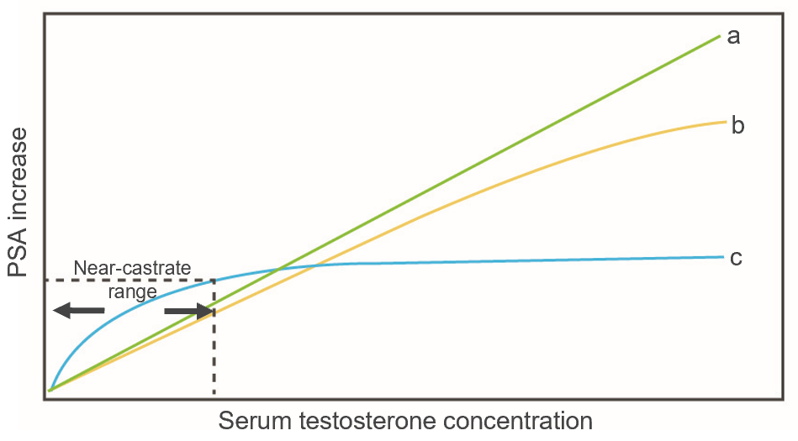
Saturation model: near-castrate and greater T levels have little or no effect on PCa growth
Proposed saturation model for relationship between PCa growth and serum T concentration^{1,2}
Curves a, b The traditional belief that a higher T concentration causes increasing rates of PCa growth (curves a and b) has been challenged²
Curve c The Saturation Model describes a steep T-dependent curve for PCa growth at T-concentrations at or below the near-castrate range, yet little or no further growth above this concentration^{1,2}
The proposed saturation model for the relationship between T and PCa (curve c) is consistent with that seen in many other biologic systems²
Adapted from Morgentaler et al. 2009 and 2015^{1,2}
1. Morgentaler A et al. Asian J Androl 2015; 17: 206–11;
2. Morgentaler A et al. Eur Urol 2009; 55: 310–21.
Notes:
“A simple analogy is the dehydrated house plant that grows lushly when it finally receives water; yet once adequately watered any further growth will depend on factors other than the relative abundance of water.”
Reference
Morgentaler A et al. Eur Urol 2009; 55: 310–21.

Slide 10
Saturation Model Analogy:
T for PCa is like “water for a thirsty tumor”
Growth
Once the “thirst” has been quenched, additional T has no further effect
Serum Testosterone

Slide 11
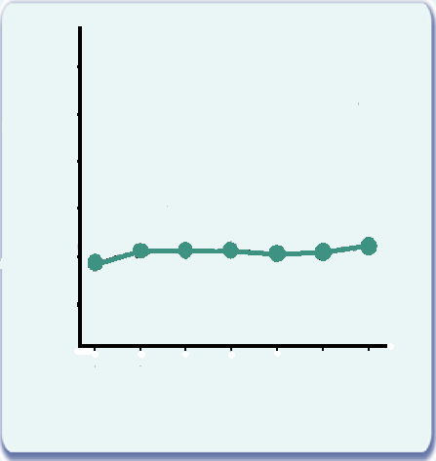
Evolution of Prostate Specific Antigen (PSA) by Duration of Treatment in Long-Term Study
PSA (ng/mL)
3.0
2.5
2.0
1.5
1.0
0.5
0.0
Baseline
6
12
18
24
30
36
Treatment (months)
Wang C, Cunningham G et al. J Clin Endo Metab 2004; 89:2085-98.

Slide 12
Safety Data – Mean PSA Levels (PADAM Study)
Placebo/ testosterone gel following 6 months’ placebo
2.0
Transdermal testosterone gel only
1.8
1.6
1.4
1.2
PSA (ng/ml)
1.0
0.8
0.6
0.4
0.2
0.0
Baseline
3
6
9
12
18
Time (months)
Behre, HM et al. The Aging Male, 2012; 15(4): 198–207

Slide 13
The relationship between total testosterone (TT) and prostate cancer (PCa) is unclear
Summary chart highlighting inconsistent results in trials that looked at association between TT and PCa
Review of 45 articles*¹
18 studies
17 studies
10 studies
Association between low
TT & PCa
Association between high
TT & PCa
No association between
TT & PCa
Because the relationship is unclear, SPCs for all testosterone therapies still carry the contraindication and warnings²⁻⁷
*Literature search identified 45 articles published between 1994 and 2014 reporting the findings of randomised controlled trials, prospective studies or studies containing observational data on the relationship between TT and PCa.
Chart adapted from Klap et al J Urol 2015; 193: 403–13.
1. Klap J et al. J Urol 2015; 193: 403–13. 2. TESTOGEL® 16.2 mg/g Summary of Product Characteristics July 2018. 3. TESTOGEL® 50 mg Summary of Product Characteristics August 2018. 4. Tostran 2% gel Summary of Product Characteristics February 2017. 5. Testavan 20 mg/g Summary of Product Characteristics September 2018. 6. Nebido 1000mg/4ml Summary of Product Characteristics October 2018. 7. Sustanon 250, 250mg/ml Summary of Product Characteristics January 2017.
Notes:
Results from studies included in this review were not consistent and therefore it is not possible to demonstrate conclusively what the relationship between TT and pCA is.
Because of this inconsistency, the contraindications and warnings in the testosterone product licenses exist.
Reference
Klap J et al. J Urol 2015; 193: 403–13.

Slide 14
Meta-analysis of 51 studies showed no significant effect on prostate outcomes (1 of 2)
Fernandez-Balsells et al. Adverse Effects of TTh in Adult Men: A Systematic Review & Meta-analysis
Journal of Clinical Endocrinol Metab, June 2010, 95(6):2560–2575
Systematic review & meta-analysis of 51 randomised and non-randomised comparative studies of adult men with low or low-normal testosterone receiving TTh for ≥3 months to 3 years
Objective was to conduct an updated systematic review of randomised trials and observational studies with long term follow up, to evaluate the adverse effects of testosterone therapy in men, including prostate outcomes.
Prostate outcomes included: Diagnosis of prostate cancer, PSA > 4ng/mL or an increase of PSA >1.4ng/mL above baseline, prostatic biopsy, increase in IPSS >4, acute urinary retention and a composite endpoint that combines all of the above
There was no significant effect of TTh on any prostatic/urological outcomes when compared with the placebo/non-intervention group (See Table 1 on following slide)
1. Fernández-Balsells MM et al. J Clin Endocrinol Metab 2010; 95: 2560–75.
IPSS – International Prostate Symptom Score CI, confidence interval; NA, not available; PSA, prostate-specific antigen; RR, relative risk; TTh, testosterone therapy.

Slide 15
Meta-analysis of 51 studies showed no significant effect on prostate outcomes (2 of 2)
Fernandez-Balsells et al. Adverse Effects of TTh in Adult Men: A Systematic Review & Meta-analysis
Journal of Clinical Endocrinol Metab, June 2010, 95(6):2560–2575
Table 1: Relative risk of prostatic/urological outcomes for testosterone treated group vs placebo treated group
Endpoint | Relative Risk (RR) | 95% CI
 |  | Lower boundary | Upper boundary
Composite prostate endpoint (a combination of all the below) | 1.41 | 0.93 | 2.14
Impaired urinary flow | 0.86 | 0.13 | 5.53
PSA level >4 ng/mL | 1.22 | 0.67 | 2.21
Increase in PSA (>1.5 ng/mL unless otherwise specified) | 1.56 | 0.87 | 2.8
Prostate symptom scale (increases in IPSS >4) | 0.29 | -0.44 | 1.02
Prostate cancer | 0.79 | 0.28 | 2.28
Prostate biopsies | 3.82 | 0.97 | 15
Adapted from Fernández-Balsells MM et al. J Clin Endocrinol Metab 2010; 95: 2560–75.
1. Fernández-Balsells MM et al. J Clin Endocrinol Metab 2010; 95: 2560–75.
IPSS – International Prostate Symptom Score CI, confidence interval; NA, not available; PSA, prostate-specific antigen; RR, relative risk; TTh, testosterone therapy.

Slide 16
A more recent meta-analysis (2014) of 22 RCTs also showed no significant effect of TTh on incidence of prostate cancer vs placebo
Cui et al. The effect of testosterone replacement therapy on prostate cancer: a systematic review and meta-analysis.
Prostate Cancer and Prostatic Disease (2014) 17, 132–143
Meta-analysis of 22 randomised controlled trials in men receiving TTh^ or placebo
11 RCTs compared TTh vs Placebo over the short term (<12 months)
11 RCTs compared TTh vs placebo over the long term (12-36 months)
For all 22 RCTs, no patients had prostate enlargement at baseline, all had normal PSA levels at baseline, and no patient had suspected or confirmed diagnosis of prostate cancer at study entry
Objective of the study was to evaluate the effect of testosterone therapy on incidence of prostate cancer
No significant effect of TTh on the incidence of prostate cancer, compared with placebo.
Table 2: Odds Ratio (OR) for prostate cancer in patients using transdermal TTh vs placebo
Event | Short-term studies * |  | Long-term studies **
 | OR | 95% CI | OR | 95% CI
Prostate cancer | 1.10 | 0.26, 4.65 | 3.06 | 0.12, 76.70
Adapted from Cui Y et al. Prostate Cancer Prostatic Dis 2014; 17: 132–43.
CI, confidence interval; pCA, prostate cancer; OR, Odds Ratio; TTh, testosterone therapy
1. Cui Y et al. Prostate Cancer Prostatic Dis 2014; 17: 132–43.
^ Oral, transdermal or injectable T therapy
* Data from 5 RCTs (n = 1168). ** Data from 3 RCTs (n=379)
Notes:
When the confidence interval for the odds ratio includes 1.00 the result is not significant

Slide 17
What do the Guidelines say about TTh and risk of prostate cancer?
The Endocrine Society state that the relationship between T administration and the risk of prostate cancer remains poorly understood and that no RCT has been long enough or large enough to have adequate statistical power to determine whether T administration increases the risk of prostate cancer⁵
The EAU Guidelines state that most recent studies indicate that testosterone therapy does not increase the risk of prostate cancer, but long-term follow-up data are not yet available¹
Other guidelines from the BSSM,² ICSM,³ ISSM,⁴ and ISSAM⁶ conclude that there is no compelling evidence that T therapy is associated with an increased risk of pCA
“Careful assessment of the prostate before starting T therapy and regular monitoring for prostate disease once the patient is on T therapy remain essential. Early increases in PSA after initiation of T therapy could unmask an occult prostate carcinoma that was undetected at baseline.”
BSSM Guidelines on Adult Testosterone Deficiency with Statements for UK Practice 2017²
EAU, European Association of Urology; BSSM, British Society for Sexual Medicine; ICSM, International Consultation for Sexual Medicine;
ISSM, International Society of Sexual Medicine; ES, Endocrine Society; ISAAM, International Study of the Aging Male.
1. Dohle GR et al. Guidelines of Male Hypogonadism. European Association of Urology 2015. Available at: https://uroweb.org/wp-content/uploads/18-Male-Hypogonadism_LR1.pdf Accessed February 2019. 2. Hackett G, et al. J Sex Med 2017;14:1504-1523. 3. Khera M, Adaikan G, Buvat J, et al. J Sex Med 2016;13:1787-1804. 4. Dean JD, McMahon CG, Guay AT, et al. J Sex Med 2015;12:1660-1686. 5. Bhasin S, Cunningham GR, Hayes FJ, et al; J Clin Endocrinol Metab 2010;95:2536-2559. 6. Lunenfeld B, Mskhalaya G, Zitzmann M, et al. Aging Male 2015;18:5-15.

Slide 18
Urological Evaluation
Patients should be referred for further urological evaluation if they meet one of the following criteria:
Unevaluated prostate nodule or induration
Baseline PSA level higher than 4 ng/mL (or >3 ng/mL in men at high risk of pCa, such as African Americans and those with first-degree relatives who have pCa)
PSA increases >1.4 ng/mL over any 1-year period after initiation of TTh
PSA velocity increased >0.4 ng/mL/year during sequential measurement over >2 years after initiation of TTh
Hackett, G et al J Sex Med 2017;14:1504-1523

Slide 19
Testosterone & Cardiovascular Disease

Slide 20
TESTOGEL® and Cardiovascular Risk¹
Special Warnings and Precautions
In patients suffering from severe cardiac, hepatic or renal insufficiency or ischaemic heart disease, treatment with testosterone may cause severe complications characterised by oedema with or without congestive cardiac failure. In such case treatment must be stopped immediately. In addition, diuretic therapy may be required
Testosterone may cause a rise in blood pressure and TESTOGEL® should be used with caution in men with hypertension
Testosterone should be used with caution in patients with thrombophilia or risk factors for venous thromboembolism (VTE), as there have been post-marketing studies and reports of thrombotic events (e.g. deep-vein thrombosis, pulmonary embolism, ocular thrombosis) in these patients during testosterone therapy.
In thrombophilic patients, VTE cases have been reported even under anticoagulation treatment, therefore continuing testosterone treatment after first thrombotic event should be carefully evaluated. In case of treatment continuation, further measures should be taken to minimise the individual VTE risk.
1. TESTOGEL® 16.2 mg/g Summary of Product Characteristics March 2021.
Notes:
What do competitor SPCs say about CV risk?
Tostran 2% gel Summary of Product Characteristics February 2017:
In patients suffering from severe cardiac, hepatic, or renal insufficiency or ischaemic heart disease, treatment with testosterone may cause severe complications characterised by oedema with or without congestive cardiac failure. In such case, treatment must be stopped immediately
Testosterone may cause a rise in blood pressure and Tostran should be used with caution in men with hypertension
Testosterone should be used with caution in patients with thrombophilia, as there have been post-marketing studies and reports of thrombotic events in these patients during testosterone therapy.
Testavan 20 mg/g Summary of Product Characteristics September 2018:
In patients suffering from severe cardiac, hepatic, or renal insufficiency or ischaemic heart disease, treatment with testosterone may cause severe complications characterised by oedema with or without congestive cardiac failure. In such case, treatment must be stopped immediately
Testosterone may cause a rise in blood pressure and Testavan should be used with caution in men with hypertension
Testosterone should be used with caution in patients with thrombophilia, as there have been post-marketing studies and reports of thrombotic events in these patients during testosterone therapy.
Nebido 1000mg/4ml Summary of Product Characteristics October 2018:
In patients suffering from severe cardiac, hepatic, or renal insufficiency or ischaemic heart disease, treatment with testosterone may cause severe complications characterised by oedema with or without congestive cardiac failure. In such case, treatment must be stopped immediately
Caution should be exercised in patients predisposed to oedema, e.g. in case of severe cardiac, hepatic, or renal insufficiency or ischaemic heart disease, as treatment with androgens may result in increased retention of sodium and water. In case of severe complications characterized by oedema with or without congestive heart failure treatment must be stopped immediately
Testosterone may cause a rise in blood pressure and Nebido should be used with caution in men with hypertension
Testosterone should be used with caution in patients with thrombophilia, as there have been post-marketing studies and reports of thrombotic events in these patients during testosterone therapy.
Sustanon 250, 250mg/ml Summary of Product Characteristics January 2017:
In patients suffering from severe cardiac, hepatic, or renal insufficiency or ischaemic heart disease, treatment with testosterone may cause severe complications characterised by oedema with or without congestive cardiac failure. In such case, treatment must be stopped immediately
Patients who experienced myocardial infarction, cardiac-, hepatic- or renal insufficiency, hypertension, epilepsy, or migraine should be monitored due to the risk of deterioration of or reoccurrence of disease. In such cases treatment must be stopped immediately.
Testosterone may cause a rise in blood pressure and Sustanon 250 should be used with caution in men with hypertension
Testosterone should be used with caution in patients with thrombophilia, as there have been post-marketing studies and reports of thrombotic events in these patients during testosterone therapy.
Restandol® Testocaps 40 mg capsule Summary of Product Characteristics March 2019:
In patients suffering from severe cardiac, hepatic or renal insufficiency or ischaemic heart disease, treatment with testosterone may cause severe complications characterised by oedema with or without congestive cardiac failure. In such case, treatment must be stopped immediately.
Patients who experienced myocardial infarction, cardiac, hepatic or renal insufficiency, hypertension, epilepsy, or migraine should be monitored due to the risk of deterioration or reoccurrence of disease. In such cases, treatment must be stopped immediately. In addition to discontinuation of the drug, diuretic therapy may be required.
Testosterone may cause a rise in blood pressure and Restandol Testocaps should be used with caution in men with hypertension
Testosterone should be used with caution in patients with thrombophilia, as there have been post-marketing studies and reports of thrombotic events in these patients during testosterone therapy.
Testosterone Enantate Ampoules Summary of Product Characteristics Dec 2016
In patients suffering from severe cardiac, hepatic or renal insufficiency or ischaemic heart disease, treatment with testosterone may cause severe complications characterised by oedema with or without congestive cardiac failure. In such case, treatment must be stopped immediately.
Testosterone may cause a rise in blood pressure and Testosterone Enantate should be used with caution in men with hypertension.
Testosterone should be used with caution in patients with thrombophilia, as there have been post-marketing studies and reports of thrombotic events in these patients during testosterone therapy.
Testim although still licensed for use is no longer marketed by Ferring Pharmaceuticals
(ref: https://www.prescriber.org.uk/2018/01/notice-of-testim-discontinuation/ )

Slide 21
Recent media controversy surrounding CV risk of TTh
Historical Evidence
There is extensive literature, spanning >30 years in which low levels of testosterone (T) have been repeatedly associated with increased mortality and CV risk factors, and treatment with T in these cases appears to improve both outcomes and risk factors¹
Papers published from 2010 to 2014 by Vigen² , Finkle³ , Basaria⁴ and Xu⁵ demonstrated an association between TTh with increased rate of mortality, MI and stroke
Media coverage of these findings led some physicians to stop prescribing TTh
The FDA announced plans to review CV safety issues, and issue alerts to HCPs to inform patients of possible elevated CV risk with testosterone use, as well as requiring manufacturers of T therapies to conduct a trial to address the question of whether an increased risk of heart attack or stroke exists with testosterone products^{6,7} (TRAVERSE study ongoing)
The EMA PRAC was also asked to review the benefit/risk balance following concerns raised with regards to potential risk of CV events in the Finkle, Vigen and Xu studies⁸
MI, myocardial infarction; FDA, Food and Drug Administration; CV, cardiovascular; HCP, healthcare professional; EMA, European Medicines Agency; PRAC, pharmacovigilance & risk assessment committee.
1. Morgentaler A & Lunenfeld B. Aging Male 2014;17(2)63–652. 2. Vigen R, et al. JAMA 2013;310(17):1829-36; 3. Finkle WD, et al. PloS One 2014;9(1):e85805. 4. Basaria S, et al. N Engl J Med 2010;363:109-22. 5. Xu L et al. BMC Medicine 2013, 11:108 6. Morgentaler A, et al. May Clin Proc 2015.90(2):224-251. 7. https://www.fda.gov/downloads/Drugs/DrugSafety/UCM436270.pdf 8. Pharmacovigilance Risk Assessment Committee EMEA/H/A-31/1396 EMA/PRAC/599233/2014.

Slide 22
EMA PRAC Evaluation of CV risk following TTh ¹
In 2014, the EMA Pharmacovigilance & Risk Assessment Committee (PRAC) were also prompted to conduct a review of the benefit risk balance of testosterone containing medicinal products, with regards to the potential increased risk of CV events.
The PRAC reviewed all data available from clinical trials, observational studies, meta-analyses, post-marketing data and further published data on the cardiovascular risks associated with testosterone therapy
The studies and their limitations were considered together with the overall evidence available to date, and judged that the signal for an increased cardiovascular risk associated with the use of testosterone remains weak and inconclusive.
The PRAC recommended the variation to the European licenses for testosterone-containing medicinal products to reflect current knowledge on CV risks associated with testosterone therapy and the need to monitor
1. Pharmacovigilance Risk Assessment Committee EMEA/H/A-31/1396 EMA/PRAC/599233/2014.

Slide 23
Subsequent studies have also shown no compelling evidence of increased CV risk with TTh
In 2015, Morgentaler et al¹ published a review of the literature looking at a number of specific topics related to T and CV risks. As studies with considerable media attention, Vigen and Finkle were individually analysed in this paper, which were both found to have methodological limitations.
He concluded that there was no compelling evidence suggesting T therapy is associated with elevated CV risk.¹
A meta-analysis by Corona et al² was conducted in 2018 including 15 pharmaco-epidemiological studies and 93 RCTs looking at whether TTh represents a possible risk factor for CV morbidity and mortality.
The objective was to verify whether T therapy (TTh) represents a possible risk factor for CV morbidity and mortality.
When TTh was applied within recommended dosages, it was not associated with an increase in CV risk
.
1. Morgentaler A, et al. Mayo Clin Proc 2015.90(2):224-251, 2. Corona G, et al. J Sex Med 2018;15:820-838

Slide 24
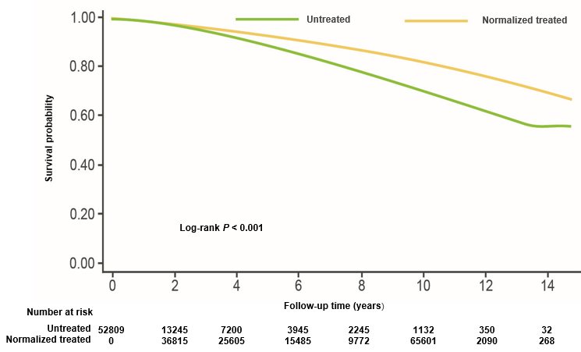
Normalisation of T level was associated with reduced incidence of MI & mortality in men without previous history of MI or ischaemic stroke¹
All-cause mortality among untreated vs normalised treated men
A retrospective analysis of 83,010 US veterans with low T levels:
- Group 1: normalised T with treatment
- Group 2: non-normalised T with treatment
- Group 3: untreated
Primary outcome measures:
Incidence of MI, ischaemic stroke, and all-cause mortality determined using dates of death in CDW data augmented with vital status files
Results:
Group 1 (normalized treated) vs Group 3 (untreated):
Mortality HR 0.44 (CI95% 0.42 - 0.46)
MI HR 0.76 (CI95% 0.63 - 0.93)
Stroke HR 0.64 (CI95% 0.43 - 0.96)
Similarly, all cause mortality, MI risk and stroke were significantly lower in the normalised treated group vs the non-normalized treated group but only for all-cause mortality in the non-normalised vs untreated groups
“…the weight of evidence indicates that T therapy is not associated with increased cardiovascular risk...” Khera M, et al. 2015²
Regulators have requested a study to further define the issue of CV safety with testosterone and that is currently ongoing - TRAVERSE
T, testosterone; MI, myocardial infarction; ICD, International Classification of Diseases; CDW, corporate data warehouse; HR, hazard ratio; CI, confidence interval; CVD, cardiovascular disease.
1. Sharma R, et al. Eur Heart J 2015.36(40):2706-2715.
Notes:
Why getting the levels into the physiological range is so important…
This really interesting retrospective study by Sharma and co-workers looked at over 80,000 individuals split into 3 groups.
One was a group of men with low testosterone who were treated and their testosterone levels normalised. Another was a group that got testosterone treatment but their levels failed to normalise so still remained low. And the 3rd was an untreated group.
The best results were seen in the men who were treated with testosterone and their levels normalised. When compared to the men whose levels did not normalise or even untreated men, the mortality rate was reduced by about half, heart attack rate was down and stroke rate was down.
A rather remarkable study that suggests that just applying testosterone may not be enough, but actually we need to get adequate treatment as evidenced by an increase in the blood levels.
In 2014, Sharma et al conducted a retrospective cohort study, examining 83010 male veterans with low T levels
Subjects were categorised into three groups
- Group 1: patients treated with TTh resulting normalisation of T levels (n=43,931)
- Group 2: patients treated with TTh without normalisation of T levels (n=25,701)
- Group 3: Patients who did not receive TTh (n=13,378)
The primary outcome measures of this study were
(I) the incidence of Myocardial Infarction (MI)
(ii) the incidence of Ischaemic Stroke
(iii) All cause mortality
Results for the outcome measures in the Normalised T group (Group1) vs the Untreated group (Group3) showed significant decreases in all three outcomes.
All-cause mortality for Group 1 vs Group 3 is illustrated in the Kaplan-Meier curve on this slide, where the group treated to normalised T levels had significantly fewer deaths compared to the group wo did not receive TTh
Similarly, results for all 3 outcome measures were significantly reduced for the normalised T group vs the non-normalised T group, indicating that achieving normalisation of T levels through treatment is important.
(There was a significant reduction in mortality for the non-normalised group and the untreated group, but no significant differences in the outcomes of MI or Ischaemic stroke between these two groups)
It is important to note that this is a retrospective, observational study and therefore not without its limitations, as acknowledge by the authors. The authors concluded that treatment with TTh should aim for doses resulting in normalisation of T levels, as this was shown to be associated with a reduction in adverse CV events. However adequately powered, prospective, well-designed trials with a long term follow up will be needed to reach a conclusive agreement regarding the effect of TTh on CV risk.

Slide 25
TRAVERSE: study overview
Ongoing Phase 4, randomised, blinded, placebo-controlled, multicentre trial to evaluate the effect of TTh on the incidence of MACE and efficacy measures in hypogonadal men
Estimated completion June 2022
Expected to enrol 6,000 men aged 45–80 years with low serum testosterone concentrations (<300 ng/dL) and ≥1 sign or symptom of hypogonadism, and have evidence of CV disease or are at increased risk for CV disease
Primary endpoint
Secondary endpoints
Incidence of MACE (composite endpoint consisting of any of the following: nonfatal MI, nonfatal stroke or death due to CV causes)
CV safety (composite endpoint consisting of: nonfatal MI, nonfatal stroke, death due to CV causes or cardiac revascularization procedures/cardiac PCI and CABG)
Prostate safety
CABG, coronary artery bypass graft; CV, cardiovascular; MACE, major adverse cardiovascular events; MI, myocardial infarction; PCI, percutaneous coronary intervention; TRAVERSE, Testosterone Replacement Therapy for Assessment of Long-term Vascular Events and Efficacy Response; TTh, testosterone therapy
Clinicaltrials.gov. identifier NCT03518034. Available at: https://clinicaltrials.gov/ct2/show/NCT03518034 (accessed July 2020).
Notes:
TRAVERSE is an ongoing Phase 4, randomised, blinded, placebo-controlled, multicentre trial to evaluate the effect of TTh on the incidence of MACE and efficacy measures in hypogonadal men.
The study is expected to enrol 6,000 men aged 45–80 years with low serum testosterone concentrations (<300 ng/dL) and ≥1 sign or symptom of hypogonadism, and have evidence of CV disease or are at increased risk for CV disease.
The exclusion criteria are:
Men with congenital or acquired hypogonadism for whom long-term therapy with placebo would not be medically appropriate.
Men with prostate specific antigen >3.0 ng/mL (or 1.5 if on 5-alpha reductase inhibitors).
Men who have been treated with testosterone in the past 6 months and for whom TTh is contraindicated.
Confirmed testosterone <100 ng/dL.
Body mass index >50.
HbA_{1c} >11%.
Haematocrit >50%.
Estimated glomerular filtration rate <30 mL/min.
History of deep vein thrombosis or pulmonary embolism or prostate cancer or heart failure.
The primary endpoint of the study is the incidence of MACE (a composite endpoint consisting of any of the following: nonfatal MI, nonfatal stroke or death due to CV causes).
The key secondary endpoints are:
CV safety (assessed by a composite endpoint consisting of nonfatal myocardial infarction, nonfatal stroke, death due to CV causes or cardiac revascularisation procedures/cardiac PCI and CABG.
Prostate safety.
The estimated date for completion of the study is June 2022.
CABG, coronary artery bypass graft; CV, cardiovascular; HbA_{1c}, glycated haemoglobin; MACE, major adverse cardiovascular events; MI, myocardial infarction; PCI, percutaneous coronary intervention; TRAVERSE, Testosterone Replacement Therapy for Assessment of Long-term Vascular Events and Efficacy Response; TTh, testosterone therapy
Reference
Clinicaltrials.gov identifier NCT03518034. Available at: https://clinicaltrials.gov/ct2/show/NCT03518034 (accessed July 2020).

Slide 26
Haematocrit

Slide 27
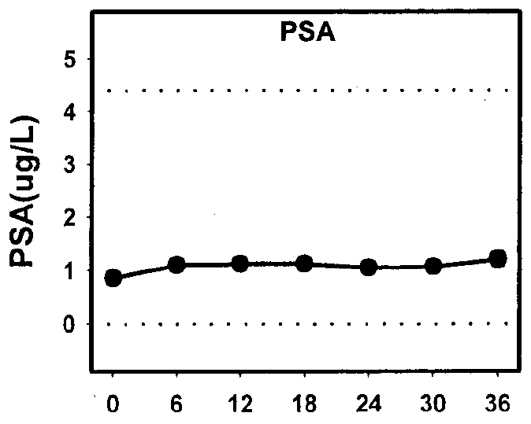
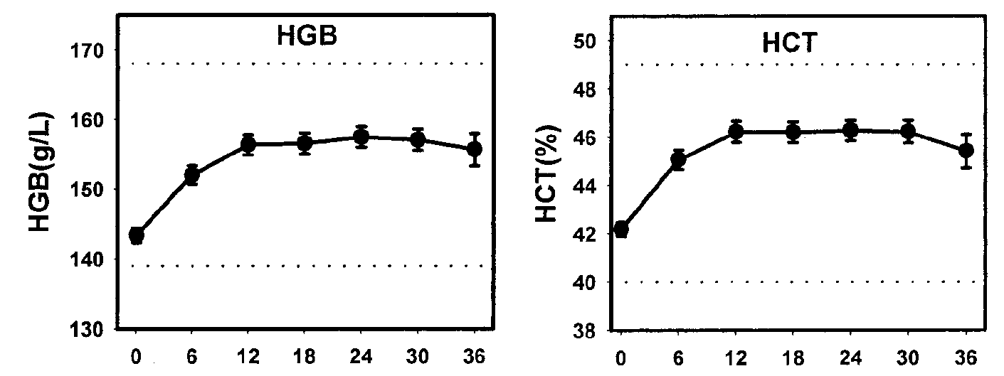
Wang C et al. Long-Term Testosterone Gel (AndroGel*) Treatment Maintains Beneficial Effects on Sexual Function and Mood, Lean and Fat Mass, and Bone Mineral Density in Hypogonadal Men. J Clin Endocrinol Metab 2004;89:2085–98.
The effect of long-term T gel application on safety parameters
Safety | Skin Irritation Application site skin reaction occurred in 12/163 subjects (one was classified as moderate). One subject discontinued after 12 months of T Gel (5g) because of worsening erythema and rash. IPSS & PSA Mean IPSS score did not change significantly across time with T gel. None of the individual scores showed any clinically meaningful changes Baseline PSA level was 0.85ng/ml. With T replacement there were significant increases in PSA levels over time. Mean serum PSA was 1.11ng/ml at month 6 and showed no further significant increases with continued T treatment (P = 0.150). 3 subjects (1.8%) aged >63 years whose serum PSA rose above the predetermined critical value of 5.5 ng/dl had T treatment stopped and had confirmed PCa on biopsy Haematocrit Except for the anticipated increase in haematocrit and haemoglobin, there were no clinically significant changes in blood counts or biochemistry.
Figure 15: Haemoglobin (HGB), haematocrit (HCT) and PSA concentrations over time
Figure 15: Adapted from Wang et al.
Notes:
Of the subjects who had elevated PSA during the study, three had confirmed prostate cancer on biopsy. All three subjects were over 63 years old at enrolment in the study.
The incidence of prostate cancer in three of 163 (1.8%) subjects who were enrolled in this study was similar to that reported in older men by Snyder et al. who were treated with scrotal transdermal patches for 3 year (one of 54, 1.8%).
However, if only men over 60 yr enrolled in this study were considered, the incidence would be higher: three of 39 (7.7% over a 3-yr period).
Based on the data from the Surveillance, Epidemiology, and End Result Program of the National Cancer Institute, the anticipated incidence of prostate cancer in the population of men between the ages of 65 and 74 yr is between 973 and 994 cases per 100,000 men [National Cancer Institute, Surveillance, Epidemiology, and
End Result (SEER) Program 2002, www.seer.cancer.gov].
Gynecomastia was observed only in eight more subjects during treatment (4.9%).
Acne was noted in 12 subjects (7.4%). None of these subjects was discontinued because of acne.
Prostate size was not assessed by ultrasound but was assessed during digital rectal examinations and found to be enlarged in 23 subjects (14%) at any time in the study. Most of these patients had enlarged prostate at baseline assessment.

Slide 28
Haematocrit (1/2)
T administration increases haemoglobin and haematocrit; these effects are related to T doses and circulating concentrations. ¹
In some men with hypogonadism, T therapy can cause erythrocytosis (haematocrit >54%). ¹
The increase in haematocrit during T administration and the frequency of erythrocytosis is higher in older men than in young men ¹
The European Association of Urology Guidelines on Male Hypogonadism from 2018 state that an increase in haematocrit is a more common adverse event with long-acting testosterone undecanoate. They go on to say that short-acting intramuscular injections have the highest incidence of erythrocytosis (approaching 40%). ²
The British Society for Sexual Medicine (BSSM) Guidelines on Adult Testosterone Deficiency from 2017 state that polycythaemia is more common in older men treated with injectable T preparations.³
Haematocrit should be measured before treatment, at 3-6 months, 12 months, and annually thereafter; decrease dosage, or switch preparation, if haematocrit is >0.54 (54%); if haematocrit remains high, consider stopping and reintroduce at a lower dose
1. Bhasin, S et al. J Clin Endocrinol Metab, May 2018, 103(5):1–30
2. Dohle, G et al https://uroweb.org/guideline/male-hypogonadism/#5
3. Hackett, G et al J Sex Med 2017;14:1504-1523

Slide 29
Haematocrit (2/2)
The 2020 European Academy of Andrology (EAA) guidelines on investigation, treatment and monitoring of functional hypogonadism in males (Endorsing Organization: European Society of Endocrinology) suggest the use of transdermal T gels, as the preferred preparation in the initiation of TRT due to the potentially reversible nature of functional hypogonadism¹
In frail elderly patients with multiple morbidities, in whom the risks of adverse effects are higher, a short-acting gel T preparation at a lower starting dose is advisable ¹
The 2018 British Society for Sexual Medicine (BSSM) Practical Guide for Testosterone Deficiency states that when considering side effects and drug withdrawal times, physicians should bear in mind the pharmacodynamic and pharmacokinetic properties of the injectable versus the transdermal formulations ²
1. Corona, G et al. Andrology. 2020 Sep;8(5):970-987
2. Hackett, G et al. http://www.bssm.org.uk/wp-content/uploads/2018/02/BSSM-Practical-Guide-High-Res-single-pp-view-final.pdf

Slide 30
Summary
TD is an increasingly common problem, however despite this many patients with TD remain untreated^{1,2}
There are historical concerns surrounding the use of TTh specifically with regards to prostate cancer (PCa) and CV risk³⁻⁵
Guidelines from the EAU,⁶ BSSM,¹ ICSM,⁷ ISSM,⁸ ES⁹ and ISSAM¹⁰ state that there is no compelling evidence that TTh is associated with an increased risk of PCa
However, studies have been unable to demonstrate conclusively what the relationship between TTh and PCa is
Please note that Testogel is contraindicated in known or suspected PCa^{11,12}
In 2014 the EMA PRAC reviewed all available published data on the CV risks associated with TTh, and judged that the signal for an increased risk of CV risk associated with the use of TTh remains weak and inconclusive¹³
The PRAC recommended the variation to the European licenses for testosterone-containing medicinal products to reflect current knowledge on CV risks associated with testosterone therapy and the need to monitor¹³
Short-acting testosterone gel preparations are preferred by the European Academy of Andrology (EAA) for the initial treatment of functional hypogonadism especially in the older man due to concerns over increased likelihood of erythrocytosis ¹⁴
European Association of Urology (EAU); British Society for Sexual Medicine (BSSM); International Consultation for Sexual Medicine (ICSM); International Society for Sexual Medicine (ISSM); Endocrine Society (ES); International Society for the Study of the Ageing Male (ISSAM)
1. Hackett G, et al. J Sex Med 2017;14:1504-1523. 2. David J, Diabetes & Primary Care Vol 19 No 2 2017 3. Vigen R, et al. JAMA 2013;310(17):1829-36; 4. Finkle WD, et al. PloS One 2014;9(1):e85805. 5. Huggins C, Hodges CV. Cancer Res 1941;1:293-297. 6. Dohle GR et al. Guidelines of Male Hypogonadism. European Association of Urology 2015. Available at: https://uroweb.org/wp-content/uploads/18-Male-Hypogonadism_LR1.pdf Accessed February 2019. 7. Khera M, Adaikan G, Buvat J, et al. J Sex Med 2016;13:1787-1804. 8. Dean JD, McMahon CG, Guay AT, et al. J Sex Med 2015;12:1660-1686. 9. Bhasin S, Cunningham GR, Hayes FJ, et al; J Clin Endocrinol Metab 2010;95:2536-2559. 10. Lunenfeld B, Mskhalaya G, Zitzmann M, et al. Aging Male 2015;18:5-15. 11. TESTOGEL® 16.2 mg/g Summary of Product Characteristics July 2018. 12. TESTOGEL® 50 mg Summary of Product Characteristics August 2018.13. Pharmacovigilance Risk Assessment Committee EMEA/H/A-31/1396 EMA/PRAC/599233/2014. 14. Corona, G et al. Andrology. 2020 Sep;8(5):970-987

Slide 31
Safety Consideration Questions:
1. Who were the authors of the 1941 paper that concluded that cancer of the prostate is activated by testosterone injections?
Dohle & Hackett
Behre & Heufelder
Morgentaler & Traish
Huggins & Hodges
(choose 1 answer)

Slide 32
Safety Consideration Questions:
2. How many patients received testosterone injections in the Huggins & Hodges study from 1941?
175
3
49
122
(choose 1 answer)

Slide 33
Safety Consideration Questions:
3. Which of these is NOT a criteria for sending patients for further urological evaluation prior to commencing or during TTh?
Unevaluated prostate nodule or induration
Baseline PSA level higher than 4 ng/mL (or >3 ng/mL in men at high risk of pCa, such as African Americans and those with first-degree relatives who have pCa)
PSA increases >1.4 ng/mL over any 1-year period after initiation of TTh
Nocturia
PSA velocity increased >0.4 ng/mL/year during sequential measurement over >2 years after initiation of TTh
(choose 1 answer)

Slide 34
Safety Consideration Questions:
4. According to the BSSM guidelines, at what level of haematocrit is it recommended for HCPs to reduce the dose or even stop testosterone treatment?
>54%
>52%
>50%
>48%
(choose 1 answer)

Slide 35
Safety Consideration Questions:
5. How many RCTs were included in the 2014 meta-analysis by Cui et al that concluded that there was no significant effect of TTh on the incidence of prostate cancer, compared with placebo?
11
22
33
44
(choose 1 answer)

Slide 36
Safety Consideration Questions:
6. What is the name of the ongoing gold-standard RCT cardiovascular safety study that is due to complete in 2022?
TRANSCEND
TRAVESTY
TRACTION
TRAVERSE
(choose 1 answer)

Slide 37
Safety Consideration Questions:
7. Who authored the study from 2015 of 83,010 US veterans that demonstrated the importance of not just treating TD patients with TTh but ensuring that T levels normalise?
Sharma
Srinivas-Shankar
Cunningham
Wang
(choose 1 answer)

Slide 38
Safety Consideration Questions:
8. Following a review of the data in 2014, what did the EMA PRAC conclude regarding the safety signal for an increased risk of CV risk associated with the use of TTh?
It is strong & worrisome
It is weak & inconclusive
It provides sufficient evidence to revoke licenses for testosterone products
It is non-existent
(choose 1 answer)

Slide 39
Safety Consideration Questions:
9. What do the European Academy of Andrology (EAA) recommend for the initial treatment of functional hypogonadism due to concerns over erythrocytosis?
Short-acting injectables
Transdermal patches
Transdermal gels
Long-acting injectables
(choose 1 answer)

Slide 40
Safety Consideration Questions:
10. Who was the lead author of the 2018 meta-analysis of 15 pharmaco-epidemiological studies and 93 RCTs that concluded that when TTh was applied within recommended dosages, it was not associated with an increase in CV risk?
Corona
Dohle
Zitzmann
Morgentaler
(choose 1 answer)

Slide 41
Safety Consideration Answers:
Q1: Huggins & Hodges
Q2: 3
Q3: Nocturia
Q4: >54%
Q5: 22
Q6: TRAVERSE
Q7: Sharma
Q8: Weak & Inconclusive
Q9: Transdermal gels
Q10: Corona

