Slide 1
Pathophysiology & Epidemiology
Besins Healthcare
Global Medical Affairs
March 2021

Slide 2
Hypo*gonad*ism
Definitions
Inadequate gonadal function, as manifested by deficiencies in gametogenesis and/or the secretion of gonadal hormones
Male hypogonadism may be defined as a failure of the testes to produce testosterone or sperm
Primary (testes)
Secondary (pituitary, hypothalamus)
Mixed (combination)
Notes:
Male hypogonadism is a reduced or absent secretion of testosterone from the testes and is characterized by the resulting signs and symptoms. The term “testosterone deficiency” may be used to eliminate confusion arising from the various classifications of hypogonadism and to more fully convey the clinical significance associated with lack of stimulation of androgen-dependent functions.
Male hypogonadism results from insufficient secretion of testosterone. Testosterone deficiency may occur with a number of disorders, including those that damage the testes (primary testicular failure) or those associated with a reduction in gonadotropin stimulation of the testes (hypogonadotropic hypogonadism). Functionally, the hypogonadal states may be classified according to the level at which the hypothalamic-pituitary-testicular axis is defective.

Slide 3
What is Testosterone Deficiency (TD)?
Testosterone deficiency is a well-established and significant medical condition
It is defined as a clinical and biochemical syndrome that can be associated with advancing age and comorbidities
It is characterised by a deficiency in serum androgen levels and relevant signs and symptoms
Testosterone deficiency can adversely affect multiple organ systems and result in significant decreases in quality of life, including changes in sexual function
1. Hackett G, et al. British Society for Sexual Medicine Guidelines on Adult Testosterone Deficiency, With Statements for UK Practice. J Sex Med 2017;14:1504-1523.
Notes:
Hypogonadism is now often referred to as testosterone deficiency

Slide 4
Classification of TD^{1,2}
Primary TD
Testicular damage
↑
Hypergonadotropic
Functional TD
Caused by morbidities influencing Leydig Cell function and hypothalamic/pituitary response
Testosterone
↓
LH/FSH
Classical
TD
→
Low normogonadotropic
Secondary TD
Hypothalamic/pituitary damage
↓
Hypogonadotropic
LH: luteinizing hormone, FSH: follicle-stimulating hormone
Dohle GR et al. Guidelines of Male Hypogonadism. European Association of Urology 2018. Available at: https://uroweb.org/guideline/male-hypogonadism/#4 Accessed Sept 2020
Bhasin et al. Testosterone Therapy in Men With Hypogonadism: An Endocrine Society Clinical Practice Guideline. J Clin Endocrinol Metab. 2018;103(5):1715-1744.

Slide 5
Clinical Features of Hypogonadism
Depends upon whether the impairment involves only spermatogenesis or if testosterone secretion is also impaired
Impaired spermatogenesis
Infertility
Decreased testicular size
Impaired testosterone secretion
Signs and symptoms vary depending upon the time of onset
Griffin JE & Wilson JD. In Williams Text book of Endocrinology. 2003: 712.
Plymate S. In Androgens in Health and Disease. 2003: 45-75.
Notes:
The clinical manifestations of hypogonadism depend on the age of onset as well as the cause, severity and duration of the deficiency.

Slide 6
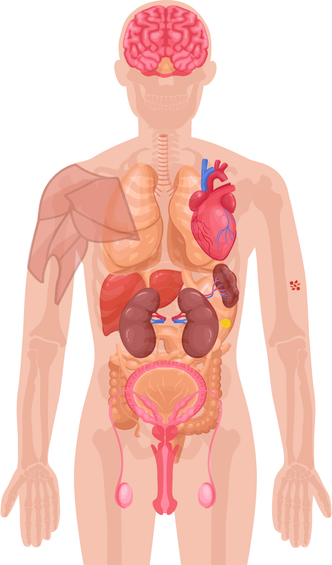
Symptoms of Testosterone Deficiency ¹⁻⁵
Psychological
Cardiometabolic
Physical
Sexual
Changes in mood (e.g. anger, irritability, sadness, depression)
Decreased well-being/poor self-rated health
Diminished cognitive function (including impaired concentration, verbal memory and spatial performance)
Increased body mass index (BMI)/obesity
Visceral obesity
Metabolic syndrome
Insulin resistance and type 2 diabetes
Decreased body hair
Gynaecomastia
Decreased muscle mass and strength
Hot flushes/sweats
Sleep disturbances
Fatigue
Osteoporosis/height loss/low trauma fractures
Delayed puberty
Small testes
Infertility
Decreased sexual desire and activity
Decreased frequency of sexual thoughts
Erectile dysfunction
Delayed ejaculation
Decreased volume of ejaculate
Decreased or absent morning/night-time erections
1. Khera M et al. Diagnosis and Treatment of Testosterone Deficiency: Recommendations From the Fourth International Consultation for Sexual Medicine (ICSM 2015). J Sex Med 2016;13:1787-804. 2. Lunenfeld B et al. Recommendations on the diagnosis, treatment and monitoring of hypogonadism in men. Aging Male 2015;18:5-15. 3. Hackett G et al. UK policy statements on testosterone deficiency. Int J Clin Pract 2017 Mar;71(3-4). doi: 10.1111/ijcp.12901. Epub 2017 Mar 20. 4. Dohle GH et al. Guidelines on Male Hypogonadism. European Association of Urology 2017. Available at: http://uroweb.org/guideline/male-hypogonadism/ (Accessed September 2017). 5. Dean JD et al. The International Society for Sexual Medicine’s process of care for the assessment and management of testosterone deficiency in adult men. J Sex Med 2015;12:1660-86.
Notes:
With aging, men experience reproductive changes that are more gradual and subtle than the more profound cessation of ovarian function experienced by women at menopause. Although early investigations reported equivocal findings, studies have now clearly demonstrated that men experience a slow but continuous (approximately 1% to 2% per year) decline in total and bioavailable serum testosterone levels after approximately age 30 years. However, not all older men with a low testosterone will have the clinical features of hypogonadism. Therefore, it is the general consensus to treat men with age-related hypogonadism only when clinical symptoms are present that can be potentially corrected by testosterone administration as they will benefit most from such therapy.

Slide 7
Prevalence of TD
Estimates vary widely (2.1% to 38.7%) depending on the criteria used to define TD
 | BLSA, 2001 | MMAS, 2005 | HIM, 2006 | BACH, 2007 | EMAS, 2010
No of patients | 890 | 1691 | 2165 | 1475 | 3369
Age | 22-91 yrs (mean 53.8) | 40-69 yrs | ≥ 45 yrs (mean 60.5) | 30-79 yrs (mean 47.3) | 40-79yrs (means 59,7)
TT and FT levels | TT <325ng/dl | TT <200 ng/dl x 2 | TT <300 ng/dl x 1 | TTl < 300 ng/dl and FT < 5 ng/dl | TT<320 ng/dl and FT<6.4 ng/dl
Symptoms evaluation | No | ADAM | Questions | Questions | Questions
Prevalence of hypogonadism | Defined by TT 50s = 12% 60s = 19% 70s = 28% 80s = 49% | Defined by TT and symptoms Baseline = 6% Follow-up =12.3% | Defined by TT 38.7% | Defined by TT and symptoms 5.6% (18.4% in 70s) | Defined by TT, FT and presence of at least three sexual symptoms 2.1% (5.1% in 70-79yrs)
Harman SM, Metter EJ et al. JCEM 2001; 86: 724-731; Araujo AB, O’Donnell AB et al. JCEM 2004; 89: 5920-5926; Mulligan T, Frick MF et al. Int J Clin Pract. 2006; 60:762-9; Araujo AB, Esche GR et al. JCEM 2007; 92: 4241-4247; Wu F , Tajar A et al. NEJM 2010; 363(2):123-135.

Slide 8
Causes of (TD)
Primary TD |  | Secondary TD
Organic Klinefelter syndrome Cryptorchidism, anorchia Myotonic dystrophy Irradiation, chemotherapy Castration, trauma Orchitis Older age* | Functional Chronic illness* Ketoconazole | Organic Pituitary/hypothalamic tumour, surgery, trauma or disease Stalk section or disease Hypopituitarism Haemochromatosis Kallman syndrome, idiopathic hypogonadotropic hypogonadism | Functional Opioids Glucocorticoid excess* Hyperprolactinaemia Organ failure Chronic illness*, malnutrition, wasting Malnutrition Obesity/ type 2 diabetes mellitus* Excessive exercise Androgens, progestins, oestrogens, GnRH agonists Older age (with comorbidities)*
*Combined primary and secondary. GnRH, gonadotropin-release hormone; TD, testosterone deficiency.
1. Hackett G, et al. British Society for Sexual Medicine Guidelines on Adult Testosterone Deficiency, With Statements for UK Practice. J Sex Med 2017;14:1504-1523.

Slide 9
Drugs that affect testosterone levels
Opioids
Regular use can suppress Testosterone levels in up to 70% of men
Glucocorticoids
May suppress HPT-axis
Anticonvulsants
↑ SHBG, ↓ Free & Bioavailable Testosterone
Antipsychotics
Can lead to hyperprolactinemia, or ↑ prolactin levels
Dean J et al. J Sex Med 2015;12:1660-86.

Slide 10
Testosterone Measurement
Total Testosterone
Serum T = free T + protein bound T (albumin & sex hormone binding globulin)
Gold Standard method for measuring T is LC-MSMS (liquid chromatography-tandem mass spectrometry) but this is not commonly available
Common methods include immunoassay or radioimmunoassay
Free Testosterone
Free T = non protein bound T
Free T can be calculated from TT, SHBG, albumin
Wang C, Catlin DH et al. J Clin Endocrinol Metab 2004; 89:534-543.
Notes:
The gold standard for measuring testosterone is the LC-MSMS = liquid chromatography-tandem mass spectrometry method but this is much more complicated to do that a RIA or immunoassay. These methods give similar results ± 20% so the local laboratories need to calibrate their RIA method. Radioimmunoassay is performed using an antibody to the testosterone-protein complex that is tagged with a radioactive nuclide. After washing, the radioactivity bound is measured and related directly to the concentration of bound testosterone with suitable quantified controls.

Slide 11
Testosterone fractions in the blood
60% of testosterone in the blood is tightly bound to SHBG
A further 38% is loosely bound to albumin.
Only 2% of the testosterone in the blood is free testosterone
The albumin-bound and the free testosterone portions make up the bio-available testosterone
SHBG, sex hormone-binding globulin; T, testosterone
Figure adapted from Anawalt BD & Braunstein GD. Testes; In Greenspan’s Basic & Clinical Endocrinology 10th Edition. Gardner DG & Shoback D, McGraw-Hill Education, 2018

Slide 12
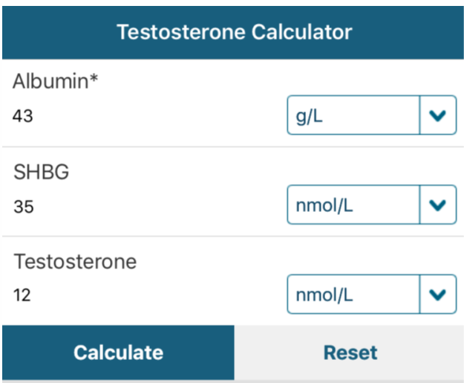
“T Calc” App
Free App - available on iOS and Android
Defaults to European Units (nmol/L)
Includes BSSM guidance on Free T cut-off levels
Aids interpretation of Testosterone results
http://www.pctag.uk/testosterone-calculator/

Slide 13
Testosterone Deficiency & Co-Morbidities
TD prevalence increases with age but can occur in men of all ages and is frequently associated with conditions that include:¹
100%
Chronic opioid
use – 53% (74% with
long-acting formulations)
HIV-associated
weight loss: 16-70%
(linked to poor
health status)
90%
80%
Osteoporosis: 44%
(effect mediated
by low E2/SHBG)
70%
Obesity: 52%
(BMI > 30 kg/m²)
Type 2
diabetes: 50%
Fractures: 50% hip,
20% vertebral
60%
50%
40%
30%
20%
10%
0%
E2: estradiol, SHBG: sex hormone binding globulin
1. Khera et al J Sex Med 2016;13:1787-1804.

Slide 14
Pre-diabetes & Diabetes
Pre-diabetes defined as either:¹
Fasting plasma glucose: 5.5 mmol/L to 6.9 mmol/L or
HbA1c: 42 to 47 mmol/mol (6.0 to 6.4%)
Type 2 diabetes defined as:²
Fasting plasma glucose concentration ≥ 7.0 mmol/l or
HbA1c: > 48 mmol/mol (> 6.5%) or
Plasma glucose concentration ≥ 11.1 mmol/l two hours after 75g anhydrous glucose in an oral glucose tolerance test (OGTT)
Type 1 diabetes: results from β-cell destruction, usually leading to absolute insulin deficiency
Type 2 diabetes: results from a progressive insulin secretory defect on the background of insulin resistance
Type 2 diabetes: prevention in people at high risk | NICE Public Health Guideline 38;
https://www.diabetes.org.uk/professionals/position-statements-reports/diagnosis-ongoing-management-monitoring/new_diagnostic_criteria_for_diabetes

Slide 15
Men with T2DM frequently have low testosterone levels
Cross-sectional study to assess the prevalence of clinical hypogonadism in 355 men with T2DM (mean age 58.1 years)
In total, 20% (n=71) and 31% (n=109) of men with T2DM had total testosterone levels <8 nmol/L and 8–12 nmol/L, respectively
Free testosterone <0.255 nmol/L: 50% (n=179)
Proportion of men with low or borderline low testosterone levels per decade of life (n=180)
Total testosterone <8 nmol/L
Total testosterone <12 nmol/L
Calculated free testosterone <0.255 nmol/L
Patients (%)
Patients (%)
Age (years)
Age (years)
T2DM, type 2 diabetes mellitus
Kapoor D et al. Diabetes Care 2007;30:911–17.
Notes:
This cross-sectional study assessed the prevalence of clinical hypogonadism in men with T2DM.
It included 355 men with T2DM (mean age: 58.1 years) who were registered with the Centre for Diabetes and Endocrinology, Barnsley Hospital NHS Foundation Trust, Barnsley, UK. Study participants were recruited from the diabetic clinic and district retinal screening programme.
In total, 70 patients were treated with diet alone, 95 with insulin, and 160 with oral hypoglycaemic agents.
Patients were excluded if they had any inflammatory disease or infection with elevated CRP >10 mg/L, or were already receiving TTh.
Assessments were always made between 8:00 and 10:00 in the morning.
Total testosterone levels were measured by ELISA, with <8 nmol/L considered ‘low’ and 8–12 nmol/L considered ‘borderline low’.
Age distribution and mean total and free testosterone levels, respectively, were:
<40 years (n=13; 4%): 11.1 and 4.05 nmol/L.
40–49 years (n=60; 17%): 12.3 and 4.34 nmol/L.
50–59 years (n=124; 35%): 12.4 and 4.05 nmol/L.
60–69 years (n=112; 32%): 13.5 and 4.03 nmol/L.
>69 years (n=46; 12%): 12.45 and 3.51 nmol/L.
20% of men (n=71) had total testosterone levels <8 nmol/L.
31% of men (n=109) had total testosterone levels between 8–12 nmol/L.
50% of men (n=179) had free testosterone levels <0.255 nmol/L.
CRP, C-reactive protein; ELISA, enzyme-linked immunosorbent assay; NHS, National Health Service; T2DM, type 2 diabetes mellitus; TTh, testosterone therapy
Reference
Kapoor D et al. Diabetes Care 2007;30:911–7.

Slide 16
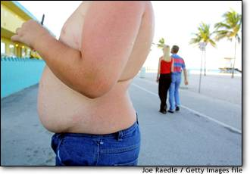
Metabolic syndrome
Metabolic syndrome is a cluster of risk factors for CV disease and T2DM
These include abdominal obesity, raised blood pressure, dyslipidaemia (raised TG and lowered HDL-C) and raised blood glucose¹
Patients with metabolic syndrome are twice as likely to develop CV disease over the next 5–10 years as those without it, and their lifetime risk will be greater still¹
Metabolic syndrome also confers a 5-fold increased risk of T2DM¹
IDF Consensus Worldwide Definition of the Metabolic Syndrome²
 | Abdominal obesity (Europids: ♂ WC ≥94 cm)
 | plus any 2 of (or treatment for) the following:
 | Elevated TG | ≥1.7 mmol/L
 | Reduced HDL-C | <1.03 mmol/L (♂)
 | Raised blood pressure | ≥130/85 mmHg
 | Raised fasting plasma glucose | ≥5.6 mmol/L
CV, cardiovascular; HDL-C, high-density lipoprotein cholesterol; T2DM, type 2 diabetes mellitus; TG, triglycerides; WC, waist circumference
1. Alberti KG et al. Circulation 2009;20;120:1640–5; 2. International Diabetes Federation 2006. https://www.idf.org/e-library/consensus-statements/60-idfconsensus-worldwide-definitionof-the-metabolic-syndrome.html (accessed July 2020).
Notes:
It is estimated that ~20–25% of the world’s adult population have metabolic syndrome.
While the pathogenesis of the metabolic syndrome and each of its components is complex and not well understood, central obesity and insulin resistance are acknowledged as important causative factors.
Central (i.e. abdominal) obesity is easily assessed using waist circumference and is independently associated with each of the other metabolic syndrome components, including insulin resistance.
According to the International Diabetes Federation 2006 definition, central obesity is a prerequisite risk factor for diagnosis of the metabolic syndrome. Insulin resistance, which is difficult to measure in day-to-day clinical practice, is not an essential requirement.
Reference
International Diabetes Federation 2006. https://www.idf.org/e-library/consensus-statements/60-idfconsensus-worldwide-definitionof-the-metabolic-syndrome.html (accessed July 2020).

Slide 17
Prevalence of TD increases with increasing number of metabolic syndrome components
p<0.0001 for trend
In all subgroups
Corona G, et al. Int J Androl 2009; 32: 587–598.
n=1491 patients attending Andrology Unit for ED
Notes:
In a consecutive series of 1491 attending an andrology clinic for erectile dysfunction, the prevalence of testosterone deficiency syndrome increased as a function of the number of metabolic syndrome components present in those men.¹
1. Corona G et al. Int J Androl 2009; 32: 587-598

Slide 18
Guideline recommendations for screening men with T2DM, obesity, chronic opiate use and ED for TD
In recent years, established specialist medical societies have produced guidance on which male patients should be screened for TD. The guidelines include:
British Society for Sexual Medicine Guidelines (BSSM)
American Association of Clinical Endocrinologists (AACE) and American College of Endocrinology (ACE) Guidelines
European Association of Urology (EAU) Guidelines
Endocrine Society (ES) Guidelines
American Urological Association (AUA) Guidelines
American Diabetes Association (ADA) Guidelines
1. Hackett G, et al. J Sex Med 2017;14:1504-23; 2. Dohle GR, et al. European Association of Urology 2015. Available at: https://uroweb.org/wp-content/uploads/18-Male-Hypogonadism_LR1.pdf Accessed May 2019; 3. Mulhall JP, et al. American Urological Association 2018. 4. Bhasin S, et al. J Clin Endocrinol Metab 2018;103(5):1715-44; 5. https://www.endocrinology.org/media/2710/male-hypogonadism-and-ageing-2018.pdf Accessed June 2019

Slide 19
Men with type 2 diabetes mellitus (T2DM)
The BSSM recommend screening for TD in all men with T2DM¹
The American Association of Clinical Endocrinologists (AACE) and American College of Endocrinology (ACE) recommend:
All male patients with T2DM should be evaluated to exclude TD²
The American Diabetes Association (ADA) recommend:
In men with diabetes and symptoms or signs of TD, such as decreased libido or ED, consider screening with a morning serum T level³
The European Association of Urology (EAU) recommendations include:
Testosterone assessment in men with a disease in which TD is common, and in whom treatment may be indicated, such as T2DM⁴
TD – Testosterone Deficiency; T - testosterone; T2DM – Type 2 Diabetes; ED – Erectile Dysfunction
1. Hackett G, et al. J Sex Med 2017;14:1504-23; 2. Garvey TW, et al. American Association of Clinical Endocrinologists and American College of Endocrinology Clinical Practice Guidelines for Comprehensive Medical Care of Patients with Obesity. Available at: aace.com/files/guidelines/ObesityExecutiveSummary.pdf Accessed May 2019; 3. American Diabetes Association. Diabetes Care 2019;42(Suppl.1):S34–S45. Available at: care.diabetesjournals.org/content/diacare/suppl/2018/12/17/42.Supplement_1.DC1/DC_42_S1_Combined_FINAL.pdf Accessed May 2019; 4. Dohle GR, et al. Guidelines of Male Hypogonadism. European Association of Urology 2015. Available at: uroweb.org/wp-content/uploads/18-Male-Hypogonadism_LR1.pdf Accessed May 2019.

Slide 20
Men with Obesity
BSSM recommend screening for TD in all men with BMI >30 kg/m2 or waist circumference (WC) >102 cm² ¹
AACE and ACE recommend:²
All men with increased WC or obesity should be assessed for TD by history and physical exam, and tested for TD if indicated
Men with TD and obesity not seeking fertility treatment should be considered for TTh in addition to lifestyle intervention. TTh in these patients results in weight loss, decreased WC, and improvements in metabolic parameters (glucose, haemoglobin A1c, lipids and blood pressure)
EAU recommendations include T assessment in men with a disease in which TD is common, and in whom treatment may be indicated, such as obesity ³
TD – Testosterone Deficiency; TTh – testosterone therapy; BMI – Body Mass Index; T - testosterone
1. Hackett G, et al. J Sex Med 2017;14:1504-23; 2. Garvey TW, et al. American Association of Clinical Endocrinologists and American College of Endocrinology Clinical Practice Guidelines for Comprehensive Medical Care of Patients with Obesity. Available at: aace.com/files/guidelines/ObesityExecutiveSummary.pdf Accessed May 2019; 3. Dohle GR, et al. Guidelines of Male Hypogonadism. European Association of Urology 2015. Available at: uroweb.org/wp-content/uploads/18-Male-Hypogonadism_LR1.pdf Accessed May 2019.

Slide 21
Men on chronic opioid medication
BSSM recommends screening for TD in all men on long-term opiate medication¹
The Endocrine Society recommend:²
Treatment with opioids affects T production therefore the Endocrine Society suggest measuring the serum T level in men receiving opioid medication
T therapy should be considered in men with opioid-induced TD who are experiencing sexual symptoms and in whom discontinuation of opioid medication seems unlikely
1. Hackett G, et al. J Sex Med 2017;14:1504-23; 2. Bhasin S, et al. J Clin Endocrinol Metab 2010;95:2536-59.

Slide 22
Men with Erectile Dysfunction (ED)
The British Society for Sexual Medicine (BSSM) guidelines state that:¹
TD is a treatable cause of ED that may also make men less/non-responsive to phosphodiesterase type 5 inhibitors (PDE5i’s), therefore all men with ED should have serum T measured on a blood fasting sample taken in the morning 8-11am
25-50% of men fail to respond within 12 months to PDE5i’s. Rates are higher in men with type 2 diabetes mellitus (T2DM) or post-radical prostatectomy.
Correction of testosterone levels <10.4nmol/L may salvage non-responders to PDE5i ⁴
The American Urological Association (AUA) states:²
ED is a symptom associated with TD. Clinicians are advised to measure TT in all ED patients
The Endocrine Society (ES) suggests measurement of serum T concentrations in men with low libido or ED ³
TD – Testosterone Deficiency; T - testosterone; ED – Erectile Dysfunction; PDE5i’s – Phosphodiesterase 5 inhibitors; TT – Total Testosterone
1. Hackett G, et al. J Sex Med 2017;14:1504-23; 2. Mulhall JP, et al. J Urol 2018;200(2):423-32; 3. Bhasin S, et al. J Clin Endocrinol Metab 2018;103(5):1715-44. 4. http://www.bssm.org.uk/wp-content/uploads/2018/09/ED-Practical-Guide-v3-for-BSSM-review.pdf

Slide 23
TD Guideline Summary
There is overall consensus among the guidance produced by expert groups in recent years that a diagnosis of TD should be made when both signs and symptoms and low T levels are confirmed to be present ¹⁻⁴
The majority of guidelines also recommend routine screening for TD in men with the following conditions:
Erectile Dysfunction (ED)
Type 2 diabetes mellitus (T2DM)
Obesity
Chronic opiate use ^{1,3-6}
TD – Testosterone Deficiency; T - testosterone
1. Hackett G, et al. J Sex Med 2017;14:1504-23. 2. Dohle GR, et al. Guidelines of Male Hypogonadism. European Association of Urology 2015. Available at: uroweb.org/wp-content/uploads/18-Male-Hypogonadism_LR1.pdf Accessed May 2019; 3. Bhasin S, et al. J Clin Endocrinol Metab 2018;103(5):1715-44. 4. Mulhall JP, et al. American Urological Association 2018. 5. Garvey TW, et al. American Association of Clinical Endocrinologists and American College of Endocrinology Clinical Practice Guidelines for Comprehensive Medical Care of Patients with Obesity. Available at: aace.com/files/guidelines/ObesityExecutiveSummary.pdf Accessed May 2019; 6. American Diabetes Association. Diabetes Care 2019;42(Suppl.1):S34–S45. Available at: care.diabetesjournals.org/content/diacare/suppl/2018/12/17/42.Supplement_1.DC1/DC_42_S1_Combined_FINAL.pdf Accessed May 2019.

Slide 24
Pathophysiology & Epidemiology Questions
1. Primary hypogonadism is a disorder of the:
Testes
Hypothalamus
Stomach
Pituitary gland
(choose 1 answer)

Slide 25
Pathophysiology & Epidemiology Questions
2. Primary hypogonadism is characterized by:
Low testosterone; low FSH, LH
Elevated testosterone; elevated FSH, LH
Low testosterone; elevated FSH, LH
Hypergonadotropic hypogonadism
(choose >1 answer)

Slide 26
Pathophysiology & Epidemiology Questions
3. Secondary hypogonadism is characterized by:
Elevated testosterone; low or normal FSH, LH
Low testosterone; elevated FSH, LH
Hypergonadotropic hypogonadism
Low testosterone; low or normal FSH, LH
Hypogonadotropic hypogonadism
(choose >1 answer)

Slide 27
Pathophysiology & Epidemiology Questions
4. Testosterone binds to what in the blood?
LH
FSH
Erythrocytes
SHBG
Albumin
(choose >1 answer)

Slide 28
Pathophysiology & Epidemiology Questions
5. What is the most common type of test used to measure total testosterone?
ELISA
HPLC
Immunoassay
Southern blot
LCMS-MS
(choose 1 answer)

Slide 29
Pathophysiology & Epidemiology Questions
6. Which of the following is NOT a component of the metabolic syndrome?
Abdominal obesity
Reduced HDL-C
Raised blood pressure
Raised fasting plasma glucose
Sarcopenia
(choose 1 answer)

Slide 30
Pathophysiology & Epidemiology Questions
7. Which of the following is a type of drug that can cause testosterone levels to decrease?
Beta-Blocker
PDE5 inhibitor
Glucocorticoid
Opioid
Anti-Histamine
(choose >1 answer)

Slide 31
Pathophysiology & Epidemiology Questions
8. Which of these medical conditions are associated with hypogonadism?
Epispadias
Obesity
Type 2 Diabetes
Erectile Dysfunction
IBS
(choose >1 answer)

Slide 32
Pathophysiology & Epidemiology Questions
Q.9 Is the following statement True or False?
The American Diabetes Association (ADA) recommend that in men with diabetes and symptoms or signs of TD, such as decreased libido or ED, consider screening with a morning serum T level

Slide 33
Pathophysiology & Epidemiology Questions
10. True or False.
The prevalence of TD increases with a decreasing number of metabolic syndrome components.

Slide 34
Pathophysiology & Epidemiology Answers:
Q1: Testes
Q2: Low testosterone; elevated FSH, LH / Hypergonadotropic hypogonadism
Q3: Low testosterone, FSH & LH normal or low
Q4: SHBG and Albumin
Q5: Immunoassay
Q6: Sarcopenia
Q7: Glucocorticoid & Opioid
Q8: Obesity, type 2 diabetes, erectile dysfunction
Q9: True
Q10: False

