Slide 1
Testosterone 16.2mg/g Gel in Pump
Kaufman, JM et al 2011
Clinical Trial Summary
Besins Healthcare
Global Medical Affairs
March 2021

Slide 2
Kaufman JM et al. Efficacy and Safety Study of 16.2mg/g Testosterone Gel for the Treatment of Hypogonadal Men
J Sex Med 2011;2079-2089
Pivotal RCT investigating the efficacy and safety of testosterone 16.2mg/g gel vs placebo
Study design | Phase III, multicentre, randomised, double-blind placebo-controlled study in hypogonadal men over 182 days
Study treatment | All eligible subjects were started at a dose of 2.5g of 16.2mg/g testosterone gel or matching placebo on day 1 of the study. Subjects returned to the clinic on Days 14, 28, and 42 for testosterone measurement and the dose was then titrated to either 1.25g, 2.5g, 3.75g or 5.0g accordingly^ Both testosterone gel and placebo gel were applied once daily to either upper arms/shoulders or abdomen
Study population | A total of 274 hypogonadal men (234 active; 40 placebo) with average serum total testosterone concentrations <300ng/dL (<10.4nmol/L) and prostate-specific antigen <2.5ng/mL
Efficacy objectives | The primary objective of this study was to demonstrate the efficacy and safety of optimised doses of 16.2mg/g testosterone gel, applied to hypogonadal men over 182 days. The primary statistical objective was to achieve a responder rate of at least 75% in the testosterone gel-treated subjects. Responders were defined as subjects who had Cav in the eugonadal range (300–1,000 ng/dL)** Cav measurements were taken on days 14, 56, 112 and 182
Safety objectives | To determine whether safety was maintained during long-term administration Assessment of application site effects of testosterone gel Prostate safety was assessed by DRE and IPSS
^ Dose was titrated up or down in 1.25g increments if total T levels were not within the prespecified range of 350 to 750ng/dL. (12.1 – 26nmol/L)
** This equates to 10.4-34.7nmol/L in UK units.
DRE - Digital Rectal Examination; IPSS - International Prostate Symptom Score; Cav - average serum testosterone level
Notes:
Design:
A multicentre, randomised, double-blind, placebo-controlled study. Upon completion of the double-blind treatment, subjects were permitted to enrol in an open-label extension for a period of 182 days to further evaluate the efficacy and safety of the testosterone gel.
All eligible subjects were started at a dose of 2.5g 1.62% testosterone gel or placebo.
On days 14, day 28, and 42, predose serum total testosterone assessments and other secondary assessments were performed.
No dose was titrated below 1.25g or above 5.0g.

Slide 3
82.2% of hypogonadal men achieved T levels within the normal range at Day 182, following treatment with testosterone 16.2mg/g gel
Testosterone 16.2mg/g increases C_{av} testosterone levels to within the normal range in hypogonadal men
Results | Efficacy The success criterion was determined to be ≥75% of subjects achieving testosterone levels within the normal range of 300-1000ng/dL This was met in all population samples on all study days by the testosterone treatment group except on day 14 (65.7%) Significantly more subjects receiving titrated doses of testosterone gel at day 182 had testosterone Cav values within the eugonadal range vs placebo (p<0.0001) After titration, the dose distribution was 1.25g (7.3% n=17/234), 2.5g (25.6% n=60/234), 3.75g (28.2% n=66/234), and 5.0g (38.9% n=91/234).
Number & percentage of subjects achieving C_{av} target range (300-1000ng/dL)* for testosterone on day 182 following dose titration
Study day | 16.2mg/g testosterone gel |  | Placebo |  | P value
 | n/N (%) | 95% Cl | n/N (%) | 95% Cl
182 | 139/169 (82.2) | (75.6, 87.7) | 8/28 (28.6) | (13.2, 48.7) | <0.0001
* This equates to 10.4-34.7nmol/L; C_{av} - serum total testosterone average concentrations; T - Testosterone
Table adapted from Kaufman JM, et al 2011

Slide 4
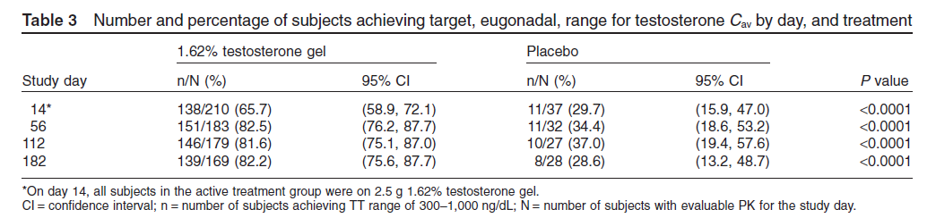
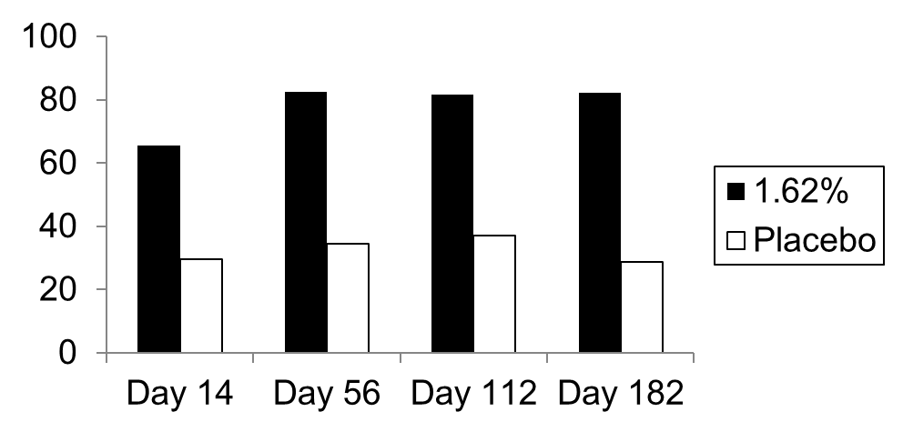
*
*
*
*
* p<0.0001
% of subjects achieving target range for testosterone (Cav)

Slide 5
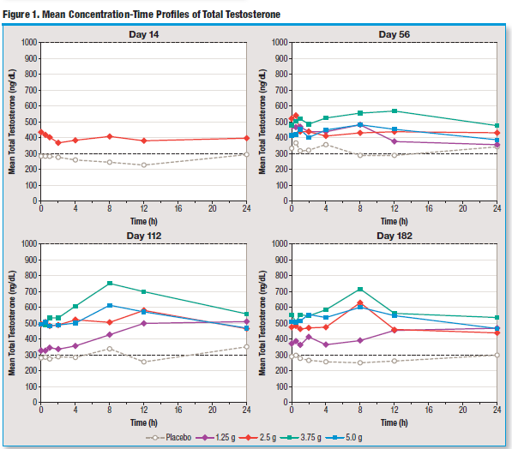

Slide 6
Kaufman JM et al (2011): Safety Results
Testosterone 16.2mg/g is an efficacious and well tolerated therapy for the treatment of hypogonadal men
Safety Results | A similar percentage of serious treatment-emergent adverse events (TEAEs) occurred in the 16.2mg/g testosterone gel (2.1%) and placebo groups (2.5%). The percentage of subjects who experienced at least one TEAE during the study was 55.6% (N = 130/234) for the testosterone-treated group vs. 37.5% (n= 15/40) for the placebo group. Skin irritation assessment indicated no clinically or statistically significant differences between 16.2mg/g testosterone gel and placebo groups. No subject discontinued due to an application site reaction or effect. The most common AE leading to discontinuation was increased PSA (PSA >4.0 ng/mL and/or PSA increase from baseline >0.75 ng/mL). which was prespecified in the protocol as a discontinuation criterion. There were no increases in symptoms of prostatic hypertrophy based on IPSS results. There were no clinically significant abnormal DRE results.
AE – Adverse Event; PSA – Prostate Specific Antigen; DRE – Digital Rectal Examination; IPSS – International Prostate Symptom Score

Slide 7
Kaufman JM et al (2011): Conclusions
Testosterone 16.2mg/g is an efficacious and well tolerated therapy for the treatment of hypogonadal men
Conclusions | 16.2mg/g testosterone gel offers a convenient, flexible and well tolerated dosing regimen that achieves eugonadal testosterone levels in hypogonadal men This 16.2mg/g testosterone gel has increased viscosity and provides patients the opportunity to reduce the total mass of gel applied, which should decrease the overall surface area required for gel application vs. 1% testosterone gel products. The authors state that the safety & efficacy profile of testosterone 16.2mg/g appears to be comparable to the 1% testosterone gels used in hypogonadal men however this study did not directly compare the 2 products.

