Slide 1
The Management of Testosterone Deficiency (TD) in General Practice
PLEASE ADD NAME AND PLACE OF WORK OF THE HEALTHCARE PROFESSIONAL

Slide 2
Disclosure
Please ask the healthcare professional to complete this slide, stating if he/she has received honorarium from Besins Healthcare and other healthcare organisations to speak at such meetings

Slide 3
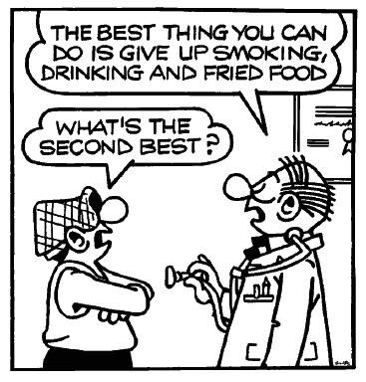
The Importance of Men’s Health
Male life expectancy is, on average, 6.1 years lower than female life expectancy, and men have higher death rates for most of the leading causes of death and at all ages.
Many of the chronic diseases that are associated with premature mortality in men (e.g. coronary heart disease, stroke, diabetes and some cancers) are associated with lifestyle and preventable risk factors.
There is an urgent need for more targeted measures that enable men to recognise their health risks and to take increased responsibility for managing their own health.
1. EC(2011) The State of Men’s Health in Europe. Luxembourg, The European Commission

Slide 4
The Gateway to Men’s Health
“General Practice is by far the most common entrance point into the healthcare system for preventative health strategies and management of acute and chronic disease in men”
Men’s Health Handbook for General Medical Practice 2019
David, J; Coxon, J; Hackett, G; Kirby, M; Patel, A; Edwards, D et al

Slide 5

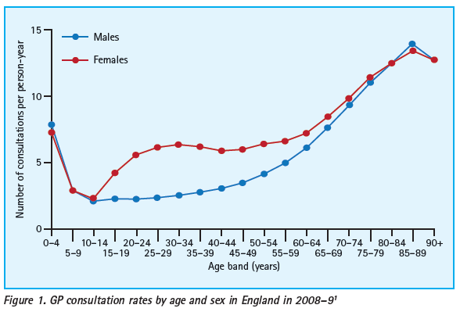
TRENDS IN UROLOGY & MEN’S HEALTH SEPTEMBER/OCTOBER 2013

Slide 6
Life expectancy between the sexes
Lancet 2012;380:2071-94 Lancet 2015;385:117-71

Slide 7
Testosterone &
Testosterone Deficiency (TD)

Slide 8
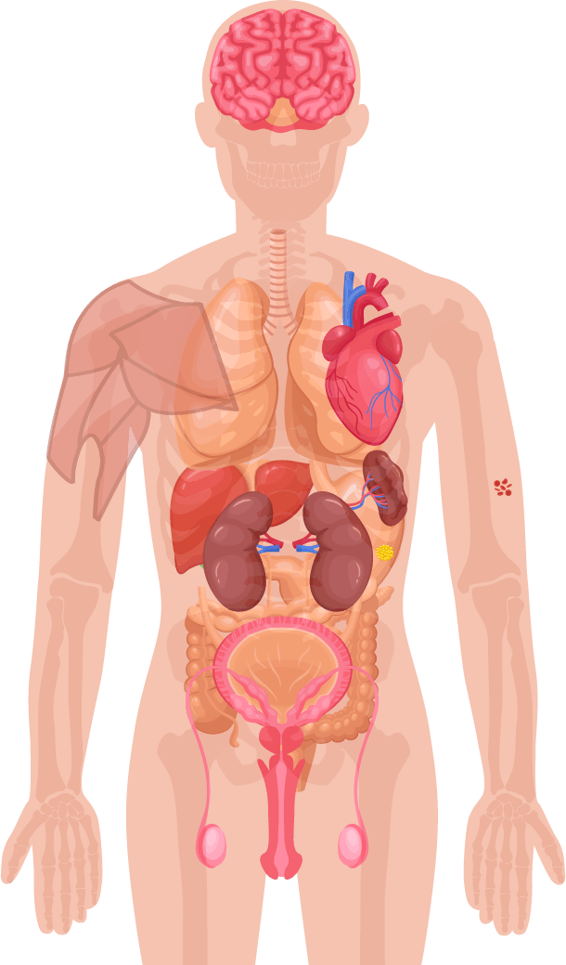
Role of Testosterone in Men’s Health
Mood, Cognitive ability¹
Bone mass¹
Muscle mass, strength¹
Red blood cell production¹
Fat distribution¹
Sexual function, sexual desire and sperm production¹
1. Hackett G, et al. British Society for Sexual Medicine Guidelines on Adult Testosterone Deficiency, With Statements for UK Practice. J Sex Med 2017;14:1504-1523.
Notes:
Testosterone is a sex hormone that is important to health.
In men, testosterone is believed to regulate:¹
Sexual function and sexual desire
Bone mass
Fat distribution
Muscle mass and strength
Production of red blood cells
Production of sperm
Mood
Cognitive ability

Slide 9
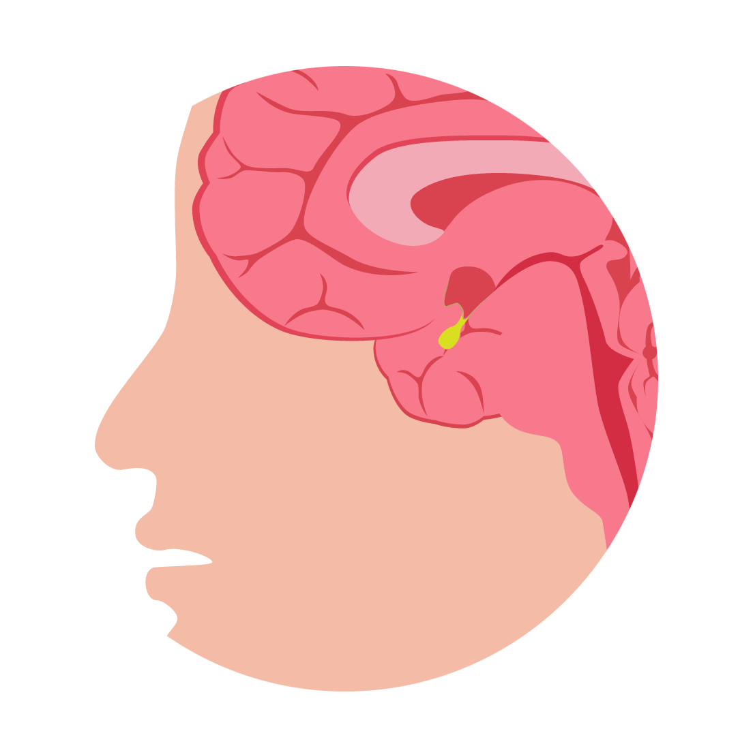
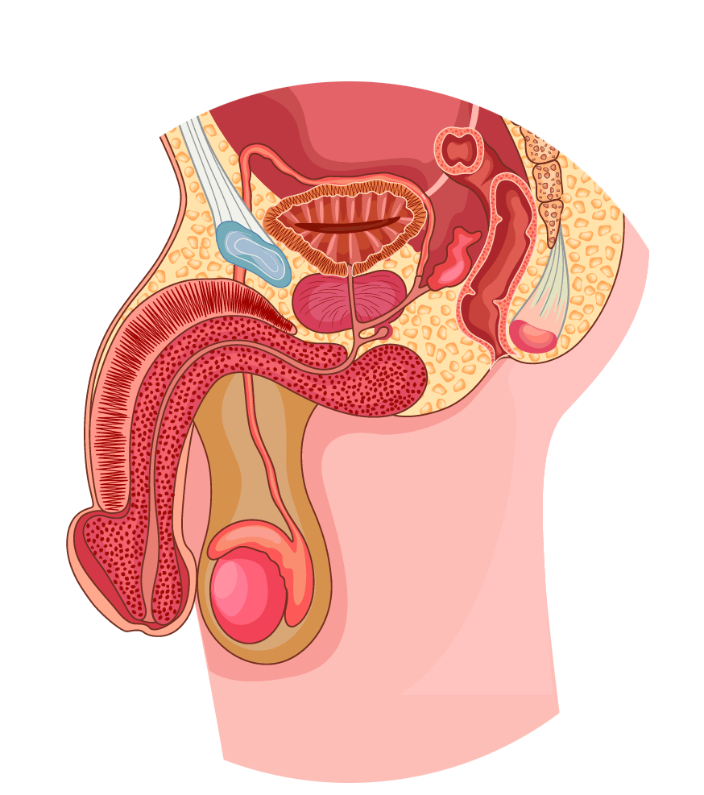
Testosterone Physiology - Production
Hypothalamic-Pituitary-Testicular (HPT) Axis¹
Pituitary gland
Hypothalamus
GnRH
Anterior pituitary
Prostate gland and gonadal tissue
FSH
LH
Sertoli cells
Leydig cells
Testis
Seminiferous tubules
LH receptor¹
Spermatozoa
Testosterone
FSH: follicle-stimulating hormone, LH: luteinizing hormone
Adapted from Dandona P & Rosenberg MT. 2010¹
1. Dandona P & Rosenberg MT. A practical guide to male hypogonadism in the primary care setting. J Clin Pract 2010.64(6):682-696.
Notes:
In the brain, the hypothalamus releases gonadotropin-releasing hormone (GnRH) every 60-90 minutes, stimulating the release of luteinising hormone (LH) from the pituitary gland into the bloodstream¹
LH binds the LH receptor on the Leydig cells of the testes¹
Leydig cells are composed of cholesterol¹
Via a cascade of events, cholesterol is converted into testosterone¹
Testosterone is then secreted by the testes into the bloodstream to be carried to target tissues to exert its biological effect:¹
- In liver, muscle and adipose tissue, testosterone binds directly to its androgen receptor (AR)
- In skin, hair, prostate gland and gonadal tissue, testosterone is first converted to dihydrotestosterone (DHT)
- In bone and brain, testosterone is first converted to oestradiol
Testosterone has multiple effects on the body. In the brain, it stimulates libido and aggression and aids cognition, memory, and feelings. In the kidneys, it promotes erythropoiesis. In the skin, it supports collagen production and stimulates hair growth and sebum production. Testosterone also affects muscle mass and strength, bone growth, density and erythropoiesis (red blood cell production – think haematocrit/haemoglobin), growth of the sex organs, spermatogenesis, and erectile function.¹
T is a steroid hormone that is produced primarily in the testes (> 95% from Testes) with the remainder being produced from the adrenal cortex

Slide 10
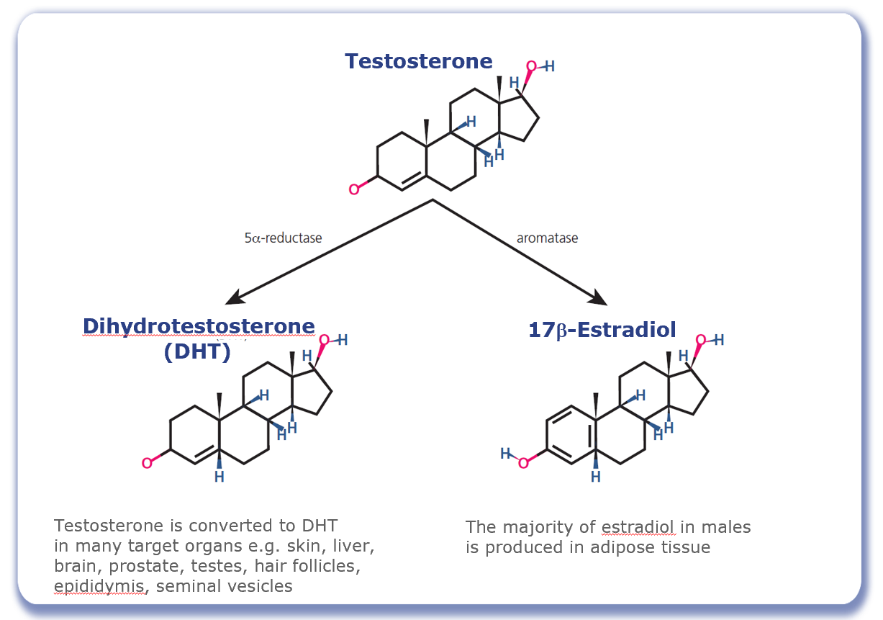
Testosterone Physiology - Conversion
Figure adapted from Molina PE. Male Reproductive System. In: Raff H, Levitzky M, eds. Medical Physiology: A Systems Approach: The McGraw-Hill Companies; 2011: 683-694.
Notes:
At its target cells testosterone can have a direct androgen receptor-mediated effect, or alternatively it may be metabolized to 17β-estradiol through the action of aromatase or to 5α-dihydrotestosterone (DHT) through the action of 5α-reductase.¹
Aromatase is expressed in Sertoli cells as well as in extragonadal tissues including the brain and adipose tissue; the majority of estradiol in males is produced in adipose tissue through the aromatisation of testosterone.
Testosterone is converted to DHT in many target organs including the skin, liver, brain, prostate, testes, hair follicles, epididymis, and seminal vesicle.
DHT is highly biologically active – three- to six-fold compared to testosterone.²
In many tissues, the activity of testosterone depends on its conversion to DHT, which also binds to the cytosolic androgen receptor. Subsequently, the steroid-receptor complex is translocated to the nucleus where it initiates the transcription and cellular changes related to androgen action.³
References: 1. Molina PE. Male Reproductive System. In: Raff H, Levitzky M, eds. Medical Physiology: A Systems Approach: The McGraw-Hill Companies; 2011: 683-694. 2. Weinbauer G, Luetjens C, Simoni M, Nieschlag E. Physiology of Testicular Function. In: Nieschlag E, Behre H, Nieschlag S, eds. Andrology: Springer Berlin Heidelberg; 2010: 11-59. 3. Griffin JE, Wilson JD. Disorders of the testes and the male reproductive tract. In: Larson PR, Kronenberg HM, Melmed S, Polonsky KS, eds. Williams Textbook of Endocrinology. Philadelphia: W. B. Saunders; 2003: 709-769.

Slide 11
What is Testosterone Deficiency (TD)?
Testosterone deficiency is a well-established and significant medical condition
It is defined as a clinical and biochemical syndrome associated with advancing age and comorbidities
It is characterised by a deficiency in serum androgen levels and relevant signs and symptoms
Testosterone deficiency can adversely affect multiple organ systems and result in significant decreases in quality of life, including changes in sexual function
1. Hackett G, et al. British Society for Sexual Medicine Guidelines on Adult Testosterone Deficiency, With Statements for UK Practice. J Sex Med 2017;14:1504-1523.

Slide 12
Symptoms of Testosterone Deficiency ¹⁻⁵
Psychological
Cardiometabolic
Physical
Sexual
Changes in mood (e.g. anger, irritability, sadness, depression)
Decreased well-being/poor self-rated health
Diminished cognitive function (including impaired concentration, verbal memory and spatial performance)
Increased body mass index (BMI)/obesity
Visceral obesity
Metabolic syndrome
Insulin resistance and type 2 diabetes
Decreased body hair
Gynaecomastia
Decreased muscle mass and strength
Hot flushes/sweats
Sleep disturbances
Fatigue
Osteoporosis/height loss/low trauma fractures
Delayed puberty
Small testes
Infertility
Decreased sexual desire and activity
Decreased frequency of sexual thoughts
Erectile dysfunction
Delayed ejaculation
Decreased volume of ejaculate
Decreased or absent morning/night-time erections
1. Khera M et al. Diagnosis and Treatment of Testosterone Deficiency: Recommendations From the Fourth International Consultation for Sexual Medicine (ICSM 2015). J Sex Med 2016;13:1787-804. 2. Lunenfeld B et al. Recommendations on the diagnosis, treatment and monitoring of hypogonadism in men. Aging Male 2015;18:5-15. 3. Hackett G et al. UK policy statements on testosterone deficiency. Int J Clin Pract 2017 Mar;71(3-4). doi: 10.1111/ijcp.12901. Epub 2017 Mar 20. 4. Dohle GH et al. Guidelines on Male Hypogonadism. European Association of Urology 2017. Available at: http://uroweb.org/guideline/male-hypogonadism/ (Accessed September 2017). 5. Dean JD et al. The International Society for Sexual Medicine’s process of care for the assessment and management of testosterone deficiency in adult men. J Sex Med 2015;12:1660-86.

Slide 13
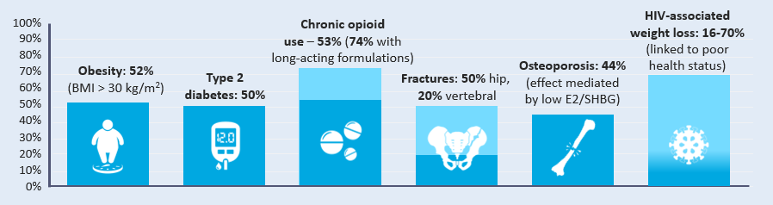


Prevalence of TD
Estimates vary widely depending on the criteria used to define TD
TD prevalence increases with age but can occur in men of all ages. Conditions associated with a high prevalence include:¹
100%
Chronic opioid
use – 53% (74% with
long-acting formulations)
HIV-associated
weight loss: 16-70%
(linked to poor
health status)
90%
80%
Osteoporosis: 44%
(effect mediated
by low E2/SHBG)
70%
Obesity: 52%
(BMI > 30 kg/m²)
Type 2
diabetes: 50%
Fractures: 50% hip,
20% vertebral
60%
50%
40%
30%
20%
10%
0%
E2: estradiol, SHBG: sex hormone binding globulin
1. Khera et al J Sex Med 2016;13:1787-1804.

Slide 14
Classification of TD^{1,2}
Primary TD
Testicular damage
↑
Hypergonadotropic
Functional TD
Caused by morbidities influencing Leydig Cell function and hypothalamic/pituitary response
Testosterone
↓
LH/FSH
Classical
TD
→
Low normogonadotropic
Secondary TD
Hypothalamic/pituitary damage
↓
Hypogonadotropic
LH: luteinizing hormone, FSH: follicle-stimulating hormone
Dohle GR et al. Guidelines of Male Hypogonadism. European Association of Urology 2018. Available at: https://uroweb.org/guideline/male-hypogonadism/#4 Accessed Sept 2020
Bhasin et al. Testosterone Therapy in Men With Hypogonadism: An Endocrine Society Clinical Practice Guideline. J Clin Endocrinol Metab. 2018;103(5):1715-1744.

Slide 15
Causes of (TD)
Primary TD |  | Secondary TD
Organic Klinefelter syndrome Cryptorchidism, anorchia Myotonic dystrophy Irradiation, chemotherapy Castration, trauma Orchitis Older age* | Functional Chronic illness* Ketoconazole | Organic Pituitary/hypothalamic tumour, surgery, trauma or disease Stalk section or disease Hypopituitarism Haemochromatosis Kallman syndrome, idiopathic hypogonadotropic hypogonadism | Functional Opioids Glucocorticoid excess* Hyperprolactinaemia Organ failure Chronic illness*, malnutrition, wasting Malnutrition Obesity/ type 2 diabetes mellitus* Excessive exercise Androgens, progestins, oestrogens, GnRH agonists Older age (with comorbidities)*
*Combined primary and secondary. GnRH, gonadotropin-release hormone; TD, testosterone deficiency.
1. Hackett G, et al. British Society for Sexual Medicine Guidelines on Adult Testosterone Deficiency, With Statements for UK Practice. J Sex Med 2017;14:1504-1523.

Slide 16
Drugs that affect testosterone levels
Opioids
  Regular use can suppress Testosterone levels in up to 70% of men
Glucocorticoids
  May suppress HPT-axis
Anticonvulsants
  ↑ SHBG, ↓ Free & Bioavailable Testosterone
Antipsychotics
  Can lead to hyperprolactinemia, or ↑ prolactin levels
Dean J et al. J Sex Med 2015;12:1660-86.

Slide 17

Case study – Part 1: Patient Profile
Chris: 54 year old office worker with type 2 diabetes mellitus (T2DM)
He has had erectile dysfunction for several years which is putting a strain on his marriage.
Whilst he was being managed by the secondary care diabetic team he was started on daily sildenafil 50mg for erectile dysfunction which worked on rare occasions.
He didn’t think anymore could be done about it.
* This patient profile is based on a real patient, and has been anonymised and reproduced with permission.

Slide 18
Diagnosis of
Testosterone Deficiency (TD)

Slide 19
Challenges of diagnosing TD
Treatment seeking is often delayed
Variable and non-specific signs and symptoms¹
Lack of definitive cut-off point for serum levels¹
There is a wide variation in reference ranges for total testosterone²
Inadequate attention to sexual health by men and physicians¹
Undefined age range for investigation of testosterone levels¹
No NICE guidelines for TD
1. Defeudis G, et al. The CATCH checklist to investigate adult-onset hypogonadism. Andrology 2018.6;5. Available at: https://onlinelibrary.wiley.com/doi/full/10.1111/andr.12506
Accessed February 2019. 2. Ramachandran et al. Managing Clinical Heterogeneity: An Argument for Benefit-Based Action Limits ASME J of Medical Diagnostics 1(3), 034701

Slide 20
Treatment seeking for TD can often be delayed
In total, 55% of all respondents waited between 3 and 24 months, with 35% waiting for more than 2 years before seeking advice
Reasons for delaying among respondents who waited at least 3 months before seeking advice
J David et al: The Journal of Sexual Medicine, Volume 13, Number 5, Supplement 2, May 2016
Respondents (n=90), %
Notes:
Source: Bryter Tables - Question #4b: Why did you wait before seeking advice?
Base: All respondents who sought advice after 3 or more months of symptoms.

Slide 21
Variable & non-specific signs and symptoms of testosterone deficiency (TD)
Single most influential symptom that encouraged seeking of doctor’s advice prior to diagnosis
J David et al: The Journal of Sexual Medicine, Volume 13, Number 5, Supplement 2, May 2016
Respondents (n=101), %
Notes:
Source: Bryter Tables - Question #5: You indicated that you experienced the following symptoms PRIOR to being diagnosed as having low testosterone. Which ONE, if any of them, was MOST influential on your decision to seek advice from your doctor?

Slide 22

GP triggers for considering TD
Erectile Dysfunction
Obesity
Osteoporosis
Depression
Medications
Post-Orchidectomy
TATT
Anaemia*
Fatigue/Sleep
Cognition/Memory
Reduced Muscle Mass
T2DM/MetS
Low Libido
CVD
*Screening for primary hypogonadism should form part of
anaemia work-up by all physicians, not just endocrinologists¹
1. Al-Sharefi A & Quinton R. Clin Endocrinol (Oxf) 2018;89:527–9.

Slide 23
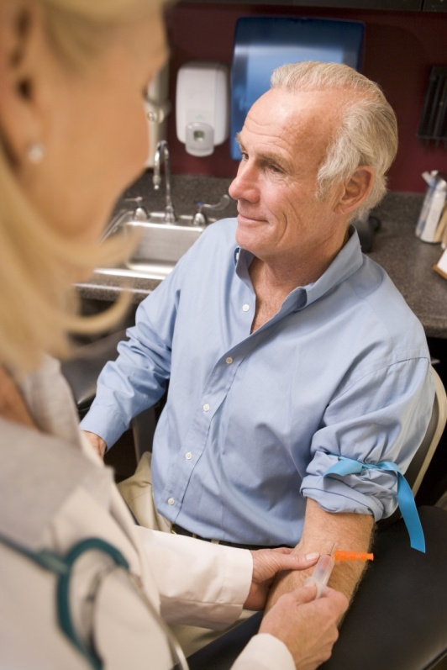
What is required to diagnose TD?
The 2018 Endocrine Society guidelines recommend diagnosing hypogonadism in men with symptoms and signs of testosterone deficiency and unequivocally and consistently low serum total testosterone and/or free testosterone concentrations (when indicated).
1. Bhasin S, et al. J Clin Endocrinol Metab 2018; 103: 1715–1744.

Slide 24
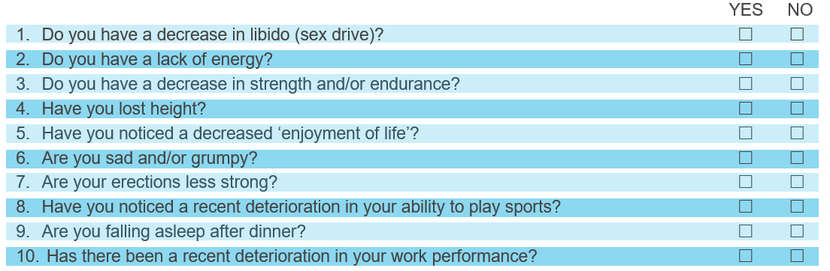
Establishing presence of signs & symptoms of TD - ADAM Questionnaire¹
Validated clinical screening tool to identify males >40 years who may have TD. Positive result defined as respondent answering “yes” to questions 1 or 7 or any 3 other questions
ADAM – Androgen Deficiency in the Ageing Male
1. Morley JE et al. Metabolism 2000; 49:1239–1242.
Notes:
The Aging Males’ Symptoms scale (AMS)¹ is another popular questionnaire to determine the presence and severity of TD symptoms
1. Moore C, et al. Eur Urol 2004. 46(1):80-7.

Slide 25
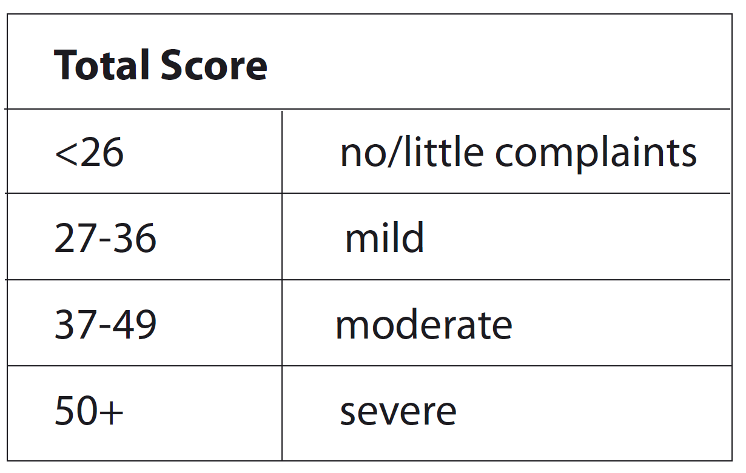
Establishing presence of signs & symptoms of TD - AMS Score¹
AMS – Ageing Male Symptoms
1. Moore C, et al. Eur Urol 2004. 46(1):80-7.
Notes:
The Aging Males’ Symptoms scale (AMS)¹ is another popular questionnaire to determine the presence and severity of TD symptoms

Slide 26
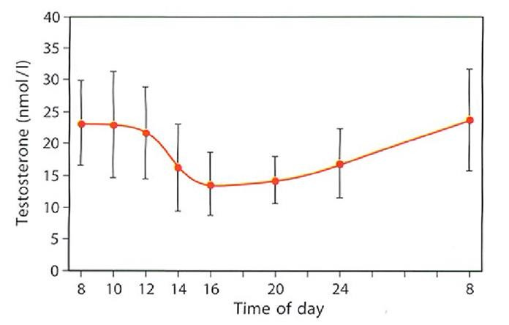
Measuring Serum Testosterone
The diurnal/circadian rhythm of serum T means levels are highest in the early morning
Fasting T levels should be measured from 7 to 11 AM on at least 2 occasions with a reliable method preferably 4 weeks apart and, if possible, not during an acute illness.
In addition, measure free testosterone (FT) in men with levels close to lower normal range (8-12 nmol/L) or those with suspected or known abnormal sex hormone binding globulin (SHBG) level
Measure luteinising hormome (LH) serum levels to differentiate primary from secondary TD
Base decisions on therapy on published action levels rather than laboratory reference ranges
Circadian rhythm of testosterone
* Above levels of testosterone are taken from young healthy males
Adapted from Diver M et al. Clin Endocrinol 2003;58:710-717

Slide 27
BSSM Evidence-Based Action Levels
The British Society for Sexual Medicine (BSSM) recommend the use of evidence-based action levels to advise HCPs of serum testosterone (T) values that may require Testosterone Therapy (TTh):
  Usually requires TTh: Total T (TT) level <8 nmol/L or free T (FT) <0.180 nmol/L
  May require a trial of TTh for a minimum of 6 months: TT 8-12 nmol/L or free T 0.180-0.225 nmol/L
  Does not require TTh: TT level >12 nmol/L or free T >0.225 nmol/L
Free Testosterone should be calculated when the TT is 8-12nmol/L.
Hackett G, et al. British Society for Sexual Medicine Guidelines on Adult Testosterone Deficiency, With Statements for UK Practice. J Sex Med 2017;14:1504-1523.
Notes:
BSSM guidelines also state:¹
A FT level lower than 225 pmol/L (0.225 nmol/L) provides supportive evidence for T therapy in the presence of appropriate symptoms.
Additional recommendations include:
Increased luteinising hormone (LH) levels and T levels below normal or in the lower
quartile range indicate testicular failure, so T therapy should be considered.
Compensated TD occurs when men have normal levels of T but higher gonadotropin levels. Characterized by increased LH levels and older age, compensated TD has been proposed as a genuine clinical subgroup of late-onset hypogonadism, from which some men could eventually progress to overt primary TD.
Recent data from the European Male Aging Study (EMAS) found that clinical symptoms were more closely related to calculated FT.²
Hackett G, et al. British Society for Sexual Medicine Guidelines on Adult Testosterone Deficiency, With Statements for UK Practice. J Sex Med 2017;14:1504-1523.
Wu FCW, Tajar A, Beynon JM, et al; EMAS Group. Identification of late-onset hypogonadism in middle aged and elderly men. N Engl J Med 2010;363:123-135.

Slide 28
Testosterone fractions in the blood
60% of testosterone in the blood is tightly bound to SHBG
A further 38% is loosely bound to albumin.
Only 2% of the testosterone in the blood is free testosterone
The albumin-bound and the free testosterone portions make up the bio-available testosterone
SHBG, sex hormone-binding globulin; T, testosterone
Figure adapted from Anawalt BD & Braunstein GD. Testes; In Greenspan’s Basic & Clinical Endocrinology 10th Edition. Gardner DG & Shoback D, McGraw-Hill Education, 2018

Slide 29
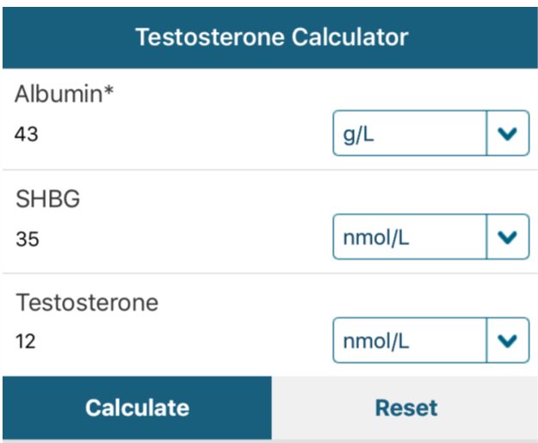

“T Calc” App
Free App - available on iOS and Android
Defaults to European Units (nmol/L)
Includes BSSM guidance on Free T cut-off levels
Aids interpretation of Testosterone results
http://www.pctag.uk/testosterone-calculator/

Slide 30
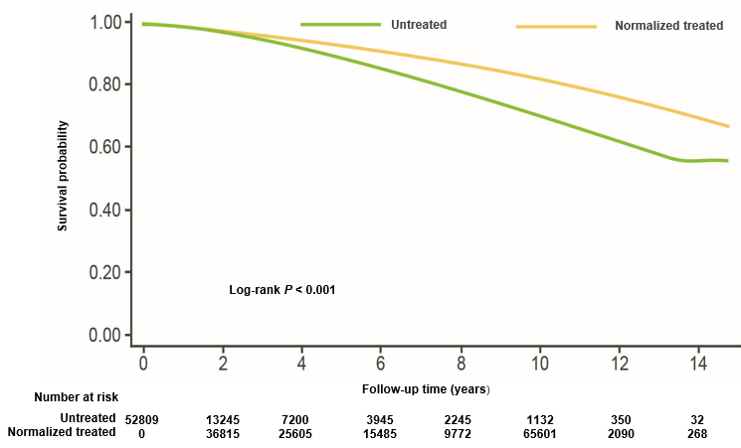
Normalisation of T level was associated with reduced incidence of MI & mortality in men without previous history of MI or ischaemic stroke¹
All-cause mortality among untreated vs normalised treated men
A retrospective analysis of 83,010 US veterans with low T levels:
- Group 1: normalised T with treatment
- Group 2: non-normalised T with treatment
- Group 3: untreated
Primary outcome measures:
Incidence of MI, ischaemic stroke, and all-cause mortality determined using dates of death in CDW data augmented with vital status files
Results:
Group 1 (normalized treated) vs Group 3 (untreated):
Mortality HR 0.44 (CI95% 0.42 - 0.46)
MI HR 0.76 (CI95% 0.63 - 0.93)
Stroke HR 0.64 (CI95% 0.43 - 0.96)
Similarly, all cause mortality, MI risk and stroke were significantly lower in the normalised treated group vs the non-normalized treated group but only for all-cause mortality in the non-normalised vs untreated groups
T, testosterone; MI, myocardial infarction; ICD, International Classification of Diseases; CDW, corporate data warehouse; HR, hazard ratio; CI, confidence interval; CVD, cardiovascular disease.
1. Sharma R, et al. Eur Heart J 2015.36(40):2706-2715.
Notes:
Why getting the levels into the physiological range is so important…
This really interesting retrospective study by Sharma and co-workers looked at over 80,000 individuals split into 3 groups.
One was a group of men with low testosterone who were treated and their testosterone levels normalised. Another was a group that got testosterone treatment but their levels failed to normalise so still remained low. And the 3rd was an untreated group.
The best results were seen in the men who were treated with testosterone and their levels normalised. When compared to the men whose levels did not normalise or even untreated men, the mortality rate was reduced by about half, heart attack rate was down and stroke rate was down.
A rather remarkable study that suggests that just applying testosterone may not be enough, but actually we need to get adequate treatment as evidenced by an increase in the blood levels.
In 2014, Sharma et al conducted a retrospective cohort study, examining 83010 male veterans with low T levels
Subjects were categorised into three groups
- Group 1: patients treated with TTh resulting normalisation of T levels (n=43,931)
- Group 2: patients treated with TTh without normalisation of T levels (n=25,701)
- Group 3: Patients who did not receive TTh (n=13,378)
The primary outcome measures of this study were
(I) the incidence of Myocardial Infarction (MI)
(ii) the incidence of Ischaemic Stroke
(iii) All cause mortality
Results for the outcome measures in the Normalised T group (Group1) vs the Untreated group (Group3) showed significant decreases in all three outcomes.
All-cause mortality for Group 1 vs Group 3 is illustrated in the Kaplan-Meier curve on this slide, where the group treated to normalised T levels had significantly fewer deaths compared to the group wo did not receive TTh
Similarly, results for all 3 outcome measures were significantly reduced for the normalised T group vs the non-normalised T group, indicating that achieving normalisation of T levels through treatment is important.
(There was a significant reduction in mortality for the non-normalised group and the untreated group, but no significant differences in the outcomes of MI or Ischaemic stroke between these two groups)
It is important to note that this is a retrospective, observational study and therefore not without its limitations, as acknowledge by the authors. The authors concluded that treatment with TTh should aim for doses resulting in normalisation of T levels, as this was shown to be associated with a reduction in adverse CV events. However adequately powered, prospective, well-designed trials with a long term follow up will be needed to reach a conclusive agreement regarding the effect of TTh on CV risk.

Slide 31



Consider the Current Situation….
Disease awareness campaign helps a 51 year-old man identify with his symptoms of ED, lethargy, low mood & low libido & decides to visit his GP
His GP who has a non-expert knowledge of Men’s Health suspects presenting symptoms could possibly be due to TD
The GP orders a total testosterone from the laboratory to help confirm the diagnosis of TD
The laboratory conduct the test and find the T level is 5.8nmol/L.
The local reference range for the laboratory is 5.0-31.0nmol/L.
Laboratory send result to the GP with a comment of “normal”
Despite the T level being low according to guideline recommendations, the GP tells the patient he doesn’t have TD so instead advises lifestyle changes & prescribes a PDE5i for his ED +/- an antidepressant for his lethargy & low mood. His symptoms do not improve.

Slide 32
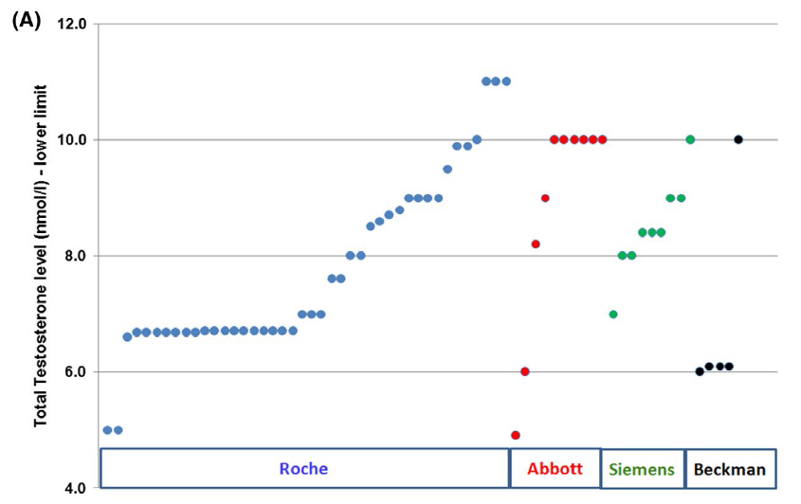
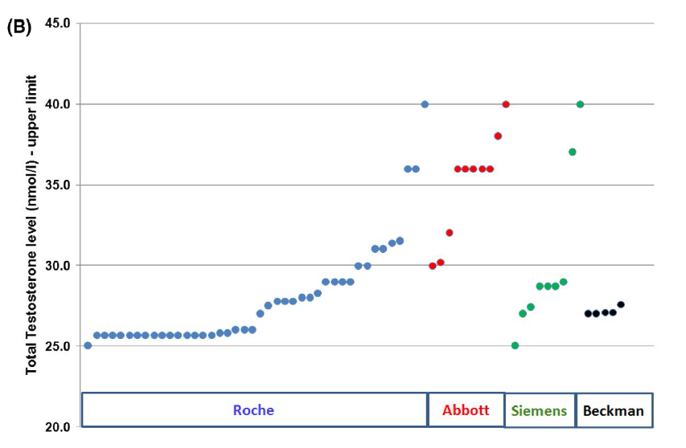
Variation in laboratory reference ranges for testosterone
UK audit demonstrated that the lower limit of “normal” used to diagnose TD can range from 5-11nmol/L.
Upper limit of “normal” also ranged dramatically depending on which assay was used
BSSM recommend that evidence-based action limits should replace local reference ranges. Clinicians need to appreciate that reference ranges quoted by laboratories represent the normal population and that the action levels recommended by the BSSM refer to men with clinical symptoms of TD
A, Lower limits of the reference ranges arranged by the immunoassay methods (Roche: 5.0–11.0nmol/L, Abbott: 4.9–10.0 nmol/L, Siemens: 7.0–10.0 nmol/L, Beckman: 6.0–10.0 nmol/L). Each laboratory is represented by a marker on the chart. B, Upper limits of the reference ranges arranged by the immunoassay methods (Roche: 25.0–40.0 nmol/L, Abbott: 30.0–40.0 nmol/L, Siemens: 25.0–40.0nmol/L, Beckman: 27.0–27.6 nmol/L).Each laboratory is represented by a marker on the chart.
Livingston, M et al. Int J Clin Pract. 2020

Slide 33
Case study – Part 2: Route to Diagnosis
Chris: 54 year old office worker with type 2 diabetes mellitus (T2DM)
He had his bloods taken in GP diabetic clinic and a testosterone level was added to the screening.
  Total Testosterone (TT) = 5.6nmol/L, Free Testosterone (FT) = 0.125nmol/L
Chris was asked to attend the practice to discuss these results. On further questioning it transpired that he was dissatisfied with his erections and had a low libido.
  His AMS score was 48 (moderate to severe symptoms)
  Waist circumference: 42 inches
  HbA1c: 68mmol/mol
Chris was counselled regarding TD and had no contraindications to testosterone therapy (TTh).
He was started on daily testosterone gel and his PDE5i was changed to a daily dose.
* This patient profile is based on a real patient, and has been anonymised and reproduced with permission.

Slide 34
Treatment of TD with Testosterone Therapy (TTh) in Adult Men

Slide 35
Testosterone Therapy: Prior to Initiation
Confirm Diagnosis
  Signs/Symptoms & Biochemical Evidence (x2)
  Physical Examination
Consider Aetiology
  Primary or Secondary (Check LH/FSH)
  Reversible (Opioids, Glucocorticoids, Anti-Psychotics)
Consider Contraindications & Cautions*
  CaP, Abnormal DRE, Breast Cancer
  Fertility requirement, Haematocrit <54%
*Please consult the Summary of Product Characteristics or Prescribing Information for a full list of cautions and contraindications
Hackett, G; Kirby, M et al J Sex Med 2017;14:1504-1523

Slide 36
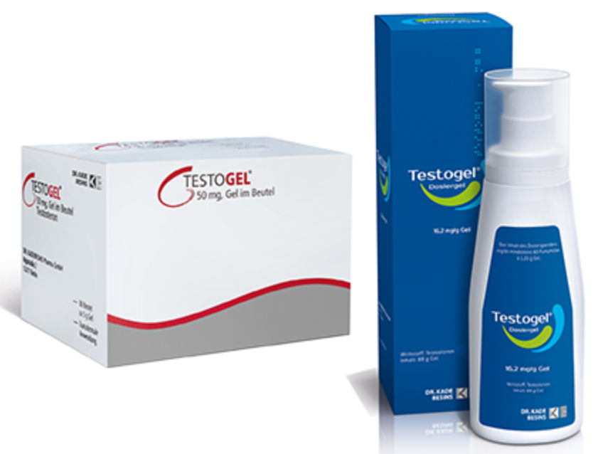
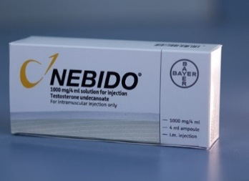
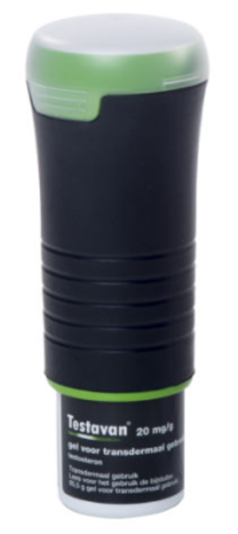
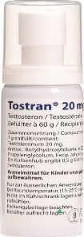
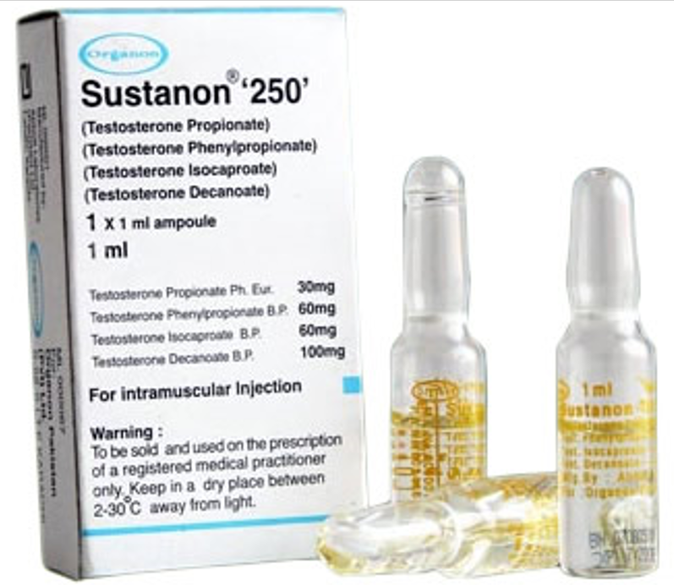
Testosterone Therapy (TTh) – UK ¹
Preparations differ:
  Route of delivery
  Ease of use
  Pharmacokinetics
  Cost
Compliance is crucial
Must advise re: all options, including not treating i.e. lifestyle advice
MIMS Online: Accessed Feb 2020

Slide 37
Testosterone Therapy (TTh)
The Major Goal of TTh:
  To achieve & maintain normal physiological testosterone levels to relieve symptoms of androgen deficiency, such as loss of libido, erectile dysfunction, changes in body composition and psychological impairment
EMA/716062/2014 Pharmacovigilance Risk Assessment Committee (PRAC)
Notes:
Papers postulate that once symptoms improve people become less adherent to treatment.
Should this statement be updated to reinforce the benefits of long-term therapy…..?

Slide 38
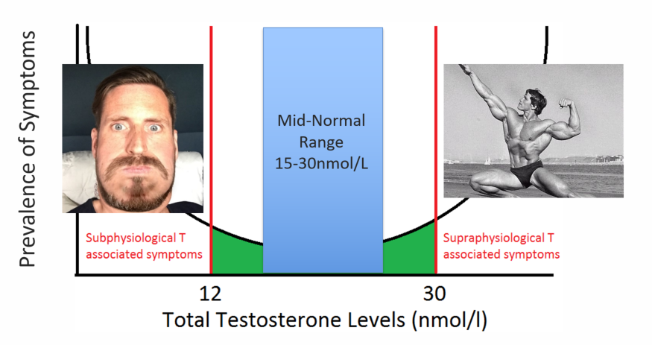
TTh - ‘U’ Shaped Curve
12
35
Hackett, G; Kirby, M et al J Sex Med 2017;14:1504-1523

Slide 39
Monitoring of Testosterone Levels
Optimum time to measure serum T whilst on TTh ¹
Short-acting T injection
  Midway in treatment cycle
Long-acting T undecanoate injection
  Just prior to the next injection
Transdermal T gels*
  Within 24 hours of precedent application, 2–8 hours after application
*Guidance on monitoring with T gels varies between the different products. Refer to individual product SmPC for full details
Buvat et al J Sex Med 2013;10:245–284

Slide 40



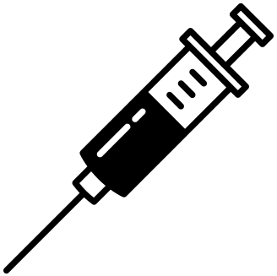
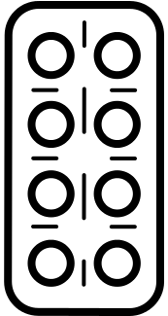

Benefits of Testosterone Therapy (TTh)
Improved sexual function
Increased lean
muscle mass & strength
Reduced mortality risk
Improved mood
Improved cognitive function
Decreased frailty
Reduced osteoporosis risk
Hackett G. Ther Adv Urol 2016; 8: 147–60; Hackett G et al. J Sex Med 2016; 13: 887–904.

Slide 41
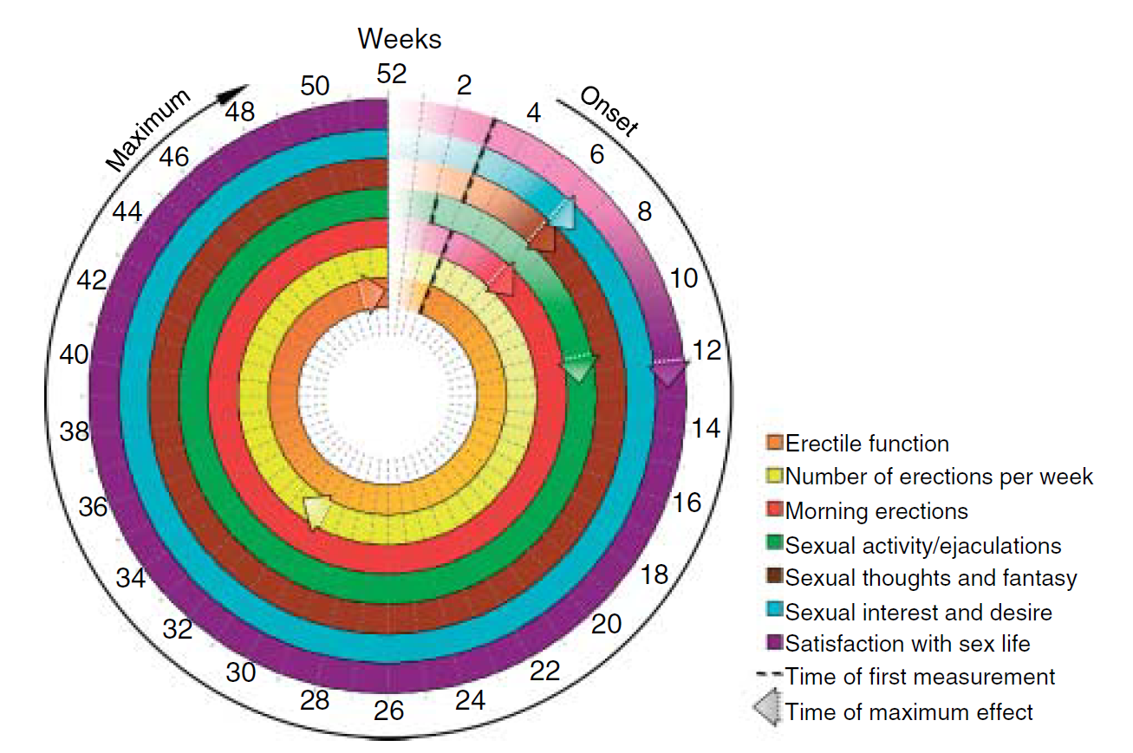
Time to Onset of TD Symptom Improvement
Time-dependent and symptom-specific onset of effects of TTh
Sexual Parameters
Saad et al. European Journal of Endocrinology (2011) 675-685

Slide 42
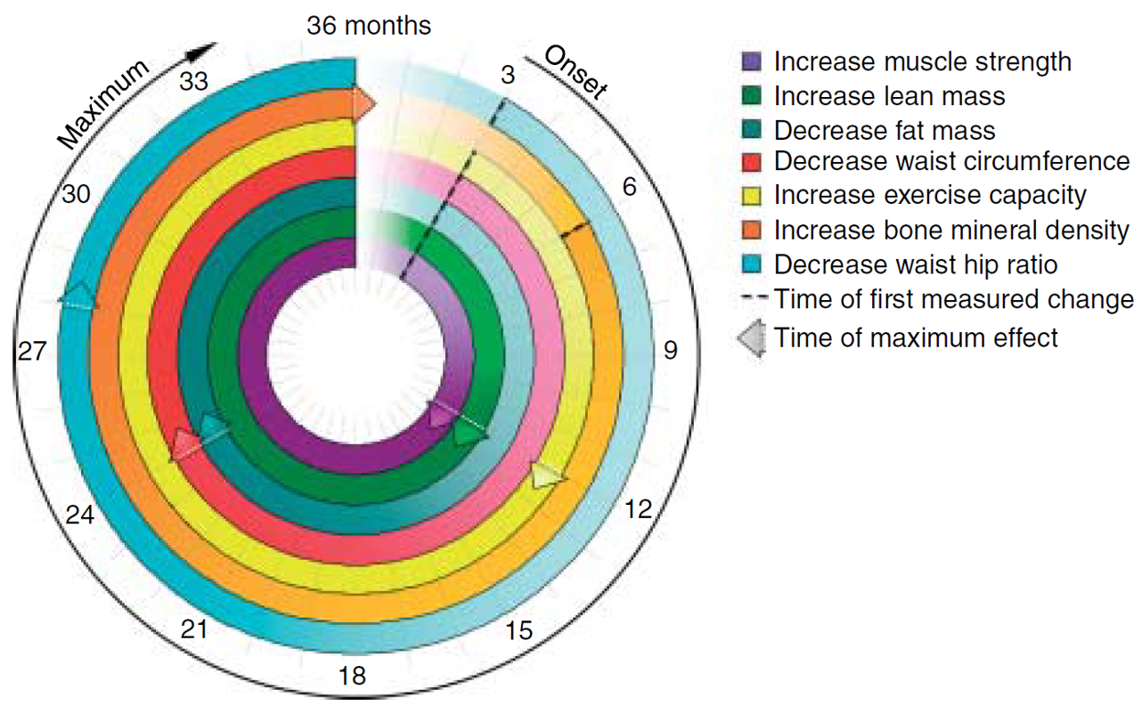
Time to Onset of TD Symptom Improvement
Time-dependent and symptom-specific onset of effects of TTh
Body Composition
Saad et al. European Journal of Endocrinology (2011) 675-685

Slide 43
TTh: For how long?
Hypogonadism is a chronic disease which requires long-term treatment, not unlike diabetes.
Important to realise that TTh is considered lifelong therapy¹
In patients who have a positive response to TTh, treatment should continue in accordance with a standardised monitoring plan²
1. Chakrabarty A. Androl Gynecol: Curr Res 2013, 1:3
2. Bhasin S, et al. J Clin Endocrinol Metab 2010; 95: 2536-2559.

Slide 44
Potential adverse effects linked to TTh
Erythrocytosis
Growth of metastatic prostate cancer
Detection of subclinical prostate cancer
Leg oedema and worsening of heart failure
Reduced sperm production and infertility
Acne, oiliness of skin
Breast tenderness
Induction/worsening of obstructive sleep apnoea
Gynaecomastia
Growth of breast cancer
Male pattern balding
Formulation-specific effects
Thrombotic events in patients with thrombophilia, or those with risk factors for VTE
Increases in blood pressure
Weak evidence of association with TTh
Consult Summary of Product characteristics for a full list of adverse events
Bhasin S, Basaria S. Best Pract Res Clin Endocrinol Metab 2011; 25: 251–270.
Bhasin S, et al. J Clin Endocrinol Metab 2010; 95: 2536–2559.
Testogel 16.2mg/g SmPC https://www.medicines.org.uk/emc/product/8919/smpc Last Accessed Sept 2020

Slide 45
Guideline
Recommendations

Slide 46

Who should be initiating & monitoring TD patients?
“The committee recommends that TTh be initiated
and monitored by the generalist in urology or
family medicine, for most patients, provided that
authoritative clinical guidelines are followed” ¹
Dean J et al. J Sex Med 2015;12:1660-86.

Slide 47
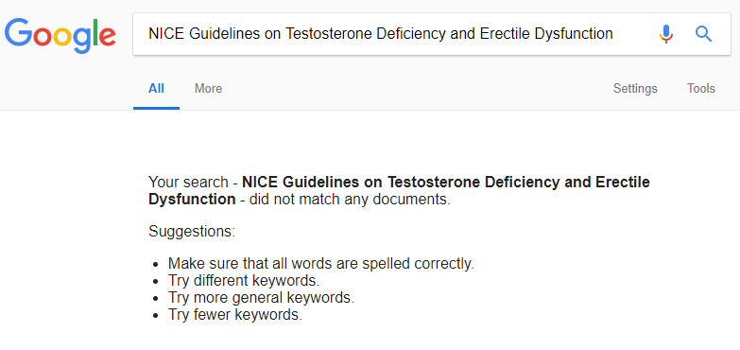

No Gold Standard NICE MH Guidelines

Slide 48
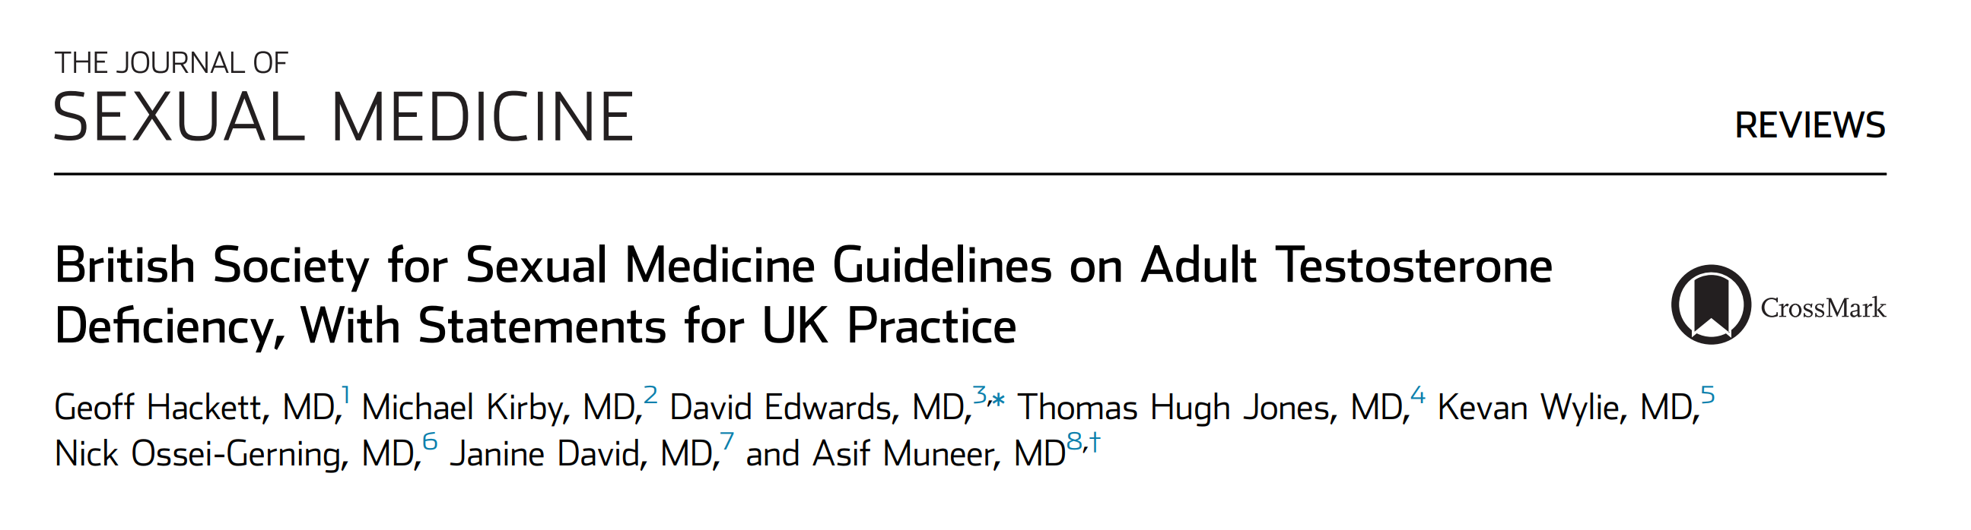




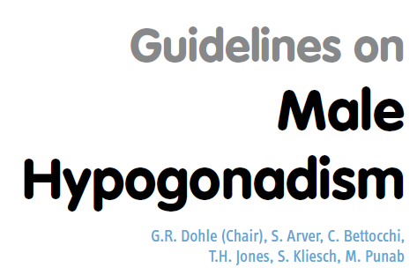
Testosterone Deficiency Guidelines
“EAU Guidelines: the best current evidence for clinical practice”
Notes:
The AACE ACE guidelines here are their obesity guidelines which include significant mention of testosterone

Slide 49

The British Society for Sexual Medicine (BSSM) guidelines on adult testosterone deficiency, with statements for UK practice 2017
Journal of Sexual Medicine. Volume 14, Issue 12: December 2017
http://www.bssm.org.uk/
Google “BSSM Guideline Resources”

Slide 50
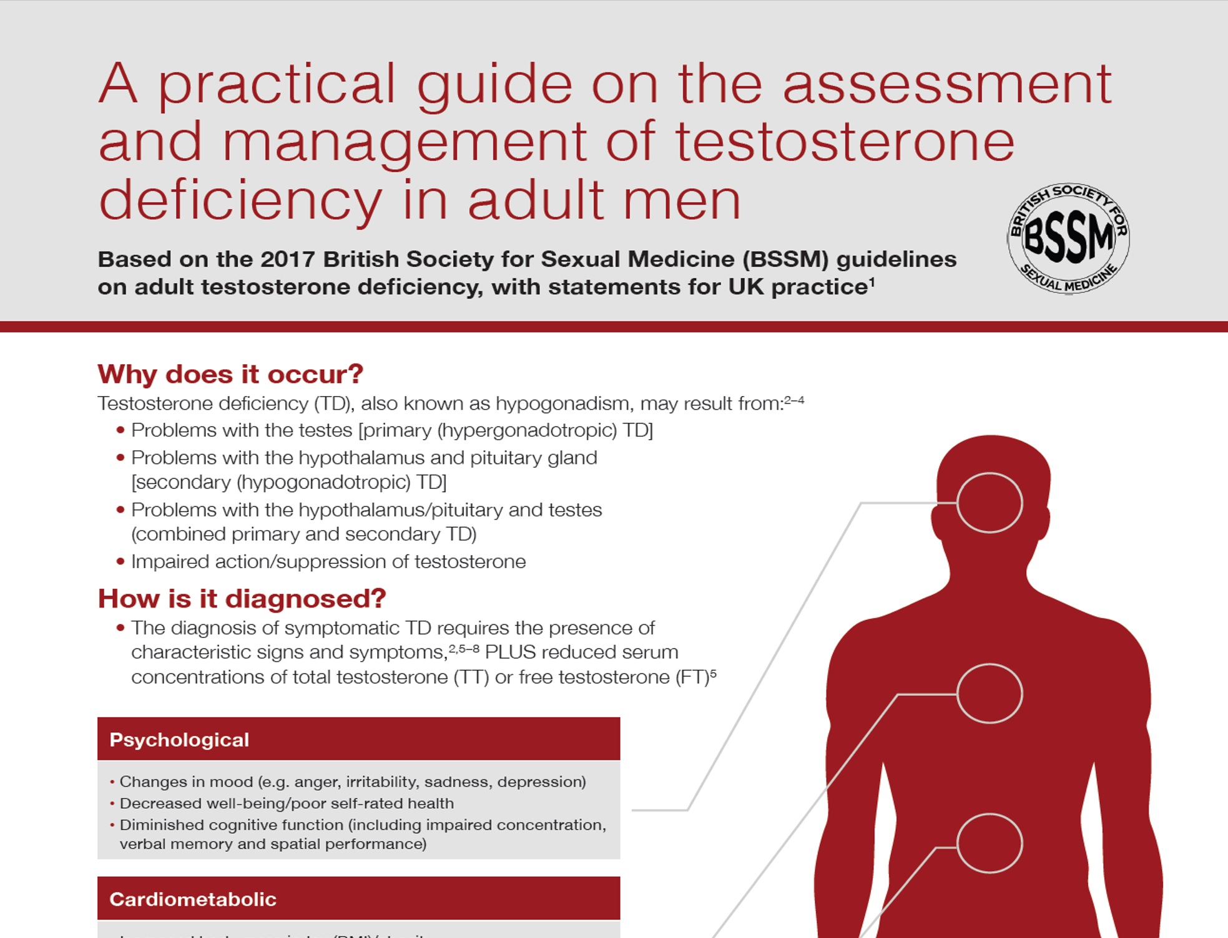

Slide 51
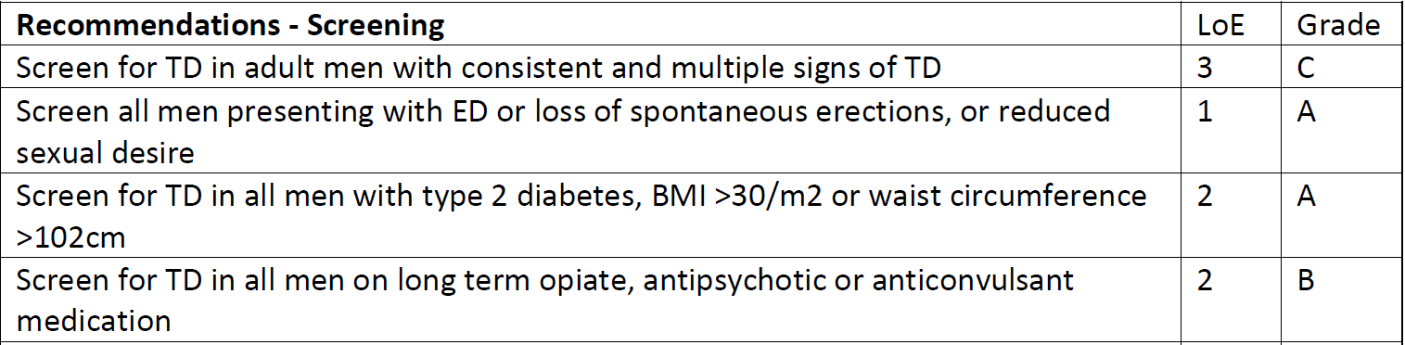
Screening
BSSM recommendations for UK practice with levels of evidence and grades of recommendation
Journal of Sexual Medicine. Volume 14, Issue 12: December 2017

Slide 52
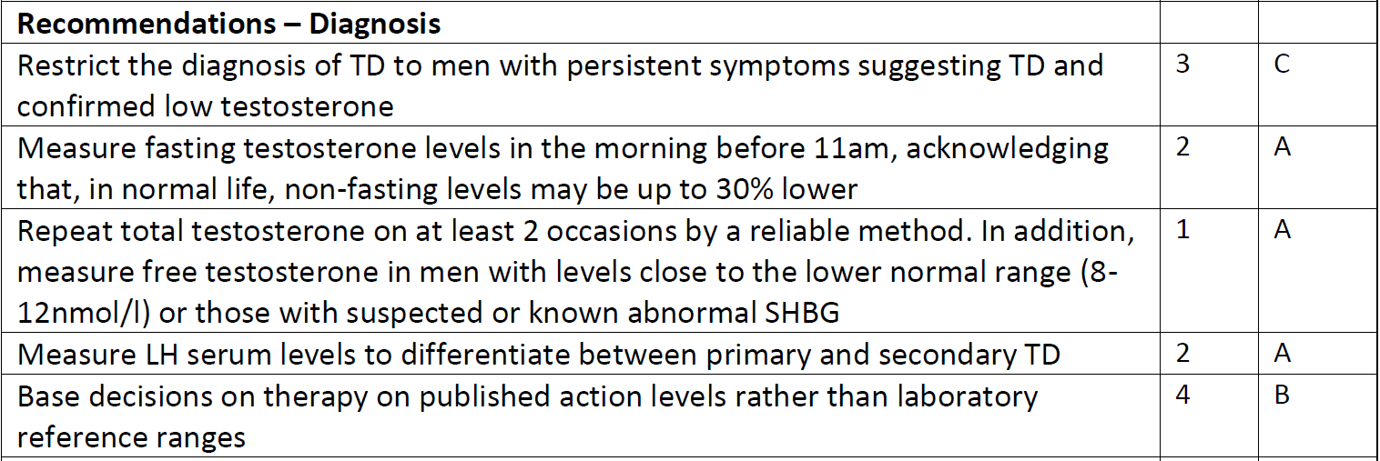

BSSM recommendations for UK practice with levels of evidence and grades of recommendation
Diagnosis
Journal of Sexual Medicine. Volume 14, Issue 12: December 2017

Slide 53
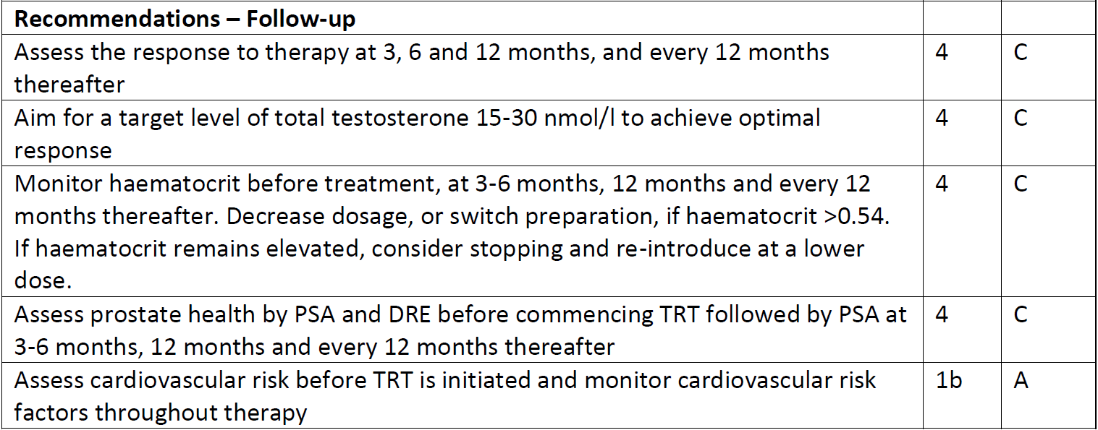
BSSM recommendations for UK practice with levels of evidence and grades of recommendation
Follow-up
Journal of Sexual Medicine. Volume 14, Issue 12: December 2017

Slide 54
Case study – Part 1: Patient Profile
Chris: 54 year old office worker with type 2 diabetes mellitus (T2DM)
He has had erectile dysfunction for several years which is putting a strain on his marriage.
Whilst he was being managed by the secondary care diabetic team he was started on daily sildenafil 50mg for erectile dysfunction which worked on rare occasions.
He didn’t think anymore could be done about it.
* This patient profile is based on a real patient, and has been anonymised and reproduced with permission.

Slide 55
Case study – Part 2: Route to Diagnosis
Chris: 54 year old office worker with type 2 diabetes mellitus (T2DM)
He had his bloods taken in GP diabetic clinic and a testosterone level was added to the screening.
  Total Testosterone (TT) = 5.6nmol/L, Free Testosterone (FT) = 0.125nmol/L
Chris was asked to attend the practice to discuss these results. On further questioning it transpired that he was dissatisfied with his erections and had a low libido.
  His AMS score was 48 (moderate to severe symptoms)
  Waist circumference: 42 inches
  HbA1c: 68mmol/mol
Chris was counselled regarding TD and had no contraindications to testosterone therapy (TTh).
He was started on daily testosterone gel and his PDE5i was changed to a daily dose.
* This patient profile is based on a real patient, and has been anonymised and reproduced with permission.

Slide 56
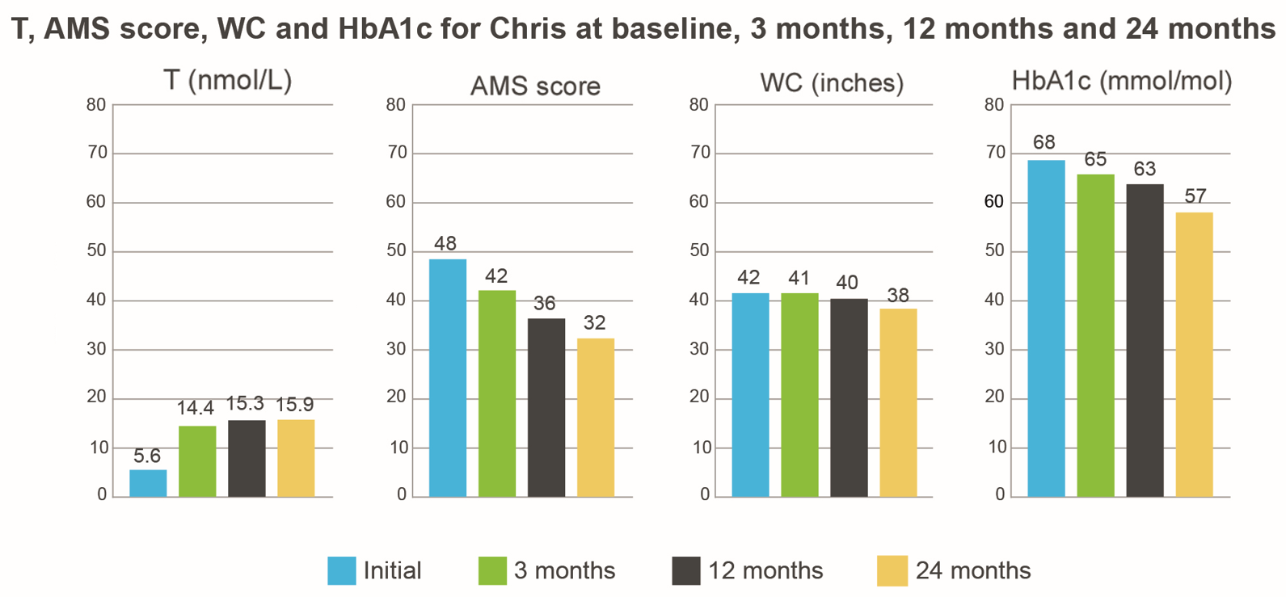
Case study – Part 3: Two years later
Chris: 54 year old office worker with type 2 diabetes mellitus (T2DM)
Following Testogel** treatment for his TD after 24 months:
  Testosterone: 15.9nmol/L
  AMS score: 32
  WC: 38 inches
  HbA1c: 57mmol/mol
Feels much better
His wife said, “Thank you so much for helping Chris. He’s like the man I fell in love with”
* This patient profile is based on a real patient, and has been anonymised and reproduced with permission.
**This patient started treatment in Sept 2016 on one sachet of Testogel 50mg per day. In February 2018 he was changed to Testogel 16.2mg/g pump (40.5mg/day)
AMS - Ageing Males’ Symptoms; TD - Testosterone Deficiency; WC - Waist Circumference; T - Testosterone

Slide 57
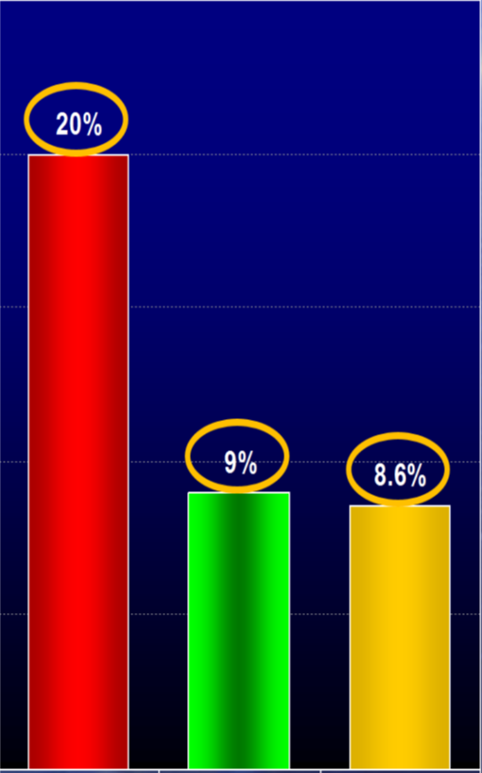
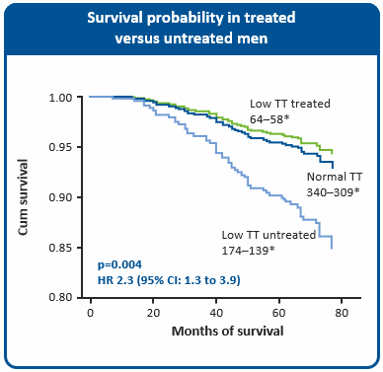
Low Testosterone predicts increased mortality and TTh improves survival in 587 men with Type 2 Diabetes
25
20
15
Mortality (%)
10
5
0
Low T (<10.4nmol/L)
Untreated
Normal T
Low T Treated
*The number of patients alive at the start of the
study and at the end of the study.
Graphs adapted from Muraleedharan V et al 2013
Mean follow-up – 5.8 years
Muraleedharan V et al. Eur J Endocrinol 2013. 166; 725-733
Notes:
This long-term follow-up study examined the effect of baseline testosterone and TTh
on all-cause mortality in men with T2DM and low testosterone.
The study included 581 men with T2DM (mean age 59.5 years) who had testosterone levels measured in 2002–05 and were followed up for a mean of 5.8 years.
The effect of TTh on mortality was assessed retrospectively by analysing data from men
who had received TTh for >1 year.
Mean duration of TTh was 41.6 months.
Participants were stratified by total testosterone level >10.4 nmol/L (300 ng/dL; n=343)
or ≤10.4 nmol/L (n=238).
Of the 238 men with low testosterone, 64 received TTh and 174 did not.
Mortality was increased in the low testosterone group (41/238; 17.2%) compared with
the normal testosterone group (31/343; 9%; p=0.003).
In a Cox regression model, after adjusting for covariates (age, pre-existing cardiovascular disease, weight, height, body mass index, HbA_{1c}, smoking, statin and angiotensin II receptor blocker/angiotensin-converting enzyme inhibitor therapy) at baseline, the multivariate-adjusted HR for decreased survival was 2.02 (95% CI: 1.2 to 3.4; p=0.009).
TTh was associated with a significant reduction in mortality compared with the untreated group (8.4% vs 19.2%, respectively; p=0.002).
CI, confidence interval; HbA_{1c}, glycated haemoglobin; HR, hazard ratio; T2DM, type 2 diabetes mellitus; TTh, testosterone therapy
Reference
Muraleedharan V et al. Eur J Endocrinol 2013;169:725–33.

Slide 58
Mortality Data of Men with Type 2 Diabetes mellitus not receiving PDE5 Inhibitors followed for approximately 4 Years (n= 682)
Mortality (%)
70-80 years
Hackett G et al. Int J Clin Pract 70(3): 244-253 (2016)

Slide 59

Case study 2*: Borderline Total Testosterone
Peter: 60 year old man complaining of ED, low libido, increased anxiety & fatigue
Initial tests done in December 2018:
  1st – TT (11.2nmol/L) SHBG (54nmol/L) FT (0.161) nmol/L
  2nd – TT (11.4nmol/L) SHBG (55nmol/L) FT (0.162) nmol/L
  WC 94cm / BMI 28 / AMS 49
Diagnosed with TD based on symptoms and a low free testosterone. Treatment started with Testogel 16.2mg/g
Follow up appointment October 2019:
  Most recent TT (20.0) FT (0.307) nmol/L
  Doing very well, symptoms have improved, has confidence to meet new people and has started to date again.
  He has increased work capacity, general improvement in quality of life and is very happy with TTh
* This patient profile is based on a real patient, and has been anonymised and reproduced with permission.
AMS - Ageing Males’ Symptoms; TD - Testosterone Deficiency; WC - Waist Circumference; TT – Total Testosterone; FT – Free Testosterone; BMI – Body Mass Index; SHBG – Sex Hormone Binding Globulin; TTh – Testosterone Therapy

Slide 60
Conclusions
TD is not just a “lifestyle” condition but rather a well-established and significant medical condition
There are an abundance of patient cohorts that should be screened for TD. Is it worth focussing on one cohort initially e.g. T2DM?
We need to be aware of and adhere to evidence-based action limits as opposed to varying local laboratory reference ranges when diagnosing patients
We need to reinforce compliance to and longevity of treatment. Manage expectations of the patient at treatment initiation.
You may only get one opportunity to positively impact the health of any given male patient – Don’t waste that opportunity!

Slide 61
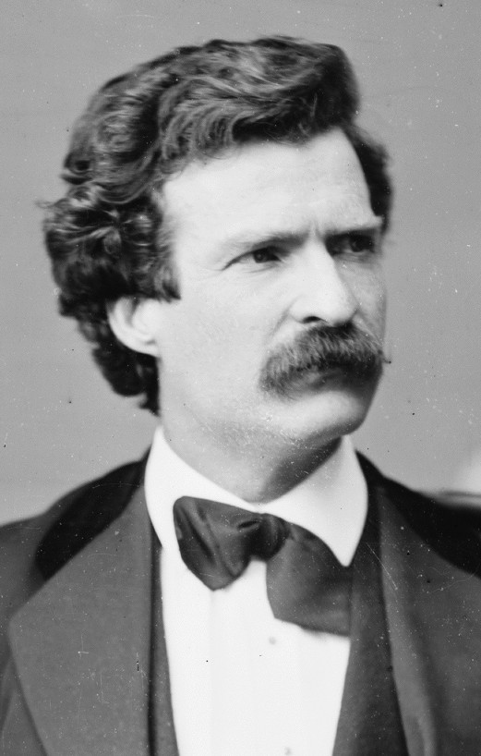
“You can’t throw a habit out of the window, you have to coax it downstairs one step at a time!”
Mark Twain

Slide 62
Thank you for your attention
QUESTIONS?

