Slide 1
Testosterone Deficiency (TD) &
Testosterone Therapy (TTh)
PLEASE ADD NAME AND PLACE OF WORK OF THE HEALTHCARE PROFESSIONAL

Slide 2
Disclosure
Please ask the healthcare professional to complete this slide, stating if he/she has received honorarium from Besins Healthcare and other healthcare organisations to speak at such meetings

Slide 3
Agenda
The Importance of Men’s Health
Testosterone & Testosterone Deficiency
  Physiology/Disease Overview/Prevalence
Diagnosis of TD
Treating TD with Testosterone Therapy (TTh)
Guideline Recommendations
  Screening/Diagnosis/Treatment/Follow up
Primary Clinical Benefits of TTh
Secondary Clinical Benefits of TTh
Safety considerations with TTh
Summary

Slide 4
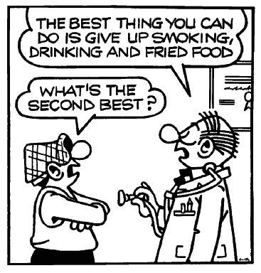
The Importance of Men’s Health
Male life expectancy is, on average, 6.1 years lower than female life expectancy, and men have higher death rates for most of the leading causes of death and at all ages.
Many of the chronic diseases that are associated with premature mortality in men (e.g. coronary heart disease, stroke, diabetes and some cancers) are associated with lifestyle and preventable risk factors.
There is an urgent need for more targeted measures that enable men to recognise their health risks and to take increased responsibility for managing their own health.
1. EC(2011) The State of Men’s Health in Europe. Luxembourg, The European Commission

Slide 5
The Gateway to Men’s Health
“General Practice is by far the most common entrance point into the healthcare system for preventative health strategies and management of acute and chronic disease in men”
Men’s Health Handbook for General Medical Practice 2019
David, J; Coxon, J; Hackett, G; Kirby, M; Patel, A; Edwards, D et al

Slide 6
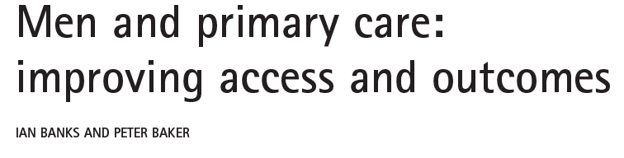
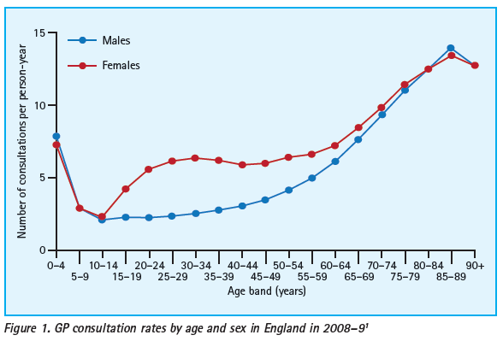
TRENDS IN UROLOGY & MEN’S HEALTH SEPTEMBER/OCTOBER 2013

Slide 7
Life expectancy between the sexes
Lancet 2012;380:2071-94 Lancet 2015;385:117-71

Slide 8
Testosterone &
Testosterone Deficiency (TD)

Slide 9
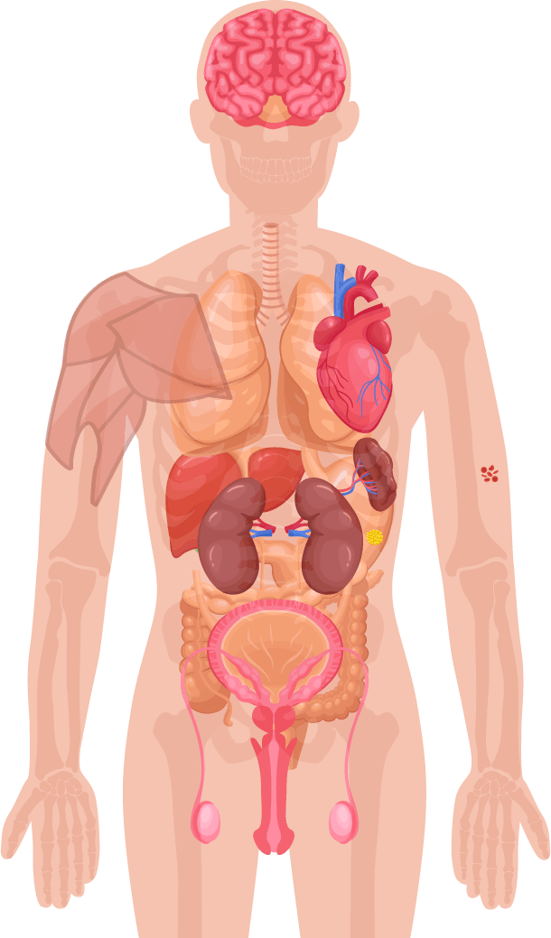
Role of Testosterone in Men’s Health
Mood, Cognitive ability¹
Bone mass¹
Muscle mass, strength¹
Red blood cell production¹
Fat distribution¹
Sexual function, sexual desire and sperm production¹
1. Hackett G, et al. British Society for Sexual Medicine Guidelines on Adult Testosterone Deficiency, With Statements for UK Practice. J Sex Med 2017;14:1504-1523.
Notes:
Testosterone is a sex hormone that is important to health.
In men, testosterone is believed to regulate:¹
Sexual function and sexual desire
Bone mass
Fat distribution
Muscle mass and strength
Production of red blood cells
Production of sperm
Mood
Cognitive ability

Slide 10
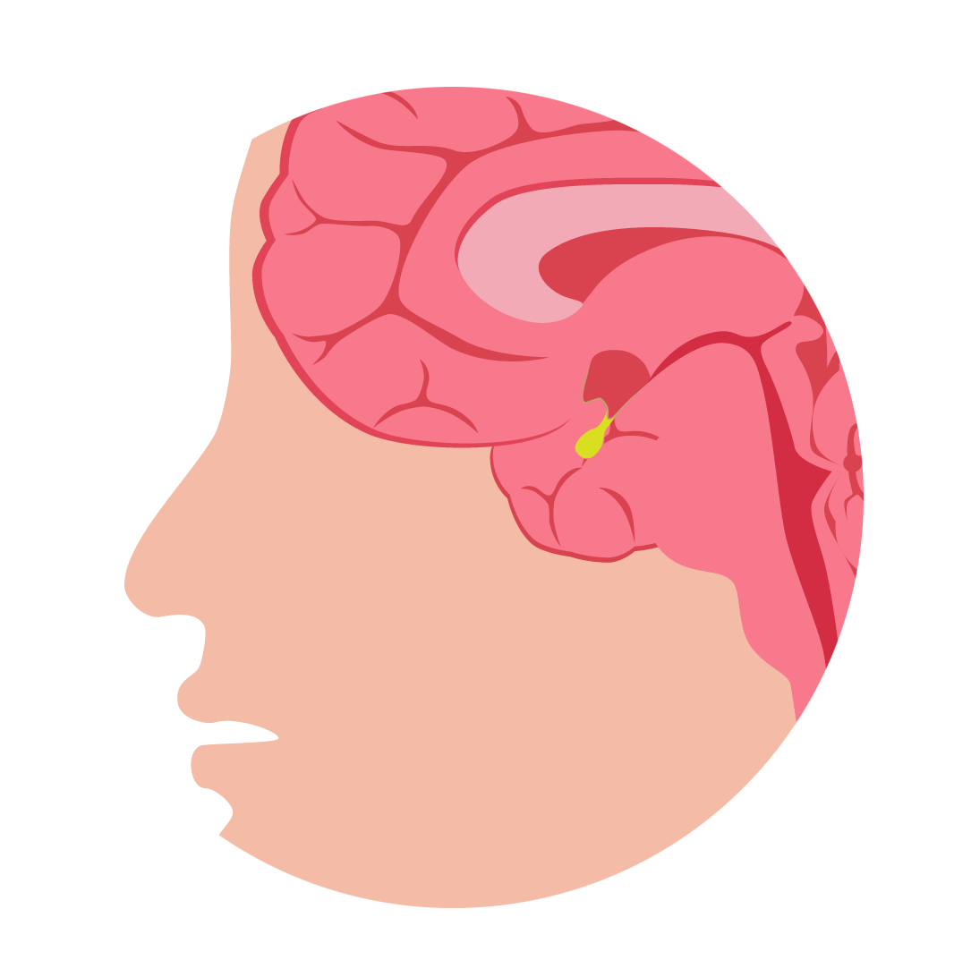
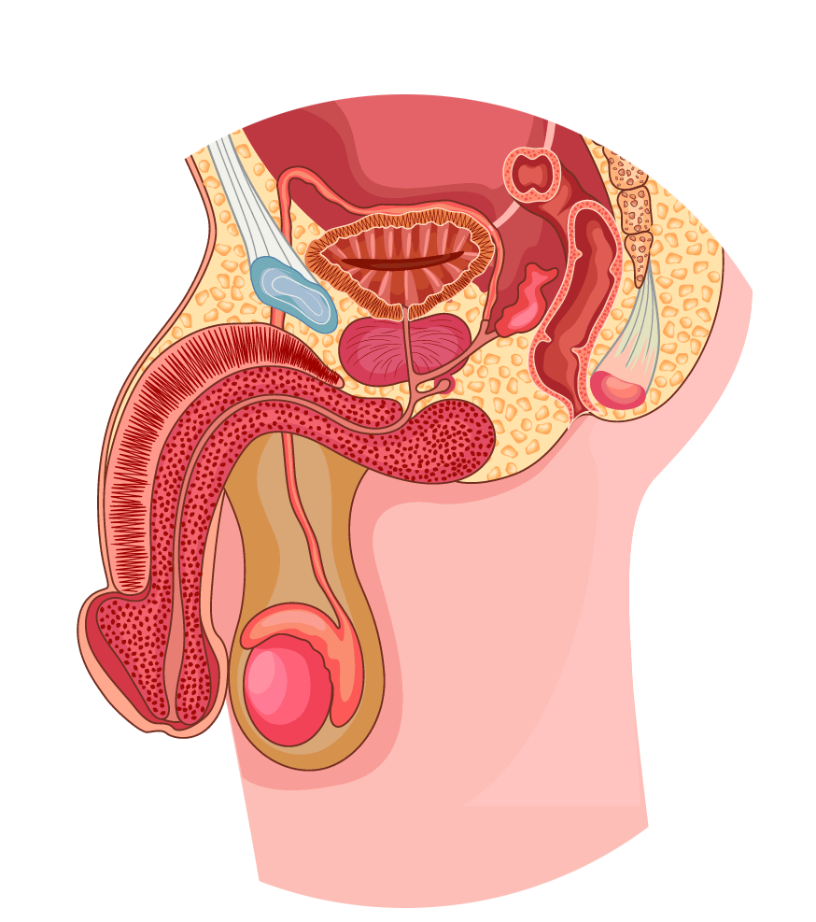
Testosterone Physiology - Production
Hypothalamic-Pituitary-Testicular (HPT) Axis¹
Pituitary gland
Hypothalamus
GnRH
Anterior pituitary
Prostate gland and gonadal tissue
FSH
LH
Sertoli cells
Leydig cells
Testis
Seminiferous tubules
LH receptor¹
Spermatozoa
Testosterone
FSH: follicle-stimulating hormone, LH: luteinizing hormone
Adapted from Dandona P & Rosenberg MT. 2010¹
1. Dandona P & Rosenberg MT. A practical guide to male hypogonadism in the primary care setting. J Clin Pract 2010.64(6):682-696.
Notes:
In the brain, the hypothalamus releases gonadotropin-releasing hormone (GnRH) every 60-90 minutes, stimulating the release of luteinising hormone (LH) from the pituitary gland into the bloodstream¹
LH binds the LH receptor on the Leydig cells of the testes¹
Leydig cells are composed of cholesterol¹
Via a cascade of events, cholesterol is converted into testosterone¹
Testosterone is then secreted by the testes into the bloodstream to be carried to target tissues to exert its biological effect:¹
- In liver, muscle and adipose tissue, testosterone binds directly to its androgen receptor (AR)
- In skin, hair, prostate gland and gonadal tissue, testosterone is first converted to dihydrotestosterone (DHT)
- In bone and brain, testosterone is first converted to oestradiol
Testosterone has multiple effects on the body. In the brain, it stimulates libido and aggression and aids cognition, memory, and feelings. In the kidneys, it promotes erythropoiesis. In the skin, it supports collagen production and stimulates hair growth and sebum production. Testosterone also affects muscle mass and strength, bone growth, density and erythropoiesis (red blood cell production – think haematocrit/haemoglobin), growth of the sex organs, spermatogenesis, and erectile function.¹
T is a steroid hormone that is produced primarily in the testes (> 95% from Testes) with the remainder being produced from the adrenal cortex

Slide 11
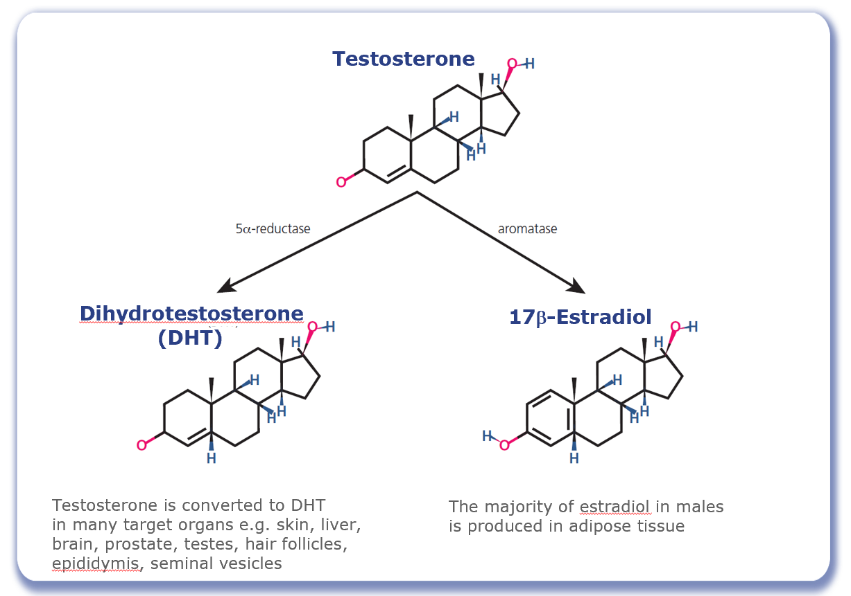
Testosterone Physiology - Conversion
Figure adapted from Molina PE. Male Reproductive System. In: Raff H, Levitzky M, eds. Medical Physiology: A Systems Approach: The McGraw-Hill Companies; 2011: 683-694.
Notes:
At its target cells testosterone can have a direct androgen receptor-mediated effect, or alternatively it may be metabolized to 17β-estradiol through the action of aromatase or to 5α-dihydrotestosterone (DHT) through the action of 5α-reductase.¹
Aromatase is expressed in Sertoli cells as well as in extragonadal tissues including the brain and adipose tissue; the majority of estradiol in males is produced in adipose tissue through the aromatisation of testosterone.
Testosterone is converted to DHT in many target organs including the skin, liver, brain, prostate, testes, hair follicles, epididymis, and seminal vesicle.
DHT is highly biologically active – three- to six-fold compared to testosterone.²
In many tissues, the activity of testosterone depends on its conversion to DHT, which also binds to the cytosolic androgen receptor. Subsequently, the steroid-receptor complex is translocated to the nucleus where it initiates the transcription and cellular changes related to androgen action.³
References: 1. Molina PE. Male Reproductive System. In: Raff H, Levitzky M, eds. Medical Physiology: A Systems Approach: The McGraw-Hill Companies; 2011: 683-694. 2. Weinbauer G, Luetjens C, Simoni M, Nieschlag E. Physiology of Testicular Function. In: Nieschlag E, Behre H, Nieschlag S, eds. Andrology: Springer Berlin Heidelberg; 2010: 11-59. 3. Griffin JE, Wilson JD. Disorders of the testes and the male reproductive tract. In: Larson PR, Kronenberg HM, Melmed S, Polonsky KS, eds. Williams Textbook of Endocrinology. Philadelphia: W. B. Saunders; 2003: 709-769.

Slide 12
What is Testosterone Deficiency (TD)?
Testosterone deficiency is a well-established and significant medical condition
It is defined as a clinical and biochemical syndrome associated with advancing age and comorbidities
It is characterised by a deficiency in serum androgen levels and relevant signs and symptoms
Testosterone deficiency can adversely affect multiple organ systems and result in significant decreases in quality of life, including changes in sexual function
1. Hackett G, et al. British Society for Sexual Medicine Guidelines on Adult Testosterone Deficiency, With Statements for UK Practice. J Sex Med 2017;14:1504-1523.

Slide 13
Symptoms of Testosterone Deficiency ¹⁻⁵
Psychological
Cardiometabolic
Physical
Sexual
Changes in mood (e.g. anger, irritability, sadness, depression)
Decreased well-being/poor self-rated health
Diminished cognitive function (including impaired concentration, verbal memory and spatial performance)
Increased body mass index (BMI)/obesity
Visceral obesity
Metabolic syndrome
Insulin resistance and type 2 diabetes
Decreased body hair
Gynaecomastia
Decreased muscle mass and strength
Hot flushes/sweats
Sleep disturbances
Fatigue
Osteoporosis/height loss/low trauma fractures
Delayed puberty
Small testes
Infertility
Decreased sexual desire and activity
Decreased frequency of sexual thoughts
Erectile dysfunction
Delayed ejaculation
Decreased volume of ejaculate
Decreased or absent morning/night-time erections
1. Khera M et al. Diagnosis and Treatment of Testosterone Deficiency: Recommendations From the Fourth International Consultation for Sexual Medicine (ICSM 2015). J Sex Med 2016;13:1787-804. 2. Lunenfeld B et al. Recommendations on the diagnosis, treatment and monitoring of hypogonadism in men. Aging Male 2015;18:5-15. 3. Hackett G et al. UK policy statements on testosterone deficiency. Int J Clin Pract 2017 Mar;71(3-4). doi: 10.1111/ijcp.12901. Epub 2017 Mar 20. 4. Dohle GH et al. Guidelines on Male Hypogonadism. European Association of Urology 2017. Available at: http://uroweb.org/guideline/male-hypogonadism/ (Accessed September 2017). 5. Dean JD et al. The International Society for Sexual Medicine’s process of care for the assessment and management of testosterone deficiency in adult men. J Sex Med 2015;12:1660-86.

Slide 14
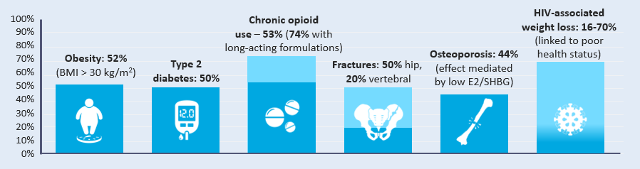


Prevalence of TD
Estimates vary widely depending on the criteria used to define TD
TD prevalence increases with age but can occur in men of all ages. Conditions associated with a high prevalence include:¹
100%
Chronic opioid
use – 53% (74% with
long-acting formulations)
HIV-associated
weight loss: 16-70%
(linked to poor
health status)
90%
80%
Osteoporosis: 44%
(effect mediated
by low E2/SHBG)
70%
Obesity: 52%
(BMI > 30 kg/m²)
Type 2
diabetes: 50%
Fractures: 50% hip,
20% vertebral
60%
50%
40%
30%
20%
10%
0%
E2: estradiol, SHBG: sex hormone binding globulin
1. Khera et al J Sex Med 2016;13:1787-1804.

Slide 15
Classification of TD^{1,2}
Primary TD
Testicular damage
↑
Hypergonadotropic
Functional TD
Caused by morbidities influencing Leydig Cell function and hypothalamic/pituitary response
Testosterone
↓
LH/FSH
Classical
TD
→
Low normogonadotropic
Secondary TD
Hypothalamic/pituitary damage
↓
Hypogonadotropic
LH: luteinizing hormone, FSH: follicle-stimulating hormone
Dohle GR et al. Guidelines of Male Hypogonadism. European Association of Urology 2018. Available at: https://uroweb.org/guideline/male-hypogonadism/#4 Accessed Sept 2020
Bhasin et al. Testosterone Therapy in Men With Hypogonadism: An Endocrine Society Clinical Practice Guideline. J Clin Endocrinol Metab. 2018;103(5):1715-1744.

Slide 16
Causes of (TD)
Primary TD |  | Secondary TD
Organic Klinefelter syndrome Cryptorchidism, anorchia Myotonic dystrophy Irradiation, chemotherapy Castration, trauma Orchitis Older age* | Functional Chronic illness* Ketoconazole | Organic Pituitary/hypothalamic tumour, surgery, trauma or disease Stalk section or disease Hypopituitarism Haemochromatosis Kallman syndrome, idiopathic hypogonadotropic hypogonadism | Functional Opioids Glucocorticoid excess* Hyperprolactinaemia Organ failure Chronic illness*, malnutrition, wasting Malnutrition Obesity/ type 2 diabetes mellitus* Excessive exercise Androgens, progestins, oestrogens, GnRH agonists Older age (with comorbidities)*
*Combined primary and secondary. GnRH, gonadotropin-release hormone; TD, testosterone deficiency.
1. Hackett G, et al. British Society for Sexual Medicine Guidelines on Adult Testosterone Deficiency, With Statements for UK Practice. J Sex Med 2017;14:1504-1523.

Slide 17
Drugs that affect testosterone levels
Opioids
  Regular use can suppress Testosterone levels in up to 70% of men
Glucocorticoids
  May suppress HPT-axis
Anticonvulsants
  ↑ SHBG, ↓ Free & Bioavailable Testosterone
Antipsychotics
  Can lead to hyperprolactinemia, or ↑ prolactin levels
Dean J et al. J Sex Med 2015;12:1660-86.

Slide 18

Case study – Part 1: Patient Profile
Chris: 54 year old office worker with type 2 diabetes mellitus (T2DM)
He has had erectile dysfunction for several years which is putting a strain on his marriage.
Whilst he was being managed by the secondary care diabetic team he was started on daily sildenafil 50mg for erectile dysfunction which worked on rare occasions.
He didn’t think anymore could be done about it.
* This patient profile is based on a real patient, and has been anonymised and reproduced with permission.

Slide 19
Diagnosis of
Testosterone Deficiency (TD)

Slide 20
Challenges of diagnosing TD
Treatment seeking is often delayed
Variable and non-specific signs and symptoms¹
Lack of definitive cut-off point for serum levels¹
There is a wide variation in reference ranges for total testosterone²
Inadequate attention to sexual health by men and physicians¹
Undefined age range for investigation of testosterone levels¹
No NICE guidelines for TD
1. Defeudis G, et al. The CATCH checklist to investigate adult-onset hypogonadism. Andrology 2018.6;5. Available at: https://onlinelibrary.wiley.com/doi/full/10.1111/andr.12506
Accessed February 2019. 2. Ramachandran et al. Managing Clinical Heterogeneity: An Argument for Benefit-Based Action Limits ASME J of Medical Diagnostics 1(3), 034701

Slide 21
Treatment seeking for TD can often be delayed
In total, 55% of all respondents waited between 3 and 24 months, with 35% waiting for more than 2 years before seeking advice
Reasons for delaying among respondents who waited at least 3 months before seeking advice
J David et al: The Journal of Sexual Medicine, Volume 13, Number 5, Supplement 2, May 2016
Respondents (n=90), %
Notes:
Source: Bryter Tables - Question #4b: Why did you wait before seeking advice?
Base: All respondents who sought advice after 3 or more months of symptoms.

Slide 22
Variable & non-specific signs and symptoms of testosterone deficiency (TD)
Single most influential symptom that encouraged seeking of doctor’s advice prior to diagnosis
J David et al: The Journal of Sexual Medicine, Volume 13, Number 5, Supplement 2, May 2016
Respondents (n=101), %
Notes:
Source: Bryter Tables - Question #5: You indicated that you experienced the following symptoms PRIOR to being diagnosed as having low testosterone. Which ONE, if any of them, was MOST influential on your decision to seek advice from your doctor?

Slide 23

GP triggers for considering TD
Erectile Dysfunction
Obesity
Osteoporosis
Depression
Medications
Post-Orchidectomy
Tired all the time (TATT)
Anaemia*
Fatigue/Sleep
Cognition/Memory
Reduced Muscle Mass
T2DM/MetS
Low Libido
CVD
*Screening for primary hypogonadism should form part of
anaemia work-up by all physicians, not just endocrinologists¹
1. Al-Sharefi A & Quinton R. Clin Endocrinol (Oxf) 2018;89:527–9.

Slide 24
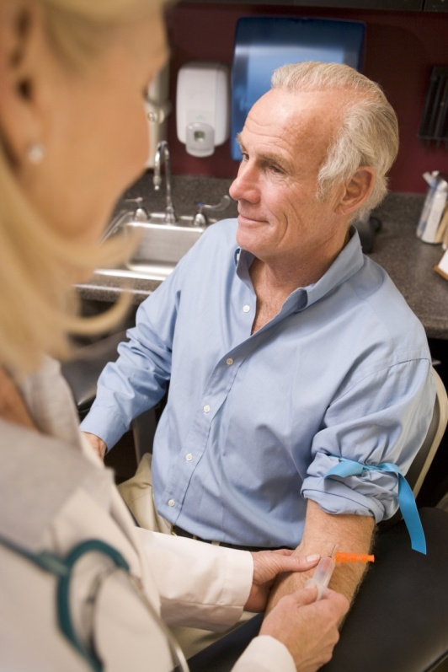
What is required to diagnose TD?
The 2018 Endocrine Society guidelines recommend diagnosing hypogonadism in men with symptoms and signs of testosterone deficiency and unequivocally and consistently low serum total testosterone and/or free testosterone concentrations (when indicated).
1. Bhasin S, et al. J Clin Endocrinol Metab 2018; 103: 1715–1744.

Slide 25
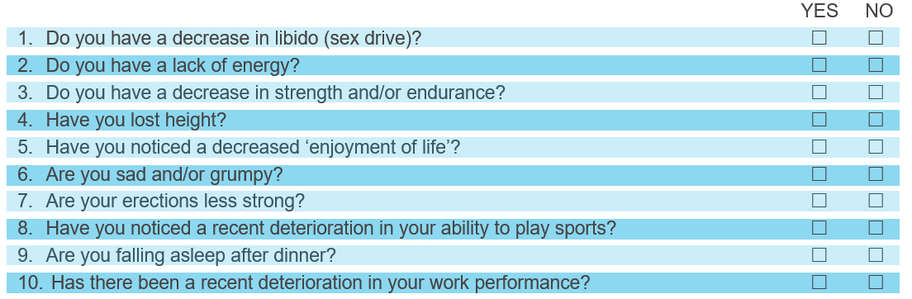
Establishing presence of signs & symptoms of TD - ADAM Questionnaire¹
Validated clinical screening tool to identify males >40 years who may have TD. Positive result defined as respondent answering “yes” to questions 1 or 7 or any 3 other questions
ADAM – Androgen Deficiency in the Ageing Male
1. Morley JE et al. Metabolism 2000; 49:1239–1242.
Notes:
The Aging Males’ Symptoms scale (AMS)¹ is another popular questionnaire to determine the presence and severity of TD symptoms
1. Moore C, et al. Eur Urol 2004. 46(1):80-7.

Slide 26
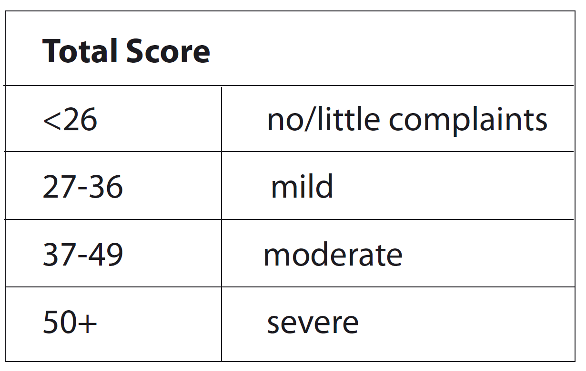
Establishing presence of signs & symptoms of TD - AMS Score¹
AMS – Ageing Male Symptoms
1. Moore C, et al. Eur Urol 2004. 46(1):80-7.
Notes:
The Aging Males’ Symptoms scale (AMS)¹ is another popular questionnaire to determine the presence and severity of TD symptoms

Slide 27
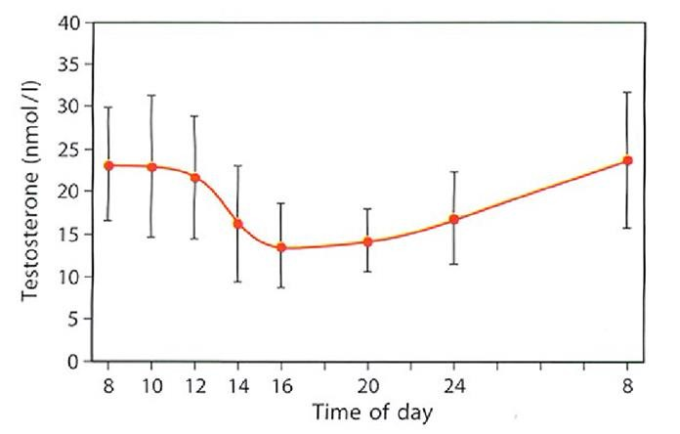
Measuring Serum Testosterone
The diurnal/circadian rhythm of serum T means levels are highest in the early morning
Fasting T levels should be measured from 7 to 11 AM on at least 2 occasions with a reliable method preferably 4 weeks apart and, if possible, not during an acute illness.
In addition, measure free testosterone (FT) in men with levels close to lower normal range (8-12 nmol/L) or those with suspected or known abnormal sex hormone binding globulin (SHBG) level
Measure luteinising hormome (LH) serum levels to differentiate primary from secondary TD
Base decisions on therapy on published action levels rather than laboratory reference ranges
Circadian rhythm of testosterone
* Above levels of testosterone are taken from young healthy males
Adapted from Diver M et al. Clin Endocrinol 2003;58:710-717

Slide 28
BSSM Evidence-Based Action Levels
The British Society for Sexual Medicine (BSSM) recommend the use of evidence-based action levels to advise HCPs of serum testosterone (T) values that may require Testosterone Therapy (TTh):
  Usually requires TTh: Total T (TT) level <8 nmol/L or free T (FT) <0.180 nmol/L
  May require a trial of TTh for a minimum of 6 months: TT 8-12 nmol/L or free T 0.180-0.225 nmol/L
  Does not require TTh: TT level >12 nmol/L or free T >0.225 nmol/L
Free Testosterone should be calculated when the TT is 8-12nmol/L.
Hackett G, et al. British Society for Sexual Medicine Guidelines on Adult Testosterone Deficiency, With Statements for UK Practice. J Sex Med 2017;14:1504-1523.
Notes:
BSSM guidelines also state:¹
A FT level lower than 225 pmol/L (0.225 nmol/L) provides supportive evidence for T therapy in the presence of appropriate symptoms.
Additional recommendations include:
Increased luteinising hormone (LH) levels and T levels below normal or in the lower
quartile range indicate testicular failure, so T therapy should be considered.
Compensated TD occurs when men have normal levels of T but higher gonadotropin levels. Characterized by increased LH levels and older age, compensated TD has been proposed as a genuine clinical subgroup of late-onset hypogonadism, from which some men could eventually progress to overt primary TD.
Recent data from the European Male Aging Study (EMAS) found that clinical symptoms were more closely related to calculated FT.²
Hackett G, et al. British Society for Sexual Medicine Guidelines on Adult Testosterone Deficiency, With Statements for UK Practice. J Sex Med 2017;14:1504-1523.
Wu FCW, Tajar A, Beynon JM, et al; EMAS Group. Identification of late-onset hypogonadism in middle aged and elderly men. N Engl J Med 2010;363:123-135.

Slide 29
Testosterone fractions in the blood
60% of testosterone in the blood is tightly bound to SHBG
A further 38% is loosely bound to albumin.
Only 2% of the testosterone in the blood is free testosterone
The albumin-bound and the free testosterone portions make up the bio-available testosterone
SHBG, sex hormone-binding globulin; T, testosterone
Figure adapted from Anawalt BD & Braunstein GD. Testes; In Greenspan’s Basic & Clinical Endocrinology 10th Edition. Gardner DG & Shoback D, McGraw-Hill Education, 2018

Slide 30

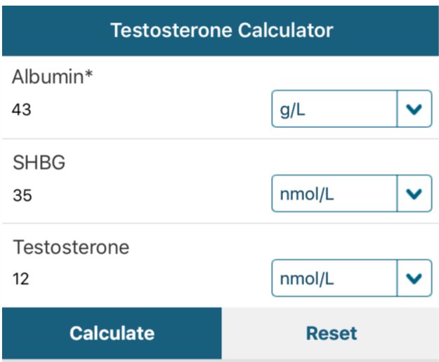
“T Calc” App
Free App - available on iOS and Android
Defaults to European Units (nmol/L)
Includes BSSM guidance on Free T cut-off levels
Aids interpretation of Testosterone results
http://www.pctag.uk/testosterone-calculator/

Slide 31



Benefits of early diagnosis
Opportunity to make lifestyle changes and receive appropriate treatment¹
Somatic, sexual and psychological benefits for improved quality of life²
Potential cost and time savings in the primary and secondary care settings³
1. Defeudis G, et al. The CATCH checklist to investigate adult-onset hypogonadism. Andrology 2018.6;5. Available at: https://onlinelibrary.wiley.com/doi/full/10.1111/andr.12506 Accessed February 2019. 2. Hackett G, et al. British Society for Sexual Medicine Guidelines on Adult Testosterone Deficiency, With Statements for UK Practice. J Sex Med 2017;14:1504-1523. Available at: http://www.bssm.org.uk/wp-content/uploads/2018/09/guidelines-on-adult-testosterone-deficiency-with-statements-for-uk-practice.pdf Accessed February 2019. 3. Hackett G. An ED patient with low testosterone. Trends in urology and men’s health 2016. Tales from the clinic pp1-2.
Notes:
Early diagnosis of both TD and associated comorbidities may be helpful for patients in terms of changing their lifestyle and getting appropriate treatment¹
Improving the diagnosis and management of TD should provide somatic, sexual and psychological benefits and subsequent improvements in quality of life²
Failure to check testosterone levels can result in wasted time and money through inappropriate referrals and medications that are unlikely to work.³

Slide 32



Consider the Current Situation….
Disease awareness campaign helps a 51 year-old man identify with his symptoms of ED, lethargy, low mood & low libido & decides to visit his GP
His GP who has a non-expert knowledge of Men’s Health suspects presenting symptoms could possibly be due to TD
The GP orders a total testosterone from the laboratory to help confirm the diagnosis of TD
The laboratory conduct the test and find the T level is 5.8nmol/L.
The local reference range for the laboratory is 5.0-31.0nmol/L.
Laboratory send result to the GP with a comment of “normal”
Despite the T level being low according to guideline recommendations, the GP tells the patient he doesn’t have TD so instead advises lifestyle changes & prescribes a PDE5i for his ED +/- an antidepressant for his lethargy & low mood. His symptoms do not improve.

Slide 33
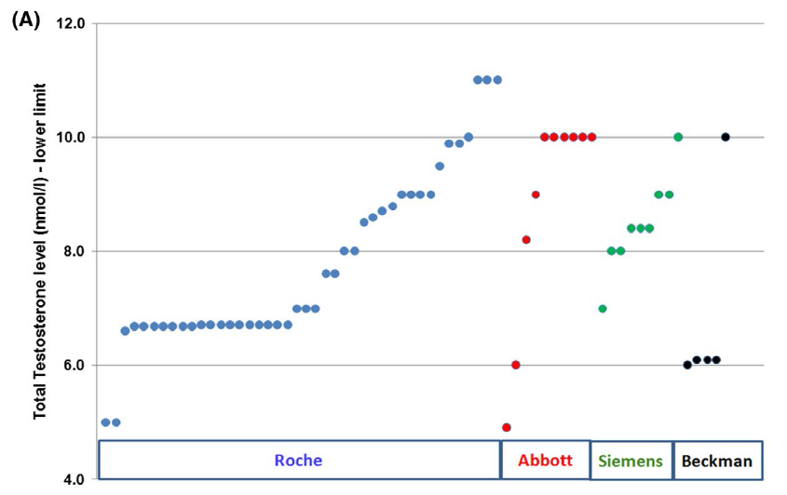
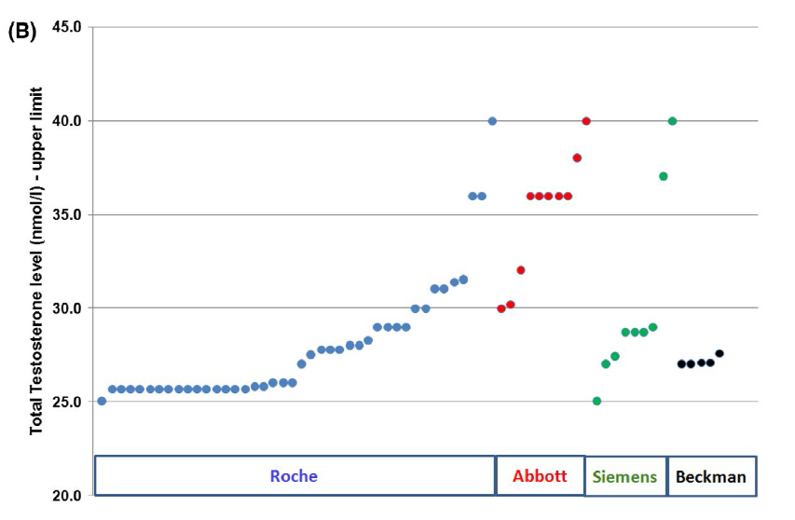
Variation in laboratory reference ranges for testosterone
UK audit demonstrated that the lower limit of “normal” used to diagnose TD can range from 5-11nmol/L.
Upper limit of “normal” also ranged dramatically depending on which assay was used
BSSM recommend that evidence-based action limits should replace local reference ranges. Clinicians need to appreciate that reference ranges quoted by laboratories represent the normal population and that the action levels recommended by the BSSM refer to men with clinical symptoms of TD
A, Lower limits of the reference ranges arranged by the immunoassay methods (Roche: 5.0–11.0nmol/L, Abbott: 4.9–10.0 nmol/L, Siemens: 7.0–10.0 nmol/L, Beckman: 6.0–10.0 nmol/L). Each laboratory is represented by a marker on the chart. B, Upper limits of the reference ranges arranged by the immunoassay methods (Roche: 25.0–40.0 nmol/L, Abbott: 30.0–40.0 nmol/L, Siemens: 25.0–40.0nmol/L, Beckman: 27.0–27.6 nmol/L).Each laboratory is represented by a marker on the chart.
Livingston, M et al. Int J Clin Pract. 2020

Slide 34
Case study – Part 2: Route to Diagnosis
Chris: 54 year old office worker with type 2 diabetes mellitus (T2DM)
He had his bloods taken in GP diabetic clinic and a testosterone level was added to the screening.
  Total Testosterone (TT) = 5.6nmol/L, Free Testosterone (FT) = 0.125nmol/L
Chris was asked to attend the practice to discuss these results. On further questioning it transpired that he was dissatisfied with his erections and had a low libido.
  His AMS score was 48 (moderate to severe symptoms)
  Waist circumference: 42 inches
  HbA1c: 68mmol/mol
Chris was counselled regarding TD and had no contraindications to testosterone therapy (TTh).
He was started on daily testosterone gel and his PDE5i was changed to a daily dose.
* This patient profile is based on a real patient, and has been anonymised and reproduced with permission.

Slide 35
Treatment of TD with Testosterone Therapy (TTh) in Adult Men

Slide 36
Testosterone Therapy: Prior to Initiation
Confirm Diagnosis
  Signs/Symptoms & Biochemical Evidence (x2)
  Physical Examination
Consider Aetiology
  Primary or Secondary (Check LH/FSH)
  Reversible (Opioids, Glucocorticoids, Anti-Psychotics)
Consider Contraindications & Cautions*
  CaP, Abnormal DRE, Breast Cancer
  Fertility requirement, Haematocrit <54%
*Please consult the Summary of Product Characteristics or Prescribing Information for a full list of cautions and contraindications
Hackett, G; Kirby, M et al J Sex Med 2017;14:1504-1523

Slide 37
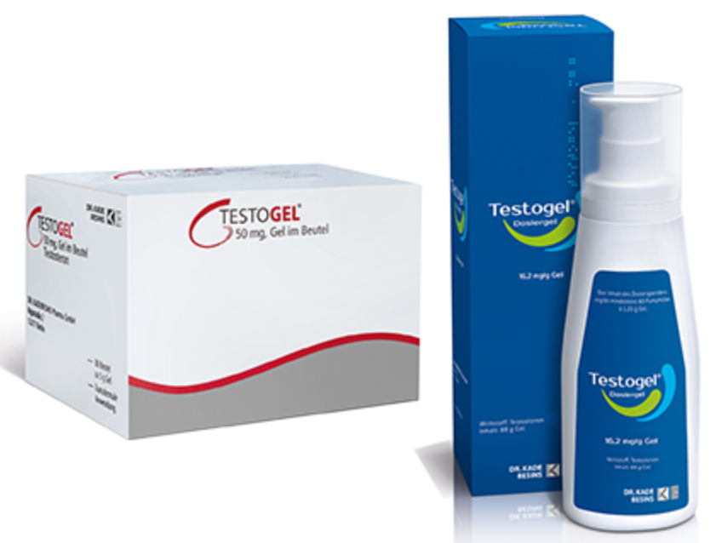
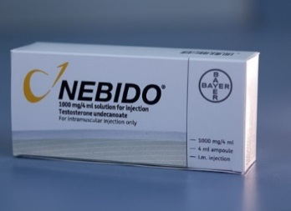
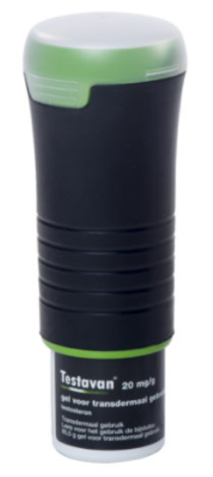
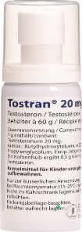
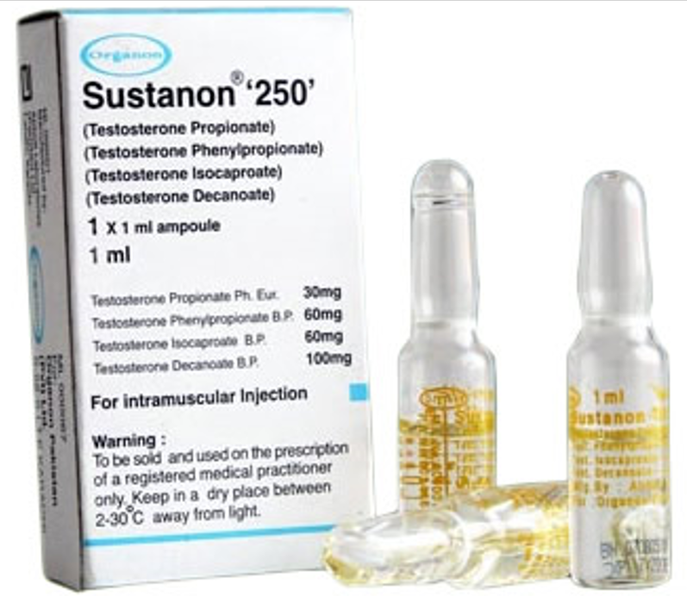
Testosterone Therapy (TTh) – UK ¹
Preparations differ:
  Route of delivery
  Ease of use
  Pharmacokinetics
  Cost
Compliance is crucial
Must advise re: all options, including not treating i.e. lifestyle advice
MIMS Online: Accessed Feb 2021

Slide 38
Testosterone Therapy (TTh)
The Major Goal of TTh:
  To achieve & maintain normal physiological testosterone levels to relieve symptoms of androgen deficiency, such as loss of libido, erectile dysfunction, changes in body composition and psychological impairment
EMA/716062/2014 Pharmacovigilance Risk Assessment Committee (PRAC)
Notes:
Papers postulate that once symptoms improve people become less adherent to treatment.
Should this statement be updated to reinforce the benefits of long-term therapy…..?

Slide 39
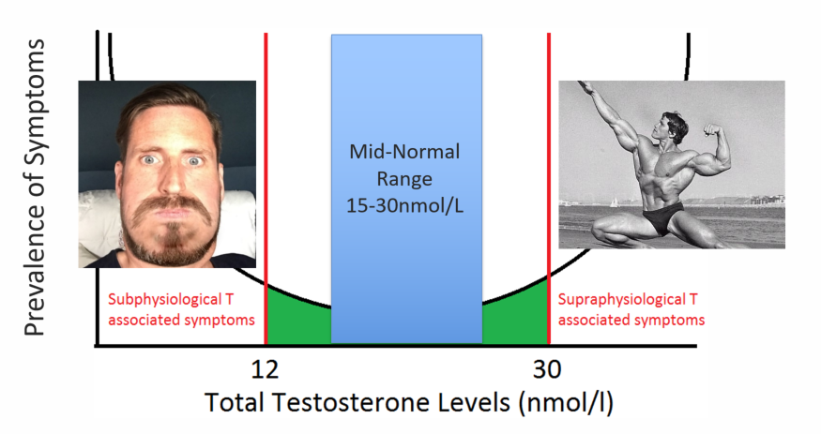
TTh - ‘U’ Shaped Curve
12
35
Hackett, G; Kirby, M et al J Sex Med 2017;14:1504-1523

Slide 40
Monitoring of Testosterone Levels
Optimum time to measure serum T whilst on TTh ¹
Short-acting T injection
  Midway in treatment cycle
Long-acting T undecanoate injection
  Just prior to the next injection
Transdermal T gels*
  Within 24 hours of precedent application, 2–8 hours after application
*Guidance on monitoring with T gels varies between the different products. Refer to individual product SmPC for full details
Buvat et al J Sex Med 2013;10:245–284

Slide 41



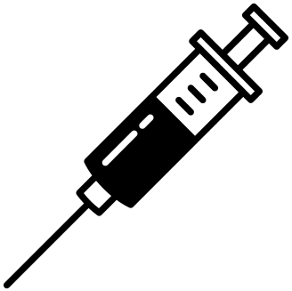


Benefits of Testosterone Therapy (TTh)
Improved sexual function
Increased lean
muscle mass & strength
Reduced mortality risk
Improved mood
Improved cognitive function
Decreased frailty
Reduced osteoporosis risk
Hackett G. Ther Adv Urol 2016; 8: 147–60; Hackett G et al. J Sex Med 2016; 13: 887–904.

Slide 42
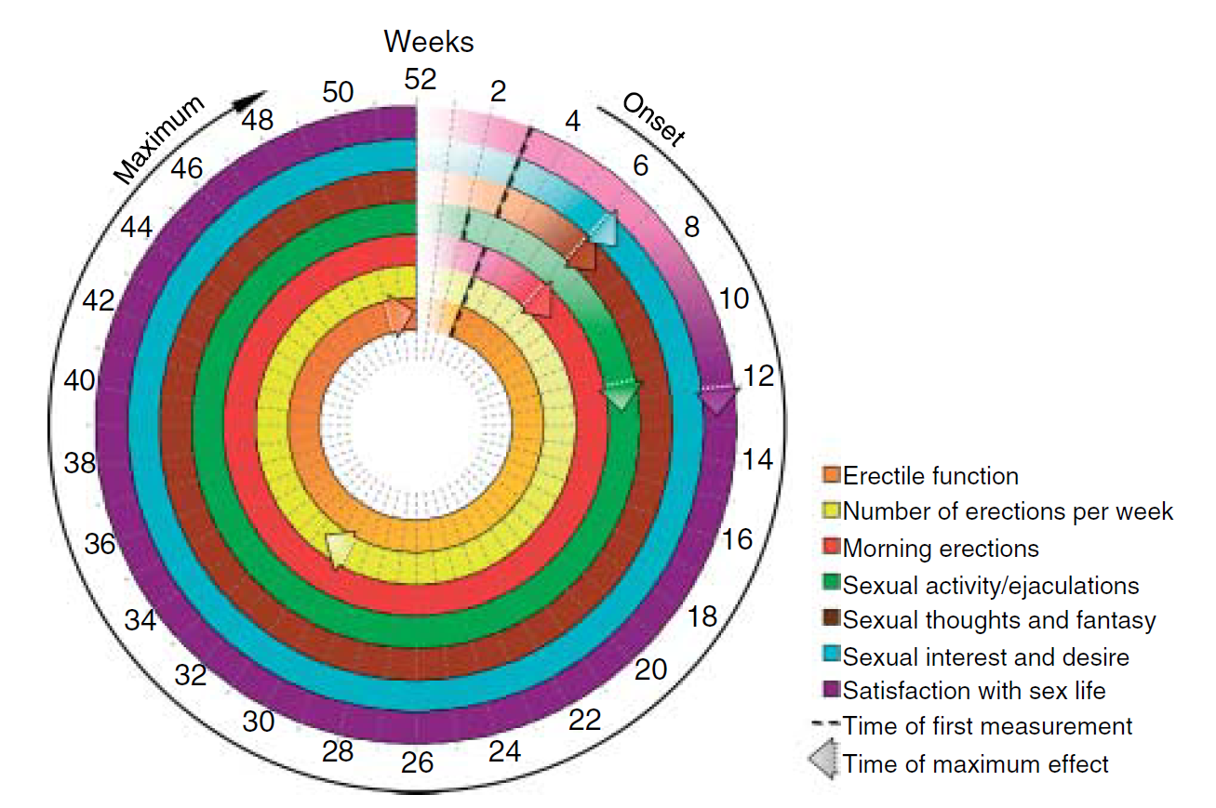
Time to Onset of TD Symptom Improvement
Time-dependent and symptom-specific onset of effects of TTh
Sexual Parameters
Saad et al. European Journal of Endocrinology (2011) 675-685

Slide 43
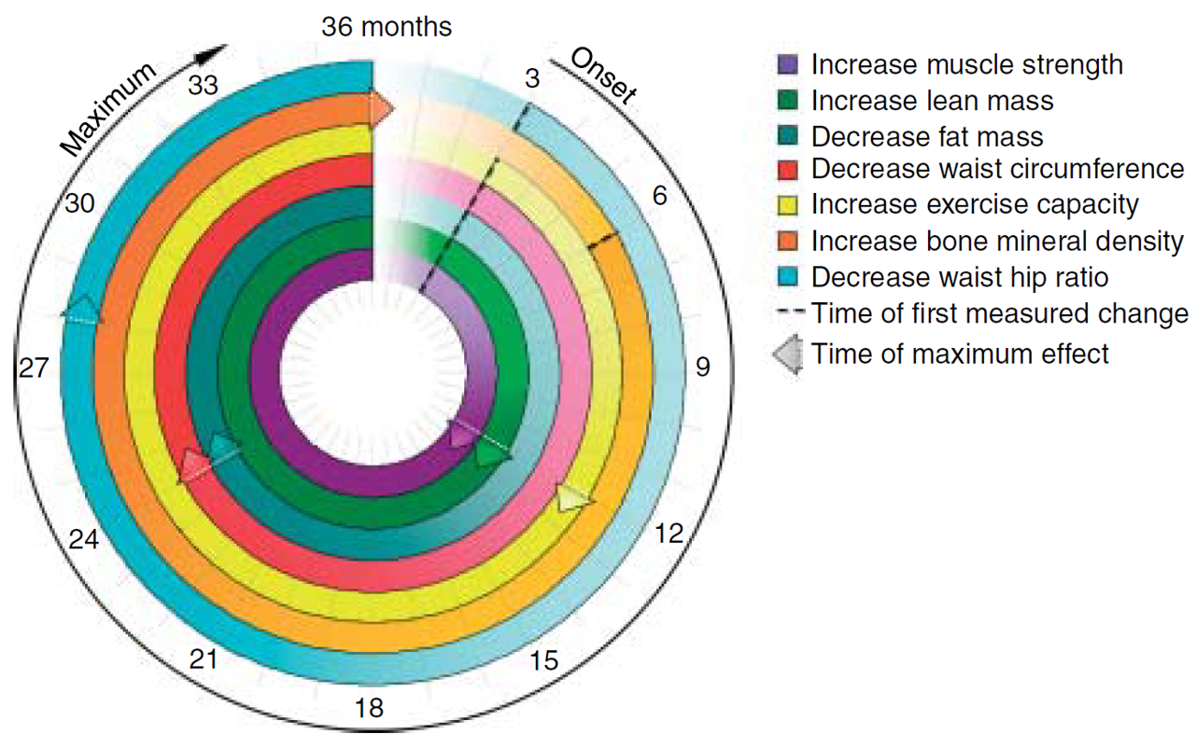
Time to Onset of TD Symptom Improvement
Time-dependent and symptom-specific onset of effects of TTh
Body Composition
Saad et al. European Journal of Endocrinology (2011) 675-685

Slide 44
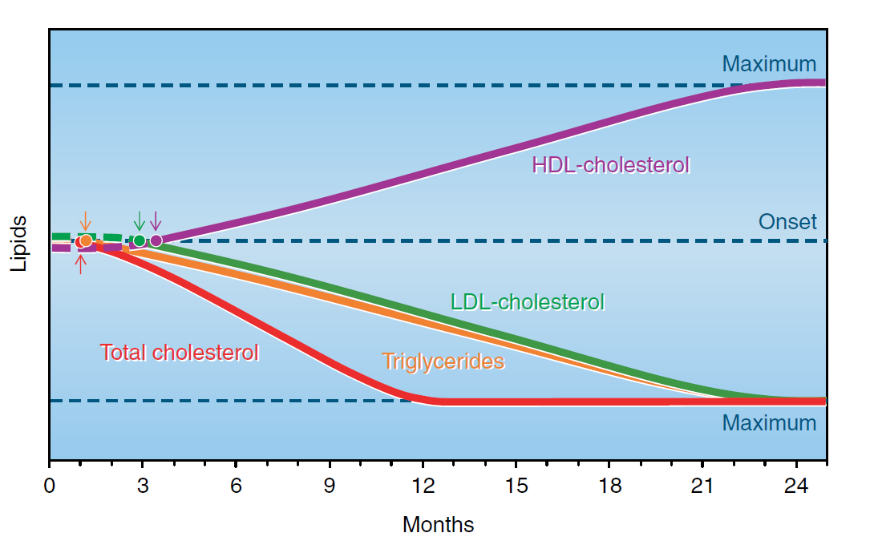
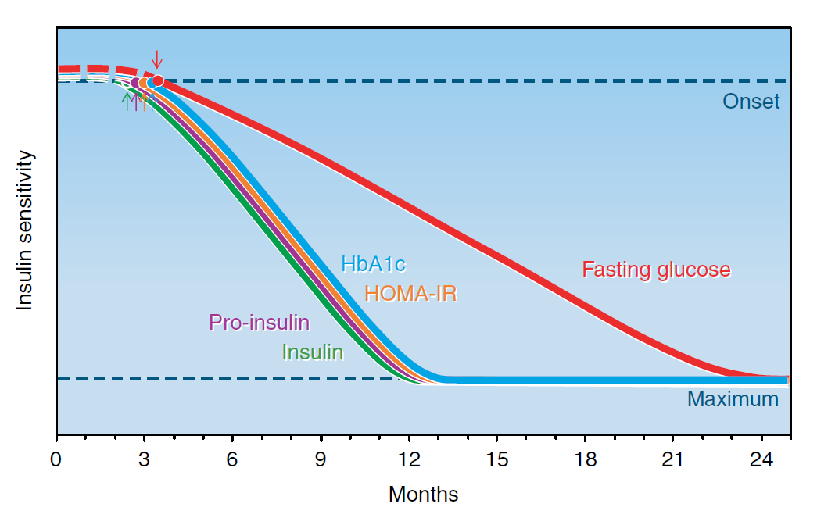
Time to Onset of TD Symptom Improvement
Time-dependent and symptom-specific onset of effects of TTh
Lipids, Glucose & Insulin
Saad et al. European Journal of Endocrinology (2011) 675-685
Notes:
Although the optimal duration of therapy is unknown, continuous therapy over a longer period is necessary to derive the benefits of TRT, with different symptoms improving or resolving at different times.
In a review of the literature, Saad et al. found rapid improvement in sexual interest, quality of life, and change in lipids, showing improvement beginning in 3 to 4 weeks. Changes in erection or ejaculation, erythropoiesis, glycemic control, body morphology (including fat mass, lean body mass, and muscle strength), and bone mass take longer to occur, ranging from 3 to 6 months, often achieving steady state at 1 year. Thus, patients who discontinue therapy after short duration may not experience the benefits of TRT

Slide 45
TTh: For how long?
Hypogonadism is a chronic disease which requires long-term treatment, not unlike diabetes.
Important to realise that TTh is considered lifelong therapy¹
In patients who have a positive response to TTh, treatment should continue in accordance with a standardised monitoring plan²
1. Chakrabarty A. Androl Gynecol: Curr Res 2013, 1:3
2. Bhasin S, et al. J Clin Endocrinol Metab 2010; 95: 2536-2559.

Slide 46
Potential adverse effects linked to TTh
Erythrocytosis
Growth of metastatic prostate cancer
Detection of subclinical prostate cancer
Leg oedema and worsening of heart failure
Reduced sperm production and infertility
Acne, oiliness of skin
Breast tenderness
Induction/worsening of obstructive sleep apnoea
Gynaecomastia
Growth of breast cancer
Male pattern balding
Formulation-specific effects
Thrombotic events in patients with thrombophilia, or those with risk factors for VTE
Increases in blood pressure
Weak evidence of association with TTh
Consult Summary of Product characteristics for a full list of adverse events
Bhasin S, Basaria S. Best Pract Res Clin Endocrinol Metab 2011; 25: 251–270.
Bhasin S, et al. J Clin Endocrinol Metab 2010; 95: 2536–2559.
Testogel 16.2mg/g SmPC https://www.medicines.org.uk/emc/product/8919/smpc Last Accessed Sept 2020

Slide 47
Guideline
Recommendations
1. Guidelines regarding the use of testosterone (T) in testosterone deficiency (TD)
2. Guideline recommendations regarding screening certain patient groups for the presence of TD

Slide 48
1. Guidelines regarding the use of Testosterone Therapy (TTh) in men with Testosterone Deficiency (TD)
In recent years, established specialist medical societies have produced guidance on the use of TTh in men with TD. These include:
  The British Society for Sexual Medicine (BSSM)¹
  The European Association of Urology (EAU)²
  American Urological Association (AUA)³
  The Endocrine Society (ES)⁴
  The Society for Endocrinology (SfE) Position Statement⁵
1. Hackett G, et al. J Sex Med 2017;14:1504-23; 2. Dohle GR, et al. European Association of Urology 2015. Available at: https://uroweb.org/wp-content/uploads/18-Male-Hypogonadism_LR1.pdf Accessed May 2019; 3. Mulhall JP, et al. American Urological Association 2018. 4. Bhasin S, et al. J Clin Endocrinol Metab 2018;103(5):1715-44; 5. https://www.endocrinology.org/media/2710/male-hypogonadism-and-ageing-2018.pdf Accessed June 2019

Slide 49
  British Society for Sexual Medicine (BSSM) Recommendations 2017 (1/2)
Screening
Men with consistent and multiple signs of TD
All men presenting with ED, loss of spontaneous erections, or low sexual desire
All men with T2D, BMI >30 kg/m2, or waist circumference > 102 cm
All men on long-term opiate, antipsychotic, or anticonvulsant medication
Diagnosis
Men with persistent symptoms suggesting TD and low testosterone (T)
Measure fasting T levels in the morning before 11am, acknowledging that, in normal life, non-fasting levels could be up to 30% lower
Repeat total testosterone (TT) assessment on ≥2 occasions by a reliable method; in addition, measure free testosterone (FT) in men with levels close to lower normal range (8-12 nmol/L) or those with suspected or known abnormal sex hormone binding globulin (SHBG) level
Measure luteinising hormome (LH) serum levels to differentiate primary from secondary TD
Base decisions on therapy on published action levels rather than laboratory reference ranges
Initiating therapy
Perform cardiovascular (CV), prostate, breast and haematologic assessment before start of treatment
Offer T therapy to symptomatic men with TD syndrome for treated localised low-risk prostate cancer*, not starting before 1 year of follow-up and without evidence of active disease**
Assess CV risk factors before commencing T therapy and optimise secondary prevention in men with established disease
1. Hackett G, et al. J Sex Med 2017;14:1504-23.
* (Gleason score <8, stages 1-2, preoperative PSA level <10 ng/mL
** based on measurable prostate specific antigen (PSA) level, digital rectal examination (DRE) result, and evidence of metastatic disease

Slide 50
  British Society for Sexual Medicine (BSSM) Recommendations 2017 (1/2)
Benefits and risks of TTh in patients with TD
Beyond 6 months there is evidence of benefit for T therapy in body composition, bone mineralisation, and features of metabolic syndrome
T therapy improves sexual desire, erectile function, and sexual satisfaction
Decreases in BMI and waist size and improved glycaemic control and lipid profile are observed
Trials of T therapy should be ≥6 months and maximal benefit is often seen beyond 12 months
Fully inform the patient about expected benefits and side effects of therapy and facilitate a joint discussion by an informed patient and physician
Fully discuss the adverse effect of T therapy and its effect on future fertility for each patient and his partner and offer alternative treatment as necessary
In patients with adult-onset TD, when TTh is prescribed, offer weight-loss and lifestyle advice as standard management
In severely symptomatic patients with TT levels <8 nmol/L, lifestyle and dietary advice alone is unlikely to produce meaningful clinical improvement within a relevant clinical period
Follow-up
Assess response to therapy at 3, 6, and 12 months and every 12 months thereafter
Aim for a target TT level of 15-30 nmol/L to achieve optimal response
Monitor haematocrit before treatment, at 3-6 months, and every 12 months thereafter; decrease dosage, or switch preparation, if haematocrit is >0.54; if haematocrit remains high, consider stopping and reintroduce at a lower dose
Assess prostate health by PSA and DRE before commencing TTh followed by a PSA at 3-6 months, 12 months, and every 12 months thereafter
Assess CV risk before TTh is initiated and monitor CV risk factors throughout therapy
Haemoglobin, liver function and lipids should be monitored periodically²
T: testosterone, BMI: body mass index, TD: testosterone deficiency, TTh: testosterone therapy, TT: total testosterone, PSA: prostate-specific antigen, DRE: digital rectal examination, CV: cardiovascular
1. Hackett G, et al. J Sex Med 2017;14:1504-23; 2. Testogel (testosterone) Summary of Product Characteristics, August 2018.

Slide 51
European Association of Urology (EAU) Recommendations 2019
The diagnosis of TD should be restricted to men with persistent symptoms
T should be measured in the morning before 11.00am in the fasting state
TT assessment should be repeated at least on 2 occasions with a reliable method.* In addition, in men with:
  TT levels close to the lower normal range (8-12 nmol/L), the FT level should be measured to strengthen the laboratory assessment
  Suspected or known abnormal SHBG levels, FT should also be included
T assessment is recommended in men with a disease or treatment in which TD is common and in whom treatment may be indicated. This includes men with T2D, obesity, treatment with opiates, osteoporosis / low-trauma fractures and HIV infection with sarcopenia.
LH & FSH serum levels should be analysed to differentiate between primary and secondary forms of TD
TD: testosterone deficiency, T: testosterone, TT: total testosterone, FT: free testosterone, SHBG: sex hormone-binding globulin, ESRD: end-stage renal disease, COPD: chronic obstructive pulmonary disease, T2D: type 2 diabetes, LH: luteinising hormone. *Both immunoassay and mass spectrometry based assays can produce valid results, as long as they are well-validated
Dohle GR, et al. European Association of Urology 2019..

Slide 52
American Urological Association (AUA)
Guideline Statements 2018
Diagnosis of Testosterone Deficiency
  The diagnosis of low testosterone should be made only after two early morning total testosterone measurements are taken on separate occasions.
  The clinical diagnosis of testosterone deficiency is only made when patients have low total testosterone levels combined with symptoms and/or signs.
Counselling Regarding Treatment of Testosterone Deficiency
  Clinicians should inform testosterone deficient patients that low testosterone is a risk factor for CV disease
Adjunctive Testing
  PSA should be measured in men >40 years of age prior to commencement of T therapy to exclude a prostate cancer diagnosis
Follow-up of Men on Testosterone Therapy
  Testosterone levels should be measured every 6-12 months while on testosterone therapy.
1. Mulhall JP, et al. American Urological Association 2018.
CV – Cardiovascular; PSA – Prostate Specific Antigen; T - Testosterone
Notes:
AUA Recommendations
Diagnosis:
Use TT <300 ng/dL (<10.4nmol/L) as the cut-off in support of diagnosis of low T
Adjunctive testing:
Measure serum LH levels
Serum oestradiol should be measured in TD patients who present with breast symptoms or gynaecomastia prior to the commencement of T therapy
Prior to offering therapy, measure haemoglobin and haematocrit and inform of the increased risk of polycythaemia
Counselling:
Inform that T therapy may result in improvements of erectile function, low sex drive, anaemia, BMD, lean body mass, depressive symptoms
Long-term impact of T on spermatogenesis should be discussed with patients interested in future fertility
Counsel patients regarding lifestyle modifications as a treatment strategy
Treatment:
Adjust dose to achieve TT level in middle tertile of normal reference range
Therapy should not be commenced for 3-6 months after a CV event
Do not prescribe alkylated oral testosterone
Commercially manufactured T products should be prescribed in preference to compounded T, wherever possible
Follow-up:
Measure initial follow-up TT level after an appropriate interval to ensure target T levels achieved
Discuss cessation of therapy 3-6 months after commencement of treatment in patients experiencing normalisation of TT levels but failing to achieve symptom/sign improvement

Slide 53
Endocrine Society Clinical Practice Guidelines 2018 (1/4)
1. Diagnosis of TD in men:
Suspected
Diagnose men with symptoms /signs of TD and unequivocally and consistently low serum TT and/or FT
Screening and case detection
The guidelines recommend against routine screening of men in the general population
Distinguishing between primary or secondary
Measure serum LH and FSH concentrations
Evaluation for determining etiology
The guidelines suggest further evaluation to identify the etiology of hypothalamic, pituitary, and/or testicular dysfunction
TD: testosterone deficiency, TT: total testosterone, FT: free testosterone, LH: luteinising hormone, FSH: follicle-stimulating hormone
1. Bhasin S, et al. J Clin Endocrinol Metab 2018;103(5):1715-44.

Slide 54
Endocrine Society Clinical Practice Guidelines 2018 (2/4)
2. Treatment of TD with TTh
T therapy to induce and maintain secondary sex characteristics and correct symptoms of TD
Not recommended in men planning fertility in the near term or men with breast or prostate cancer, a palpable prostate nodule or induration, a PSA level >4 ng/mL, a PSA level >3 ng/mL combined with a high risk of prostate cancer (without further urological evaluation), elevated haematocrit, untreated severe obstructive sleep apnea, severe lower urinary tract symptoms, uncontrolled heart failure, MI or stroke within the last 6 months, or thrombopihlia
Men 55-69 years old being considered for T therapy with a life expectancy >10 years: discuss the potential benefits and risks of evaluating prostate cancer risk and prostate monitoring and engage the patient in shared decision making regarding monitoring. If monitoring is chosen, assess risk before starting treatment then 3-12 months after treatment initiation. Men 40-69 with increased risk, discuss risk and monitoring options
Older men with age-related decline in T concentration
Routine prescribing of TTh is not recommended in asymptomatic men >65 years with low T concentrations. If they have symptoms of TD and consistently and unequivocally low morning T concentrations, offer T therapy on an individualised basis after explicit discussion of potential risks and benefits
HIV-infected men with weight loss
Consider short-term T therapy in men with low T concentrations when other causes of weight loss have been excluded to induce and maintain body weight and lean mass gain
Men with T2D
We recommend against T therapy as a means of improving glycemic control
T: testosterone, TD: testosterone deficiency, PSA: prostate-specific antigen, MI: myocardial infarction, T2D: type 2 diabetes mellitus
1. Bhasin S, et al. J Clin Endocrinol Metab 2018;103(5):1715-44.

Slide 55
Endocrine Society Clinical Practice Guidelines 2018 (3/4)
3. Monitoring of TTh
In men with TD who have started T therapy, evaluate after treatment initiation to assess response, any AEs and compliance to treatment
A urological consultation is recommended for men receiving TTh if during the first 12 months there is a confirmed increase in PSA concentration >1.4 ng/mL above baseline, confirmed PSA >4.0 ng/mL, or a prostatic abnormality detected on DRE. After 1 year, prostate monitoring should conform to standard guidelines for screening based on race and age of patient*
*NB Testogel is contraindicated in patients with known or suspected PCa
TTh: testosterone therapy, T: testosterone, AE: adverse effect, PSA: prostate-specific antigen, DRE: digital rectal examination
1. Bhasin S, et al. J Clin Endocrinol Metab 2018;103(5):1715-44.

Slide 56
Endocrine Society Clinical Practice Guidelines 2018 (4/4)
4. Monitoring recommendations
Explain the potential benefits and risks of monitoring for prostate cancer and engage the patient in shared decision making regarding the prostate monitoring plan Evaluate the patient at 3–12 months after treatment initiation and then annually to assess whether symptoms have responded to treatment and whether the patient is suffering from any adverse effects Monitor T concentrations 3–6 months after initiation of T therapy Check haematocrit at baseline, 3–6 months after starting treatment, and then annually. If haematocrit is >54%, stop therapy until haematocrit decreases to a safe level; evaluate the patient for hypoxia and sleep apnea; reinitiate therapy with a reduced dose Measure BMD of lumbar spine and/or femoral neck after 1–2 years of T therapy in hypogonadal men with osteoporosis, consistent with regional standard of care For men 55–69 years and 40–69 years at increased risk for prostate cancer who choose prostate monitoring, perform DRE and check PSA level before initiating treatment; check PSA and perform digital rectal examination 3–12 months after initiating T treatment, and then in accordance with guidelines for prostate cancer screening depending on the age and race of the patient Evaluate formulation-specific adverse effects at each visit
TTh: testosterone therapy, T: testosterone, AE: adverse effect, PSA: prostate-specific antigen, DRE: digital rectal examination
1. Bhasin S, et al. J Clin Endocrinol Metab 2018;103(5):1715-44.

Slide 57
Society for Endocrinology Position Statement May 2018
Hypogonadism is defined as a clinical syndrome complex that comprises symptoms and signs as well as biochemical evidence of testosterone deficiency.
It is increasingly recognised that older men with common medical conditions (e.g. obesity, metabolic syndrome, T2D, osteoporosis) have a higher prevalence of borderline low serum testosterone levels
A diagnosis of hypogonadism is more secure if it can be framed in the context of a recognised clinical syndrome (e.g. primary gonadal insufficiency from past chemotherapy, or secondary hypogonadism due to opiate analgesia).
A history of prostatic symptoms should be taken and measurement of PSA should be performed before commencing T treatment in men over 40 years
Since TTh may cause secondary polycythaemia, haematocrit should be assessed before and annually after therapy
T replacement should be used cautiously in men with symptomatic CVD
T treatment in the context of LOH should be considered only when a clinical diagnosis has been made and where there is a sound pathological basis for diagnosis
CVD, cardiovascular disease, LOH. Late-onset hypogonadism, PSA: prostate-specific antigen, T: testosterone
Society for Endocrinology Position Statement on Male Hypogonadism and Ageing. Available at: https://www.endocrinology.org/clinical-practice/society-position-statements/ Accessed May 2019.

Slide 58
TD Guideline Summary - 1
  Diagnosis of TD should only be made when patients have low TT levels (using 2 TT measurements taken on separate occasions, taken in early morning), combined with symptoms and/or signs (BSSM¹, EAU², ES³, AUA⁴)
  Clinicians should inform testosterone deficient patients that low testosterone is a risk factor for CV disease (AUA⁴)
Prostate health should be assessed by DRE and PSA before initiating therapy. Follow-up by PSA testing at
3, 6 and 12 months and DRE 3–12 months after initiating T treatment, and thereafter annually for both
(BSSM¹, EAU² ,ES³)
  Check haematocrit at baseline, 3–6 months after starting treatment, and then annually. If haematocrit is >54% and remains high, consider stopping therapy and reintroducing at a lower dose or switching preparations (BSSM¹, EAU², ES³)
  Assess response to therapy at regular intervals within the first year and then annually thereafter (BSSM¹, EAU², ES³)
TD – Testosterone Deficiency; TT – Total Testosterone; DRE – Digital Rectal Examination; PSA - prostate-specific antigen; T - testosterone; T2D – Type 2 Diabetes; CV - Cardiovascular
1. Hackett G, et al. J Sex Med 2017;14:1504-23; 2. Dohle GR, et al. European Association of Urology 2015. Available at: https://uroweb.org/wp-content/uploads/18-Male-Hypogonadism_LR1.pdf Accessed May 2019; 3. Bhasin S, et al. J Clin Endocrinol Metab 2018;103(5):1715-44; 4. Mulhall JP, et al. American Urological Association 2018.

Slide 59
2. Guideline recommendations for screening men with T2DM, obesity, chronic opiate use and ED for TD
In recent years, established specialist medical societies have produced guidance on which male patients should be screened for TD. The guidelines include:
  British Society for Sexual Medicine Guidelines (BSSM)
  American Association of Clinical Endocrinologists (AACE) and American College of Endocrinology (ACE) Guidelines
  European Association of Urology (EAU) Guidelines
  Endocrine Society (ES) Guidelines
  American Urological Association (AUA) Guidelines
  American Diabetes Association (ADA) Guidelines
1. Hackett G, et al. J Sex Med 2017;14:1504-23; 2. Dohle GR, et al. European Association of Urology 2015. Available at: https://uroweb.org/wp-content/uploads/18-Male-Hypogonadism_LR1.pdf Accessed May 2019; 3. Mulhall JP, et al. American Urological Association 2018. 4. Bhasin S, et al. J Clin Endocrinol Metab 2018;103(5):1715-44; 5. https://www.endocrinology.org/media/2710/male-hypogonadism-and-ageing-2018.pdf Accessed June 2019

Slide 60
Men with type 2 diabetes mellitus (T2DM)
The BSSM recommend screening for TD in all men with T2DM¹
The American Association of Clinical Endocrinologists (AACE) and American College of Endocrinology (ACE) recommend:
  All male patients with T2DM should be evaluated to exclude TD²
The American Diabetes Association (ADA) recommend:
  In men with diabetes and symptoms or signs of TD, such as decreased libido or ED, consider screening with a morning serum T level³
The European Association of Urology (EAU) recommendations include:
  Testosterone assessment in men with a disease in which TD is common, and in whom treatment may be indicated, such as T2DM⁴
TD – Testosterone Deficiency; T - testosterone; T2DM – Type 2 Diabetes; ED – Erectile Dysfunction
1. Hackett G, et al. J Sex Med 2017;14:1504-23; 2. Garvey TW, et al. American Association of Clinical Endocrinologists and American College of Endocrinology Clinical Practice Guidelines for Comprehensive Medical Care of Patients with Obesity. Available at: aace.com/files/guidelines/ObesityExecutiveSummary.pdf Accessed May 2019; 3. American Diabetes Association. Diabetes Care 2019;42(Suppl.1):S34–S45. Available at: care.diabetesjournals.org/content/diacare/suppl/2018/12/17/42.Supplement_1.DC1/DC_42_S1_Combined_FINAL.pdf Accessed May 2019; 4. Dohle GR, et al. Guidelines of Male Hypogonadism. European Association of Urology 2015. Available at: uroweb.org/wp-content/uploads/18-Male-Hypogonadism_LR1.pdf Accessed May 2019.

Slide 61
Men with Obesity
BSSM recommend screening for TD in all men with BMI >30 kg/m2 or waist circumference (WC) >102 cm² ¹
AACE and ACE recommend:²
  All men with increased WC or obesity should be assessed for TD by history and physical exam, and tested for TD if indicated
  Men with TD and obesity not seeking fertility treatment should be considered for TTh in addition to lifestyle intervention. TTh in these patients results in weight loss, decreased WC, and improvements in metabolic parameters (glucose, haemoglobin A1c, lipids and blood pressure)
EAU recommendations include T assessment in men with a disease in which TD is common, and in whom treatment may be indicated, such as obesity ³
TD – Testosterone Deficiency; TTh – testosterone therapy; BMI – Body Mass Index; T - testosterone
1. Hackett G, et al. J Sex Med 2017;14:1504-23; 2. Garvey TW, et al. American Association of Clinical Endocrinologists and American College of Endocrinology Clinical Practice Guidelines for Comprehensive Medical Care of Patients with Obesity. Available at: aace.com/files/guidelines/ObesityExecutiveSummary.pdf Accessed May 2019; 3. Dohle GR, et al. Guidelines of Male Hypogonadism. European Association of Urology 2015. Available at: uroweb.org/wp-content/uploads/18-Male-Hypogonadism_LR1.pdf Accessed May 2019.

Slide 62
Men on chronic opioid medication
BSSM recommends screening for TD in all men on long-term opiate medication¹
The Endocrine Society recommend:²
  Treatment with opioids affects T production therefore the Endocrine Society suggest measuring the serum T level in men receiving opioid medication
  T therapy should be considered in men with opioid-induced TD who are experiencing sexual symptoms and in whom discontinuation of opioid medication seems unlikely
1. Hackett G, et al. J Sex Med 2017;14:1504-23; 2. Bhasin S, et al. J Clin Endocrinol Metab 2010;95:2536-59.

Slide 63
Men with Erectile Dysfunction (ED)
The British Society for Sexual Medicine (BSSM) guidelines state that:¹
  TD is a treatable cause of ED that may also make men less/non-responsive to phosphodiesterase type 5 inhibitors (PDE5i’s), therefore all men with ED should have serum T measured on a blood fasting sample taken in the morning 8-11am
  25-50% of men fail to respond within 12 months to PDE5i’s. Rates are higher in men with type 2 diabetes mellitus (T2DM) or post-radical prostatectomy.
  Correction of testosterone levels <10.4nmol/L may salvage non-responders to PDE5i ⁴
The American Urological Association (AUA) states:²
  ED is a symptom associated with TD. Clinicians are advised to measure TT in all ED patients
The Endocrine Society (ES) suggests measurement of serum T concentrations in men with low libido or ED ³
TD – Testosterone Deficiency; T - testosterone; ED – Erectile Dysfunction; PDE5i’s – Phosphodiesterase 5 inhibitors; TT – Total Testosterone
1. Hackett G, et al. J Sex Med 2017;14:1504-23; 2. Mulhall JP, et al. J Urol 2018;200(2):423-32; 3. Bhasin S, et al. J Clin Endocrinol Metab 2018;103(5):1715-44. 4. http://www.bssm.org.uk/wp-content/uploads/2018/09/ED-Practical-Guide-v3-for-BSSM-review.pdf

Slide 64
TD Guideline Summary - 2
  There is overall consensus among the guidance produced by expert groups in recent years that a diagnosis of TD should be made when both signs and symptoms and low T levels are confirmed to be present ¹⁻⁴
  The majority of guidelines also recommend routine screening for TD in men with the following conditions:
    Erectile Dysfunction (ED)
    Type 2 diabetes mellitus (T2DM)
    Obesity
    Chronic opiate use ^{1,3-6}
TD – Testosterone Deficiency; T - testosterone
1. Hackett G, et al. J Sex Med 2017;14:1504-23. 2. Dohle GR, et al. Guidelines of Male Hypogonadism. European Association of Urology 2015. Available at: uroweb.org/wp-content/uploads/18-Male-Hypogonadism_LR1.pdf Accessed May 2019; 3. Bhasin S, et al. J Clin Endocrinol Metab 2018;103(5):1715-44. 4. Mulhall JP, et al. American Urological Association 2018. 5. Garvey TW, et al. American Association of Clinical Endocrinologists and American College of Endocrinology Clinical Practice Guidelines for Comprehensive Medical Care of Patients with Obesity. Available at: aace.com/files/guidelines/ObesityExecutiveSummary.pdf Accessed May 2019; 6. American Diabetes Association. Diabetes Care 2019;42(Suppl.1):S34–S45. Available at: care.diabetesjournals.org/content/diacare/suppl/2018/12/17/42.Supplement_1.DC1/DC_42_S1_Combined_FINAL.pdf Accessed May 2019.

Slide 65

Who should be initiating & monitoring TD patients?
“The committee recommends that TTh be initiated
and monitored by the generalist in urology or
family medicine, for most patients, provided that
authoritative clinical guidelines are followed” ¹
Dean J et al. J Sex Med 2015;12:1660-86.

Slide 66
Primary Clinical Benefits of Testosterone Therapy (TTh)

Slide 67
Swerdloff RS et al. Long-Term Pharmacokinetics of Transdermal Testosterone Gel in Hypogonadal Men J Clin Endocrinol Metab 2000;85(12):4500–10.
Landmark 6-month study assessing the pharmacokinetic profiles of 2 doses of T gel and a T patch
Study design | A randomised, multicentre (16 centres), 6-month, active-comparator study to compare two doses of Testosterone gel (5g and 10g per day) versus a single dose of two Testosterone patches (total 5mg/day) The study was double blinded until day 90 with respect to the T gel groups and open label for the T patch group Statistical comparisons between groups were only performed until day 90 (randomised controlled part) using the original treatment assignments (50mg or 100mg T gel, or patch) as the independent groups.
Study population & treatment | 227 hypogonadal men (aged 19-68 years) with morning serum testosterone levels at ≤10.4 nmol/L (300ng/dL), PSA <4ng/mL and a normal DRE were included in the analysis. Day 0-90 (Randomised period): ▪ T Gel 50mg/day* (n=73) ▪ T Gel 100mg/day* (n=78) ▪ T patch (2x 2.5mg patch)/day** (n=76) Day 91-180 (non-randomised period) ▪ Doses could be adjusted to T Gel 75mg/day for patients on; T gel 50mg/day with levels <10.4nmol/L, or T gel 100mg/day with levels >34.7nmol/L
Study Objectives | To compare pharmacokinetic measurements of T and FT for T-Gel 50mg/day, T-Gel 100mg/day and a T patch (5mg/day), to assess T Gel as a suitable mode of delivery To determine the effect of transdermal T-application on other assays including serum DHT, E2, FSH, LH and SHBG Safety endpoints included any adverse effects and skin irritation.
*T Gel was applied to the upper arms, shoulders or abdomen. The study was double blinded with respect to the T Gel groups in this period.
**Both T patches were applied at the same time to a clean, dry area of skin on the back, abdomen, upper arms or thighs. The study was open label for the T patch group.
DHT - Dihydrotestosterone; E2 – Oestradiol; LH – Luteinising Hormone; FSH – Follicle Stimulating Hormone; SHBG – Sex Hormone Binding Globulin; T – Testosterone; FT – Free Testosterone
Notes:
Background Information:
Transdermal T patches (although not marketed in the UK any longer) did normalise serum T levels and reverse the symptoms of testosterone deficiency in hypogonadal men. However, acceptance of transdermal testosterone patches was limited in part because of skin irritation and/or a lack of adherence.
Design:
Patients applying testosterone gel had a single, preapplication serum testosterone measurement made on day 60; if the levels were within the normal range (10.4 –34.7nmol/L; 300-1000ng/dL), they remained on their original dose. Men with testosterone levels at 60 days of treatment <10.4 nmol/L and who were applying 50 mg gel and those with testosterone levels >34.7 nmol/L who had received 100mg gel were then assigned to the 75mg/day gel group for days 91–180.
No changes in dose were made to subjects randomised to testosterone patch.
The subjects had no history of chronic medical illness or alcohol or drug abuse. The subjects had a normal rectal examination, a prostate-specific antigen level of less than 4 ng/mL, and a urine flow rate of more than 12 mL/s before enrolment to the study. They were excluded if they had a generalized skin disease that might affect T absorption or a prior history of skin irritability with the non-scrotal T patch (Androderm). Subjects with body weight of less than 80 or more than 140% of ideal body weight and subjects taking medications known to alter the cytochrome P450 enzyme systems were also excluded from this study.
A placebo group was not included because 6-month placebo treatment of hypogonadal men was not believed to be justifiable, as untreated hypogonadism will result in impaired libido, decreased strength, bone mineral loss, and other clinical defects.
Reference
Swerdloff RS, Wang C, Cunningham G, et al. Long-Term Pharmacokinetics of Transdermal Testosterone Gel in Hypogonadal Men. J Clin Endocrinol Metab 2000;85(12):4500–10.

Slide 68
Swerdloff RS et al. Long-Term Pharmacokinetics of Transdermal Testosterone Gel in Hypogonadal Men J Clin Endocrinol Metab 2000;85(12):4500–10.
Testosterone levels returned to the normal range with all transdermal testosterone formulations
PK Results (T Levels) | Effect on Serum T levels (Figure 1) At Day 0 (baseline), average serum T concentrations over 24hours were below the normal adult range for all three groups (range 8.22-8.60nmol/L) On Days 30 and 90, after gel application, the Cav in the T Gel 100mg/day group was 27.46nmol/L, 1.4-fold higher than the T Gel 50mg/day group (Cav = 19.62nmol/L and 19.17nmol/L for Days 30 and 90, respectively), and 1.9-fold higher than the T patch group (14.62nmol/L and 14.46nmol/L for Days 30 and 90, respectively) (p=0.0001) On Day 180, the serum T concentrations achieved and the pharmacokinetic parameters were similar to those on Days 30 and 90, for patients who continued in their original randomised treatment groups Effect on Serum Free T levels Similar to the total T results, the free T Cav achieved by the T gel 100mg group was 1.4- and 1.7-fold higher than those in the T gel 50mg and T patch groups, respectively (P = 0.001).
PK – Pharmacokinetic; Cav - average serum testosterone level (0-24h); T – Testosterone
Notes:
For patients who switched from T Gel 100mg/day or T Gel 50mg/day to T Gel 75mg/day, their Cav on Day 180 was 20.84nmol/L, midway between the two original groups. However these results were not homogenous, with the Cav for patients who had swapped from T Gel 100mg/day to 75mg/day (n=20) being 1.7-fold higher than the Cav for patients who had swapped from T Gel 50mg/day to 75mg/day (n=20).

Slide 69
Wang C et al. Long-Term Testosterone Gel (AndroGel*) Treatment Maintains Beneficial Effects on Sexual Function and Mood, Lean and Fat Mass, and Bone Mineral Density in Hypogonadal Men. J Clin Endocrinol Metab 2004;89:2085–98.
Long term open-label efficacy, outcome and safety follow up study of Swerdloff 2000
Study design | 36-month open-label follow-up study of the randomised controlled study, Swerdloff 2000 (42 months total). To evaluate the long term efficacy of T Gel
Study treatment | All patients were treated with T Gel at a dose of either 5g, 7.5g or 10g of gel daily (50mg, 75mg or 100mg testosterone respectively) All subjects previously on the T patch were assigned to 5g AndroGel* Men previously on T gel 5g/day with levels <10.4nmol/L (or T gel 10g/day with levels >34.7nmol/L) were assigned to 7.5g/day gel group. Due to the long duration of the study, the study design allowed dose adjustment in increments of 2.5g/day (range min: 2.5g/day max: 10g/day) throughout the study period, depending on clinical symptoms and serum T levels.
Study population | A total of 163 subjects (aged 19-68 years) participated in the long-term study and were included in the safety analysis 123 subjects were included in the efficacy analysis n=49 (primary hypogonadism), n=27 (secondary hypogonadism), n=47 (age-related/adult-onset hypogonadism)
Notes:
Design:
Subjects were permitted entry into a long-term efficacy study of 24 months (total exposure 30 months), which was further extended for up to 36 months (total exposure 42 months)
40 subjects were excluded from the efficacy analysis:
- If there was an interval of ≥90days between the end of the 6-month study and the long-term study in which the subjects could have received some other treatment (20 subjects)
If the subjects participated for <3 months in the long-term study (9 subjects), or
If the subjects were enrolled in this study without having completed the 6-month study (11 subjects)
In the initial 6-month study, patients randomised to testosterone gel had a single, preapplication serum testosterone measurement on Day 60; if levels were within the normal range (10.4 –34.7 nmol/litre; 300-1000 ng/dl), they remained on their original dose.

Slide 70
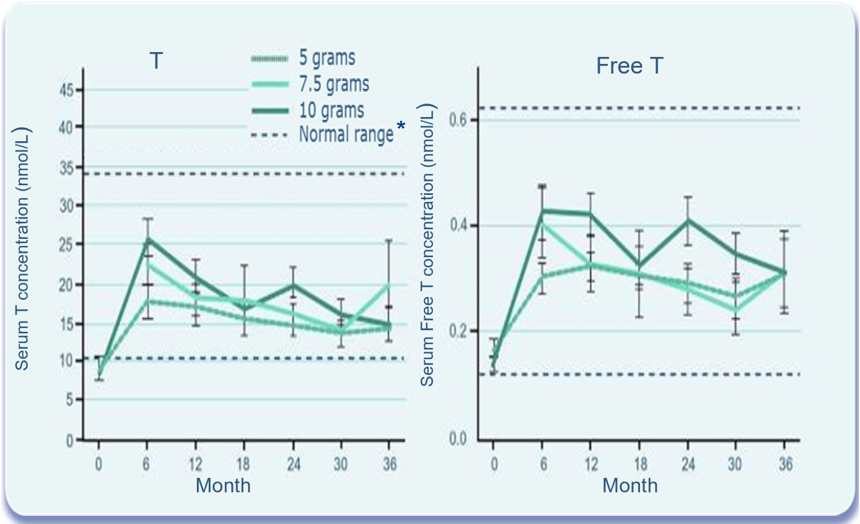
Wang C et al. Long-Term Testosterone Gel (AndroGel*) Treatment Maintains Beneficial Effects on Sexual Function and Mood, Lean and Fat Mass, and Bone Mineral Density in Hypogonadal Men. J Clin Endocrinol Metab 2004;89:2085–98.
Testosterone Gel maintains T levels in the normal range* for 36 months post baseline (Fig 4)
Results | Serum T and Free T levels (Figure 4) At 6 months, the beginning of the long-term study, mean serum T levels were at 14.1, 22.4 and 25.6 nmol/L for the 5g, 7.5g and 10g groups, respectively, which were significantly different between the groups (p = 0.012) At 12 months the differences in T concentrations between the different dose groups became smaller but remained significant (p= 0.042) Thereafter with dose adjustment for the subjects, serum T levels were not different between the three groups. Serum free T followed the same pattern as serum T and also showed no significant differences among the dose groups after 12 months. Because mean serum T and free T differences among the dose groups were small and became not significant with dose adjustments to maintain serum T concentrations within the normal male adult range, all other serum hormone and efficacy data are presented for all subjects as a group (figs 5-15)
Figure 4: Serum T and Free T concentrations in patients receiving T Gel 5g, 7.5g and 10 g per day over 36 months.
Figure 4: Adapted from Wang C, et al 2004
*Dotted lines reflect the U.S. normal range described in this paper. Serum T: (10.4 - 34.7nmol/L), Free T: (0.121 - 0.62nmol/L)
T – Testosterone; Free T – Free Testosterone

Slide 71
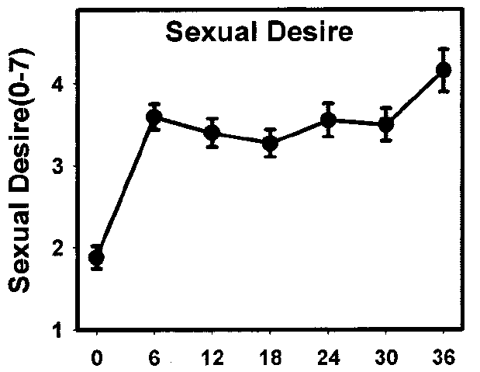
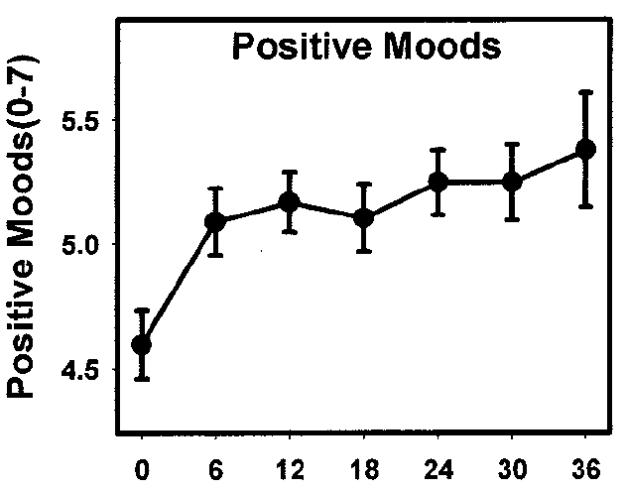

Wang C et al. Long-Term Testosterone Gel (AndroGel*) Treatment Maintains Beneficial Effects on Sexual Function and Mood, Lean and Fat Mass, and Bone Mineral Density in Hypogonadal Men. J Clin Endocrinol Metab 2004;89:2085–98.
Testosterone Gel therapy significantly improves sexual symptoms and mood
Results | Sexual Function and Mood scores After treatment with T Gel, Sexual Desire (Fig 10), Sexual Enjoyment and Sexual Activity improved, compared with baseline, and were maintained at the same level from 6 months until the end of the treatment period. Positive mood scores improved with treatment and were sustained (Fig 11), whereas negative mood parameters were decreased and remained significantly lower (p=0.0013) than baseline without further changes after 6 months of T Gel replacement therapy.
(Fig 11) Change in mood parameters by self-report questionnaire during T treatment
(Fig 10) Change in sexual desire by self-report questionnaire during T treatment
(Figure 10)
(Figure 11)
p = 0.0001 from month 6 to end of the treatment period
p = 0.0022 from month 6 to end of the treatment period
Figures 10 & 11: Adapted from Wang et al.

Slide 72
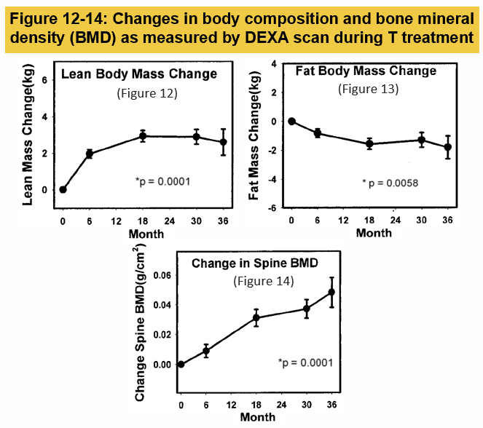
Wang C et al. Long-Term Testosterone Gel (AndroGel*) Treatment Maintains Beneficial Effects on Sexual Function and Mood, Lean and Fat Mass, and Bone Mineral Density in Hypogonadal Men. J Clin Endocrinol Metab 2004;89:2085–98.
The effect of T gel application on body composition parameters
Results | Body Composition and BMD, Bone Markers and Muscle Strength Average Total Body Mass and Lean Body Mass (Fig 12) increased significantly vs baseline (p=0.0157 and p=0.0001, respectively), whereas Fat Mass (Fig 13) decreased significantly (p=0.0058). The decreases in fat mass (p=0.032) and percent fat (p=0.0001) were observed only in the younger subjects but not in older men (>60years) BMD of the hip and spine (Fig 14) showed a significant (p=0.0004 and p=0.0001, respectively) and progressive increase with treatment. Bone markers indicated that there was an early phase in which there was decreased bone resorption and increased bone formation, and a later phase suggestive of continued bone formation but without a further decrease in bone resorption Muscle strength tested via chest and leg press increased but did not reach statistical significance over time.
Figures 12-14: Adapted from Wang et al.
T – Testosterone; BMD – Bone Mineral Density; DEXA Scan - Dual-energy X-ray Absorptiometry Scan

Slide 73
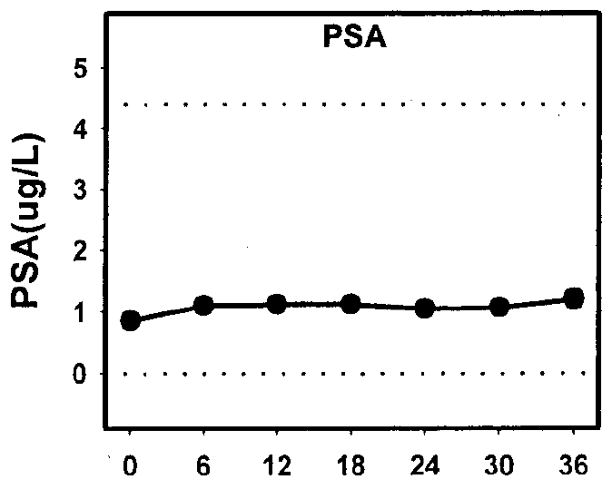
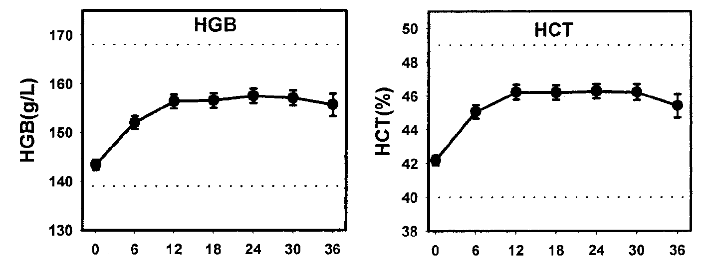
Wang C et al. Long-Term Testosterone Gel (AndroGel*) Treatment Maintains Beneficial Effects on Sexual Function and Mood, Lean and Fat Mass, and Bone Mineral Density in Hypogonadal Men. J Clin Endocrinol Metab 2004;89:2085–98.
The effect of long-term T gel application on safety parameters
Safety | Skin Irritation Application site skin reaction occurred in 12/163 subjects (one was classified as moderate). One subject discontinued after 12 months of T Gel (5g) because of worsening erythema and rash. IPSS & PSA Mean IPSS score did not change significantly across time with T gel. None of the individual scores showed any clinically meaningful changes Baseline PSA level was 0.85ng/ml. With T replacement there were significant increases in PSA levels over time. Mean serum PSA was 1.11ng/ml at month 6 and showed no further significant increases with continued T treatment (P = 0.150). 3 subjects (1.8%) aged >63 years whose serum PSA rose above the predetermined critical value of 5.5 ng/dl had T treatment stopped and had confirmed PCa on biopsy Haematocrit Except for the anticipated increase in haematocrit and haemoglobin, there were no clinically significant changes in blood counts or biochemistry.
Figure 15: Haemoglobin (HGB), haematocrit (HCT) and PSA concentrations over time
Figure 15: Adapted from Wang et al.
Notes:
Of the subjects who had elevated PSA during the study, three had confirmed prostate cancer on biopsy. All three subjects were over 63 years old at enrolment in the study.
The incidence of prostate cancer in three of 163 (1.8%) subjects who were enrolled in this study was similar to that reported in older men by Snyder et al. who were treated with scrotal transdermal patches for 3 year (one of 54, 1.8%).
However, if only men over 60 yr enrolled in this study were considered, the incidence would be higher: three of 39 (7.7% over a 3-yr period).
Based on the data from the Surveillance, Epidemiology, and End Result Program of the National Cancer Institute, the anticipated incidence of prostate cancer in the population of men between the ages of 65 and 74 yr is between 973 and 994 cases per 100,000 men [National Cancer Institute, Surveillance, Epidemiology, and
End Result (SEER) Program 2002, www.seer.cancer.gov].
Gynecomastia was observed only in eight more subjects during treatment (4.9%).
Acne was noted in 12 subjects (7.4%). None of these subjects was discontinued because of acne.
Prostate size was not assessed by ultrasound but was assessed during digital rectal examinations and found to be enlarged in 23 subjects (14%) at any time in the study. Most of these patients had enlarged prostate at baseline assessment.

Slide 74
82.2% of hypogonadal men achieved T levels within the normal range at Day 182, following treatment with testosterone 16.2mg/g gel
Testosterone 16.2mg/g increases C_{av} testosterone levels to within the normal range in hypogonadal men
Results | Efficacy The success criterion was determined to be ≥75% of subjects achieving testosterone levels within the normal range of 300-100ng/dL This was met in all population samples on all study days by the testosterone treatment group except on day 14 (65.7%) Significantly more subjects receiving titrated doses of testosterone gel at day 182 had testosterone Cav values within the eugonadal range vs placebo (p<0.0001) After titration, the dose distribution was 1.25g (7.3% n=17/234), 2.5g (25.6% n=60/234), 3.75g (28.2% n=66/234), and 5.0g (38.9% n=91/234).
Number & percentage of subjects achieving C_{av} target range (300-1000ng/dL)* for testosterone on day 182 following dose titration
Study day | 16.2mg/g testosterone gel |  | Placebo |  | P value
 | n/N (%) | 95% Cl | n/N (%) | 95% Cl
182 | 139/169 (82.2) | (75.6, 87.7) | 8/28 (28.6) | (13.2, 48.7) | <0.0001
* This equates to 10.4-34.7nmol/L; C_{av} - serum total testosterone average concentrations; T - Testosterone
Table adapted from Kaufman JM, et al 2011

Slide 75
Kaufman JM et al (2012): >77% of patients achieved normal T levels after 1 year following dose titration with 16.2mg/g T gel
Testosterone 16.2mg/g gel for up to 1 year is efficacious with >77% of patients achieving normal testosterone levels following dose titration
Results | Efficacy On final visit, day 364, 77.9% and 87.0% of patients previously receiving testosterone gel or placebo gel respectively in the previous 6 month double-blind study had C_{av} values within the eugonadal range (300-1000ng/dL*) Based on the last titrated dose (following day 266), final dose allocation to 16.2mg/g testosterone gel was: 1.25g (7.8% n=15/191), 2.5g (21.5% n=41/191), 3.75g (22.5% n=43/191), and 5.0g (48.2% n=92/191).
Number & percentage of subjects achieving C_{av} target range (300-1000ng/dL)* for testosterone on day 364 following dose titration
Study day | Continuing Active |  | Formerly Placebo |  | Total (Continuing Active + Placebo)
 | n/N (%) | 95% Cl | n/N (%) | 95% Cl | n/N (%) | 95% Cl
364 | 106/136 (77.9) | 70.0, 84.6 | 20/23 (87.0) | 66.4, 97.2 | 126/159 (79.2) | 72.1, 85.3
* This equates to 10.4-34.7nmol/L; C_{av} - serum total testosterone average concentrations; T - Testosterone

Slide 76
Primary Clinical Benefits - Summary (1/2)
Pivotal studies on testosterone gel from the early 2000s were designed to demonstrate that a transdermal gel delivery system would be an acceptable route of administration when compared to a testosterone patch.^{1,2}
The landmark pharmacokinetic study by Swerdloff RS et al showed that AndroGel* can efficiently elevate serum T and FT levels to the normal range in hypogonadal men whilst also being able to provide dose flexibility. ¹
Wang et al continued the work of Swerdloff to look at the long term efficacy, outcome and safety results of testosterone gel application over a 42 month period. They demonstrated that AndroGel* restored and maintained T and FT levels within the normal range and showed sustained benefits on sexual symptoms and body composition parameters. Safety parameters were shown to be comparable to other delivery systems. ²
Wang therefore concluded that AndroGel* is effective & well-tolerated when used in the long-term treatment of hypogonadal men. ²
Swerdloff RS, Wang C, Cunningham G, et al. Long-Term Pharmacokinetics of Transdermal Testosterone Gel in Hypogonadal Men. J Clin Endocrinol Metab 2000;85(12):4500–10.
Wang C, Cunningham G, Dobs A, et al. Long-Term Testosterone Gel (AndroGel) Treatment Maintains Beneficial Effects on Sexual Function and Mood, Lean and Fat Mass, and Bone Mineral Density in Hypogonadal Men. J Clin Endocrinol Metab 2004;89:2085–98.

Slide 77
Primary Clinical Benefits - Summary (2/2)
More recently, trials to acquire marketing authorisations for new testosterone products have principally been designed to demonstrate that the responder rate (as defined by C_{av} in the normal range) is at least 75% in testosterone treated subjects and that long-term safety can be demonstrated.
In 2011, Kaufman JM et al demonstrated that 82.2% of subjects achieved C_{av} target range (300-1000ng/dL)* for testosterone on day 182 following dose titration.¹
He concluded that 16.2mg/g testosterone gel offers an effective, convenient, flexible and well tolerated dosing regimen that achieves eugonadal testosterone levels in hypogonadal men and provides patients the opportunity to reduce the total mass of gel applied vs. 1% testosterone gel products. ¹
Kaufman then extended the original trial by a further 6 months in an open-label phase following which he concluded that 16.2mg/g testosterone gel for up to 1 year was well tolerated and efficacious, with >77% of patients achieving normal serum testosterone levels following dose titration. ²
* This equates to 10.4-34.7nmol/L. C_{av} - serum total testosterone average concentrations.
Kaufman JM, Miller MG, Garwin JL, et al. Efficacy and safety study of 1.62% testosterone gel for the treatment of hypogonadal men. J Sex Med 2011;8:2079–89.
Kaufman JM, Miller MG, Fitzpatrick S, et al. One-year efficacy and safety study of a 1.62% testosterone gel in hypogonadal men: Results of a 182-day open-label extension of a 6-month double-blind study. J Sex Med 2012;9:1149–61.

Slide 78
Secondary Clinical Benefits of Testosterone Therapy (TTh)

Slide 79
Men with T2DM frequently have low testosterone levels
Cross-sectional study to assess the prevalence of clinical hypogonadism in 355 men with T2DM (mean age 58.1 years)
In total, 20% (n=71) and 31% (n=109) of men with T2DM had total testosterone levels <8 nmol/L and 8–12 nmol/L, respectively
  Free testosterone <0.255 nmol/L: 50% (n=179)
Proportion of men with low or borderline low testosterone levels per decade of life (n=180)
Total testosterone <8 nmol/L
Total testosterone <12 nmol/L
Calculated free testosterone <0.255 nmol/L
Patients (%)
Patients (%)
Age (years)
Age (years)
  T2DM, type 2 diabetes mellitus
  Kapoor D et al. Diabetes Care 2007;30:911–17.
Notes:
This cross-sectional study assessed the prevalence of clinical hypogonadism in men with T2DM.
It included 355 men with T2DM (mean age: 58.1 years) who were registered with the Centre for Diabetes and Endocrinology, Barnsley Hospital NHS Foundation Trust, Barnsley, UK. Study participants were recruited from the diabetic clinic and district retinal screening programme.
In total, 70 patients were treated with diet alone, 95 with insulin, and 160 with oral hypoglycaemic agents.
Patients were excluded if they had any inflammatory disease or infection with elevated CRP
>10 mg/L, or were already receiving TTh.
Assessments were always made between 8:00 and 10:00 in the morning.
Total testosterone levels were measured by ELISA, with <8 nmol/L considered ‘low’ and
8–12 nmol/L considered ‘borderline low’.
Age distribution and mean total and free testosterone levels, respectively, were:
<40 years (n=13; 4%): 11.1 and 4.05 nmol/L.
40–49 years (n=60; 17%): 12.3 and 4.34 nmol/L.
50–59 years (n=124; 35%): 12.4 and 4.05 nmol/L.
60–69 years (n=112; 32%): 13.5 and 4.03 nmol/L.
>69 years (n=46; 12%): 12.45 and 3.51 nmol/L.
20% of men (n=71) had total testosterone levels <8 nmol/L.
31% of men (n=109) had total testosterone levels between 8–12 nmol/L.
50% of men (n=179) had free testosterone levels <0.255 nmol/L.
CRP, C-reactive protein; ELISA, enzyme-linked immunosorbent assay; NHS, National Health Service; T2DM, type 2 diabetes mellitus; TTh, testosterone therapy
Reference
Kapoor D et al. Diabetes Care 2007;30:911–7.

Slide 80
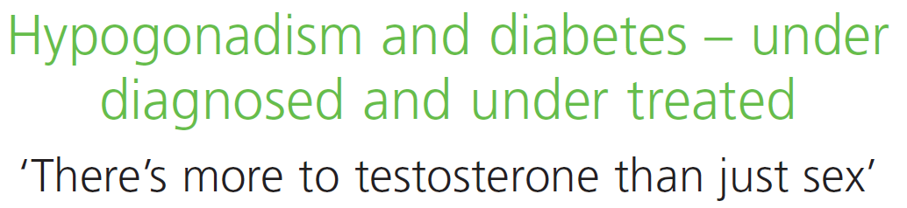
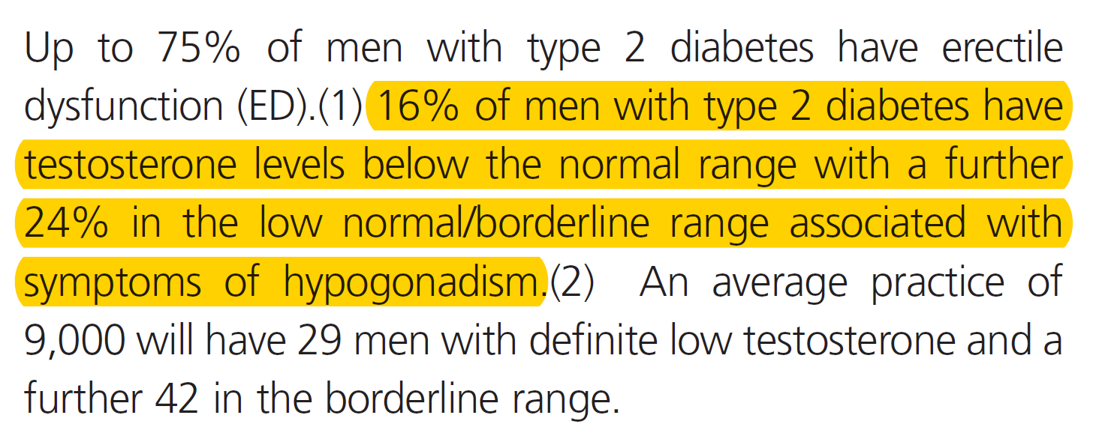

Low testosterone and hypogonadal symptoms are common in men with T2DM
40%
of men with T2DM have testosterone levels <12 nmol/L
NHS, UK National Health Service; T2DM, type 2 diabetes mellitus
Notes:
NHS Factsheet #36
A Factsheet produced in March 2012 (#36) by the NHS highlights the high number of men with T2DM who also have low testosterone and/or hypogonadal symptoms.
Among men with T2DM, 16% are hypogonadal; a further 24% have low-normal/borderline testosterone levels, but present with symptoms of hypogonadism.
Therefore, the prevalence of men with T2DM and testosterone levels <12 nmol/L is ~40%.
NHS, UK National Health Service; T2DM, type 2 diabetes mellitus

Slide 81
Low testosterone and T2DM are linked
In a study of 1,413 men aged ≥20 years in NHANES III, those in the first (lowest) tertiles of low free and total testosterone were four times more likely to have diabetes than those in the third tertiles [OR 4.12 (95% CI: 1.25 to 13.55 and OR 3.93 (95% CI: 1.39 to 11.13), respectively]¹
A meta-analysis of 37 prospective and cross-sectional studies showed that:²
  After adjusting for age and BMI, T2DM was associated with lower total testosterone levels (p<0.0001)
  Analysis of longitudinal studies demonstrated that baseline total testosterone was significantly lower among patients with incident diabetes versus controls [HR -2.08 (95% CI: -3.57 to -0.59); p<0.001]
  Analysis of RCTs showed that TTh was associated with a significant reduction in fasting plasma glucose, HbA_{1c}, fat mass and triglycerides
  BMI, body mass index; CI, confidence interval; HbA_{1c}, glycated haemoglobin; NHANES III, Third National Health and Nutrition Examination Survey; OR, odds ratio;
  RR, relative risk; T2DM, type 2 diabetes mellitus
1. Selvin E et al. Diabetes Care 2007;30:234–8; 2. Corona G et al. J Sex Med 2011;34:528–40.
Notes:
In a study conducted in 1,413 men aged ≥20 years who participated in NHANES III:¹
Low free testosterone concentrations in the normal range were associated with diabetes, independent of adiposity.
In multivariate models adjusted for age, race/ethnicity, and adiposity, men in the first tertile (lowest) of free testosterone level were four times more likely to have prevalent diabetes compared with men in the third tertile [OR 4.12 (95% CI: 1.25
to 13.55)].
These associations persisted even after excluding men with clinically abnormal testosterone concentrations, defined as total testosterone <11.3 mmol/L or free testosterone <0.2 nmol/L.
Corona et al. performed a literature search to identify prospective and cross-sectional studies investigating the relationship between androgen levels and type 2 diabetes mellitus (T2DM).²
A total of 37 studies were included in the meta-analysis.
Patients with T2DM showed significantly lower testosterone plasma levels compared with those without diabetes.
Similar results were obtained when patients with T2DM with and without erectile dysfunction were analysed separately.
In a multiple regression model, after adjusting for age and body mass index (BMI), T2DM was still associated with lower total testosterone levels (adjusted r = -0.568; p<0.0001).
Analysis of longitudinal studies demonstrated that baseline TT was significantly lower in men with incident diabetes compared with controls (hazard ratio = -2.08 [95% CI -3.57;-0.59]; p<0.001).
When combining the RCTs, TRT was associated with a significant reduction in fasting plasma glucose, glycated haemoglobin, fat mass and triglycerides. No significant difference was observed for total and high-density lipoprotein cholesterol, blood pressure or BMI.
These data suggest that T2DM can be considered independently associated with male hypogonadism.
BMI, body mass index; CI, confidence interval; NHANES III, Third National Health and Nutrition Examination Survey;
OR, odds ratio; RCT, randomised controlled trial; T2DM, type 2 diabetes mellitus; TTh, testosterone therapy
References
1. Selvin E et al. Diabetes Care 2007;30:234–8; 2. Corona G et al. J Sex Med 2011;34:528–40.

Slide 82





Guideline recommendations for men with T2DM
Guideline
Recommendation
BSSM¹
Screen for testosterone deficiency in all men with T2DM
AACE/
ACE²
All male patients with T2DM should be evaluated to exclude testosterone deficiency
In men with diabetes and symptoms or signs of testosterone deficiency, e.g. decreased libido or ED, consider screening with a morning serum testosterone level
ADA³
Consider testosterone assessment in men with a disease or treatment in which testosterone deficiency is common and in whom treatment may be indicated, such as T2DM
EAU⁴
  AACE, American Association of Clinical Endocrinologists; ACE, American College of Endocrinology; ADA, American Diabetes Association; BSSM, British Society for Sexual Medicine; EAU, European Associate of Urology; ED, erectile dysfunction; T2DM, type 2 diabetes mellitus
1. Hackett G et al. J Sex Med 2017;14:1504–23; 2. Garvey WT et al. Endocr Pract 2016;22(Suppl. 3):1–203; 3. American Diabetes Association. Diabetes Care 2019;42(Suppl.1):S34–S45; 4. Dohle GR et al. European Association of Urology Guidelines on Male Hypogonadism 2018. Available at: https://uroweb.org/guideline/male-hypogonadism/ (last accessed September 2020).
Notes:
Guidelines from the BSSM, AACE/ACE, ADA and EAU all recognise the link between T2DM and hypogonadism, and recommend screening for low testosterone in this population.
AACE, American Association of Clinical Endocrinologists; ACE, American College of Endocrinology; ADA, American Diabetes Association; BSSM, British Society for Sexual Medicine; EAU, European Associate of Urology; T2DM, type 2 diabetes mellitus
References
1. Hackett G et al. J Sex Med 2017;14:1504–23; 2. Garvey WT et al. Endocr Pract 2016;22(Suppl. 3):1–203; 3. American Diabetes Association. Diabetes Care 2019;42(Suppl.1):S34–S45; 4. Dohle GR et al. European Association of Urology Guidelines on Male Hypogonadism 2018. Available at: https://uroweb.org/guideline/male-hypogonadism/ (last accessed September 2020).

Slide 83
TTh significantly improves glycaemic control in obese, hypogonadal men
Analysis of two prospective, cumulative registry studies including 411 obese, hypogonadal men (mean age: 59.5 years) treated with TTh, of whom 25% had prediabetes, 42% had T2DM and 6% had T1DM
TTh significantly improved glycaemic control at 8 years of follow-up
Association between TTh and increased sexual activity in men with low testosterone
Effect of TTh on glycaemic control in obese, hypogonadal men
  BMI, body mass index; HbA_{1c}, glycated haemoglobin; T1DM, type 1 diabetes mellitus; T2DM, type 2 diabetes mellitus; TTh, testosterone therapy
Saad F et al. Int J Obesity 2016;40:162–70.
BMI 30.0–34.9 kg/m²
HbA_{1c} reduction: 1.15% (p<0.0001)
BMI 35.0–39.9 kg/m²
HbA_{1c} reduction: 1.79% (p<0.0001)
BMI ≥40 kg/m²
HbA_{1c} reduction: 1.87% (p<0.0001)
Notes:
This study investigated the effects of long-term TTh for up to 8 years in obese, hypogonadal men.
From two prospective, cumulative registry studies of 622 hypogonadal men, 411 (66.1% of all patients) with varying classes of obesity were identified:
Class I (BMI 30–34.9 kg/m²): n=214; mean age 58.6 years.
Class II (BMI 35–39.9 kg/m²): n=150; mean age 60.4 years.
Class III (BMI ≥40 kg/m²): n=47; mean age 60.5 years.
Among these obese, hypogonadal men, 72.7% (n=299) had prediabetes or diabetes [prediabetes: 25.1% (n=103), T2DM: 42.1% (n=173), T1DM: 5.6% (n=23)].
All men were treated with TTh (testosterone undecanoate injection) for up to 8 years.
Men were entered into the registry once they had received 1 year of TTh.
Inclusion criteria were two separate morning measures of total testosterone ≤12.1 nmol /L and the presence of hypogonadal symptoms measured by the Aging Males’ symptoms scale.
Exclusion criteria for TTh included previous treatment with androgens, prostate cancer or any suspicion thereof, International Prostate Symptom Score of 419 points, breast cancer, a history of congestive heart failure or recent angina, or severe untreated sleep apnoea.
Significant reductions in HbA_{1c} with long-term TTh were observed (all p<0.0001):
Class I: 6.67% to 5.4% (change from baseline of −1.2%).
Class II: 7.5% to 5.8 (change from baseline of −1.8%).
Class III: 7.6% to 5.7% (change from baseline of −1.9%).
BMI, body mass index; HbA_{1c}, glycated haemoglobin; T1DM, type 1 diabetes mellitus;
T2DM, type 2 diabetes mellitus; TTh, testosterone therapy
Reference
Saad F et al. Int J Obesity 2016;40:162–70.

Slide 84
Significant improvements in glycaemic control with TTh are lost if treatment is interrupted, but reappear when TTh is resumed
Observational registry study including 262 middle-aged and elderly hypogonadal men who received TTh for up to 11 years, representing 2088.5 patient-years
Significant decreases in fasting glucose and HbA_{1c} seen with TTh use were reversed upon withdrawal of TTh, but returned again to pre-interruption values when TTh was restarted
Association between TTh and increased sexual activity in men with low testosterone
Effect of continuous or interrupted TTh on glycaemic control in men with low testosterone
Continuous TTh (n=115) Interrupted TTh (n=147)
Fasting glucose
(mg/dL)
p<0.0001
HbA_{1c} (%)
p<0.0001
p<0.0001
p<0.0001
p=NS
p=NS
p=0.0043
p=0.0012
1
2
3
1
2
3
Period
Period
p values are for comparison of end of period vs beginning of period
HbA_{1c}, glycated haemoglobin; TTh, testosterone therapy
Yassin A et al. Clin Endocrinol 2016;84:107–14.
Notes:
This observational registry study included 262 hypogonadal, middle-aged and elderly men who received TTh for a maximum of 11 years, representing 2088.5 patient-years.
After having been on TTh for a mean duration of 65.5 months, treatment was temporarily interrupted in 147 patients for a mean of 16.9 months due to cost reimbursement issues,
as well as PCa for 7 of these patients. All men resumed TTh for a mean period of 14.5 months.
The other 115 men were treated continuously with TTh.
Serum total and free testosterone levels increased significantly in both groups. In men who received continuous TTh, serum testosterone levels were maintained over the study period, while in men whose TTh was interrupted, testosterone levels returned to baseline but increased to previous levels after treatment was resumed.
In men on continuous TTh, there was a progressive significant improvement in fasting glucose levels and HbA_{1c}. In men on intermittent therapy, there was a similar initial significant improvement in both glycaemic control parameters, which was reversed when TTh was interrupted, but became evident again after TTh was reinstated.
HbA_{1c}, glycated haemoglobin; PCa, prostate cancer; TTh, testosterone therapy
Reference
Yassin A et al. Clin Endocrinol 2016;84:107–14.

Slide 85
TTh is independently associated with reduced mortality in men with T2DM
Prospective study of 857 men with T2DM from 5 UK primary care practices: 320 were eugonadal and 537 were hypogonadal* (n=175 TTh-treated, n=362 did not receive TTh)
Mortality in eugonadal men or hypogonadal/TTh-treated men was significantly reduced versus hypogonadal/TTh-untreated men [HR 0.62 (95% CI: 0.41 to 0.94) and HR 0.38
(95% CI: 0.16 to 0.90), respectively]
Effect of TTh on mortality in men with T2DM with or without hypogonadism (N=857)
*Total testosterone ≤12 nmol/L or free testosterone ≤0.25 nmol/L
CI, confidence interval; HR, hazard ratio; TTh, testosterone therapy; T2DM, type 2 diabetes mellitus
Hackett G et al. Int J Clin Pract 2016;70:244–53.
Notes:
The primary aim of this longitudinal, observational study was to assess the association between mortality, testosterone levels and TTh use in 857 men with T2DM enrolled from 5 primary care practices between April 2007 and April 2009.
Based on early morning serum testosterone levels, men were classified as being eugonadal (total testosterone >12 nmol/L and free testosterone >0.25 nmol/L) or hypogonadal (total testosterone
≤12 nmol/L or free testosterone ≤0.25 nmol/L). In patients with total testosterone ≤12 nmol/L,
a second morning testosterone measurement was taken at ≥2 weeks later, according to European Association of Urology guidelines.
Of these men, 175/637 with serum total testosterone ≤12 nmol/L or free testosterone ≤0.25 nmol/L received TTh for a mean of 3.8 years. PDE-5 inhibitors and statins were prescribed to 175/857 and 662/857 men, respectively.
The primary endpoint of the study was all-cause mortality. Cox regression analysis was used to study the association between TTh and mortality.
Compared with the hypogonadal/TTh-untreated group, mortality in the eugonadal (p=0.023) and hypogonadal/ TTh-treated (p=0.027) groups was significantly reduced.
After repeating the Cox regression analysis in 682/857 men not given a PDE-5 inhibitor (which may
be a confounding factor), mortality in the eugonadal and hypogonadal/TTh-treated groups was significantly lower than in the reference hypogonadal/TTh-untreated group.
Low baseline testosterone is associated with increased all-cause mortality in men with T2DM, and
TTh is independently associated with reduced all-cause mortality, especially in men aged >60 years.
PDE-5, phosphodiesterase type 5; T2DM, type 2 diabetes mellitus; TTh, testosterone therapy
Reference
Hackett G et al. Int J Clin Pract 2016;70:244–53.

Slide 86
TTh is independently associated with reduced mortality in men with T2DM
Effect of TTh on mortality among men with T2DM (N=581)
Study of 581 men with T2DM who had testosterone levels measured during 2002–05 and were followed up for a mean of 5.8 years
  Eugonadal status (total testosterone
  >10.4 nmol/L): n=343
  Hypogonadal status (total testosterone
  ≤10.4 nmol/L): n=238
Mortality was significantly increased in hypogonadal vs eugonadal men (17% vs 9%, respectively; p=0.003), and TTh-untreated vs TTh-treated hypogonadal men (20% vs 9%, respectively; p=0.002)
There was a significant decrease in survival in TTh-untreated men versus TTh-treated and eugonadal men, after controlling for covariates*
1.00
Hypogonadal/TTh-treated
0.95
Eugonadal
0.90
Cumulative survival
0.85
Hypogonadal/TTh-untreated
HR 2.3 (95% CI: 1.3 to 3.9); p=0.004
0.80
0
20
40
60
80
Months of survival
*Age, weight, height, body mass index, glycated haemoglobin, pre-existing cardiovascular disease, smoking, statin and ARB/ACE inhibitor treatment
ACE, angiotensin-converting enzyme; ARB, angiotensin receptor blocker; CI, confidence interval; HR, hazard ratio; TTh, testosterone therapy; T2DM, type 2 diabetes mellitus. Muraleedharan V et al. Eur J Endocrinol 2013;166:725–33.
Notes:
This 6-year follow-up study included 581 men with type 2 diabetes who had testosterone levels measured between 2002–05.
Mortality rates were compared between eugonadal men (total testosterone >10.4 nmol/L; n=343) and hypogonadal men (total testosterone ≤10.4 nmol/L; n=238).
The effect of TTh (as per normal clinical practice: 85.9% testosterone gel and 14.1% intramuscular testosterone undecanoate) was assessed retrospectively in the hypogonadal group.
Kaplan–Meier survival curves showed a significant decrease in survival in the hypogonadal group compared with the eugonadal group (p=0.002).
In the Cox regression model, after adjusting for covariates of age, weight, height, body mass index, glycated haemoglobin, pre-existing cardiovascular disease, smoking, statin and angiotensin receptor blocker/angiotensin-converting enzyme inhibitor therapy) at baseline, the hazard ratio for decreased survival was 2.02 (95% CI: 1.2 to 3.4); p=0.009.
Mean baseline testosterone levels were significantly low in patients who died (10.9 ± 5.2 nmol/L) compared with those who were alive (12.6 ± 5.5 nmol/L; p=0.018). The mortality rate was 17.2% (41/238) in hypogonadal men compared with 9% (31/343; p=0.003) in eugonadal men.
Of the 238 hypogonadal men, 64 (27%) received TTh and 174 did not. A total of 60 hypogonadal men received TTh for ≥12 months and 51 had treatment for ≥2 years.
There was a significant increase in mortality rate in the TTh-untreated group (20.1% [35/174]) compared with the TTh-treated group [9.4% (6/64); p=0.002] and eugonadal men [9.1% (31/340)].
The multivariate-adjusted hazard ratio for decreased survival in TTh-untreated hypogonadal men was
2.3 (95% CI: 1.3 to 3.9; p=0.004).
Low testosterone levels predicted an increase in all-cause mortality during long-term follow-up.
CI, confidence interval; T2DM, type 2 diabetes mellitus; TTh, testosterone therapy
Reference
Muraleedharan V et al. Eur J Endocrinol 2013;166;725–33.

Slide 87

Long-term TTh use in men with hypogonadism prevents progression from prediabetes to T2DM and improves glycaemic control, lipid profile and AMS scale score
Long-term registry study to evaluate whether TTh use in men with hypogonadism and prediabetes prevents progression to T2DM
In total, 316 men with prediabetes (HbA_{1c} 5.7–6.4%) and total testosterone level ≤12.1 nmol/L plus symptoms of hypogonadism were analysed, of whom 229 received TTh, and 87 served as untreated controls
Association between TTh and increased sexual activity in men with low testosterone
Effect of TTh on glycaemic control in men with hypogonadism and T2DM (N=316)
TTh Placebo Difference
1.5
1.0
1.0
0.5
0.5
0
0
Change in fasting glucose (mmol/L)
Change in HbA_{1c} (%)
-0.5
-1.0
-0.5
-1.5
-1.0
0
1
2
3
4
5
6
7
8
0
1
2
3
4
5
6
7
8
Year
Year
AMS, Aging Males’ Symptoms; HbA_{1c}, glycated haemoglobin; T2DM, type 2 diabetes mellitus; TTh, testosterone therapy
Yassin A et al. Diabetes Care 2019;42:1104–11.
Notes:
This registry study analysed 316 men with prediabetes (defined as HbA_{1c} 5.7–6.4%) and total testosterone levels ≤12.1 nmol/L with symptoms of hypogonadism.
Patients in this study were pooled from two ongoing urological registries.
In total, 229 men received parenteral testosterone undecanoate every 12 weeks after an initial 6-week interval and 87 men served as untreated controls.
The following parameters were measured: total testosterone, weight, waist circumference, body weight, haemoglobin, haematocrit, fasting glucose, HbA_{1c}, systolic/diastolic blood pressure, heart rate, and lipids (total cholesterol, low-density lipoprotein cholesterol,
high-density lipoprotein cholesterol, triglycerides).
Metabolic and anthropometric parameters were measured twice-yearly for 8 years.
TTh led to substantial improvements in glycaemic parameters; both fasting blood glucose and HbA_{1c} values were reduced in the TTh-treated group but were increased in the
TTh-untreated group.
HbA_{1c}, glycated haemoglobin; TTh, testosterone therapy
Reference
Yassin A et al. Diabetes Care 2019;42:1104–11.

Slide 88

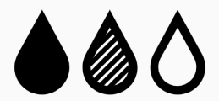



Long-term TTh use in men with hypogonadism prevents progression from prediabetes to T2DM and improves glycaemic control, lipid profile and AMS scale score
TTh-treated group (n=229)
TTh-untreated group (n=87)
HbA_{1c} decreased by 0.39%
Significant improvement in fasting glucose
90% of men achieved normal
glucose regulation (HbA_{1c} <5.7%)
0% of men progressed to T2DM (HbA_{1c} >6.5%)
HbA_{1c} increased by 0.63%
Significant worsening in fasting glucose
1% of men achieved normal
glucose regulation (HbA_{1c} <5.7%)
40% of men progressed to T2DM (HbA_{1c} >6.5%)
Significant improvements in lipid profile and AMS scale score
Significant worsening in lipid profile and AMS scale score
Incidence of non-fatal MI: 0.4%
Incidence of non-fatal MI: 5.7%
Mortality: 7.4%
Mortality: 16.1%
AMS, Aging Males’ Symptoms; HbA_{1c}, glycated haemoglobin; T2DM, type 2 diabetes mellitus; TTh, testosterone therapy
Yassin A et al. Diabetes Care 2019;42:1104–11.
Notes:
HbA_{1c} decreased by 0.39 ± 0.03% (p<0.0001) in the TTh-treated group and increased by
0.63 ± 0.1% (p<0.0001) in the TTh-untreated group.
The differences in glucose concentrations and HbA_{1c} were substantial and significant between the two groups throughout the entire follow-up period, amounting to a difference in HbA_{1c} of 1.02% at 8 years.
In the TTh-treated group, 90% achieved normal glucose regulation (HbA_{1c} <5.7%) versus
1% in the TTh-untreated group.
In the TTh-untreated group, 40.2% of men progressed to T2DM (HbA_{1c} >6.5%), compared with 0% of TTh-treated men.
TTh was also associated with significant improvements in fasting glucose, lipids accumulation product, total cholesterol, low-density lipoprotein cholesterol, high-density lipoprotein cholesterol, non-high-density lipoprotein cholesterol, triglycerides and Aging Males’ Symptoms (AMS) scale scores. Significant deterioration in all these parameters was seen
in the TTh-untreated group.
Mortality was 7.4% in the TTh-treated group and 16.1% in the TTh-untreated group (p<0.05).
The incidence of non-fatal myocardial infarction was 0.4% in the TTh-treated group and 5.7% in the TTh-untreated group (p<0.005).
HbA_{1c}, glycated haemoglobin; T2DM, type 2 diabetes mellitus; TTh, testosterone therapy
Reference
Yassin A et al. Diabetes Care 2019;42:1104–11.

Slide 89
Long-term TTh use in men with hypogonadism and T2DM significantly improves glycaemic control
Prospective, long-term, single-centre registry study in Germany to evaluate the effects of TTh use in men with hypogonadism and T2DM
In total, 356 men with T2DM [HbA_{1c} 62–79 mmol/mol (7.8–9.4%)] and total testosterone level ≤12.1 nmol/L plus symptoms of hypogonadism were analysed, of whom 178 received TTh, and 178 served as untreated controls
Association between TTh and increased sexual activity in men with low testosterone
Effect of TTh on glycaemic control in men with hypogonadism and T2DM (N=356)
TTh Untreated Difference
2
40
1
20
0
0
Change in fasting glucose (mmol/L)
Change in HbA_{1c} (mmol/mol)
-1
-20
-2
-40
-3
-60
-4
-80
0
1
2
3
4
5
6
7
8
9
10
11
0
1
2
3
4
5
6
7
8
9
10
11
Year
Year
p<0.0001 between groups.
HbA_{1c}, glycated haemoglobin; T2DM, type 2 diabetes mellitus; TTh, testosterone therapy
Haider KS et al. Diabetes Obes Metab 2020;doi: 10.1111/dom.14122.
Notes:
This registry study analysed 356 men with diabetes [baseline HbA_{1c} of 62–79 mmol/mol (7.8–9.4%)] and total testosterone levels ≤12.1 nmol/L with symptoms of hypogonadism.
All patients were managed by the same local diabetes centre and received standard diabetes treatment, including mandatory educational courses and materials.
In total, 178 men received parenteral testosterone undecanoate every 12 weeks after an initial 6-week interval and 178 men served as untreated controls.
The following parameters were measured: height, weight, waist circumference, blood pressure, haemoglobin, haematocrit, fasting glucose, HbA_{1c}, insulin, systolic/diastolic blood pressure, heart rate, lipids (total cholesterol, low-density lipoprotein cholesterol,
high-density lipoprotein cholesterol, triglycerides), high-sensitivity C-reactive protein, total testosterone, quality of life (assessed using the Aging Males’ Symptoms scale) and erectile function (assessed using the International Index of Erectile Function – Erectile Function domain).
Clinical variables were assessed at least twice-yearly for 11 years.
TTh led to significant and sustained gradual reductions in fasting blood glucose and HbA_{1c} values in hypogonadal men with T2DM; in contrast, both parameters increased in the
TTh-untreated group.
HbA_{1c}, glycated haemoglobin; T2DM, type 2 diabetes mellitus; TTh, testosterone therapy
Reference
Haider KS et al. Diabetes Obes Metab 2020;doi: 10.1111/dom.14122.

Slide 90

Long-term TTh use in men with hypogonadism and T2DM is associated with disease remission, return to normal glucose control, and decreased all-cause mortality
Effect of TTh on disease parameters and mortality in men with hypogonadism and T2DM (N=356)
HbA_{1c} ≤47.5 mmol/mol
HbA_{1c} ≤53.0 mmol/mol
Men achieving outcome (%)
100
80
TTh
60
Untreated
Survival (%)
40
20
0
0
1
2
3
4
5
6
7
8
9
10
11
12
Patients, n
Year
TTh
Untreated
178 178 178 168 154 125 113 101 86 76 60 55 42
178 178 178 176 165 153 144 134 120 110 86 49 18
HbA_{1c}, glycated haemoglobin; T2DM, type 2 diabetes mellitus; TTh, testosterone therapy
Haider KS et al. Diabetes Obes Metab 2020;doi: 10.1111/dom.14122.
Notes:
This registry study analysed 356 men with diabetes [baseline HbA_{1c} of 62–79 mmol/mol (7.8–9.4%)]
and total testosterone levels ≤12.1 nmol/L with symptoms of hypogonadism.
All patients were managed by the same local diabetes centre and received standard diabetes treatment, including mandatory educational courses and materials.
In total, 178 men received parenteral testosterone undecanoate every 12 weeks after an initial 6-week interval and 178 men served as untreated controls.
The following parameters were measured: height, weight, waist circumference, blood pressure, haemoglobin, haematocrit, fasting glucose, HbA_{1c}, insulin, systolic/diastolic blood pressure, heart rate, lipids (total cholesterol, low-density lipoprotein cholesterol, high-density lipoprotein cholesterol, triglycerides), high-sensitivity
C-reactive protein, total testosterone, quality of life (assessed using the Aging Males’ Symptoms scale) and erectile function (assessed using the International Index of Erectile Function – Erectile Function domain).
Clinical variables were assessed at least twice-yearly for 11 years.
Among men with T2DM receiving TTh:
34.3% and 46.6% achieved remission of T2DM [defined as HbA_{1c} <47.5 mmol/mol (6.5%) and discontinuation of all glucose-lowering agents, including metformin] and normal glucose regulation [defined as HbA_{1c} <39 mmol/mol (5.7%)], respectively. Of the latter, 22 men had been on insulin at baseline. The mean time to discontinuation of glucose-lowering medications was 8.6 ± 2.9 years,
and the mean time following remission was 2.5 ± 2.3 years. There were no relapses.
83.1% and 91.0% achieved HbA_{1c} values of 47.5 mmol/mol and 53.0 mmol/mol, respectively.
In contrast, no remission of T2DM or reduction in glucose or HbA_{1c} levels was noted in the untreated group.
There were fewer all-cause deaths in the TTh group than the untreated group [13 (7.3%) versus 52 (29.2%)].
These observations are consistent with other studies showing reduced mortality in men with hypogonadism and T2DM receiving TTh.
HbA_{1c}, glycated haemoglobin; T2DM, type 2 diabetes mellitus; TTh, testosterone therapy
Reference
Haider KS et al. Diabetes Obes Metab 2020;doi: 10.1111/dom.14122.

Slide 91
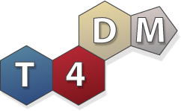
The T4DM study: in high-risk men, TTh decreased the 2-year risk of T2DM by 41% beyond lifestyle interventions alone
Randomised, double-blind, placebo-controlled multicentre Phase 3 trial in men aged 50–74 years (N=1007) with waist circumference >95cm, serum total testosterone ≤14nmol/L
and newly diagnosed T2DM
Men were randomised 1:1 to either TTh (1000 mg/4 mL IM) or placebo at baseline, 6 weeks and then 3-monthly for 2 years; all were enrolled in a lifestyle program
Co-primary 2-year endpoints
Proportion of men with OGTT 2-hour glucose ≥11.1 mmol/L at 2 years
Mean change in OGTT 2-hour glucose at 2 years (mmol/L)
IM, intramuscular; OGTT, oral glucose tolerance test; T2DM, type 2 diabetes mellitus; TTh, testosterone therapy
Wittert GA et al. Diabetes 2020;69(Suppl 1): https://doi.org/10.2337/db20-274-OR.
Notes:
The primary hypothesis of the T4DM study was that TTh for 2 years will prevent progression to, or reverse, T2DM in high-risk men concurrently enrolled in a community-based lifestyle programme.¹
A key secondary hypothesis was that TTh for 2 years will lead to metabolically favourable changes in body composition, improve sexual function and enhance adherence to the lifestyle programme.¹
This randomised, placebo-controlled, double-blind, 2-year, Phase IIIb trial was conducted at 6 Australian Tertiary Care centres.²
Inclusion criteria were age 50–74 years; waist circumference ≥95 cm; OGTT 2-hour glucose 7.8–15.0 nmol/L (140–270 ng/dL) and serum testosterone concentration ≤14 nmol/L.²
Exclusion criteria were: HPG pathology; TTh in the past 12 months; any prior anabolic steroid abuse; medications affecting testosterone or sex hormone-binding globulin; previously diagnosed T2DM; medication to lower blood glucose; OGTT 2-hour glucose >15 mmol/L;
anti-obesity drugs, prior or planned bariatric surgery; major cardiovascular event in previous 6 months or active cardiac disease; systolic blood pressure ≥160 mmHg, diastolic blood pressure ≥100 mmHg, transient ischaemic attack or stroke within the previous 3 years and significant psychiatric disorder.²
HPG, hypothalamo-pituitary-gonadal; OGTT, oral glucose tolerance test; T2DM, type 2 diabetes mellitus; TTh, testosterone therapy
References
1. Wittert GA et al. Diabetes 2020;69(Suppl 1): https://doi.org/10.2337/db20-274-OR.
2. Wittert G et al. Diabetes Obes Metab 2019;21:772–80.

Slide 92
T4DM Participants n=1007
Parameter | Placebo Group (n=503) | Testosterone Group (n=504)
Age (years) | 59.6 (6.4) | 59.8 (6.3)
BMI kg/m² | 34.6 (5.1) | 34.8 (5.1)
Prediabetes (2-hour glucose 7.8 ≥to <11.1 mmol/L) | 400 (79.5%) | 397 (78.8%)
Diabetes (2-hour glucose ≥11.1-15.0 mmol/L) | 100 (19.9%) | 100 (19.8%)
HbA1c (%) | 5.7 (0.5) | 5.7 (0.5)
Screening Serum Testosterone nmol/L (ECLIA) | 10.0 (2.5) | 9.9 (2.5)
Serum Testosterone nmol/L (LCMS/MS) | 13.9 (4.6) | 13.4 (4.1)
Participants with data for primary endpoint analysis at 2 years | 413 (82.1%) | 443 (87.9%)
Wittert GA et al. Diabetes 2020;69(Suppl 1): https://doi.org/10.2337/db20-274-OR
Data are mean (SD), or n (%)

Slide 93
The T4DM study: changes in HPG axis markers over time
Blood trough levels were taken prior to each injection
Sex steroids were assayed using liquid chromatography–mass spectrometry
Placebo
TTh
20
2.0
18
1.6
260
16
1.2
E2 (pg/mL)
Testosterone (nmol/L)
DHT (nmol/L)
220
14
0.8
12
0.4
180
0
6
12
18
24
0
6
12
18
24
0
6
12
18
24
Months from randomisation
Months from randomisation
Months from randomisation
8
10
50
6
8
45
4
6
E2 (pg/mL)
LH (IU/L)
FSH (IU/L)
40
4
2
2
35
0
0
30
0
6
12
18
24
0
6
12
18
24
0
6
12
18
24
Months from randomisation
Months from randomisation
Months from randomisation
DHT, dihydrotestosterone; E2, oestradiol; FSH, follicle-stimulating hormone; HPG, hypothalamo-pituitary-gonadal; LH, luteinising hormone; TTh, testosterone therapy
Wittert GA et al. Diabetes 2020;69(Suppl 1): https://doi.org/10.2337/db20-274-OR.
Notes:
Reference
Wittert GA et al. Diabetes 2020;69(Suppl 1): https://doi.org/10.2337/db20-274-OR.

Slide 94
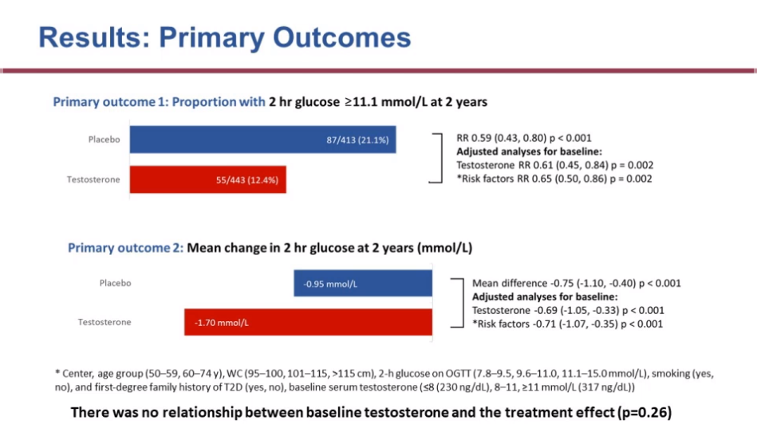
The T4DM study: primary outcomes
Primary outcome 1: proportion of men with OGTT 2-hour glucose ≥11.1 mmol/L at 2 years
Placebo
TTh
87/413 (21.1%)
RR 0.59 (95% CI: 0.43, 080); p<0.001
Adjusted analyses for baseline:
Testosterone RR 0.61 (95% CI: 0.45, 0.84); p=0.002
*Risk factors RR 0.65 (95% CI: 0.50, 0.86); p=0.002
55/443 (12.4%)
Primary outcome 2: mean change in OGTT 2-hour glucose at 2 years (mmol/L)
Mean difference -0.75 (95% CI: 01.10, -0.40); p<0.001
Adjusted analyses for baseline:
Testosterone -0.69 (95% CI: -1.05, -0.33); p<0.001
*Risk factors -0.71 (95% CI: -1.07, -0.35); p<0.001
-0.95 mmol/L
Placebo
TTh
-1.70 mmol/L
TTh decreased RR of T2DM at 2 years by ~40% beyond lifestyle programme alone
There was no relationship between baseline testosterone and the treatment effect (p=0.26)
*Centre, age group (50–59, 60–74 years), WC (95–100, 101–115, >115 cm), 2-hour glucose on OGTT (7.8–9.5, 9.6–11.0, 11.1–15.0 mmol/L), smoking (yes, no),
first-degree family history of T2DM (yes, no), baseline serum testosterone (≤8, 8–11, ≥11 mmol/L)
CI, confidence interval; OGTT, oral glucose tolerance test; T2DM, type 2 diabetes mellitus; TTh, testosterone therapy; WC, waist circumference
Wittert GA et al. Diabetes 2020;69(Suppl 1): https://doi.org/10.2337/db20-274-OR.
Notes:
Reference
Wittert GA et al. Diabetes 2020;69(Suppl 1): https://doi.org/10.2337/db20-274-OR.

Slide 95
The T4DM study: secondary outcomes
Change from baseline in body composition
Change from baseline in sexual function
-8
-6
-4
-2
0
2
-1.0
-0.5
0
0.5
1.0
1.5
p=0.06
Body weight (kg)
Erectile function score
Waist circumference (cm)
Orgasmic function score
Total muscle mass (kg)
Sexual desire score
Total fat mass (kg)
Intercourse
satisfaction score
Abdominal fat (%)
Arm muscle mass (kg)
Overall sexual
satisfaction score
Grip strength (kg)
p=0.14
Total LUTS score
Placebo TTh
Placebo TTh
All p<0.001 unless otherwise stated
LUTS, lower urinary tract symptoms; TTh, testosterone therapy
Wittert GA et al. Diabetes 2020;69(Suppl 1): https://doi.org/10.2337/db20-274-OR.
Notes:
TTh was associated with favourable changes in body composition.
Patients treated with TTh showed greater decreases from baseline in fasting glucose
(-0.17 mmol/L), waist circumference (-2.1 cm), total fat mass (-2.7 kg) and abdominal fat mass (-2.3%), and greater increases in total muscle mass (+1.7 kg), arm muscle mass
(+0.36 kg) and hand grip strength (+2.2 kg) versus those receiving placebo (all p<0.004).
TTh was also associated with small benefits on sexual function.
TTh, testosterone therapy
Reference
Wittert GA et al. Diabetes 2020;69(Suppl 1): https://doi.org/10.2337/db20-274-OR.

Slide 96
The T4DM study: secondary outcomes (cont.)
 | Placebo | TTh | Relative risk (95% CI) |  | p value
 | n/N (%)
Endpoint
Normalised blood glucose (OGTT 2-hour glucose <7.8 mmol/L) | 179/413 (43.3) | 230/443 (51.9) |  | 1.20 (1.04 to 1.38) | 0.012
Reported use of anti-diabetic drugs | 16/503 (3.2) | 20/504 (4.0) |  | 1.25 (0.65 to 2.38) | 0.50
Compliant with lifestyle program | 132/471 (28.0) | 144/480 (30.0) |  | 1.07 (0.88 to 1.31) | 0.50
Achieved sufficient weekly exercise | 280/398 (70.4) | 293/434 (67.5) |  | 0.96 (0.88 to 1.05) | 0.38
0.5
5
Favours placebo
Favours TTh
CI, confidence interval; OGTT, oral glucose tolerance test; TTh, testosterone therapy
Wittert GA et al. Diabetes 2020;69(Suppl 1): https://doi.org/10.2337/db20-274-OR.
Notes:
Reference
Wittert GA at al. Diabetes 2020;69(Suppl 1): https://doi.org/10.2337/db20-274-OR.

Slide 97
The T4DM study: safety
Summary of safety triggers by treatment
Summary of Serious AEs by treatment
 | Placebo | TTh
Participants receiving ≥1 dose of treatment | 503/503 | 504/504
Any trigger | 93/485 (19.2%) | 185/492 (37.6%)
Haematocrit ≥54%* | 6/484 (1.2%) | 106/491 (21.6%)
Increased PSA | 87/468 (18.6%) | 109/480 (22.7%)
25/106 (5% of total) had HCT ≥ 54 on repeat testing and were excluded from the study
 | Placebo | TTh
 | 41 (7%) | 55 (11%)
Arrhythmias | 3 | 8
IHD | 13 | 7
Cerebrovascular disease | 3 | 4
BPH | 3 | 8
Prostate cancer | 5 | 4
Depression | 3 | 1
Venous thrombotic events | 0 | 2
Other cancers | 10 | 4
There were 2 deaths in each group
*Denominators reflect patients with ≥1 haematocrit reading on study
BPH, benign prostatic hyperplasia; IHD, ischaemic heart disease; PSA, prostate-specific antigen; TTh, testosterone therapy
Wittert GA et al. Diabetes 2020;69(Suppl 1): https://doi.org/10.2337/db20-274-OR.
Notes:
Frequent treatment-induced elevations of haematocrit were reported. Risk factors for an increase in haematocrit should be considered before prescribing TTh.
The cardiovascular safety profile of TTh in this patient population was reassuring.
Of the 106 participants who recorded haematocrit ≥54%:
25 ceased study treatment due to confirmed raised haematocrit following hospital pathology service repeat testing
38 had flagged haematocrit occur at weeks 90 or 102 after the final study injection had already been given
5 ceased treatment for another reason prior to the visit with the flagged haematocrit
3 ceased treatment at the same visit as the flagged haematocrit for another reason
40 continued treatment after recording raised haematocrit; according to the protocol, participants should only have continued study injections if a local site (hospital) pathology test returned haematocrit <0.54% on repeat – the men in this group had haematocrit at or just over 0.54% on the core laboratory measurement, but were <0.54 on repeat and did not attract a subsequent flag
TTh, testosterone therapy
Reference Wittert GA et al. Diabetes 2020;69(Suppl 1): https://doi.org/10.2337/db20-274-OR.

Slide 98
Case study – Part 1: Patient Profile
Chris: 54 year old office worker with type 2 diabetes mellitus (T2DM)
He has had erectile dysfunction for several years which is putting a strain on his marriage.
Whilst he was being managed by the secondary care diabetic team he was started on daily sildenafil 50mg for erectile dysfunction which worked on rare occasions.
He didn’t think anymore could be done about it.
* This patient profile is based on a real patient, and has been anonymised and reproduced with permission.

Slide 99
Case study – Part 2: Route to Diagnosis
Chris: 54 year old office worker with type 2 diabetes mellitus (T2DM)
He had his bloods taken in GP diabetic clinic and a testosterone level was added to the screening.
  Total Testosterone (TT) = 5.6nmol/L, Free Testosterone (FT) = 0.125nmol/L
Chris was asked to attend the practice to discuss these results. On further questioning it transpired that he was dissatisfied with his erections and had a low libido.
  His AMS score was 48 (moderate to severe symptoms)
  Waist circumference: 42 inches
  HbA1c: 68mmol/mol
Chris was counselled regarding TD and had no contraindications to testosterone therapy (TTh).
He was started on daily testosterone gel and his PDE5i was changed to a daily dose.

Slide 100
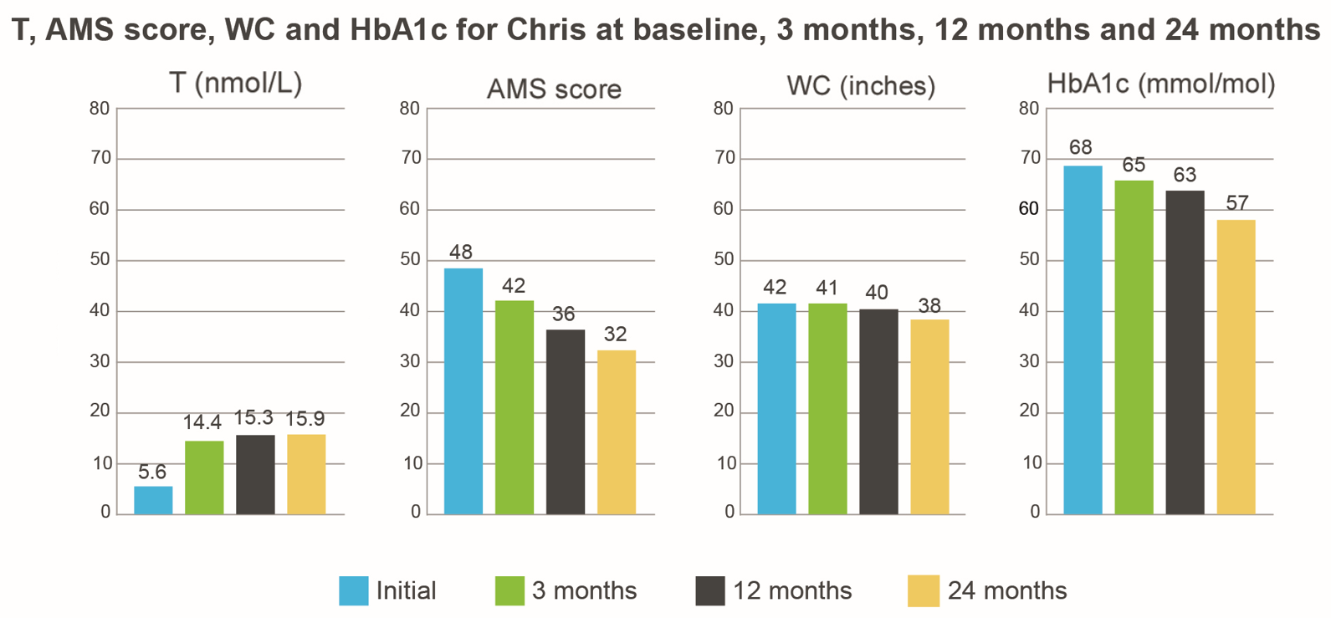
Case study – Part 3: Two years later
Chris: 54 year old office worker with type 2 diabetes mellitus (T2DM)
Following Testogel** treatment for his TD after 24 months:
  Testosterone: 15.9nmol/L
  AMS score: 32
  WC: 38 inches
  HbA1c: 57mmol/mol
Feels much better
His wife said, “Thank you so much for helping Chris. He’s like the man I fell in love with”
* This patient profile is based on a real patient, and has been anonymised and reproduced with permission.
**This patient started treatment in Sept 2016 on one sachet of Testogel 50mg per day. In February 2018 he was changed to Testogel 16.2mg/g pump (40.5mg/day)
AMS - Ageing Males’ Symptoms; TD - Testosterone Deficiency; WC - Waist Circumference; T - Testosterone

Slide 101

Case study 2*: Borderline Total Testosterone
Peter: 60 year old man complaining of ED, low libido, increased anxiety & fatigue
Initial tests done in December 2018:
  1st – TT (11.2nmol/L) SHBG (54nmol/L) FT (0.161) nmol/L
  2nd – TT (11.4nmol/L) SHBG (55nmol/L) FT (0.162) nmol/L
  WC 94cm / BMI 28 / AMS 49
Diagnosed with TD based on symptoms and a low free testosterone. Treatment started with Testogel 16.2mg/g
Follow up appointment October 2019:
  Most recent TT (20.0) FT (0.307) nmol/L
  Doing very well, symptoms have improved, has confidence to meet new people and has started to date again.
  He has increased work capacity, general improvement in quality of life and is very happy with TTh
* This patient profile is based on a real patient, and has been anonymised and reproduced with permission.
AMS - Ageing Males’ Symptoms; TD - Testosterone Deficiency; WC - Waist Circumference; TT – Total Testosterone; FT – Free Testosterone; BMI – Body Mass Index; SHBG – Sex Hormone Binding Globulin; TTh – Testosterone Therapy

Slide 102
Safety Considerations with Testosterone Therapy (TTh)

Slide 103
Challenges and controversies of treating testosterone deficiency (TD) with testosterone therapy (TTh)
TD is an increasingly common problem, with significant health implications for those affected¹
National guidelines from the British Society for Sexual Medicine (BSSM) are clear that improving the diagnosis and management of TD in adult men should provide somatic, sexual and psychological benefits and subsequent improvements in quality of life.¹
Erectile dysfunction (ED) is one of the most common symptoms of TD. Therefore, the increasing realisation that ED is a strong marker for CHD risk, and recent recommendations on obesity and diabetes by the AACE, ACE and the ADA, are likely to increase the number of men with TD detected by routine screening¹
Despite these guidelines and recommendations many patients remain untreated²
Treatment has been limited, in some part, by specific studies that appeared to find evidence linking testosterone (T) with prostate cancer and CV risk³⁻⁵
CHD, coronary heart disease; AACE, American Association of Clinical Endocrinologists; ACE, American College of Endocrinology; ADA, American Diabetes Association; CV, cardiovascular.
1. Hackett G, et al. J Sex Med 2017;14:1504-1523. 2. David J, Diabetes & Primary Care Vol 19 No 2 2017 3.. Vigen R, et al. JAMA 2013;310(17):1829-36; 4. Finkle WD, et al. PloS One 2014;9(1):e85805. 5. Huggins C, Hodges CV. Cancer Res 1941;1:293-297.

Slide 104
Testosterone Therapy &
Prostate Cancer (PCa)

Slide 105
TESTOGEL® (testosterone) contraindications regarding PCa
Contraindication
TESTOGEL® is contraindicated in cases of known or suspected prostatic cancer or breast carcinoma^{1,2}
Special Warnings and Precautions
Androgens may accelerate the progression of sub-clinical prostatic cancer^{1,2}
Data on prostate cancer risk in association with testosterone therapy are inconclusive²
TESTOGEL® 16.2 mg/g Summary of Product Characteristics July 2018.
TESTOGEL® 50 mg Summary of Product Characteristics August 2018.
Notes:
What do competitor SPCs say about contraindications regarding prostate cancer?
Tostran 2% gel Summary of Product Characteristics February 2017:
Contraindicated in cases of known or suspected carcinoma of the breast or the prostate
Androgens may accelerate the progression of subclinical prostatic cancer and benign prostatic hyperplasia
Data on prostate cancer risk in association with testosterone therapy are inconclusive
Testavan 20 mg/g Summary of Product Characteristics September 2018:
Contraindicated incases of known or suspected carcinoma of the breast or the prostate
Androgens may accelerate the progression of subclinical prostatic cancer and benign prostatic hyperplasia
Data on prostate cancer risk in association with testosterone therapy are inconclusive
Nebido 1000mg/4ml Summary of Product Characteristics October 2018:
Contraindicated in men with androgen dependent carcinoma of the prostate or of the male mammary gland
Androgens may accelerate the progression of subclinical prostatic cancer and benign prostatic hyperplasia
Sustanon 250, 250mg/ml Summary of Product Characteristics January 2017:
Contraindicated in cases of known or suspected carcinoma of the breast or the prostate
Restandol® Testocaps 40 mg capsule Summary of Product Characteristics March 2019:
Contraindicated in cases of known or suspected carcinoma of the breast or the prostate
Testosterone Enantate Ampoules Summary of Product Characteristics Dec 2016
Contraindicated in Androgen-dependent carcinoma of the prostate or of the male mammary gland
Older patients treated with androgens may be at increased risk for the development of prostatic hyperplasia. Although there are no clear indications that androgens actually generate prostatic carcinoma, these can enhance the growth of any existing prostatic carcinoma. Therefore carcinoma of the prostate has to be excluded before starting therapy with testosterone preparations.
Testim although still licensed for use is no longer marketed by Ferring Pharmaceuticals
(ref: https://www.prescriber.org.uk/2018/01/notice-of-testim-discontinuation/ )

Slide 106
Historical perspective on testosterone and prostate cancer (1/2)
Morgentaler A. Testosterone and Prostate Cancer:
An Historical Perspective on a Modern Myth - Eur Urol 2006;50(5):935-939.
In 2006, Abraham Morgentaler, a urologist at the Beth Israel Deaconess Medical Centre, Harvard Medical School, carried out a review of the historical origins and current evidence for the belief that testosterone (T) caused prostate cancer (PCa) growth¹
The review included historical literature regarding T administration and PCa, as well as more recent studies investigating the relationship of T and PCa ¹
He explained that in 1941, Huggins and Hodges reported that marked reductions in T by castration or oestrogen treatment caused metastatic PCa to regress, and administration of exogenous T caused PCa to grow
1. Morgentaler A. Eur Urol 2006;50(5):935-939. 2. Huggins C, Hodges CV. Cancer Res 1941;1:293-297.

Slide 107
Historical perspective on testosterone and prostate cancer (2/2)
However, at the time of review, the published rate of PCa from more recent data from clinical trials was approximately 1%, similar to the cancer detection rate in prostate cancer screening trials
Furthermore, no direct correlation between total T levels and PCa was identified in any of the 16 longitudinal studies evaluated, nor was a reduced risk of PCa identified in men with low T levels
Therefore, there appears to be a lack of evidence for what has been assumed for decades to be a solid relationship between T and PCa
In 2009, Morgentaler and Traish published the saturation model², a conceptual framework that had been developed to help account for the apparent paradox in which; If lowering T causes PCa to regress, why is it that raising T fails to cause PCA to grow?
The Saturation Model is described on the next slide, and was developed using publications dating from 1941 to 2008 that addressed the experimental and clinical effects of androgens on prostate growth in human and animal studies. This included studies investigating the effect of testosterone administration in hypogonadal men without PCa
Morgentaler A. Eur Urol 2006;50(5):935-939.
Morgentaler A et al. Eur Urol 2009; 55: 310–21

Slide 108
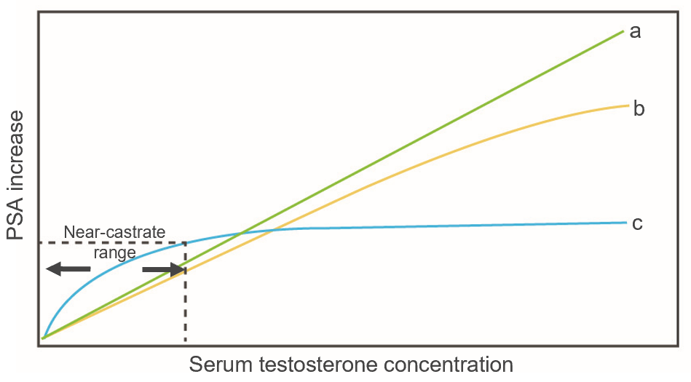
Saturation model: near-castrate and greater T levels have little or no effect on PCa growth
Proposed saturation model for relationship between PCa growth and serum T concentration^{1,2}
Curves a, b
The traditional belief that a higher T concentration causes increasing rates of PCa growth (curves a and b) has been challenged²
Curve c
The Saturation Model describes a steep T-dependent curve for PCa growth at T-concentrations at or below the near-castrate range, yet little or no further growth above this concentration^{1,2}
  The proposed saturation model for the relationship between T and PCa (curve c) is consistent with that seen in many other biologic systems²
Adapted from Morgentaler et al. 2009 and 2015^{1,2}
1. Morgentaler A et al. Asian J Androl 2015; 17: 206–11;
2. Morgentaler A et al. Eur Urol 2009; 55: 310–21.
Notes:
“A simple analogy is the dehydrated house plant that grows lushly when it finally receives water; yet once adequately watered any further growth will depend on factors other than the relative abundance of water.”
Reference
Morgentaler A et al. Eur Urol 2009; 55: 310–21.

Slide 109
The relationship between total testosterone (TT) and prostate cancer (PCa) is unclear
Summary chart highlighting inconsistent results in trials that looked at association between TT and PCa
Review of 45 articles*¹
18 studies
17 studies
10 studies
Association between low
TT & PCa
Association between high
TT & PCa
No association between
TT & PCa
Because the relationship is unclear, SPCs for all testosterone therapies still carry the contraindication and warnings²⁻⁷
*Literature search identified 45 articles published between 1994 and 2014 reporting the findings of randomised controlled trials, prospective studies or studies containing observational data on the relationship between TT and PCa.
Chart adapted from Klap et al J Urol 2015; 193: 403–13.
1. Klap J et al. J Urol 2015; 193: 403–13. 2. TESTOGEL® 16.2 mg/g Summary of Product Characteristics July 2018. 3. TESTOGEL® 50 mg Summary of Product Characteristics August 2018. 4. Tostran 2% gel Summary of Product Characteristics February 2017. 5. Testavan 20 mg/g Summary of Product Characteristics September 2018. 6. Nebido 1000mg/4ml Summary of Product Characteristics October 2018. 7. Sustanon 250, 250mg/ml Summary of Product Characteristics January 2017.
Notes:
Results from studies included in this review were not consistent and therefore it is not possible to demonstrate conclusively what the relationship between TT and pCA is.
Because of this inconsistency, the contraindications and warnings in the testosterone product licenses exist.
Reference
Klap J et al. J Urol 2015; 193: 403–13.

Slide 110
Meta-analysis of 51 studies showed no significant effect on prostate outcomes (1 of 2)
Fernandez-Balsells et al. Adverse Effects of TTh in Adult Men: A Systematic Review & Meta-analysis
Journal of Clinical Endocrinol Metab, June 2010, 95(6):2560–2575
  Systematic review & meta-analysis of 51 randomised and non-randomised comparative studies of adult men with low or low-normal testosterone receiving TTh for ≥3 months to 3 years
  Objective was to conduct an updated systematic review of randomised trials and observational studies with long term follow up, to evaluate the adverse effects of testosterone therapy in men, including prostate outcomes.
  Prostate outcomes included: Diagnosis of prostate cancer, PSA > 4ng/mL or an increase of PSA >1.4ng/mL above baseline, prostatic biopsy, increase in IPSS >4, acute urinary retention and a composite endpoint that combines all of the above
  There was no significant effect of TTh on any prostatic/urological outcomes when compared with the placebo/non-intervention group (See Table 1 on following slide)
1. Fernández-Balsells MM et al. J Clin Endocrinol Metab 2010; 95: 2560–75.
IPSS – International Prostate Symptom Score
CI, confidence interval; NA, not available; PSA, prostate-specific antigen; RR, relative risk; TTh, testosterone therapy.

Slide 111
Meta-analysis of 51 studies showed no significant effect on prostate outcomes (2 of 2)
Fernandez-Balsells et al. Adverse Effects of TTh in Adult Men: A Systematic Review & Meta-analysis
Journal of Clinical Endocrinol Metab, June 2010, 95(6):2560–2575
Table 1: Relative risk of prostatic/urological outcomes for testosterone treated group vs placebo treated group
Endpoint | Relative Risk (RR) | 95% CI
 |  | Lower boundary | Upper boundary
Composite prostate endpoint (a combination of all the below) | 1.41 | 0.93 | 2.14
Impaired urinary flow | 0.86 | 0.13 | 5.53
PSA level >4 ng/mL | 1.22 | 0.67 | 2.21
Increase in PSA (>1.5 ng/mL unless otherwise specified) | 1.56 | 0.87 | 2.8
Prostate symptom scale (increases in IPSS >4) | 0.29 | -0.44 | 1.02
Prostate cancer | 0.79 | 0.28 | 2.28
Prostate biopsies | 3.82 | 0.97 | 15
Adapted from Fernández-Balsells MM et al. J Clin Endocrinol Metab 2010; 95: 2560–75.
1. Fernández-Balsells MM et al. J Clin Endocrinol Metab 2010; 95: 2560–75.
IPSS – International Prostate Symptom Score
CI, confidence interval; NA, not available; PSA, prostate-specific antigen; RR, relative risk; TTh, testosterone therapy.

Slide 112
A more recent meta-analysis (2014) of 22 RCTs also showed no significant effect of TTh on incidence of prostate cancer vs placebo
Cui et al. The effect of testosterone replacement therapy on prostate cancer: a systematic review and meta-analysis.
Prostate Cancer and Prostatic Disease (2014) 17, 132–143
  Meta-analysis of 22 randomised controlled trials in men receiving TTh^ or placebo
    11 RCTs compared TTh vs Placebo over the short term (<12 months)
    11 RCTs compared TTh vs placebo over the long term (12-36 months)
  For all 22 RCTs, no patients had prostate enlargement at baseline, all had normal PSA levels at baseline, and no patient had suspected or confirmed diagnosis of prostate cancer at study entry
  Objective of the study was to evaluate the effect of testosterone therapy on incidence of prostate cancer
  No significant effect of TTh on the incidence of prostate cancer, compared with placebo.
Table 2: Odds Ratio (OR) for prostate cancer in patients using transdermal TTh vs placebo
Event | Short-term studies * |  | Long-term studies **
 | OR | 95% CI | OR | 95% CI
Prostate cancer | 1.10 | 0.26, 4.65 | 3.06 | 0.12, 76.70
Adapted from Cui Y et al. Prostate Cancer Prostatic Dis 2014; 17: 132–43.
CI, confidence interval; pCA, prostate cancer; OR, Odds Ratio; TTh, testosterone therapy
1. Cui Y et al. Prostate Cancer Prostatic Dis 2014; 17: 132–43.
^ Oral, transdermal or injectable T therapy
* Data from 5 RCTs (n = 1168). ** Data from 3 RCTs (n=379)
Notes:
When the confidence interval for the odds ratio includes 1.00 the result is not significant

Slide 113
What do the Guidelines say about TTh and risk of prostate cancer?
The Endocrine Society state that the relationship between T administration and the risk of prostate cancer remains poorly understood and that no RCT has been long enough or large enough to have adequate statistical power to determine whether T administration increases the risk of prostate cancer⁵
The EAU Guidelines state that most recent studies indicate that testosterone therapy does not increase the risk of prostate cancer, but long-term follow-up data are not yet available¹
Other guidelines from the BSSM,² ICSM,³ ISSM,⁴ and ISSAM⁶ conclude that there is no compelling evidence that T therapy is associated with an increased risk of pCA
“Careful assessment of the prostate before starting T therapy and regular monitoring for prostate disease once the patient is on T therapy remain essential. Early increases in PSA after initiation of T therapy could unmask an occult prostate carcinoma that was undetected at baseline.”
BSSM Guidelines on Adult Testosterone Deficiency with Statements for UK Practice 2017²
EAU, European Association of Urology; BSSM, British Society for Sexual Medicine; ICSM, International Consultation for Sexual Medicine;
ISSM, International Society of Sexual Medicine; ES, Endocrine Society; ISAAM, International Study of the Aging Male.
1. Dohle GR et al. Guidelines of Male Hypogonadism. European Association of Urology 2015. Available at: https://uroweb.org/wp-content/uploads/18-Male-Hypogonadism_LR1.pdf Accessed February 2019. 2. Hackett G, et al. J Sex Med 2017;14:1504-1523. 3. Khera M, Adaikan G, Buvat J, et al. J Sex Med 2016;13:1787-1804. 4. Dean JD, McMahon CG, Guay AT, et al. J Sex Med 2015;12:1660-1686. 5. Bhasin S, Cunningham GR, Hayes FJ, et al; J Clin Endocrinol Metab 2010;95:2536-2559. 6. Lunenfeld B, Mskhalaya G, Zitzmann M, et al. Aging Male 2015;18:5-15.

Slide 114
Testosterone &
Cardiovascular Disease

Slide 115
TESTOGEL® and Cardiovascular Risk¹
Special Warnings and Precautions
In patients suffering from severe cardiac, hepatic or renal insufficiency or ischaemic heart disease, treatment with testosterone may cause severe complications characterised by oedema with or without congestive cardiac failure. In such case treatment must be stopped immediately. In addition, diuretic therapy may be required
Testosterone may cause a rise in blood pressure and TESTOGEL® should be used with caution in men with hypertension
Testosterone should be used with caution in patients with thrombophilia or risk factors for venous thromboembolism (VTE), as there have been post-marketing studies and reports of thrombotic events (e.g. deep-vein thrombosis, pulmonary embolism, ocular thrombosis) in these patients during testosterone therapy.
In thrombophilic patients, VTE cases have been reported even under anticoagulation treatment, therefore continuing testosterone treatment after first thrombotic event should be carefully evaluated. In case of treatment continuation, further measures should be taken to minimise the individual VTE risk.
1. TESTOGEL® 16.2 mg/g Summary of Product Characteristics March 2021.
Notes:
What do competitor SPCs say about CV risk?
Tostran 2% gel Summary of Product Characteristics February 2017:
In patients suffering from severe cardiac, hepatic, or renal insufficiency or ischaemic heart disease, treatment with testosterone may cause severe complications characterised by oedema with or without congestive cardiac failure. In such case, treatment must be stopped immediately
Testosterone may cause a rise in blood pressure and Tostran should be used with caution in men with hypertension
Testosterone should be used with caution in patients with thrombophilia, as there have been post-marketing studies and reports of thrombotic events in these patients during testosterone therapy.
Testavan 20 mg/g Summary of Product Characteristics September 2018:
In patients suffering from severe cardiac, hepatic, or renal insufficiency or ischaemic heart disease, treatment with testosterone may cause severe complications characterised by oedema with or without congestive cardiac failure. In such case, treatment must be stopped immediately
Testosterone may cause a rise in blood pressure and Testavan should be used with caution in men with hypertension
Testosterone should be used with caution in patients with thrombophilia, as there have been post-marketing studies and reports of thrombotic events in these patients during testosterone therapy.
Nebido 1000mg/4ml Summary of Product Characteristics October 2018:
In patients suffering from severe cardiac, hepatic, or renal insufficiency or ischaemic heart disease, treatment with testosterone may cause severe complications characterised by oedema with or without congestive cardiac failure. In such case, treatment must be stopped immediately
Caution should be exercised in patients predisposed to oedema, e.g. in case of severe cardiac, hepatic, or renal insufficiency or ischaemic heart disease, as treatment with androgens may result in increased retention of sodium and water. In case of severe complications characterized by oedema with or without congestive heart failure treatment must be stopped immediately
Testosterone may cause a rise in blood pressure and Nebido should be used with caution in men with hypertension
Testosterone should be used with caution in patients with thrombophilia, as there have been post-marketing studies and reports of thrombotic events in these patients during testosterone therapy.
Sustanon 250, 250mg/ml Summary of Product Characteristics January 2017:
In patients suffering from severe cardiac, hepatic, or renal insufficiency or ischaemic heart disease, treatment with testosterone may cause severe complications characterised by oedema with or without congestive cardiac failure. In such case, treatment must be stopped immediately
Patients who experienced myocardial infarction, cardiac-, hepatic- or renal insufficiency, hypertension, epilepsy, or migraine should be monitored due to the risk of deterioration of or reoccurrence of disease. In such cases treatment must be stopped immediately.
Testosterone may cause a rise in blood pressure and Sustanon 250 should be used with caution in men with hypertension
Testosterone should be used with caution in patients with thrombophilia, as there have been post-marketing studies and reports of thrombotic events in these patients during testosterone therapy.
Restandol® Testocaps 40 mg capsule Summary of Product Characteristics March 2019:
In patients suffering from severe cardiac, hepatic or renal insufficiency or ischaemic heart disease, treatment with testosterone may cause severe complications characterised by oedema with or without congestive cardiac failure. In such case, treatment must be stopped immediately.
Patients who experienced myocardial infarction, cardiac, hepatic or renal insufficiency, hypertension, epilepsy, or migraine should be monitored due to the risk of deterioration or reoccurrence of disease. In such cases, treatment must be stopped immediately. In addition to discontinuation of the drug, diuretic therapy may be required.
Testosterone may cause a rise in blood pressure and Restandol Testocaps should be used with caution in men with hypertension
Testosterone should be used with caution in patients with thrombophilia, as there have been post-marketing studies and reports of thrombotic events in these patients during testosterone therapy.
Testosterone Enantate Ampoules Summary of Product Characteristics Dec 2016
In patients suffering from severe cardiac, hepatic or renal insufficiency or ischaemic heart disease, treatment with testosterone may cause severe complications characterised by oedema with or without congestive cardiac failure. In such case, treatment must be stopped immediately.
Testosterone may cause a rise in blood pressure and Testosterone Enantate should be used with caution in men with hypertension.
Testosterone should be used with caution in patients with thrombophilia, as there have been post-marketing studies and reports of thrombotic events in these patients during testosterone therapy.
Testim although still licensed for use is no longer marketed by Ferring Pharmaceuticals
(ref: https://www.prescriber.org.uk/2018/01/notice-of-testim-discontinuation/ )

Slide 116
Recent media controversy surrounding CV risk of TTh
Historical Evidence
There is extensive literature, spanning >30 years in which low levels of testosterone (T) have been repeatedly associated with increased mortality and CV risk factors, and treatment with T in these cases appears to improve both outcomes and risk factors¹
Papers published from 2010 to 2014 by Vigen² , Finkle³ , Basaria⁴ and Xu⁵ demonstrated an association between TTh with increased rate of mortality, MI and stroke
  Media coverage of these findings led some physicians to stop prescribing TTh
The FDA announced plans to review CV safety issues, and issue alerts to HCPs to inform patients of possible elevated CV risk with testosterone use, as well as requiring manufacturers of T therapies to conduct a trial to address the question of whether an increased risk of heart attack or stroke exists with testosterone products^{6,7} (TRAVERSE study ongoing)
  The EMA PRAC was also asked to review the benefit/risk balance following concerns raised with regards to potential risk of CV events in the Finkle, Vigen and Xu studies⁸
MI, myocardial infarction; FDA, Food and Drug Administration; CV, cardiovascular; HCP, healthcare professional; EMA, European Medicines Agency; PRAC, pharmacovigilance & risk assessment committee.
1. Morgentaler A & Lunenfeld B. Aging Male 2014;17(2)63–652. 2. Vigen R, et al. JAMA 2013;310(17):1829-36; 3. Finkle WD, et al. PloS One 2014;9(1):e85805. 4. Basaria S, et al. N Engl J Med 2010;363:109-22. 5. Xu L et al. BMC Medicine 2013, 11:108 6. Morgentaler A, et al. May Clin Proc 2015.90(2):224-251. 7. https://www.fda.gov/downloads/Drugs/DrugSafety/UCM436270.pdf 8. Pharmacovigilance Risk Assessment Committee EMEA/H/A-31/1396 EMA/PRAC/599233/2014.

Slide 117
EMA PRAC Evaluation of CV risk following TTh ¹
In 2014, the EMA Pharmacovigilance & Risk Assessment Committee (PRAC) were also prompted to conduct a review of the benefit risk balance of testosterone containing medicinal products, with regards to the potential increased risk of CV events.
  The PRAC reviewed all data available from clinical trials, observational studies, meta-analyses, post-marketing data and further published data on the cardiovascular risks associated with testosterone therapy
  The studies and their limitations were considered together with the overall evidence available to date, and judged that the signal for an increased cardiovascular risk associated with the use of testosterone remains weak and inconclusive.
  The PRAC recommended the variation to the European licenses for testosterone-containing medicinal products to reflect current knowledge on CV risks associated with testosterone therapy and the need to monitor
1. Pharmacovigilance Risk Assessment Committee EMEA/H/A-31/1396 EMA/PRAC/599233/2014.

Slide 118
Subsequent studies have also shown no compelling evidence of increased CV risk with TTh
In 2015, Morgentaler et al¹ published a review of the literature looking at a number of specific topics related to T and CV risks. As studies with considerable media attention, Vigen and Finkle were individually analysed in this paper, which were both found to have methodological limitations.
  He concluded that there was no compelling evidence suggesting T therapy is associated with elevated CV risk.¹
A meta-analysis by Corona et al² was conducted in 2018 including 15 pharmaco-epidemiological studies and 93 RCTs looking at whether TTh represents a possible risk factor for CV morbidity and mortality.
  The objective was to verify whether T therapy (TTh) represents a possible risk factor for CV morbidity and mortality.
  When TTh was applied within recommended dosages, it was not associated with an increase in CV risk
.
1. Morgentaler A, et al. Mayo Clin Proc 2015.90(2):224-251, 2. Corona G, et al. J Sex Med 2018;15:820-838

Slide 119
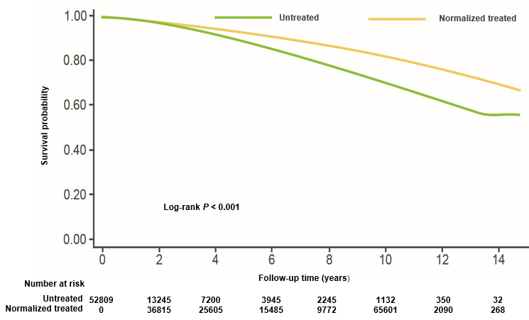
Normalisation of T level was associated with reduced incidence of MI & mortality in men without previous history of MI or ischaemic stroke¹
All-cause mortality among untreated vs normalised treated men
A retrospective analysis of 83,010 US veterans with low T levels:
- Group 1: normalised T with treatment
- Group 2: non-normalised T with treatment
- Group 3: untreated
Primary outcome measures:
Incidence of MI, ischaemic stroke, and all-cause mortality determined using dates of death in CDW data augmented with vital status files
Results:
Group 1 (normalized treated) vs Group 3 (untreated):
Mortality HR 0.44 (CI95% 0.42 - 0.46)
MI HR 0.76 (CI95% 0.63 - 0.93)
Stroke HR 0.64 (CI95% 0.43 - 0.96)
Similarly, all cause mortality, MI risk and stroke were significantly lower in the normalised treated group vs the non-normalized treated group but only for all-cause mortality in the non-normalised vs untreated groups
“…the weight of evidence indicates that T therapy is not associated with increased cardiovascular risk...” Khera M, et al. 2015²
Regulators have requested a study to further define the issue of CV safety with testosterone and that is currently ongoing
T, testosterone; MI, myocardial infarction; ICD, International Classification of Diseases; CDW, corporate data warehouse; HR, hazard ratio; CI, confidence interval; CVD, cardiovascular disease.
1. Sharma R, et al. Eur Heart J 2015.36(40):2706-2715.
Notes:
Why getting the levels into the physiological range is so important…
This really interesting retrospective study by Sharma and co-workers looked at over 80,000 individuals split into 3 groups.
One was a group of men with low testosterone who were treated and their testosterone levels normalised. Another was a group that got testosterone treatment but their levels failed to normalise so still remained low. And the 3rd was an untreated group.
The best results were seen in the men who were treated with testosterone and their levels normalised. When compared to the men whose levels did not normalise or even untreated men, the mortality rate was reduced by about half, heart attack rate was down and stroke rate was down.
A rather remarkable study that suggests that just applying testosterone may not be enough, but actually we need to get adequate treatment as evidenced by an increase in the blood levels.
In 2014, Sharma et al conducted a retrospective cohort study, examining 83010 male veterans with low T levels
Subjects were categorised into three groups
- Group 1: patients treated with TTh resulting normalisation of T levels (n=43,931)
- Group 2: patients treated with TTh without normalisation of T levels (n=25,701)
- Group 3: Patients who did not receive TTh (n=13,378)
The primary outcome measures of this study were
(I) the incidence of Myocardial Infarction (MI)
(ii) the incidence of Ischaemic Stroke
(iii) All cause mortality
Results for the outcome measures in the Normalised T group (Group1) vs the Untreated group (Group3) showed significant decreases in all three outcomes.
All-cause mortality for Group 1 vs Group 3 is illustrated in the Kaplan-Meier curve on this slide, where the group treated to normalised T levels had significantly fewer deaths compared to the group wo did not receive TTh
Similarly, results for all 3 outcome measures were significantly reduced for the normalised T group vs the non-normalised T group, indicating that achieving normalisation of T levels through treatment is important.
(There was a significant reduction in mortality for the non-normalised group and the untreated group, but no significant differences in the outcomes of MI or Ischaemic stroke between these two groups)
It is important to note that this is a retrospective, observational study and therefore not without its limitations, as acknowledge by the authors. The authors concluded that treatment with TTh should aim for doses resulting in normalisation of T levels, as this was shown to be associated with a reduction in adverse CV events. However adequately powered, prospective, well-designed trials with a long term follow up will be needed to reach a conclusive agreement regarding the effect of TTh on CV risk.

Slide 120
Summary (1/4)
Testosterone is important to many aspects of men’s health, including mood, energy levels, sexual function and sexual desire^{1,2}
Testosterone exerts a biological effect in multiple organs of the body, including the testes, muscles, adipose tissue, skin, hair, bone and the brain³
In healthy younger men, testosterone levels are highest in the morning, but this circadian rhythm tends to become less pronounced in older men⁴
There can be many causes of testosterone deficiency, including obesity, type 2 diabetes, certain medications, as well as the normal ageing process⁵
Symptoms of testosterone deficiency can be sexual, cardiometabolic, physical and psychological¹
1. Hackett G, et al. British Society for Sexual Medicine Guidelines on Adult Testosterone Deficiency, With Statements for UK Practice. J Sex Med 2017;14:1504-1523. 2. Kumar P, et al. J Adv Pharm Technol Res 2010.1(3):297-301. 3. Dandona P & Rosenberg MT. A practical guide to male hypogonadism in the primary care setting. J Clin Pract 2010.64(6):682-696. 4. Tenover JS, Matsumoto AM et al. Age-related alterations in the circadian rhythms of pulsatile luteinizing hormone and testosterone secretion in healthy men. J Gerontol. 1988 Nov;43(6):M163-9. 5. Khera et al J Sex Med 2016;13:1787-1804.

Slide 121
Summary (2/4)
As well as ‘classical’ forms of TD, ‘functional’ (late-onset or age-related) TD is now recognised as being common in men >50 yrs with conditions such as obesity and type 2 diabetes¹
TD causes not only physical symptoms, but also has a psychological impact in men, leading to depression, anxiety, and changes in sexual desire²
TD is challenging to diagnose due to:
  variable and non-specific signs and symptoms
  lack of definitive cut-off point for serum levels
  a wide variation in laboratory reference ranges for total testosterone
  inadequate attention to sexual health by men and physicians
  An undefined age range for investigation of T levels³
The ADAM questionnaire can help establish signs and symptoms of TD and the BSSM has recommended action levels to advise HCPs of serum T values that may require TTh¹
Early diagnosis and management can help men make lifestyle changes,³ receive treatment³ and enjoy an improved quality of life,¹ which can potentially deliver cost and time savings in primary and secondary care⁵
1. Hackett G, et al. British Society for Sexual Medicine Guidelines on Adult Testosterone Deficiency, With Statements for UK Practice. J Sex Med 2017;14:1504-1523. 2. Kumar P, et al. J Adv Pharm Technol Res 2010.1(3):297-301. 3. Defeudis G, et al. The CATCH checklist to investigate adult-onset hypogonadism. Andrology 2018.6;5. Available at: https://onlinelibrary.wiley.com/doi/full/10.1111/andr.12506 Accessed February 2019. 4. Morley JE et al. Metabolism 2000; 49:1239–1242. 5. Hackett G. An ED patient with low testosterone. Trends in urology and men’s health 2016. Tales from the clinic pp1-2.

Slide 122
Summary (3/4)
TD is an increasingly common problem, however despite this many patients with TD remain untreated^{1,2}
There are historical concerns surrounding the use of TTh specifically with regards to prostate cancer (PCa) and CV risk³⁻⁵
Guidelines from the EAU,⁶ BSSM,¹ ICSM,⁷ ISSM,⁸ ES⁹ and ISSAM¹⁰ state that there is no compelling evidence that TTh is associated with an increased risk of PCa
  However, studies have been unable to demonstrate conclusively what the relationship between TTh and PCa is
  Please note that Testogel is contraindicated in known or suspected PCa^{11,12}
In 2014 the EMA PRAC reviewed all available published data on the CV risks associated with TTh, and judged that the signal for an increased risk of CV risk associated with the use of TTh remains weak and inconclusive¹³
  The PRAC recommended the variation to the European licenses for testosterone-containing medicinal products to reflect current knowledge on CV risks associated with testosterone therapy and the need to monitor¹³
European Association of Urology (EAU); British Society for Sexual Medicine (BSSM); International Consultation for Sexual Medicine (ICSM); International Society for Sexual Medicine (ISSM); Endocrine Society (ES); International Society for the Study of the Ageing Male (ISSAM)
1. Hackett G, et al. J Sex Med 2017;14:1504-1523. 2. David J, Diabetes & Primary Care Vol 19 No 2 2017 3. Vigen R, et al. JAMA 2013;310(17):1829-36; 4. Finkle WD, et al. PloS One 2014;9(1):e85805. 5. Huggins C, Hodges CV. Cancer Res 1941;1:293-297. 6. Dohle GR et al. Guidelines of Male Hypogonadism. European Association of Urology 2015. Available at: https://uroweb.org/wp-content/uploads/18-Male-Hypogonadism_LR1.pdf Accessed February 2019. 7. Khera M, Adaikan G, Buvat J, et al. J Sex Med 2016;13:1787-1804. 8. Dean JD, McMahon CG, Guay AT, et al. J Sex Med 2015;12:1660-1686. 9. Bhasin S, Cunningham GR, Hayes FJ, et al; J Clin Endocrinol Metab 2010;95:2536-2559. 10. Lunenfeld B, Mskhalaya G, Zitzmann M, et al. Aging Male 2015;18:5-15. 11. TESTOGEL® 16.2 mg/g Summary of Product Characteristics July 2018. 12. TESTOGEL® 50 mg Summary of Product Characteristics August 2018.13. Pharmacovigilance Risk Assessment Committee EMEA/H/A-31/1396 EMA/PRAC/599233/2014.

Slide 123
Summary (4/4)
TD is not just a “lifestyle” condition but rather a well-established and significant medical condition
There are an abundance of patient cohorts that should be screened for TD. Is it worth focussing on one cohort initially e.g. T2DM?
We need to be aware of, and adhere to, evidence-based action limits as opposed to varying local laboratory reference ranges when diagnosing patients
We need to reinforce compliance to and longevity of treatment. Manage expectations of the patient at treatment initiation.
You may only get one opportunity to positively impact the health of any given male patient – Don’t waste that opportunity!

Slide 124
Thank you for your attention
QUESTIONS?

