Slide 1
Diagnosis of
Testosterone Deficiency (TD)
Besins Healthcare
Global Medical Affairs
March 2021

Slide 2
What is Testosterone Deficiency (TD)?
Testosterone deficiency is a well-established and significant medical condition
It is defined as a clinical and biochemical syndrome associated with advancing age and comorbidities
It is characterised by a deficiency in serum androgen levels and relevant signs and symptoms
Testosterone deficiency can adversely affect multiple organ systems and result in significant decreases in quality of life, including changes in sexual function
1. Hackett G, et al. British Society for Sexual Medicine Guidelines on Adult Testosterone Deficiency, With Statements for UK Practice. J Sex Med 2017;14:1504-1523.

Slide 3
Challenges of diagnosing TD
Treatment seeking is often delayed
Variable and non-specific signs and symptoms¹
Lack of definitive cut-off point for serum levels¹
There is a wide variation in reference ranges for total testosterone²
Inadequate attention to sexual health by men and physicians¹
Undefined age range for investigation of testosterone levels¹
No NICE guidelines for TD
1. Defeudis G, et al. The CATCH checklist to investigate adult-onset hypogonadism. Andrology 2018.6;5. Available at: https://onlinelibrary.wiley.com/doi/full/10.1111/andr.12506
Accessed February 2019. 2. Ramachandran et al. Managing Clinical Heterogeneity: An Argument for Benefit-Based Action Limits ASME J of Medical Diagnostics 1(3), 034701

Slide 4
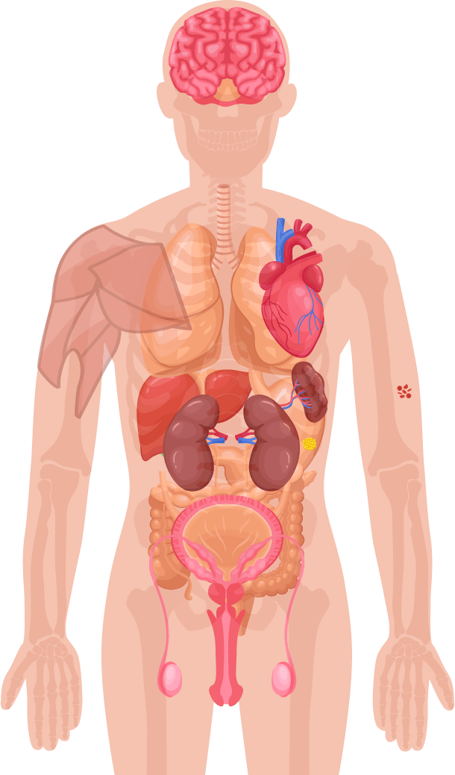
Symptoms of Testosterone Deficiency ¹⁻⁵
Psychological
Cardiometabolic
Physical
Sexual
Changes in mood (e.g. anger, irritability, sadness, depression)
Decreased well-being/poor self-rated health
Diminished cognitive function (including impaired concentration, verbal memory and spatial performance)
Increased body mass index (BMI)/obesity
Visceral obesity
Metabolic syndrome
Insulin resistance and type 2 diabetes
Decreased body hair
Gynaecomastia
Decreased muscle mass and strength
Hot flushes/sweats
Sleep disturbances
Fatigue
Osteoporosis/height loss/low trauma fractures
Delayed puberty
Small testes
Infertility
Decreased sexual desire and activity
Decreased frequency of sexual thoughts
Erectile dysfunction
Delayed ejaculation
Decreased volume of ejaculate
Decreased or absent morning/night-time erections
1. Khera M et al. Diagnosis and Treatment of Testosterone Deficiency: Recommendations From the Fourth International Consultation for Sexual Medicine (ICSM 2015). J Sex Med 2016;13:1787-804. 2. Lunenfeld B et al. Recommendations on the diagnosis, treatment and monitoring of hypogonadism in men. Aging Male 2015;18:5-15. 3. Hackett G et al. UK policy statements on testosterone deficiency. Int J Clin Pract 2017 Mar;71(3-4). doi: 10.1111/ijcp.12901. Epub 2017 Mar 20. 4. Dohle GH et al. Guidelines on Male Hypogonadism. European Association of Urology 2017. Available at: http://uroweb.org/guideline/male-hypogonadism/ (Accessed September 2017). 5. Dean JD et al. The International Society for Sexual Medicine’s process of care for the assessment and management of testosterone deficiency in adult men. J Sex Med 2015;12:1660-86.

Slide 5
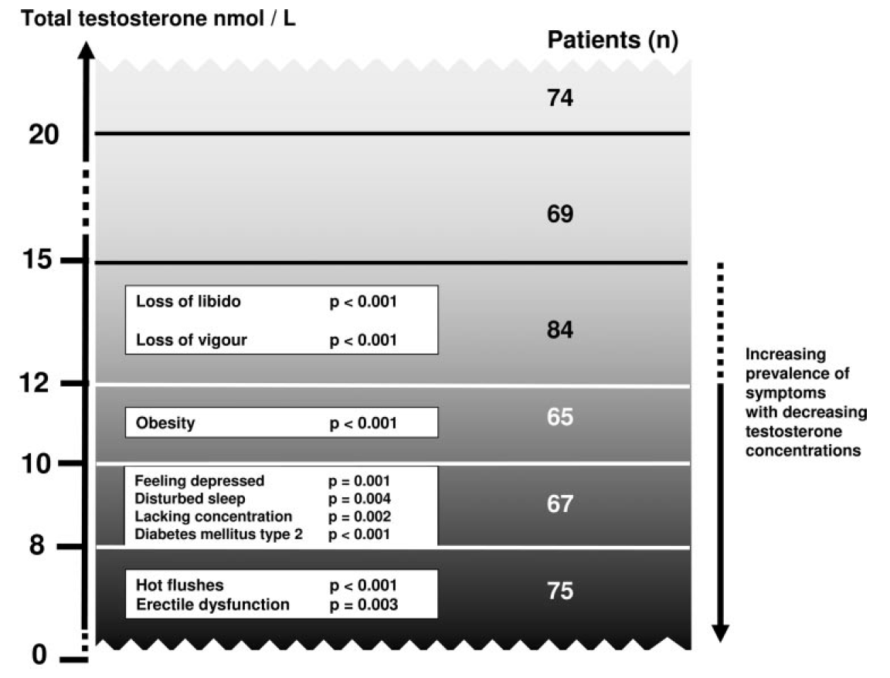
Clinical Features in Relation to Testosterone Levels
J Clin Endocrinol Metab, November 2006, 91(11):4335–4343
Zitzmann M, Faber S et al. J Clin Endocrinol Metab 2006; 91: 4335-4343.
Notes:
Zitzmann M, Faber S, Nieschlag E. Association of specific symptoms and metabolic risks with serum testosterone in older men. J Clin Endocrinol Metab 2006; 91: 4335-4343.
Overview of symptom specific concentrations of TT levels below which the prevalence of the respective symptom starts to increase, hence, a lack of androgen exerts an influence.

Slide 6
Treatment seeking for TD can often be delayed
In total, 55% of all respondents waited between 3 and 24 months, with 35% waiting for more than 2 years before seeking advice
Reasons for delaying among respondents who waited at least 3 months before seeking advice
David, J et al: The Journal of Sexual Medicine, Volume 13, Number 5, Supplement 2, May 2016
Respondents (n=90), %
Notes:
Source: Bryter Tables - Question #4b: Why did you wait before seeking advice?
Base: All respondents who sought advice after 3 or more months of symptoms.

Slide 7
Variable & non-specific signs and symptoms of testosterone deficiency (TD)
Single most influential symptom that encouraged seeking of doctor’s advice prior to diagnosis
David, J et al: The Journal of Sexual Medicine, Volume 13, Number 5, Supplement 2, May 2016
Respondents (n=101), %
Notes:
Source: Bryter Tables - Question #5: You indicated that you experienced the following symptoms PRIOR to being diagnosed as having low testosterone. Which ONE, if any of them, was MOST influential on your decision to seek advice from your doctor?

Slide 8

Triggers for considering TD
Erectile Dysfunction
Obesity
Osteoporosis
Depression
Medications
Post-Orchidectomy
Tired all the time (TATT)
Anaemia*
Fatigue/Sleep
Cognition/Memory
Reduced Muscle Mass
T2DM/MetS
Low Libido
CVD
*Screening for primary hypogonadism should form part of
anaemia work-up by all physicians, not just endocrinologists¹
1. Al-Sharefi A & Quinton R. Clin Endocrinol (Oxf) 2018;89:527–9.

Slide 9
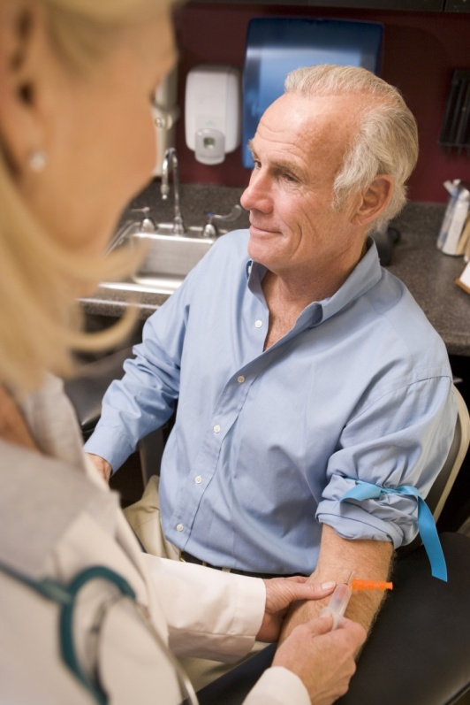
What is required to diagnose TD?
The 2018 Endocrine Society guidelines recommend diagnosing hypogonadism in men with symptoms and signs of testosterone deficiency and unequivocally and consistently low serum total testosterone and/or free testosterone concentrations (when indicated).
1. Bhasin S, et al. J Clin Endocrinol Metab 2018; 103: 1715–1744.

Slide 10
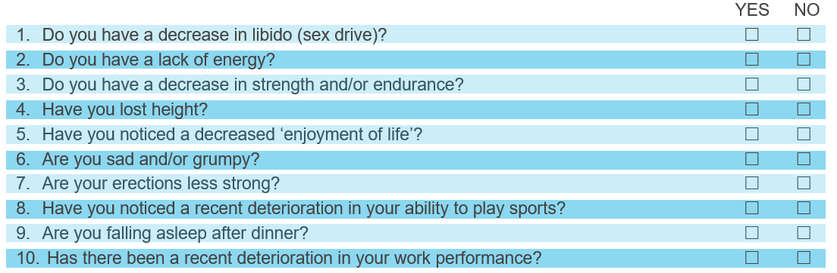
Establishing presence of signs & symptoms of TD - ADAM Questionnaire¹
Validated clinical screening tool to identify males >40 years who may have TD. Positive result defined as respondent answering “yes” to questions 1 or 7 or any 3 other questions
ADAM – Androgen Deficiency in the Ageing Male
1. Morley JE et al. Metabolism 2000; 49:1239–1242.
Notes:
The Aging Males’ Symptoms scale (AMS)¹ is another popular questionnaire to determine the presence and severity of TD symptoms
1. Moore C, et al. Eur Urol 2004. 46(1):80-7.

Slide 11
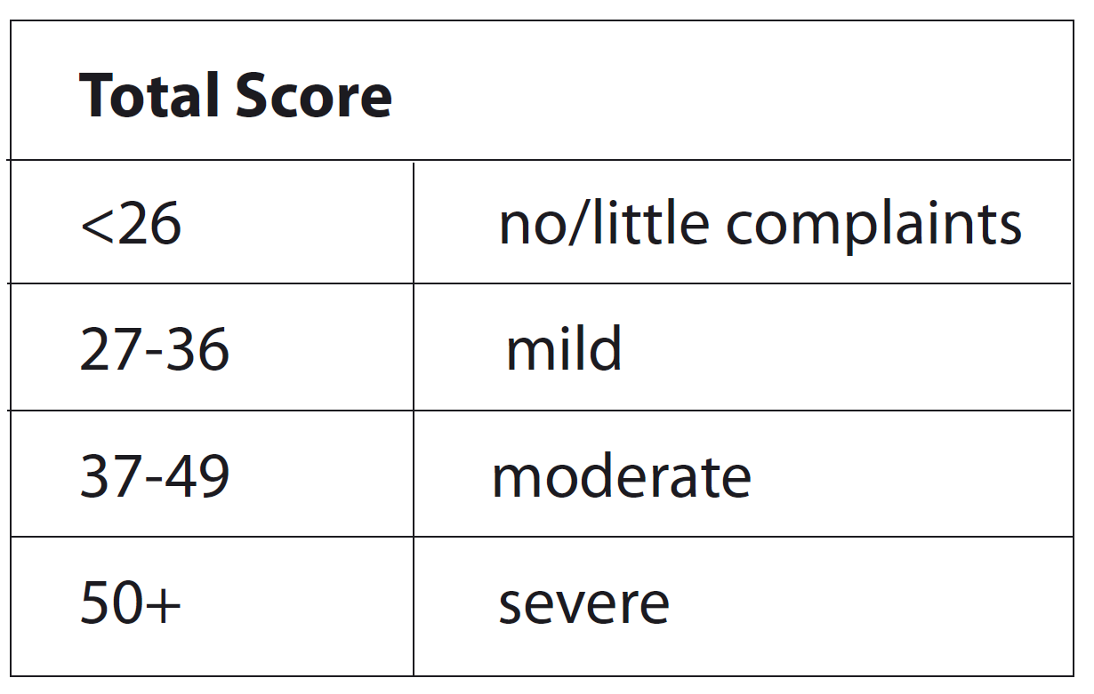
Establishing presence of signs & symptoms of TD - AMS Score¹
AMS – Ageing Male Symptoms
1. Moore C, et al. Eur Urol 2004. 46(1):80-7.
Notes:
The Aging Males’ Symptoms scale (AMS)¹ is another popular questionnaire to determine the presence and severity of TD symptoms

Slide 12
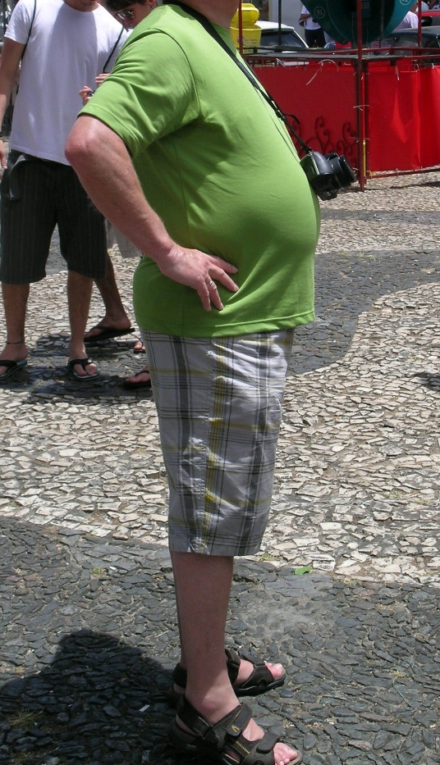

Physical Examination
On physical examination, features suggestive of TD include:
  Decreased body hair
  Decreased testicular size
  Gynaecomastia
  Fine wrinkling of the skin, especially around the mouth, can be apparent.
  BMI
  Waist circumference >94cm

Slide 13
Measurements of Testosterone
  Total Testosterone (TT)
    Serum T = free T + protein bound T
  Free Testosterone (FT)
    Free T = non protein bound T
    Free T can be calculated from TT, SHBG, albumin
  Bioavailable Testosterone (Bio T)
    Less frequently used to diagnose TD
    Bio T = Free T + albumin bound T
Bhasin S, Cunningham GR et al. J Clin Endocrin Metab. 2006; 91:1995-2010.
Wang C, Nieschlag E et al. Aging Male 2008; 1-8.
Notes:
Testosterone levels follow a diurnal rhythm in men with the highest levels occurring early in the morning. Thus, patients should have samples taken in the morning, and tests repeated in those individuals with subnormal levels.
Testosterone is biologically available only when in a free form, but predominantly circulates bound to SHBG or albumin. When bound to SHBG, in particular, it cannot readily dissociate, and is therefore unable to exert its effects. Therefore, when hypogonadism is suspected, but total testosterone levels are normal, free testosterone should be assessed and this can be done via measuring the level of SHBG and making a calculation.
Current immunometric methods for measurement of testosterone can distinguigh between hypogonadism and normal adult men. However, methods based on mess spectrometry are more accurate and precise and are increasingly recognized as the method of choice for serum testosterone measurement. Equilibrium dialysis is the gold standard for free testosterone measurement.

Slide 14
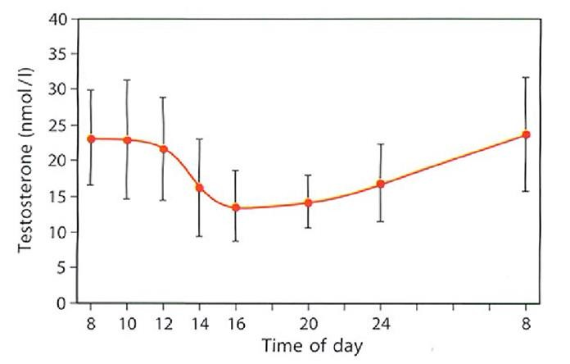
Measuring Serum Testosterone
The diurnal/circadian rhythm of serum T means levels are highest in the early morning
Fasting T levels should be measured from 7 to 11 AM on at least 2 occasions with a reliable method preferably 4 weeks apart and, if possible, not during an acute illness.
In addition, measure free testosterone (FT) in men with levels close to lower normal range (8-12 nmol/L) or those with suspected or known abnormal sex hormone binding globulin (SHBG) level
Measure luteinising hormone (LH) and follicle stimulating hormone (FSH) serum levels to differentiate primary from secondary TD
Serum prolactin levels should be measured when LH and FSH levels are low. A very low TT level (<5.2 nmol/L) and low LH and FSH levels are more likely to be associated with hyperprolactinemia or when secondary TD from a pituitary tumour or other pituitary disease is suspected
Base decisions on therapy on published action levels rather than laboratory reference ranges
Circadian rhythm of testosterone
* Above levels of testosterone are taken from young healthy males
Adapted from Diver M et al. Clin Endocrinol 2003;58:710-717

Slide 15
BSSM Evidence-Based Action Levels
The British Society for Sexual Medicine (BSSM) recommend the use of evidence-based action levels to advise HCPs of serum testosterone (T) values that may require Testosterone Therapy (TTh):
  Usually requires TTh: Total T (TT) level <8 nmol/L or free T (FT) <0.180 nmol/L
  May require a trial of TTh for a minimum of 6 months: TT 8-12 nmol/L or free T 0.180-0.225 nmol/L
  Does not require TTh: TT level >12 nmol/L or free T >0.225 nmol/L
Free Testosterone should be calculated when the TT is 8-12nmol/L.
Hackett G, et al. British Society for Sexual Medicine Guidelines on Adult Testosterone Deficiency, With Statements for UK Practice. J Sex Med 2017;14:1504-1523.
Notes:
BSSM guidelines also state:¹
A FT level lower than 225 pmol/L (0.225 nmol/L) provides supportive evidence for T therapy in the presence of appropriate symptoms.
Additional recommendations include:
Increased luteinising hormone (LH) levels and T levels below normal or in the lower
quartile range indicate testicular failure, so T therapy should be considered.
Compensated TD occurs when men have normal levels of T but higher gonadotropin levels. Characterized by increased LH levels and older age, compensated TD has been proposed as a genuine clinical subgroup of late-onset hypogonadism, from which some men could eventually progress to overt primary TD.
Recent data from the European Male Aging Study (EMAS) found that clinical symptoms were more closely related to calculated FT.²
Hackett G, et al. British Society for Sexual Medicine Guidelines on Adult Testosterone Deficiency, With Statements for UK Practice. J Sex Med 2017;14:1504-1523.
Wu FCW, Tajar A, Beynon JM, et al; EMAS Group. Identification of late-onset hypogonadism in middle aged and elderly men. N Engl J Med 2010;363:123-135.

Slide 16
Testosterone fractions in the blood
60% of testosterone in the blood is tightly bound to SHBG
A further 38% is loosely bound to albumin.
Only 2% of the testosterone in the blood is free testosterone
The albumin-bound and the free testosterone portions make up the bio-available testosterone
SHBG, sex hormone-binding globulin; T, testosterone
Figure adapted from Anawalt BD & Braunstein GD. Testes; In Greenspan’s Basic & Clinical Endocrinology 10th Edition. Gardner DG & Shoback D, McGraw-Hill Education, 2018

Slide 17
Conditions Associated with an Alteration in SHBG
Decrease SHBG:
  Moderate obesity
  Nephrotic syndrome
  Hypothyroidism
  Use of glucocorticoids, progestins, androgenic steroids
Increased SHBG:
  Aging
  Hepatic cirrhosis
  Hyperthyroidism
  Use of anticonvulsants, estrogens
  HIV
Bhasin S, Cunningham GR et al. J Clin Endocrin Metab. 2006; 91:1995-2010.
Notes:
Testosterone measurements are also influenced by alterations in SHBG concentrations that occur in obese men; older men; men with comorbid illness, hyper- and hypothyroidism; and men taking certain medications. It is therefore suggested that free or bioavailable testosterone levels, rather than total testosterone, levels should be used in men suspected of having alterations in their SHBG levels.
Nephrotic syndrome is a disorder where the kidneys have been damaged, causing them to leak protein from the blood into the urine.

Slide 18

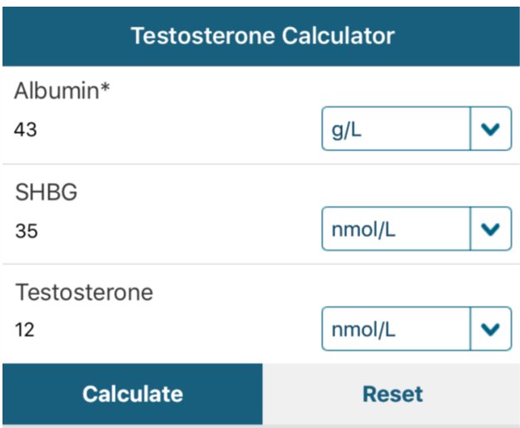
“T Calc” App
Free App - available on iOS and Android
Defaults to European Units (nmol/L)
Includes BSSM guidance on Free T cut-off levels
Aids interpretation of Testosterone results
http://www.pctag.uk/testosterone-calculator/

Slide 19



Benefits of early diagnosis
Opportunity to make lifestyle changes and receive appropriate treatment¹
Somatic, sexual and psychological benefits for improved quality of life²
Potential cost and time savings in the primary and secondary care settings³
1. Defeudis G, et al. The CATCH checklist to investigate adult-onset hypogonadism. Andrology 2018.6;5. Available at: https://onlinelibrary.wiley.com/doi/full/10.1111/andr.12506 Accessed February 2019. 2. Hackett G, et al. British Society for Sexual Medicine Guidelines on Adult Testosterone Deficiency, With Statements for UK Practice. J Sex Med 2017;14:1504-1523. Available at: http://www.bssm.org.uk/wp-content/uploads/2018/09/guidelines-on-adult-testosterone-deficiency-with-statements-for-uk-practice.pdf Accessed February 2019. 3. Hackett G. An ED patient with low testosterone. Trends in urology and men’s health 2016. Tales from the clinic pp1-2.
Notes:
Early diagnosis of both TD and associated comorbidities may be helpful for patients in terms of changing their lifestyle and getting appropriate treatment¹
Improving the diagnosis and management of TD should provide somatic, sexual and psychological benefits and subsequent improvements in quality of life²
Failure to check testosterone levels can result in wasted time and money through inappropriate referrals and medications that are unlikely to work.³

Slide 20



Consider the Current Situation….
Disease awareness campaign helps a 51 year-old man identify with his symptoms of ED, lethargy, low mood & low libido & decides to visit his GP
His GP who has a non-expert knowledge of Men’s Health suspects presenting symptoms could possibly be due to TD
The GP orders a total testosterone from the laboratory to help confirm the diagnosis of TD
The laboratory conduct the test and find the T level is 5.8nmol/L.
The local reference range for the laboratory is 5.0-31.0nmol/L.
Laboratory send result to the GP with a comment of “normal”
Despite the T level being low according to guideline recommendations, the GP tells the patient he doesn’t have TD so instead advises lifestyle changes & prescribes a PDE5i for his ED +/- an antidepressant for his lethargy & low mood. His symptoms do not improve.

Slide 21
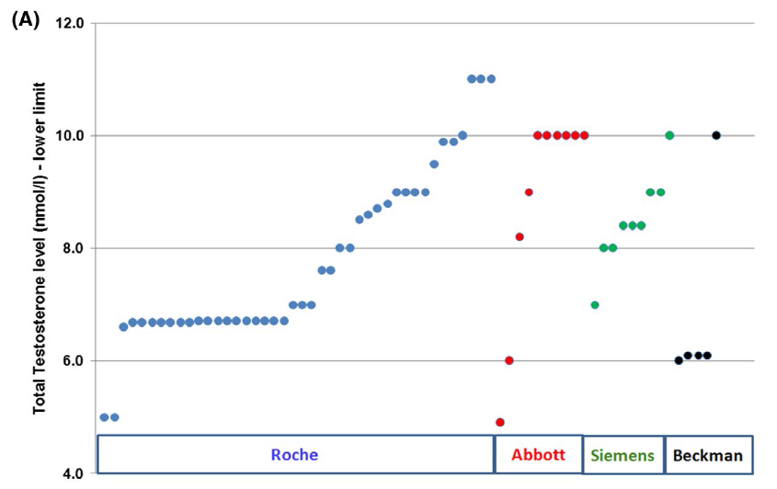
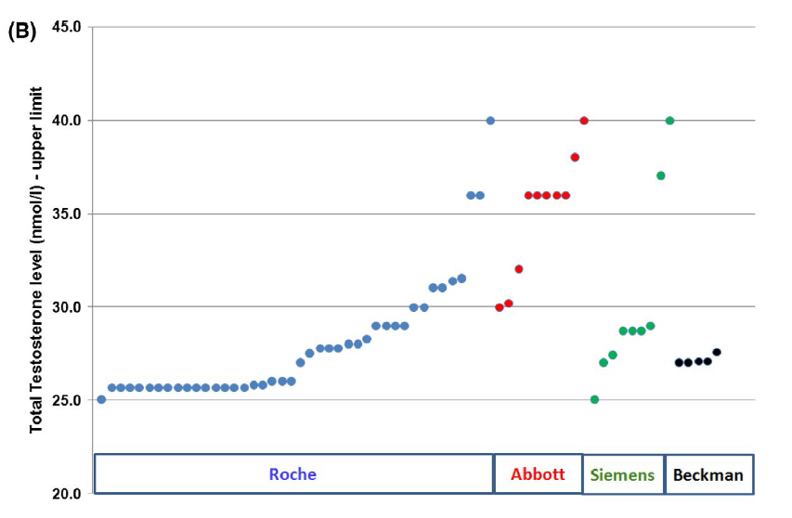
Variation in laboratory reference ranges for testosterone
UK audit demonstrated that the lower limit of “normal” used to diagnose TD can range from 5-11nmol/L.
Upper limit of “normal” also ranged dramatically depending on which assay was used
BSSM recommend that evidence-based action limits should replace local reference ranges. Clinicians need to appreciate that reference ranges quoted by laboratories represent the normal population and that the action levels recommended by the BSSM refer to men with clinical symptoms of TD
A, Lower limits of the reference ranges arranged by the immunoassay methods (Roche: 5.0–11.0nmol/L, Abbott: 4.9–10.0 nmol/L, Siemens: 7.0–10.0 nmol/L, Beckman: 6.0–10.0 nmol/L). Each laboratory is represented by a marker on the chart. B, Upper limits of the reference ranges arranged by the immunoassay methods (Roche: 25.0–40.0 nmol/L, Abbott: 30.0–40.0 nmol/L, Siemens: 25.0–40.0nmol/L, Beckman: 27.0–27.6 nmol/L).Each laboratory is represented by a marker on the chart.
Livingston, M et al. Int J Clin Pract. 2020

Slide 22
Testosterone Therapy: Prior to Initiation
Confirm Diagnosis
  Signs/Symptoms & Biochemical Evidence (x2)
  Physical Examination
Consider Aetiology
  Primary or Secondary (Check LH/FSH)
  Reversible (Opioids, Glucocorticoids, Anti-Psychotics)
Consider Contraindications & Cautions*
  CaP, Abnormal DRE, Breast Cancer
  Fertility requirement, Haematocrit <54%
*Please consult the Summary of Product Characteristics or Prescribing Information for a full list of cautions and contraindications
Hackett, G; Kirby, M et al J Sex Med 2017;14:1504-1523

Slide 23
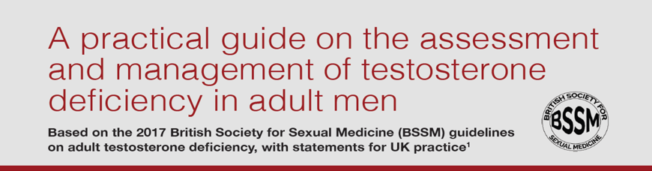
http://www.bssm.org.uk/
Google “BSSM Guideline Resources”

Slide 24
Diagnosis Questions
1. Which of the following are symptoms of TD?
  Low Mood
  Low Libido
  Hyperactivity
  Fatigue
  Erectile Dysfunction
  (choose >1 answer)

Slide 25
Diagnosis Questions
2. What is measured when a “total testosterone” is ordered?
  Free T only
  Free T + protein bound T
  Bioavailable T + Albumin bound T
  Albumin bound T + SHBG bound T
  DHT + Estradiol
  (choose 1 answer)

Slide 26
Diagnosis Questions
3. If a 1st total testosterone test comes back as low, what additional tests should then be ordered?
  FSH
  Testosterone
  SHBG
  LH
  All of the above
  (choose 1 answer)

Slide 27
Diagnosis Questions
4. A pituitary tumour or other pituitary disease should be suspected when a secondary TD is confirmed with a total T of less than what level?
  <8nmol/L
  <10.4nmol/L
  <6.7nmol/L
  <5.2nmol/L
  (choose 1 answer)

Slide 28
Diagnosis Questions
5. Which of these can INCREASE the SHBG level?
  Moderate obesity
  Nephrotic syndrome
  Hypothyroidism
  Use of glucocorticoids, progestins, androgenic steroids
  Ageing
  (choose 1 answer)

Slide 29
Diagnosis Questions
6. According to the BSSM guidelines what level of total testosterone on 2 separate occasions would warrant a 6-month trial of testosterone therapy?
  >12nmol/L
  <8nmol/L
  10-12nmol/L
  8-12nmol/L
  5-11nmol/L
  (choose 1 answer)

Slide 30
Diagnosis Questions
7. What physical examinations should be performed to aid a diagnosis of TD?
  BMI
  Waist circumference
  Body hair
  Testicular size
  Presence of gynecomastia
  (choose >1 answer)

Slide 31
Diagnosis Questions
8. What safety and general considerations should be ruled out prior to initiating TTh?
  Presence of prostate cancer
  Haematocrit above 54%
  Fertility Requirement
  Presence of breast cancer
  All of the above
  (choose 1 answer)

Slide 32
Diagnosis Questions
9. What tests should be performed to rule out the presence of prostate cancer?
  RDE & PAS
  IPSS & DRE
  PSA & DRE
  PSA & IPSS
  PSA & HCT
  (choose 1 answer)

Slide 33
Diagnosis Questions
10. Which questionnaires are often used to determine the presence of symptoms associated with TD?
  ADAM & AMS
  AMS & IPSS
  PDQ-9
  FACIT
  TQSM
  (choose 1 answer)

Slide 34
Diagnosis Answers
  Q1: Low Mood, Low Libido, Fatigue, Erectile Dysfunction
  Q2: Free T + protein bound T
  Q3: All of the above
  Q4: <5.2nmol/L
  Q5: Ageing
  Q6: 8-12nmol/L
  Q7: BMI, Waist circumference, Body hair, Testicular size, Presence of gynaecomastia
  Q8: All of the above
  Q9: PSA and DRE
  Q10: ADAM & AMS

