Slide 1
Competitor Testosterone Therapies
Besins Healthcare
Global Medical Affairs
March 2021

Slide 2
Testosterone Delivery Systems – Historical
Oral
Andriol / Restandol Testocaps®
Buccal (transmucosal)
Striant®
Intramuscular
Sustanon® 250
Nebido®
Androtardyl®
Subcutaneous Implants
Testopel pellets®
Patch (transdermal)
Testoderm®
Androderm®
Gel (transdermal)
AndroGel®
Testim®
Fortesta ® / Tostran®
Gooren LJG, Bunck MCM. Drugs. 2004; 64:1861-1891. Leichtnam ML, Rolland H et al. Pharm Res. 2006; 23:1117-1132.
Notes:
These are the routes of administration and the products that are available.
Three approaches are used to make testosterone therapeutically effective:
routes of administration, esterification in the 17β-position and
chemical modification of the molecule, or
a combination of approaches.
In clinical practice, particularly in the perception of the patient, the route of administration is most relevant and is used to categorize the preparations.

Slide 3
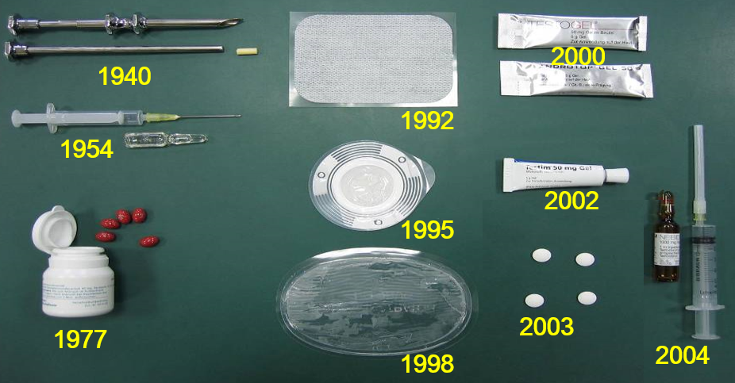
Testosterone Preparations – 1940 to 2004

Slide 4
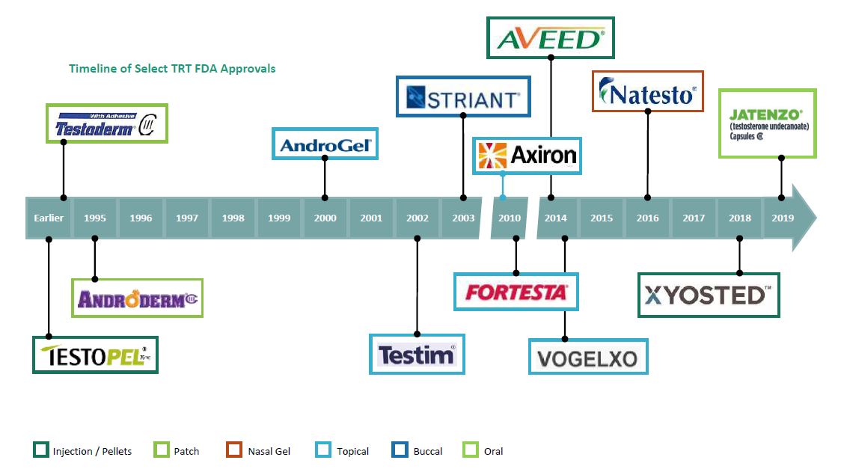
Testosterone Preparations – More Recent FDA Approvals
* Short-acting testosterone i.m. injections and older oral preparations were approved earlier then what this timeline depicts

Slide 5
Testosterone Delivery Systems – 2021
Oral
Jatenzo®
Andriol® / Restandol ®
Intramuscular Injections
Sustanon® 250
Nebido® / Reandron ® / Aveed ®
Androtardyl ®
Testosterone Cypionate
Subcutaneous Injections
XyostedTM
Patches
Androderm ®
Testoderm ®
Buccal
Striant ®
Gel (transdermal)
AndroGel®
Testavan®
Fortesta ® / Tostran®
Vogelxo®
Testim®
Gel (nasal)
Natesto®
Solution
Axiron®
Cream
AndroForte® 5 / AndroForte® 2
Pellets
Testopel®
Notes:
These are the routes of administration and the products that are available.
Three approaches are used to make testosterone therapeutically effective:
routes of administration, esterification in the 17β-position and
chemical modification of the molecule, or
a combination of approaches.
In clinical practice, particularly in the perception of the patient, the route of administration is most relevant and is used to categorize the preparations.

Slide 6
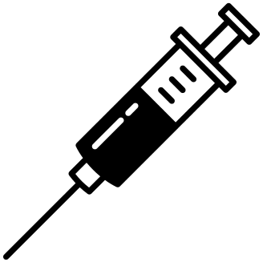
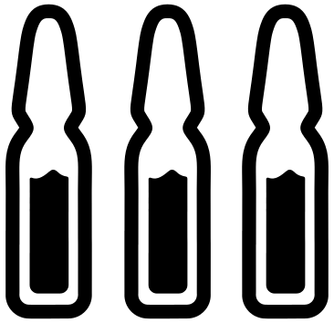
This competitor deck will focus primarily on the following products:
Testosterone Gels:
Tostran/Fortesta ® (Transdermal Gel)
Testavan ® (Transdermal Gel)
Natesto ® (Nasal Gel)
Testosterone Injectables:
Nebido®/Reandron ® (Long-acting intramuscular injection)*
Androtardyl ® (Short-acting intramuscular injection)
Sustanon ® 250 (Short-acting intramuscular injection)
Xyosted TM (Short-acting subcutaneous injection)
Testosterone Oral Formulations:
Andriol/Restandol Testocaps ® (Older Oral Testosterone)
Jatenzo ® (Newer Oral Testosterone)
*Known as AVEED in the U.S. with a different dose and dosing schedule

Slide 7
Brief overview of older testosterone preparations:
Patches - Androderm®/Testoderm®
Pellets - Testopel®
Buccal - Striant®

Slide 8
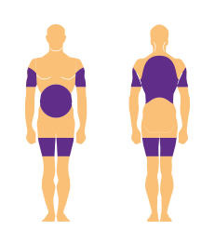
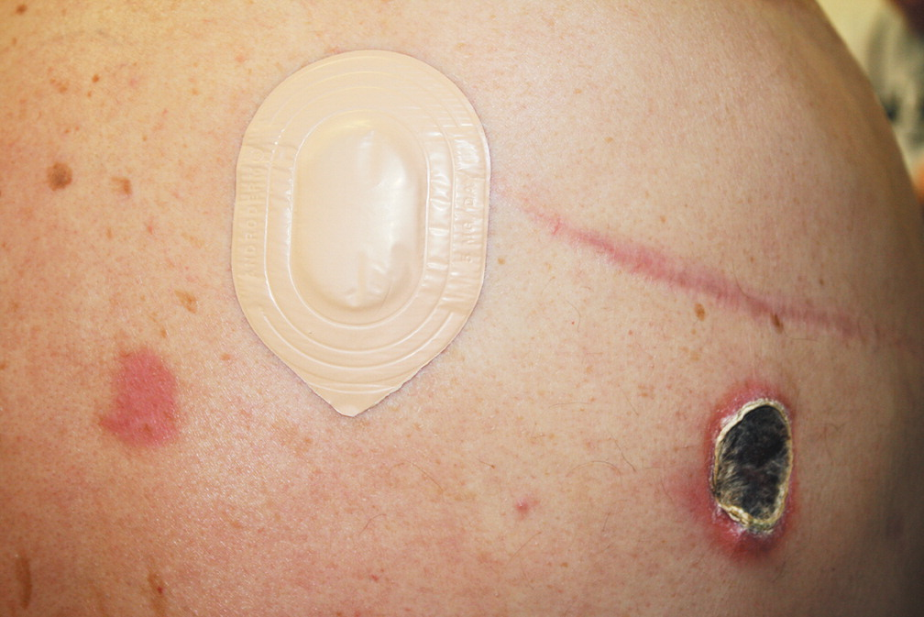
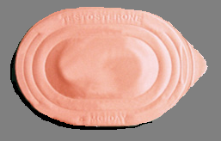
Testosterone Patches (Androderm®)
Eschar Formation from Testosterone Patch
Advantages:
Daily application maintains normal testosterone levels
Non-Scrotal
Normal testosterone level achieved in 28 days
Good efficacy
Disadvantages:
Large patch – 44cm²
>60% local irritations & adverse events*
Very visible
Patch may fall off during exercise
Dose is difficult to adjust
Orme C, Imaeda S. N Engl J Med 2012;366:e28.
* Rhoden E at al. Risks of Testosterone-Replacement Therapy and Recommendations for Monitoring. N Engl J Med 2004;350:482-92.

Slide 9
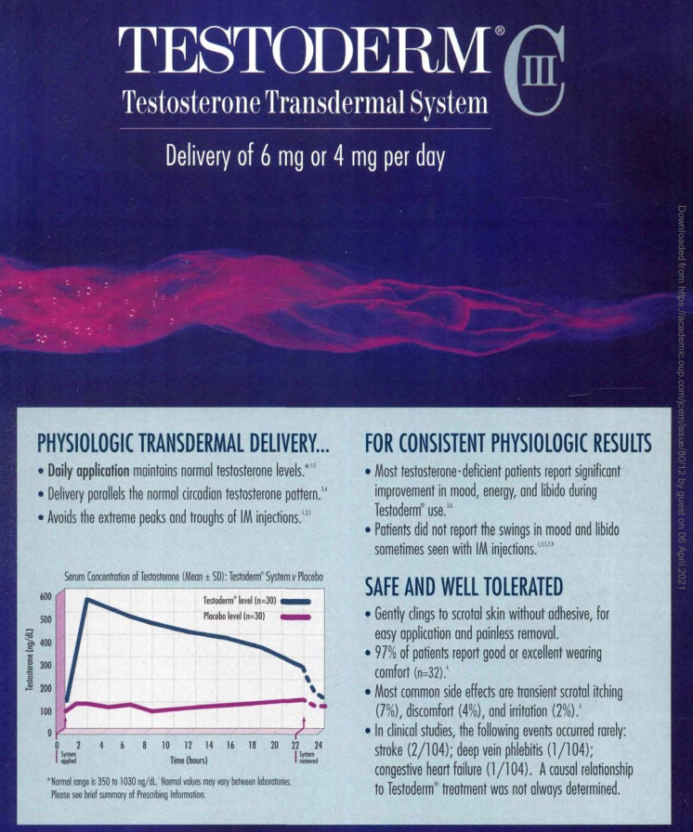
Testosterone Patches (Testoderm®)
Advantages:
Scrotal or non-scrotal application
Daily application maintains normal testosterone levels
Avoids peaks and troughs
Good efficacy
Disadvantages:
Very visible
Two scrotal patch options are 60cm²

Slide 10
Testosterone Pellets (Testopel®)
Advantages:
Restores testosterone levels in men with low testosterone for 3 to 4 months, sometimes up to 6 months
No transfer risk
Disadvantages:
Requires a 15 minute procedure
SC (subcutaneous) surgical insertion (see below)
Pain and inflammation at implant site
Risk of infection and extrusion of the implants (5 to 10%)

Slide 11
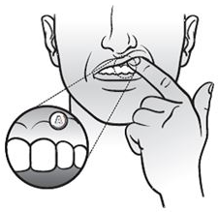
Testosterone Buccal System (Striant®)
Advantages:
Restore T levels in the majority of patients
Disadvantages:
Short half-life, requiring twice-daily application
Rotate application site with each application
Impossible to adjust the dose
Disagreeable flavour
Mouth Irritation and pain at the site of application
Can get displaced

Slide 12
Testosterone Gels
The 2020 European Academy of Andrology (EAA) guidelines on investigation, treatment and monitoring of functional hypogonadism in males suggest the use of transdermal T gels, as the preferred preparation in the initiation of testosterone therapy due to the potentially reversible nature of functional hypogonadism¹
1. Corona, G et al. Andrology. 2020 Sep;8(5):970-987 (Endorsing Organization: European Society of Endocrinology)

Slide 13
Transdermal Gels
Tostran®/Fortesta®
Testavan®

Slide 14
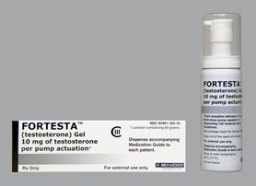
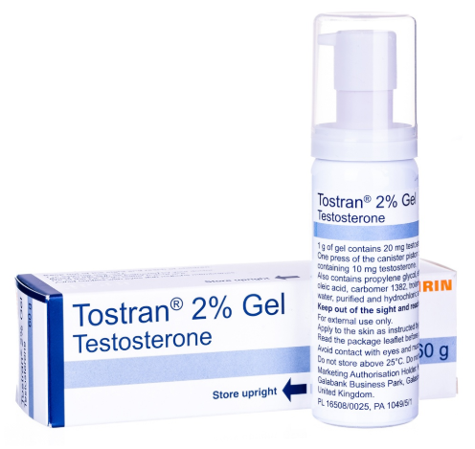
Testosterone Transdermal Gel (Tostran®/Fortesta®)
Hydroalcoholic gel containing 2% testosterone (20mg/g)
Metered-dose pump
Clear, colourless gel
Important to note:
Tostran & Fortesta have different licenses/dosing options
Tostran recommended dose = 60mg/day (min 10mg/day, max 80mg/day)
Fortesta recommended dose = 40mg/day (min 10mg/day, max 70mg/day)

Slide 15
Testosterone Transdermal Gel (Tostran®)
Pump dispenser containing 60 g of gel
Recommended dose is 60mg (6 actuations)
10mg testosterone per actuation in 0.5 g of gel
60mg of testosterone in 3 g of gel
At the recommended dose, a pump dispenser will supply 20 days treatment
Tostran 2% Gel - Summary of Product Characteristics (SmPC) https://www.medicines.org.uk/emc/product/332 Accessed March 2021. Tostran 2% Gel - Patient Information Leaflet (PIL) https://www.medicines.org.uk/emc/product/332/pil. Accessed March 2021

Slide 16
Testosterone Transdermal Gel (Tostran®)
One press of metered-dose device delivers 0.5 g containing 10 mg testosterone

Slide 17
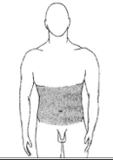
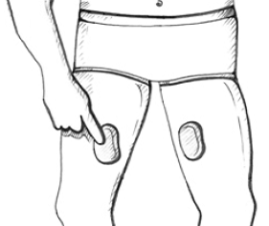
Testosterone Transdermal Gel (Tostran®)
Apply the gel onto clean, dry intact skin, once a day at the same time each day, for example in the morning after showering
The gel should either be rubbed onto the abdomen (over an area of at least 10 by 30 cm) or divided in half and one half rubbed onto the inside of each thigh (over an area of at least 10 by 15 cm). It is recommended that you rub Tostran onto your abdomen or both your inner thighs, alternating your chosen area each day
Application to other sites should be avoided. In particular do not apply Tostran to the genitals
Rub the gel in gently with one finger until dry, and then cover the area with loose clothing (e.g. T shirt, shorts, pants). When finished, wash your hands thoroughly with soap and water
If you are thinking of taking a shower or bath, do so either before application of Tostran or wait for at least two hours after the application
Tostran 2% Gel - Summary of Product Characteristics (SmPC) https://www.medicines.org.uk/emc/product/332 Accessed March 2021. Tostran 2% Gel - Patient Information Leaflet (PIL) https://www.medicines.org.uk/emc/product/332/pil. Accessed March 2021

Slide 18
Testosterone Transdermal Gel (Tostran®/Fortesta®)
Advantages:
Less gel to apply due to 2% concentration
Flexible dose and easy to titrate (i.e. increments of 10mg)
Rapid decrease in T levels if treatment stopped due to the presence of adverse events
Predictable bioavailability and consistent testosterone levels
Disadvantages:
Daily administration
Transfer risk
Adverse skin reactions reported in 26% of patients
Complicated application instructions
Rotate application site with each application
Difficult for HCPs to assess compliance to dosing instructions
Patients need to fully depress the actuator 8 times to ensure that the pump is fully primed and the pump should be stored in an upright position between use.
Only 20 days treatment per canister at recommended dose (Tostran)
Tostran 2% Gel - Summary of Product Characteristics (SmPC) https://www.medicines.org.uk/emc/product/332 Accessed March 2021. Tostran 2% Gel - Patient Information Leaflet (PIL) https://www.medicines.org.uk/emc/product/332/pil. Accessed March 2021

Slide 19
Testosterone Transdermal Gel (Testavan®)
Hydroalcoholic gel containing 2% testosterone (20mg/g)
1 gram of gel contains 20mg of testosterone
Metered-dose pump
Translucent to slightly opalescent gel
One pump actuation delivers 1.15 g (1.25 mL) of gel equivalent to 23 mg of testosterone
Testavan SmPC https://www.medicines.org.uk/emc/product/9489/smpc last accessed March 2021

Slide 20
Testosterone Transdermal Gel (Testavan®)
Each pump contains 85.5 g gel (93ml in volume)
Recommended dose is 23mg (1 actuation)
23mg testosterone per actuation in 1.15 g of gel
Maximum dose is 69mg (3 actuations)
At the recommended dose, a pump dispenser will supply 56 days treatment
Testavan SmPC https://www.medicines.org.uk/emc/product/9489/smpc last accessed March 2021
Testvan PIL https://www.medicines.org.uk/emc/files/pil.9489.pdf last accessed March 2021

Slide 21
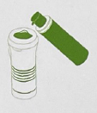
Testosterone Transdermal Gel (Testavan®) – How to use
Always apply Testavan® gel on clean, dry and normal healthy areas of the skin on the upper arm and shoulder. Before use, take the applicator off the pump and remove the lid.
Step 1 – Pump:
Hold the pump facing the applicator surface and press the pump head all the way down once
Step 2 – Apply:
Use the applicator to spread the gel evenly across one upper arm and shoulder
Step 3 – Let dry:
Let the gel dry completely before getting dressed. Wait at least 2 hours before showering, bathing or swimming
Testvan PIL https://www.medicines.org.uk/emc/files/pil.9489.pdf last accessed March 2021

Slide 22
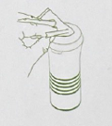
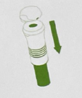
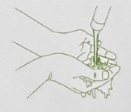
Testosterone Transdermal Gel (Testavan®) – After using
Clean:
Clean the applicator with a tissue and safely throw away the used tissue into your household rubbish
Store:
Store Testavan safely and out of reach of children after putting the lid and the applicator back onto the pump
Wash:
Wash your hands with soap and water after using Testavan, especially if you have gel on them
Testavan SmPC https://www.medicines.org.uk/emc/product/9489/smpc last accessed March 2021
Testvan PIL https://www.medicines.org.uk/emc/files/pil.9489.pdf last accessed March 2021

Slide 23
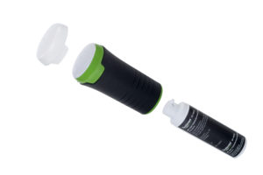
Testosterone Transdermal Gel (Testavan®) – Clinical Data
From the Testavan SmPC:
“If the serum testosterone concentration is below 17.3nmol/L, the daily Testavan dose may be increased by 1 pump actuation”¹
In Cunningham et al, 97% of subjects required titration to the 46mg or 69mg/day dose at day 90²
23 mg/day Cav 12.8nmol/L (n = 5) (less than 17.3nmol/L)
46 mg/day Cav 17.5nmol/L (n = 45) (just above 17.3nmol/L)
69 mg/day Cav 15.2nmol/L (n = 89) (less than 17.3nmol/L)
Average dose required at Day 90 is 59.8mg/day (2.6 actuations)²
Testavan SmPC https://www.medicines.org.uk/emc/product/9489/smpc last accessed March 2021
Cunningham et al; Testosterone for Hypogonadal Men, Endocr Pract. 2017;23(No. 5)
Notes:
2. Cunningham et al:
At Day 90, 5 patients were on 23mg, 45 patients were on 46mg and 89 patients were on 69mg
(5 x 23) + (45 x 46) + (89 x 69) = 8326mg/139 patients = 59.8mg/patient on average.

Slide 24
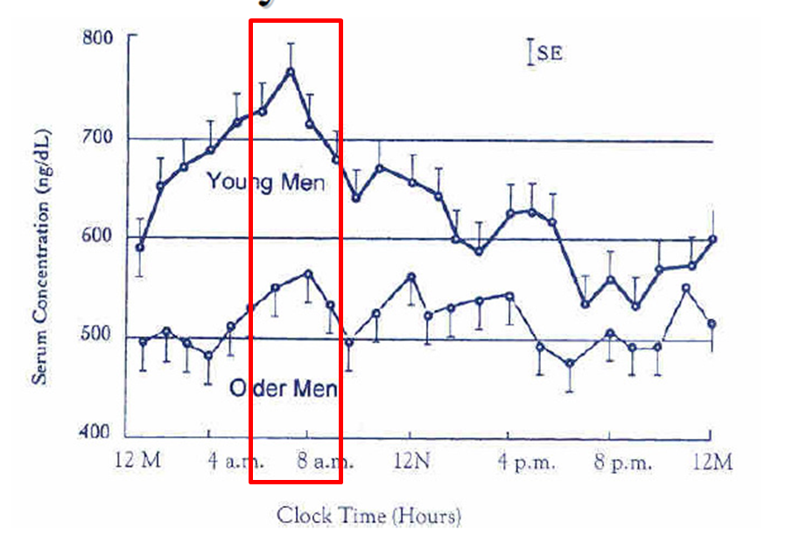
Testosterone Transdermal Gel (Testavan®) – Clinical Data
Olsson et al claim that Testavan has enhanced bioavailability and more rapid absorption vs Testogel and that is also provides a circadian-like rhythm resembling the natural diurnal variation in testosterone¹
All 5 authors work for Ferring and study funded by Ferring
11 patients who were testosterone-suppressed healthy men (not hypogonadal men)
Open label
Circadian pattern can become blunted with ageing
Bremner et al. J Clin Endocrinol Metab 1983;56:1278-81.
Mean Age 25
Mean Age 71
Olsson et al Clinical Pharmacology in Drug Development 3(5) 358–364
Notes:
2. Cunningham et al:
At Day 90, 5 patients were on 23mg, 45 patients were on 46mg and 89 patients were on 69mg
(5 x 23) + (45 x 46) + (89 x 69) = 8326mg/139 patients = 59.8mg/patient on average.

Slide 25
Testosterone Transdermal Gel (Testavan®)
Advantages:
Less gel to apply due to 2% concentration
Only 4% application site reactions
Applicator might reduce transfer risk
Lowest recommended dose for a transdermal testosterone gel
Likely cost advantages based on 56 days of treatment at recommended dose
Less gel to apply due to 2% concentration
Rapid decrease in T levels if treatment stopped due to the presence of adverse events
Predictable bioavailability and consistent testosterone levels
Testavan SmPC https://www.medicines.org.uk/emc/product/9489/smpc last accessed March 2021
Testvan PIL https://www.medicines.org.uk/emc/files/pil.9489.pdf last accessed March 2021
Cunningham et al; Testosterone for Hypogonadal Men, Endocr Pract. 2017;23(No. 5)

Slide 26
Testosterone Transdermal Gel (Testavan®)
Disadvantages:
Daily administration
Transfer risk still exists
Rotation of application site required when more than 1 actuation is needed
Box of tissues required
Hand washing post application still recommended
Clinical data suggests 97% of patients will require up-titration
Testavan SmPC https://www.medicines.org.uk/emc/product/9489/smpc last accessed March 2021
Testvan PIL https://www.medicines.org.uk/emc/files/pil.9489.pdf last accessed March 2021
Cunningham et al; Testosterone for Hypogonadal Men, Endocr Pract. 2017;23(No. 5)

Slide 27
Nasal Gel
Natesto®

Slide 28
Testosterone Nasal Gel (Natesto®)
Why nasal administration?:
The nasal cavity's easily accessible, rich vascular plexus permits topically administered drugs to rapidly achieve effective blood levels
Because of this easily accessed vascular bed, nasal administration of medications is emerging as a promising method of delivering medications directly to the blood stream.
Administering medications via the nasal mucosal offers several advantages:
The rich vascular plexus of the nasal cavity provides a direct route into the blood stream for medications that easily cross mucous membranes.
This direct absorption into the blood stream avoids gastrointestinal destruction and hepatic first pass metabolism
For many intranasal medications the rates of absorption and plasma concentrations are typically better than subcutaneous or intramuscular routes.
Intranasal drug administration is essentially painless, and does not require sterile technique or invasive devices.

Slide 29
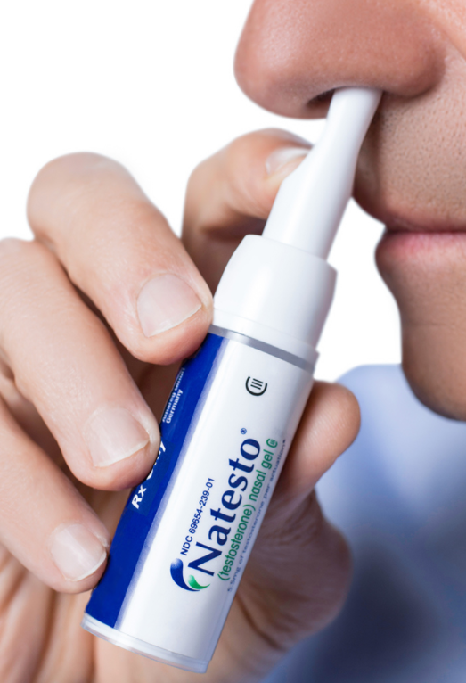
Testosterone Nasal Gel (Natesto®)
The 1st and only FDA-approved intranasal testosterone therapy
Unique nasal delivery system
4.5% testosterone gel (45mg/g)
Slightly yellow gel
Dispensed in a metered dose pump containing 11g of gel dispensed as 60 metered pump actuations
Each pump actuation delivers 5.5mg of testosterone in 122.5mg (0.1225g) of gel
Recommended dose is 11mg (5.5mg in each nostril) two times daily which can be titrated to three times daily (Canada)
Recommended dose is 11mg (5.5mg in each nostril) three times daily (United States)

Slide 30
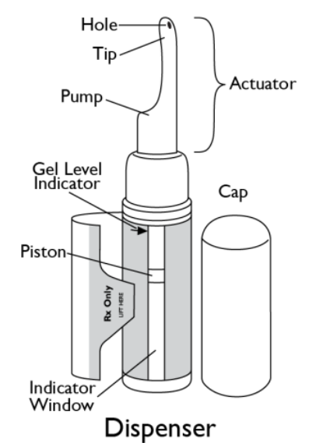
Testosterone Nasal Gel (Natesto®)
Convenient no-touch administration that is applied in 10 seconds
Restores normal T levels with rapid symptom relief (improvement in mood and sexual function as early as day 30)
Excellent safety profile – Low dose of testosterone and reduced risk of secondary transfer

Slide 31
Testosterone Nasal Gel (Natesto®)
Administration:
The drug is administered from a pump dispenser which administers 5.5 mg of gel directly onto the mucosa of the nasal vestibule of each nostril.
Light massaging of the nostrils spreads the gel inside the lower nasal cavity, from where it is absorbed into the bloodstream
To administer the dose, patients should be instructed to perform the following steps:
Blow the nose
Remove the cap from the dispenser.
Place the right index finger on the pump of the actuator and while in front of a mirror, slowly advance the tip of the actuator into the left nostril upwards until their finger on the pump reaches the base of the nose.
Tilt the actuator so that the opening on the tip of the actuator is in contact with the lateral wall of the nostril to ensure that the gel is applied to the nasal wall.
Slowly depress the pump until it stops.
Remove the actuator from the nose while wiping the tip along the inside of the lateral nostril wall to fully transfer the gel.
Using your left index finger, repeat the steps outlined in bullets 3 through 6 for the right nostril.
Use a clean, dry tissue to wipe the tip of the actuator.
Replace the cap on the dispenser.
Press on the nostrils at a point just below the bridge of the nose and lightly massage.
Refrain from blowing the nose or sniffing for 1 hour after administration.

Slide 32
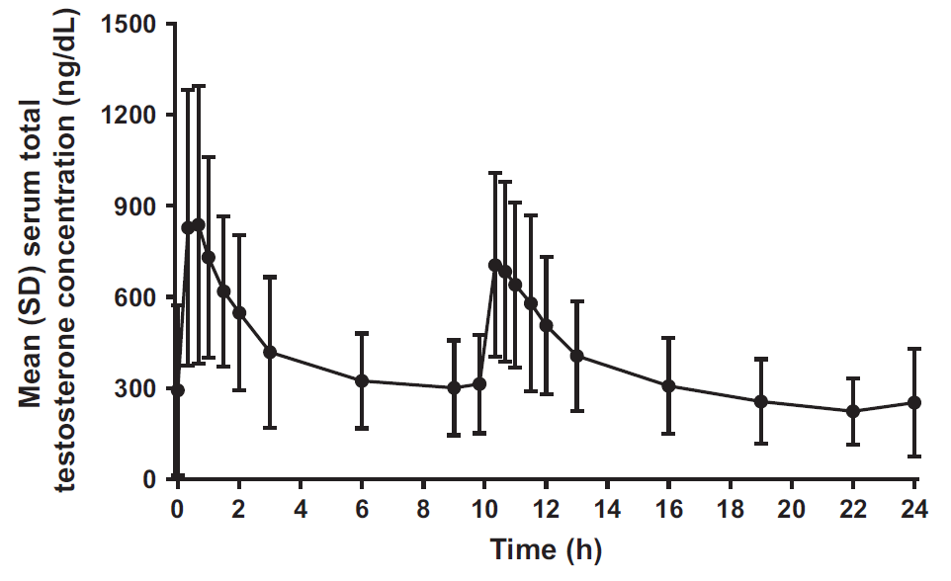
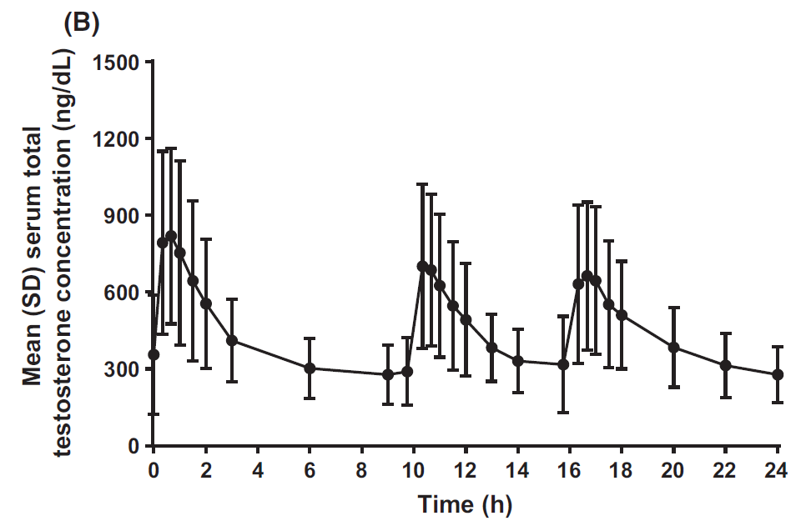
Testosterone Nasal Gel (Natesto®)
Pharmacokinetics:
Natesto® delivers physiological amounts of testosterone, producing circulating concentrations that approximate normal testosterone concentrations seen in healthy men.
The maximum concentration for Natesto is achieved within approximately 40 minutes of administration and has a half-life ranging from 10 to 100 minutes.
The average daily testosterone concentration produced by Natesto administered as 11 mg of testosterone three times daily on Day 90 was 428 ng/dL or 14.8nmol/L
The average daily testosterone concentration produced by Natesto administered as 11 mg of testosterone two times daily on Day 90 was 415 ng/dL or 14.4nmol/L
Rogol, AD et al. Andrology, 2016, 4, 46–54. Plot of 24-h total testosterone concentration-time curves by treatment regimen and time point at Day 90 in the intent-to-treat population. Data are shown for the b.i.d. dosing (n = 141) (A), and the t.i.d. dosing (n = 77) (B).

Slide 33
Testosterone Nasal Gel (Natesto®)
Efficacy:
Natesto was evaluated for efficacy in a 90-day, open-label, multicenter study of 306 hypogonadal men.
The primary endpoint was the percentage of patients with Cavg within the normal range (10.4-36.4nmol/L) on Day 90.
Criterion for success was ≥75% of subjects with a serum total testosterone Cavg value in the normal range.
Intent to treat population:
62 of 69 patients (90%) receiving Natesto t.i.d. for the duration of the study had a Cavg within the normal range (10.4-36.4nmol/L) on Day 90
86 of 122 patients (71%) receiving Natesto b.i.d. for the duration of the study had a Cavg within the normal range (10.4-36.4nmol/L) on Day 90
Per protocol population:
61 of 67 patients (91%) receiving Natesto t.i.d. for the duration of the study had a Cavg within the normal range (10.4-36.4nmol/L) on Day 90
76 of 102 patients (75%) receiving Natesto b.i.d. for the duration of the study had a Cavg within the normal range (10.4-36.4nmol/L) on Day 90
Improvement from baseline in mean erectile function (p<0.0001 both dose groups) and in mood scores (p<0.0001 for mean positive affect, p<0.01 for negative affect) achieved statistical significance by Day 90.
Positive changes from baseline in body composition (increase in lean body mass from baseline, p=0.0384 at Day 180) were observed.
Clearly, the best efficacy results are achieved with the t.i.d. regime, and the b.i.d. regime only just met the success criterion (75%) in the per protocol population and not in the intent to treat population.
Rogol AD, et al. Andrology 2016; 4: 46-54

Slide 34
Testosterone Nasal Gel (Natesto®)
Safety:
Proportions of patients with ≥1 TEAE and ≥1 possibly drug-related TEAE were:
63.4% and 30.3% for the two-times daily dose group
64.6% and 40.9% for the three-times daily dose group.
4.6% had ≥1 severe TEAE.
Adverse event discontinuation rates were 2.1% (two-times daily) and 3.7% (three-times daily)
The most common side effects of Natesto include:
Headache
Runny nose
Nose bleeds
Nose pain
Sore throat
Cough
Upper respiratory infection
Sinus infection
Nose scabs
Rogol AD, et al. Andrology 2016; 4: 46-54

Slide 35
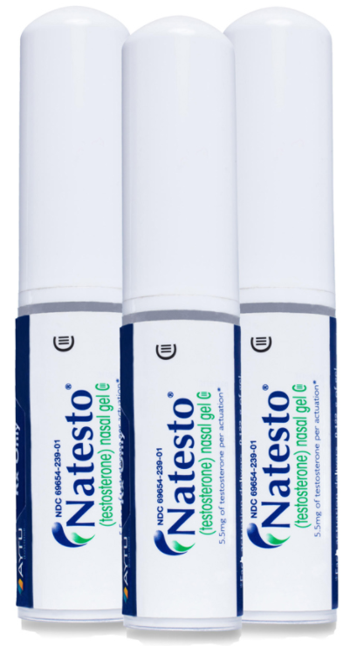
Testosterone Nasal Gel (Natesto®)
Pricing:
1 dispenser contains 60 actuations
Twice-daily administration requires 4 actuations/day (1 actuation per nostril twice a day)
Dispenser will last only 15 days
Three times daily administration requires 6 actuations/day (1 actuation per nostril three times a day)
Dispenser will last only 10 days
Patients will require 3 dispensers/month if they start on, or are titrated up to, 33mg/day
Cost could be restrictive vs other treatments depending on unit price.

Slide 36
Testosterone Nasal Gel (Natesto®)
Impact on fertility:
Maintenance of fertility and endogenous testosterone production is something they are using to try to differentiate themselves from other testosterone therapies
This is based upon the short duration of action and the short inhibitory impact on the GnRH pulse generator which leads to less suppression of the hypothalamic-pituitary-gonadal (HPG) axis as compared to testosterone therapies that maintain a consistent level for 24 hours or longer.
Suppression of the HPG axis does not allow the testis to produce intratesticular testosterone and adequate sperm
They claim that the frequent dosing/short acting property of Natesto mimics physiologic testosterone release as compared with other testosterone therapies

Slide 37
Testosterone Nasal Gel (Natesto®)
Impact on fertility:
Effect of Natesto on Reproductive Hormones, Semen Parameters and Hypogonadal Symptoms: A Single Center, Open Label, Single Arm Trial
Purpose:
To evaluate the effect of short-acting 4.5% nasal testosterone gel on serum testosterone, gonadotropins, total motile sperm count, health related quality of life and sexual function.
Materials and methods:
This was a single institution, open label, single arm trial conducted between November 2017 and September 2019 at the University of Miami.
Men 18 to 55 years old diagnosed with symptomatic hypogonadism (total testosterone less than 300 ng/dL on 2 occasions) were included.
Men with azoospermia, vasectomy or a total motile sperm count less than 5 million were excluded.
Enrolled patients were treated with Natesto, a short-acting nasal testosterone (11.0mg testosterone per dose, TID) for 6 months.
Ramasamy, R et al. J Urol. 2020 Sep;204(3):557-563.

Slide 38
Testosterone Nasal Gel (Natesto®)
Impact on fertility:
Effect of Natesto on Reproductive Hormones, Semen Parameters and Hypogonadal Symptoms: A Single Center, Open Label, Single Arm Trial
Results:
In total, 60 men were enrolled in the study.
Of these, 44 and 33 patients were evaluated for testosterone at 3 and 6 months, respectively.
A total of 31 patients (90.9%) reached a normal testosterone level (greater than 300 ng/dl) at 6 months.
Follicle stimulating hormone and luteinizing hormone levels were maintained within the normal range in 81.8% and 72.7% of patients at 6 months, respectively.
Total motile sperm count was maintained with total motile sperm count greater than 5 million over the treatment period in 88.4% of men at 3 months and 93.9% at 6 months.
There were statistically significant improvements on International Index of Erectile Function sexual desire and overall satisfaction domains at 6 months.
Ramasamy, R et al. J Urol. 2020 Sep;204(3):557-563.

Slide 39
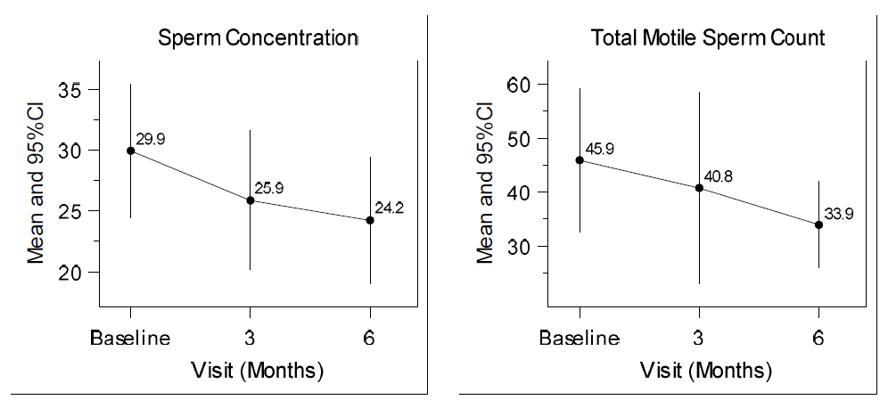
Testosterone Nasal Gel (Natesto®)
Impact on fertility:
Effect of Natesto on Reproductive Hormones, Semen Parameters and Hypogonadal Symptoms: A Single Center, Open Label, Single Arm Trial
Effect of Natesto® on semen parameters
Ramasamy, R et al. J Urol. 2020 Sep;204(3):557-563.

Slide 40
Testosterone Nasal Gel (Natesto®)
Impact on fertility:
Natesto appears to increase testosterone while maintaining semen parameters in a majority of men.
There are no significant differences among means of sperm concentration and total motile sperm count at 3 and 6 months
Only Natesto® has demonstrated this preservation of sperm production in a clinical study
Natesto has the potential to be a safe and effective treatment for men with functional hypogonadism who wish to preserve semen parameters.
Long-term studies beyond 6 months are needed before HCPs can safely prescribe nasal testosterone gel for men interested in maintaining fertility
They don’t have a license for preservation of fertility
Ramasamy, R et al. J Urol. 2020 Sep;204(3):557-563.

Slide 41
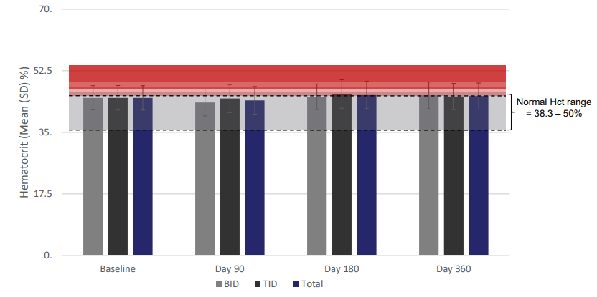
Testosterone Nasal Gel (Natesto®)
Baseline, BID & TID Dosing through Day 360
Impact on haematocrit:
No haematocrit value above the normal range was clinically significant
No subject was discontinued due to changes in haematocrit
Natesto appears to maintain haematocrit levels throughout treatment
Guidry, et al., 2017. One-Year Hematologic Safety of Natesto® (testosterone) Nasal Gel in Men with Hypogonadism. Poster session presented at the Annual Endocrine Society meeting, Orlando, FL

Slide 42
Testosterone Nasal Gel (Natesto®)
Advantages:
The 1st and only FDA-approved intranasal testosterone therapy
Unique nasal delivery system
Small amount of gel to apply
Small dispenser which is easy to carry around
Convenient no-touch administration that is applied in 10 seconds
Effective symptom relief
90% of men reach normal testosterone levels (t.i.d. regimen)
Good safety profile
Rapid decrease in T levels if treatment stopped due to adverse events
Low dose of testosterone and reduced risk of secondary transfer
Short duration of action means less impact on endogenous T production due to less inhibition of the HPG axis
Potential benefits on fertility which need to be confirmed by longer studies

Slide 43
Testosterone Nasal Gel (Natesto®)
Disadvantages:
European launch plans delayed until 2024
Efficacy is better with t.i.d. regimen which means patients will need 3 dispensers per month which could have cost implications
In the study by Rogol et al, the C_{avg} in both dosing regimens at day 90 was <15nmol/L which is the lower limit of the treatment target range as recommended by the British Society for Sexual Medicine (15-30nmol/L)
Nasal related side effects
Natesto can be used with a type of nasal decongestant such as oxymetazoline however Natesto should not be used with other nasal sprays as it is not known if Natesto is safe and effective when used with other nasal sprays.
Long-term studies beyond 6 months are needed before HCPs can safely prescribe nasal testosterone gel for men interested in maintaining fertility

Slide 44
Intramuscular Injections

Slide 45
Intramuscular Injections (Long-acting)
Nebido® / Reandron®

Slide 46
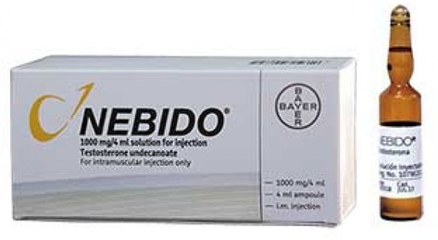
Testosterone Intramuscular Injections (Nebido®)
Testosterone undecanoate
Clear, yellowish, oily solution
Comes as either vial or ampoule
1000 mg/4 mL, 631.5 mg testosterone, corresponding to 157.9 mg of testosterone per mL
Testosterone contained in castor oil
Administered by a healthcare professional
Administered by very slow (2 mins) deep intramuscular injection into gluteal muscle (22G needle is recommended)
Loading dose required 6 weeks after initial injection (one time only)
Adjust subsequent injection intervals according to serum testosterone
Every 10-14 weeks once stabilised
FDA approved a lower dose (750mg/3mL) every 10 weeks, with a 4-week loading dose following the initial dose. This product is called Aveed®

Slide 47
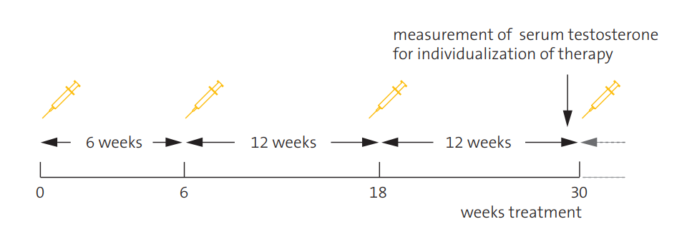
Recommended dosing regimen
Testosterone Intramuscular Injections (Nebido®)
Serum testosterone levels should be measured before start and during initiation of treatment
Depending on serum testosterone levels and clinical symptoms, the first injection interval may be reduced to a minimum of 6 weeks as compared to the recommended range of 10 to 14 weeks for maintenance
With this loading dose, sufficient steady state testosterone levels may be achieved more rapidly
Nebido® Monograph | Testosterone Undecanoate Injections | Bayer. https://hcp.nebido.com/sites/g/files/blfpry596/files/2019-07/Nebido-Product-Monograph.pdf Accessed March 2021
Nebido 1000mg/4ml, solution for injection - Summary of Product Characteristics (SmPC). https://www.medicines.org.uk/emc/product/3873 Accessed March 2021
1. Nebido Summary of Product Characteristics; 2004.

Slide 48
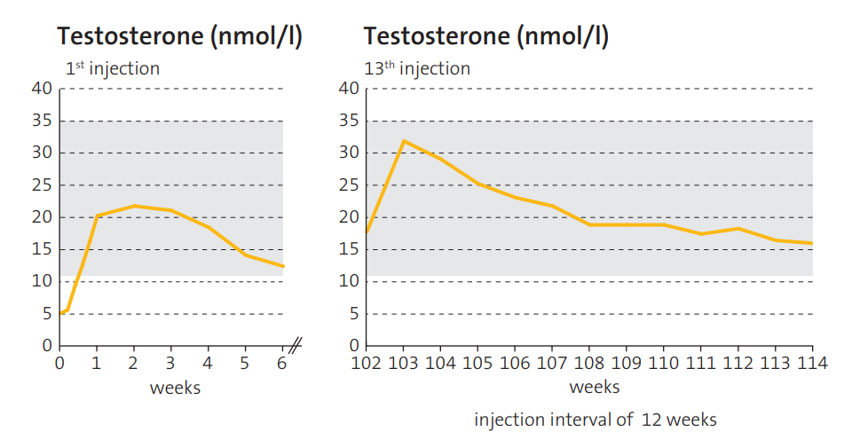
Testosterone Intramuscular Injections (Nebido®)
Pharmacokinetics:
These graphs are adapted from data from two different studies. The left chart represents data from an initial study of 14 hypogonadal men who were given a single injection of Nebido and testosterone levels measured for 8 weeks.¹
The right chart represents data from a long-term study of 7 men who were receiving long-term treatment with Nebido. The graph represents testosterone levels measured weekly following the 13th injection of Nebido.²
These graphs demonstrate the importance of the loading dose for hypogonadal men, and show that Nebido maintains testosterone levels in the physiological range without accumulation of testosterone.
1. Behre HM, Abshagen K, Oettel M, et al. Eur J Endocrinol 1999;140(5):414–419. 2. von Eckardstein S, Nieschlag E. J Androl. 2002;23(3):419–425.
1. Von Eckardstein & Nieschlag E. J Androl 2002; 23:419-425. 2. Behre HM et al. Eur J Endocrinol 1999; 140:414-419.
Notes:
This graph is adapted from data from two different studies. The filled orange circles represent data from an initial study of 14 hypogonadal men who were given a single injection of Nebido and testosterone levels measured for 8 weeks.¹ The white circles represent data from a long-term study of 7 men who were receiving long-term treatment with Nebido. The graph represents testosterone levels measured weekly following the 13th injection of Nebido.²
These graphs demonstrate the importance of the loading dose for hypogonadal men, and show the Nebido maintains testosterone levels in the physiological range without accumulation of testosterone.
1. Von Eckardstein & Nieschlag E. J Androl 2002; 23:419-425. 2. Behre HM et al. Eur J Endocrinol 1999; 140:414-419.

Slide 49
Testosterone Intramuscular Injections (Nebido®)
Tolerability:
The most frequent side effects observed with Nebido® are reactions at the injection site.
These reactions are generally mild and transient.
All other side effects observed in isolated cases are typical of testosterone (such as diarrhoea, joint pain, sweating, headache, acne, chest pain and gynaecomastia).
Pulmonary oil micro-embolism (POME) has been observed after injection during routine clinical practice and in rare cases lead to signs and symptoms such as cough, dyspnoea, malaise, hyperhidrosis, chest pain, dizziness, paraesthesia, or syncope.
These reactions may occur during or immediately after the injection and are reversible.
The patient should therefore be observed during and immediately after each injection in order to allow for early recognition of possible signs and symptoms of POME
Treatment of POME is usually supportive, e.g. by administration of supplemental oxygen.
POME is an injection-based reaction pathophysiologically related to fat embolism syndrome that can occur following vascular or lymphovascular delivery of oil-based preparations (not just Nebido)
Nebido® Monograph | Testosterone Undecanoate Injections | Bayer. https://hcp.nebido.com/sites/g/files/blfpry596/files/2019-07/Nebido-Product-Monograph.pdf Accessed March 2021

Slide 50
Testosterone Intramuscular Injections (Nebido®)
Advantages:
Administered only 4-5 times a year
Theoretically avoids physiological peaks and troughs
Popular with key opinion leaders, especially in secondary care
Established & comprehensive digital educational platforms for HCPs and patients*
HCP retains control over dosing
Good efficacy
Robust supportive clinical evidence, most notably the recent T4DM study
Disadvantages:
Steady-state conditions are achieved between the 3rd and 5th injection (potentially >9months)
Potentially painful, high-volume, deep IM injection, must be given by a healthcare professional
T ½ life is 90 ± 40 days so rapid discontinuation is not possible (in case of adverse events)
Possible issues with pulmonary micro-embolism (POME)
Not recommended for the initiation of TTh, particularly in testosterone naïve patients
* www.restoretheman.co.uk and www.nebido.com
Nebido® Monograph | Testosterone Undecanoate Injections | Bayer. https://hcp.nebido.com/sites/g/files/blfpry596/files/2019-07/Nebido-Product-Monograph.pdf Accessed March 2021

Slide 51
Intramuscular Injections (Short-acting)
Androtardyl®
Sustanon®

Slide 52
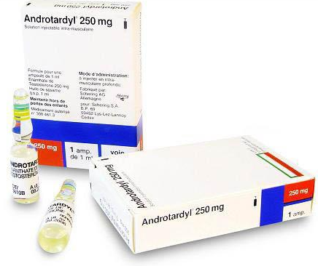
Testosterone Intramuscular Injections (Androtardyl®)
Testosterone enanthate
Oily solution for intramuscular injection
250 mg testosterone/1mL ampoule
Testosterone contained in castor oil
Initially, 250mg by slow intramuscular injection every 2—3 weeks.
Maintenance, 250mg by intramuscular injection every 3—6 weeks according to response
Known by different names and likely available as a generic medicine
Low price

Slide 53
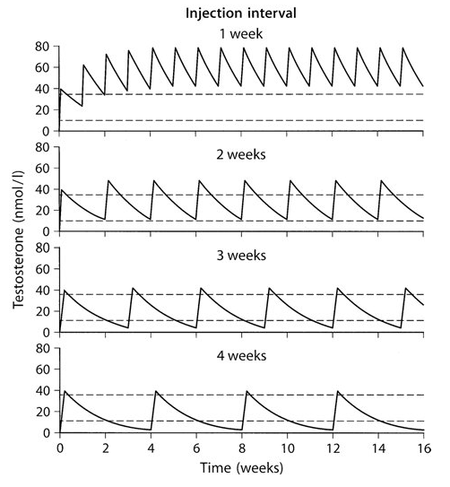
Testosterone Intramuscular Injections (Androtardyl®)
Pharmacokinetics:
Representation of multiple-dose pharmacokinetics of testosterone enanthate after injection of 250 mg testosterone enanthate.
Weekly (upper panel),
every 2 weeks (upper middle panel)
every 3 weeks (lower middle panel) and
every 4 weeks (lower panel).
Solid curves: PK simulations
Broken lines: Range of normal T values.
Pharmacology of testosterone preparations. H.M. Behre, C. Wang, D.J. Handelsman and E. Nieschlag 2004 DOI: 10.1017/CBO9780511545221.015

Slide 54
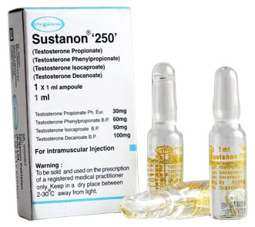
Testosterone Intramuscular Injections (Sustanon®250)
Testosterone as:
testosterone propionate
testosterone phenylpropionate
testosterone isocaproate
testosterone decanoate
Four esters of testosterone contained in peanut (arachis) oil
Oily solution for deep intramuscular injection
250 mg testosterone/1mL ampoule
Clear, pale yellow solution
1mL administered every 3 weeks but can be adjusted according to individual response
Licensed indications for male hypogonadism and for female-to-male transsexuals
Low price

Slide 55
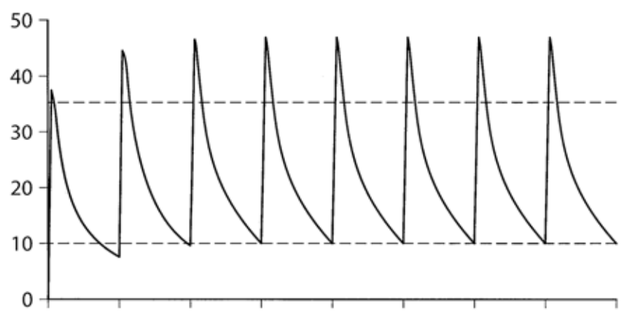
Testosterone Intramuscular Injections (Sustanon®250)
Pharmacokinetics:
Sustanon 250 contains four esters of testosterone with different durations of action.
The esters are hydrolysed into the natural hormone testosterone as soon as they enter the general circulation.
A single dose of Sustanon 250 leads to an increase of total plasma testosterone with peak levels of approximately 70nmol/L, which are reached approximately 24-48 h after administration.
Plasma testosterone levels return to the lower limit of the normal range in males in approximately 21 days.
Representation of the multiple-dose pharmacokinetics of a testosterone ester mixture (note: Not Sustanon® 250)
Pharmacology of testosterone preparations. H.M. Behre, C. Wang, D.J. Handelsman and E. Nieschlag 2004 DOI: 10.1017/CBO9780511545221.015

Slide 56
Testosterone Intramuscular Injections (Androtardyl® & Sustanon®250)
Advantages:
Low price
Some patients like the “surge” feeling of supraphysiological testosterone
Can be administered by the patient or their partner
Good efficacy
Licensed for female-to-male transgender use (Sustanon 250)
Disadvantages:
Pain at injection site
Lots of peaks & troughs – potential aggressive/depressive symptoms
Peanut oil (Sustanon 250) so potential allergy issues
Fluctuations in mood and libido
Higher occurrence of erythrocytosis in old people

Slide 57
Subcutaneous Injections
XyostedTM

Slide 58
Testosterone Subcutaneous Injections (XyostedTM)
Testosterone Enanthate
Auto-injector
Subcutaneous, once-weekly, single use, fixed dose
Available in 3 doses
50mg/0.5mL TE in oil solution
75mg/0.5mL TE in oil solution
100mg/0.5mL TE in oil solution
Easy to use and store at room temperature
Fine 27-gauge needle allows for rapid subcutaneous delivery of sesame oil suspension
Locking needle guard hides the needle before, during and after administration and reduces risk of needle stick injuries

Slide 59
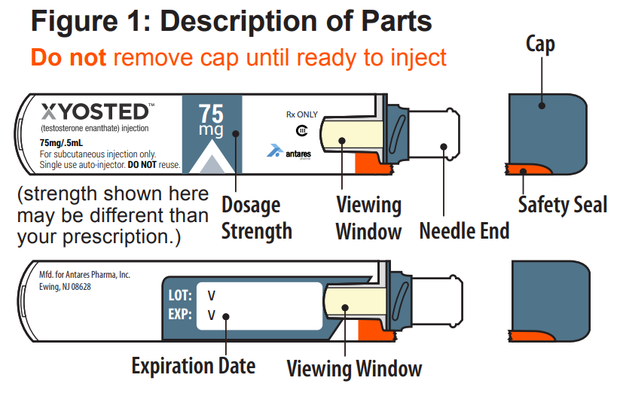
Testosterone Subcutaneous Injections (XyostedTM)
Supplies Patients Need:
1 XYOSTED Auto-Injector
1 alcohol swab
1 cotton ball or gauze
Storage Conditions:
Do not refrigerate or freeze.
Protect from light.
Use at room temperature.
Store at 68° - 77° F (20° - 25° C).

Slide 60
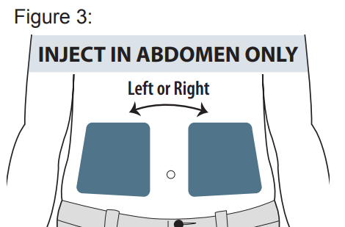
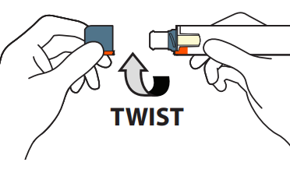
Testosterone Subcutaneous Injections (XyostedTM)
Only use the left or right side of the abdomen (belly) for injection sites. Do not use the area within 2 inches around your navel (belly button)
Twist the Cap to remove (this will also break the red safety seal).

Slide 61
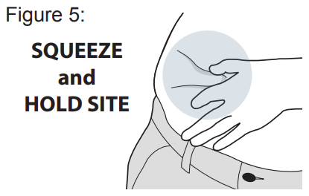
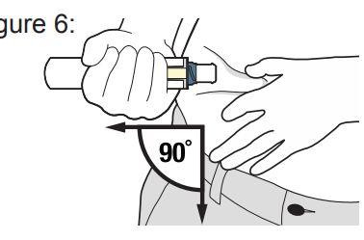
Testosterone Subcutaneous Injections (XyostedTM)
Gently squeeze the abdomen injection site to create a raised area and hold that area firmly until after the injection is complete
Place the Needle End of the Auto-Injector on the abdomen injection site. Keep the Auto-Injector straight at a 90-degree angle to the abdomen injection site

Slide 62
Testosterone Subcutaneous Injections (XyostedTM)
Firmly push the Auto-Injector down on the abdomen site and continue to hold it down after you hear the click. Continue to hold for 10 seconds
After injecting, inspect the Viewing Window. It should be orange, confirming the dose was administered

Slide 63
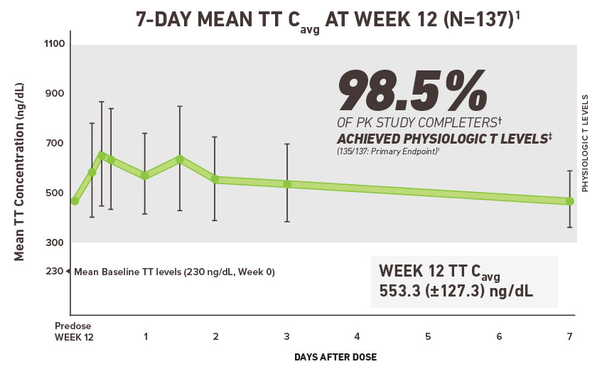
Testosterone Subcutaneous Injections (XyostedTM)
Pharmacokinetics – Week 12:

Slide 64
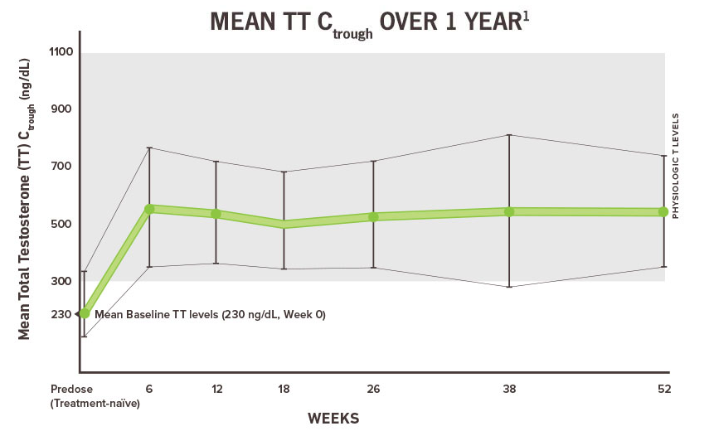
Testosterone Subcutaneous Injections (XyostedTM)
Pharmacokinetics – 1 year:

Slide 65
Testosterone Subcutaneous Injections (XyostedTM)
Advantages:
First and only weekly auto-injector of TTh and available in 3 fixed doses
Pharmacokinetics suggest steady levels of testosterone as compared to short-acting intramuscular injections
Steady state achieved in 6 weeks and then maintained
Xyosted is a once-weekly, at-home, subcutaneously administered testosterone product
Clinical data suggests that it is virtually pain free when administered
The subcutaneous dosing of Xyosted removes transfer risk concerns commonly associated with gels
Xyosted reduces the need for in-office injection procedures that may require more frequent patient visits.
Needle guard reduces risk of needle stick injuries

Slide 66
Testosterone Subcutaneous Injections (XyostedTM)
Disadvantages:
Xyosted contains a boxed warning regarding elevations in blood pressure that can increase the risk for major adverse cardiovascular events (MACE), including nonfatal myocardial infarction, nonfatal stroke, and cardiovascular death.
The label advises that the patient's baseline cardiovascular risk be considered before starting Xyosted and that blood pressure be adequately controlled.
Periodic monitoring for new-onset hypertension or exacerbations of pre-existing hypertension is advised.
Likely to have limited success in countries with government funded healthcare due to high cost but could be popular in private markets
Use of Xyosted is indicated only for the treatment of men with hypogonadal conditions associated with structural or genetic aetiologies: primary hypogonadism (congenital or acquired) and hypogonadotropic hypogonadism (congenital or acquired).

Slide 67
Oral Preparations
Andriol® / Restandol® Testocaps
Jatenzo®

Slide 68
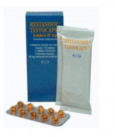
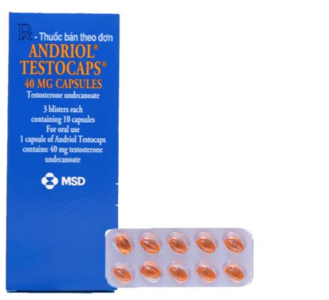
Testosterone Oral Preparations (Andriol®/ Restandol® Testocaps )
Andriol®/Restandol® capsules are soft oval, glossy, transparent and orange-coloured
They contain a yellow oil.
Each capsule contains 40.0 mg testosterone undecanoate which is equivalent to 25.3 mg of testosterone
They must be taken with a meal, preferably in the morning and evening, and swallowed without chewing
If an uneven number of capsules is taken daily, the greater part should be taken in the morning
120-160 mg (3-4 capsules) daily loading dose for 2-3 weeks
40-120 mg (1-3 capsules) daily maintenance dose based on patient response
https://www.nps.org.au/medicine-finder/andriol-testocaps-capsules#product-description

Slide 69
Testosterone Oral Preparations (Andriol®/ Restandol® Testocaps )
Serum testosterone levels fluctuate intra-individually
Huge inter-individual variation in blood levels (see figure)
At 6 months, total testosterone was unchanged from baseline in the testosterone group and increased slightly in the placebo group; the difference between the testosterone and placebo group at 6 months was −3.2 nmol/L (95% CI, −4.2 to −2.2; P.001).
The lack of increase in serum testosterone levels at the end of the study in the testosterone treatment group is a known effect of oral supplementation of testosterone undecenoate capsules, and is consistent with other studies
Emmelot-Vonk et al. JAMA. 2008; 299(1): 39-52

Slide 70
Testosterone Oral Preparations (Andriol®/ Restandol® Testocaps )
Advantages:
Oral administration of any medication is usually preferred by HCPs
No transfer risk, injection site pain or skin reactions
Works fast; peak T levels reached within 4-5 hours; steady state reached after 3 days
When discontinued, T levels return to baseline in 1 day
Lowers SHBG concentration, increasing bioavailable T
Disadvantages:
Serum testosterone levels fluctuate intra-individually
At 6 months, total testosterone was unchanged from baseline
Delivery reliability is poor and dependent upon type of food intake
Requires a high frequency of administration (2-4 times/day)
Oral therapies are rarely used in the UK because of the need for multiple dosing regimens and fears of hepatotoxicity – BSSM TD Guidelines 2017
Andriol SmPC 2005; Andriol Monograph 2005. Emmelot-Vonk et al. JAMA. 2008; 299(1): 39-52

Slide 71
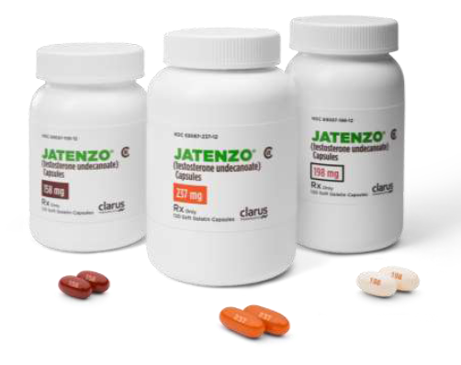
Testosterone Oral Preparations (Jatenzo®)
Testosterone undecanoate formulated as a lipophilic prodrug
Liquid-Filled Soft Gelatin Capsules
The first and only FDA-approved oral softgel for testosterone therapy
Self-Emulsifying Drug Delivery System (SEDDS)
Available in multiple capsule strengths for individualized dosing
Starting dose is 1 x 237mg capsule taken twice a day, once in the morning and once in the evening
Must be taken with food
Blood pressure concerns
Alternative oral therapies applying for FDA approval (Tlando®) and (Kyzatrex®)

Slide 72
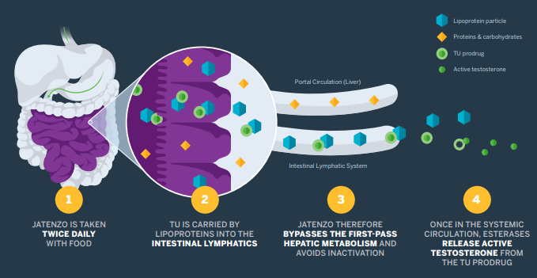
Testosterone Oral Preparations (Jatenzo®)
Pharmacokinetics:
Each capsule contains TU, a prodrug formed by attaching a fatty acid to testosterone, which the body naturally cleaves off to release testosterone
Once in the intestine, this lipophilic prodrug combines with lipoprotein particles, allowing absorption into the intestinal lymphatic system. In contrast, carbohydrates and proteins are absorbed into the portal circulation.
JATENZO passes into the intestinal lymphatic system (therefore bypassing the liver) as testosterone awaits activation.
After TU releases from lipoprotein particle, endogenous esterases liberate testosterone from TU. Fatty acid is metabolized like dietary fatty acids

Slide 73
Testosterone Oral Preparations (Jatenzo®)
Pharmacokinetics:
Men reached steady state T levels as early as Day 7 and maintained stable testosterone levels in PK studies

Slide 74
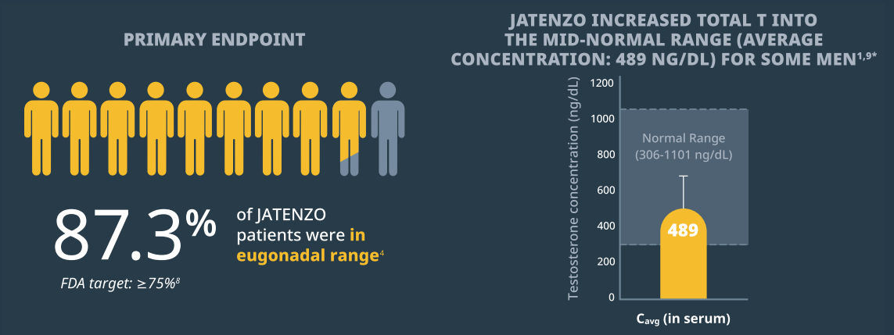
Testosterone Oral Preparations (Jatenzo®)
Efficacy:
At the end of the 4-month phase 3 InTUne trial, 87.3% (145/166) of men (FDA target 75%) raised their T level to mid-normal range
In the InTUne study, testosterone concentrations were measured in plasma isolated from blood collected into NaF-EDTA tubes.
In a typical clinical setting, testosterone concentrations are measured in serum isolated from blood collected in plain tubes.
To account for the lower testosterone concentrations measured in plasma vs serum, a conversion factor of 1.214 was determined and used to approximate the equivalent mean serum concentration of 489ng/dL from the mean NaF-EDTA plasma testosterone value of 403ng/dL

Slide 75
Testosterone Oral Preparations (Jatenzo®)
Advantages:
The first and only FDA-approved oral softgel for testosterone therapy
Oral administration of any medication is usually preferred by HCPs
No transfer risk, injection site pain or skin reactions
Available in multiple capsule strengths for individualized dosing
Better adherence and compliance to oral therapies
Bypasses first-pass hepatic metabolism
No liver toxicity-related events observed in clinical trials
Not known to cause hepatic adverse events
Good efficacy - 87.3% (145/166) of men raised their T level to mid-normal range

Slide 76
Testosterone Oral Preparations (Jatenzo®)
Disadvantages:
Must be taken with food
Twice daily administration
Can increase blood pressure, which can increase risk of heart attack or stroke
Can increase your risk of death due to heart attack or stroke
Extra monitoring of blood pressure required
Existing products including AndroGel state that hypertension is a common adverse reaction and that testosterone may cause a rise in blood pressure and AndroGel should be used with caution in men with hypertension

Slide 77
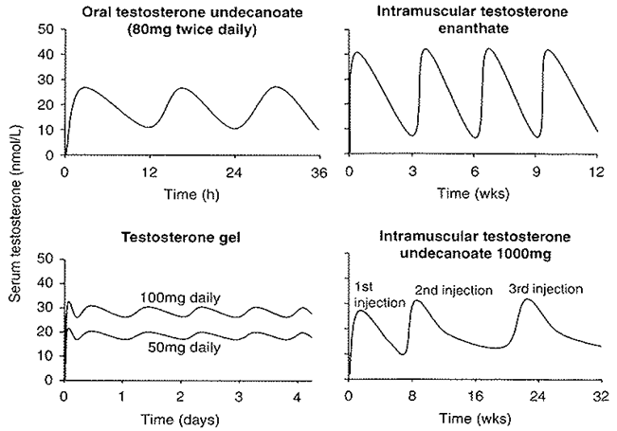
Summary of pharmacokinetics of testosterone preparations
Normal range of serum testosterone is 12-35 nmol/L
Below this level, the patient is hypogonadal, above this level, the patient has supraphysiological testosterone levels
It is important to realise that the x-axes on these graphs are on different timescales depending on the duration of action of the therapy, but you can clearly see how certain therapies more closely reproduce physiological levels of testosterone
When considering side effects and drug withdrawal times, physicians should bear in mind the pharmacodynamic and pharmacokinetic properties of the injectable versus the transdermal formulations
Adapted from Gooren LJG et al. Drugs 2004.64(17):1861-1891.
A practical guide on the assessment and management of testosterone deficiency in adult men. Based on: Hackett G, Kirby M, Edwards D, et al. J Sex Med. 2017;14(12):1504–1523. http://www.bssm.org.uk/wp-content/uploads/2018/02/BSSM-Practical-Guide-High-Res-single-pp-view-final.pdf Accessed March 2021
Notes:
Normal range of serum testosterone is 12-35 nmol/L. Below this level, the patient is hypogonadal, above this level, the patient has supraphysiological testosterone levels.
It is important to realise that the x axes on these graphs are on different timescales depending on the duration of action of the therapy, but you can clearly see how certain therapies more closely reproduce physiological levels of testosterone.

Slide 78
Other testosterone therapies available in limited markets:
AndroForte® 2
AndroForte® 5
Aveed®
Testosterone Cypionate
Testim®
Vogelxo®
Axiron®

Slide 79
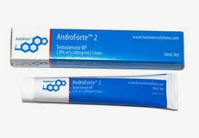
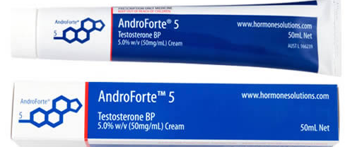
AndroForte® 2
AndroForte® 5
Testosterone cream 2% (20mg/mL)
White, opaque, oil-in-water cream.
Available in a 50mL sealed laminated tube
Each 50mL tube contains 1000mg of testosterone
Each 1ml dose delivers 20mg of testosterone
Supplied with a dose applicator
Daily scrotal application
Testosterone Cmax occurs 3-5 hours after application
Steady state achieved within 10 days
Testosterone cream 5% (50mg/mL)
White, opaque, oil-in-water cream
Supplied in a 50mL sealed tube with a graduated syringe-style measuring device in a carton
Each 1ml dose delivers 50mg of testosterone
Daily scrotal or upper body application
Recommended dose is 0.5mL/25mg testosterone for scrotal application
Recommended dose is 2mL/100mg testosterone for upper body application

Slide 80
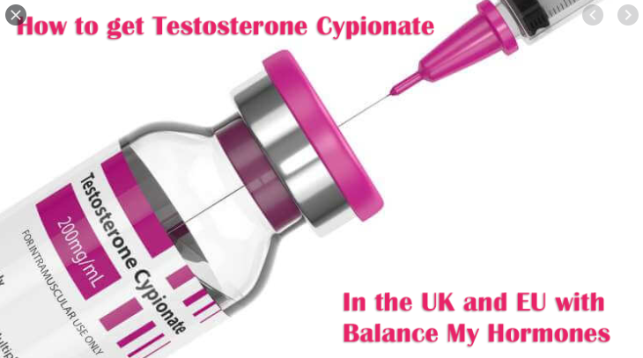
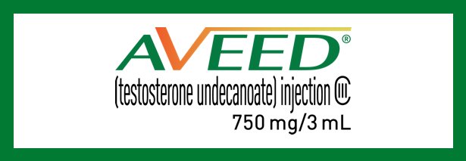
Aveed®
Testosterone Cypionate
FDA approved version of Nebido®
3mL injection containing 750mg of testosterone
Deep intramuscular injection into the buttock slowly administered over 60-90 seconds
10 weekly injections following one-time loading dose at 4 weeks post initial injection
Same issues as Nebido in terms of pulmonary oily micro-embolism (POME)
Good efficacy
200mg/mL intramuscular injection in cottonseed oil
Popular with younger men/private market
Injection every 2-4 weeks at home by patient/partner
Internet forums suggest off-label (micro-dosing) use of this product is gold-standard treatment
No good clinical evidence to support this use
Limited licensed use outside U.S. however more specialist pharmacies are getting import licenses for it

Slide 81
Testim®
Vogelxo®
Hydroalcoholic gel containing 1% testosterone (T)
Clear to translucent gel
Each 5-g tube contains 50 mg testosterone
Has a musky smell
Tubes are preferred for off-label use in women¹
Hydroalcoholic gel containing 1% testosterone (T)
Clear to translucent gel available in tube, sachet & pump
All formulations are also available as generic
Each 5-g tube/sachet contains 50 mg testosterone
Each pump dispenses 60 metered 1.25 g of gel containing 12.5mg of testosterone
Tubes are preferred for off-label use in women¹
1. International Society for the Study of Women’s Sexual Health Clinical Practice Guideline for the Use of Systemic Testosterone for Hypoactive Sexual Desire Disorder in Women CLIMACTERIC https://doi.org/10.1080/13697137.2021.1891773

Slide 82
Axiron®
Testosterone topical, clear and colourless solution
Metered-dose pump containing 110mL of solution
The pump is capable of dispensing 90mL of solution in 60 metered pump or twist actuations
Recommended dose 3mL/60mg of testosterone
Delivers 1.5mL/30mg of testosterone per pump
Delivers 1.5mL/30 mg of testosterone per twist
Each pump is supplied with an applicator
Daily application to an applicator then to the axilla. Rotate axilla if multiple actuations required.
Stick or roll-on deodorant to be applied 2 minutes prior to Axiron application

Slide 83
Competitor Testosterone Therapies Questions
1. Which of these is NOT a currently approved method of administering testosterone?
Transdermal
Underarm Solution
Subcutaneous Injection
Buccal
Eyedrop
(choose 1 answer)

Slide 84
Competitor Testosterone Therapies Questions
2. Name potential disadvantages of Nebido?
Cannot be quickly withdrawn in the event of an adverse reaction
Testosterone levels need to be measured every week
Has to be administered by a healthcare professional
Has to be applied to an applicator prior to administration
Pain at injection site
(choose >1 answer)

Slide 85
Competitor Testosterone Therapies Questions
3. What methods of administration are licensed for scrotal application?
Testosterone Solution
Testosterone Cream
Testosterone Injection
Testosterone Patch
Testosterone Gel
(choose >1 answer)

Slide 86
Competitor Testosterone Therapies Questions
4. What is the name of the first and only licensed nasal testosterone gel and how much testosterone is dispensed in each pump of the dispenser?
Testonose® / 33mg testosterone
Nasaltest® / 11mg testosterone
Nostresta® / 25mg testosterone
Natesto® / 5.5mg testosterone
Natostest® / 11mg testosterone
(choose 1 answer)

Slide 87
Competitor Testosterone Therapies Questions
5. Which of these testosterone esters is NOT a constituent ester of Sustanon® 250?
Testosterone propionate
Testosterone cypionate
Testosterone phenylpropionate
Testosterone isocaproate
Testosterone decanoate
(choose 1 answer)

Slide 88
Competitor Testosterone Therapies Questions
6. Which product is a once-weekly, at-home, subcutaneous injectable form of testosterone?
Jatenzo®
Vogelxo®
Axiron®
XyostedTM
Androderm®
(choose 1 answer)

Slide 89
Competitor Testosterone Therapies Questions
7. Which of the following are 2% (20mg/g) testosterone gels?
Testim®
Androgel® 16.2mg/g
Vogelxo®
Tostran®/Fortesta®
Testavan®
(choose >1 answer)

Slide 90
Competitor Testosterone Therapies Questions
8. Which product can cause mouth irritation and pain at the site of application?
Striant®
Axiron®
Jatenzo®
XyostedTM
Natesto®
(choose 1 answer)

Slide 91
Competitor Testosterone Therapies Questions
9. How many different capsule strengths of Jatenzo® are there? And how many different individual dosing regimens does that equate to?
5 different capsule strengths / 3 individual dosing regimens
3 different capsule strengths / 5 individual dosing regimens
4 different capsule strengths / 4 individual dosing regimens
3 different capsule strengths / 3 individual dosing regimens
5 different capsule strengths / 5 individual dosing regimens
(choose 1 answer)

Slide 92
Competitor Testosterone Therapies Questions
10. Which of these testosterone products does NOT exist?
AndroForte® 5
Aveed®
Testotran®
Androtardyl®
Testopel®
Androderm®
(choose 1 answer)

Slide 93
Competitor Testosterone Therapies Answers
Q1: Eyedrop
Q2: Cannot be quickly withdrawn in the event of an adverse reaction, has to be administered by a HCP, pain at injection site
Q3: Testosterone Patch & Testosterone Cream
Q4: Natesto® / 5.5mg testosterone
Q5: Testosterone cypionate
Q6: XyostedTM
Q7: Tostran®/Fortesta® and Testavan®
Q8: Striant®
Q9: 3 different capsule strengths / 5 individual dosing regimens
Q10: Testotran®

