Slide 1
AndroGel Clinical Trials
Besins Healthcare
Global Medical Affairs
March 2021

Slide 2
AndroGel 1%
Clinical Trials
Besins Healthcare
Global Medical Affairs
March 2021

Slide 3
Swerdloff, RS et al.
Long-Term Pharmacokinetics of Transdermal Testosterone Gel in Hypogonadal Men
J Clin Endocrinol Metab, 2000 Vol. 85 No. 12
Besins Healthcare
Global Medical Affairs
March 2021

Slide 4
AndroGel® 1% Clinical Trials
Major Trials
  6 month (180 day) clinical trial
    First 90 days, randomized, double blind to AndroGel dose, parallel groups
    Second 90 days, open label
    T- patch and T-gel groups
  3-year follow-up clinical trial (extension of above)
    Open label trial
    T-gel groups only as T-patch patients were switched to T-gel
Wang C, Swerdloff RS et al. J Clin Endocrinol Metab 2000; 85: 2839-2853.
Wang C, Cunningham G et al. J Clin Endocrinol Metab 2004; 89: 2085-2098.
Notes:
Solvay (Unimed) initially performed one clinical trial. As it was approaching completion, it was decided to extend it and this became the long term trial.

Slide 5

AndroGel® - Main Clinical Trials
Type of Trial | Publications
6-month trial 90-day randomized, double blind, parallel groups + 90-day open label extension 180 days = 6 month | Swerdloff RS, Wang C et al. Long-term pharmacokinetics of transdermal testosterone gel in hypogonadal men. J Clin Endo Metab 2000; 85: 4500-10. (Pharmacokinetics) Wang C, Swerdloff RS et al. Transdermal testosterone gel improves sexual function, mood, muscle strength, and body composition parameters in hypogonadal men. J Clin Endo Metab. 2000 ;85: 2839-53. (Clinical Features) Wang C, Swerdloff RS et al. Effects of transdermal testosterone gel on bone turnover markers and bone mineral density in hypogonadal men. Clin Endocrinol 2001; 54: 739-50. (Clinical Features)
3-year trial 36-month extension of trial above | Wang C, Cunningham G et al. Long-term testosterone gel (AndroGel) treatment maintains beneficial effects on sexual function and mood, lean and fat mass, and bone mineral density in hypogonadal men. J Clin Endo Metab 2004; 89: 2085-98. (Clinical Features)
Notes:
Swerdloff RS, Wang C, Cunningham G, Dobs A, Iranmanesh A, Matsumoto AM, Snyder PJ, Weber T, Longstreth J, Berman N. Long-term pharmacokinetics of transdermal testosterone gel in hypogonadal men.
J Clin Endocrinol Metab. 2000 Dec;85(12):4500-10.
Wang C, Swerdloff RS, Iranmanesh A, Dobs A, Snyder PJ, Cunningham G, Matsumoto AM, Weber T, Berman N; Testosterone Gel Study Group.
Transdermal testosterone gel improves sexual function, mood, muscle strength, and body composition parameters in hypogonadal men.
J Clin Endocrinol Metab. 2000;85(8):2839-53.
Wang C, Swerdloff RS, Iranmanesh A, Dobs A, Snyder PJ, Cunningham G, Matsumoto AM, Weber T, Berman N. Effects of transdermal testosterone gel on bone turnover markers and bone mineral density in hypogonadal men.Clin Endocrinol (Oxf). 2001;54(6):739-50.
Wang C, Cunningham G, Dobs A, Iranmanesh A, Matsumoto AM, Snyder PJ, Weber T,Berman N, Hull L, Swerdloff RS. Long-term testosterone gel (AndroGel) treatment maintains beneficial effects on sexual function and mood, lean and fat mass, and bone mineral density in hypogonadal men.
J Clin Endocrinol Metab. 2004;89(5):2085-98.

Slide 6
6 Month (180 Day) AndroGel® 1% Trial
Study Design
  Prospective, randomized, multicenter, parallel study, 3 groups
    1% T-gel 50 mg / day (n=73)
    1% T-gel 100 mg / day (n=78)
    T-patch 5 mg / day (n=76)
  Double blinded until day 90 with respect to T- gel groups
  Open label from day 90 -180 with additional group created to accommodate T-gel dose titration
    1% T-gel 75 mg / day
Swerdloff RS, Wang C et al. J Clin Endo Metab 2000; 85:4500-10.
Notes:
The study is a randomized, multicenter (16 centers), parallel study including 2 doses of T gel and a single dose of T patches. A placebo group was not included because 6-month placebo treatment of hypogonadal men was not believed to be justifiable, as untreated hypogonadism will result in impaired libido, decreased strength, bone mineral loss, and other clinical defects. The study was double blinded until day 90 with respect to the T gel groups and open label for the T patch group. For the first 3 months of the study (days 1–90), the subjects were randomized to receive 50 mg/day T gel (in 5 g gel delivering about 5mg T/day), 100 mg/day T gel (in 10 g gel delivering about 10 mg T/day), or 2 patches delivering 5 mg T/day (T patch). In the following 3 months (days 91–180), the subjects were administered 1 of the following treatments: 50 mg/day T gel, 100 mg/day T gel, 75 mg/day T gel, or 5.0 mg/day T patch. Patients who were applying T gel had a single, preapplication serum T measurement made on day 60; if the levels were within the normal range (10.4 –34.7 nmol/L; 300-1000 ng/dL), they remained on their original dose. Men with T levels at 60 days of treatment less than 10.4 nmol/L and who were applying 50 mg T gel and those with T levels more than 34.7 nmol/L who had received 100 mg T gel were then assigned to the 75 mg/day T gel group for days 91–180. No changes in dose were made to subjects randomized to T patch. On days 0, 1, 30, 90, and 180 subjects had multiple blood.

Slide 7
6 Month (180 Day) AndroGel® 1% Trial
  Efficacy End Points
  Blood Samples
    Pharmacokinetics of TT, FT
    Concentrations of DHT, E2, LH, FSH
  Questionnaire
    Sexual Function
    Mood
  Efficacy End Points
  Body composition
    Total body mass
    Lean mass
    Fat mass
  Muscle strength
  Bone mineral density
  Bone turnover markers
Swerdloff RS, Wang C et al. J Clin Endo Metab 2000; 85:4500-10.
Wang C, Swerdloff RS et al. J Clin Endocrinol Metab. 2000; 85:2839-53.
Wang C, Swerdloff RS et al. Clin Endocrinol (Oxf). 2001; 54:739-50.
Notes:
Blood samples for testosterone and free testosterone on Days 0, 1, 30, 90, and 180 at 30, 15 and 0 minutes before and 2, 4, 8, 12, 16 and 24 hours after patch/gel application.
Blood samples for DHT, E2, LH and FSH on Days 0, 30, 60, 90, 120, 150 and 180 before patch/gel application.
Questionnaire completed for 7 consecutive days before clinic visits at baseline and Days 30, 60, 90, 120, 150, 180.
Sexual motivation: sexual day dreams, anticipation of sex, flirting, sexual interaction.
Sexual performance: orgasm, erection, masturbation, ejaculation, intercourse.
Positive mood: alert, friendly, full of energy, well/good feelings.
Negative mood: angry, irritable, sad, tired nervous.
Body composition: Assessed Days 0, 90, 180 via DEXA scan.
Muscle strength: Assessed Days 0, 90, 180 via bench/leg press.
Bone mineral density: Assessed Days 0 and 180 via DEXA scan.
Bone turnover markers: Assessed Days 0, 30, 90, 120, 180 via calcium, inorganic phosphorus, parathyroid hormone (PTH), markers of ossteoblastic activity and bone resorption markers.

Slide 8
6 Month (180 Day) AndroGel® 1% Trial
  Safety Assessment
  Prostate
    PSA
    International Prostate Symptom Score
    (1 - 35 with 35 being the most problematic obstruction symptoms)
  Skin Irritation
    Scale from 0 - 4
  Safety Assessment
  Blood Chemistry
    Complete blood count
    Liver function tests
    Lipid profile
  Adverse Events
Swerdloff RS, Wang C et al. J Clin Endo Metab 2000; 85:4500-10.
Notes:
Skin irritation assessment were measured at every clinic visit using the following scale:
0 = no erythema, 1 = minimal erythema, 2 = moderate erythema with sharply defined borders, 3 = intense erythema with or without edema, and 4 = intense erythema with edema and blistering/erosion.
When subjects developed skin irritation, pretreatment with corticosteroid cream was advised.
The Prostate Symptom Score were assessed on days 0, 30, and 90 using the International Prostate Symptom Score (I-PSS). The maximum score for I-PSS is 35.
Complete blood counts, serum clinical chemistry, and serum PSA levels were measured at each center’s laboratory.
Adverse events were noted at every clinic visit.

Slide 9
6 Month (180 Day) AndroGel® 1% Trial
Inclusion Criteria
  Single morning T ≤ 300 ng/dL (10.4 nmol/dL)
  No history of chronic medical illness or alcohol or drug abuse
  Normal DRE, PSA < 4 ng/mL, urine flow rate >12 mL/s
  227 healthy hypogonadal males (19-68 yrs)
Swerdloff RS, Wang C et al. J Clin Endo Metab 2000; 85:4500-10.
Notes:
Two hundred and twenty-seven hypogonadal men were recruited, randomized, and studied in 16 centers in the United States. About one third of the subjects were randomized into each treatment group. The patients were between 19–68 yr of age and had single morning serum T levels at screening of 10.4 nmol/L (300 ng/dL) or less. The screening serum T concentrations were measured at each center’s clinical laboratory. Previously treated hypogonadal men were withdrawn from T ester injection for at least 6 weeks and from oral or transdermal androgens for 4 weeks before the screening visit. Aside from the hypogonadism, the subjects were in good health, as evidenced by medical history, physical examination, complete blood count, urinalysis, and serum biochemistry. If the subjects were taking lipid- lowering agents or tranquilizers, the doses were stabilized for at least 3 months before enrollment. The subjects had no history of chronic medical illness or alcohol or drug abuse. The subjects had a normal rectal examination, a prostate-specific antigen level of less than 4 ng/mL, and a urine flow rate of more than 12 mL/s before enrollment to the study.

Slide 10
6 Month (180 Day) AndroGel® 1% Trial
Exclusion Criteria
  Generalized skin disease that might affect T absorption
  Prior history of skin irritability with the non-scrotal T patch
  Body weight < 80% or > 140% of ideal body weight
  On medications known to alter the cytochrome P450 enzyme
Swerdloff RS, Wang C et al. J Clin Endo Metab 2000; 85:4500-10.
Notes:
Subjects were excluded if they had a generalized skin disease that might affect T absorption or a prior history of skin irritability with the non-scrotal T patch (Androderm). Subjects with body weight of less than 80 or more than 140% of ideal body weight and subjects taking medications known to alter the cytochrome P450 enzyme systems were also excluded from this study.

Slide 11
6 Month (180 Day) AndroGel® 1% Trial
Assessment During Trial:
  Physical exam, AE assessment, skin irritation, hormone levels
  Multiple blood samples on Day 0, 1,30, 90 and 180
    Total T (normal range: 298-1,043 ng/dL, 10.33-36.17 nmol/L)
    Free T (normal range: 3.48-17.9 ng/dL, 121-620 pmol/L)
  Single blood sample on Day 0, 30, 60, 90, 120, 150 and 180
    DHT, E2, LH, FSH, SHBG
  Tests for various efficacy endpoints
Swerdloff RS, Wang C et al. J Clin Endo Metab 2000; 85:4500-10.
Notes:
On days 0, 1, 30, 90, and 180 subjects had multiple blood samples for T and free T measurements at 30, 15, and 0 min before and 2, 4, 8, 12, 16, and 24 h after T gel or patch application. Brief history and physical examinations were performed, and any complaints or adverse events were documented in the subject’s records. In addition, subjects returned to each study center on days 60, 120, and 150 for a single blood sampling before application of the gel or patch. Serum DHT, estradiol (E2), FSH, LH, and sex hormone-binding globulin (SHBG) were measured in samples collected before gel or patch application on days 0, 30, 60, 90, 120, 150, and 180. Sera for hormones were stored frozen at 220 C until assay. All samples for a patient for each hormone were measured in the same assay whenever possible. In addition, the subjects were examined for any adverse effects and skin irritation.

Slide 12
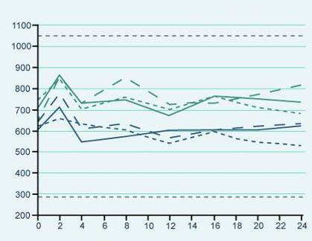
Results of the 6 Month AndroGel® 1% Trial
Pharmacokinetics
  T levels were restored & were generally maintained within the normal range
  T levels were very similar on Day 30, 90 and 180
  Pharmacokinetics are not altered by chronic therapy
Day 30
Day 90
Day 180
AndroGel® 10 g
Testosterone concentration (ng/dL)
AndroGel® 5 g
Time (hours) after application
Swerdloff RS, Wang C et al. J Clin Endo Metab 2000; 85:4500-10.
Notes:
The testosterone concentration-time profiles were similar on Day 30, Day 90 and Day 180, indicating that the pharmacokinetics are not altered by chronic therapy, and the concentrations were generally maintained within the eugonadal range. AndroGel® also maintained mean trough levels in the normal range.

Slide 13
Results of the 6 Month AndroGel® 1% Trial
Testosterone levels returned to the normal range with all transdermal testosterone formulations
PK Results (T Levels) | Effect on Serum T levels (Figure 1) At Day 0 (baseline), average serum T concentrations over 24hours were below the normal adult range for all three groups (range 8.22-8.60nmol/L) On Days 30 and 90, after gel application, the Cav in the T Gel 100mg/day group was 27.46nmol/L, 1.4-fold higher than the T Gel 50mg/day group (Cav = 19.62nmol/L and 19.17nmol/L for Days 30 and 90, respectively), and 1.9-fold higher than the T patch group (14.62nmol/L and 14.46nmol/L for Days 30 and 90, respectively) (p=0.0001) On Day 180, the serum T concentrations achieved and the pharmacokinetic parameters were similar to those on Days 30 and 90, for patients who continued in their original randomised treatment groups Effect on Serum Free T levels Similar to the total T results, the free T Cav achieved by the T gel 100mg group was 1.4- and 1.7-fold higher than those in the T gel 50mg and T patch groups, respectively (P = 0.001).
PK – Pharmacokinetic; Cav - average serum testosterone level (0-24h); T – Testosterone
Notes:
For patients who switched from T Gel 100mg/day or T Gel 50mg/day to T Gel 75mg/day, their Cav on Day 180 was 20.84nmol/L, midway between the two original groups. However these results were not homogenous, with the Cav for patients who had swapped from T Gel 100mg/day to 75mg/day (n=20) being 1.7-fold higher than the Cav for patients who had swapped from T Gel 50mg/day to 75mg/day (n=20).

Slide 14
Results of the 6 Month AndroGel® 1% Trial
Average serum hormone assays Day 180 compared to baseline | T-gel 5g n = 73 | T-gel 10 g n = 78 | T-patch n = 76
Percent free-T / T | No significant alteration
SHBG | Small decrease across 3 groups
DHT [fold increase] | 3.6 | 4.8 | 1.3
Estradiol [% increase] | 30.9 | 45.5 | 9.2
LH suppression [%] | 55 - 60 | 80 - 85 | 30 - 40
Swerdloff RS, Wang C et al. J Clin Endo Metab 2000; 85:4500-10.
Notes:
The results of the hormone assays are presented in the table.

Slide 15
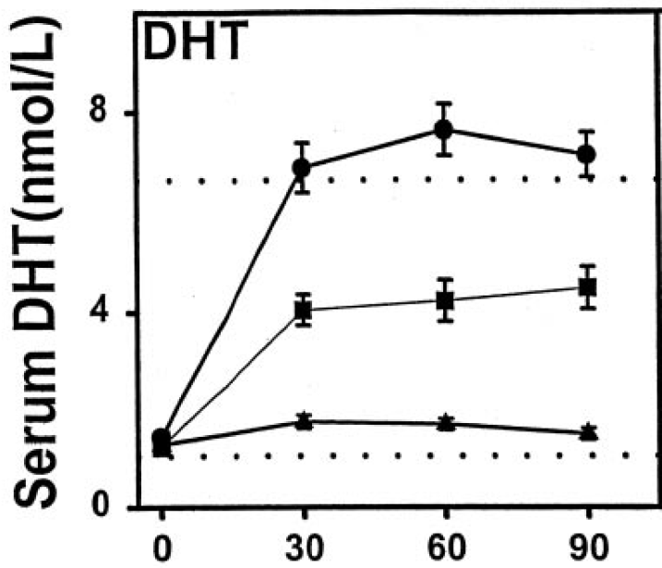
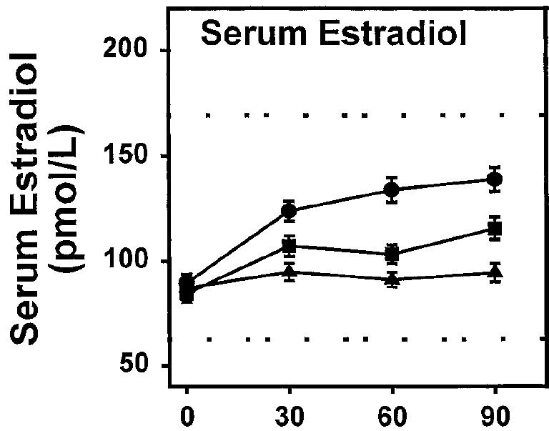
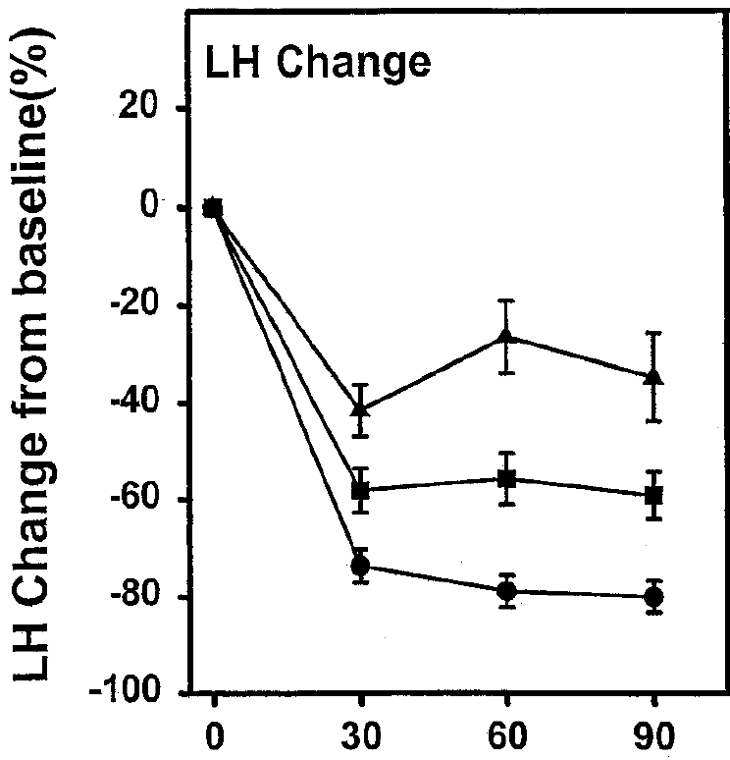
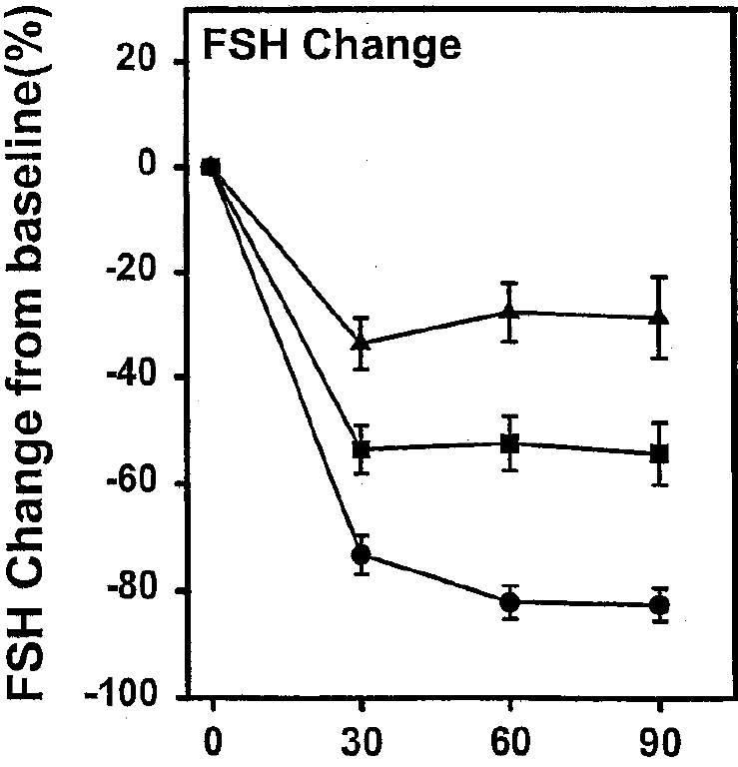




Results of the 6 Month AndroGel® 1% Trial
Concentration of T metabolites increase & gonadotropins decrease following T application
PK Results (Other) | Mean serum DHT* levels increased above the baseline after application of 50mg and 100mg gel Mean serum E2* increased to stable levels. LH* and FSH* levels were suppressed in proportion to serum T levels. Small decreases in SHBG* were seen in all three groups, indicating that when T is administered by the transdermal route, the lack of first pass effect results in minor, if any, decreases in SHBG.
Figure 2: Preapplication serum concentrations of DHT and E2 during daily transdermal T treatment from Days 1-90
Figures 2 & 3
Labels
Figure 3: Percent change in serum LH and FSH from baseline values after transdermal T replacement therapy from days 1–90
50mg T gel
100mg T gel
5mg T patch
Notes:
Results:
*The authors note that these decreases in SHBG are probably not clinically significant (though they may be statistically significant). Serum DHT/T ratios were raised after T gel applications but these ratios remained within the normal range.
Relevance of DHT in TD
Testosterone gets converted to DHT via the enzyme 5-alpha reductase. DHT is the critical factor of prostate growth. 5-alpha reductase is localised mainly in the prostate and therefore circulating testosterone gets converted into DHT in the prostate. The DHT binds to the androgen receptors in the prostate causing it to grow. Drugs that are prescribed to counteract this prostate growth by inhibiting DHT synthesis in the prostate are knows as 5-alpha-reductase inhibitors and include products such as dutasteride and finasteride.
Relevance of Oestradiol in TD
Testosterone also gets converted to oestradiol via the enzyme aromatase. Oestradiol is important in men for bone mineral density (BMD) so a man with low testosterone will consequently have low levels of oestradiol and therefore may have reduced BMD. With testosterone administration, higher levels of testosterone can lead to increased aromatisation of testosterone to oestradiol and therefore potential improvements in BMD.
Why LH and FSH are suppressed with TTh (Fig 3)
The previously described hypothalamic-pituitary-testicular (HPT) axis from module 1 explained that LH binds to the Leydig cells in the testes and through a cascade of events produces testosterone. If testosterone is applied exogenously and if the body is therefore receiving adequate levels of testosterone, then the feedback mechanism will mean that the hypothalamus will reduce the production of GnRH which in turn will reduce the production of LH which is what we see in Figure 3.
Similarly, if testosterone is applied exogenously and if the body is therefore receiving adequate levels of testosterone, then the feedback mechanism will mean that the hypothalamus will reduce the production of GnRH which in turn will also reduce the production of FSH (see Figure 3). FSH binds to the Sertoli cells in the testes which produce sperm. So less FSH production means less sperm production. This explains why men who wish to maintain fertility are not generally candidates for T therapy.

Slide 16
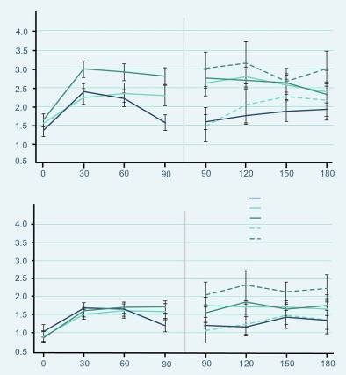
Effects on Sexual Function (6 Months)
  Similar scores at baseline
  Significant improvement compared to baseline in:
    Sexual motivation
    Sexual performance
    Sexual desire
    Satisfaction with erection
    For parameters (p=0.0001)
Motivation (0-7)
T patch
50 mg/day T gel
100 mg/day T gel
50-75 mg/day T gel
100-75 mg/day T gel
Performance (0-7)
Wang C, Swerdloff RS et al. J Clin Endocrinol Metab. 2000; 85:2839-53.
Day
Notes:
At baseline, the sexual motivation and performance scores were similar across groups.
After treatment – all subjects as a group showed significant improvement (p=0.0001).
A significant improvement in sexual function, as assessed by patient-completed questionnaires, was observed during 180 days of treatment with AndroGel® 5 g and 10 g. Patients with a dose adjustment to 7.5 mg at Day 90 had a very similar response to those remaining on their initial dose. Improvements were seen in sexual motivation (sexual day dreams, anticipation of sex, flirting and sexual interaction), sexual performance (orgasm, erection, masturbation, ejaculation and intercourse), sexual desire, sexual enjoyment with and without a partner, satisfaction with erection and the percentage of full erection achieved. These improvements occurred within 30 days and were sustained with continued therapy.

Slide 17
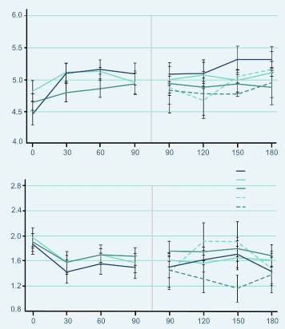
Effects on Mood (6 Months)
  Similar scores at baseline
  Positive Mood
    showed significant improvement (p=0.0001)
  Negative Mood
    showed significant decreases (p=0.0001)
Positive moods (0-7)
T patch
50 mg/day T gel
100 mg/day T gel
50-75 mg/day T gel
100-75 mg/day T gel
Negative moods (0-7)
Wang C, Swerdloff RS et al. J Clin Endocrinol Metab. 2000; 85:2839-53.
Day
Notes:
Parameters of mood were assessed by using questionnaires that the patients answered daily for 7 consecutive days before clinic visits on day 0 and on days 30, 60, 90, 120, 150, and 180 days during gel and patch application.
This chart shows the positive and negative mood summary responses to T replacement therapy.
All three treatment groups had similar scores at baseline, and all subjects as a group showed improvement in positive mood (P=0.0001).
Positive mood parameters included being alert, friendly, full of energy and well/good feelings.
The negative mood summary scores were also similar in the three groups at baseline.
Negative mood parameters were anger, irritable, sad, tired and nervousness.
The responses to transdermal T applications showed significant decreases (P=0.0001) without showing between-group differences.

Slide 18
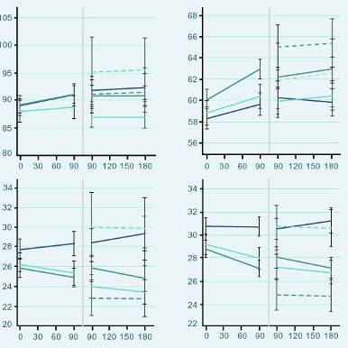
Effects on Body Composition (6 Months)
  Similar scores at baseline
  Increase in body mass
    due to the increase in lean body mass
    positively correlated with the increase in serum T from baseline
  Fat mass and percent body fat significantly decreased with T gel
T patch
50 mg/day T gel
100 mg/day T gel
50-75 mg/day T gel
100-75 mg/day T gel
Total Body Mass
Lean Mass
Total Body Mass (Kg)
Fat Mass
% Fat
Fat Mass (Kg)
Day
Day
Wang C, Swerdloff RS et al. J Clin Endocrinol Metab. 2000; 85:2839-53.
Notes:
Body composition (total body mass, lean body mass, fat mass, and percent fat) was measured by dual x-ray absorptiometry on days 0, 90, and 180.
At baseline there were no significant differences in these body composition parameters in the three treatment groups.
The increase in body mass was mainly due to the increases in lean body mass.
The percent body fat and fat mass decreased in all treatment groups.
AndroGel® 5 g and 10 g treatment for 180 days resulted in statistically significant increases in total body mass and total lean body mass, whereas the total body fat mass and percentage body fat decreased significantly. The changes to lean body mass and total fat mass were significant by Day 90. The total fat mass remained significantly lower until Day 180. Similar changes were seen in patients titrated to the 7.5 g dose. At the end of 180 days of treatment, the increase in lean body mass was positively correlated with the increase in serum testosterone concentrations from baseline.

Slide 19
Effects on Muscle Strength (6 Months)
Increase in arm and leg muscle strength Day 90 compared to baseline | T-gel 5g n = 73 | T-gel 10 g n = 78 | T-patch n = 76
Leg muscle strength with leg press exercises | 13.7 ± 3.4 kg (p=0.0003) | 12.7 ± 2.7 kg (p=0.0001) | 11.6 ± 2-5 kg (p=0.0001)
Arm/chest muscle strength | 2.6 ± 0.7 kg (p=0.0009) | 2.9 ± 0.8 kg (p=0.0004) | 1.5 ± 0.8 kg (p=0.08)
Wang C, Swerdloff RS et al. J Clin Endocrinol Metab. 2000; 85:2839-53.
Notes:
There was an increase in muscle strength in the legs and arm/chest. After 90 days of treatment, the muscle strength in leg press exercises had increased by 13.7 ± 3.4 kg (p=0.0003) and 12.7 ± 2.7 kg (p=0.0001) with 5 g and 10 g AndroGel®, respectively. Somewhat smaller increases were seen in arm/chest muscle strength: 2.6 ± 0.7 kg (p=0.0009) with 5 g and 2.9 ± 0.8 kg (p=0.0004) with 10 g.

Slide 20
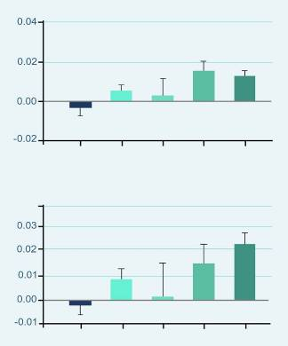
Effects on Bone Mineral Density (6 Months)
  BMD increased with T gel in a dose dependent fashion
  Significant increase in BMD with the 10 g dose at both
    Hip (* p=0.0001)
    Spine (* p=0.0001)
  Significant increase in hip BMD with patients titrated down to 7.5 g after Day 90
    Hip (**p=0.016)
**
*
Change in hip BMD (g/cm²)
Patch
50 mg
50-
75 mg
100-
75 mg
100 mg
T Gel
*
Change in spine BMD (g/cm²)
Patch
50 mg
50-
75 mg
100-
75 mg
100 mg
T Gel
Wang C, Swerdloff RS et al. Clin Endocrinol (Oxf). 2001;54:739-50.
Notes:
Bone mineral density in the hip and spine, as measured by DEXA, increased after 180 days of treatment with 5 g or 10 g AndroGel®. The effect was statistically significant with the 10 g dose. Patients titrated down to 7.5 g after Day 90 also showed a significant increase in hip bone mineral density (p=0.016), whilst no significant change was seen in those titrated up to 7.5 g.
There were also positive changes in urinary markers of bone catabolism. The N-telopeptide:creatine ratio declined within 30 days of treatment with both the 5 g and 10g doses of AndroGel®, and remained below baseline at Day 180.

Slide 21
Compliance During the 6 Month Trial
Compliance | T-gel 5g n = 73 | T-gel 10 g n = 78 | T-patch n = 76
Day 1 - 90 | 93.1% | 96.0% | 89.8%
Day 1 - 180 | 93.3% | 96.5% | 86.3%
  Compliance with AndroGel was much better than with the patch
  After completion of day 90, the discontinuation rate (21/76, 27.6%) in the T patch group was higher (P=0.0002) than those in the T gel groups (50 mg: 6/73, 8.2%; 100 mg: 5/78, 6.4%).
  Most of the discontinuation in the T patch group was due to adverse skin reaction. 3 patients who were receiving the T patch until day 90 were switched to T gel 50 from days 91–180 because of skin irritation from the patches
Swerdloff RS, Wang C et al. J Clin Endo Metab 2000; 85:4500-10.
Notes:
Compliance rates were higher with AndroGel® than with the testosterone patch. During the first 3 months of use (Day 1–90), the mean treatment compliance rates were 93.1% and 96.0% for AndroGel® 5 g and 10 g in comparison with 89.8% for the testosterone patch. During the whole 6-month study period (Day 1–180), the mean compliance rate continued to remain over 90% for AndroGel®, 93.3% and 96.5% for the 5 g and 10 g doses, whereas it fell to 86.3% for the testosterone patch.

Slide 22
Safety Results During the 6 Month Trial
  Prostate
  AE were reported by 3%, 3% and 5% of patients for doses of 5, 7.5 and 10 g
    Enlarged prostate (n=5)
    BPH (n=1)
    Elevated PSA (n=1)
  No prostate cancer cases were diagnosed. However, 2 cases were diagnosed in the 3-year long term study
  Blood Chemistry
  Abnormal laboratory tests
  AE were reported by 6%, 5% and 3% of patients for doses of 5, 7.5 and 10 g (n = 9)
    ↑Hb or Hct
    hyperlipidemia, ↓HDL cholesterol, ↑triglycerides
    hypokalemia, ↑glucose,
    ↑creatinine, ↑total bilirubin
Wang C, Swerdloff RS et al. J Clin Endocrinol Metab. 2000; 85:2839-53.
Wang C, Cunningham G et al. J Clin Endo Metab 2004; 89:2085-98.
US AndroGel® Prescribing Information. Dec 2007.
Notes:
Prostate adverse events were reported by 3%, 3% and 5% of patients in the 5, 7.5 and 10 g AndroGel® groups, respectively. They included five patients with an enlarged prostate, one patient with benign prostatic hyperplasia and one patient with elevated prostate specific antigen.
Abnormal laboratory test occurred in 9 patients with one or more of the following events: Elevated hemoglobin or hematocrit, hyperlipidemia, elevated triglycerides, hypokalemia, decreased HDL cholesterol, elevated glucose, elevated creatinine or elevated total bilirubin.

Slide 23
Safety Results During the 6 Month Trial
  Skin Irritation
  5%, 3% and 4% for doses
  of 5, 7.5 and 10 g AndroGel®
  No skin reaction was severe enough to require treatment or discontinuation of AndroGel®
  Additional Side Effects in ≥ 1% of Patients
  Acne, Libido decreased, Alopecia, Testis disorder
  Asthenia, Depression, Emotional lability, Nervousness
  Gynecomastia, Pain breast
  Headache, Hypertension
Wang C, Swerdloff RS et al. J Clin Endocrinol Metab. 2000; 85:2839-53.
US AndroGel® Prescribing Information. Dec 2007.
Notes:
Adverse events at least possibly related to AndroGel® use and reported by ≥1% of patients at some time during the 180 day controlled clinical trial are shown above. This was in addition to prostate disorders and abnormal laboratory tests. .Only a relatively small percentage of patients reported application site reactions: 5%, 3% and 4% of patients in the 5, 7.5 and 10 g AndroGel® groups, respectively (Table 12).25 No skin reaction was severe enough to require treatment or discontinuation of AndroGel®.
Adverse events at least possibly related to AndroGel® use that occurred in <1% of patients included amnesia, anxiety, discolored hair, dizziness, dry skin, hirsutism, hostility, impaired urination, paresthesia, penis disorder, peripheral edema, sweating and vasodilation

Slide 24
Summary of the 6 Month AndroGel® 1% Trial
AndroGel®
Normalized testosterone
Restored sexual function
Improved mood
Increased muscle strength BUT only up to 90 days
Decreased fat mass
Increased bone density
The pharmacokinetic profile and the dose proportionality observed after testosterone gel application indicate that AndroGel 1% may provide dose flexibility and serum testosterone levels from the low to the high normal adult male range.

Slide 25
Wang, C et al.
Long-Term Testosterone Gel Treatment Maintains Beneficial Effects on Sexual Function and Mood, Lean and Fat Mass, and Bone Mineral Density in Hypogonadal Men
J Clin Endocrinol Metab, May 2004, 89(5):2085–2098.
Besins Healthcare
Global Medical Affairs
March 2021

Slide 26
3 Year AndroGel® 1% Open Label Trial
Long term open-label efficacy, outcome and safety follow up study of Swerdloff, RS et al 2000
Study design | 36-month open-label follow-up study of the RCT by Swerdloff, RS et al 2000 (42 months total). To evaluate the long term efficacy of T Gel
Study treatment | All patients were treated with T Gel at a dose of either 5g, 7.5g or 10g of gel daily (50mg, 75mg or 100mg testosterone respectively) All subjects previously on the T patch were assigned to 5g AndroGel Men previously on T gel 5g/day with levels <10.4nmol/L (or T gel 10g/day with levels >34.7nmol/L) were assigned to 7.5g/day gel group. Due to the long duration of the study, the study design allowed dose adjustment in increments of 2.5g/day (range min: 2.5g/day max: 10g/day) throughout the study period, depending on clinical symptoms and serum T levels.
Study population | A total of 163 subjects (aged 19-68 years) participated in the long-term study and were included in the safety analysis 123 subjects were included in the efficacy analysis n=49 (primary hypogonadism), n=27 (secondary hypogonadism), n=47 (age-related/adult-onset hypogonadism)
Notes:
Design:
Subjects were permitted entry into a long-term efficacy study of 24 months (total exposure 30 months), which was further extended for up to 36 months (total exposure 42 months)
40 subjects were excluded from the efficacy analysis:
- If there was an interval of ≥90days between the end of the 6-month study and the long-term study in which the subjects could have received some other treatment (20 subjects)
If the subjects participated for <3 months in the long-term study (9 subjects), or
If the subjects were enrolled in this study without having completed the 6-month study (11 subjects)
In the initial 6-month study, patients randomised to testosterone gel had a single, preapplication serum testosterone measurement on Day 60; if levels were within the normal range (10.4 –34.7 nmol/litre; 300-1000 ng/dl), they remained on their original dose.

Slide 27
3 Year AndroGel® 1% Open Label Trial
Assessment Every 6 Months
  Physical exam, AE assessment, skin irritation every 6 months
  Blood samples every 6 months
    Total T, Free T, DHT, E2, LH, FSH, SHBG, bone turnover markers
    Safety blood chemistry and PSA
  Questionnaire for sexual function and mood every 6 months
  Body Composition and BMD at baseline, 6, 18 and 30 months
  Muscle strength every 6 months
Wang C, Cunningham G et al. J Clin Endo Metab 2004; 89:2085-98.
Notes:
Questionnaire for sexual function and mood every 6 months.
Sexual motivation: sexual day dreams, anticipation of sex, flirting, sexual interaction.
Sexual performance: orgasm, erection, masturbation, ejaculation, intercourse.
Positive mood: alert, friendly, full of energy, well/good feelings.
Negative mood: angry, irritable, sad, tired nervous.
Body composition assessed after 6, 18 and 30 months by DEXA scan.
Muscle strength assessed every 6 months by bench/leg press.
Bone mineral density assessed after 6, 18 and 30 months by DEXA scan.
Bone turnover markers assessed every 6 months by calcium, inorganic phosphorus, parathyroid hormone (PTH), markers of osteoblastic activity and bone resorption markers.
Blood samples every 6 months for total testosterone, free testosterone, DHT, E2, LH, FSH, SHBG, laboratory parameters, PSA and bone turnover markers

Slide 28
Patients Enrolled in the 3 Year AndroGel® 1% Trial
Number of Patients
Months
Wang C, Cunningham G et al. J Clin Endo Metab 2004; 89:2085-98.
Notes:
The number of patients who dropped out of the trial increased as time went on.

Slide 29
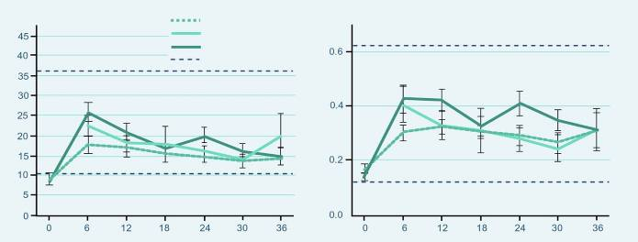
Results of the 3 Year AndroGel® 1% Trial
  Testosterone Levels
5 grams
7.5 grams
10 grams
Normal range
Months
Months
  At 6 months, the beginning of the long-term study, mean serum T levels were at 14.1, 22.4 and 25.6 nmol/L for the 5g, 7.5g and 10g groups, respectively, which were significantly different between the groups (p = 0.012)
  At 12 months the differences in T concentrations between the different dose groups became smaller but remained significant (p= 0.042)
  Thereafter with dose adjustment for the subjects, serum T levels were not different between the three groups.
  Serum free T followed the same pattern as serum T and also showed no significant differences among the dose groups after 12 months.
Wang C, Cunningham G et al. J Clin Endo Metab 2004; 89:2085-98.
Notes:
At 6 months, which is the beginning of the long-term study, mean serum T levels were at 14.1 ± 1.3, 22.4 ±2.7 and 25.6 ± 2.4 nmol/L which was significantly different for the 5, 7.5 and 10g T gel dose group, respectively (p = 0.012). At 12 months the differences in serum T concentrations between the different dose groups became smaller but remained significant (p = 0.042: T gel 5 g/d 16.9 ± 1.9 nmol/L; 7.5 g/d, 17.9 ± 3.9 nmol/L; and 10 g/d, 20.5 ± 1.5 nmol/L). Thereafter with dose adjustment for the subjects, serum T levels were not different between the three groups.
Serum free T followed the same pattern as serum T and also showed no significant differences among the dose groups after 12 months.

Slide 30
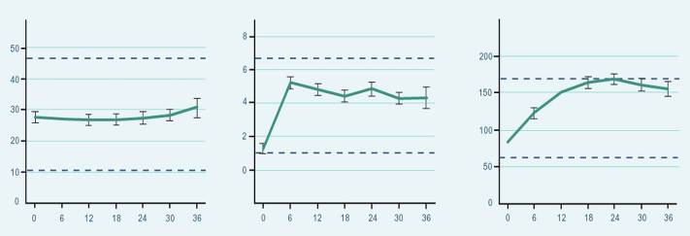
Results of the 3 Year AndroGel® 1% Trial
  SHBG: No significant changes
  DHT & E2: significantly higher concentrations from baseline
SHBG
DHT
E2
Months
Months
Months
Wang C, Cunningham G et al. J Clin Endo Metab 2004; 89 : 2085-98.
Notes:
Serum SHBG showed no significant change with treatment and remained within the adult male reference range.
Mean serum DHT concentrations were significantly higher after treatment (p=0.0001) and were maintained within the adult male range for the treatment period. Mean serum DHT was different in the three dose groups at 12 (p = 0.0031) and 24 (p = 0.018) months with the levels in the 10 g group higher than the other two. Serum DHT to T ratio was 0.21 at baseline and remained between 0.26 to 0.30 throughout the treatment period without any time effect.
Mean serum E2 levels were significantly different higher after T gel replacement (p =0.0001) and increased progressively until month 18 of treatment while remaining at the upper limit of the male reference range. Serum E2: T ratio increased during treatment from 0.006 at 6 months to 0.013 and 0.016 at 18 and 24 months, respectively (p=0.0001 and 0.0115 respectively). Mean serum E2 concentrations were also significantly different amongst the three groups at 12 (p = 0.009) and 24 (p = 0.005) months where the levels are higher in the 10 g dose group.

Slide 31
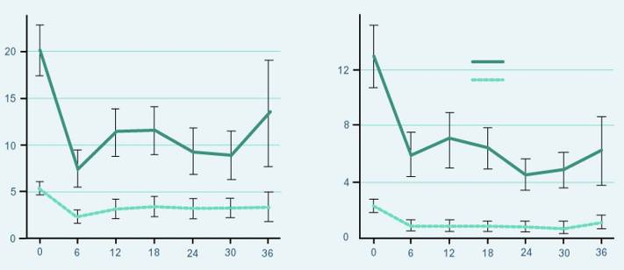
Results of the 3 Year AndroGel® 1% Trial
  LH & FSH: Long term suppression maintained from baseline (p<0.0001)
FSH
LH
Primary failure
Other
FSH (IU/L)
Months
Months
Wang C, Cunningham G et al. J Clin Endo Metab 2004; 89:2085-98.
Notes:
Compared with baseline, mean serum LH and FSH concentrations were suppressed significantly with T gel treatment in subjects with primary and secondary hypogonadism as well as in those with low baseline serum T and normal serum gonadotropins (P < 0.0001). This suppression of LH and FSH was maintained throughout the treatment period without further significant changes after 6 months .

Slide 32
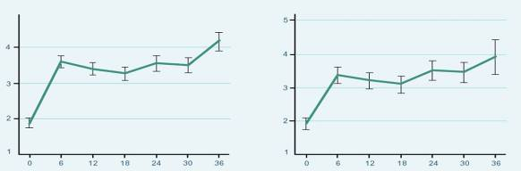
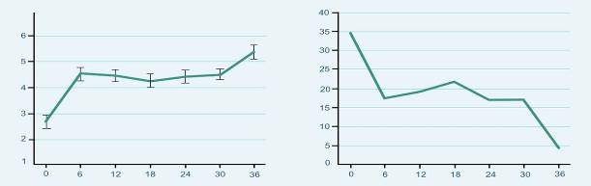
Effects on Sexual Function (3 Years)
  After treatment with T Gel, Sexual Desire, Sexual Enjoyment and Sexual Activity improved, compared with baseline, and were maintained at the same level from 6 months until the end of the treatment period.
Sexual Desire
Sexual Activity
*
*
Sexual activity (0-7)
Sexual desire (0-7)
Satisfaction with Erection
% Without Erections
*
Satisfaction (0-7)
Subjects without erections (%)
Months
Months
Wang C, Cunningham G et al. J Clin Endo Metab 2004; 89:2085-98.
Notes:
After treatment with T gel, as a group sexual desire (P = 0.0001), enjoyment without partner (P = 0.0001), enjoyment with partner (P= 0.0022), percent full erection (P = 0.0001), and self-assessment of satisfaction with erections (P= 0.0001) improved, compared with baseline, and were maintained at the same level from 6 months until the end of the treatment period. Sexual activity scores were also significantly increased and maintained at the same level from 6 months throughout the treatment period (P = 0.0001). The proportion of subjects with erections increased from a baseline of 64.8% to 81.7% at 6 months without subsequent further significant increases.

Slide 33
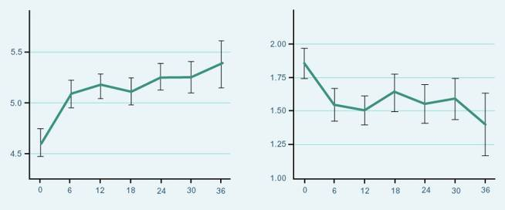
Effects on Mood(3 Years)
  Positive mood improved significantly and changes were sustained from baseline
  Negative mood parameters were decreased and remained significantly lower (p=0.0013) than baseline without further changes after 6 months of T Gel replacement therapy.
Positive Moods
Negative Moods
Positive moods (0-7)
p = 0.0022
p = 0.0013
Months
Months
Wang C, Cunningham G et al. J Clin Endo Metab 2004; 89:2085-98.
Notes:
Positive mood scores improved with treatment and were sustained (P=0.0022), whereas negative mood parameters were decreased and remained significantly lower (P=0.0013) than baseline without further changes after 6 months of T gel replacement. There was overall improvement in psychosexual function in men over 60 yr, but the changes were smaller, compared with those younger than 60 yr of age (e.g. sexual activity P=0.0129 in older men and P= 0.0001 in younger men).

Slide 34
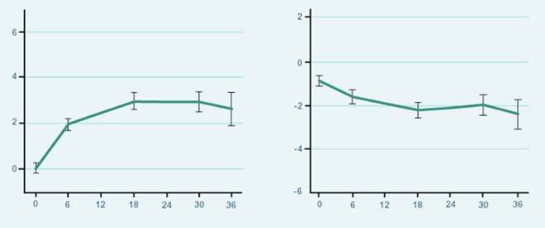
Effects on Body Composition (3 Years)
  Lean and fat body mass changed significantly from baseline
Lean Body Mass Change
Fat Body Mass Change
Fat mass change (kg)
*
Lean mass change (kg)
*
* p = 0.0001
* p = 0.0058
Months
Months
Wang C, Cunningham G et al. J Clin Endo Metab 2004; 89:2085-98.
Notes:
Average total body mass increased by 1.2 ± 0.3 kg at 6 months (P=0.0157) and did not significantly change with continued T gel therapy.
Lean body mass increased significantly (P=0.0001) from baseline and remained increased throughout the study period. The change in lean body mass was 1.97 ± 0.24 kg at 6 months and was further increased to 2.93 ± 0.32 kg at 18 months and 2.89 ± 0.41 kg at 30 months (P=0.0065). The differences in the lean body mass between the dose groups and those over and under age 60 yr were not significant.
Fat mass decreased significantly as a group with T gel replacement (P=0.0058). The decrease in fat mass was 0.8 ± 0.3 kg at 6 months and 1.57 ± 0.38 and 1.30 ± 0.51 kg at 18 and 30 months (P= 0.088 when compared with 6 months), respectively, without significant differences among the different dose groups. The decreases in fat mass (P=0.032) and percent fat (P=0.0001) were observed only in the younger subjects but not in older men. The changes in body composition parameters were not related to the change in serum T concentrations during replacement therapy.

Slide 35
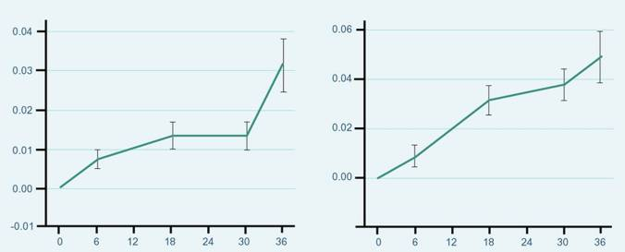
Effects on Body Composition (3 Years)
  BMD showed significant gradual and progressive increase from baseline
Change Hip BMD
Change Spine BMD
Change in hip BMD (g/cm²)
Change in spine BMD (g/cm²)
p = 0.0004
p = 0.0001
Months
Months
Wang C, Cunningham G et al. J Clin Endo Metab 2004; 89:2085-98.
Notes:
BMD of the hip (P = 0.0004) and spine (P= 0.0001) showed a gradual and progressive increase with treatment. The increase in the BMD was more marked in the spine than the hip. Spine BMD increased by 0.031± 0.006 (3.1%) and 0.037 ± 0.006 g/cm2 (3.8%) at 18 and 30 months of treatment, respectively, and was significantly higher than that at 6 months (P =0.0001). There were no significant differences in the improvement in BMD among the three dose groups or between the younger and older age groups. The absolute increase in BMD in the hip and spine was not related to the baseline serum T or the change in serum T levels but was significantly related to baseline BMD (P= 0.0001).

Slide 36
Results of the 3 Year AndroGel® 1% Trial
After 36-month treatment | T-gel 5g n = 62 | T-gel 7.5g n = 22 |  | T-gel 10 g n = 39
Mean muscle strength | No statistically significant change over time
Compliance to therapy | 117 % |  | 88.2 % |  | 71.4 %
Mean PSA levels | No further significant increases after 6 months with continued T treatment
Tolerance (skin irritation) [%] | 8.1 % |  | 13.6 % |  | 10.3 %
Wang C, Cunningham G et al. J Clin Endo Metab 2004; 89:2085-98.
Notes:
Muscle strength testing of the upper and lower extremities by the chest and leg press increased, but this did not reach statistical significance over time because of the large variations within and between subjects. The mean chest press increased by 1.7 to 4.1 kg and the leg press by 8.7 to 14.5 kg over the treatment period of up to 36 months. There were no sustained differences among the different dose groups or between subjects who were younger or older than 60 yr.
Overall compliance was 117, 88.2, and 71.4% of the prescribed dose in the 5-, 7.5-, and 10-g groups, respectively. The proportions of patients who were taking less than 80% of their prescribed dose were higher in the 7.5- and 10-g groups, whereas those who were taking more than 120% of their prescribed dose were higher in the 5-g group.
The baseline PSA level was 0.85 0.06 ng/ml. With T replacement there were significant increases in PSA levels over time (P 0.001 in the whole group, P 0.0002 in subjects 60 yr, and P 0.0160 in those 60 yr). Mean serum PSA was 1.11 0.08 ng/ml at month 6 and showed no further significant increases with continued T treatment (P = 0.150).
Application site skin reaction occurred in 12 of 163 subjects (five, three, and four subjects were receiving 5, 7.5, and 10 g T gel/d), 11 had minimal or mild erythema, and one was classified as moderate. Only one subject discontinued from the study after 12 months of 5 g T treatment because of worsening of minimal erythema and punctate rash.

Slide 37
Safety Results During the 3 Year Trial
  Prostate
  Enlarged prostate 11.7% (n=19)
  (most were enlarged at baseline)
  Prostate cancer 1.2% (n=2)
  Urinary symptoms 3.7% (n=6)
    nocturia, urinary hesitancy, urinary incontinence, urinary retention, urinary urgency and weak urinary stream
  Blood Chemistry
  Abnormal laboratory tests
  AE were reported by 9.3%
  (n = 15)
    ↑Hb or Hct
    ↑AST, ↑ ALT
    ↑testosterone
    ↑cholesterol, ↑cholesterol/LDL ratio,
    ↑ triglycerides, ↑HDL
    ↑creatinine
Wang C, Cunningham G et al. J Clin Endo Metab 2004; 89:2085-98.
US AndroGel® Prescribing Information. Dec 2007.
Notes:
Urinary symptoms included nocturia, urinary hesitancy, urinary incontinence, urinary retention, urinary urgency and weak urinary stream
Lab test abnormal occurred in fifteen patients with one or more of the following events: elevated aspartate aminotransferase (AST), elevated alanine aminotransferase (ALT), elevated testosterone, elevated hemoglobin or hematocrit, elevated cholesterol, elevated cholesterol/LDL ratio, elevated triglycerides, elevated HDL, or elevated serum creatinine.
Prostate size was not assessed by ultrasound but was assessed during digital rectal examinations. Most of these patients had enlarged prostate at baseline assessment.

Slide 38
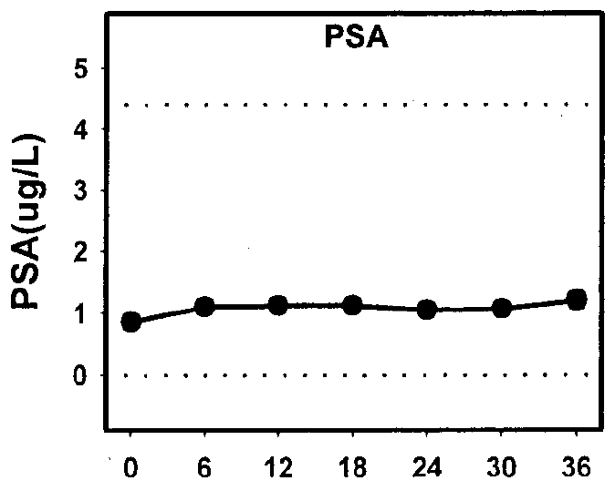

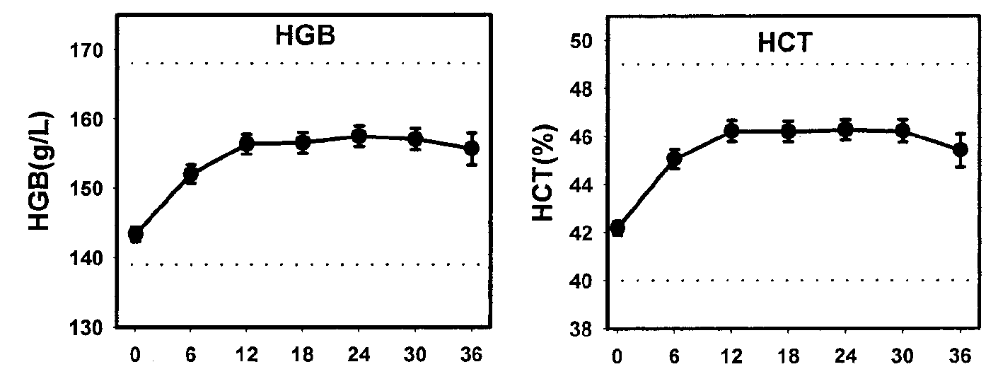
Safety Results During the 3 Year Trial
The effect of long-term T gel application on safety parameters
Safety | Skin Irritation Application site skin reaction occurred in 12/163 subjects (one was classified as moderate). One subject discontinued after 12 months of T Gel (5g) because of worsening erythema and rash. IPSS & PSA Mean IPSS score did not change significantly across time with T gel. None of the individual scores showed any clinically meaningful changes Baseline PSA level was 0.85ng/ml. With T replacement there were significant increases in PSA levels over time. Mean serum PSA was 1.11ng/ml at month 6 and showed no further significant increases with continued T treatment (P = 0.150). 3 subjects (1.8%) aged >63 years whose serum PSA rose above the predetermined critical value of 5.5 ng/dl had T treatment stopped and had confirmed PCa on biopsy Haematocrit Except for the anticipated increase in haematocrit and haemoglobin, there were no clinically significant changes in blood counts or biochemistry.
Figure 1: Haemoglobin (HGB), haematocrit (HCT) and PSA concentrations over time
Figure 1: Adapted from Wang et al.
Notes:
Of the subjects who had elevated PSA during the study, three had confirmed prostate cancer on biopsy. All three subjects were over 63 years old at enrolment in the study.
The incidence of prostate cancer in three of 163 (1.8%) subjects who were enrolled in this study was similar to that reported in older men by Snyder et al. who were treated with scrotal transdermal patches for 3 year (one of 54, 1.8%).
However, if only men over 60 yr enrolled in this study were considered, the incidence would be higher: three of 39 (7.7% over a 3-yr period).
Based on the data from the Surveillance, Epidemiology, and End Result Program of the National Cancer Institute, the anticipated incidence of prostate cancer in the population of men between the ages of 65 and 74 yr is between 973 and 994 cases per 100,000 men [National Cancer Institute, Surveillance, Epidemiology, and
End Result (SEER) Program 2002, www.seer.cancer.gov].
Gynecomastia was observed only in eight more subjects during treatment (4.9%).
Acne was noted in 12 subjects (7.4%). None of these subjects was discontinued because of acne.
Prostate size was not assessed by ultrasound but was assessed during digital rectal examinations and found to be enlarged in 23 subjects (14%) at any time in the study. Most of these patients had enlarged prostate at baseline assessment.

Slide 39
Safety Results During the 3 Year Trial
Additional Side Effects reported by 2 or more subjects in at least 1 treatment group
  Acne
  Pruritus
  Skin dry
  Testis disorder
  Gynecomastia
  Anemia
Wang C, Cunningham G et al. J Clin Endo Metab 2004; 89:2085-98.
US AndroGel® Prescribing Information. Dec 2007.
Notes:
AndroGel® was well tolerated, as evidenced by the low incidence of erythema and absence of discontinuations due to application site reactions.
Adverse events at least possibly related to AndroGel® use reported by or more patients in at least one treatment group at some time the 3 year open label extension study:
Testis disorder occurred in three patients: two patients with a non-palpable testis and one patient with slight right testicular tenderness.
Gynecomastia was observed only in eight more subjects during treatment (4.9%). Breast enlargement was rated as mild in five and moderate in three subjects; all resolved without treatment. Of the eight with breast enlargement with treatment, only one had the diagnosis of Klinefelter’s syndrome.
Acne was noted in 12 subjects (7.4%). None of these subjects was discontinued because of acne.

Slide 40
Summary of the 3 Year AndroGel® 1% Trial
AndroGel®
Normalized testosterone
Restored sexual function
Improved mood
Did NOT Increase muscle strength
Decreased fat mass
Increased bone density
Wang C, Cunningham G et al. J Clin Endo Metab 2004; 89:2085-98.

Slide 41
Summary of the 3 Year AndroGel® 1% Trial
AndroGel is well tolerated and effective when used in the long-term treatment of hypogonadal men.
Conclusions | AndroGel replacement in hypogonadal men led to the restoration of serum T and free T into the adult male range, which was sustained with long term treatment. Long term effects on other hormone assays and improvements in mood, sexual function, and body composition were also sustained with long term treatment. The safety parameters were comparable with other delivery systems. The authors note that the benefits of androgen replacement must be weighed against potential risks. As with all androgen replacement, continuous vigilance is required for the monitoring of serum PSA, haematocrit and haemoglobin.
Wang C, Cunningham G et al. J Clin Endo Metab 2004; 89:2085-98.

Slide 42
Behre, HM et al
A randomized, double-blind, placebo-controlled trial of testosterone gel on body composition and health-related quality-of-life in men with hypogonadal to low-normal levels of serum testosterone and symptoms of androgen deficiency over 6 months with 12 months open-label follow-up (The PADAM Study)
The Aging Male, 2012; 15(4): 198–207
Besins Healthcare
Global Medical Affairs
March 2021

Slide 43
Aims & Objectives
The aim of this randomized, placebo-controlled study was to investigate the efficacy and safety of treatment with a 1% testosterone gel in men aged 50-80 years with hypogonadal to low-normal total serum testosterone (<15.0nmol/l) along with putative symptoms of testosterone deficiency.
The primary objective was the assessment of changes in lean body mass (LBM) after 6 months of treatment with AndroGel compared with placebo.
A secondary study objective was assessment of changes in LBM during open label treatment with AndroGel from study month 6 to 18, and assessment of changes in LBM in subgroups of patients.
Other secondary study objectives were assessment of changes in T serum levels, fat mass, total body mass, bone density, health-related quality of life (HRQoL) as assessed by the Ageing Male Symptoms (AMS) rating scale and monitoring of safety parameters.
Behre, HM et al. The Aging Male, 2012; 15(4): 198–207

Slide 44
Patients & Methods
Phase IV study, randomised, double blind
Efficacy and Safety of Testogel® in Men with Partial Androgen Deficiency of Aging Males (PADAM)
362 men aged
  50 to 80 years
  Total testosterone <15nmol/L
  AMS rating scale total score > 36 with typical symptoms of PADAM
    Total AMS scores and scores for the psychological, somatic, and sexual subscales were calculated
First 6 months: 2 treatment arms (5g Testogel® 1%vs. placebo)
  Depending on clinical response and serum testosterone levels, dose could be increased to 7.5 g after 3 months.
Follow up period: 12 months, open label, active treatment
30 centres in 8 countries
Final analysis after all patients completed 18 months treatment
Behre, HM et al. The Aging Male, 2012; 15(4): 198–207

Slide 45
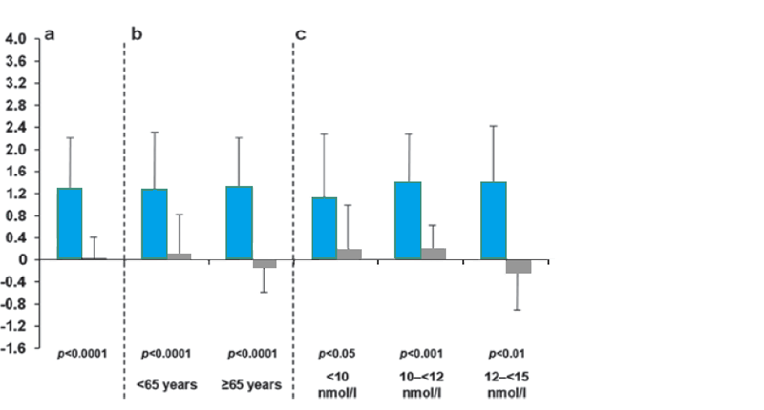
Improvements in LBM independent of age & baseline serum testosterone level
Mean (SD) changes in lean body mass at 6 months with testosterone versus placebo in all patients (a), in patients grouped by age (b) and by baseline serum total testosterone levels (c).
Placebo (6 months)
Transdermal testosterone gel only
Change in lean body mass (kg)
Age group: <65 years: placebo n=121; testosterone gel n=115
≥65 years: placebo n=57; testosterone gel n=68
Behre, HM et al. The Aging Male, 2012; 15(4): 198–207

Slide 46
Improvements in LBM independent of age
<65 years
≥65 years
3.6
Placebo (6 months)
3.2
2.8
Transdermal testosterone
gel only
2.4
Transdermal testosterone gel
following 6 months’ placebo
2.0
*
**
1.6
1.2
* p<0.005
** p<0.0001
Change in lean body mass (kg)
0.8
0.4
0
-0.4
-0.8
-1.2
-1.6
6 months
18 months
6 months
18 months
Age group: <65 years: placebo n=121; testosterone gel n=115
≥65 years: placebo n=57; testosterone gel n=68
Behre, HM et al. The Aging Male, 2012; 15(4): 198–207
Notes:
46

Slide 47
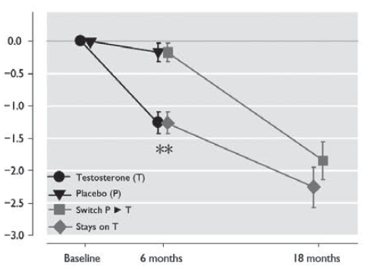
Changes in fat mass, BMD and total body mass
FAT MASS
Change in fat mass from baseline
Significant decreases in fat mass were associated with testosterone therapy.
This decrease in fat mass was similar across subgroups of age, baseline total testosterone & baseline BMI.
The effect on body fat mass was more pronounced in the obese population (i.e. BMI ≥30 kg/m2).
Changes in bone mineral density, bone mass, and total body mass were not significantly different between the randomized groups
Behre, HM et al. The Aging Male, 2012; 15(4): 198–207
Notes:
Significant decreases in fat mass were associated with testosterone therapy; after 6 months, the mean (SD) decrease in fat mass following testosterone and placebo treatment was –1.16 ± 0.16 and – 0.14 ± 0.12 kg, respectively (p < 0.001).
This decrease in fat mass was largely similar across subgroups of age, baseline total testosterone, and baseline BMI.
The effect on body fat mass was somewhat more pronounced in the obese population (i.e. BMI ≥30 kg/m2).
Over the next 12 months of the study there was a statistically significant progressive decrease of fat mass.
In the testosterone treated group at month 18, fat mass had decreased further (by an additional –1.11 ± 0.24 kg to a total of 2.45 ± 0.48 kg. In the placebo group that switched to testosterone after 6 months an almost similar decrease in fat mass was seen at the end of the 18 month study

Slide 48
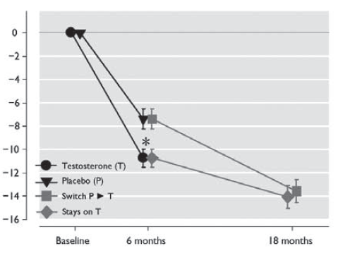
Improvements in Health-Related Quality of Life (AMS)
TOTAL SCORE
Change from baseline in total AMS score
While AMS scale scores improved in both the AndroGel® 1% and the placebo group at 6 months, AndroGel® 1% therapy was associated with significantly greater decreases in the mean AMS total score (p=0.002)
Changes in outcomes during the trial according to treatment status. Error bars represent standard error (SE). *: p < 0.05 for difference between the two groups. **: p < 0.001 for difference between the two groups.

Slide 49
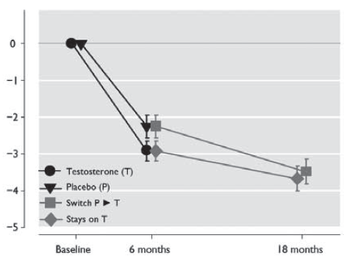
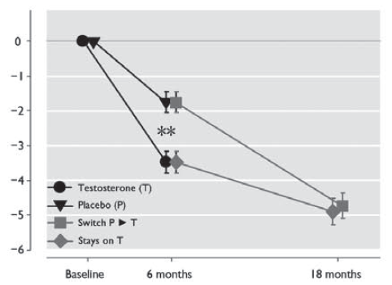
Improvements in Health-Related Quality of Life (AMS)
PSYCHOLOGICAL SCORE
SEXUAL SCORE
Change from baseline in psychological subscale
Change from baseline in sexual subscale
AndroGel® 1% therapy was associated with significantly greater decreases in the mean AMS psychological subscale score (p=0.049), and sexual subscale score (p<0.001)
Changes in outcomes during the trial according to treatment status. Error bars represent standard error (SE). *: p < 0.05 for difference between the two groups. **: p < 0.001 for difference between the two groups.

Slide 50
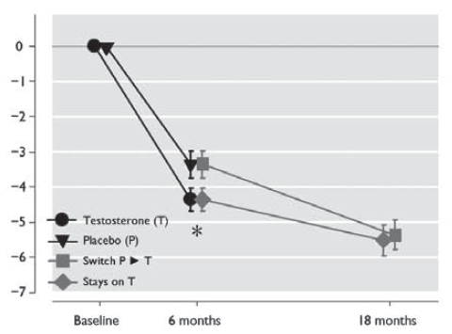
Improvements in Health-Related Quality of Life (AMS)
SOMATIC SCORE
Change from baseline in somatic subscale
AndroGel® 1% therapy was associated with a decrease that approached statistical significance for the somatic subscale score (p=0.053)
Changes in outcomes during the trial according to treatment status. Error bars represent standard error (SE). *: p < 0.05 for difference between the two groups. **: p < 0.001 for difference between the two groups.

Slide 51
Safety Data – Adverse Events
During the double-blind treatment phase, 10/183 (5.5%) and 12/179 (6.7%) patients in the testosterone and placebo groups, respectively, discontinued the study due to adverse events.
Adverse event profiles were similar in the groups receiving testosterone and placebo.
The number of patients experiencing one or more serious adverse events was 7/183 (3.8%) and 6/179 (3.4%) in testosterone and placebo groups, respectively.
Five patients experienced serious adverse events considered to be potentially related to the study medication (testosterone group).
One patient in the testosterone group died of coronary artery disease; this cause of death was not considered related to the study medication.
Behre, HM et al. The Aging Male, 2012; 15(4): 198–207
Notes:
Five patients experienced serious adverse events considered to be potentially related to the study medication (testosterone group). One patient was diagnosed with prostate cancer and subsequently treated with radical prostatectomy. Another underwent a prostate biopsy in which intraepithelial neoplasia was diagnosed, and the third experienced a worsening of prostate-related symptoms which resolved following transurethral resection of the prostate (TURP). A fourth patient had a tendon rupture of the biceps, and a fifth a deep vein thrombosis.

Slide 52
Safety Data – Haematocrit
The number of patients in the testosterone group that discontinued the study due to increased haematocrit (>54%) during the first 6 months of treatment was 2/183 (1.1%).
No patients in the placebo group discontinued due to an increased haematocrit.
In the 12 months extension period 21/249 patients left the study because of elevations of the haematocrit.
Behre, HM et al. The Aging Male, 2012; 15(4): 198–207

Slide 53
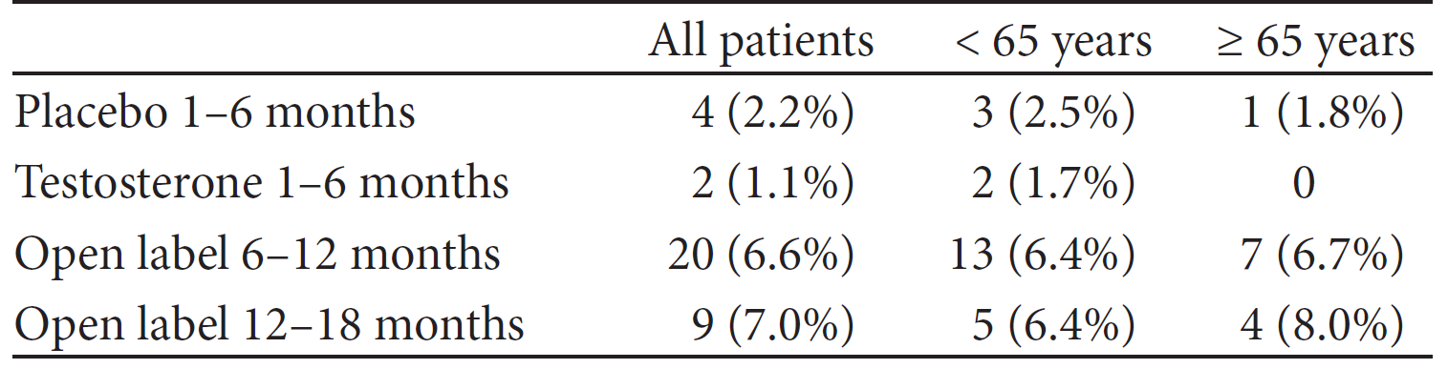
Safety Data – Prostate
Mean International Prostate Symptom Score (IPSS) at baseline and 6 months, respectively, were 7.1 and 6.4 in the testosterone group and 8.1 and 8.7 in the placebo group.
Subsequent treatment with testosterone gel until month 18 resulted in mean values of 6.1.
Abnormal digital rectal examinations at baseline and 6 months were reported in 14.4% and 9.8% of testosterone-treated patients, and 13.6% and 8.5% of patients in the placebo group.
Discontinuations due to increases of serum PSA >1 ng/mL and/or >50% above value at screening
Behre, HM et al. The Aging Male, 2012; 15(4): 198–207

Slide 54
Safety Data – Mean PSA Levels
Placebo/ testosterone gel following 6 months’ placebo
2.0
Transdermal testosterone gel only
1.8
1.6
1.4
1.2
PSA (ng/ml)
1.0
0.8
0.6
0.4
0.2
0.0
Baseline
3
6
9
12
18
Time (months)
Behre, HM et al. The Aging Male, 2012; 15(4): 198–207

Slide 55
SUMMARY
This large, randomized, double-blind, placebo-controlled study demonstrated that 6 months’ treatment with testosterone improves lean body mass and HRQoL and decreases fat mass in men with serum total T < 15.0 nmol/L and symptoms of androgen deficiency.
Treatment increased median testosterone levels by approximately 7 nmol/L
Testosterone therapy was associated with improvements in cardiovascular and metabolic profiles in this population
At the end of the 6-month double-blind study period, 89% of the original 362 patients (i.e. patients from both the AndroGel® 1% and the placebo group) elected to continue with AndroGel® 1% treatment in a 12-month open-label extension phase.
Over this 12-month period there was a progressive decrease in scores on the AMS scale and its subscales indicating progressive improvement of HRQoL.
Transdermal testosterone gel preparation possesses good safety and efficacy profiles when used in the treatment of late-onset hypogonadism
Behre, HM et al. The Aging Male, 2012; 15(4): 198–207
Bouloux PM et al. Results presented at the EAU Congress, Italy 2008.

Slide 56
Heufelder, AE et al
Fifty-two–Week Treatment With Diet and Exercise Plus
Transdermal Testosterone Reverses the Metabolic Syndrome and
Improves Glycemic Control in Men With Newly Diagnosed Type 2
Diabetes and Subnormal Plasma Testosterone
Journal of Andrology, Vol. 30, No. 6, November/December 2009
Besins Healthcare
Global Medical Affairs
March 2021

Slide 57
Materials and Methods
32 hypogonadal males (MetS and newly diagnosed T2D)
Randomized to either supervised diet and exercise (D&E) alone (recommendations by certified dieticians and physiotherapists) or in combination with testosterone gel (AndroGel® 1% 50 mg once daily)
Single blind
Testosterone deficiency was defined as a morning plasma testosterone concentration lower than 12 nmol/L on 2 occasions
Participants with a serum prostate-specific antigen (PSA) concentration lower than 4.0 mg/L and with a normal digital rectal examination the prostate were included.
Participants received supervised D&E
Mean baseline HbA1c for both groups was 7.5
Heufelder AE et al. J Androl 2009; 30(6) :726-733.
Notes:
Materials and Methods
Subjects and Intervention
A total of 32 hypogonadal males with the MetS and newly
diagnosed T2D (fasting plasma glucose .7.0 at baseline and/or
.11.1 after a 2-hour, 75-g oral glucose tolerance test, and an
elevated level of HbA1c) were randomized to either supervised
diet and exercise (D&E) alone or in combination with
testosterone gel (50 mg once daily; Testogel; Bayer Schering
Pharma AG, Berlin, Germany). The procedure of randomization
followed recommendations as described in Kenjo et al
(2000). The gel was provided by the personnel of the Business
Unit Primary Care, Men’s Healthcare, Scientific Affairs, Bayer
Schering Pharma AG, Berlin, Germany; hospital pharmacy not
involved in the study. The study design was single blind; that is,
study personnel were not aware of the treatment arm to which
participants were randomized, and participants were instructed
by the prescribing physician not to disclose their treatment to
study personnel. Testosterone deficiency was defined as a
morning plasma testosterone concentration lower than
12 nmol/L on 2 occasions (normal .14.0 nmol/L). For safety
reasons, only participants with a serum prostate-specific antigen
(PSA) concentration lower than 4.0 mg/L and with a normal
digital rectal examination of the prostate were included. The
MetS was defined according to the definition of the IDF
(Alberti et al, 2005). Participants had not been treated
previously with any oral antihyperglycemic agent or insulin.
Participants received supervised D&E recommendations by
certified dieticians and physiotherapists. They were frequently
(at least twice a week) contacted by telephone, text messaging,
and e-mail to encourage adherence to treatment. In short,
participants were instructed to have 3 meals per day that were
low glycemic load, low in saturated fats, and rich in omega-3 fatty acids, and to attempt to eat approximately 25% fewer
calories per meal compared with their pretreatment diet. At
each visit, the advised dietary changes were reviewed. Additionally,
participants were offered a controlled and supervised
physical activity program: participants walked 3 times per week
for 30 minutes and were told to do 15 minutes of musclebuilding
exercises with weights or elastic strings 3 times per
week. Probably, as a result of frequent interactions between
staff and participants, compliance with diet and exercise was
100%, and none of the participants dropped out of the study.
Finally, in both treatment groups, participants were contacted
by telephone twice a week for additional follow-up and advice
by a research nurse. All participants completed the study
without adverse effects and without protocol violations, and no
oral or injectable treatment of the diabetes was allowed or used.

Slide 58
Increased percentage of hypogonadal men with newly diagnosed type 2 diabetes reaching HbA_{1c} target after Testogel® (testosterone) therapy in addition to lifestyle modifications compared to lifestyle modifications alone (52 weeks)
n = 32 hypogonadal men newly diagnosed with type 2 diabetes
*
*
* p<0.001 vs diet & exercise alone
*
Percentage of patients achieving HbA1c values less than 7.0% (left) and less than 6.5% (right)
Target value
Heufelder AE et al. J Androl 2009; 30(6) :726-733.
Notes:
This single-blind study involved 32 men with testosterone deficiency syndrome and newly diagnosed type 2 diabetes. They were randomised to receive either diet and exercise or diet and exercise plus testosterone therapy for a 12 month period. The diet and exercise programme involved 3x30 minute walking plus 3x15 minute resistance training per week, a calorie- and carbohydrate-restricted diet and no other medication for type 2 diabetes. Those subjects receiving testosterone replacement received testosterone gel 50mg once daily.
The group receiving additional testosterone replacement therapy showed a significant improvement in patients reaching their target HbA1c levels (p<0.001) and a significant reduction in the percentage of patients classified as having metabolic syndrome.
1. Heufelder A et al. J Androl 2009;30:726-733

Slide 59
Testogel® (testosterone) therapy alongside lifestyle modifications in hypogonadal men with type 2 diabetes & metabolic syndrome can help improve glycaemic control
n = 32 hypogonadal men with metabolic syndrome & newly diagnosed with type 2 diabetes
*
*
* p<0.001
n=16
n=16
Heufelder AE et al. J Androl 2009; 30(6) :726-733.

Slide 60
Testogel® (testosterone) therapy in addition to lifestyle modifications in hypogonadal men with type 2 diabetes can have an effect on waist circumference
n = 32 hypogonadal men newly diagnosed with type 2 diabetes
6.7cm
p<0.05
14.6cm
p<0.05*
* Compared to baseline.
n=16
n=16
Heufelder AE et al. J Androl 2009; 30(6) :726-733.

Slide 61
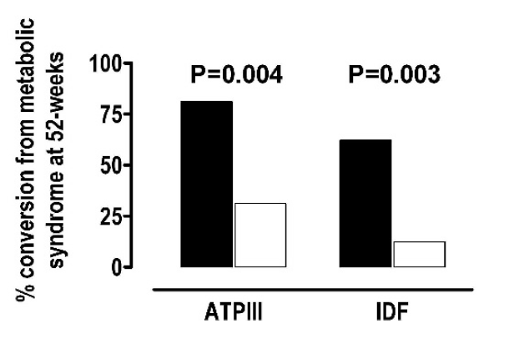
Metabolic syndrome (MetS) conversion rate during the 52-week course of the study
% of patients recovering from the metabolic syndrome after 52-weeks of treatment according ATP-III or IDF definitions.
White boxes indicate supervised diet and exercise alone; Black boxes, supervised diet and exercise in combination with transdermal testosterone administration.
Heufelder AE et al. J Androl 2009; 30(6) :726-733.
ATP III indicates Adult Treatment Panel III; IDF, International Diabetes Federation

Slide 62
Summary
Supervised diet & exercise treatment has beneficial effects on glycemic control, components of the MetS, and insulin sensitivity in hypogonadal patients with the MetS and newly diagnosed T2D.
Addition of AndroGel 1% to supervised diet & exercise resulted in greater therapeutic improvements in glycemic control and more than 80% of patients reversing MetS, reaching all the set targets for glycemic control.
Serum PSA concentrations did not differ between the 2 treatment groups
This study with Testogel was a pilot proof of concept study. Nevertheless, it had a very strong design, but was performed more than 10 years ago in a limited number of patients.
Heufelder AE et al. J Androl 2009; 30(6) :726-733.

Slide 63
Shabsigh, R et al
Randomized study of testosterone gel as adjunctive therapy to sildenafil in hypogonadal men with erectile dysfunction who do not respond to sildenafil alone
Journal of Urology 2004; 172: 658-663
Besins Healthcare
Global Medical Affairs
March 2021

Slide 64
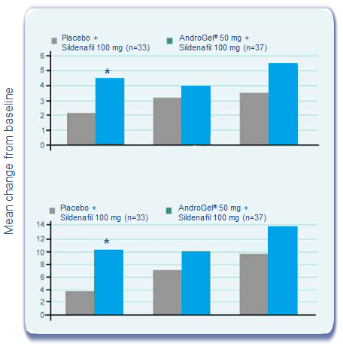
Effect of AndroGel® on Erectile Function in Hypogonadal Men
Randomized Controlled Trial:
  75 hypogonadal men with erectile dysfunction who had failed prior sildenafil therapy
  Daily dose of 5g AndroGel® or placebo plus sildenafil for 12 weeks
  Significantly better response at 4 weeks with AndroGel® for IIEF
    Erectile function (p = 0.029)
    Total score (p = 0.011)
Shabsigh, R et al. Journal of Urology 2004; 172: 658-663
Notes:
Shabsigh R, Kaufman JM, Steidle C et al. Randomized study of testosterone gel as adjunctive therapy to sildenafil in hypogonadal men with erectile dysfunction who do not respond to sildenafil alone. J Urol 2004; 172: 658-663
PURPOSE: We compared the efficacy of testosterone gel (T-gel) versus placebo as adjunctive therapy to sildenafil in hypogonadal men with erectile dysfunction who do not respond to sildenafil alone.
MATERIALS AND METHODS: A randomized, placebo controlled, double-blind, parallel group, multicenter study was performed. A total of 75 hypogonadal men (18 to 80 years old, morning serum total testosterone 400 ng/dl or less) with confirmed lack of response to sildenafil monotherapy were randomized (1:1) to receive a daily dose of 1% T-gel or 5 gm placebo gel as adjunctive therapy to 100 mg sildenafil during a 12-week period. Subjects were evaluated for sexual function, primarily based on the International Index of Erectile Function (IIEF), quality of life and serum testosterone levels at baseline and weeks 4, 8 and 12.
RESULTS: Testosterone treated subjects had greater improvement in erectile function compared to those who received placebo, reaching statistical significance at week 4 (4.4 vs 2.1, p = 0.029, 95.1% CI 0.3, 4.7). Similar trends were observed for improvements in orgasmic function, overall satisfaction, total IIEF score and percentage of IIEF responders. T-gel significantly (p < or =0.004) increased total and free testosterone levels throughout the study, although no significant correlations were made between testosterone levels and the IIEF at end point.
CONCLUSIONS: T-gel taken with sildenafil may be beneficial in improving erectile function in hypogonadal men with erectile dysfunction who are unresponsive to sildenafil alone.

Slide 65
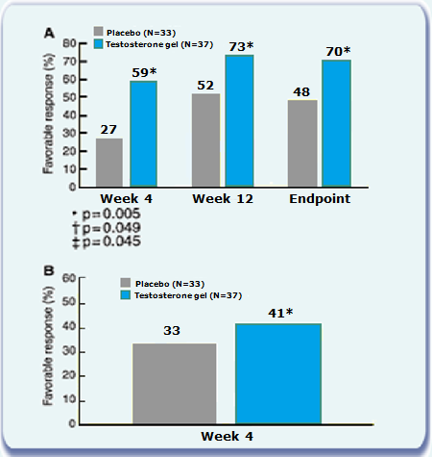
Testosterone gel therapy improved response to sildenafil
A. Did your gel improve your response to sildenafil?
B. Did your gel improve your erections when sildenafil was not taken within 4h before sexual activity?
Shabsigh, R et al. Journal of Urology 2004; 172: 658-663

Slide 66
Buvat, J et al
Hypogonadal Men Non-responders to the PDE5 Inhibitor Tadalafil
Benefit from Normalization of Testosterone Levels with a 1%
Hydroalcoholic Testosterone Gel in the Treatment of Erectile
Dysfunction (TADTEST Study)
Journal of Sexual Medicine 2011;8:284–293
Besins Healthcare
Global Medical Affairs
March 2021

Slide 67

Change in the score of the IIEF Erectile Function Domain after combination of testosterone (n = 41) or placebo (n = 32) gels to 10 mg tadalafil once a day in the 73 patients of the ITT population non responders to PRN administration of PDE5I then to 10 mg tadalafil OAD alone for 4 weeks who had a baseline TT level < 3 ng/ml
*
Buvat, J et al. Journal of Sexual Medicine 2011;8:284–293

Slide 68
Conclusion
The study confirms the T dependence of PDE5i.
T therapy with 1% hydro-alcoholic T gel (AndroGel®) significantly improves the response to 10 mg tadalafil OAD* in ED patients non responders to PDE5i with a baseline TT < 3 ng/ml or cFT < 51.6 pg/ml.
Above this level tadalafil 10 mg OAD alone is able to salvage a part of the patients.
More recently, the British Society for Sexual Medicine (BSSM) guidelines for ED state that low testosterone is a frequent reason for failure to respond to PDE5i and correction of low testosterone has been shown in multiple studies to restore the response to PDE5is. In one study this was significant for total testosterone levels below 10.4 nmol/L and below 8 nmol/L in men with T2DM, but improvement in sexual desire was seen up to 12 nmol/L in men with T2DM. Because sexual desire is important in motivating men to take both PDE5Is on demand, we recommend a cut-off of 12 nmol/L for initiating testosterone therapy for PDE5i failures.
Buvat, J et al. Journal of Sexual Medicine 2011;8:284–293
*OAD = Once A Day
Buvat J et al.
J Sex Med. 2011; 8: 284-293.

Slide 69
Srinivas-Shankar, U et al
Effects of Testosterone on Muscle Strength, Physical Function, Body Composition, and Quality of Life in Intermediate-Frail and Frail Elderly Men: A Randomized, Double-Blind, Placebo-Controlled Study
J Clin Endocrinol Metab, February 2010, 95(2):639–650
Besins Healthcare
Global Medical Affairs
March 2021

Slide 70
Objective, Design & Methods
Objective: To determine the effects of 6 months T treatment in intermediate-frail and frail elderly men, on muscle mass and strength, physical function, and quality of life.
Design and Setting: Randomized, double-blind, placebo-controlled, parallel group, single-centre study.
Participants: Community-dwelling intermediate-frail and frail elderly men at least 65 years of age with a total T at or below 12 nmol/L or free T at or below 250 pmol/L
Methods: Two hundred seventy-four participants were randomized to transdermal T (50 mg/day) or placebo gel for 6 months.
Outcome measures included muscle strength, lean and fat mass, physical function, and self-reported quality of life.

Slide 71
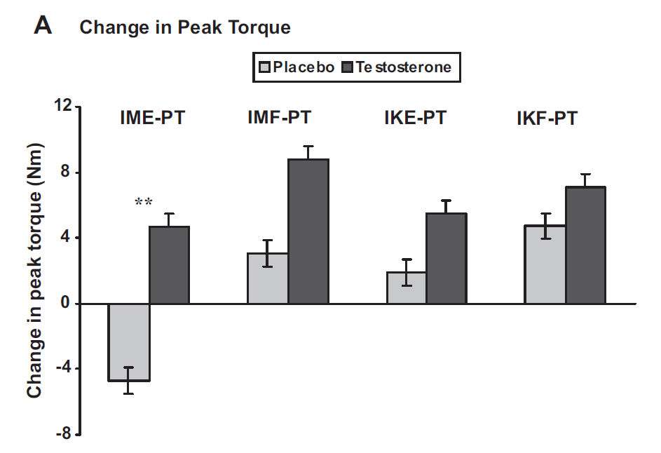

Change in Peak Torque (Muscle strength)
Change in IME-, IMF-, IKE-, and IKF-PT in the placebo and T groups at 6 months
Isometric knee extension peak torque (IME-PT), isokinetic knee extension peak torque (IKE-PT), isometric knee flexion peak torque (IMF-PT) & isokinetic knee flexion peak torque (IKF-PT)
Srinivas-Shankar, U et al. J Clin Endocrinol Metab 2010; 95: 639–650

Slide 72
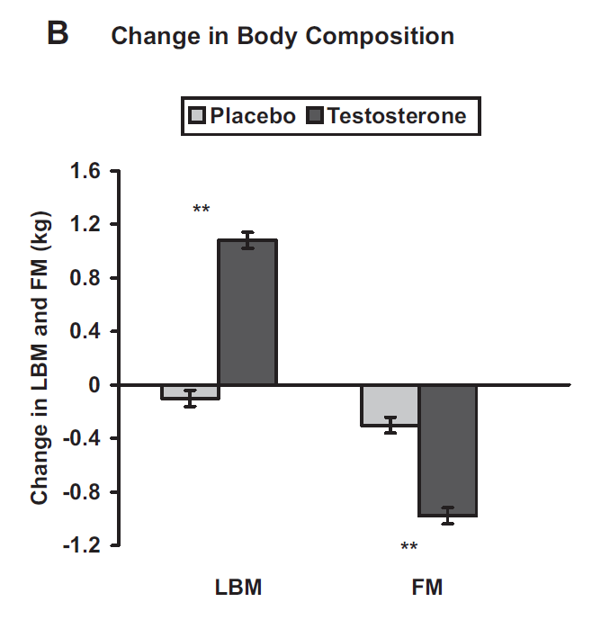
Change in Body Composition
Srinivas-Shankar, U et al. J Clin Endocrinol Metab 2010; 95: 639–650

Slide 73
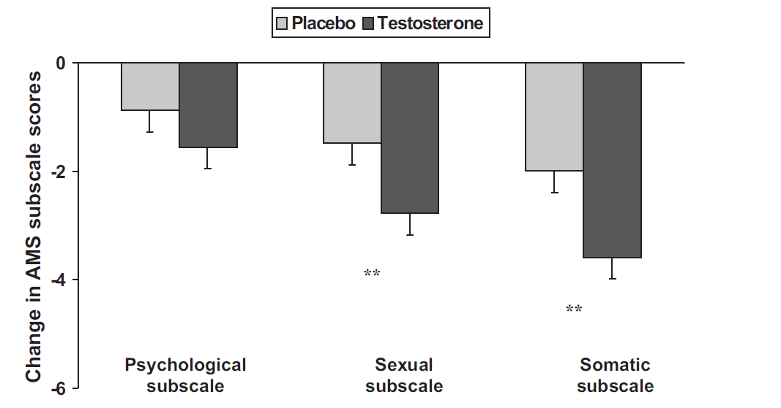
Change in Quality of Life
Srinivas-Shankar, U et al. J Clin Endocrinol Metab 2010; 95: 639–650

Slide 74
Summary
Increasing testosterone levels for 6 months in intermediate-frail and frail elderly men:
    Increases muscle strength in the lower limbs
    Increases lean body mass & decreases fat mass
    Improves physical function (both objective & self reported)
    Improves somatic & sexual domain symptoms (AMS scale)
    Improves several domains of SF 36
Testosterone as a treatment modality for intermediate-frail and frail elderly men with low to borderline-low circulating T levels:
    Prevents deterioration in muscle strength
    Improves body composition and symptom-related QoL.
    Is associated with improved physical function in older and frailer men, highlighting possible functional consequences of small changes in physical performance.
Short term safety is reassuring
AndroGel® as a treatment modality for intermediate-frail and frail elderly men prevents deterioration in muscle strength, improves body composition and symptom-related QoL and is associated with improved physical function.
Srinivas-Shankar, U et al. J Clin Endocrinol Metab 2010; 95: 639–650
Srinivas-Shankar U et al.
J Clin Endocrinol Metab 2010; 95: 639–650
Notes:
In summary, we have shown that increasing testosterone levels for 6 months in prefrail and frail elderly men leads to improvement in body composition, increases muscle strength and contributes to improvement in physical function. In addition it improves somatic and sexual domain symptoms.
Most importantly short term safety is reassuring.
It is important to remember that the management of physical frailty is multidisciplinary. Although, there are unanswered questions (duration of treatment etc).
Our data suggests that increasing testosterone levels in prefrail and frail men, offers promise of improving muscle strength and function and halting the downward spiral of immobility, institutionalisation and death.

Slide 75
The Testosterone Trials
(TTrials)
Besins Healthcare
Global Medical Affairs
March 2021

Slide 76

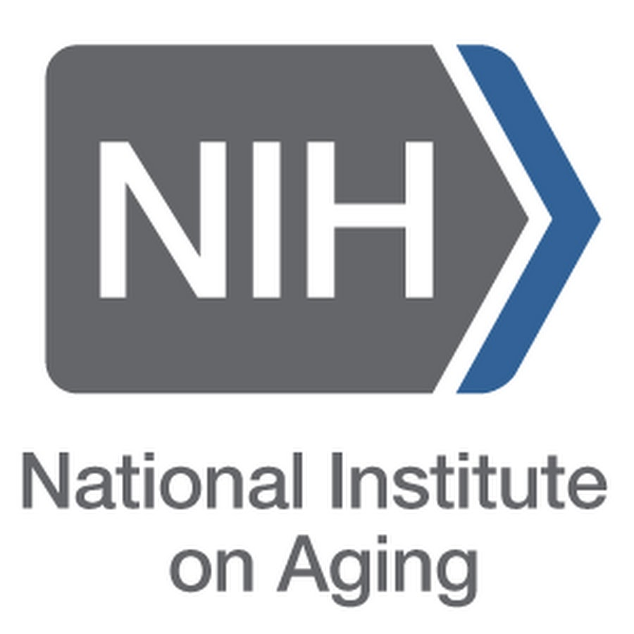









The Testosterone Trials: background
2002
National
Institute
on Aging
NIA and NCI asked the IOM (now the National Academy of Medicine) to assess the evidence on TTh for older men
2003
IOM concluded that the available evidence on TTh was insufficient
IOM recommended that the NIA fund a coordinated set of clinical trials to determine the benefits of TTh in older men with low testosterone
  NIA supported the development of the TTrials
2016
to
2017
Key findings of the individual TTrials studies were published
Sexual
Function
(2016)
Physical
Function
(2016)
Cognitive
Function
(2017)
Vitality
(2016)
Anaemia
(2017)
Cardiovascular
(2017)
Bone
(2017)
IOM, Institute of Medicine; NCI, National Cancer Institute; NIA, National Institute on Aging; TTh, testosterone therapy
Snyder PJ et al. Endocr Rev 2018;39:369–86.
Notes:
In 2002, the US NIA and NCI requested that the IOM (now the National Academy of Medicine) assess the status of current clinical research on TTh for older men.
In 2003, the IOM committee concluded that the evidence on the effects of TTh in older men with low testosterone was insufficient and recommended that the NIA fund a coordinated set of clinical trials to determine whether TTh has any benefits in this population, and to fund a larger trial to determine the possible risks of TTh, but only if benefits were found.
The NIA followed this advice and supported the development of the TTrials to implement the IOM’s recommendation.
The Testosterone Trials were 7 coordinated clinical trials conducted at 12 US sites to assess the efficacy of TTh for 1 year in older men with hypogonadism [testosterone levels <9.5 nmol/L (<275 ng/dL)]:
Sexual Function, Physical Function and Vitality studies (first key publications in 2016).
Cognitive Function, Anaemia, Cardiovascular and Bone studies (first key publications
in 2017).
IOM, Institute of Medicine; NCI, National Cancer Institute; NIA, National Institute on Aging;
TTh, testosterone therapy
Reference
Snyder PJ et al. Endocr Rev 2018;39:369–86.

Slide 77





The Testosterone Trials: the impact of TTh on seven clinical outcomes in older men with low testosterone
Shared characteristics of the Testosterone Trials
12 US
study sites
TTrials (n=7): Sexual Function, Physical Function, Vitality, Cognitive Function, Anaemia, Cardiovascular, Bone
Non-randomised, double-blinded, placebo-controlled design
Men with average testosterone level <9.5 nmol/L (<275 ng/dL)
Participants received 1% testosterone gel in a pump dispenser (5 g/day, adjusted to maintain normal testosterone levels for a young man) or placebo gel for 12 months
Treatment allocated by minimisation
(allows balancing with a larger number of variables than stratified randomisation)
  Balancing variables included age ≤ or >75 years, screening testosterone levels ≤ or >6.9 nmol/L (200 ng/dL), use/non-use of antidepressants and use/non-use of PDE-5 inhibitors
PDE-5, phosphodiesterase type 5; TTh, testosterone therapy
Snyder PJ et al. Endocr Rev 2018;39:369–86.
Notes:
The Testosterone Trials were 7 coordinated clinical trials conducted at 12 US sites to assess the efficacy of TTh in older men with hypogonadism [testosterone levels <9.5 nmol/L (<275 ng/dL)]:
Sexual Function.
Physical Function.
Vitality.
Cognitive Function.
Anaemia.
Cardiovascular.
Bone.
Participants were allocated to receive 1% testosterone gel (5 g/day, adjusted to maintain normal testosterone levels for a young man) or placebo gel for 1 year, and efficacy was assessed every 3 months.
Participants were allocated treatment by minimisation, which allows balancing with a larger number of variables than stratified randomisation.
Balancing variables included age < or >75 years, screening testosterone levels
< or >6.9 nmol/L (200 ng/dL), use/non-use of antidepressants and use/non-use
of PDE-5 inhibitors.
PDE-5, phosphodiesterase type 5; TTh, testosterone therapy
Reference
Snyder PJ et al. Endocr Rev 2018;39:369–86.

Slide 78



Sexual Function Trial: effect of TTh on sexual activity in older men with low testosterone
To determine if TTh for older men with low testosterone increases sexual activity, assessed by PDQ-Q4
Aim
n=
459
enrolled in the Sexual Function Trial and analysed
n=
771
enrolled in all TTrials and analysed
Selected
baseline characteristics
and demographics
Mean age
Race
PDE-5 inhibitor use
72.2 years
89% White
8.4%
BMI, body mass index; PDE-5, phosphodiesterase type 5; PDQ-Q4, question 4 of the Psychosexual Daily Questionnaire; TTh, testosterone therapy
Snyder PJ et al. N Engl J Med 2016;374:611–24; Snyder PJ et al. Endocr Rev 2018;39:369–86.
Notes:
The PDQ is a 7-day diary used in multiple trials to evaluate both the frequency and intensity of sexual desire and performance across sexual activities.¹
PDQ-Q4 asks participants to list how many of 12 specified activities (sexual daydreams, anticipation of sex, sexual interactions with partner, flirting by you, flirting toward you, orgasm, ejaculation, intercourse, masturbation, night spontaneous erection,
day spontaneous erection, and erection in response to sexual activity) they engaged
in each day of the week, and the daily count is averaged over 7 days for a total score ranging from 0–12 (higher scores indicate more activity).^{1,2}
Previous studies show that in hypogonadal men, sexual activity assessed by the PDQ significantly improved after administration of TTh.¹
In the Sexual Function Trial, sexual activity was assessed by PDQ-Q4, administered by interactive voice response daily for 7 days at baseline and 3, 6, 9 and 12 months. An average of the scores for the 7 days at each time point were taken.³
PDQ-Q4 was also administered to all men in the T Trials; however, the primary outcome was determined only for men who were enrolled in the Sexual Function Trial, and analyses of PDQ-Q4 in the overall T Trial population were exploratory only.^{2,3}
PDQ-Q4, question 4 of the Psychosexual Daily Questionnaire (PDQ); TTh, testosterone therapy
References
1. Wang C et al. J Sex Med 2018;15:997–1009; 2. Snyder PJ et al. N Engl J Med 2016;374:611–24;
3. Snyder PJ et al. Endocr Rev 2018;39:369–86.

Slide 79
Sexual Function Trial: TTh significantly improved sexual function versus placebo in older men with low testosterone
Averaged over all follow-up visits, TTh significantly increased sexual activity versus placebo among hypogonadal men enrolled in both the Sexual Function Trial and across all TTrials^{1,2}
  TTh also substantially increased libido and, to a lesser degree, erectile function²
Association between TTh and increased sexual activity in men with low testosterone
Effect of TTh on sexual activity, assessed by PDQ-Q4, in older men with low testosterone²
Men enrolled
in the Sexual Function Trial (n=459)
All men in the TTrials
(n=771)
1.0
p<0.001
1.0
p<0.001
0.8
0.8
0.6
0.6
0.4
0.4
Change from baseline
in response to PDQ-Q4
Change from baseline
in response to PDQ-Q4
0.2
0.2
0
0
-0.2
-0.2
-0.5
TTh
Placebo
-0.5
0
3
6
9
12
0
3
6
9
12
No. at risk
TTh
Placebo
Month
No. at risk
TTh
Placebo
Month
230
229
206
201
208
191
205
191
193
194
387
384
348
335
349
317
339
314
328
319
PDQ-Q4, question 4 of the Psychosexual Daily Questionnaire; TTh, testosterone therapy
1. Snyder PJ et al. N Engl J Med 2016;374:611–24; 2. Snyder PJ et al. Endocr Rev 2018;39:369–86.
Notes:
TTh, compared with placebo, substantially increased sexual activity, averaged over all follow-up visits, for men enrolled in the Sexual Function Trial (n=459) and also for all men in the TTrials (n=771). This effect was seen for most types of sexual activity assessed, including sexual daydreams, flirting, sexual intercourse, masturbation and spontaneous erections at night.^{1,2}
The treatment effect (defined as the mean difference in the change from baseline between participants assigned to TTh and those assigned to placebo) was 0.58
and 0.62 for men in the Sexual Function Trial and all men in the TTrials, respectively (both p<0.001).³
The clinical significance of this effect can be judged from the effect size of 0.45,
which is close to a ‘moderate’ effect of 0.5, and that TTh increased sexual activity
of all types about four times a week.¹
Elevations in plasma testosterone level during TTh were proportional to increases
in PDQ-Q4 score (p<0.001 by instrumental variable analysis).³
TTh also substantially increased libido and, to a lesser degree, erectile function.¹
Incremental increases in total and free testosterone and oestradiol levels were substantially associated with greater improvements in sexual activity and libido, but not erectile function.¹
CI, confidence interval; OR, odds ratio; PDQ-Q4, question 4 of the Psychosexual Daily Questionnaire; TTh, testosterone therapy
References
1. Snyder PJ et al. Endocr Rev 2018;39:369–86; 2. Matsumoto AM. Curr Opin Endocr Metab Res 2019;6:34–41; 3. Snyder PJ et al. N Engl J Med 2016;374:611–24.

Slide 80

Physical Function Trial: effect of TTh on 6-minute walking distance in older men with low testosterone
To determine if TTh for older men with low testosterone increases
6MWD >50 m beyond the baseline distance
Aim
387
n=
enrolled in the Physical Function Trial and analysed
788
n=
enrolled in all TTrials and analysed
Selected
baseline characteristics
and demographics
Mean age
Race
Gait speed
72.2 years
89% White
1.1 m/s
6MWD, 6-minute walking distance; TTh, testosterone therapy
Snyder PJ et al. N Engl J Med 2016;374:611–24; Snyder PJ et al. Endocr Rev 2018;39:369–86.
Notes:
For the Physical Function Trial, 6MWD was chosen as the primary efficacy outcome, rather than
an outcome based on muscle strength, because of the importance of walking in maintaining independence as men age. It was specifically postulated that TTh, compared with placebo,
would increase the fraction of men whose 6MWD increased by >50 m beyond the baseline distance, because enrolled men had reported difficulty walking and/or climbing stairs and because their gait speed was <1.2 m/s.
Great care was taken to standardise the administration of the 6MWD test by using a set test course, timing the walk with a stopwatch, and training the site personnel initially and retraining them annually.
A secondary outcome was self-reported mobility and function, assessed using the physical function domain scale (PF-10) of the SF-36.
6MWD, 6-minute walking distance; SF-36, 36-item Medical Outcomes Short Form Survey;
TTh, testosterone therapy
References
Snyder PJ et al. N Engl J Med 2016;374:611–24; Snyder PJ et al. Endocr Rev 2018;39:369–86.

Slide 81
Physical Function Trial: TTh significantly improved walking distance versus placebo in older men with low testosterone
Among men in the Physical Function Trial, TTh did not substantially increase the proportion of men whose 6MWD increased >50 m beyond that at baseline, or the absolute increase in their distance walked, versus placebo
However, TTh significantly improved these two parameters when analysing all men in the TTrials
Effect of TTh on proportion of men achieving a 6MWD >50 m further than baseline in older men with low testosterone
Men enrolled
in the Physical Function Trial (n=387)
All men in the TTrials
(n=788)
30
TTh
Placebo
p=0.20
30
p=0.003
20
20
Percent of men who
walked ≥50 m further
than at baseline
Percent of men who
walked ≥50 m further
than at baseline
10
10
0
0
0
3
6
9
12
0
3
6
9
12
No. at risk
TTh
Placebo
Month
No. at risk
TTh
Placebo
Month
191
196
179
179
174
171
172
159
172
165
392
389
368
356
358
339
348
320
346
326
6MWD, 6-minute walking distance; TTh, testosterone therapy
Snyder PJ et al. Endocr Rev 2018;39:369–86.
81
Notes:
Among men in the Physical Function Trial, TTh did not substantially increase the proportion of men whose 6MWD increased >50 m beyond that at baseline, or the absolute increase in their distance walked, versus placebo (primary outcome), although the trend was toward greater increases for men assigned to TTh.
However, TTh did substantially improve these two parameters when data from all men in the TTrials were analysed.
The improvement was statistically significant for the men who had not qualified for the Physical Function Trial, demonstrating that this result was not simply a question of increased power.
Importantly, irrespective of study population, men who received TTh were significantly more likely than those who received placebo to perceive that their walking ability had improved since the beginning of the trial (p=0.002), as judged by the PF-10 and a patient global assessment of change question.
There was a significant between-group difference in:
Percentage of men whose 6MWD increased by ≥50 m (OR 1.77; p=0.003).
Change from baseline in 6MWD (mean difference 6.69 m; p=0.007).
Percentage of men whose PF-10 score increased by ≥8 points (OR 1.50; p=0.02).
Change from baseline in PF-10 score (mean difference 3.06 points; p=0.002).
6MWD, 6-minute walking distance; OR, odds ratio; PF-10, physical function domain scale of the SF-36; SF-36, 36-item Medical Outcomes Short Form Survey; TTh, testosterone therapy
References
Snyder PJ et al. N Engl J Med 2016;374:611–24; Snyder PJ et al. Endocr Rev 2018;39:369–86.

Slide 82
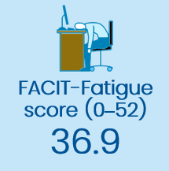
Vitality Trial: effect of TTh on vitality and fatigue in older men with low testosterone
To assess if TTh for older men with low testosterone increases the proportion of men scoring a ≥4-point increase on the FACIT-Fatigue scale
Aim
n=
474
enrolled in the Vitality Trial and analysed
n=
788
enrolled in all TTrials and analysed
Men self-reported low vitality and had a FACIT–Fatigue score <40
Selected
baseline characteristics
and demographics
Mean age
Race
72.2 years
89% White
FACIT, Functional Assessment of Chronic Illness Therapy; TTh, testosterone therapy
Snyder PJ et al. N Engl J Med 2016;374:611–24; Snyder PJ et al. Endocr Rev 2018;39:369–86.
Notes:
Inclusion in the Vitality Trial required self-reported low vitality/diminished energy and a score
of <40 on the FACIT-Fatigue scale (range: 0 to 52, higher scores indicate less fatigue).
The FACIT-Fatigue questionnaire distinguishes between energy at one end of the spectrum and fatigue at the other, and has been validated for assessing energy vs fatigue in many different diseases.
The primary outcome measure of the Vitality Trial was the proportion of men whose score on the FACIT–Fatigue scale increased by ≥4 points.
Secondary outcomes were change from baseline in FACIT–Fatigue score; vitality scale score
(range: 0 to 100, higher scores indicate more vitality) of the SF-36; scores on the PANAS scales (range: 5 to 50 for positive and negative effects, higher scores indicate a greater intensity of the effect); and the PHQ-9 depression score (range: 0 to 27, higher scores indicate greater severity
of depressive symptoms).
FACIT, Functional Assessment of Chronic Illness Therapy; PANAS, Positive and Negative Affect Schedule; PHQ-9, Patient Health Questionnaire 9; TTh, testosterone therapy
References
Snyder PJ et al. N Engl J Med 2016;374:611–24; Snyder PJ et al. Endocr Rev 2018;39:369–86.

Slide 83
Vitality Trial: TTh significantly improved vitality and fatigue versus placebo in older men with low testosterone
TTh did not increase the proportion of men who demonstrated a FACIT-Fatigue score ≥4 higher than at baseline, versus placebo
However, TTh was associated with a small but significant effect on vitality (assessed using the SF-36 vitality subscale), mood (using PANAS scores) and depressive symptoms (using the PHQ-9)
Association between TTh and improvements in vitality and fatigue in older men with low testosterone
Men enrolled
in the Vitality Trial (n=474)
All men in the TTrials
(n=788)
100
TTh
Placebo
p=0.30
100
p=0.22
80
80
60
60
Percent of men who scored ≥4 higher than at baseline on the FACIT-Fatigue scale
Percent of men who scored
≥4 higher than at baseline
on the FACIT-Fatigue scale
40
40
20
20
0
0
0
3
6
9
12
0
3
6
9
12
No. at risk
TTh
Placebo
Month
No. at risk
TTh
Placebo
Month
236
238
219
207
217
196
206
188
203
191
394
394
351
337
350
329
337
317
333
316
FACIT, Functional Assessment of Chronic Illness Therapy; PANAS, Positive and Negative Affect Schedule; PHQ-9, Patient Health Questionnaire 9; TTh, testosterone therapy
Matsumoto AM. Curr Opin Endocr Metab Res 2019;6:34–41; Snyder PJ et al. N Engl J Med 2016;374:611–24; Snyder PJ et al. Endocr Rev 2018;39:369–86.
Notes:
Among men enrolled in the Vitality Trial, TTh showed no significant benefit over placebo
with respect to vitality, as determined by an increase of ≥4 points in the FACIT–Fatigue score (primary outcome) (OR 1.23; p=0.30).
However, there was a small effect on change from baseline in FACIT–Fatigue score that
did not reach significance (mean difference 1.21 points; p=0.06). In addition, a greater increase
in testosterone level was associated with a greater increment in FACIT-Fatigue score (p=0.02
by instrumental variable analysis), and the effect of TTh on change from baseline in the score
in men in the three core TTrials trials (Sexual Function, Physical Function, Vitality) combined
was significant (p=0.006).
There were significant differences between the TTh and placebo groups in SF-36 vitality score (mean difference 2.41 points; p=0.03), PANAS positive affect score (mean difference 0.47 points; p=0.04), PANAS negative affect score (mean difference −0.49 points; p<0.001), and PHQ-9 depression score (mean difference −0.72 points; p=0.004).
Effect sizes (mean between-group differences in outcome divided by the baseline standard deviations) were all <0.20.
Men who received TTh were more likely than men who received placebo to report that their energy was better at the end of the trial (P<0.001).
FACIT, Functional Assessment of Chronic Illness Therapy; OR, odds ratio; PANAS, Positive and Negative Affect Schedule; PHQ-9, Patient Health Questionnaire 9; TTh, testosterone therapy
References
Matsumoto AM. Curr Opin Endocr Metab Res 2019;6:34–41; Snyder PJ et al. N Engl J Med 2016;374:611–24; Snyder PJ et al. Endocr Rev 2018;39:369–86.

Slide 84

Cognitive Function Trial: effect of TTh on memory & cognition in older men with low testosterone and AAMI
To determine if TTh for older men with low testosterone and AAMI improves verbal memory and other cognitive functions, versus placebo
Aim
493
enrolled in the Cognitive Function Trial and analysed
n=
AAMI defined as both subjective memory complaints and relative impairment on objective tests of memory performance
Selected
baseline characteristics
and demographics
Mean age
Race
3MSE
72.3 years
87% White
92.7
3MSE, Modified Mini-Mental State Examination; AAMI, age-associated memory impairment; TTh, testosterone therapy
Resnick SM et al. JAMA 2017;317:717–27; Snyder PJ et al. Endocr Rev 2018;39:369–86.
Notes:
Inclusion in the Cognitive Function Trial required men to satisfy AAMI criteria, comprising
both subjective memory complaints and relative impairment on objective tests of
memory performance.
Subjective memory complaints were indicated by a score of 4 or 5 on ≥1 item of
the MAC-Q.
Objective memory impairment was defined by a score >1 SD below the performance
for young men (aged 20–24 years), but not >2 SD below the scores of age-matched men on tests of delayed paragraph recall or visual memory.
Men were considered ‘normal for age’ if they did not meet criteria for AAMI and had scores of ≥80 on the 3MSE measure of global cognitive function.
The primary outcome measure was mean change from baseline to Month 6 and Month 12
for delayed paragraph recall (score range: 0 to 50) among men with AAMI.
Secondary outcomes were mean change in visual memory (Benton Visual Retention Test;
score range: 0 to −26), executive function (Trail-Making Test B minus A; range: −290 to 290),
and spatial ability (Card Rotation Test; score range: −80 to 80) among men with AAMI.
Tests were administered at baseline, Month 6 and Month 12.
3MSE, Modified Mini-Mental State Examination; AAMI, age-associated memory impairment; MAC-Q, Memory Assessment Clinics Questionnaire; TTh, testosterone therapy
References
Resnick SM et al. JAMA 2017;317:717–27; Snyder PJ et al. Endocr Rev 2018;39:369–86.

Slide 85
Cognitive Function Trial: TTh did not improve memory or other cognitive functions in older men with low testosterone
Association between TTh and memory, executive function and spatial ability in older men with low testosterone
3
Verbal memory (primary outcome)
2.0
Visual memory
TTh
Placebo
1.5
Change in Delayed Paragraph Recall Test score (Logical Memory II)
1.0
2
0.5
Change in Benton Visual Retention Test score
0
1
-0.5
-1.0
-1.5
0
-2.0
0
3
6
9
12
0
3
6
9
12
No. of participants
TTh
Placebo
Month
No. of participants
TTh
Placebo
Month
247
246
225
214
221
213
246
246
224
214
219
213
15
Executive function
4
Spatial ability
10
3
5
Change in Trail-Making
Test B minus A (s)
2
0
Change in Card Rotation
Test score
-5
1
-10
0
-15
-20
-1
0
3
6
9
12
0
3
6
9
12
No. of participants
TTh
Placebo
Month
No. of participants
TTh
Placebo
Month
245
245
223
212
219
211
245
243
223
208
217
210
TTh, testosterone therapy
Resnick SM et al. JAMA 2017;317:717–27.
Notes:
No significant mean changes from baseline to Months 6 and 12 in delayed paragraph
recall score were observed among men with AAMI in the TTh and placebo groups
[adjusted estimated difference −0.07 (95% CI: −0.92 to 0.79); p=0.88].
Mean scores for delayed paragraph recall were 14.0 at baseline, 16.0 at Month 6 and 16.2 at Month 12 in the TTh group and 14.4 at baseline, 16.0 at Month 6 and 16.5 at Month 12 in the placebo group.
TTh was also not associated with significant differences in visual memory [−0.28 (95%CI: −0.76 to 0.19); p=0.24], executive function [−5.51 (95% CI: −12.91 to 1.88); p=0.14] or
spatial ability [−0.12 (95% CI: −1.89 to 1.65); p=0.89].
AAMI, age-associated memory impairment; CI, confidence interval; TTh, testosterone therapy
Reference
Resnick SM et al. JAMA 2017;317:717–27.

Slide 86



Anaemia Trial: relationship between testosterone levels and anaemia, and impact of TTh in older men
To determine if TTh for older men with low testosterone increases haemoglobin concentration and can correct anaemia
Aim
788
n=
n=126 with anaemia (n=62 with unexplained anaemia)
enrolled
Selected
baseline characteristics
and demographics
Mean age
Race
Mean BMI
74.8 years
85% White
30.7 kg/m²
*Haemoglobin concentration <12.7 g/dL; BMI, body mass index; TTh, testosterone therapy; vBMD, volumetric bone mineral density
Roy CN et al. JAMA Intern Med 2017;177:480–90; Snyder PJ et al. Endocr Rev 2018;39:369–86.
Notes:
For the Anaemia Trial, men had baseline haemoglobin levels ≤12.7 g/dL and were classified using family history and blood/laboratory testing into cohorts with either unexplained anaemia (n=62, 49.2%) or anaemia of known cause (n=64, 50.8%):
Myelodysplasia, n=8 (6.3%).
Iron deficiency, n=42 (33.3%).
Vitamin B12 deficiency, n=3 (2.4%).
Anaemia of inflammation/chronic disease, n=10 (7.9%).
Plasma cell dyscrasia, n=1 (0.8%).
No cases of renal insufficiency, folate deficiency, haemolytic anaemia or
monoclonal gammopathy.
TTh, testosterone therapy
Reference
Roy CN et al. JAMA Intern Med 2017;177:480–90.

Slide 87
TTh significantly increased Hb levels in older men with low testosterone and unexplained anaemia
Significantly more men with anaemia of unknown cause had an increase in Hb level ≥1 g/dL from baseline at Month 12 with TTh (54%) than placebo (15%)
  Adjusted OR 31.5, 95% CI: 3.7–277.8; p=0.002
  More men were not anaemic at Month 12 with TTh (58.3%) than placebo (22.2%)
  Adjusted OR 17.0, 95% CI: 2.8–104.0; p=0.002
Association between TTh and Hb concentration in men with unexplained anaemia
Unexplained anaemia at baseline
Change in haemoglobin levels for
unexplained anaemia from baseline
80
Testosterone
Placebo
p=0.002
1.5
p=0.02
60
1.0
Percent of men whose haemoglobin levels increased ≥1 from baseline
Change in haemoglobin levels from baseline
40
0.5
20
0
0
-0.5
0
3
6
9
12
0
3
6
9
12
No. at risk
Testosterone
Placebo
Month
No. at risk
Testosterone
Placebo
Month
27
35
24
32
22
27
24
28
24
27
27
35
24
32
22
27
24
28
24
27
CI, confidence interval; Hb, haemoglobin; OR, odds ratio; TTh, testosterone therapy
Roy CN et al. JAMA Intern Med 2017;177:480–90.
Notes:
In cases of unexplained anaemia, more men receiving TTh achieved improvements in haemoglobin concentration ≥1.0 g/dL at Month 12 versus baseline, compared with placebo treatment (adjusted OR 31.5, 95% CI: 3.7–277.8; p=0.02) (primary outcome).
In total, 54% of TTh-treated men and 15% of placebo-treated men had increases of ≥1.0 g/dL versus baseline.
TTh also increased haemoglobin concentrations by continuous analysis in men with unexplained anaemia (secondary outcome):
Adjusted mean difference 0.83 g/dL, 95% CI: 0.48–1.39; p<0.001.
At Month 12, 58.3% (n=14/24) of TTh-treated men with unexplained anaemia at baseline were no longer anaemic, compared with 22.2% (n=6/27) of placebo-treated men
(OR 17.0, 95% CI: 2.8–104.0; p=0.002).
CI, confidence interval; OR, odds ratio; TTh, testosterone therapy
Reference
Roy CN et al. JAMA Intern Med 2017;177:480–90.

Slide 88
TTh significantly increased Hb levels in older men with low testosterone and anaemia of known cause
Significantly more men with anaemia of known cause had an increase in Hb level
≥1 g/dL from baseline at Month 12 with TTh (52%) than placebo (19%)
  Adjusted OR 8.2, 95% CI: 2.1–31.9; p=0.003
Association between TTh and Hb concentration in men with anaemia of known cause
Anaemia of known cause
at baseline
Change in haemoglobin levels for anaemia of known cause from baseline
80
Testosterone
Placebo
p=0.003
1.5
p=0.02
60
1.0
Percent of men whose haemoglobin levels increased ≥1 from baseline
Change in haemoglobin levels from baseline
40
0.5
20
0
0
-0.5
0
3
6
9
12
0
3
6
9
12
No. at risk
Testosterone
Placebo
Month
No. at risk
Testosterone
Placebo
Month
29
35
25
31
26
25
25
26
25
27
29
35
25
31
26
25
25
26
25
27
CI, confidence interval; Hb, haemoglobin; OR, odds ratio; TTh, testosterone therapy
Roy CN et al. JAMA Intern Med 2017;177:480–90.
Notes:
In cases of anaemia of known cause, more men receiving TTh achieved improvements in haemoglobin concentration ≥1.0 g/dL at Month 12 versus baseline, compared with placebo treatment (adjusted OR 8.2, 95% CI: 2.1–31.9; p=0.003).
In total, 52% of TTh-treated men and 19% of placebo-treated men had increases of ≥1.0 g/dL versus baseline.
TTh also increased haemoglobin concentrations by continuous analysis in men with anaemia of known cause:
Adjusted mean difference 0.64 g/dL, 95% CI: 0.12–1.17; p=0.02.
At Month 12, 60.0% (n=15/25) of TTh-treated men with anaemia of known cause at baseline were no longer anaemic, compared with 14.8% (n=4/27) of placebo-treated men
(OR 9.4, 95% CI: 1.4–60.5; p=0.02).
CI, confidence interval; OR, odds ratio; TTh, testosterone therapy
Reference
Roy CN et al. JAMA Intern Med 2017;177:480–90.

Slide 89
TTh significantly increased Hb levels in older men with low testosterone without anaemia
Administration of TTh resulted in an Hb concentration of >17.5 g/dL in 6 older, hypogonadal men without anaemia
Association between TTh and Hb concentration in men without anaemia
No anaemia at baseline
Change in haemoglobin levels for no anaemia from baseline
80
Testosterone
Placebo
p<0.001
1.5
p<0.001
60
1.0
Percent of men whose haemoglobin levels increased ≥1 from baseline
Change in haemoglobin levels from baseline
40
0.5
20
0
0
-0.5
0
3
6
9
12
0
3
6
9
12
No. at risk
Testosterone
Placebo
Month
No. at risk
Testosterone
Placebo
Month
336
321
323
304
314
298
309
284
305
285
336
321
323
304
314
298
309
284
305
285
CI, confidence interval; Hb, haemoglobin; OR, odds ratio; TTh, testosterone therapy
Roy CN et al. JAMA Intern Med 2017;177:480–90.
Notes:
More men without anaemia receiving TTh achieved improvements in haemoglobin concentration ≥1.0 g/dL at Month 12 versus baseline, compared with those receiving placebo (adjusted OR 20.7, 95% CI: 12.9–33.3; p<0.001).
In total, 38% of TTh-treated men and 4% of placebo-treated men had increases of ≥1.0 g/dL versus baseline.
TTh also increased haemoglobin concentrations by continuous analysis in men without anaemia:
Adjusted mean difference 0.90 g/dL, 95% CI: 0.78–1.03; p<0.001.
Administration of TTh resulted in a haemoglobin concentration of >17.5 g/dL in 6 men who were not anaemic at baseline.
CI, confidence interval; OR, odds ratio; TTh, testosterone therapy
Reference
Roy CN et al. JAMA Intern Med 2017;177:480–90.

Slide 90

Cardiovascular Trial: effect of TTh on coronary artery plaque volume in older men with low testosterone
To test whether TTh slows the progression of non-calcified coronary artery plaque volume, determined by CTA
Aim
170
n=
n=138 completed the trial
enrolled
Selected
baseline characteristics
and demographics of study completers
Mean age
Race
Severe atherosclerosis
71.2 years
81% White
50.7%
CTA, computed tomographic angiography; TTh, testosterone therapy
Budoff MJ et al. JAMA 2017;317:708–16; Snyder PJ et al. Endocr Rev 2018;39:369–86.
Notes:
Because the number of men in the TTrials was insufficient to determine clinical cardiovascular risk, it was decided that the Cardiovascular Trial would test whether TTh improves a surrogate outcome, non-calcified coronary artery plaque volume, as determined by CTA.
This outcome has apparent clinical relevance and good reproducibility, making it desirable for a longitudinal study.
Of 170 men enrolled in the Cardiovascular Trial, 138 completed the study. At baseline, 70 of these completers (50.7%) had a coronary artery calcification score >300 Agatston units, reflecting the presence of severe atherosclerosis.
The primary efficacy outcome was non-calcified coronary artery plaque volume, as determined by CTA.
Secondary outcomes included total coronary artery plaque volume and coronary artery calcium score (range: 0 to >400 Agatston units, with higher values indicating more severe atherosclerosis).
CTA, computed tomographic angiography; TTh, testosterone therapy
References
Budoff MJ et al. JAMA 2017;317:708–16; Snyder PJ et al. Endocr Rev 2018;39:369–86.

Slide 91
Cardiovascular Trial: TTh significantly increased non-calcified coronary artery plaque volume versus placebo in older men with low testosterone
In older men with low testosterone, TTh was associated with a significant increase in non-calcified coronary artery plaque volume of 41 mm³ more than placebo (p=0.003)
  An increase in non-calcified plaque volume has been associated with subsequent cardiovascular adverse events in other studies, and any compromise of the coronary artery lumen could be deleterious
  However, the clinical implications of these findings need to be confirmed in larger studies
Effect of TTh on cardiovascular outcomes in older men with low testosterone
Non-calcified
plaque volume, mm³
41 (14 to 67)
p=0.003
Total plaque
volume, mm³
47 (13 to 80)
p=0.006
Estimated difference (95% CI)*
*Least squares mean difference in change from baseline to Month 12 for men assigned to TTh vs those assigned to placebo, with adjustment for balancing factors: baseline total testosterone level (6.94 or >6.94 nmol/L (200 or >200 ng/dL), age (75 or >75 years), trial site, participation in the main trials, use or nonuse of antidepressants, use or non-use of PDE-5 inhibitors, and baseline value of the outcome variable; CI, confidence interval; PDE-5, phosphodiesterase type 5; TTh, testosterone therapy
Budoff MJ et al. JAMA 2017;317:708–16; Snyder PJ et al. Endocr Rev 2018;39:369–86.
Notes:
For the primary outcome, TTh compared with placebo was associated with a significantly greater increase in non-calcified plaque volume from baseline to Month 12 [from a median value of 204 to 232 mm³ vs 317 to 325 mm³, respectively; estimated difference 41 mm³; (95% CI: 14 to 67 mm³); p=0.003].¹
For the secondary outcomes, the median total plaque volume increased from baseline to Month 12 from 272 to 318 mm³ in the TTh group vs from 499 to 541 mm³ in the placebo group [estimated difference 47 mm³; (95% CI: 13 to 80 mm³); p=0.006], and the median coronary artery calcification score changed from 255 to 244 Agatston units in the TTh group vs 494 to 503 Agatston units in the placebo group [estimated difference −27 Agatston units; (95% CI: −80 to 26 Agatston units).¹
The increase in non-calcified plaque volume in men treated with TTh compared with men treated with placebo is concerning, because it has been associated with subsequent cardiovascular adverse events in other studies, and any decrease in the coronary artery lumen could be considered deleterious. Whether this effect on the surrogate outcome of plaque volume also increases clinical cardiovascular risk can only be determined by a larger trial of longer duration.^{2,3}
CI, confidence interval; TTh, testosterone therapy
References
1. Budoff MJ et al. JAMA 2017;317:708–16; 2. Snyder PJ et al. Endocr Rev 2018;39:369–86;
3. Matsumoto AM. Curr Opin Endocr Metab Res 2019;6:34–41.

Slide 92
Bone Trial: effect of TTh on bone mineral density and strength in older men with low testosterone
To determine if TTh of older men with low testosterone increases vBMD, assessed using quantitative computed tomography
Aim
211
n=
Osteoporosis was not an entry criterion
enrolled
Selected
baseline characteristics
and demographics
Mean age
Race
Mean BMI
72.3 years
86% White
31.2 kg/m²
BMI, body mass index; TTh, testosterone therapy; vBMD, volumetric bone mineral density
Snyder PJ et al. JAMA Intern Med 2017;177:471–9; Snyder PJ et al. Endocr Rev 2018;39:369–86.
Notes:
For the Bone Trial, men were excluded if they were taking a medication known to affect bone, except for calcium and over-the-counter vitamin D preparations; if they did not have
≥1 evaluable lumbar vertebra; and/or if they had a DEXA T-score at any site of less than −3.0.
Osteoporosis was not an entry criterion for the study.
The primary efficacy outcome was percent change from baseline in vBMD of trabecular bone in the lumbar spine, assessed by QCT.
Volumetric BMD was chosen as the main method of assessment rather than aBMD by DEXA because it is not artifactually influenced by osteophytes and aortic calcification, and because it can distinguish between trabecular bone, which testosterone primarily affects, and cortical bone.
Secondary outcomes were vBMD of peripheral bone and whole bone of the lumbar spine and trabecular, peripheral and whole bone of the hip; estimated strength of the same sites by finite element analysis from computed tomographic data; and aBMD of the spine and hip by DEXA.
aBMD, areal bone mineral density; DEXA, dual-energy x-ray absorptiometry; QCT, quantitative computed tomography; TTh, testosterone therapy; vBMD, volumetric bone mineral density
References
Snyder PJ et al. JAMA Intern Med 2017;177:471–9; Snyder PJ et al. Endocr Rev 2018;39:369–86.

Slide 93
Bone Trial: TTh significantly increased vBMD and bone strength versus placebo in older men with low testosterone
In older men with low testosterone, TTh significantly increased vBMD and estimated bone strength, especially in trabecular bone and the spine, but also in peripheral bone and the hip
  TTh increased mean lumbar spine trabecular vBMD by an additional 6.8% (95% CI: 4.8 to 8.7%; p<0.001, r² 0.26) and estimated spine trabecular bone strength by an additional 8.5% (95% CI: 6.0 to 10.9%; p<0.001) versus placebo
Effect of TTh on vBMD and estimated bone strength in older men with low testosterone
vBMD
Estimated bone strength
12
*
16
*
TTh
Placebo
10
14
*
8
*
12
10
*
6
*
8
Change from baseline (%)
Change from baseline (%)
4
*
*
*
6
**
2
4
*
*
0
2
0
-2
-2
Trabecular
Peripheral
Whole
Trabecular
Peripheral
Whole
Trabecular
Peripheral
Whole
Trabecular
Peripheral
Whole
Spine
Hip
Spine
Hip
*p<0.001, **p<0.005 vs placebo; CI, confidence interval; TTh, testosterone therapy; vBMD, volumetric bone mineral density
Snyder PJ et al. JAMA Intern Med 2017;177:471–9.
Notes:
TTh was associated with significantly greater increases versus placebo in mean spine trabecular vBMD [7.5% (95% CI: 4.8% to 10.3%) vs 0.8% (95% CI: −1.9% to 3.4%); treatment effect 6.8% (95% CI: 4.8% to 8.7%; p<0.001)], spine peripheral vBMD, and hip trabecular and peripheral vBMD.
TTh was also associated with significantly greater increases in mean estimated strength of spine trabecular bone [10.8% (95% CI: 7.4% to 14.3%) vs 2.4% (95% CI: −1.0% to 5.7%); treatment effect 8.5% (95% CI: 6.0% to 10.9%; p<0.001)], spine peripheral bone, and hip trabecular and peripheral bone.
The estimated strength increases were greater in trabecular than peripheral bone and greater in the spine than the hip.
CI, confidence interval; TTh, testosterone therapy; vBMD, volumetric bone mineral density
Reference
Snyder PJ et al. JAMA Intern Med 2017;177:471–9.

Slide 94



TTrials: similar safety profiles for men receiving TTh or placebo
Adverse event, n (%)
Placebo group
(n=394)
TTh group
(n=394)
Prostate events PSA increase ≥10 ng/mL PCa IPSS >19 Haemoglobin ≥175 g/dL | 8 0 26 0 | (2.0) (0) (6.6) (0) | 23 1 27 7 | (5.8) (<1) (6.9) (1.8)
CV events MI (definite/probable) Stroke (definite/probable) CV death Total (MI, stroke, CV death) | 1 5 1 7 | (<1) (1.3) (<1) (1.8) | 2 5 0 7 | (<1) (1.3) (0) (1.8)
Serious adverse events Death Hospitalisation Other* | 7 78 6 | (1.8) (19.8) (1.5) | 3 68 7 | (<1) (17.3) (1.8)
In the TTrials, compared with placebo, TTh was:
  Associated with an increased risk
  of erythrocytosis (although the overall incidence was low)
  Not associated with substantially more diagnoses of PCa
  Not associated with a higher incidence of MACE
*Congenital anomaly, disability or important medical or life-threatening event; CV, cardiovascular; IPSS, International Prostate Symptom Score;
MACE, major adverse cardiovascular events; MI, myocardial infarction; PCa, prostate cancer; PSA, prostate-specific antigen; TTh, testosterone therapy
Snyder PJ et al. Endocr Rev 2018;39:369–86.
Notes:
The findings of the TTrials confirm that TTh increases the risk of erythrocytosis, although the relatively low incidence compared with that in previous trials suggests that careful monitoring of haemoglobin concentration and reduction of TTh dose (when appropriate) should minimise this risk.
In the TTrials, compared with placebo, TTh was not associated with substantially more
PCa diagnoses.
This result might have been influenced by the relatively small number of prostate biopsies, although a much larger number of men were referred for consideration of biopsy because of an increase in PSA. The low percentage of men who underwent biopsy likely reflects the judgment of the site urologists.
TTh was also not associated with a higher incidence of MACE, versus placebo.
Only a trial enrolling a much larger number of older men with low testosterone who are then treated and followed up for a much longer period would be able to determine whether TTh increases the risk of PCa and lower urinary tract symptoms, and/or increases cardiovascular risk.
MACE, major adverse cardiovascular events; PCa, prostate cancer; PSA, prostate-specific antigen; TTh, testosterone therapy
Reference
Snyder PJ et al. Endocr Rev 2018;39:369–86.

Slide 95
Summary
In the TTrials, TTh in the form of a gel given for 1 year to older men with low testosterone:
  Improved all aspects of sexual function
  Improved walking distance by a small amount
  Improved haemoglobin levels and corrected mild to moderate anaemia
  Markedly increased vBMD and estimated bone strength
  Did not improve vitality, but slightly improved mood and depressive symptoms
  Did not improve memory or cognitive function
  Increased coronary artery plaque volume
  Was not associated with more CV or prostate adverse events; however, the number of men and treatment duration were insufficient to draw definitive conclusions about the risks of TTh in this regard
CV, cardiovascular; TD, testosterone deficiency; TTh, testosterone therapy; vBMD, volumetric bone mineral density
Snyder PJ et al. Endocr Rev 2018;39:369–86.

Slide 96
AndroGel 16.2mg/g (1.62%)
Clinical Trials
Besins Healthcare
Global Medical Affairs
March 2021

Slide 97
Testosterone 16.2mg/g Gel in Pump
Kaufman, JM et al 2011
Clinical Trial Summary
Besins Healthcare
Global Medical Affairs
March 2021

Slide 98
Kaufman JM et al. Efficacy and Safety Study of 16.2mg/g Testosterone Gel for the Treatment of Hypogonadal Men
J Sex Med 2011;2079-2089
Pivotal RCT investigating the efficacy and safety of testosterone 16.2mg/g gel vs placebo
Study design | Phase III, multicentre, randomised, double-blind placebo-controlled study in hypogonadal men over 182 days
Study treatment | All eligible subjects were started at a dose of 2.5g of 16.2mg/g testosterone gel or matching placebo on day 1 of the study. Subjects returned to the clinic on Days 14, 28, and 42 for testosterone measurement and the dose was then titrated to either 1.25g, 2.5g, 3.75g or 5.0g accordingly^ Both testosterone gel and placebo gel were applied once daily to either upper arms/shoulders or abdomen
Study population | A total of 274 hypogonadal men (234 active; 40 placebo) with average serum total testosterone concentrations <300ng/dL (<10.4nmol/L) and prostate-specific antigen <2.5ng/mL
Efficacy objectives | The primary objective of this study was to demonstrate the efficacy and safety of optimised doses of 16.2mg/g testosterone gel, applied to hypogonadal men over 182 days. The primary statistical objective was to achieve a responder rate of at least 75% in the testosterone gel-treated subjects. Responders were defined as subjects who had Cav in the eugonadal range (300–1,000 ng/dL)** Cav measurements were taken on days 14, 56, 112 and 182
Safety objectives | To determine whether safety was maintained during long-term administration Assessment of application site effects of testosterone gel Prostate safety was assessed by DRE and IPSS
^ Dose was titrated up or down in 1.25g increments if total T levels were not within the prespecified range of 350 to 750ng/dL. (12.1 – 26nmol/L)
** This equates to 10.4-34.7nmol/L in UK units.
DRE - Digital Rectal Examination; IPSS - International Prostate Symptom Score; Cav - average serum testosterone level
Notes:
Design:
A multicentre, randomised, double-blind, placebo-controlled study. Upon completion of the double-blind treatment, subjects were permitted to enrol in an open-label extension for a period of 182 days to further evaluate the efficacy and safety of the testosterone gel.
All eligible subjects were started at a dose of 2.5g 1.62% testosterone gel or placebo.
On days 14, day 28, and 42, predose serum total testosterone assessments and other secondary assessments were performed.
No dose was titrated below 1.25g or above 5.0g.

Slide 99
82.2% of hypogonadal men achieved T levels within the normal range at Day 182, following treatment with testosterone 16.2mg/g gel
Testosterone 16.2mg/g increases C_{av} testosterone levels to within the normal range in hypogonadal men
Results | Efficacy The success criterion was determined to be ≥75% of subjects achieving testosterone levels within the normal range of 300-1000ng/dL* This was met in all population samples on all study days by the testosterone treatment group except on day 14 (65.7%) Significantly more subjects receiving titrated doses of testosterone gel at day 182 had testosterone Cav values within the eugonadal range vs placebo (p<0.0001) After titration, the dose distribution was 1.25g (7.3% n=17/234), 2.5g (25.6% n=60/234), 3.75g (28.2% n=66/234), and 5.0g (38.9% n=91/234).
Number & percentage of subjects achieving C_{av} target range (300-1000ng/dL)* for testosterone on day 182 following dose titration
Study day | 16.2mg/g testosterone gel |  | Placebo |  | P value
 | n/N (%) | 95% Cl | n/N (%) | 95% Cl
182 | 139/169 (82.2) | (75.6, 87.7) | 8/28 (28.6) | (13.2, 48.7) | <0.0001
* This equates to 10.4-34.7nmol/L; C_{av} - serum total testosterone average concentrations; T - Testosterone
Table adapted from Kaufman JM, et al 2011

Slide 100
Kaufman JM et al (2011): Safety Results
Testosterone 16.2mg/g is an efficacious and well tolerated therapy for the treatment of hypogonadal men
Safety Results | A similar percentage of serious treatment-emergent adverse events (TEAEs) occurred in the 16.2mg/g testosterone gel (2.1%) and placebo groups (2.5%). The percentage of subjects who experienced at least one TEAE during the study was 55.6% (N = 130/234) for the testosterone-treated group vs. 37.5% (n= 15/40) for the placebo group. Skin irritation assessment indicated no clinically or statistically significant differences between 16.2mg/g testosterone gel and placebo groups. No subject discontinued due to an application site reaction or effect. The most common AE leading to discontinuation was increased PSA (PSA >4.0 ng/mL and/or PSA increase from baseline >0.75 ng/mL). which was prespecified in the protocol as a discontinuation criterion. There were no increases in symptoms of prostatic hypertrophy based on IPSS results. There were no clinically significant abnormal DRE results.
AE – Adverse Event; PSA – Prostate Specific Antigen; DRE – Digital Rectal Examination; IPSS – International Prostate Symptom Score

Slide 101
Kaufman JM et al (2011): Conclusions
Testosterone 16.2mg/g is an efficacious and well tolerated therapy for the treatment of hypogonadal men
Conclusions | 16.2mg/g testosterone gel offers a convenient, flexible and well tolerated dosing regimen that achieves eugonadal testosterone levels in hypogonadal men This 16.2mg/g testosterone gel has increased viscosity and provides patients the opportunity to reduce the total mass of gel applied, which should decrease the overall surface area required for gel application vs. 1% testosterone gel products. The authors state that the safety & efficacy profile of testosterone 16.2mg/g appears to be comparable to the 1% testosterone gels used in hypogonadal men however this study did not directly compare the 2 products.

Slide 102
Testosterone 16.2mg/g Gel in Pump
Kaufman, JM et al 2012
Clinical Trial Summary
Besins Healthcare
Global Medical Affairs
March 2021

Slide 103
Kaufman JM et al. One-year efficacy and safety study of a 16.2mg/g testosterone gel in hypogonadal men:
J Sex Med 2012;9:1149–61
A 182-day open-label extension of a previous pivotal 6-month double-blind efficacy study (Kaufman 2011)
Study design | Open-label extension of 16.2mg/g testosterone gel following a randomised, double-blind study in hypogonadal men
Study treatment | Subjects who completed the initial 182-day portion of the study were eligible to enter the open-label extension for up to 1 year of total participation. At day 182, subjects initially randomised to 16.2mg/g testosterone gel continued on therapy with an opportunity for dose titration, if needed. Formerly placebo subjects were assigned 2.5g testosterone gel and titrated accordingly thereafter Testosterone gel was applied once daily to either upper arms/shoulders or abdomen
Study population | A total of 191 men comprising of 163 hypogonadal men who continued on testosterone gel from the initial double-blind study and a further 28 men who were formerly on placebo.
Study objectives | To evaluate the efficacy and safety of 16.2mg/g testosterone gel after daily application to the skin in a 6-month open-label extension of the initial 6-month double-blind study The primary efficacy objective was ≥ 75% of subjects from the continuing active group attaining the normal range (300-1000ng/dL)** at final visit (day 364) The safety assessments included TEAEs, electrocardiograms (ECGs), and skin assessments. Subjects received follow-up DRE and IPSS assessments on days 266 and 364 to assess prostate safety
** This equates to 10.4-34.7nmol/L. TEAE - treatment-emergent adverse events; DRE – Digital Rectal Examination; IPSS – International Prostate Symptom Score
Notes:
Design:
A 182-day, open-label extension of a previous, pivotal, 6-month, double-blind, randomised, phase III study in adult hypogonadal males.
Placebo-treated subjects from the pivotal 182-day double-blind study were started on 2.5 g of 16.2mg/g testosterone gel and had the dose titrated to achieve serum total testosterone concentrations within the normal range (300-1000ng/dL) ** This equates to 10.4-34.7nmol/L in UK units

Slide 104
Kaufman JM et al (2012): >77% of patients achieved normal T levels after 1 year following dose titration with 16.2mg/g T gel
Testosterone 16.2mg/g gel for up to 1 year is efficacious with >77% of patients achieving normal testosterone levels following dose titration
Results | Efficacy On final visit, day 364, 77.9% and 87.0% of patients previously receiving testosterone gel or placebo gel respectively in the previous 6 month double-blind study had C_{av} values within the eugonadal range (300-1000ng/dL*) Based on the last titrated dose (following day 266), final dose allocation to 16.2mg/g testosterone gel was: 1.25g (7.8% n=15/191), 2.5g (21.5% n=41/191), 3.75g (22.5% n=43/191), and 5.0g (48.2% n=92/191).
Number & percentage of subjects achieving C_{av} target range (300-1000ng/dL)* for testosterone on day 364 following dose titration
Study day | Continuing Active |  | Formerly Placebo |  | Total (Continuing Active + Placebo)
 | n/N (%) | 95% Cl | n/N (%) | 95% Cl | n/N (%) | 95% Cl
364 | 106/136 (77.9) | 70.0, 84.6 | 20/23 (87.0) | 66.4, 97.2 | 126/159 (79.2) | 72.1, 85.3
* This equates to 10.4-34.7nmol/L; C_{av} - serum total testosterone average concentrations; T - Testosterone

Slide 105
Kaufman JM et al (2012): Safety Results
The safety profile of Testosterone 16.2mg/g gel was consistent with the initial double-blind portion of the study
Safety Results | No clinically significant changes in ECGs, IPSS score, or skin irritation assessment were observed. The percentage of patients with at least one TEAE was 41.4% (79/191) in the testosterone group vs 42.9% (12/28) in the formerly placebo group. The most common TEAEs in the testosterone group were upper respiratory tract infection (5.2%) and PSA increase* (5.2%). TEAEs that led to permanent discontinuation of study medication were experienced by 4.7% (9/191) of subjects. The most common of these TEAEs that led to discontinuation was PSA increase* One patient was discontinued due to a serious adverse event of prostate cancer which was reported as mild and possibly related to study medication.
*Average of 2 PSA measurements >4.0ng/ml and/or change from baseline of >0.75ng/ml ** This equates to 10.4-34.7nmol/L, TEAE – Treatment Emergent Adverse Event; PSA – Prostate Specific Antigen; ECG – Electrocardiogram; IPSS – International Prostate Symptom Score

Slide 106
Kaufman JM et al (2012): Conclusions
The conclusions from Kaufman 2012 are consistent with the initial double-blind portion of the study
Conclusions | 16.2mg/g testosterone gel for up to 1 year was well tolerated and efficacious, with >77% of patients achieving normal serum testosterone levels following dose titration. 16.2mg/g testosterone gel offers the patient an opportunity to reduce the total volume of gel applied daily while maintaining eugonadal testosterone levels defined as 300-1000ng/dL**
** This equates to 10.4-34.7nmol/L

Slide 107
Clinical AndroGel Questions:
1. Who is the lead author of the 2000 paper looking at the Long-Term Pharmacokinetics of Transdermal Testosterone Gel in Hypogonadal Men?
  Swerdloff, R
  Wang, C
  Heufelder, AE
  Shabsigh, R
  (choose 1 answer)

Slide 108
Clinical AndroGel Questions:
2. Who was the lead author of the paper entitled “Long-Term Testosterone Gel Treatment Maintains Beneficial Effects on Sexual Function and Mood, Lean and Fat Mass, and Bone Mineral Density in Hypogonadal Men”?
  Buvat, J
  Behre, HM
  Kaufman, JM
  Wang, C
  (choose 1 answer)

Slide 109
Clinical AndroGel Questions:
3. Which of these is NOT one of the T trials?
  Anaemia
  Cognitive Function
  Diabetes Prevention
  Vitality
  (choose 1 answer)

Slide 110
Clinical AndroGel Questions:
4. In the 2011 paper by Kaufman, what percentage of men achieved normal physiological levels of testosterone following dose titration at day 182?
  81.3%
  82.2%
  77.9%
  79.2%
  (choose 1 answer)

Slide 111
Clinical AndroGel Questions:
5. What testosterone product was used throughout the T Trials?
  AndroGel 50mg 1% Pump
  AndroGel 16.2mg/g Pump
  Androgel 16.2mg/g Sachets
  AndroGel 50mg 1% Sachets
  (choose 1 answer)

Slide 112
Clinical AndroGel Questions:
6. In the Heufelder study, what percentage of men on a regime of diet, exercise and testosterone gel therapy achieved a target HbA1c level of <6.5% at 12 months?
  88.2%
  87.5%
  100%
  92.3%
  (choose 1 answer)

Slide 113
Clinical AndroGel Questions:
7. In the Anaemia T Trial by Roy et al, how many men with unexplained anaemia at baseline, received Androgel and were no longer anaemic at 12 months?
  58.3%
  60.0%
  27.4%
  77.9%
  (choose 1 answer)

Slide 114
Clinical AndroGel Questions:
8. What is the acronym used for the study by Behre, HM et al from 2012 in the Aging Male?
  MADAM
  T4DM
  TADTEST
  PADAM
  (choose 1 answer)

Slide 115
Clinical AndroGel Questions
9. What PDE5 inhibitor did Shabsigh, R and colleagues use in their trial looking at the impact of combined treatment of PDE5i and Testogel on erectile dysfunction?
  Avanafil
  Tadalafil
  Vardenafil
  Sildenafil
  (choose 1 answer)

Slide 116
Clinical AndroGel Questions:
10. What was the normal range of testosterone used throughout both Kaufman studies from 2011 and 2012?
  350-950ng/dL
  300-1000ng/dL
  500-800ng/dL
  300-800ng/dL
  (choose 1 answer)

Slide 117
Clinical AndroGel Answers:
Q1: Swerdloff, R
Q2: Wang, C
Q3: Diabetes Prevention
Q4: 82.2%
Q5: AndroGel 50mg 1% Pump
Q6: 87.5%
Q7: 58.3%
Q8: PADAM
Q9: Sildenafil
Q10: 300-1000ng/dL

