Slide 1
Classical causes of hypogonadism
Date of preparation: May 2023
Version 1.0

Slide 2
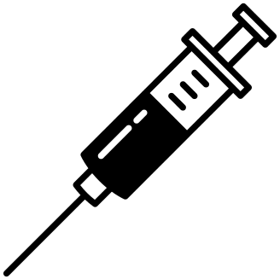
Licensed indications of current TTh
Newer preparations of TTh (particularly in the USA) have limited licensed indications, and are generally contraindicated in men with hypogonadal conditions not associated with structural or genetic aetiologies, such as ‘age-related/late-onset hypogonadism’
EU/UK SmPC wording
Male hypogonadism when testosterone deficiency has been confirmed by clinical features and biochemical tests
Transdermal gel
Intramuscular injection
US product labelling wording
Replacement therapy in males for conditions associated with a deficiency or absence of endogenous testosterone:
Primary hypogonadism (congenital or acquired)
Hypogonadotropic hypogonadism (congenital or acquired)
Safety and efficacy in men with ‘age-related hypogonadism’ have not been established
Transdermal gel/patch
Intramuscular injection
Oral capsule
Subcutaneous pellet
Intranasal gel
SmPC, summary of product characteristics; TTh, testosterone therapy.
References can be found in the slide notes.
Notes:
Newer preparations of TTh (particularly in the USA) have limited licensed indications, and are generally contraindicated in men with hypogonadal conditions not associated with structural or genetic aetiologies, such as ‘age-related/late-onset hypogonadism.^{1–20}
SmPCs for the majority of TTh formulations marketed in the EU and/or UK (transdermal gel,^{1–4} intramuscular injection^{5–7}) state that they are licensed for:
“Male hypogonadism when testosterone deficiency has been confirmed by clinical features and biochemical tests.”^{1–7}
Sustanon (preparation of 3–4 testosterone esters for intramuscular injection) is also indicated as “supportive therapy for female-to-male transsexuals.”⁷
US PIs for several marketed TTh formulations (transdermal gel/patch,^{8–12} intramuscular injection,^{13–15} oral capsule,^{16–18} subcutaneous pellet,¹⁹ intranasal gel²⁰) state that they are licensed for:
“Replacement therapy in males for conditions associated with a deficiency or absence of endogenous testosterone,”^{8–20} and that “Safety and efficacy in men with ‘age-related hypogonadism’ have not been established.”^{8–14,19,20}
Aetiologies for these underlying conditions can include congenital or acquired primary hypogonadism (testicular failure due to conditions such as cryptorchidism, bilateral torsion, orchitis, vanishing testis syndrome, orchiectomy, Klinefelter syndrome, chemotherapy or toxic damage from alcohol or heavy metals) or hypogonadotropic hypogonadism (GnRH or LHRH deficiency or pituitary-hypothalamic injury from tumours, trauma or radiation).^{8–20}
GnRH, gonadotropin-releasing hormone; LHRH, luteinising hormone-releasing hormone; PI, prescribing information; SmPC, summary of product characteristics; TTh, testosterone therapy.
References
1. Testogel® SmpC. Available at: https://www.medicines.org.uk/emc/product/8919/smpc. (accessed May 2023); 2. Testim® SmPC. Available at: https://www.medicines.org.uk/emc/product/9633. (accessed May 2023); 3. Tostran® SmPC. Available at: https://www.medicines.org.uk/emc/product/332. (accessed May 2023); 4. Testavan® SmPC. Available at: https://www.medicines.org.uk/emc/product/13936. (accessed May 2023); 5. Nebido® SmPC. Available at: https://www.medicines.org.uk/emc/product/3873. (accessed May 2023); 6. Testosterone enantate for injection SmPC. Available at: https://www.medicines.org.uk/emc/product/3733. (accessed May 2023); 7. Sustanon® SmPC. Available at: https://www.medicines.org.uk/emc/product/5373. (accessed May 2023); 8. Androgel® PI. Available at: https://www.accessdata.fda.gov/drugsatfda_docs/label/2019/022309s020lbl.pdf. (accessed May 2023); 9. Fortesta® PI. Available at: https://www.accessdata.fda.gov/drugsatfda_docs/label/2020/021463s025lbl.pdf. (accessed May 2023); 10. Testim® PI. Available at: https://www.accessdata.fda.gov/drugsatfda_docs/label/2021/021454s034lbl.pdf. (accessed May 2023); 11. Vogelxo® PI. Available at: https://www.accessdata.fda.gov/drugsatfda_docs/label/2020/204399s012lbl.pdf. (accessed May 2023); 12. Androderm® PI. Available at: https://www.accessdata.fda.gov/drugsatfda_docs/label/2020/020489s036lbl.pdf. (accessed May 2023); 13. Aveed® PI. Available at: https://www.accessdata.fda.gov/drugsatfda_docs/label/2021/022219s015lbl.pdf. (accessed May 2023); 14. Depo®-testosterone PI. Available at: https://labeling.pfizer.com/ShowLabeling.aspx?id=548. (accessed May 2023); 15. Xyosted® PI. Available at: https://www.accessdata.fda.gov/drugsatfda_docs/label/2019/209863s002lbl.pdf. (accessed May 2023); 16. Jatenzo® PI. Available at: https://www.accessdata.fda.gov/drugsatfda_docs/label/2019/206089s000lbl.pdf. (accessed May 2023); 17. Kyzatrex® PI. Available at: https://www.accessdata.fda.gov/drugsatfda_docs/label/2022/213953s000lbl.pdf. (accessed May 2023); 18. Tlando™ PI. Available at: https://www.accessdata.fda.gov/drugsatfda_docs/label/2022/208088s000lbl.pdf. (accessed May 2023); 19. Testopel® PI. Available at: https://www.testopel.com/about-testopel. (accessed May 2023); 20. Natesto® PI. Available at: https://www.accessdata.fda.gov/drugsatfda_docs/label/2016/205488s002lbl.pdf. (accessed May 2023).

Slide 3
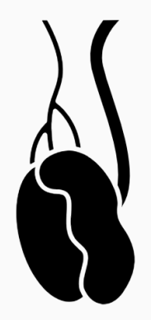
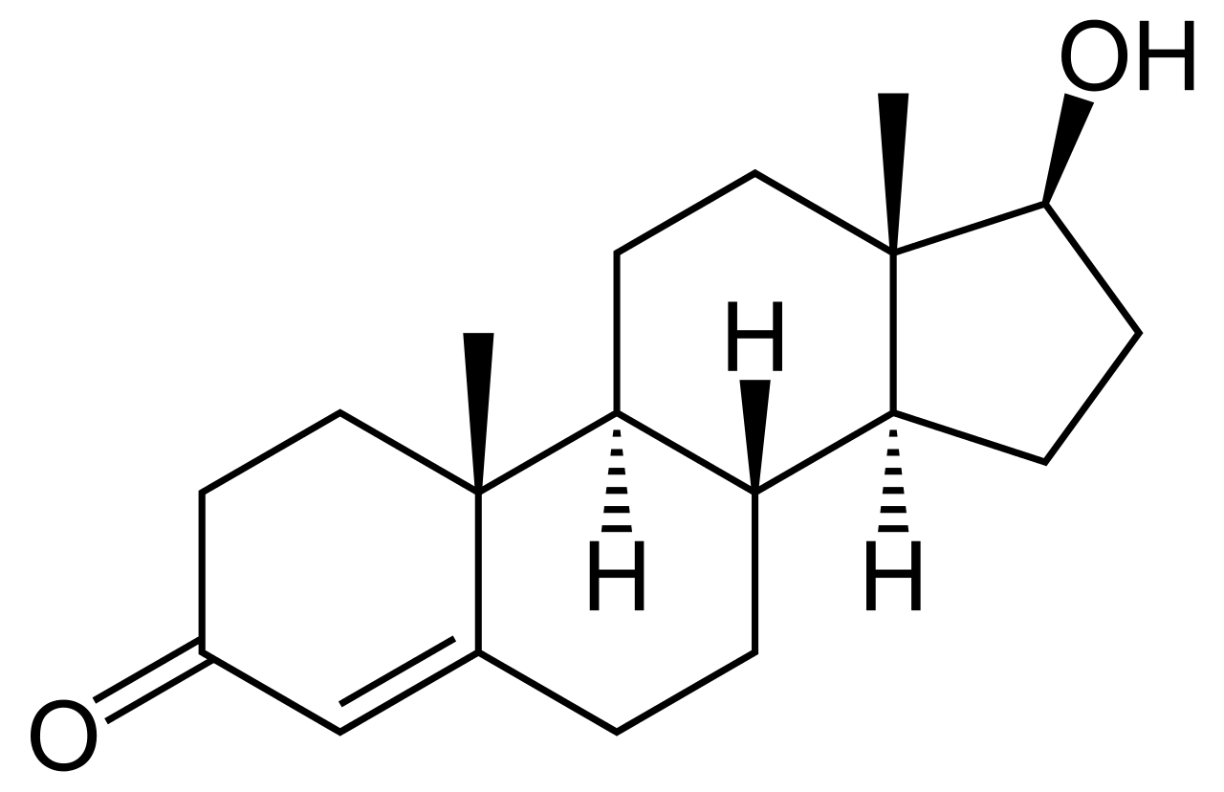
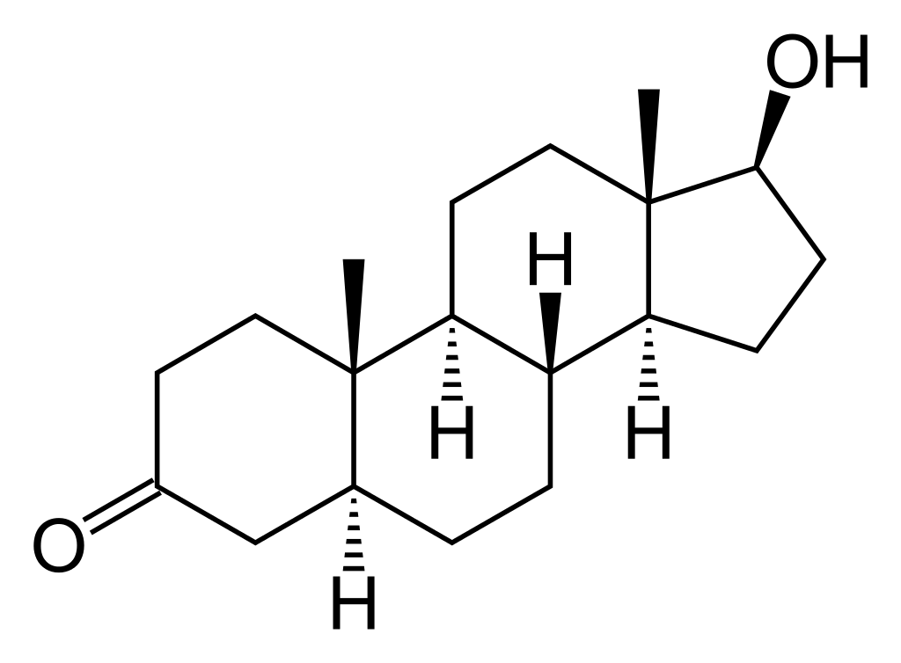
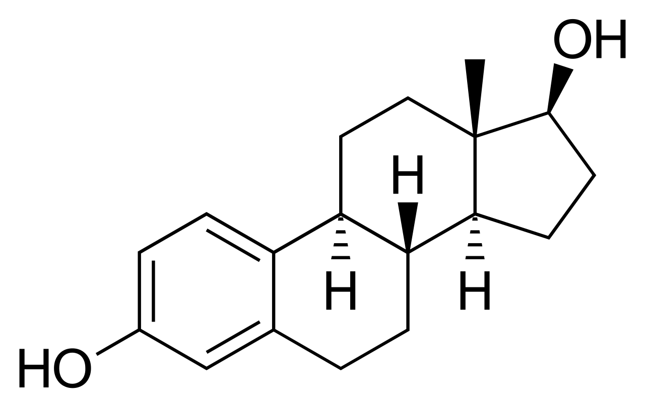
Classification of male hypogonadism
Androgen biosynthesis²
Male hypogonadism can be classified according to the origin of the underlying problem¹
Hypothalamus
2˚
Secondary hypogonadism¹
GnRH
1˚
Primary hypogonadism¹
Pituitary or hypothalamic dysfunction
Also known as hypogonadotropic hypogonadism
The testes are inadequately stimulated by gonadotropins (inappropriate and/or reduced levels)
Pituitary gland
Testicular dysfunction
Also known as hypergonadotropic hypogonadism
The pituitary gland attempts to compensate for testicular dysfunction by increasing central stimulation
FSH
LH
Testis
5-α reductase 1
P450 aromatase
Testosterone
DHT
Oestradiol
DHT, dihydrotestosterone; FSH, follicle-stimulating hormone; GnRH, gonadotropin-releasing hormone; LH, luteinising hormone.
1. Salonia A et al. EAU 2023 Guidelines on Sexual and Reproductive Health. Available at: https://uroweb.org/guidelines/sexual-and-reproductive-health (accessed May 2023); 2. Nieschlag E et al. Andrology: Male reproductive health and dysfunction, 3rd edition, Springer, 2010.
Notes:
Androgen biosynthesis involves hormonal and steroidal communication between the hypothalamic-pituitary system and the testes.¹
LH and FSH are synthesised in the pituitary gland and secreted under the control of GnRH produced by the hypothalamus.¹
Leydig cells adjacent to the seminiferous tubules in the testes synthesise and secrete testosterone under the control of LH.¹
Testosterone has a variety of downstream functions, supporting spermatogenesis and male fertility, and promoting androgenic effects after being metabolised to DHT by testicular 5α-reductase activity and to oestradiol by testicular aromatase activity.¹
Male hypogonadism can be classified according to the origin of the underlying problem into primary hypogonadism, caused by testicular dysfunction, or secondary hypogonadism, caused by pituitary or hypothalamic dysfunction.²
Primary hypogonadism is also called hypergonadotropic hypogonadism, because the pituitary gland tries to compensate for testicular dysfunction by increasing central stimulation.²
In secondary hypogonadism, the testes are inadequately stimulated by gonadotropins (usually inappropriately normal or reduced gonadotropin levels).²
By following this classification based on the aetiology of hypogonadism, clinicians are able to select appropriate treatment options. In patients with secondary hypogonadism, testosterone normalisation can be theoretically achieved with a variety of treatments, including lifestyle changes, gonadotropin therapy and TTh, whereas in primary hypogonadism only TTh can be considered as treatment.²
DHT, dihydrotestosterone; FSH, follicle-stimulating hormone; GnRH, gonadotropin-releasing hormone; LH, luteinising hormone; TTh, testosterone therapy.
References
1. Nieschlag E et al. Andrology: Male reproductive health and dysfunction, 3rd edition, Springer, 2010; 2. Salonia A et al. EAU 2023 Guidelines on Sexual and Reproductive Health. Available at: https://uroweb.org/guidelines/sexual-and-reproductive-health. (accessed May 2023).

Slide 4
Causes of primary hypogonadism
1˚
Primary hypogonadism results in low T concentrations, impaired spermatogenesis and elevated gonadotropin levels¹
Common^{1,2}
Uncommon^{1,2}
Klinefelter syndrome
Rare chromosomal abnormalities: XX male syndrome, 47 XYY syndrome, 48 XXYY syndrome
Trisomy 21 (Down syndrome)
Noonan syndrome
Autosomal translocations
Defects of T biosynthesis
CAH (testicular adrenal rest tumours)
Disorders of sex development (gonadal dysgenesis)
LHR gene mutations
Myotonic dystrophy
Uncorrected cryptorchidism (including INSL3 and LGR8/GREAT mutations)
Bilateral congenital anorchia
Sickle cell disease
Adreno-leukodystrophy
Cancer chemotherapy
Testicular radiation exposure
Trauma
Torsion
Infectious orchitis
HIV infection
CAH, congenital adrenal hyperplasia; HIV, human immunodeficiency virus; T, testosterone.
1. Bhasin S et al. J Clin Endocrinol Metab 2018;103:1715–44; 2. Salonia A et al. EAU 2023 Guidelines on Sexual and Reproductive Health. Available at: https://uroweb.org/guidelines/sexual-and-reproductive-health (accessed May 2023).
Notes:
Primary hypogonadism results in low T concentrations, impairment of spermatogenesis, and elevated gonadotropin levels.¹
Klinefelter syndrome, a trisomy associated with a 47,XXY karyotype, is the most prevalent genetic cause of primary hypogonadism.²
Other less-common causes of primary hypogonadism include:^{1,2}
Rare chromosomal abnormalities: XX male syndrome, 47 XYY syndrome, 48 XXYY syndrome
Trisomy 21 (Down syndrome)
Noonan syndrome
Autosomal translocations
Defects of T biosynthesis
CAH (testicular adrenal rest tumours)
Disorders of sex development (gonadal dysgenesis)
LHR gene mutations
Myotonic dystrophy
Uncorrected cryptorchidism (including INSL3 and LGR8/GREAT mutations)
Bilateral congenital anorchia
Sickle cell disease
Adreno-leukodystrophy
Some types of cancer chemotherapy
Testicular radiation exposure
Trauma
Torsion
Infectious orchitis
HIV infection.
CAH, congenital adrenal hyperplasia; HIV, human immunodeficiency virus; T, testosterone.
References
1. Bhasin S et al. J Clin Endocrinol Metab 2018;103:1715–44; 2. Salonia A et al. EAU 2023 Guidelines on Sexual and Reproductive Health. Available at: https://uroweb.org/guidelines/sexual-and-reproductive-health (accessed May 2023).

Slide 5
Causes of secondary hypogonadism
2˚
Secondary hypogonadism results in low T concentrations, impaired spermatogenesis and low or inappropriately normal gonadotropin levels¹
Common^{1,2}
Uncommon^{1,2}
Haemochromatosis/ iron overload syndromes
Combined hormone pituitary deficiency
IHH and variants:
Normosmic IHH
Kallmann syndrome
Isolated LH beta gene mutations
Prader-Willi syndrome
Hyperprolactinaemia
Severe obesity
AAS withdrawal syndrome
Alcohol or marijuana abuse
Hypothalamic or pituitary tumours or infiltrative/ destructive disease
Use of opioids, glucocorticoids or androgen-deprivation therapy with GnRH agonists
Nutritional deficiency
Excessive exercise
Head trauma
Pituitary surgery or radiation exposure
AAS, androgenic-anabolic steroid; GnRH, gonadotropin-releasing hormone; IHH, idiopathic hypogonadotropic hypogonadism; LH, luteinising hormone; T, testosterone.
1. Bhasin S et al. J Clin Endocrinol Metab 2018;103:1715–44; 2. Salonia A et al. EAU 2023 Guidelines on Sexual and Reproductive Health. Available at: https://uroweb.org/guidelines/sexual-and-reproductive-health (accessed May 2023).
Notes:
Secondary hypogonadism results in low T concentrations, impairment of spermatogenesis, and low or inappropriately normal gonadotropin levels.¹
Haemochromatosis/iron overload syndromes are a common cause of secondary hypogonadism.²
Other less-common causes of secondary hypogonadism include:^{1,2}
Rare chromosomal abnormalities: XX male syndrome, 47 XYY syndrome, 48 XXYY syndrome
Combined hormone pituitary deficiency
IHH and variants:
Normosmic IHH
Kallmann syndrome
Isolated LH beta gene mutations
Prader-Willi syndrome
Hyperprolactinaemia
Severe obesity
AAS withdrawal syndrome
Alcohol or marijuana abuse
Hypothalamic or pituitary tumours or infiltrative/destructive disease
Use of opioids, glucocorticoids or androgen-deprivation therapy with GnRH agonists
Nutritional deficiency
Excessive exercise
Head trauma
Pituitary surgery or radiation exposure.
AAS, androgenic-anabolic steroid; GnRH, gonadotropin-releasing hormone; IHH, idiopathic hypogonadotropic hypogonadism; LH, luteinising hormone; T, testosterone.
References
1. Bhasin S et al. J Clin Endocrinol Metab 2018;103:1715–44; 2. Salonia A et al. EAU 2023 Guidelines on Sexual and Reproductive Health. Available at: https://uroweb.org/guidelines/sexual-and-reproductive-health (accessed May 2023).

Slide 6
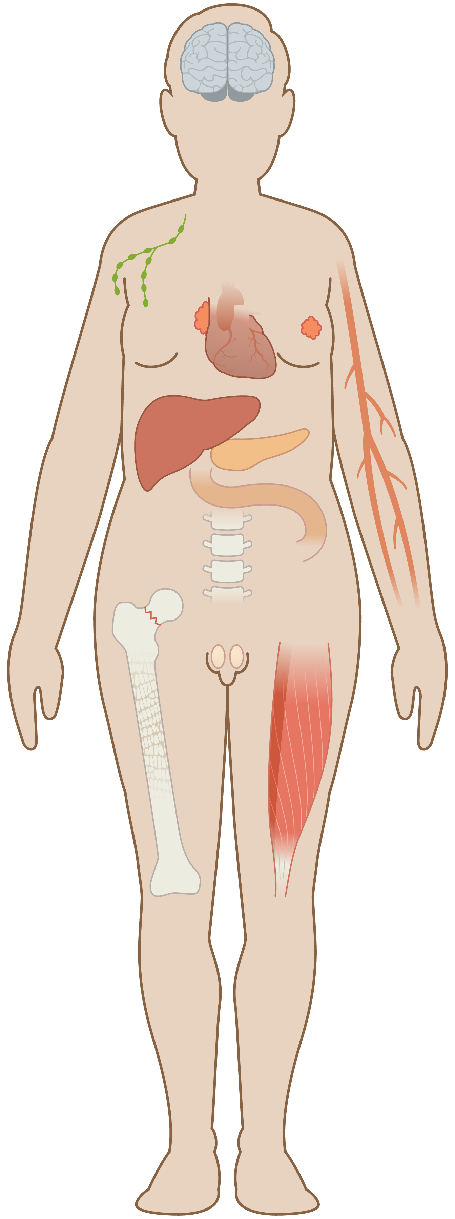
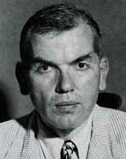
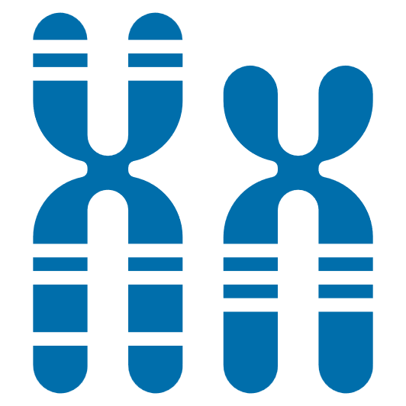
Overview of Klinefelter syndrome
1˚
The most common sex chromosome disorder^{1,2}
Affected males carry an additional X chromosome, which results in male hypogonadism, androgen deficiency and impaired spermatogenesis¹
Classic signs include gynaecomastia, small testes, sparse body hair, tall stature and infertility, but not all individuals will show these features¹
Harry F.
Klinefelter
Edward C.
Reifenstein
Fuller
Albright
First described in 1942 in 9 men with gynaecomastia, small testes, azoospermia and elevated gonadotropin levels^{1,2}
Karyotyping individuals with Klinefelter syndrome²
47,XXY
46,XX/47,XXY
mosaicism or multiple X chromosome aneuploidy
46,XY/47,XXY
mosaicism
Prevalence²
85–90%
6–7%
47,XXY/48,XXXY
48,XXXY
85–223 per 100,000 males
48,XXYY
49,XXXXY
3–8%
1. Smyth CM, Bremner WJ. Arch Intern Med 1998;158:1309–14; 2. Gravholt CH et al. Endocr Rev 2018;39:389–423.
Notes:
Klinefelter syndrome is the most common sex chromosome disorder.^{1,2}
Affected males carry an additional X chromosome, which results in male hypogonadism, androgen deficiency and impaired spermatogenesis.¹
Classic signs of Klinefelter syndrome include gynaecomastia, small testes, sparse body hair, tall stature and infertility. However, because of the wide variability in clinical expression, not all individuals with Klinefelter syndromes will show these features.¹
Klinefelter syndrome was first described in 1942 by Harry F. Klinefelter, Edward C. Reifenstein and Fuller Albright, who were studying 9 men with gynaecomastia, small testes, azoospermia and elevated gonadotropin levels.^{1,2}
Most males with Klinefelter syndrome have the karyotype 47,XXY (85–90%), 6–7% have a 46,XY/47,XXY mosaicism karyotype, and the remaining 3–8% display either 46,XX/47,XXY or multiple X chromosome aneuploidy, including some individuals who have an additional Y chromosome (47,XXY/48,XXXY; 48,XXXY; 48,XXYY; 49,XXXXY). These latter cases display a more severe phenotype.²
References
1. Smyth CM, Bremner WJ. Arch Intern Med 1998;158:1309–14; 2. Gravholt CH et al. Endocr Rev 2018;39:389–423.

Slide 7
Klinefelter syndrome is under-recognised and underdiagnosed
1˚
A diagnosis of Klinefelter syndrome is based on clinical appearance and a karyotype of 47,XXY or 47,XXY mosaicism
Among individuals with Klinefelter syndrome:
Only 25–40% are ever diagnosed
Only 10% are diagnosed during childhood or adolescence
The majority of individuals with Klinefelter syndrome are diagnosed during adulthood, typically in the course of a fertility workup
80
Median age at diagnosis:
27 years
70
60
50
40
Age at diagnosis (years)
30
20
Age at diagnosis of 252 prenatally and 1252 postnatally diagnosed males with Klinefelter syndrome in Denmark
10
0
Prenatal
0
50
100
250
Individuals diagnosed (n)
Gravholt CH et al. Endocr Rev 2018;39:389–423.
Notes:
Klinefelter syndrome is greatly under-recognised and underdiagnosed.
A diagnosis of Klinefelter syndrome is based on clinical appearance and a karyotype of 47,XXY or 47,XXY mosaicism; however, there is no universal agreement on the necessary clinical signs or symptoms that should lead to karyotyping.
Overt clinical signs of Klinefelter syndrome are often absent, and many males with the condition are difficult to distinguish from a healthy 46,XY male.
Among individuals with Klinefelter syndrome, only 25–40% are ever diagnosed and only 10% are diagnosed during childhood or adolescence.
The majority of individuals with Klinefelter syndrome are diagnosed during adulthood, typically in the course of a fertility workup.
The median age of diagnosis in a study of 252 prenatally and 1252 postnatally diagnosed males with Klinefelter syndrome in Denmark was 27 years.
Reference Gravholt CH et al. Endocr Rev 2018;39:389–423.

Slide 8
Klinefelter syndrome is associated with a variety of abnormalities and underlying comorbidities
1˚
Increased gonadotropin levels: >75%
Increased gonadotropin levels: >75%
Tremor (Parkinson-like symptoms): >25%
Learning disabilities: >75%
Breast cancer: ~4-fold increased risk
Mediastinal cancer: possible association
Psychiatric disturbances: >25%
Psychiatric disturbances: >25%
Gynaecomastia: 28–75%
Gynaecomastia: 28–75%
Decreased facial hair: 60–80%
Decreased facial hair: 60–80%
Ischaemic heart disease: ~1.5-fold increased risk
Ischaemic heart disease: ~1.5-fold increased risk
Autoimmune disorders: increased risk
Venous thrombosis: ~3–6-fold increased risk
Venous thrombosis: ~3–6-fold increased risk
Decreased testosterone levels: >75%
Metabolic syndrome: 46%
Type 2 diabetes: 10–39%
Decreased testosterone levels: >75%
Metabolic syndrome: 46%
Type 2 diabetes: 10–39%
Infertility: >99%
Azoospermia: >95%
Cryptorchidism: 27–37%
Decreased bi-testicular testis volume: >95%
Decreased pubic hair: 30–60%
Decreased penile size: 10–25%
Abdominal adiposity: ~50%
Increased body fat
Abdominal adiposity: ~50%
Increased body fat
Osteopenia: 40%
Osteoporosis: 5–10%
Fractures: ~2–40-fold increased risk
Osteoarthritis: ~4-fold increased risk
Osteopenia: 40%
Osteoporosis: 5–10%
Fractures: ~2–40-fold increased risk
Osteoarthritis: ~4-fold increased risk
Decreased muscle mass and strength: ~40%
Decreased muscle mass and strength: ~40%
Increased height: >30%
TTh has the potential to impact all of these aspects of Klinefelter syndrome
TTh, testosterone therapy.
Gravholt CH et al. Endocr Rev 2018;39:389–423.
Notes:
Klinefelter syndrome is associated with a variety of abnormalities and underlying comorbidities, including:
Increased gonadotropin levels (>75% of cases)
Learning disabilities (>75% of cases) and psychiatric disturbances (>25% of cases)
Decreased facial hair (60–80% of cases)
Autoimmune disorders (increased risk)
Metabolic syndrome (46% of cases) and type 2 diabetes (10–39% of cases)
Abdominal adiposity (~50% of cases) and increased body fat
Osteopenia (40% of cases), osteoporosis (5–10% of cases), fractures (~2–40-fold increased risk) and osteoarthritis (~4-fold increased risk)
Increased height (>30% of cases)
Tremor (Parkinson-like symptoms; >25% of cases)
Gynaecomastia (28–75% of cases)
Breast cancer (~4-fold increased risk) and mediastinal cancer (possible association)
Ischaemic heart disease (~1.5-fold increased risk)
Venous thrombosis (~3–6-fold increased risk)
Decreased testosterone levels (>75% of cases)
Infertility (99% of cases)
Azoospermia (>95% of cases)
Cryptorchidism (27–37% of cases)
Decreased bi-testicular testis volume (>95% of cases)
Decreased pubic hair (30–60% of cases)
Decreased penile size (10–25% of cases)
Decreased muscle mass and strength (~40% of cases).
TTh administration can potentially impact the aspects of Klinefelter syndrome highlighted in bold.¹
TTh, testosterone therapy.
Reference
Gravholt CH et al. Endocr Rev 2018;39:389–423.

Slide 9
Klinefelter syndrome is associated with an increased risk of certain underlying conditions
1˚
Individuals with Klinefelter syndrome have an increased risk of several underlying conditions
This may be due to a combination of the effects of the chromosomal aberration itself (e.g. congenital malformations) and/or hypogonadism (e.g. diabetes, obesity, anaemia, osteoarthritis/osteoporotic fractures)
Klinefelter syndrome, n Controls, n HR (95% CI)
709 2834 1.69 (1.54–1.86)
HRs for first hospital admission by cause
Individuals with Klinefelter syndrome vs age-matched controls (46,XY)
28 1 119 (116.2–1880)
49 105 2.30 (1.61–3.29)
15 33 2.21 (1.18–4.14)
25 38 3.71 (2.14–6.40)
37 6 34.8 (13.7–88.6)
276 144 10.7 (8.63–13.3)
79 343 1.33 (1.03–1.72)
23 38 3.15 (1.73–5.76)
72 229 1.71 (1.28–2.29)
39 41 5.29 (3.29–8.50)
19 26 3.60 (1.92–6.74)
38 58 4.46 (2.82–7.06)
135 474 1.41 (1.16–1.72)
108 313 1.80 (1.44–2.26)
145 230 3.65 (2.92–4.55)
*Including heart, genitalia and retention of the testis. CI, confidence interval; HR, hazard ratio.
Bojesen A et al. J Clin Endocrinol Metab 2006;91:1254–60.
Notes:
Individuals with Klinefelter syndrome have an increased risk of several underlying conditions and disorders.
This may be due to a combination of the effects of the chromosomal aberration itself (e.g. congenital malformations) and/or hypogonadism (e.g. diabetes, obesity, anaemia, osteoporosis/osteoporotic fractures). Some diagnoses may also be an expression of poor general health, possibly in combination with the reduced socioeconomic living conditions that affect many men with Klinefelter syndrome.
Klinefelter syndrome appears to be associated with an increased risk of the following (not an exhaustive list):
Hypogonadism
Diabetes (type 1 and type 2 separately, and combined)
Gynaecomastia
Congenital malformations, including heart, genitalia and retention of the testis
Cancer, particularly breast and mediastinal tumours
Anaemia
Ischaemic heart disease
Thrombophlebitis and venous thrombosis
Pulmonary embolism
Osteoarthritis and osteoporotic fractures
Infections
Psychiatric disorders.
Reference
Bojesen A et al. J Clin Endocrinol Metab 2006;91:1254–60.

Slide 10
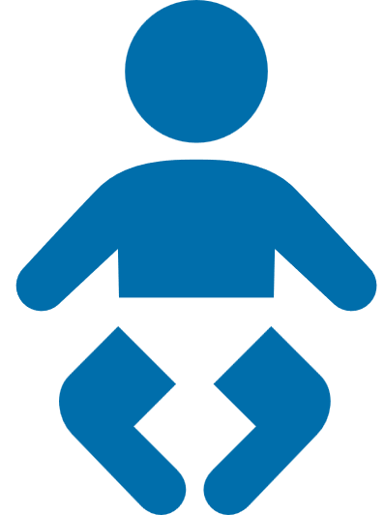
Possible diagnostic phenotypic features of Klinefelter syndrome by life stage
1˚
The ‘classic’ Klinefelter syndrome phenotype (tall stature, gynaecomastia, undervirilisation) is not always apparent¹
The most universal and reliable indicator of Klinefelter syndrome is small testicular size, which is perceptible from adolescence¹
Certain phenotypic features of Klinefelter syndrome appear at different specific life stages, which may assist diagnosis:^{1,2}
Cryptorchidism (27–37%)
Decreased testosterone levels (63–85%)
Decreased facial (60–80%) and pubic hair (30–60%)
Osteopenia (~40%), osteoporosis (10%)
Delayed speech (>40%)
Gynaecomastia (38–75%)
Metabolic syndrome (46%), type 2 diabetes (10–39%)
Small testes (>95%), infertility (>99%)
Learning difficulties (>75%)
Newborn
0–1 years
Infant
3–5 years
Child
6–10 years
Adolescent
11–19 years
Adult
20+ years
The figure shows key phenotypic features and their estimated frequencies that may prompt further clinical investigation by karyotyping (adapted from Herlihy et al. 2011).
1. Herlihy AS et al. Med J Aust 2011;194:24–8; 2. Gravholt CH et al. Endocr Rev 2018;39:389–423.
Notes:
The ‘classic’ Klinefelter syndrome phenotype (tall stature, gynaecomastia, undervirilisation) is not always apparent in males with the condition.¹
The most universal and reliable indicator of Klinefelter syndrome is small testicular size, which is perceptible from adolescence.¹
Certain phenotypic features of Klinefelter syndrome appear at different specific life stages, and this may assist diagnosis.^{1,2}
Cryptorchidism (occurring in 27–37% of cases), delayed speech (>40% of cases) and learning difficulties (>75% of cases) may be noticeable during childhood and into adolescence.
During adolescence, individuals with Klinefelter syndrome may show decreased facial and pubic hair (60–80% and 30–60% of cases, respectively), gynaecomastia (38–75% of cases) and small testes (>95% of cases) with accompanying infertility (>99% of cases). Decreased testosterone levels (63–85% of cases) are also apparent, persisting throughout life in the untreated condition.
During adulthood, individuals with Klinefelter syndrome may have endocrine disorders such as metabolic syndrome (46% of cases) and type 2 diabetes (10–30% of cases), and osteopenia (~40% of cases) and osteoporosis (10% of cases).
These phenotypic features and underlying conditions may prompt further clinical investigation by karyotyping.¹
References
1. Herlihy AS et al. Med J Aust 2011;194:24–8; 2. Gravholt CH et al. Endocr Rev 2018;39:389–423.

Slide 11
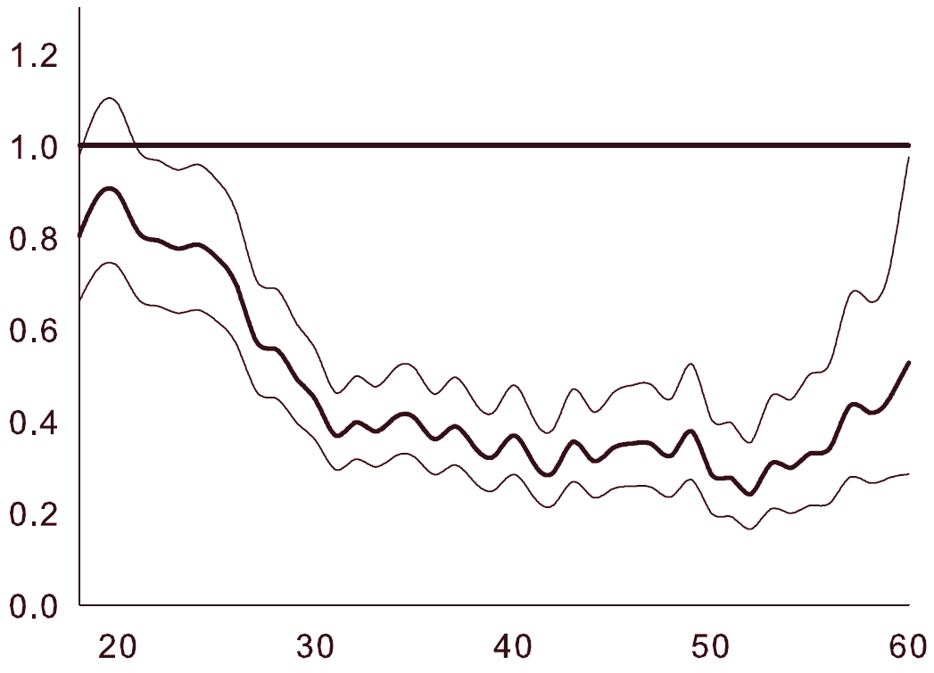
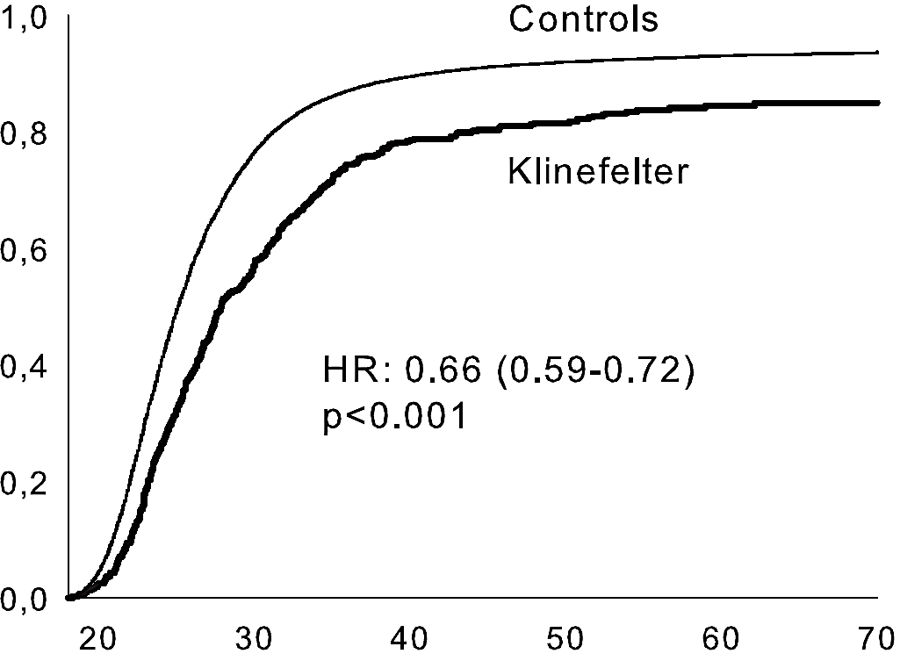
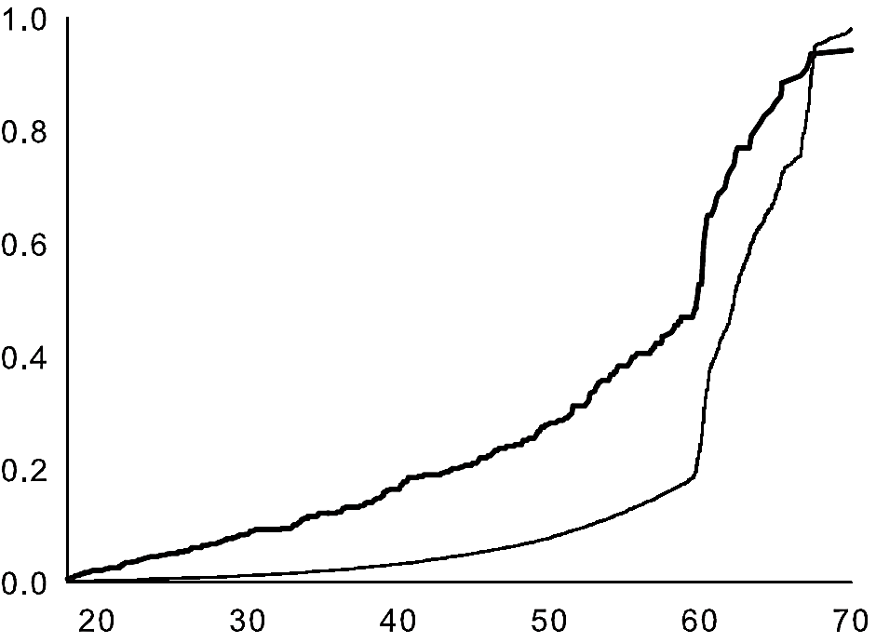
Individuals with Klinefelter syndrome tend to have a poorer quality of life and socioeconomic status
1˚
In a Danish registry study comparing 1049 individuals with Klinefelter syndrome and 100,824 age- and time-matched controls, the former cohort:
Had significantly fewer partnerships (HR 0.66) and entered into them later in life (median age 27.1 vs 24.6 years)
Had a lower educational level (HR 0.27) and received a lower annual income
Were more likely to leave the workforce at a younger age (43.5 vs 60.3 years)
Proportion who have ever had a partner
Likelihood of males with Klinefelter syndrome having income above the median for controls
Proportion who have left the workforce
1.0
Control cohort
1.0
1.0
Klinefelter
cohort
0.8
Klinefelter cohort
0.8
0.8
0.6
0.6
0.6
Proportion of population
0.4
HR (95% CI): 0.66 (0.59–0.72)
p<0.001
0.4
0.4
0.2
0.2
0.2
Control
cohort
0
0
OR (bold line) and 95% CIs (lighter lines)
0
20
30
40
50
60
70
20
30
40
50
60
20
30
40
50
60
70
Age (years)
Age (years)
Age (years)
HR, hazard ratio; OR, odds ratio.
Bojesen A et al. J Clin Endocrinol Metab 2011;96:2098–104.
Notes:
Individuals with Klinefelter syndrome tend to have a poorer quality of life and socioeconomic status.
In a Danish registry study comparing 1049 individuals with Klinefelter syndrome and 100,824 age- and time-matched controls, patients in the Klinefelter syndrome cohort:
Had significantly fewer partnerships (HR 0.66) and entered into them later in life (median age 27.1 vs 24.6 years)
Had a lower educational level (HR 0.27) and received a lower annual income
Were more likely to leave the workforce at a younger age (43.5 vs 60.3 years).
HR, hazard ratio.
Reference
Bojesen A et al. J Clin Endocrinol Metab 2011;96:2098–104.

Slide 12
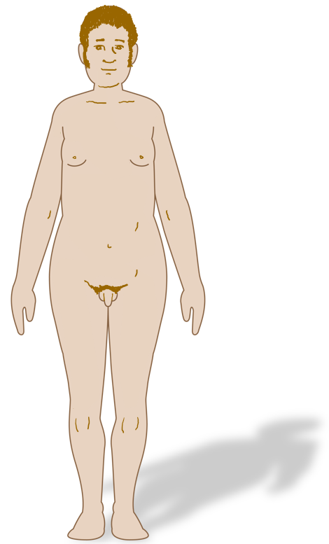
Klinefelter syndrome is associated with an increased risk of death
1˚
Mortality rates among males with Klinefelter syndrome are greater than those of matched controls or the general population
This excess mortality is likely a result of the presence of associated conditions, including hypogonadism; circulatory, respiratory, endocrine and metabolic diseases; and cancer
Poor socioeconomic conditions may also be a contributor
Differentiated excess mortality in Klinefelter syndrome (all age groups)
Cancer
Diseases of the circulatory system
Mental disorders
Diseases of the nervous system
Diseases of the digestive system
Diseases of the genitourinary system
Mortality
Congenital abnormalities
Hazard ratio of 1.9
Equating to a median of 5.6 years
of life lost
Diseases of the respiratory system
Accidents and violence, including fractures
Endocrine, metabolic and nutritional disorders
Gravholt CH et al. Endocr Rev 2018;39:389–423.
Notes:
Mortality rates among males with Klinefelter syndrome are greater than those of matched controls or the general population.
This observation of increased mortality is also observed in other sex chromosome abnormality syndromes, such as Turner syndrome, 47,XXX and 47,XYY, thus it appears to be an intrinsic consequence of sex chromosome aneuploidy.
The excess mortality among males with Klinefelter syndrome is likely a result of the presence of associated underlying conditions, including hypogonadism; circulatory, respiratory, endocrine and metabolic diseases; and cancer, and poor socioeconomic conditions may also be a contributing factor.
It is estimated that mortality among males with Klinefelter syndrome is increased with a hazard ratio of 1.9, which corresponds to a median of 5.6 years of life lost.
Reference
Gravholt CH et al. Endocr Rev 2018;39:389–423.

Slide 13
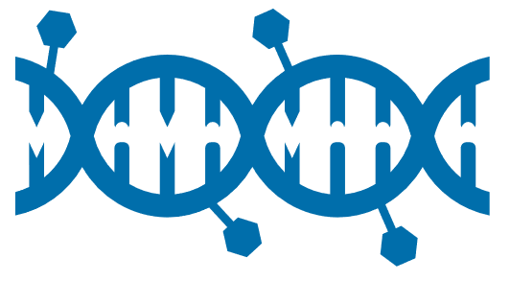
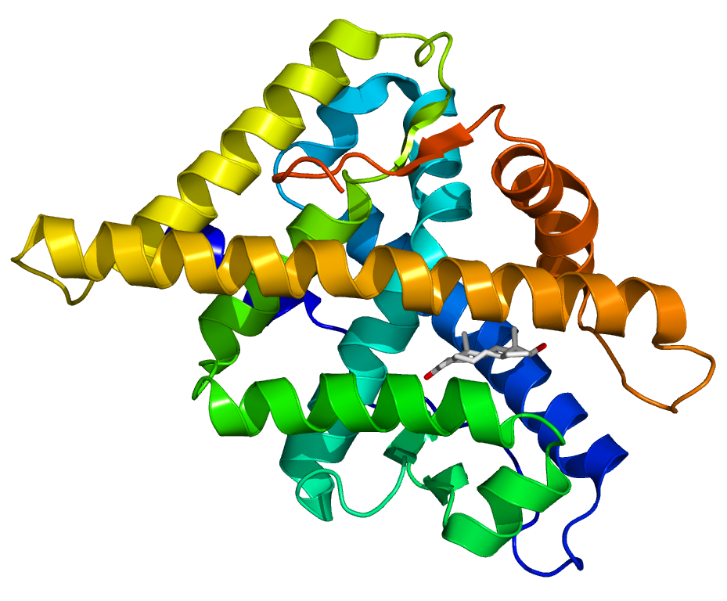
The genomic mechanisms underlying Klinefelter syndrome remain to be understood
1˚
The relationship between genotype and phenotype in Klinefelter syndrome has not yet been fully elucidated
Pervasive but discrete changes in the epigenome and transcriptome are thought to partly explain the phenotype of Klinefelter syndrome, but strong evidence for this is still needed
Other genetic mechanisms may be involved, such as CAG-repeat copy number variation and/or additional expression of escape genes, e.g. SHOX, on the extra X chromosome
Putative genetic mechanisms and pathways in Klinefelter syndrome
Epigenetics
Global hypermethylation
Global hypomethylation
Other epigenetic mechanisms?
SHOX
Phenotype
Tall stature
Small testes
Infertility
Hypergonadotropic hypogonadism
Type 2 diabetes
Autoimmunity
Neurocognitive problems
Other traits…
RNA
Global differential expression
Differential non-coding RNA expression?
XXY
(the extra X)
Parental origin?
Skewed X inactivation
SHOX gene overexpression
Other non-inactivated/ escape genes?
Proteins
Differential protein-protein interactions
RNA, ribonucleic acid; SHOX, short-stature homeobox gene.
Gravholt CH et al. Endocr Rev 2018;39:389–423.
Notes:
The relationship between genotype and phenotype in Klinefelter syndrome remains to be fully understood.
The overarching biological question related to Klinefelter syndrome is how to merge our understanding of the genome, epigenome and transcriptome with the different phenotypic manifestations related to different target organs, viability, occurrence of congenital malformations, and other characteristics of the condition.
Diverse traits including type 2 diabetes, infertility, hypergonadotropic hypogonadism, congenital malformations, and altered neurocognitive performance remain unexplained.
Importantly, the research and thinking behind the genomics era has moved away from a focus on single genes on the supernumerary X chromosome, to a focus on more subtle pervasive and discrete changes in the epigenome and transcriptome, in order to partly explain the majority of phenotypes in Klinefelter syndrome; however, compelling evidence to support this model is not yet available.
It is becoming clear that other genetic mechanisms may be involved, such as CAG-repeat copy number variation and/or additional expression of non-inactivated/escape genes, e.g. SHOX, on the extra X chromosome.
The presence of three copies of the SHOX gene explains excess height in Klinefelter syndrome, and CAG repeat length is related to different anthropometric measures (e.g. height, arm span/length, leg length, penile length) and possibly other measures (e.g. response to TTh, onset of pubertal reactivation of the pituitary gonadal axis, attained education level, chances of entering partnership).
SHOX, short-stature homeobox gene; TTh, testosterone therapy.
Reference
Gravholt CH et al. Endocr Rev 2018;39:389–423.
The ribbon model in the figure shows the androgen receptor.

Slide 14
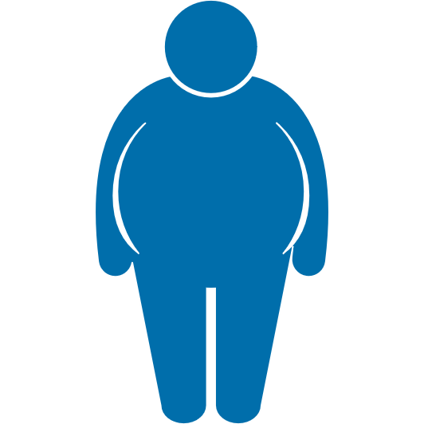
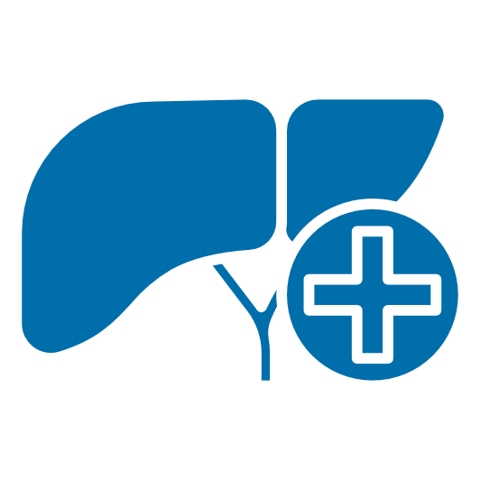
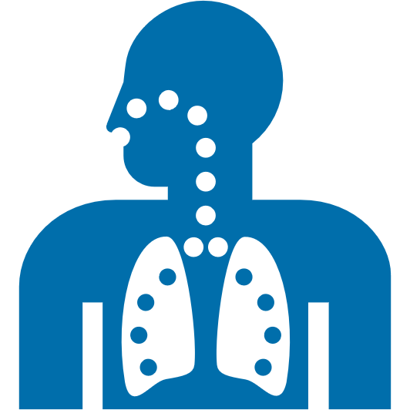
Aberrant autosomal DNA methylation is implicated in the Klinefelter syndrome phenotype
1˚
Aberrant autosomal DNA methylation appears to play a role in the increased likelihood of certain underlying conditions in Klinefelter syndrome
In a DNA methylation profiling study of 67 males with Klinefelter syndrome (47,XXY) and 67 age-matched controls (46,XY), gene set enrichment analysis of DMPs on autosomal DNA yielded terms associated with well-known comorbidities and traits seen in Klinefelter syndrome, including:
Type 1 and 2 diabetes, insulin resistance
Cancer (breast, prostate, colon, pancreas, leukaemia, non-Hodgkin lymphoma)
Height
Dyslipidaemia
Obesity
Osteoarthritis and osteoporosis
Metabolic syndrome
Cerebrovascular disease
Hypertension
Liver disease
Ischaemic heart disease
Chronic obstructive airway disease
Infections
DMP, differentially methylated position; DNA, deoxyribonucleic acid.
Skakkebæk A et al. Sci Rep 2018;8:13740.
Notes:
Aberrant autosomal DNA methylation appears to play a role in the increased likelihood of certain underlying conditions in Klinefelter syndrome.
DNA methylation profiling study
Participants included 67 males with Klinefelter syndrome [47,XXY; mean age (SD): 36.4 (10.0) years] and 67 age-matched controls [46,XY; mean age (SD): 36.3 (9.71) years].
DNA methylation profiling was performed on peripheral blood samples from all participants.
Gene set enrichment analysis of differentially methylated positions on autosomal DNA yielded terms associated with well-known comorbidities seen in Klinefelter syndrome, including:
Type 1 and 2 diabetes, and insulin resistance
Tall stature
Obesity
Metabolic syndrome
Hypertension
Ischaemic heart disease
Cancer (breast, prostate, colon, pancreas, leukaemia, non-Hodgkin lymphoma)
Dyslipidaemia
Osteoarthritis and osteoporosis
Cerebrovascular disease
Liver disease
Chronic obstructive airway disease
Infections.
These data support a biological function for aberrant genome-wide DNA methylation alterations in contributing to the phenotype of Klinefelter syndrome.
DNA, deoxyribonucleic acid; SD, standard deviation.
Reference
Skakkebæk A et al. Sci Rep 2018;8:13740.

Slide 15
Overview of iron overload disorders
2˚
Iron overload disorders occur when mechanisms regulating dietary iron absorption are deficient
Iron is important for spermatogenesis and steroid production
Testosterone directly regulates iron levels through inhibition of hepcidin, the main regulator of iron metabolism
Under high body iron conditions, serum hepcidin levels rise and ferroportin expression decreases; this prevents dietary iron absorption and impairs iron release from hepatocytes and macrophages, leading to a reduction in serum iron levels
Profoundly low testosterone levels are a common finding in severe iron overload
Hypogonadotropic hypogonadism, infertility and sexual dysfunction may occur if excess iron is not removed from the body
Hepcidin
Severe iron overload disorders include:
Hereditary haemochromatosis
Hepcidin is uncoupled from body iron stores
Hepcidin levels thus remain low and iron continues to be absorbed from the diet despite extreme iron overload
β-thalassemia
The need for regular blood transfusions to treat the condition ends up bypassing the hepcidin-ferroportin regulation of dietary iron uptake, resulting in massive iron loading
Gabrielsen JS et al. Curr Urol Rep 2018;19:60.
Notes:
The male reproductive system is highly sensitive to iron overload.
At the whole-body level, iron stores are coordinated by hepcidin, a circulating peptide produced by the liver.
Hepcidin binds ferroportin, which leads to the internalisation and degradation of iron.
Under high body iron conditions, serum hepcidin levels rise and ferroportin expression decreases. This prevents absorption of dietary iron and impairs the release of iron from hepatocytes and macrophages, thereby reducing serum iron levels.
When serum iron levels fall, hepcidin expression decreases and ferroportin increases, resulting in release of iron from hepatocytes and macrophages and increased absorption from the diet.
Severe iron overload occurs when these regulatory mechanisms fail.
Low testosterone levels are common in patients with severe iron overload. For example, in one study, hypogonadism was present in 65% of men with β-thalassemia.
Iron overload decreases levels of luteinising hormone and testosterone.
Conversely, testosterone regulates body iron levels by inhibiting hepcidin synthesis.
Thus, increasing testosterone levels increase dietary iron absorption and body iron stores. This effect of testosterone overrides iron regulation by hepcidin.
Two notable severe iron overload disorders are hereditary haemochromatosis and β-thalassemia.
In the former, hepcidin is uncoupled from body iron stores; thus, hepcidin levels remain low and iron continues to be absorbed from the diet, despite extreme iron overload. In the latter, the need for regular blood transfusions to treat the condition ends up bypassing the hepcidin-ferroportin regulation of dietary iron uptake, resulting in massive iron loading.
Reference
Gabrielsen JS et al. Curr Urol Rep 2018;19:60.

Slide 16
Overview of hereditary haemochromatosis
2˚
Four main types; distinguished by the proteins involved in iron homeostasis that are affected¹
Diagnostic evaluation should start with measurement of serum ferritin and transferrin saturation levels²
If ferritin levels are raised and transferrin saturation is >45%, patients should be referred for haemochromatosis genetic testing²
Investigations should include a hormonal check-up³
The management of hereditary haemochromatosis has remained unchanged for many years^{1,4}
First-line therapy is phlebotomy¹
TTh may be used for the treatment of hypogonadotropic hypogonadism associated with hereditary haemochromatosis, given in combination with phlebotomy³
~2–3×
more men
are affected than women²
5th
decade
When the disease usually becomes apparent in men²
Prevalence²
1 in 300–500 individuals
TTh, tetosterone therapy.
1. Rombout-Sestrienkova E et al. Br J Haematol 2016;175:759‒70; 2. Sood R et al. Bri J Gen Pract 2013;63:331-2; 3. Osta RE et al. Basic Clin Androl 2017;27:13; 4. Murphree CR et al. Vox Sang 2020;115:255‒62.
Notes:
Hereditary haemochromatosis is classified into 4 types, according to the proteins involved in iron haemostasis that are affected.¹
Men are affected around 2–3 times more often than women, and disease usually becomes apparent in the fifth decade in men.²
Diagnosis starts with evaluation of serum ferritin and transferrin saturation levels, and depending on the results of these assessments, referall for haemochromatosis genetic testing may be warranted.²
Since 1950, phlebotomy has been the most widely accepted treatment for hereditary haemochromatosis. Repeated withdrawal of red blood cells reduces the iron that is present in haemoglobin – this stimulates erythropoiesis and thereby mobilises iron stored in organs, eliminating a state of excessive stored iron.¹
Although phlebotomy is the first-line therapy for hereditary haemochromatosis, this is contraindicated in patients with chronic transfusion-dependent anaemia and those with unstable haemodynamic status. In these patients, iron chelation is the mainstay of therapy.³
Age at diagnosis and disease stage, in particular including liver complications, are factors which determine the success of phlebotomy.⁴
Iron overload causes endocrine dysfunction, particularly on the gonadotropic axis, which is responsible for infertility. However, the impact of haemochromatosis on reproductive function is multifactorial and depends mainly on pituitary and testicular damage.⁴
A decrease in serum testosterone level in men with hypogonadism causes a decrease in sexual desire, reduces ejaculation frequency and impacts on the quality and quantity of semen.⁴
Treatment with the combination of TTh and phlebotomy can completely restore pituitary function.⁴
TTh, testosterone therapy.
References
1. Rombout-Sestrienkova E et al. Br J Haematol 2016;175:759‒70;
2. Sood R et al. Bri J Gen Pract 2013;63:331-2;
3. Murphree CR et al. Vox Sang 2020;115:255‒62;
4. Osta RE et al. Basic Clin Androl 2017;27:13.

Slide 17
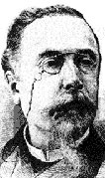
Overview of normosmic IHH and Kallmann syndrome
2˚
Hypogonadotropic hypogonadism is referred to as idiopathic (IHH) in the absence of any anatomical or functional lesions of the pituitary gland or hypothalamus¹
Caused by an isolated defect in hypothalamic GnRH secretion or the action of GnRH on pituitary gonadotrophins^{1,2}
IHH is defined by a delay or absence of puberty, combined with either a normal sense of smell (normosmic IHH) or an absent/impaired sense of smell (Kallmann syndrome)²
IHH is found in both sexes; males are more commonly diagnosed²
IHH varies in clinical severity and age of onset³
A link between anosmia and hypogonadism was noted in 1856 by Aureliano Maestre de San Juan⁴
Kallmann syndrome was identified as a clinical entity in 1944 by Franz Josef Kallmann⁴
Incidence¹
~1–10 per 100,000 live births (two-thirds of cases are due to Kallmann syndrome)
GnRH, gonadotropin-releasing hormone; IHH, idiopathic hypogonadotropic hypogonadism.
1. Chelaghma N et al. Endocrinol Diabetes Metab Case Rep 2018;2018:18-0028; 2. National Organization for Rare Disorders. Kallmann Syndrome. Available at: https://rarediseases.org/rare-diseases/kallmann-syndrome/ (accessed May 2023); 3. Nieschlag E et al. Andrology: Male reproductive health and dysfunction, 3rd edition, Springer, 2010; 4. Dodé C, Hardelin JP. Eur J Hum Genet 2009;17:139–46.
Notes:
In the absence of any anatomical or functional lesions of the pituitary gland or hypothalamus, hypogonadotropic hypogonadism is referred to as idiopathic hypogonadotropic hypogonadism (IHH).¹
IHH is a rare genetic disorder defined by a delay or absence of puberty, combined with either a normal sense of smell (normosmic IHH) or anosmia (Kallmann syndrome), and caused by an isolated defect in GnRH secretion by the hypothalamus or the action of GnRH on pituitary gonadotrophins.^{1,2}
IHH occurs in both sexes, but males are more commonly diagnosed with the condition.²
The incidence of IHH is approximately 1–10 in 100,000 live births, with approximately two-thirds of cases due to Kallmann syndrome.¹
IHH varies in clinical severity and age of onset. As well as the fully expressed disease, minor forms with partial pubertal development or onset of GnRH deficiency in adulthood have been described, and FGF8 mutations have been documented in the rare, adult-onset form of IHH.³
Aureliano Maestre de San Juan first described a link between anosmia and hypogonadism in 1856, after observing an association between the absence of olfactory structures in the brain and the presence of small testes in an individual.⁴
Kallmann syndrome was identified as a clinical entity in 1944 by the American medical geneticist, Franz Josef Kallmann, who carried out a study on the occurrence of hypogonadism accompanied by anosmia in three affected families. He showed the cosegregation of anosmia and hypogonadism in all affected individuals, establishing that this syndrome can be hereditary.⁴
GnRH, gonadotropin-releasing hormone; IHH, idiopathic hypogonadotropic hypogonadism.
References
1. Chelaghma N et al. Endocrinol Diabetes Metab Case Rep 2018;2018:18-0028; 2. National Organization for Rare Disorders. Kallmann Syndrome. Available at: https://rarediseases.org/rare-diseases/kallmann-syndrome/ (accessed May 2023); 3. Nieschlag E et al. Andrology: Male reproductive health and dysfunction, 3rd edition, Springer, 2010; 4. Dodé C, Hardelin JP. Eur J Hum Genet 2009;17:139–46.

Slide 18
The clinical picture of IHH
2˚
Clinical hallmark of IHH
Absent or incomplete pubertal development with severe hypogonadism¹
+ Anosmia for Kallmann syndrome¹
Patients frequently present with unilateral or bilateral cryptorchidism (absence of one or both testicles), and the scrotum may be hypoplastic and hypopigmented¹
Other possible features in IHH²
Facial abnormalities e.g. cleft lip/palate
Absence of one kidney
Shortened digits
Deafness
Eye movement abnormality
Other signs of hypogonadism in IHH¹
Underdevelopment of the penis, scrotum and prostate
Markedly subnormal testicular volume
Absent or sparse pubic, axillary and body hair
Lack of beard growth
Eunuchoid body proportions (arm span greater than height)
Female distribution pattern of adipose tissue
Osteoporosis (in longstanding cases of hypogonadism)
Untreated men with IHH are infertile because of aspermia or azoospermia¹
GnRH, gonadotropin-releasing hormone.
1. Nieschlag E et al. Andrology: Male reproductive health and dysfunction, 3rd edition, Springer, 2010; 2. National Organization for Rare Disorders. Kallmann Syndrome. Available at: https://rarediseases.org/rare-diseases/kallmann-syndrome/ (accessed May 2023).
Notes:
The clinical hallmark of IHH is absent or incomplete pubertal development with severe hypogonadism, coupled with anosmia in cases of Kallmann syndrome.¹
Men with IHH frequently present with unilateral or bilateral cryptorchidism (the absence of one or both testicles), and the scrotum may be hypoplastic and hypopigmented.¹
Other signs of hypogonadism in IHH include underdevelopment of the penis, scrotum and prostate; markedly subnormal testicular volume; absent or sparse pubic, axillary and body hair; lack of beard growth; eunuchoid body proportions (arm span greater than height); straight frontal hair line; straight pubic hair line; and a female distribution pattern of adipose tissue.¹
Osteoporosis may also be present as a secondary complication of longstanding hypogonadism.¹
Anosmia is a key characteristic of Kallmann syndrome – the inability to perceive olfactory stimuli results from aplasia or hypoplasia of the olfactory bulbs and tracts. The insensitivity relates only to aromatic olfactants, and mucosal irritants such as ammonia evoke a normal reaction in individuals with Kallmann syndrome.¹
Untreated men with IHH are infertile because of aspermia or azoospermia.¹
In addition to hypogonadism and anosmia, other anomalies may be associated with normosmic IHH/ Kallmann syndrome, e.g. 5–10% of patients have impaired hearing or oral anomalies such as cleft lip or high arched palate, and numerous other malformations and functional problems have also been described in single case reports.^{1,2}
IHH, idiopathic hypogonadotropic hypogonadism.
References
1. Nieschlag E et al. Andrology: Male reproductive health and dysfunction, 3rd edition, Springer, 2010; 2. National Organization for Rare Disorders. Kallmann Syndrome. Available at: https://rarediseases.org/rare-diseases/kallmann-syndrome/ (accessed May 2023).

Slide 19
Diagnosis of IHH
2˚
Consists of hormone evaluation, olfactometry and imaging
The most important endocrine parameters to check are basal serum levels of LH, FSH, testosterone and oestradiol
Individuals with IHH typically have markedly subnormal basal levels of LH, FSH and testosterone
Measurement of prolactin, TSH, ACTH, IGF-1, growth and thyroid hormones to evaluate whether other hypothalamic-pituitary axes are involved
In unclear cases, a GnRH test is mandatory, performed both before and after a period of pulsatile GnRH stimulation
In individuals with IHH, responsiveness of gonadotropins to GnRH stimulation is poor or absent
Olfactometry is used to identify anosmia and confirm Kallmann syndrome
Imaging procedures should include testicular and renal ultrasound, and MRI of the hypothalamic-pituitary region
Bone density measurement should also be included in the routine diagnostic workup
ACTH, adrenocorticotrophic hormone; FSH, follicle-stimulating hormone; GnRH, gonadotropin-releasing hormone; IGF-1, Insulin-like growth factor-1; IHH, idiopathic hypogonadotropic hypogonadism; LH, luteinising hormone; MRI, magnetic resonance imaging; TSH, thyroid-stimulating hormone.
Nieschlag E et al. Andrology: Male reproductive health and dysfunction, 3rd edition, Springer, 2010.
Notes:
Diagnostic approaches for IHH consist of hormone evaluation, assessment of the individual’s sense of smell (olfactometry), and imaging procedures.
Poor or lack of responsiveness of gonadotropins to GnRH should not be misinterpreted as a sign of a primary abnormality at the pituitary level.
To differentiate between real pituitary pathology and reversible unresponsiveness due to the lack of preceding exposure to GnRH, a GnRH pump test may be required.
In this test, 5 μg GnRH is applied subcutaneously every 90–120 min using a portable minipump for a period of 7 days. If the gonadotropin response to a GnRH bolus has normalised after this pretreatment, a hypothalamic source of hypogonadism is indicated.
Confirming anosmia in Kallmann syndrome is usually straightforward – the patient is asked to close their eyes and identify an aromatic substance e.g. perfumed soap or coffee. More sophisticated testing with a standardised set of olfactants may sometimes be necessary. Mucosal irritants (e.g. ammonia) and gustatory stimuli are perceived normally in patients with Kallmann syndrome.
Imaging procedures should include testicular and renal ultrasound (the latter to detect renal agenesis, i.e. absence of one or both kidneys) and MRI of the hypothalamic-pituitary region. It is important not to overlook any intracranial mass, which may present with clinical symptoms indistinguishable from normosmic IHH or Kallmann syndrome.
GnRH, gonadotropin-releasing hormone; IHH, idiopathic hypogonadotropic hypogonadism; MRI, magnetic resonance imaging.
Reference
Nieschlag E et al. Andrology: Male reproductive health and dysfunction, 3rd edition, Springer, 2010.

Slide 20
Treatment of IHH
2˚
Treatment of newly diagnosed patients with IHH starts with TTh for several months to induce the development of adult male characteristics
Treatment is then changed to either GnRH or gonadotropins (hCG and recombinant FSH), with the aim of stimulating gametogenesis to produce mature sperm ‒ this is continued either until sperm appear in the ejaculate or a pregnancy has been induced
Therapy is then switched to hCG alone, which maintains testosterone production and stimulates spermatogenesis for a certain period, after which TTh is restarted
In most patients, lifelong TTh is needed to preserve secondary sexual characteristics and androgen-dependent functions, and prevent osteoporosis
There is a good chance of achieving fertility in men with IHH, and sperm production can be induced in nearly all patients
FSH, follicle-stimulating hormone; GnRH, gonadotropin-releasing hormone; hCG, Human chorionic gonadotropin; IHH, idiopathic hypogonadotropic hypogonadism; TTh, testosterone therapy.
Nieschlag E et al. Andrology: Male reproductive health and dysfunction, 3rd edition, Springer, 2010.
Notes:
Treatment of newly diagnosed patients with normosmic IHH or Kallmann syndrome starts with TTh for several months.
This leads to rapid virilisation (biological development of adult male characteristics), increased general physical wellbeing and increased sexual drive.
Treatment is then changed to either GnRH or gonadotropins, with the aim of stimulating gametogenesis to produce mature sperm. This approach is beneficial both for patients who desire fertility soon and also those who want to have children in the future. In the latter group, spermatogenesis can be restimulated more effectively when fertility is actually desired.
GnRH and gonadotropins appear to be similarly efficient in stimulating spermatogenesis.
However, both GnRH and hCG/FSH therapy are costly and can only be justified when fertility is actually desired, or in the initial phase of treatment, when spermatogenesis is to be stimulated up to the point of sperm production.
Once either goal has been achieved, therapy is then switched to hCG alone, which maintains testosterone production and stimulates spermatogenesis for a certain period, after which TTh is restarted.
FSH, follicle-stimulating hormone; GnRH, gonadotropin-releasing hormone; hCG, human chorionic gonadotropin; IHH, idiopathic hypogonadotropic hypogonadism; TTh, testosterone therapy.
Reference
Nieschlag E et al. Andrology: Male reproductive health and dysfunction, 3rd edition, Springer, 2010.

Slide 21
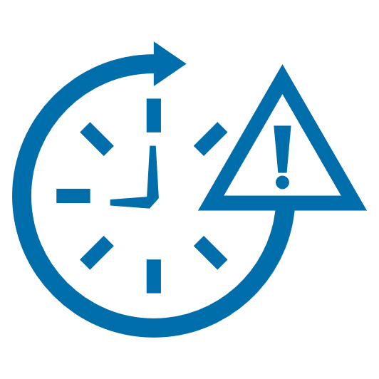
Differential diagnosis: constitutional delay of growth and puberty
2˚
Individuals with CDGP have a late but normal puberty, which starts spontaneously¹
Delayed puberty is defined as lack of increase in testicular volume >4 mL at 14 years of age or a gap of >5 years from start to end of genital growth²
CDGP affects >2% of adolescents, mainly boys²
A family history of delayed puberty is present in 50‒75% of cases²
Clinical assessment should include full physical and genital examination, evaluation of the pattern of growth and skeletal maturation of the person, family history of puberty, and measuring the height of the parents³
Diagnosis requires exclusion of other causes of pubertal delay; these are mainly organic, genetic and nutritional diseases, e.g. intestinal malabsorption, subclinical hypothyroidism or cystic fibrosis³
Spontaneous start of puberty by 18 years of age is the gold standard for distinguishing between CDGP and permanent hypogonadotropic hypogonadism²
CDGP, constitutional delay of growth and puberty.
1. Boehm U et al. Nat Rev Endocrinol 2015;11:547–64; 2. Gaudino R et al. Ital J Pediatr 2022;48:45; 3. Soliman AT, De Sanctis V. Indian J Endocrinol Metab 2012;16:698–705.
Notes:
CDGP is a transient state of hypogonadotropic hypogonadism.¹
Affected individuals experience a slowdown in growth within the first 3 years of life, followed by regular growth (even if lower than their peers) in subsequent years. At the average age of puberty, their height begins to move further from the typical growth curve because of a delay in pubertal growth spurt onset.²
The age of onset of puberty is delayed by an average of 3 years in boys with CDGP.¹
Individuals with CDGP present with spontaneous catch-up growth, and an onset of puberty and pubertal growth spurt both occurring later than average, often failing to achieve their predicted height.²
CDGP is considered a variant of normal growth rather than a disease.²
Distinguishing between CDGP and permanent hypogonadotropic hypogonadism is especially difficult because adolescents with these aetiologies are often prepubertal.²
Paediatricians are often unable to differentiate CDGP from isolated hypogonadotropic hypogonadism, until the absence of spontaneous puberty by the age of 18 years.²
CDGP, constitutional delay of growth and puberty.
References
1. Soliman AT, De Sanctis V. Indian J Endocrinol Metab 2012;16:698–705;
2. Gaudino R et al. Ital J Pediatr 2022;48:45.

Slide 22
Treatment of constitutional delay of growth and puberty
2˚
In boys, treatment is usually limited to prepubertal individuals aged >14 years with psychological distress¹
TTh can be used to induce pubertal development and accelerate growth¹
The optimal type, timing, dose and duration of treatment and the possible use of adjunctive or alternate therapies are yet to be determined²
During treatment, a progressive increase in testicular volume confirms a diagnosis of CDGP¹
Treatment should continue until a testicular volume of 12 mL is reached – at this point, a sufficient amount of testosterone can be produced to allow normal growth¹
The start of treatment should be individualised, depending on the psychological impact of CDGP, e.g. low self-esteem, poor school performance, depression and bullying¹
CDGP, constitutional delay of growth and puberty; TTh, testosterone therapy.
1. Gaudino R et al. Ital J Pediatr 2022;48:45; 2. Soliman AT, De Sanctis V. Indian J Endocrinol Metab 2012;16:698–705.
Notes:
The question of whether or not to treat individuals with CDGP presents a clinical challenge.
Although in the majority of cases, spontaneous pubertal development will ‘kick in,’ pubertal onset is unpredictable and the average delay is around 3 years, meaning that the individual is in a state of hypogonadotropic hypogonadism for a long time.
There is some evidence that a prolonged state of low testosterone, albeit transient, might affect the bone mineral content or total bone mass of adults who had CDGP when younger, although this is not universally accepted.
The effect of low testosterone on the onset and progression of spermatogenesis, follicle-stimulating hormone and future fertility is not well studied.
TTh must be tailored to induce puberty and optimise skeletal growth without inducing premature fusion of the growth plate, and avoid any harmful effects on spermatogenesis.
TTh should therefore be adjusted to simulate gradually increasing circulating levels of testosterone.
CDGP, constitutional delay of growth and puberty; TTh, testosterone therapy.
Reference
Soliman AT, De Sanctis V. Indian J Endocrinol Metab 2012;16:698–705.

Slide 23
Overview of Prader-Willi syndrome
2˚
PWS is a rare genetic disorder resulting from a lack of expression of the paternally derived chromosome, 15q11-q13¹
It is characterised by intellectual disability, behavioural problems, hypothalamic dysfunction and specific dysmorphisms¹
Hypothalamic dysfunction causes:¹
Dysregulation of energy balance associated with hypoactivity and insatiable hunger, resulting in increased fat mass and decreased muscle mass
Endocrine deficiencies, including hypogonadism
Hypogonadism typically manifests as incomplete or under-development of the genitalia, incomplete puberty and, in most cases, infertility³
Can also aggravate PWS-related issues including muscle weakness, obesity, osteoporosis, and fatigue²
The complex genetics, aetiology, multiple phenotypes and evolving natural history of PWS requires a multidisciplinary approach to management to reduce morbidity and mortality and improve quality of life³
Diagnosis of PWS relies on a combination of clinical features and genetic analysis³
Treatment of hypogonadism with TTh usually starts at around age 12–13 years for males with PWS³
Andrea
Prader
Alexis
Labhart
Heinrich
Willi
PWS first described in 1956¹
Estimated prevalence of hypogonadism in adult males with PWS²
57–100%
PWS, Prader-Willi syndrome.
1. Noordam C et al. Int J Mol Sci 2021;22:2705; 2. Pellikaan K et al. J Clin Med 2021;10:4361; 3. Yang-Li D et al. Orphanet J Rare Dis 2022;17:221.
Notes:
PWS is a rare genetic disorder resulting from a lack of expression of the paternally derived chromosome, 15q11-q13, that was first described as a clinical entity in 1956.¹
It is characterised by intellectual disability, behavioural problems, hypothalamic dysfunction and specific dysmorphisms.¹
Hypothalamic dysfunction causes hypogonadism,¹ which typically manifests as incomplete or under-development of the genitalia, incomplete puberty and, in most cases, infertility.²
Hypogonadism can affect males with PWS at any age.³
At birth and during infancy, boys with PWS can display cryptorchidism (the absence of one or both testicles in the scrotum), incomplete development or underdevelopment of the scrotum, and short penile length.³
Later in life, small penile length in combination with large amounts of suprapubic fat may lead to voiding difficulties in young adults with PWS and obesity.³
Puberty is usually delayed and incomplete. Primary testicular dysfunction is a major contributor to abnormal pubertal development in males with PWS.³
Adults with PWS often have low levels of sex steroids, and males with PWS are believed to be infertile.³
Treatment of hypogonadism with TTh usually starts at around age 12–13 years for males with PWS.³
PWS, Prader-Willi syndrome; TTh, testosterone therapy.
References
1. Noordam C et al. Int J Mol Sci 2021;22:2705;
2. Yang-Li D et al. Orphanet J Rare Dis 2022;17:221;
3. Pellikaan K et al. J Clin Med 2021;10:4361.

Slide 24
Summary
Current TTh preparations have limited licensed indications, and are generally contraindicated for hypogonadal conditions not associated with structural or genetic aetiologies
Male hypogonadism is classified into primary or secondary hypogonadism, caused by testicular or pituitary/hypothalamic dysfunction, respectively¹
Primary hypogonadism results in low T concentrations, impaired spermatogenesis and elevated gonadotropin levels, while secondary hypogonadism results in low T concentrations, impaired spermatogenesis and low or inappropriately normal gonadotropin levels²
Klinefelter syndrome is a common cause of primary hypogonadism,¹ but is greatly under-recognised and underdiagnosed³
Affected males carry an additional X chromosome, which results in male hypogonadism, androgen deficiency and impaired spermatogenesis⁴
The syndrome is associated with a variety of abnormalities (the presence of which can assist diagnosis^{3,5}) and an increased risk of certain underlying comorbidities (e.g. diabetes, obesity, anaemia, osteoarthritis), many of which can potentially be ameliorated by TTh³
Individuals with Klinefelter syndrome have an elevated risk of all-cause mortality,³ and tend to have a poorer quality of life and socioeconomic status⁶
The putative genetic mechanisms and pathways in Klinefelter syndrome remain to be completely understood,³ but aberrant autosomal DNA methylation appears to play a role⁷
DNA, deoxyribonucleic acid; T, testosterone; TTh testosterone therapy.
1. Salonia A et al. EAU 2023 Guidelines on Sexual and Reproductive Health. Available at: https://uroweb.org/guidelines/sexual-and-reproductive-health (accessed May 2023); 2. Bhasin S et al. J Clin Endocrinol Metab 2018;103:1715–44; 3. Gravholt CH et al. Endocr Rev 2018;39:389–423; 4. Smyth CM, Bremner WJ. Arch Intern Med 1998;158:1309–14; 5. Herlihy AS et al. Med J Aust 2011;194:24–8; 6. Bojesen A et al. J Clin Endocrinol Metab 2011;96:2098–104; 7. Skakkebæk A et al. Sci Rep 2018;8:13740

Slide 25
Summary (2)
Secondary hypogonadism is often caused by haemochromatosis/iron overload syndromes; less-common causes include IHH and PWS¹
Iron overload disorders (e.g. hereditary haemochromatosis, β-thalassemia) occur when the regulatory mechanisms of dietary iron absorption are disrupted²
Severe iron overload is associated with profoundly low T levels, potentially leading to hypogonadotropic hypogonadism, infertility and sexual dysfunction²
IHH, defined by delayed or absent puberty and severe hypogonadism plus either a normal sense of smell (normosmic IHH) or anosmia (Kallmann syndrome), is caused by an isolated defect in hypothalamic GnRH secretion or the action of GnRH on pituitary gonadotrophins^{3,4}
Patients with IHH typically have obvious signs of hypogonadism⁵
IHH diagnosis involves hormone evaluation, olfactometry and imaging, and initial treatment is TTh administered over several months⁵
CDGP, which affects >2% of mainly male adolescents, can appear to be hypogonadotropic hypogonadism, warranting careful differential diagnosis;^{6–8} if CDGP is confirmed, TTh is typically considered in prepubertal boys aged >14 years with psychological distress⁹
Most adult males (57–100%) with the rare genetic disorder, PWS, are hypogonadal; TTh is usually begun at age 12–13 years for males with PWS^{10–12}
CDGP, constitutional delay of growth and puberty; GnRH, gonadotropin-releasing hormone; IHH, idiopathic hypogonadotropic hypogonadism; PWS, Prader-Willi syndrome; TTh testosterone therapy.
1. Salonia A et al. EAU 2023 Guidelines on Sexual and Reproductive Health. Available at: https://uroweb.org/guidelines/sexual-and-reproductive-health (accessed May 2023); 2. Gabrielsen JS et al. Curr Urol Rep 2018;19:60; 3. Chelaghma N et al. Endocrinol Diabetes Metab Case Rep 2018;2018:18-0028; 4. National Organization for Rare Disorders. Kallmann Syndrome. Available at: https://rarediseases.org/rare-diseases/kallmann-syndrome/ (accessed May 2023); 5. Nieschlag E et al. Andrology: Male reproductive health and dysfunction, 3rd edition, Springer, 2010; 6. Boehm U et al. Nat Rev Endocrinol 2015;11:547–64; 7. Gaudino R et al. Ital J Pediatr 2022;48:45; 8. Soliman AT, De Sanctis V. Indian J Endocrinol Metab 2012;16:698–705; 9. Gaudino R et al. Ital J Pediatr 2022;48:45; 10. Noordam C et al. Int J Mol Sci 2021;22:2705; 11. Pellikaan K et al. J Clin Med 2021;10:4361; 12 Yang-Li D et al. Orphanet J Rare Dis 2022;17:221.

