Slide 1
Besins Men’s Health Training Session
Introduction to Men’s Health &
Testosterone Deficiency (TD)
Internal Use Only – Company Confidential

Slide 2
Men’s Health

Slide 3

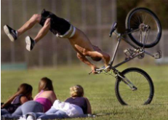
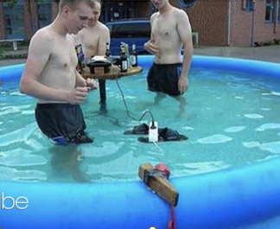

Slide 4
Life expectancy
Globally, at birth, life expectancy is 74.2 for women and 69.8 for men
Life expectancy in the UK for males is 78.2 years and for females is 82.3 years.
In other words, men live 2 hours fewer per day!
Healthy life expectancy in the UK for males is 63.5 years and for females is 65.7 years
Covid – mortality rate in men was 1.7 x higher than in women (overview of 38 countries)
https://www.menshealthforum.org.uk/key-data-mens-life-expectancy
WHO report shows that women outlive men worldwide | The BMJ BMJ 2019;365:l1631

Slide 5
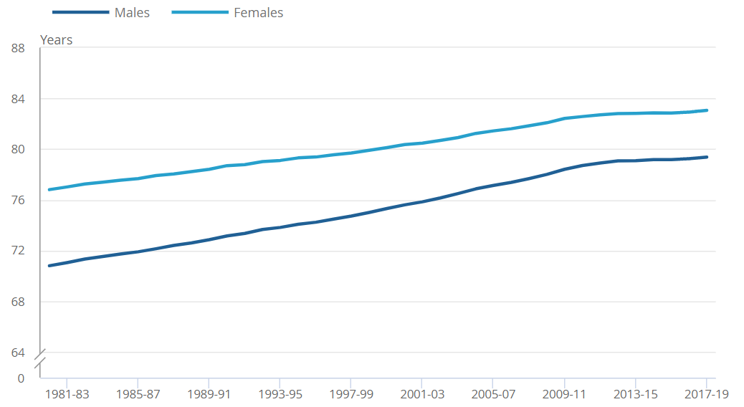
Life Expectancy Between the Sexes: UK
Life expectancy at birth for males and females, UK, between 1980 to 1982 and 2017 to 2019
Source: Office for National Statistics – National life tables – life expectancy in the UK: 2017 to 2019

Slide 6
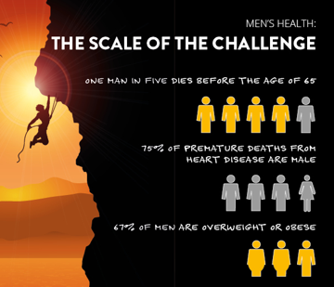
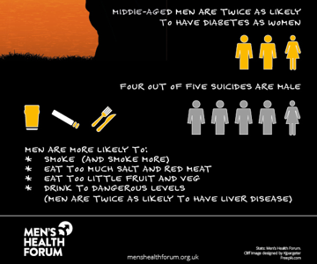
One man dies every 45 mins from prostate cancer
Suicide biggest cause of death in under 30 and takes the life of a man every two hours

Slide 7
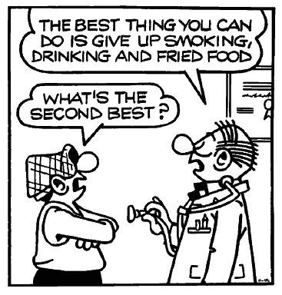
The State of Men’s Health
“Many of the chronic diseases that are associated with premature mortality in men (e.g. coronary heart disease, stroke, diabetes and some cancers) are associated with lifestyle and preventable risk factors.” ¹
It has been estimated that 36% of male deaths are preventable compared with 19% for women ²
EC(2011) The State of Men’s Health in Europe. Luxembourg, The European Commission
Trends in Urology & Men’s Health. March/April 2022

Slide 8
The Gateway to Men’s Health
“General Practice is by far the most common entrance point into the healthcare system for preventative health strategies and management of acute and chronic disease in men.”
David J, Coxon J, Hackett G, et al Men’s Health Handbook for General Medical Practice 2019

Slide 9
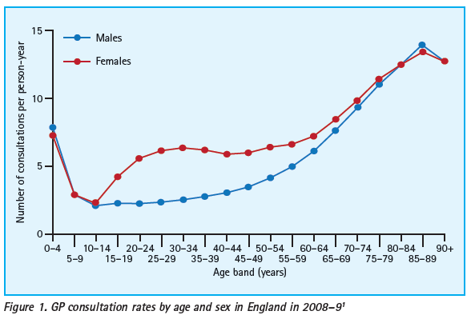
Men and Primary Care:
Improving Access and Outcomes
Banks & Baker. Trends in Urology & Men’s Health. September/October 2013

Slide 10
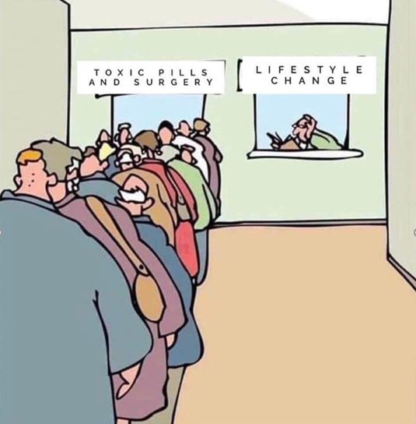
Health literacy
Men are twice as likely to have inadequate health literacy vs women
In persons aged 20-40, women attend the GP twice as often than men
Men are less likely to seek help when sick
https://www.menshealthforum.org.uk/key-data-understanding-health-and-access-services
Notes:
80% of men would like to be asked about it but only 20% would volunteer the information
Men 4 times a year to pharmacy – women 18 times a year

Slide 11
Men tend to delay diagnosis and treatment
The example of Melanoma (all ages)
Incidence Rates
Death Rates
Men
Women
Rate per 100,000
Source of data: Health for All database 2003

Slide 12
Doctor-centred considerations
Very little undergraduate or post-graduate training in Men’s Health
Lack of GPs specialising in Men’s Health
Poor communication skills re how to broach sexual histories
Financial incentives vs women’s health?
Male only hospitals?
Government ministers for Men’s Health?
Country strategies for Men’s Health?

Slide 13

How should we tackle the male consultation?
Male specific consultation modules
Direct Language
  80% of men would like to be asked about sex, only 20% would volunteer the information
  Not asking about ED is a missed opportunity (see following example)
Empowering ownership
Understanding expectations
Realistic management plans
Address health risky behaviour
Control = compliance
The way to a man’s heart is through his penis

Slide 14

The example of John & Jane….
Jane suggests John visits his GP for an over 40 health check
COMPLAINTS
Diminished energy
Reduced vitality/
well-being
Increased fatigue
Depressed mood
Impaired cognition
Diminished muscle mass and strength
Falling asleep in evening
DOESN’T MENTION/NOT ASKED
Diminished sexual desire
Erectile dysfunction
Loss of morning erections
No sex for 2+ years
Notes:
14

Slide 15
The example of John & Jane….
Jane suggests John visits his GP for an over 40 health check
Weight 106 kg, BMI 30 kg/m², WC 104 cm
BP 145/90 mmHg
TC 6.2 mmol/l, LDL 5.1 mmol/l, HDL 0.95 mmol/l, TGs 2.8 mmol/l, HbA_{1c} 43, PSA 0.525, Haematocrit 39%
Heart age 50 years
  4.7% 10-year risk
He is told he is overweight and unhealthy
He leaves with extensive lifestyle modification advice
  Most of which he already knew
John decides not to attend for follow up
BMI, body mass index; BP, blood pressure; HbA_{1c}, glycated haemoglobin; HDL, high-density lipoprotein; IFCC, International Federation of Clinical Chemistry; LDL, low-density lipoprotein; PSA, prostate-specific antigen; TC, total cholesterol; TG, triglyceride; WC, waist circumference.

Slide 16
John – The impact of a single question!
‘Many men with these health issues have problems getting and maintaining an erection – could this be a problem for you?’
A positive response would change the direction of the consultation
AMS 62, TT 7.2 nmol/l, SHBG 19 nmol/l, LH 2.0 IU/l
He therefore has metabolic syndrome, testosterone deficiency,
and ED, which significantly increases his CV risk
  ED is itself an established risk factor for CVD. Risk equivalent to current moderate level of smoking
He returns home with a prescription for a daily PDE5i & T gel
He attends 6 weeks later for follow-up – on way home from the gym

Slide 17

4 key assessments for Men > 40 in General Practice
The MENS screen.
M | Mood & Psychological Wellbeing | *Depressive Symptoms *Enjoyment of Life *Tiredness/Sleeping Patterns
E | Early Disease | *Shortness of breath or chest pain *Change in bowel habits *BMI and Waist Circumference *Consider blood screening e.g. lipids, HbA1c, PSA, TT *Blood Pressure
N | Nutrition & Exercise | *Smoking & Alcohol History *Dietary Habits *Exercise Routine
S | Sexual Health | *Prostatic Symptoms (Urinary frequency & nocturia) *Erectile Function *Libido
Men's Health 4th Edition Edited By Roger S Kirby, Culley C Carson, Alan White, Michael G Kirby https://doi.org/10.1201/9780429347238

Slide 18
Testosterone Physiology

Slide 19

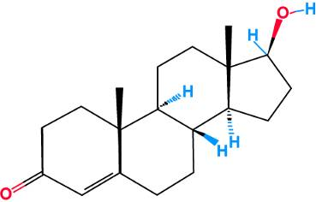
Testosterone
  Major androgen in men
  95% synthesized by Leydig cells (testes)
  5% from the adrenal glands
  Necessary for
    Foetal male sexual differentiation
    Puberty
    Maintenance of secondary male sex characteristics
Testosterone Deficiency. January 2018 DOI: 10.1016/B978-0-323-35868-2.00064-5 In book: Integrative Medicine by Robert Z. Edwards

Slide 20
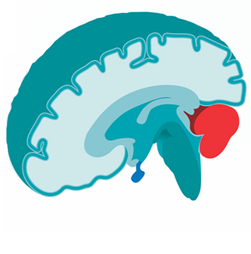
Hypothalamus
  Hormone regulator
  Sends signals to the pituitary gland via its production of hormones, e.g. gonadotropin releasing hormone (GnRH)
Hypothalamus
Griffin JE & Wilson JD. In Williams Text book of Endocrinology. 2003: 82-92.

Slide 21
Pituitary
Three sections
  Anterior lobe
  Intermediate lobe
  Posterior lobe
Anterior lobe
  Prolactin
  Luteinizing hormone (LH)
  Follicle-stimulating hormone (FSH)
  Others, e.g., thyroid-stimulating hormone (TSH)
Pituitary gland
Griffin JE & Wilson JD. In Williams Text book of Endocrinology. 2003: 82-92.

Slide 22
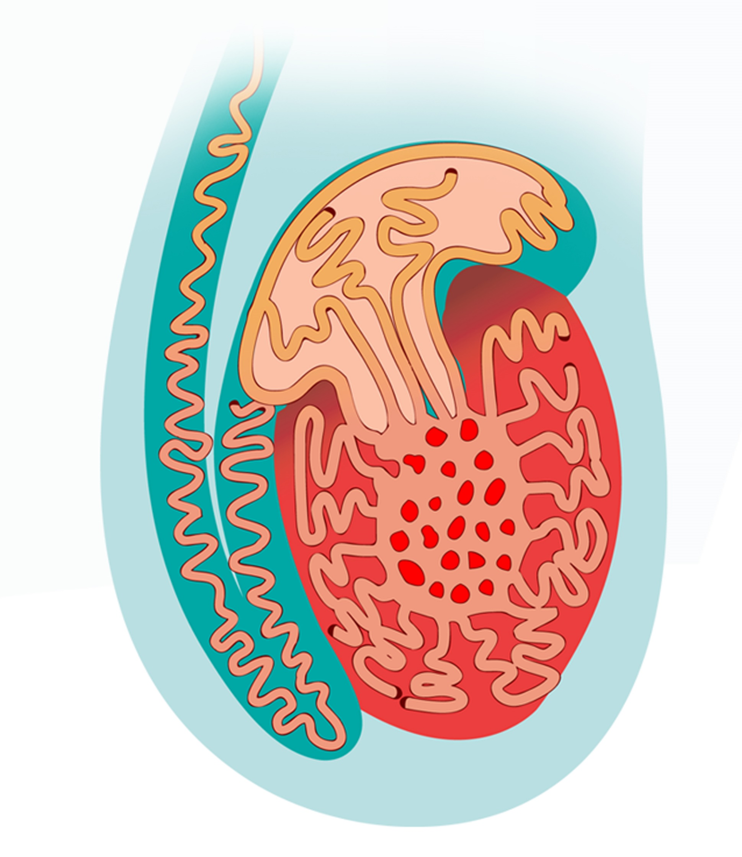
Testes
Testis
  Testes, testicles (plural)
Sertoli cells
  Synthesis of sperm
Seminiferous tubules
  Transport of sperm
Leydig cells
  Synthesis of androgens
Vas deferens
Epididymis
Seminiferous
tubules
Testis
Scrotum
Griffin JE & Wilson JD. In Williams Text book of Endocrinology. 2003: 709-753. Tanagho EA & McAninch JW. In Smith‘s General Urology. 2003: 1-17, 678-693.

Slide 23
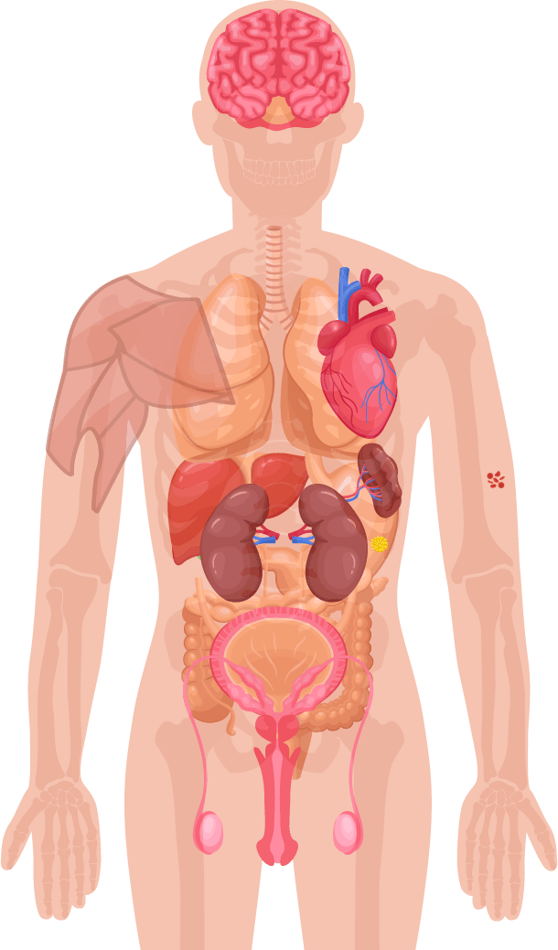
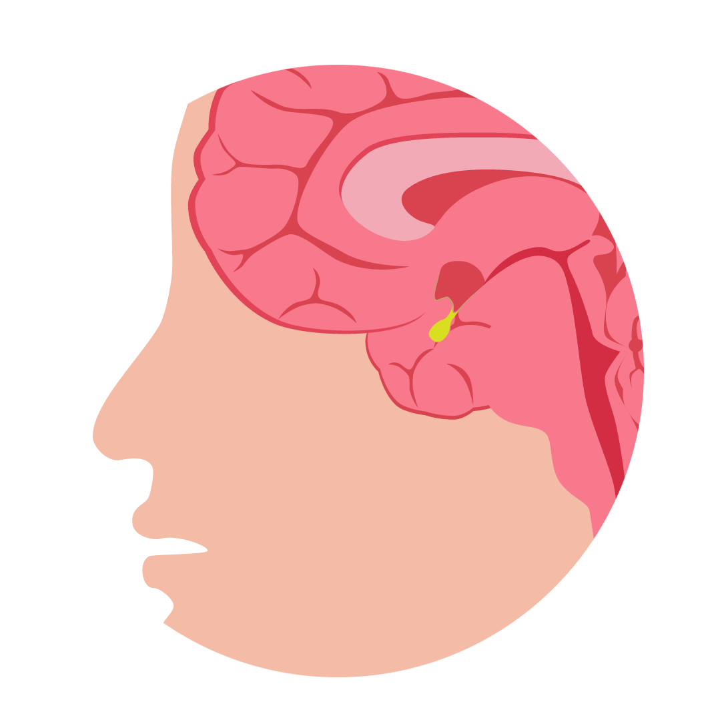
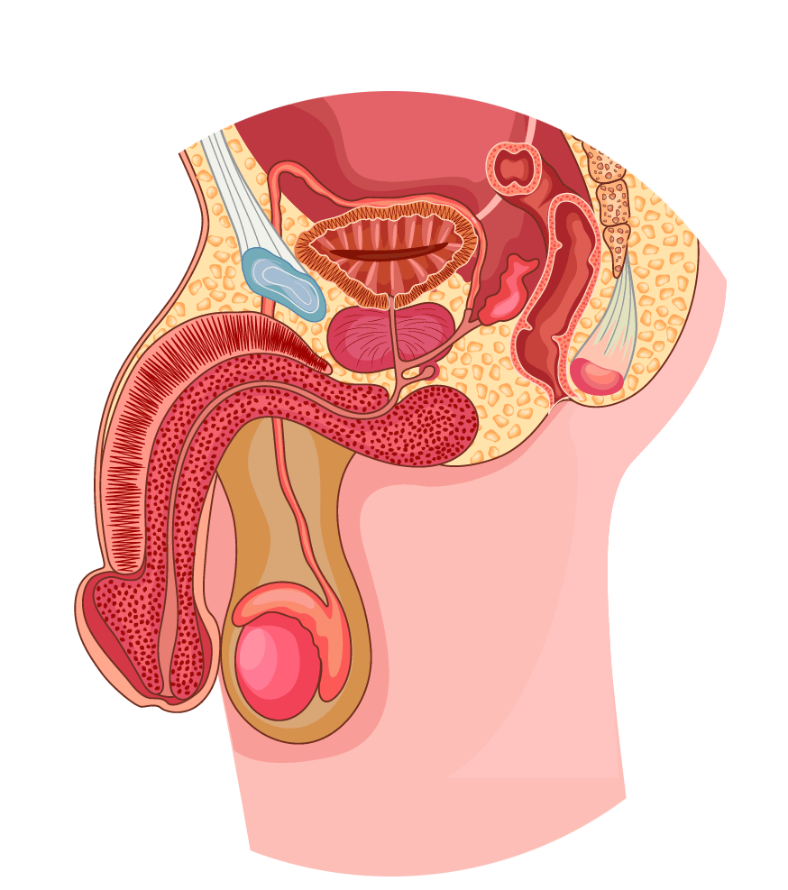
Testosterone Physiology - Production
Hypothalamic-Pituitary-Testicular (HPT) Axis¹
Pituitary gland
Hypothalamus
GnRH
Anterior pituitary
FSH
LH
Sertoli cells
Leydig cells
Testis
Seminiferous tubules
LH receptor¹
Spermatozoa
Testosterone
FSH: follicle-stimulating hormone, LH: luteinizing hormone
1. Adapted from Dandona P & Rosenberg MT. J Clin Pract 2010.64(6):682-696.

Slide 24
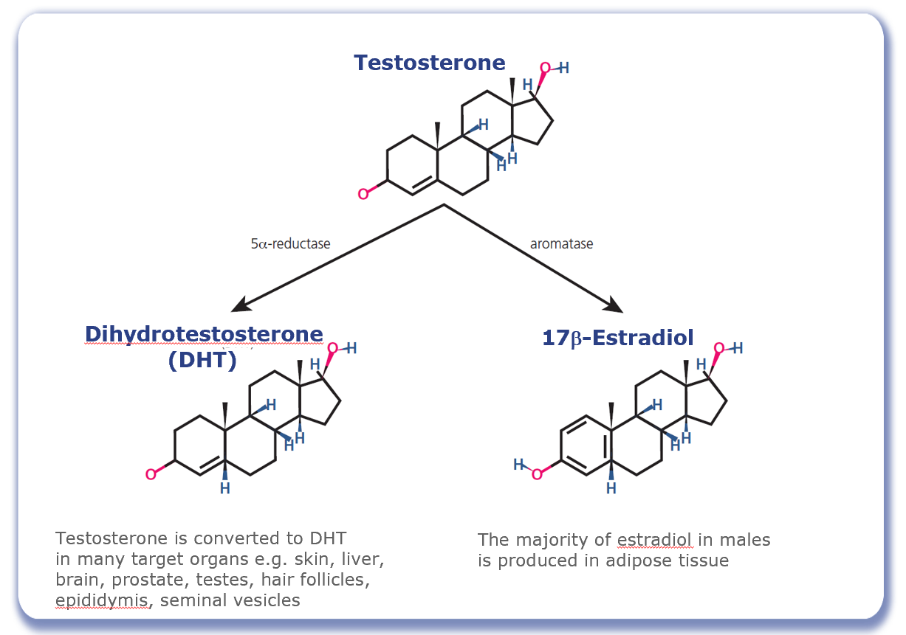
Testosterone Physiology - Conversion
Adapted from Molina PE. Male Reproductive System. In: Raff H, Levitzky M, eds. Medical Physiology: A Systems Approach: 2011: 683-694.

Slide 25
Role of Testosterone in Men’s Health
Mood, cognitive ability¹
Bone mass¹
Muscle mass, strength¹
Red blood cell production¹
Sexual function, sexual desire and sperm production¹
Fat distribution¹
1. Hackett G, et al. J Sex Med 2017; 14:1504-1523.

Slide 26
Testosterone Deficiency

Slide 27
What is Testosterone Deficiency?
Testosterone deficiency is a well-established and significant medical condition
It is characterised by a deficiency in serum androgen levels and relevant signs and symptoms.
It can be associated with advancing age and comorbidities
Testosterone deficiency can adversely affect multiple organ systems and result in significant decreases in quality of life, including changes in sexual function
1. Hackett G, et al. J Sex Med 2017; 14:1504-1523.

Slide 28

Testosterone Deficiency is a Blind Spot in Medicine
Education is scarce
Lack of awareness (HCP and patient)
Too few patients presenting and too few prescribers of TTh worldwide
The main group of prescribers (Endo/Urol) have concerns about long-term safety of TTh
The ability to diagnose patients is hindered by local laboratory reference ranges for testosterone
Notes:
Not taught in medical school or during speciality training (except endo but even then?)

Slide 29

It’s all about perspective
“No matter what you think of testosterone therapy, some scientist somewhere has data to back you up”
https://time.com/magazine/us/3062871/august-18th-2014-vol-184-no-6-u-s/
Notes:
General public perception (aggression/sex/steroids/gym), HCP perception (good vs bad)

Slide 30
Symptoms of Testosterone Deficiency¹⁻⁵
Psychological
Cardiometabolic
Changes in mood (e.g., anger, irritability, sadness, depression)
Decreased well-being/poor self-rated health
Diminished cognitive function (including impaired concentration, verbal memory and spatial performance)
Increased body mass index (BMI)/obesity
Visceral obesity
Metabolic syndrome
Insulin resistance and type 2 diabetes
Sexual
Delayed puberty
Small testes
Infertility
Decreased sexual desire and activity
Decreased frequency of sexual thoughts
Erectile dysfunction
Delayed ejaculation
Decreased volume of ejaculate
Decreased or absent morning/night-time erections
Physical
Decreased body hair
Gynaecomastia
Decreased muscle mass and strength
Hot flushes/sweats
Sleep disturbances
Fatigue
Osteoporosis/height loss/low trauma fractures
1. Khera M et al. J Sex Med 2016;13:1787-804. 2. Lunenfeld B et al. Aging Male 2015;18:5-15. 3. Hackett G et al. Int J Clin Pract 2017 Mar;71(3-4). doi: 10.1111/ijcp.12901. Epub 2017 Mar 20.
4. Dohle GH et al. Available at: http://uroweb.org/guideline/male-hypogonadism/ (Accessed September 2017). 5. Dean JD et al. J Sex Med 2015;12:1660-86.

Slide 31
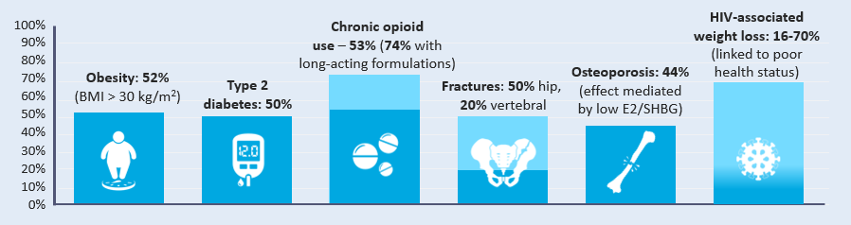


Prevalence of Testosterone Deficiency
Estimates vary widely (2.1% to 38.7%) depending on the criteria used to define TD
TD prevalence increases with age but can occur in men of all ages and is frequently associated with conditions that include:¹
100%
Chronic opioid
use – 53% (74% with
long-acting formulations)
80%
70%
Obesity: 52%
(BMI > 30 kg/m²)
Type 2
diabetes: 50%
Fractures: 50% hip,
20% vertebral
60%
50%
40%
30%
20%
10%
0%
E2: estradiol, SHBG: sex hormone binding globulin
1. Khera et al J Sex Med 2016;13:1787-1804.

Slide 32
Classification of TD^{1,2}
Primary TD
Testicular damage
↑
Hypergonadotropic
Functional TD
Caused by morbidities influencing Leydig cell function and hypothalamic/pituitary response
Testosterone
↓
LH/FSH
Classical
TD
→
Low normogonadotropic
Secondary TD
Hypothalamic/pituitary damage
↓
Hypogonadotropic
LH: luteinizing hormone, FSH: follicle-stimulating hormone
1. Dohle GR et al. Guidelines of Male Hypogonadism. European Association of Urology 2018. Available at: https://uroweb.org/guideline/male-hypogonadism/#4 Accessed Sept 2020; 2. Bhasin et al. J Clin Endocrinol Metab. 2018;103(5):1715-1744.

Slide 33
Causes of Testosterone Deficiency
Primary causes
  Testicular damage (testicular cancer, orchidectomy)
  Mumps orchitis
  Klinefelters syndrome (XXY)
  Others
Secondary causes
  Pituitary tumours
  Head injury
  Kallman syndrome
  Others
Functional causes
  Drugs, e.g. opioids
  Obesity
  Diabetes
  Increasing age
  Others
1. Hackett G, et al. J Sex Med 2017; 14:1504-1523.

Slide 34
Drugs That Affect Testosterone Levels
Opioids
  Regular use can suppress testosterone levels in up to 70% of men
Glucocorticoids
  May suppress HPT-axis
Anticonvulsants
  ↑ SHBG, ↓ free & bioavailable testosterone
Antipsychotics
  Can lead to hyperprolactinemia, or ↑ prolactin levels
Dean J et al. J Sex Med 2015;12:1660-86.

Slide 35

Case study 1 – Part 1: Patient Profile
Chris: 54-year-old office worker with type 2 diabetes mellitus (T2DM)*
He has had erectile dysfunction for several years which is putting a strain on his marriage
Whilst he was being managed by the secondary care diabetic team, he was started on sildenafil 50 mg for erectile dysfunction which worked on rare occasions
He didn’t think anymore could be done about it
* This patient profile is based on a real patient, and has been anonymised and reproduced with permission.

Slide 36
Diagnosis of
Testosterone Deficiency (TD)

Slide 37
Challenges of diagnosing TD
Treatment-seeking is often delayed
Variable and non-specific signs and symptoms¹
Inadequate attention to sexual health by men and physicians¹
Lack of HCP awareness, knowledge and confidence
There is a wide variation in laboratory reference ranges for total testosterone²
Generally, no financial incentives for MH vs WH
1. Defeudis G, et al. Andrology 2018.6;5. Available at: https://onlinelibrary.wiley.com/doi/full/10.1111/andr.12506 Accessed February 2019. 2. Ramachandran et al. J Med Diagnostics 1(3), 034701

Slide 38
Clinical Features in Relation to Testosterone Levels
434 men (age 50-86 years)
n=
74
20
69
15
Loss of libido
Loss of vigour
Increasing prevalance of symptoms with decreasing T concentrations
84
Total testosterone (nmol/L)
12
Overweight
65
10
Depression
Sleeping disorders
Lacking concentration
Type 2-Diabetes mellitus
67
8
Heat flushes
Erectile Dysfunction
75
0
Zitzmann et al. J Clin Endocrinol Metab 2006; 91(11): 4335-4343

Slide 39
Treatment-Seeking for TD Can Often be Delayed
In total, 55% of all respondents waited between 3 and 24 months, with 35% waiting for more than 2 years before seeking advice
Reasons for delaying among respondents who waited at least 3 months before seeking advice
Respondents (n=90), %
David J. et al: The Journal of Sexual Medicine, Volume 13, Number 5, Supplement 2, May 2016.

Slide 40
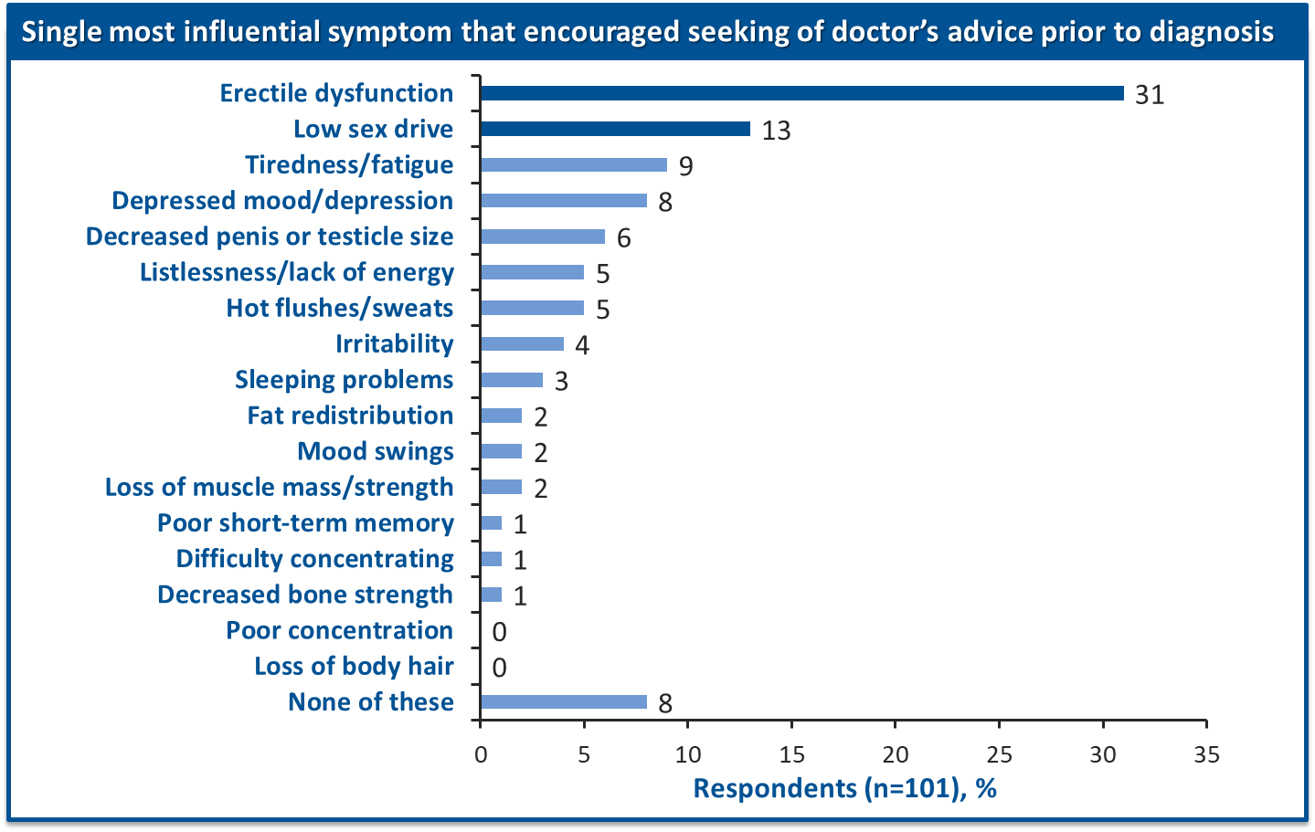
Variable and Non-specific Signs and Symptoms of TD
David J. et al: The Journal of Sexual Medicine, Volume 13, Number 5, Supplement 2, May 2016.

Slide 41



Benefits of Early Diagnosis
Opportunity to make lifestyle changes and receive appropriate treatment¹
Somatic, sexual and psychological benefits for improved quality of life²
Potential cost and time savings in the primary and secondary care settings³
You may only get one opportunity to positively impact the health of any given male patient – don’t waste that opportunity!
1. Defeudis G, et all. Andrology 2018.6;5. Available at: https://onlinelibrary.wiley.com/doi/full/10.1111/andr.12506 Accessed February 2019. 2. Hackett G, et al. British Society for Sexual Medicine Guidelines on Adult Testosterone Deficiency, With Statements for UK Practice. J Sex Med 2017;14:1504-1523. Available at: http://www.bssm.org.uk/wp-content/uploads/2018/09/guidelines-on-adult-testosterone-deficiency-with-statements-for-uk-practice.pdf Accessed February 2019. 3. Hackett G. An ED patient with low testosterone. Trends in urology and men’s health 2016. Tales from the clinic pp1-2.

Slide 42


Triggers for Considering TD
Erectile dysfunction
Osteoporosis
Depression
Medications (opioids)
Post-orchidectomy
TATT (tired all the time)
Anaemia
Fatigue/sleep
Cognition/memory
Reduced muscle mass
T2DM/MetS
CVD
Low libido
Obesity

Slide 43


Which Patients Should I Actively Screen for TD?
Opioids
Obesity
Type 2 diabetes
Pre-diabetes
Erectile dysfunction
Anaemia
Osteoporosis
Testicular cancer survivors
Low libido
Infertility

Slide 44

Focus on What’s Realistic and Achievable:
2 Cohorts Initially
Opioids
Obesity
Type 2 diabetes
Pre-diabetes
Erectile dysfunction
Anaemia
Osteoporosis
Testicular cancer survivors
Low libido
Infertility

Slide 45
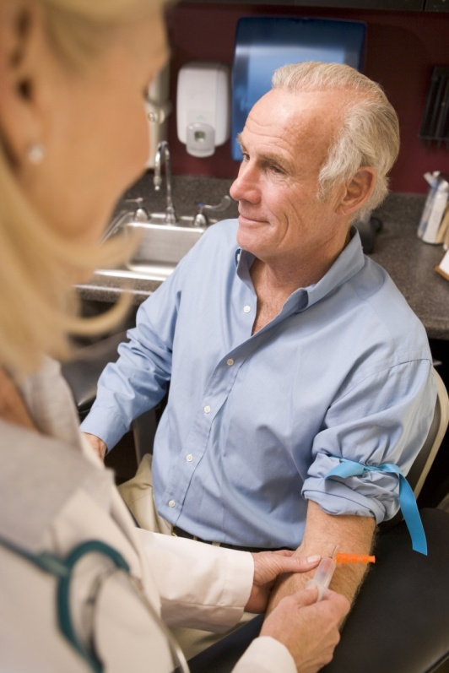
What is Required to Diagnose TD?
The 2018 Endocrine Society guidelines recommend diagnosing hypogonadism in men with symptoms and signs of testosterone deficiency and unequivocally and consistently low serum total testosterone and/or free testosterone concentrations (when indicated)
1. Bhasin S, et al. J Clin Endocrinol Metab 2018; 103: 1715–1744.

Slide 46
Signs and Symptoms

Slide 47
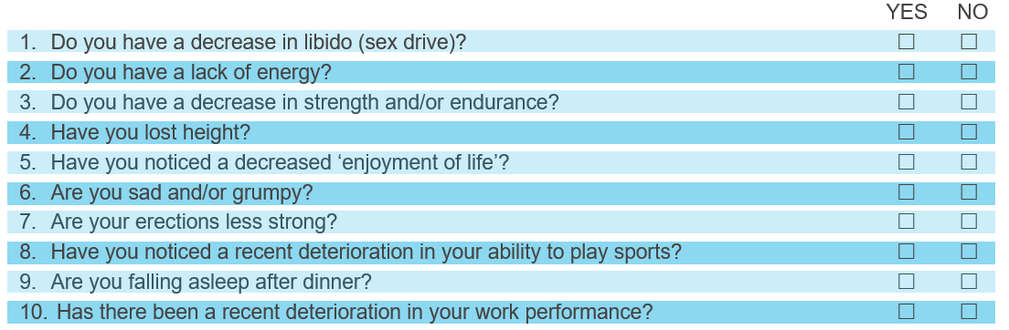
Establishing Presence of Signs & Symptoms of TD - ADAM Questionnaire¹
Validated clinical screening tool to identify males >40 years old who may have TD.
Positive result defined as respondent answering “yes” to questions 1 or 7 or any 3 other questions:
ADAM, Androgen Deficiency in the Ageing Male
1. Morley JE et al. Metabolism 2000; 49:1239–1242.

Slide 48
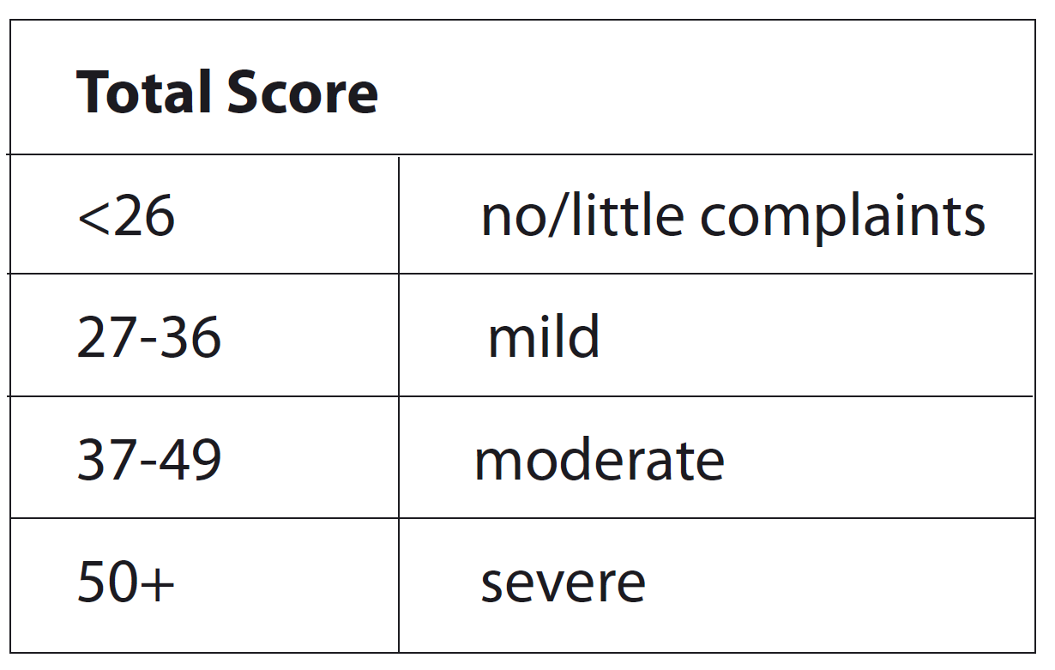
Establishing Presence of Signs & Symptoms of TD - AMS Score¹
AMS – Ageing Male Symptoms
1. Moore C, et al. Eur Urol 2004. 46(1):80-7.

Slide 49
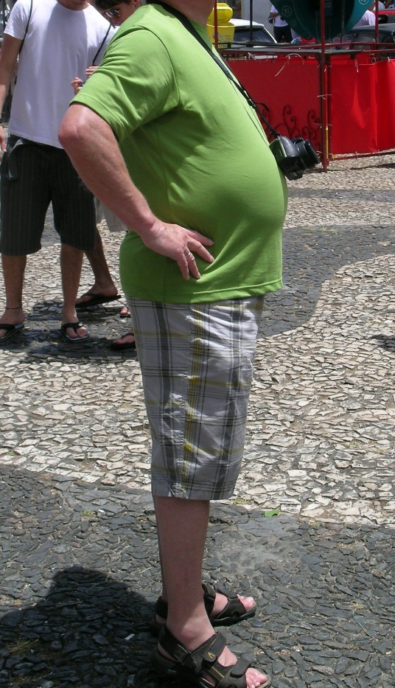

Physical Examination
On physical examination, features suggestive of TD include:
  Decreased body hair
  Decreased testicular size
  Gynaecomastia (man boobs)
  BMI >30kg/m²
  Waist circumference >102cm
1. Hackett G, et al. J Sex Med 2017; 14:1504-1523.

Slide 50
Testosterone Measurement

Slide 51
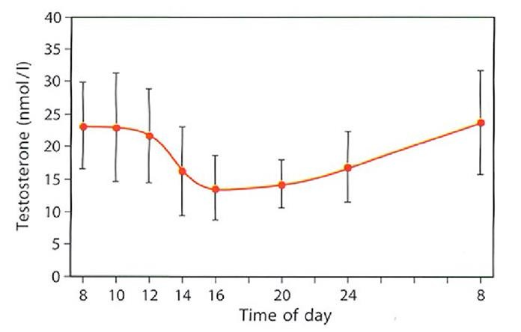
Measuring Serum Testosterone
The diurnal/circadian rhythm of serum T means levels are highest in the early morning
Circadian rhythm of testosterone
Above levels of testosterone are taken from young healthy males
Adapted from Diver M et al. Clin Endocrinol 2003;58:710-717

Slide 52
Testosterone Fractions in the Blood
60% of testosterone in the blood is tightly bound to SHBG
A further 38% is loosely bound to albumin
Only 2% of the testosterone in the blood is free testosterone
SHBG, sex hormone-binding globulin; T, testosterone
Adapted from Anawalt BD & Braunstein GD. Testes; In Greenspan’s Basic & Clinical Endocrinology 10th Edition. Gardner DG & Shoback D, McGraw-Hill Education, 2018

Slide 53
Measurements of Testosterone
  Gold standard method for measuring T is LC-MSMS (liquid chromatography-tandem mass spectrometry) but this is not commonly available
  Common methods include immunoassay or radioimmunoassay
  Total Testosterone (TT)
    Serum T = free T + protein bound T (SHBG and albumin)
  Free Testosterone (FT)
    Free T = non protein bound T
    Free T can be calculated from TT, SHBG, albumin
  Bioavailable Testosterone (Bio T)
    Less frequently used to diagnose TD
    Bio T = Free T + albumin bound T
Bhasin S, Cunningham GR et al. J Clin Endocrin Metab. 2006; 91:1995-2010; Wang C, Nieschlag E et al. Aging Male 2008; 1-8.

Slide 54
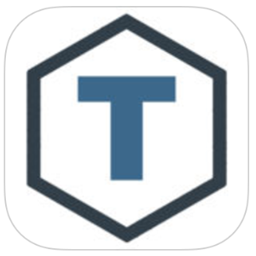
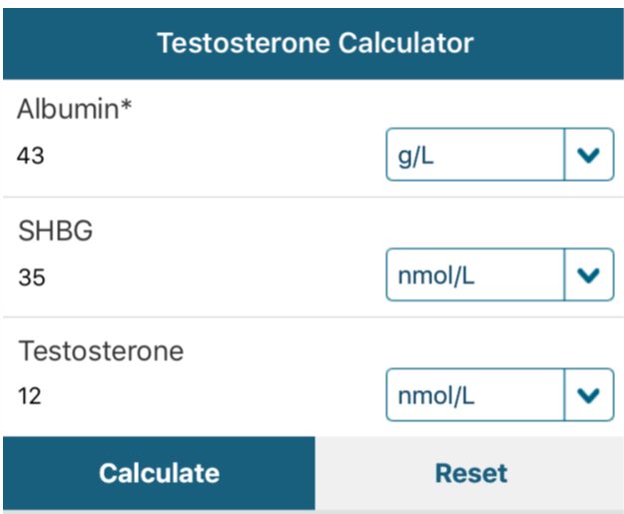
“T Calc” App
Free App - available on iOS and Android
Defaults to European Units (nmol/L)
Includes BSSM guidance on Free T cut-off levels
Aids interpretation of Testosterone results
http://www.pctag.uk/testosterone-calculator/

Slide 55
Measuring Serum Testosterone
The diurnal/circadian rhythm of serum T means levels are highest in the early morning
Circadian rhythm of testosterone
Fasting T levels should be measured from 7 to 11 AM on at least 2 occasions with a reliable method preferably 4 weeks apart and, if possible, not during an acute illness
In addition, measure free testosterone (FT) in men with levels close to lower normal range (8-12 nmol/L) or those with suspected or known abnormal sex hormone binding globulin (SHBG) level
Measure luteinising hormone (LH) serum levels to differentiate primary from secondary TD
Base decisions on therapy on published action levels rather than laboratory reference ranges
Above levels of testosterone are taken from young healthy males
Adapted from Diver M et al. Clin Endocrinol 2003;58:710-717

Slide 56
Example of Evidence-Based Action Levels
The British Society for Sexual Medicine (BSSM) recommend the use of evidence-based action levels to advise HCPs of serum testosterone (T) values that may require Testosterone Therapy (TTh):
  Usually requires TTh: Total T (TT) level <8 nmol/L or free T (FT) <0.180 nmol/L
  May require a trial of TTh for a minimum of 6 months: TT 8-12 nmol/L or free T 0.180-0.225 nmol/L
  Does not usually require TTh: TT level >12 nmol/L or free T >0.225 nmol/L
Free Testosterone should be calculated when the TT is 8-12 nmol/L
Hackett G, et al. British Society for Sexual Medicine Guidelines on Adult Testosterone Deficiency, With Statements for UK Practice. J Sex Med 2017;14:1504-1523.

Slide 57
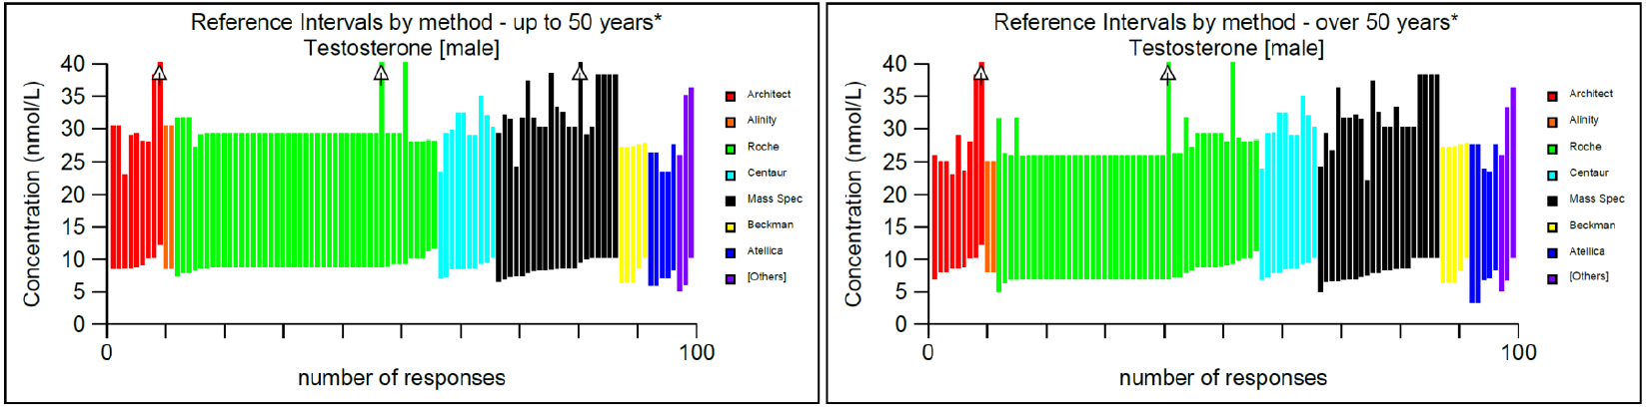
UK male testosterone reference intervals - 2021
UK audit demonstrated that the lower limit of “normal” used to diagnose TD can range from 5-11 nmol/L
Siemens assay uses 3.0nmol/L as normal!
Clinicians need to appreciate that reference ranges quoted by laboratories represent the normal population and that the action levels recommended by the BSSM refer to men with clinical symptoms of TD
Livingston, M et al. Int J Clin Pract. 2020;00:e13607.

Slide 58




Consider the Current Situation …
Disease awareness campaign helps a 51 year-old man identify with his symptoms of ED, lethargy, low mood & low libido & decides to visit his GP
His GP who has non-expert knowledge of Men’s Health suspects presenting symptoms could possibly be due to TD
The GP orders a total testosterone from the laboratory to help confirm the diagnosis of TD
The laboratory conduct the test and find the T level is 5.8 nmol/L
The local reference range for the laboratory is 5.0-31.0 nmol/L.
Laboratory send result to the GP with a comment of “normal”
Despite the T level being low according to guideline recommendations, the GP tells the patient he doesn’t have TD, so instead advises lifestyle changes and prescribes a PDE5i for his ED +/- and an antidepressant for his lethargy & low mood. His symptoms do not improve

Slide 59
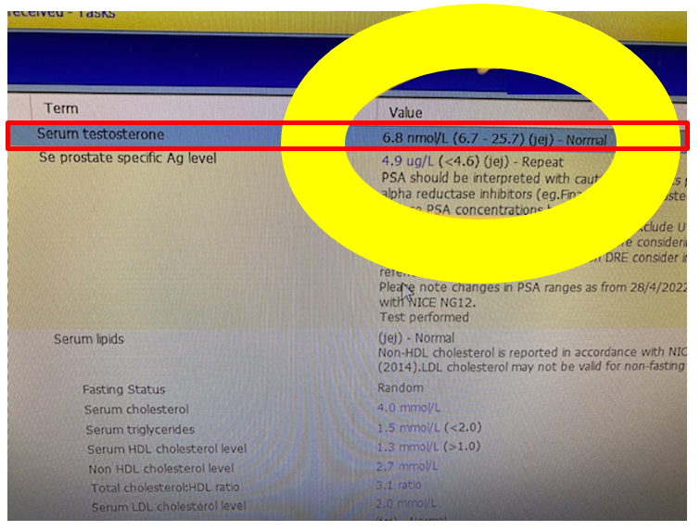
That’s the theory, what about the reality?
Typical example of what happens on a daily basis
This report was from 5th Sept 2022
Patient had ED, low libido, lethargy and low mood
Testosterone 6.8nmol/L
  Would be considered a treatable level by any international guideline in the presence of symptoms
  Local assay says normal (cut off 6.7nmol/L)
  No further guidance, no repeat test
  GP effectively shuts the door and patient is lost
We need to be talking about this to our HCPs

Slide 60
Case study 1 – Part 2: Route to Diagnosis
Chris: 54-year-old office worker with type 2 diabetes mellitus (T2DM)*
He had his bloods taken in GP diabetic clinic and a testosterone level was added to the screening
  Total Testosterone (TT) = 5.6 nmol/L, Free Testosterone (FT) = 0.125 nmol/L
Chris was asked to attend the practice to discuss these results. On further questioning it transpired that he was dissatisfied with his erections and had a low libido
  His AMS score was 48 (moderate to severe symptoms)
  Waist circumference: 42 inches
  HbA1c: 68 mmol/mol
Chris was counselled regarding TD and had no contraindications to testosterone therapy (TTh)
He was started on daily testosterone gel and his PDE5i was changed to a daily dose.
* This patient profile is based on a real patient, and has been anonymised and reproduced with permission.

Slide 61
Treatment & Management of Testosterone Deficiency (TD)

Slide 62
Testosterone Therapy (TTh): Prior to Initiation
Confirm diagnosis
  Signs/symptoms & biochemical evidence (x2)
  Physical examination
Consider aetiology
  Primary or secondary (check LH/FSH)
  Reversible (opioids, glucocorticoids, anti-psychotics)
Consider contraindications & cautions*
  Prostate cancer, abnormal DRE, breast cancer
  Fertility requirement
  Haematocrit <54%
*Please consult the Summary of Product Characteristics or Prescribing Information for a full list of cautions and contraindications.
Hackett, G; Kirby, M et al J Sex Med 2017;14:1504-1523.

Slide 63
Testosterone Therapy (TTh)
There are many different testosterone therapies available which differ in:
  Formulation
  Route of administration
  Pharmacokinetics & dosage interval
  Safety profile
  Convenience
  Cost
Currently, the choice usually lies between the transdermal and injectable route
The features of each method should be discussed with the patient
Compliance is crucial
Must advise re: all options, including not treating i.e. lifestyle advice

Slide 64
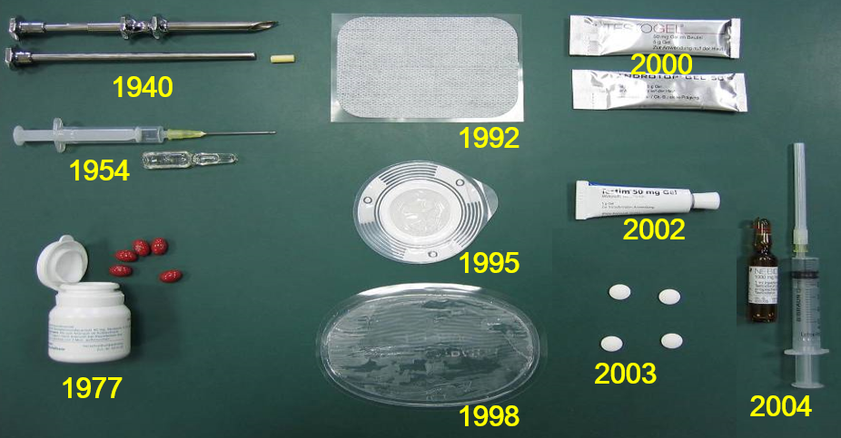
Testosterone Preparations: 1940 to 2004

Slide 65
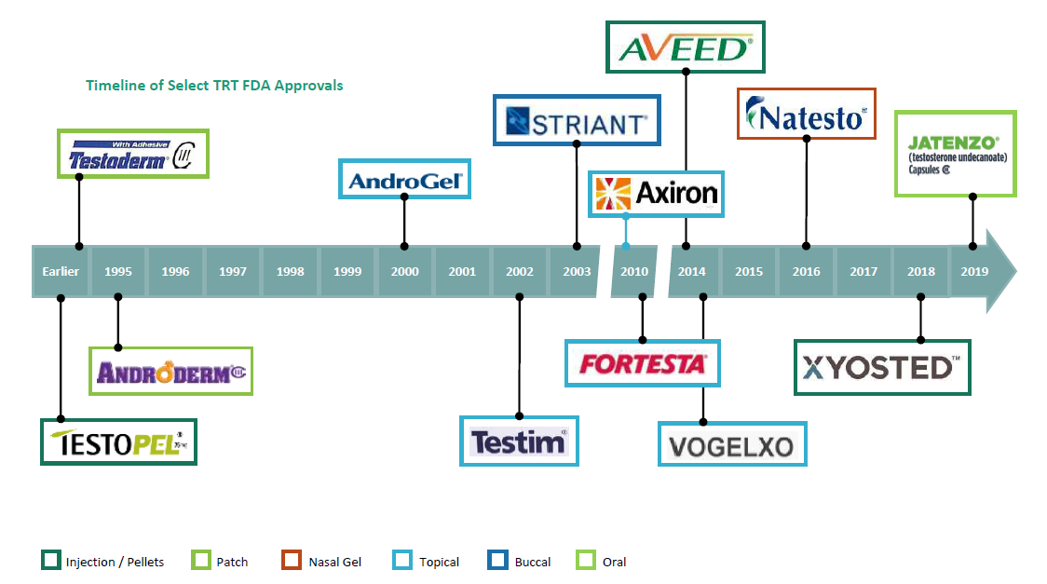



Testosterone Preparations: More Recent FDA Approvals*
2022
* Short-acting testosterone IM injections and older oral preparations were approved earlier than depicted in the timeline here.

Slide 66

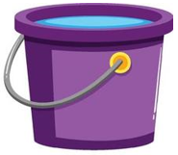


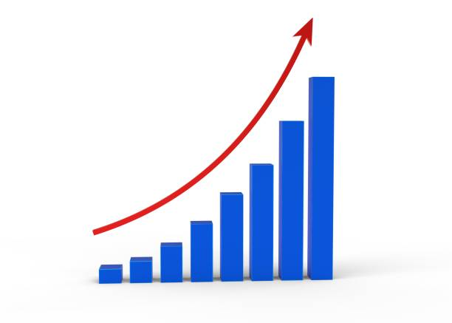
The Spectrum of Testosterone Usage
Over use/abuse
Gym (black market)
Athlete doping
Inappropriate use
Lack of clinical diagnosis
Lack of proper safety work up/monitoring
Some private clinics medicalising normal ageing
Appropriate use
HCPs who proactively diagnose, treat & manage TD
Knowledge through education
Experience
Expertise
Guidelines
Under use
10-15% of older men with genuine TD
Klinefelter Syndrome
Osteo, Anaemia & TC
Obesity & Diabetes
Opioid use
HCP lack of awareness/scepticism
Lab reference ranges
Notes:
Only a small fraction of HCPs with expert knowledge on TD will diagnose and treat patients proactively based on their own experience, expertise and guideline recommendations

Slide 67
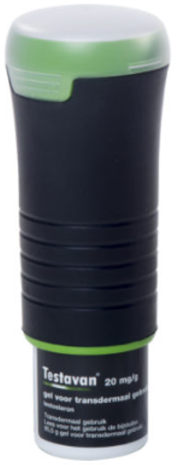
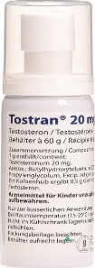
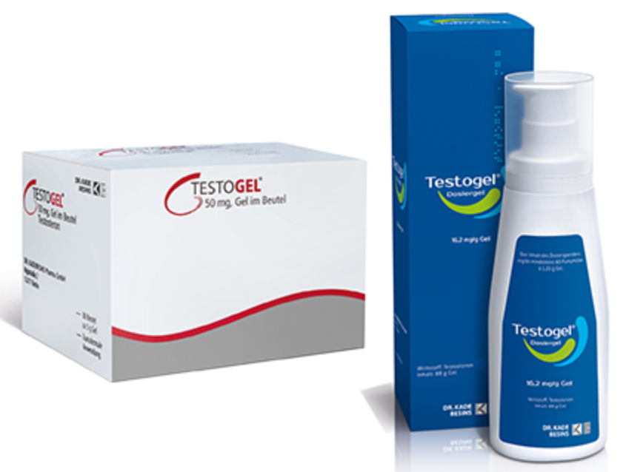
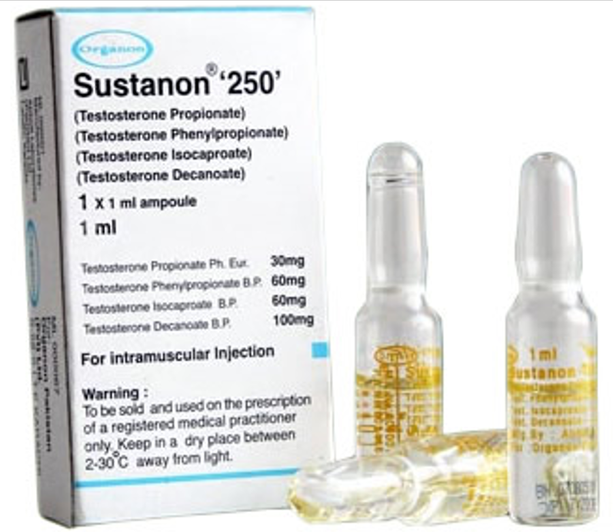
Testosterone Therapy (TTh)
The Major Goal of TTh:
  To achieve & maintain normal physiological testosterone levels to relieve symptoms of androgen deficiency, such as loss of libido, erectile dysfunction, changes in body composition and psychological impairment
EMA/716062/2014 Pharmacovigilance Risk Assessment Committee (PRAC).

Slide 68
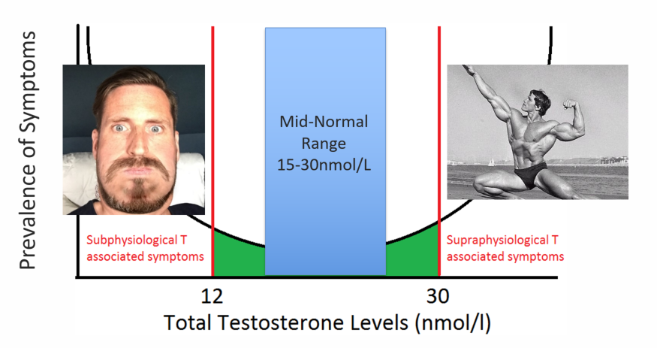
TTh - ‘U’ Shaped Curve
12 35
Hackett, G; Kirby, M et al J Sex Med 2017;14:1504-1523.

Slide 69
Testosterone Gels
The 2020 European Academy of Andrology (EAA) guidelines on investigation, treatment and monitoring of functional hypogonadism in males suggest the use of transdermal T gels, as the preferred preparation in the initiation of testosterone therapy due to the potentially reversible nature of functional hypogonadism¹
The 2021 Update from the European Association of Urology Guidelines on Sexual and Reproductive Health state that prescribers should use testosterone gels rather than long-acting depot administration when starting initial treatment, so that therapy can be adjusted or stopped in case of treatment-related adverse effects²
Corona, G et al. Andrology. 2020 Sep;8(5):970-987 (Endorsing Organization: European Society of Endocrinology).
Bettocchi C, et al. European Association of Urology Guidelines on Sexual and Reproductive Health—2021 Update: Male Sexual Dysfunction. Eur Urol (2021).

Slide 70
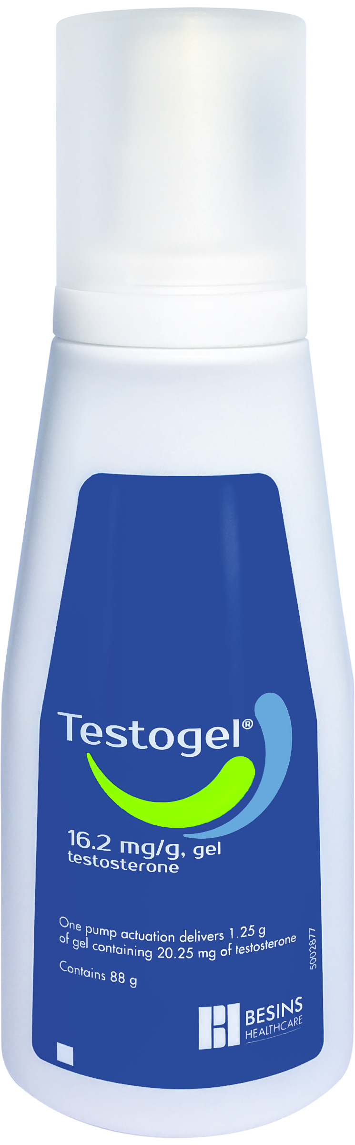
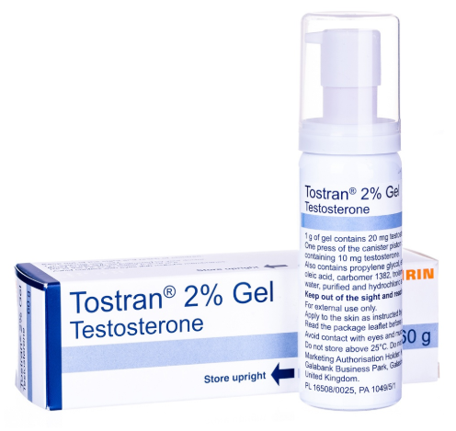
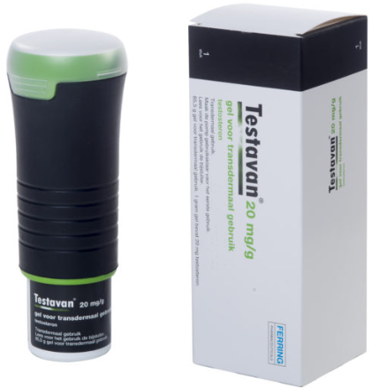
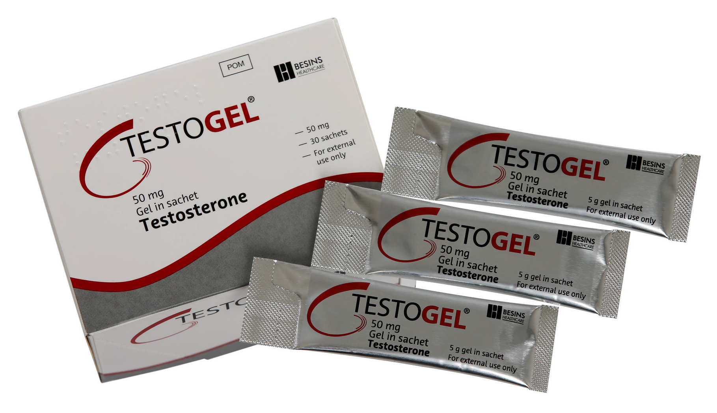
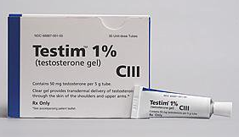
Transdermal Gels
Advantages
  Good efficacy
  Fast onset – steady state usually achieved in 48 hours
  Provide uniform and normal serum levels for 24 hours
  Predictable bioavailability and consistent testosterone levels
  Flexible dose and easy to titrate
  Rapid decrease in T levels if treatment stopped due to the presence of adverse events
1. Hackett G, et al. J Sex Med 2017; 14:1504-1523.

Slide 71
Transdermal Gels
Disadvantages
  Daily application
  Transfer risk
  Skin irritation at application site
1. Hackett G, et al. J Sex Med 2017; 14:1504-1523.

Slide 72
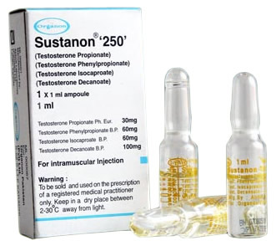

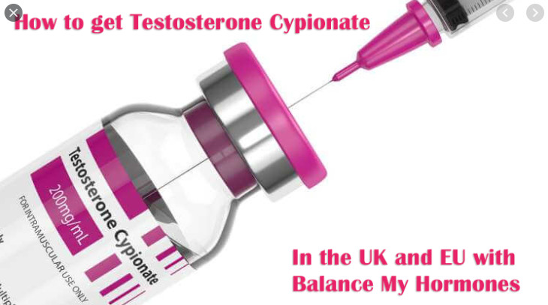
Intramuscular Injections: Short Acting
Advantages
  Good efficacy
  Likely inexpensive
  Patients/partners can be trained to self-administer
  Dosing every 3-6 weeks
1. Hackett G, et al. J Sex Med 2017; 14:1504-1523.

Slide 73
Intramuscular Injections: Short Acting
Disadvantages
  Unable to withdraw quickly in the event of adverse reaction
  Pain or reaction at injection site
  Peanut oil (Sustanon 250) so potential allergy issues
  Levels can fluctuate (more commonly with short-acting)
  Higher occurrence of erythrocytosis vs gels
1. Hackett G, et al. J Sex Med 2017; 14:1504-1523.

Slide 74
Intramuscular Injections: Long Acting
Advantages
  Administered only 4-5 times a year
  Theoretically avoids physiological peaks and troughs
  Popular with key opinion leaders
  Established & comprehensive digital educational platforms for HCPs and patients
  HCP retains control over dosing
  Good efficacy
  Robust supportive clinical evidence, most notably the recent T4DM study
1. Hackett G, et al. J Sex Med 2017; 14:1504-1523.

Slide 75
Intramuscular Injections: Long Acting
Disadvantages
  Rapid discontinuation is not possible (in case of adverse events)
  Pain or reaction at injection site
  Need to attend clinic for administration
    Cannot self-administer
  Higher occurrence of erythrocytosis vs gels
  Not recommended for the initiation of TTh, particularly in testosterone naïve patients
1. Hackett G, et al. J Sex Med 2017; 14:1504-1523.

Slide 76
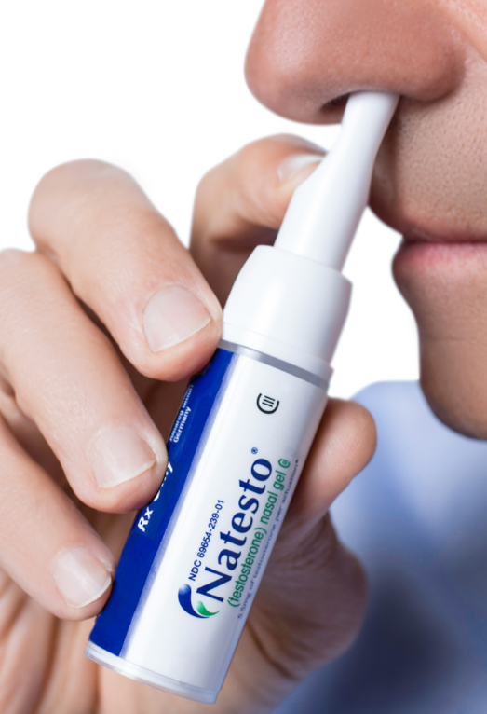
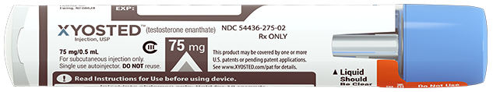
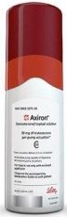
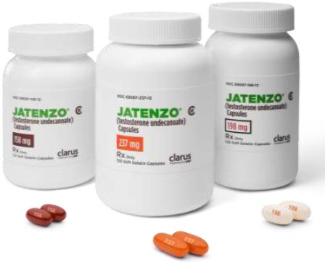
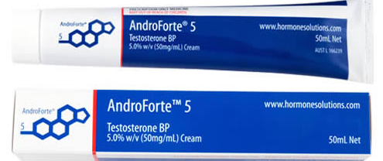
Other non-UK licensed T Preparations
Nasal gel – Natesto
Subcutaneous injection – Xyosted
New generation orals – Jatenzo, Tlando & Kyzatrex
Cream – AndroForte 5
Solution - Axiron

Slide 77


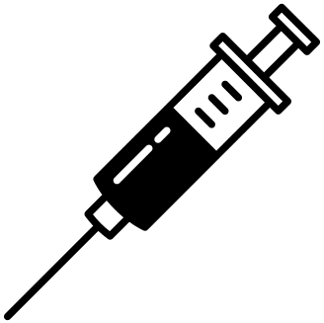


Benefits of Testosterone Therapy (TTh)
Improved sexual function
Improved body composition
Improved mood
Reduced mortality risk
Improved anaemia
Increased bone mineral density
Improved glycaemic control
Hackett G. Ther Adv Urol 2016; 8: 147–60; Hackett G et al. J Sex Med 2016; 13: 887–904; Roy CN et al. JAMA Intern Med 2017;177:480–90; Snyder PJ et al. JAMA Intern Med 2017;177:471–9; Wittert, G et al. Lancet Diabetes Endocrinol 2021; 9: 32–45.

Slide 78
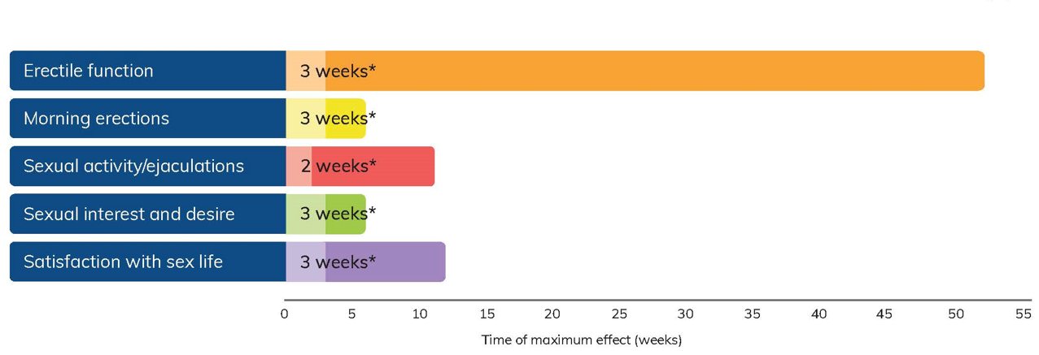
Time to Onset of TD Symptom Improvement
Time-dependent and symptom-specific onset of effects of TTh
*Time of first measured change (weeks)
Sexual Parameters
Saad et al. European Journal of Endocrinology (2011) 675-685.

Slide 79
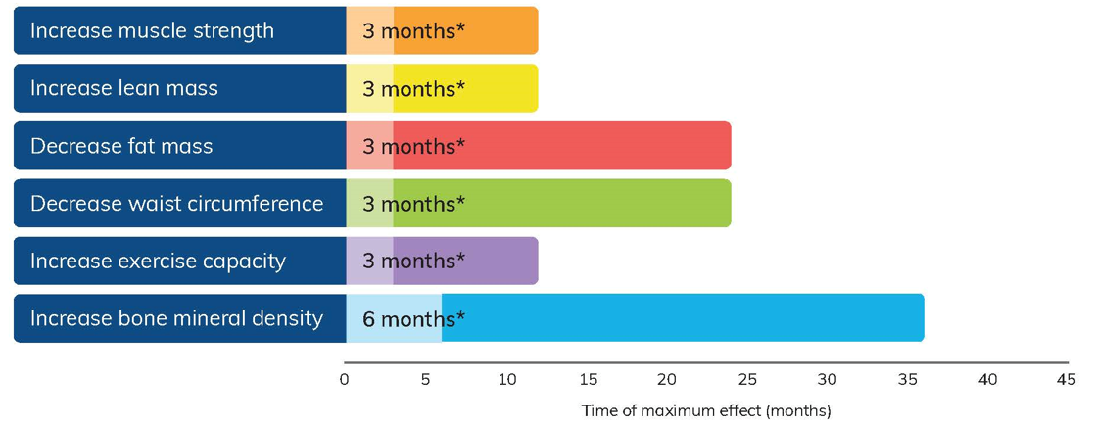
Time to Onset of TD Symptom Improvement
Time-dependent and symptom-specific onset of effects of TTh
*Time of first measured change (months)
Body Composition & Strength
Saad et al. European Journal of Endocrinology (2011) 675-685.

Slide 80
TTh: For How Long?
Testosterone Deficiency (TD) is a chronic disease which often requires long-term treatment, not unlike diabetes
Important to realise that TTh is considered lifelong therapy¹
In patients who have a positive response to TTh, treatment should continue in accordance with a standardised monitoring plan²
Patient & HCP expectations need to be managed from the outset. Signs & symptoms of TD don’t appear overnight and they don’t disappear overnight either
HCPs should ensure that their patients are compliant with therapy and that they optimise the dose of therapy for their patients early on to achieve better compliance
In some patients who do particularly well and adopt lifestyle changes, TTh can sometimes be discontinued
1. Chakrabarty A. Androl Gynecol: Curr Res 2013, 1:3; 2. Bhasin S, et al. J Clin Endocrinol Metab 2010; 95: 2536-2559.

Slide 81
Safety Considerations

Slide 82
Potential Adverse Effects Linked to TTh
Most frequently seen in practice:*
  Erythrocytosis (see following slides)
  Reduced sperm production and infertility
  Acne, oiliness of skin
  Breast tenderness
  Gynaecomastia
  Male pattern balding
  Formulation-specific effects, e.g., injection site pain or local skin reactions
*Consult the Summary of Product characteristics for a full list of adverse events
Bhasin S, Basaria S. Best Pract Res Clin Endocrinol Metab 2011; 25: 251–270.Bhasin S, et al. J Clin Endocrinol Metab 2010; 95: 2536–2559. Testogel 16.2mg/g SmPC https://www.medicines.org.uk/emc/product/8919/smpc Last Accessed Jan 2022

Slide 83
The HEAT-Registry
HEmatopoietic Affection of hypogonadal men receiving Testosterone substitution
Michael Zitzmann, Jann F. Cremers, Claudia Krallmann & Sabine Kliesch (2022) The HEAT-Registry (HEmatopoietic Affection by Testosterone): comparison of a transdermal gel vs long-acting intramuscular testosterone undecanoate in hypogonadal men, The Aging Male, 25:1, 134-144, DOI: 10.1080/13685538.2022.2063830

Slide 84
The HEAT-Registry
First direct comparison between Nebido and AndroGel
Primary aim to assess prospectively the effects of both therapies on:
  Testosterone levels
  Haemoglobin levels
  Haematocrit
  Passing a threshold of haematocrit > 50%, > 52%, >54% and > 56%
Prospective, single-centre (Muenster), observational registry for TRT
Minimum treatment period of 24 weeks
  Group 1: 498 men prescribed AndroGel
  Group 2: 304 men prescribed Nebido
Medication chosen according to patient’s and physician’s agreement
  No randomization

Slide 85



The HEAT-Registry – Higher T Levels or Less Side Effects?
  Group 1: 498 men prescribed AndroGel
  Group 2: 304 men prescribed Nebido

Slide 86


The HEAT-Registry - Results
Thresholds for haematocrit during TTh
Patients (%) with haematocrit >50%

Slide 87
The HEAT-Registry - Summary
Testosterone levels increase to a higher level with Nebido vs AndroGel after approx 6 months of treatment (p<0.001)
Testosterone substitution by either AndroGel or Nebido increases haemoglobin and haematocrit
  The effect is significantly more pronounced in men receiving Nebido (p<0.001)

Slide 88


An elevated hematocrit is the most common adverse effect
of testosterone therapy (TTh)
Any elevation above the normal range for hematocrit (HCT) usually becomes evident between 3 and 12 months after TTh initiation.
Higher HCT is more common with parenteral rather than topical formulations.
HCT > 54% should require testosterone therapy withdrawal, reduction in dose, change of formulation and venesection depending on the clinical situation to avoid any potential CV complications.
https://uroweb.org/wp-content/uploads/EAU-Guidelines-on-Sexual-and-Reproductive-Health-2021-V3.pdf
Notes:
An increased HCT is one of the greatest concerns of HCPs who treat men with TTh.

Slide 89

Much of the concern surrounding elevations in blood viscosity centers on the increased risk for venous thromboembolism (VTE), myocardial infarction (MI), and stroke¹.
Supraphysiologic/high pick serum T levels have been associated with polycythemia with an incidence that varies from 13% for transdermal gels to 67% for short-acting IM TTh².
Whether or not exogenous testosterone causes MACE or VTE is actively debated, but the relationship between TTh-induced polycythemia and subsequent risk for VTE and other CV complications has never been directly studied³.
Ohlander S. et al. Erythrocytosis Following Testosterone Therapy. Sex Med Rev. 2018; 6(1): 77–85. doi:10.1016/j.sxmr.2017.04.001
Pastuszak AW, Gomez LP, Scovell JM, et al. Comparison of the effects of testosterone gels, injections, and pellets on serum hormones, erythrocytosis, lipids, and prostate-specific antigen. Sex Med 2015;3:165-173.
Ory J et al. Secondary Polycythemia in Men Receiving Testosterone Therapy Increases Risk of Major Adverse Cardiovascular Events and Venous Thromboembolism in the First Year of Therapy. J Urol. 2022 Jun;207(6):1295-1301.

Slide 90


The objective of the study was to determine if the presence of polycythemia during TTh leads to adverse events (MACE and VTE) as a primary outcome
J Urol. 2022 Jun;207(6):1295-1301. doi: 10.1097/JU.0000000000002437.

Slide 91
The primary outcome was the odds of MACE and VTE within the first year of TRT
Study design
74 mln patients
data base
48 671 Hypogonadal men* 18+ receiving TRT**
5 887 men with et list one recorded HTC ≥52%
Matching for
the 14 risk
factors
42 784 men who never had HTC ≥52% after TRT start
*Total T less then 350 ng/dL (12,1 nmol/L)
**The group that received TRT had their first prescription within 3 months of hypogonadism diagnosis.
5 842 with
polycythemia
5 842 without
polycythemia
MACE were defined as a composite of death from any cause, MI and stroke. VTE included deep vein
thrombosis and pulmonary embolism.
Secondary Polycythemia in Men Receiving Testosterone Therapy Increases Risk of Major Adverse Cardiovascular Events and Venous Thromboembolism in the First Year of Therapy

Slide 92
5 842 with
polycythemia
Hypogonadal men receiving TTh
5 842 without
polycythemia
In the first year following TRT and after propensity-score matching, the risk of MACE/VTE was 5.2% in men who developed polycythemia vs 3.9% in those men who did not (OR 1.35; 95% CI 1.13-1.61).
the survival probability (probability of 1 year without MACE/VTE) was significantly lower in the polycythemia group (95% vs 97%, p<0.0001, HR 1.22, 95% CI 1.04-1.43);
an increased risk of developing acute MI (OR 1.81, 95% CI 1.2-2.7) and VTE (OR 1.51, 95% CI 1.17-1.94) in the men with polycythemia.
Men using testosterone should be aware that they are at a higher risk of MACE and VTE if their hematocrit reaches or exceeds 52% during the first year of TRT.
Ory J. et al. J Urol. 2022 Jun;207(6):1295-1301. doi: 10.1097/JU.0000000000002437.

Slide 93
Important considerations (1):
Guidelines recommendations on HCT cut-offs were extrapolated from data from the general population, while the results obtained by Ory et al, 2022 are based on the data from men who are using TRT.
This is the first study to establish secondary polycythemia from TTh as an independent risk factor for MACE/VTE using a specific hematocrit-based cut-off (≥52%).
Doctors prescribing TRT should be aware about increased risk of MACE and VTE related with polycythemia during the first year of TRT. TTh itself, in the absence of polycythemia, did not appear to increase risk of MACE/ VTE in hypogonadal men.
This new data provides ample reason for new iterations of guidelines to align on a level of 52% and that is where the difference between T Gel and Nebido can be highlighted to HCPs (The HEAT-registry).

Slide 94
Important considerations (2):
We can inform HCPs about this new study alongside the only head-to-head study of AndroGel and Nebido (The HEAT- Registry)
The HEAT-Registry (HEmatopoietic Affection by Testosterone): comparison of a transdermal gel vs long-acting intramuscular testosterone undecanoate in hypogonadal men
Zitzmann, M. et al. THE AGING MALE 2022, VOL. 25, NO. 1, 134–144
Testosterone substitution by either AndroGel or Nebido increases HCT, but
  The effect is significantly more pronounced in men receiving Nebido (p<0.001)

Slide 95

«Use testosterone gels rather than long-acting depot administration when starting initial treatment, so that therapy can be adjusted or stopped in the case of treatment-related adverse effects».
Question:
Based on these studies, should the EAU recommendation to start TRT with T Gels in order to reduce possible risks be applied and followed for at least first 12 months after the therapy initiation?
https://uroweb.org/wp-content/uploads/EAU-Guidelines-on-Sexual-and-Reproductive-Health-2021-V3.pdf

Slide 96
What about long-term CV safety?

Slide 97
What is the Testosterone Efficacy & Safety (TestES) Consortium?
https://www.imperial.ac.uk/metabolism-digestion-reproduction/research/diabetes-endocrinology-metabolism/endocrinology-and-investigative-medicine/nihr-testosterone/
Background: Several high quality trials have investigated the clinical benefits and risks of testosterone replacement therapy (TRT) in men with symptomatic low testosterone. Nevertheless, there remains uncertainty among clinicians regarding the clinical benefits and harm associated with.
The TestES Consortium: The UK National Institute of Health Research Health Technology Assessment (NIHR HTA) has commissioned and funded this study (500,000 GBP) to systematically review the literature on the use of TRT in symptomatic men with testosterone deficiency.
Methods: TestES uses a rigorous evidence synthesis that includes an individual participant data meta-analysis (IPD MA). This approach impartially selects and combines clinical trials data from around the world to estimate the clinical effectiveness and safety of TRT in men with TD and to inform key parameters for the development of a decision model.
Expected Outcomes: Results of this evidence synthesis and economic evaluation will provide clinicians with up-to-date, relevant information on which to form their evidence-based decisions and, therefore, are likely to impact on current clinical practice, both at national and international level.

Slide 98



  Testosterone treatment is most often given to men aged 40–65 years. Testosterone has potentially favourable effects on cardiovascular risk such as increased lean-to-fat body mass and improved insulin sensitivity and glycaemia. Conversely, testosterone treatment increases haematocrit, might lower high-density lipoprotein (HDL) cholesterol, and some studies have observed increased cardiovascular event risk. Uncertainty regarding the safety of testosterone might unduly influence decision making regarding the management of men with hypogonadism who could otherwise derive substantial benefits from treatment.
What is already known?
  The investigators designed highly sensitive search strategies to identify reports of published, ongoing, and unpublished randomised controlled trials assessing the clinical effectiveness of testosterone treatment in men with hypogonadism. Searches were restricted to reports published in English from 1992. We searched major electronic databases, clinical trial registries, and contacted clinical experts. We focused on trials with 3-month to 3 years treatment duration and mean baseline total testosterone of 12 nmol/L or less (or equivalent) before treatment. 35 trials were included and they collected individual patient data (IPD) from 17 trials (3431 participants in total). In general, the risk of bias of IPD trials was low.
Why is this study important?
Conclusion
  This individual IPD meta-analysis allowed a reliable assessment of the frequency of mortality and cardiovascular events (including subtypes) during testosterone treatment in men with hypogonadism. Few deaths have occurred during trials of testosterone in men. Furthermore, testosterone treatment is not associated with an increased risk of any recorded cardiovascular event subtype in the short to medium term. Men with hypogonadism should be counselled that there is no current evidence that testosterone treatment increases cardiovascular risk in the short to medium term.
Important: This is an internal document. Please check local regulatory and compliance before using any part of this material.
Lancet Healthy Longev 2022; 3: e381–93
https://www.thelancet.com/journals/lanhl/article/PIIS2666-7568(22)00096-4/fulltext

Slide 99
TestES Consortium:
“Our study is likely to supersede the previous evidence and suggests that, within the first year of treatment at least, testosterone treatment is not associated with heart problems. While our study does not look at the longer-term safety of the treatment, these findings will enable doctors to be more confident prescribing testosterone to men who need it.”
** Please note - Baseline HCT in the TestES analysis was 43% in the T group. Mean HCT in the T group rose to 46%
“Testosterone significantly elevated haematocrit and haemoglobin. Furthermore, testosterone treatment
was associated with a five-times higher risk of polycythemia.”
Notes:
The testosterone dose should be reduced if hematocrit rises above 52% and withheld if hematocrit levels rise above 54%.

Slide 100

The TRAVERSE study
Rationale and study design
Clinicaltrials.gov identifier NCT03518034
Notes:
Expected publication/presentation of initial results in May 2023. Could be longer. Could even be Q1 2024.

Slide 101
Effects of long-term testosterone treatment on CV outcomes in men with hypogonadism: TRAVERSE Study
There will likely never be another study of this calibre with testosterone
This is the one that HCPs have been asking for (and it’s using OUR PRODUCT!)
Likely NEJM publication
2016 T Trials (Besins/Abbvie) – Noise levels were somewhat muted
2021 T4DM (Bayer) – Conservative commentary from authors. Muted dissemination. Has not changed practice.
It will be critical to ensure that TRAVERSE gets the attention it deserves in order to:
  Change behaviours and beliefs
  Change practice
  Re-ignite the market & increase favourability towards Androgel
  Improve patient’s lives

Slide 102



Background to the TRAVERSE study
In 2013, in response to a petition from a citizen’s interest group to add
a black box warning about the potential CV dangers of TTh, the FDA extensively reviewed all available information and concluded:
“The studies presented in the petition have significant limitations that weaken their evidentiary value for confirming a causal relationship between T and adverse CV outcomes”
Nevertheless, the FDA mandated that TTh product labelling includes a possible increased risk of CV events
In parallel, the EMA concluded that there is no consistent evidence of an increased risk of coronary heart disease associated with TTh use in men with hypogonadism
CV, cardiovascular; EMA, European Medicines Agency; FDA, US Food and Drug Administration; T, testosterone; TTh, testosterone therapy.
Bhasin S et al. J Clin Endocrinol Metab 2018;103:1715–44; Bhasin S et al. Am Heart J 2022;245:41–50.
Notes:
In 2013, in response to a petition by a citizen’s interest group to add a black box warning about the potential CV dangers of TTh, as well as conflicting reports of
CV events from small clinical trials, retrospective analyses of medical records data, and pharmacovigilance studies of TTh-treated men, the FDA conducted an extensive review of the available information.^{1,2}
The FDA concluded that “the studies presented in the petition have significant limitations that weaken their evidentiary value for confirming a causal relationship between testosterone and adverse cardiovascular outcomes.”^{1,2}
Nevertheless, the FDA mandated pharmaceutical companies to add labelling information about a possible increased risk of CV events with the use of TTh.¹
An independent review conducted by the European Medicines Agency also found no consistent evidence of an increased risk of coronary heart disease associated with testosterone treatment of men with hypogonadism.^{1,2}
CV, cardiovascular; FDA, US Food and Drug Administration; MACE, major adverse cardiovascular events; TTh, testosterone therapy.
References
1. Bhasin S et al. J Clin Endocrinol Metab 2018;103:1715–44; 2. Bhasin S et al. Am Heart J 2022;245:41–50.

Slide 103
Background to the TRAVERSE study
In 2015, the guidance from the FDA was updated to state:¹
“HCPs should prescribe TTh only for men with low T levels caused
by certain medical conditions and confirmed by laboratory tests”
“The benefit and safety of these medications have not been established for the treatment of low T levels due to aging, even if a man’s symptoms seem related to low T”
“…requiring manufacturers of approved testosterone products to conduct
a well-designed clinical trial to more clearly address the question of whether
an increased risk of heart attack or stroke exists among users of these products”
In response to this FDA guidance, the Testosterone Replacement therapy for Assessment of long-term Vascular Events and efficacy ResponSE in hypogonadal men (TRAVERSE) study was designed, funded by a consortium of TTh manufacturers led by AbbVie²
CV, cardiovascular; FDA, US Food and Drug Administration; HCP, healthcare professional; MACE, major adverse cardiovascular events; T, testosterone; TTh, testosterone therapy.
1. US Food and Drug Administration. Drug Safety Communication: FDA cautions about using testosterone products for low testosterone due to aging. Available at: https://www.fda.gov/media/91048/download (accessed October 2022); 2. Bhasin S et al. Am Heart J 2022;245:41–50.
Notes:
Given the broad and growing use of TTh among middle-aged and older men with, or who are at risk for, CV disease, the FDA issued updated testosterone labelling inclusive of a limitation of use in men with ‘age-related hypogonadism,’ along with a guidance “…requiring manufacturers of approved testosterone products to conduct a well-designed clinical trial to more clearly address the question of whether an increased risk of heart attack or stroke exists among users of these products.”^{1,2}
The Testosterone Replacement therapy for Assessment of long-term Vascular Events and efficacy ResponSE in hypogonadal men (TRAVERSE) study was designed in response to this FDA guidance to determine the effects of TTh on the incidence of MACE in middle-aged and older men with hypogonadism who have, or are at high risk for, CV disease.¹
Study organisation
The TRAVERSE study is funded by a consortium of testosterone manufacturers led by AbbVie, Inc. (North Chicago, IL, USA), and coordinated by the Cleveland Clinic Coordinating Center for Clinical Research (C5Research, Cleveland, OH, USA).¹
CV, cardiovascular; FDA, US Food and Drug Administration; MACE, major adverse cardiovascular events; TTh, testosterone therapy.
References
1. Bhasin S et al. Am Heart J 2022;245:41–50; 2. US Food and Drug Administration. Drug Safety Communication: FDA cautions about using testosterone products for low testosterone due to aging. Available at: https://www.fda.gov/media/91048/download (accessed October 2022).

Slide 104

TRAVERSE: overview and key safety objectives
Ongoing Phase 4, randomised, double-blind, placebo-controlled, non-inferiority, parallel-group, multicentre trial in middle-aged and older men with hypogonadism who have, or who are at high risk for, CV disease, randomized to daily 1.62% transdermal testosterone gel or matching placebo for up to 5 years
Primary endpoint
CV safety: time from randomisation to first occurrence of any component of the MACE composite
of nonfatal MI, nonfatal stroke, or death due to CV causes
Secondary endpoints
CV safety: time to first occurrence of any component of the composite endpoint of nonfatal MI,
nonfatal stroke, death due to CV causes, or coronary revascularisation (PCI or CABG)
Prostate safety: incidence of high-grade prostate cancer, defined as a pathologically confirmed
prostate cancer with Gleason score 4 + 3 or higher
CABG, coronary artery bypass grafting; CV, cardiovascular; MACE, major adverse cardiovascular events; MI, myocardial infarction; PCI, percutaneous coronary intervention.
Bhasin S et al. Am Heart J 2022;245:41–50.
Notes:
TRAVERSE study overview
TRAVERSE (Clinicaltrials.gov identifier NCT03518034) is a phase 4, randomised, double-blind, placebo-controlled, non-inferiority, parallel-group, multicentre study of transdermal TRT in symptomatic men with hypogonadism who have pre-existing CV disease or increased risk for CV disease.
Participants will be randomised to either 1.62% transdermal testosterone gel or a matching placebo gel daily for an anticipated duration of up to 5 years.
Primary and secondary safety outcomes
The primary CV safety outcome of the study is the time from randomisation to first occurrence of any component of the MACE composite of nonfatal MI, nonfatal stroke, or death due to CV causes.
The secondary CV safety endpoint is the time to first occurrence of any component of the composite endpoint of nonfatal MI, nonfatal stroke, death due to CV causes, or coronary revascularisation (PCI or CABG).
The secondary prostate safety endpoint is the incidence of high-grade prostate cancer, defined as a pathologically confirmed prostate cancer with Gleason score
4 + 3 or higher.
CABG, coronary artery bypass grafting; CV, cardiovascular; MACE, major adverse cardiovascular events; MI, myocardial infarction; PCI, percutaneous coronary intervention.
Reference
Bhasin S et al. Am Heart J 2022;245:41–50.
SPC “There is limited experience on the safety and efficacy of the use of TESTOGEL 16.2 mg/g in patients over 65 years of age.”
The combination of coronary angioplasty with stenting is usually referred to as percutaneous coronary intervention (PCI).
Coronary Artery Bypass Graft (CABG)
For example, if the Gleason score is written as 4+3=7, it means most of the tumor is grade 4 and less is grade 3, and they are added for a Gleason score of 7) The cells look less like normal prostate cells. The cancer is likely to grow at a moderate rate

Slide 105






TRAVERSE: tertiary safety and efficacy endpoints
Tertiary endpoints
CV safety: all-cause mortality; hospitalisation or urgent visit for heart failure; venous thromboembolic events, including DVT, PE and VTE; or peripheral arterial revascularisation
Prostate safety: prostate biopsy; any prostate cancer; acute urinary retention; starting pharmacologic treatment for LUTS; and invasive prostate surgical procedures (e.g. prostatectomy, transurethral prostate resection, brachytherapy or other prostate surgical procedure for BPH)
Using PRO questionnaires, the following prespecified efficacy endpoints across five domains will be analysed as secondary outcomes in specific sub-populations
Improvement in sexual activity in participants with low libido
Correction of anaemia in participants with baseline anaemia; incidence of anaemia in participants without baseline anaemia
Remission of depression in participants with late-onset, low grade PDD
Reduction in progression from pre-diabetes to diabetes
in participants with prediabetes at baseline; glycaemic remission in participants with diabetes at baseline
Reduction in incidence
of clinical fractures
BPH, benign prostatic hyperplasia; CV, cardiovascular; DVT, deep vein thrombosis; LUTS, lower urinary tract symptoms; PDD, persistent depressive disorder (dysthymia);
PE, pulmonary embolism; PRO, patient-reported outcomes; VTE, venous thromboembolism.
Bhasin S et al. Am Heart J 2022;245:41–50.
Notes:
Tertiary safety endpoints
Tertiary safety CV endpoints include all-cause mortality; hospitalisation or urgent visit
for heart failure; venous thromboembolic events, including DVT, PE, VTE; or peripheral arterial revascularisation.
Tertiary prostate safety endpoints include prostate biopsy; any prostate cancer;
acute urinary retention; starting pharmacologic treatment for LUTS; and invasive prostate surgical procedures (e.g. prostatectomy, transurethral prostate resection, brachytherapy
or other prostate surgical procedure for BPH).
Efficacy endpoints
A limited number of pre-specified efficacy endpoints are included as secondary outcomes
in five efficacy domains, and will be evaluated in sub-studies or analyses of subpopulations using validated PRO questionnaires:
Sexual function: improvement in sexual activity in hypogonadal men with low libido.
Low-grade PDD (dysthymia): remission of depression in hypogonadal men with
late-onset, low grade PDD.
Fracture: reduction in incidence of clinical fractures.
Anaemia: correction of anaemia in subset of participants with baseline anaemia,
and incidence of anaemia among randomised subjects who did not have anaemia
at baseline.
Diabetes: reduction in progression from pre-diabetes to diabetes in subset
of participants with pre-diabetes at baseline, and glycaemic remission in subset
of participants with diabetes at baseline.
BPH, benign prostatic hyperplasia; CV, cardiovascular; DVT, deep vein thrombosis;
LUTS, lower urinary tract symptoms; PDD, persistent depressive disorder; PE, pulmonary embolism; PRO, patient-reported outcome; TTh, testosterone therapy; VTE, venous thromboembolism.
Reference
Bhasin S et al. Am Heart J 2022;245:41–50.
(CABG) surgery or angioplasty and stenting.

Slide 106



TRAVERSE: study population
6000
5076
expected to be enrolled; as of July 2021, have been randomised¹
n≈
Trial will continue until 256 primary MACE endpoints have occurred, to assess whether the 95% (2-sided) upper confidence limit for a hazard ratio of 1.5 can be ruled out¹
Inclusion criteria¹
Age 45–80 years
Confirmed low serum testosterone concentrations <10.4 nmol/L (300 ng/dL) and hypogonadal symptoms i.e. adheres to the 2018 Endocrine Society criteria for the diagnosis of hypogonadism²
Evidence of CV disease (secondary prevention) or increased risk for
CV disease (primary prevention)*
Exclusion criteria¹
Congenital or acquired hypogonadism making
long-term placebo therapy medically inappropriate
Contraindications to TTh
MI, stroke, percutaneous coronary angioplasty,
CABG surgery, unstable angina, or procedures to
treat critical limb ischaemia within the past 4 months
Use within the past 6 months of TTh, clomiphene,
anabolic steroids, androgenic steroid derivatives,
DHEA or investigational products that may affect
the reproductive hormonal system
*As of 31 May 2019, only participants with pre-existing CV disease (secondary prevention) are being enrolled.
CABG, coronary artery bypass grafting; CV, cardiovascular; DHEA, dehydroepiandrosterone; MACE, major adverse cardiovascular events;
MI, myocardial infarction; TTh, testosterone therapy.
1. Bhasin S et al. Am Heart J 2022;245:41–50; 2. Bhasin S et al. J Clin Endocrinol Metab 2018;103:1715–44.
Notes:
TRAVERSE: study population
This consists of men aged 45–80 years with confirmed serum testosterone concentrations <10.4 nmol/L (300 ng/dL) who report hypogonadal symptoms and have evidence of, or are at an increased risk for, CV disease.¹
Inclusion criteria¹
These were designed to enrol middle-aged and older men who met the Endocrine Society’s criteria for the diagnosis of hypogonadism,²
defined as the presence of: a) two serum testosterone levels <10.4 nmol/L (300 ng/dL), measured using liquid chromatography tandem mass spectrometry in fasting specimens obtained between 5–11 AM, plus b) self-report of ≥1 of the following symptoms related to testosterone deficiency: decreased sexual desire, decreased spontaneous erections, low energy or fatigue, low or depressed mood; loss of body hair or reduced shaving, or hot flashes. To enrich the study population with those at increased risk of CV events, participants were also required to have evidence of either pre-existing CV disease indicated by clinical or angiographic evidence of CAD, cerebrovascular disease, or peripheral vascular disease or increased CV risk defined by the presence of ≥3 of the following risk factors : hypertension, dyslipidaemia, current smoking, stage 3 kidney disease, diabetes, elevated high sensitivity C-reactive protein, age ≥65 years, documented historical Agatston coronary calcium score >75th percentile for age and race.
The first participant was enrolled in May 2018; in April 2019, blinded data from the first 2669 enrolled participants [of which 1799 (67%) and 870 (33%) were in the primary and secondary prevention strata, respectively] showed a pooled primary event rate in the CV risk factor cohort below the 1.5% per year projection. Therefore, on 31 May 2019, it was decided to cease enrolment of participants who qualified via CV risk factors, and subsequently enrol only those with pre-existing CV disease.
Exclusion criteria¹
The study excludes men with congenital or acquired hypogonadism for whom long-term therapy with placebo would not be medically appropriate [e.g. men with two testosterone measurements <3.5 nmol/L (100 ng/dL)], and men with conditions that constitute a contraindication for TTh, including unstable medical conditions that might compromise their safety or make it difficult or unsafe to apply transdermal testosterone gel. Thus, men are excluded if they had a history of prostate or breast cancer; undiagnosed prostate nodule or prostate induration; severe LUTS (IPSS >19); screening PSA >3 ng/mL (or >1.5 ng/mL if taking a 5-alpha reductase inhibitor); erythrocytosis; thrombophilia, unprovoked DVT or PE; haematocrit >50%; uncontrolled heart failure; untreated severe OSA; severe or end-stage CKD
(eGFR <30 mL/min/1.73 m²); or BMI >50 kg/m².
Participants are ineligible within the first 4 months after documented MI, stroke, percutaneous coronary angioplasty, CABG surgery,
unstable angina; or procedures to treat critical limb ischaemia.
To avoid confounding due to the use of other medications or conditions that might affect testosterone levels or its action, men were excluded who during the preceding 6 months had received testosterone replacement, clomiphene, anabolic steroids, compounded or over-the-counter androgenic steroid derivatives and DHEA, including investigational products that may affect the reproductive hormonal system.
Planned enrolment and randomisation¹
The study will enrol ~6000 participants and continue until at least 256 adjudicated MACE have occurred, to assess whether the 95% (2-sided) upper confidence limit for a hazard ratio of 1.5 can be ruled out.
As of 1 July 2021, 5076 subjects have been randomised.
BMI, body mass index; CABG, coronary artery bypass graft; CAD, coronary artery disease; CKD, chronic kidney disease; CV, cardiovascular;
DHEA, dehydroepiandrosterone; DVT, deep vein thrombosis; eGFR, estimated glomerular filtration rate; IPSS, International Prostate Symptom Score; LUTS, lower urinary tract symptoms; MACE, major adverse cardiovascular events; MI, myocardial infarction; OSA, obstructive sleep apnoea;
PE, pulmonary embolism; PSA, prostate-specific antigen; TTh, testosterone therapy.
References
Bhasin S et al. Am Heart J 2022;245:41–50; 2. Bhasin S et al. J Clin Endocrinol Metab 2018;103:1715–44.
Do patients do 50% worse on testosterone than placebo?

Slide 107










TRAVERSE: intervention and management
Randomised 1:1 to receive either transdermal 1.62% T gel or matching placebo gel
Study drug is provided in metered dose pumps, applied once-daily
in the morning to the shoulder(s) or upper arm(s)
For TTh, the starting dose is 40.5 mg (2 pump actuations of 20.25 mg)
TTh dose is titrated to achieve and maintain a serum
T concentration of 12.1–26.0 nmol/L (350–750 ng/dL)
Study drug is permanently discontinued in cases of:
  Serum T levels >26.0 nmol/L (750 ng/dL)
  or haematocrit >54%, even after down-titration to lowest dose
  New prostate cancer diagnosis
  Being deemed at risk for suicide
Participants who discontinue study drug for any other reason may
restart at a time deemed medically appropriate by the Investigator
T, testosterone; TTh, testosterone therapy.
Bhasin S et al. Am Heart J 2022;245:41–50.
Notes:
TRAVERSE: intervention and management
Eligible subjects are randomised using an interactive response technology system in a 1:1 ratio to receive either transdermal 1.62% testoterone gel or a matching placebo gel daily.
The study drug is provided in metered dose pumps applied once-daily in the morning to the shoulder(s) or upper arm(s).
All subjects randomised to the TTh group initiate therapy with a 40.5 mg dose
(2 pump actuations, each delivering 20.25 mg testosterone) once-daily.
The dose is titrated based on testosterone measurements to achieve and maintain serum levels at a concentration of 12.1–26.0 nmol/L (350–750 ng/dL).
Study drug is permanently discontinued in subjects with confirmed testosterone levels >26.0 nmol/L (750 ng/dL) or haematocrit >54%, even after down-titration
to the lowest dose, those with a new prostate cancer diagnosis, or those deemed at risk for suicide, as determined by the Investigator or by response to the Patient Health Questionnaire-9 in the PDD substudy.
Specific criteria are provided for management or referral to a urologist for elevated prostate-specific antigen values.
Otherwise, participants who discontinue study drug for other reasons may be restarted at any time, if deemed medically appropriate by the Investigator.
PDD, persistent depressive disorder; TTh, testosterone therapy.
Reference
Bhasin S et al. Am Heart J 2022;245:41–50.

Slide 108


Outlook and perspective
TRAVERSE is the largest and longest-duration randomised
study of TTh ever conducted
It includes a greater number of MACE endpoints than all other randomised trials
to date combined; therefore, it will help to address the uncertainty regarding
CV safety of TTh among middle-aged or older men who have, or who are at
high risk for, CV disease
By virtue of its large sample size and treatment duration, the TRAVERSE study will also allow assessment of prostate safety and provide information regarding the long-term efficacy of TTh in improving sexual function, depressive symptoms and anaemia, and its effect on progression from prediabetes to diabetes or glycaemic remission in men with diabetes, and risk of bone fractures
CV, cardiovascular; MACE, major adverse cardiovascular events; TTh, testosterone therapy.
Bhasin S et al. Am Heart J 2022;245:41–50.

Slide 109
Guideline Recommendations

Slide 110





Testosterone Deficiency Guidelines
Plus many others….
1. Hackett G, et al. J Sex Med 2017; 14:1504-1523 2. Salonia, A, et al. European Association of Urology Guidelines on Sexual and Reproductive Health—2022 Update. 3. Jayasena, C et al. Clinical Endocrinology. 2021;1–20. DOI: 10.1111/cen.14633

Slide 111

Who Should be Initiating & Monitoring TD Patients?
“The committee recommends that TTh be initiated and monitored by the generalist in urology or family medicine, for most patients, provided that authoritative clinical guidelines are followed” ¹
1. Dean J et al. J Sex Med 2015;12:1660-86.

Slide 112

The British Society for Sexual Medicine (BSSM) guidelines on adult testosterone deficiency, with statements for UK practice 2017
Journal of Sexual Medicine. Volume 14, Issue 12: December 2017
http://www.bssm.org.uk/
Google “BSSM Guideline Resources”

Slide 113

http://www.bssm.org.uk/wp-content/uploads/2018/02/BSSM-Practical-Guide-High-Res-single-pp-view-final.pdf

Slide 114

Follow-up & Monitoring
A standardized plan for monitoring of testosterone replacement therapy
Bhasin S, Ozimek N, Optimizing the Diagnostic Accuracy and Treatment Decisions in Men with Testosterone Deficiency, Endocrine Practice (2021)
Pubmed Link: https://doi.org/10.1016/j.eprac.2021.08.002

Slide 115

Case study 1 – Part 3: Two years later
Chris: 54-year-old office worker with type 2 diabetes mellitus (T2DM)*
Following Testogel† treatment for his TD
after 24 months:
  Testosterone: 15.9nmol/L
  AMS score: 32
  WC: 38 inches
  HbA1c: 57mmol/mol
Feels much better
His wife said, “Thank you so much for helping Chris. He’s like the man I fell in love with”
AMS, Ageing Males’ Symptoms; TD, Testosterone Deficiency; WC, Waist Circumference; T, Testosterone.
* This patient profile is based on a real patient, and has been anonymised and reproduced with permission. †This patient started treatment in Sept 2016 on one sachet of Testogel 50 mg per day. In February 2018 he was changed to Testogel 16.2mg/g pump (40.5mg/day).

Slide 116
Case Study #2
History:
Brian - 63 year old, semi-retired plumber.
Picked up in diabetic T screen.
Single testicle
He had never had his testosterone checked.
Decreased libido was his main complaint.
“Cannot thank you enough for checking my testosterone. I’d never considered that it was the cause of my loss of interest in sex”
* This patient profile is based on a real patient, and has been anonymised and reproduced with permission.

Slide 117
Conclusions
There needs to be a renewed and focussed approach to Men’s Health
HCPs need to be exposed to high quality education on men’s health/TD
There are an abundance of patient cohorts that should be screened for TD
HCPs need to be aware of and adhere to evidence-based action limits as opposed to local laboratory reference ranges when diagnosing patients.
There are important differences between the available testosterone treatments
HCPs need to reinforce compliance to and longevity of treatment. Important to manage expectations of the patient at treatment initiation.
HCPs may only get one opportunity to positively impact the health of any given male patient – Don’t waste that opportunity!

Slide 118
Thank you for your attention
Questions?

