Slide 1
Benefits of Testosterone Therapy (TTh)
Besins Healthcare
Global Medical Affairs
March 2021

Slide 2


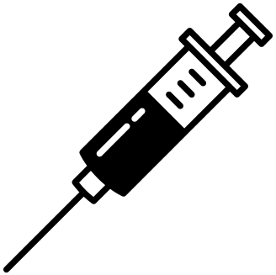

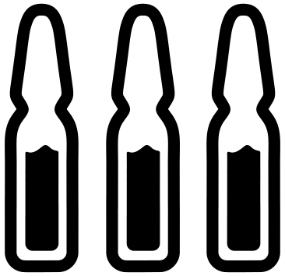
Overall Benefits of Testosterone Therapy (TTh)
Improved sexual function
Improved body composition
Improved mood
Reduced mortality risk
Improved anaemia
Increased bone mineral density
Improved glycaemic control
Hackett G. Ther Adv Urol 2016; 8: 147–60; Hackett G et al. J Sex Med 2016; 13: 887–904; Roy CN et al. JAMA Intern Med 2017;177:480–90; Snyder PJ et al. JAMA Intern Med 2017;177:471–9; Wittert, G et al. Lancet Diabetes Endocrinol 2021; 9: 32–45
.

Slide 3
  British Society for Sexual Medicine (BSSM) Recommendations 2017
Benefits and risks of TTh in patients with TD
Beyond 6 months there is evidence of benefit for T therapy in body composition, bone mineralisation, and features of metabolic syndrome
T therapy improves sexual desire, erectile function, and sexual satisfaction
Decreases in BMI and waist size and improved glycaemic control and lipid profile are observed
Trials of T therapy should be ≥6 months and maximal benefit is often seen beyond 12 months
Fully inform the patient about expected benefits and side effects of therapy and facilitate a joint discussion by an informed patient and physician
Fully discuss the adverse effect of T therapy and its effect on future fertility for each patient and his partner and offer alternative treatment as necessary
In patients with adult-onset TD, when TTh is prescribed, offer weight-loss and lifestyle advice as standard management
In severely symptomatic patients with TT levels <8 nmol/L, lifestyle and dietary advice alone is unlikely to produce meaningful clinical improvement within a relevant clinical period
T: testosterone, BMI: body mass index, TD: testosterone deficiency, TTh: testosterone therapy, TT: total testosterone, PSA: prostate-specific antigen, DRE: digital rectal examination, CV: cardiovascular
1. Hackett G, et al. J Sex Med 2017;14:1504-23; 2. Testogel (testosterone) Summary of Product Characteristics, August 2018.

Slide 4
Primary Clinical Benefits of Testosterone Therapy (TTh)

Slide 5
Testosterone Therapy (TTh)
The Major Goal of TTh:
  To achieve & maintain normal physiological testosterone levels to relieve symptoms of androgen deficiency, such as loss of libido, erectile dysfunction, changes in body composition and psychological impairment
EMA/716062/2014 Pharmacovigilance Risk Assessment Committee (PRAC)
Notes:
Papers postulate that once symptoms improve people become less adherent to treatment.
Should this statement be updated to reinforce the benefits of long-term therapy…..?

Slide 6
Swerdloff, RS et al.
Long-Term Pharmacokinetics of Transdermal Testosterone Gel in Hypogonadal Men
J Clin Endocrinol Metab, 2000 Vol. 85 No. 12
Wang C, Swerdloff RS et al.
Transdermal testosterone gel improves sexual function, mood, muscle strength, and body composition parameters in hypogonadal men.
J Clin Endo Metab. 2000 ;85: 2839-53. (Clinical Features)
Wang C, Swerdloff RS et al.
Effects of transdermal testosterone gel on bone turnover markers and bone mineral density in hypogonadal men.
Clin Endocrinol 2001; 54: 739-50. (Clinical Features)

Slide 7
Swerdloff RS et al. Long-Term Pharmacokinetics of Transdermal Testosterone Gel in Hypogonadal Men J Clin Endocrinol Metab 2000;85(12):4500–10.
Landmark 6-month study assessing the pharmacokinetic profiles of 2 doses of T gel and a T patch
Study design | A randomised, multicentre (16 centres), 6-month, active-comparator study to compare two doses of Testosterone gel (5g and 10g per day) versus a single dose of two Testosterone patches (total 5mg/day) The study was double blinded until day 90 with respect to the T gel groups and open label for the T patch group Statistical comparisons between groups were only performed until day 90 (randomised controlled part) using the original treatment assignments (50mg or 100mg T gel, or patch) as the independent groups.
Study population & treatment | 227 hypogonadal men (aged 19-68 years) with morning serum testosterone levels at ≤10.4 nmol/L (300ng/dL), PSA <4ng/mL and a normal DRE were included in the analysis. Day 0-90 (Randomised period): ▪ T Gel 50mg/day* (n=73) ▪ T Gel 100mg/day* (n=78) ▪ T patch (2x 2.5mg patch)/day** (n=76) Day 91-180 (non-randomised period) ▪ Doses could be adjusted to T Gel 75mg/day for patients on; T gel 50mg/day with levels <10.4nmol/L, or T gel 100mg/day with levels >34.7nmol/L
Study Objectives | To compare pharmacokinetic measurements of T and FT for T-Gel 50mg/day, T-Gel 100mg/day and a T patch (5mg/day), to assess T Gel as a suitable mode of delivery To determine the effect of transdermal T-application on other assays including serum DHT, E2, FSH, LH and SHBG Safety endpoints included any adverse effects and skin irritation.
*T Gel was applied to the upper arms, shoulders or abdomen. The study was double blinded with respect to the T Gel groups in this period.
**Both T patches were applied at the same time to a clean, dry area of skin on the back, abdomen, upper arms or thighs. The study was open label for the T patch group.
DHT - Dihydrotestosterone; E2 – Oestradiol; LH – Luteinising Hormone; FSH – Follicle Stimulating Hormone; SHBG – Sex Hormone Binding Globulin; T – Testosterone; FT – Free Testosterone
Notes:
Background Information:
Transdermal T patches (although not marketed in the UK any longer) did normalise serum T levels and reverse the symptoms of testosterone deficiency in hypogonadal men. However, acceptance of transdermal testosterone patches was limited in part because of skin irritation and/or a lack of adherence.
Design:
Patients applying testosterone gel had a single, preapplication serum testosterone measurement made on day 60; if the levels were within the normal range (10.4 –34.7nmol/L; 300-1000ng/dL), they remained on their original dose. Men with testosterone levels at 60 days of treatment <10.4 nmol/L and who were applying 50 mg gel and those with testosterone levels >34.7 nmol/L who had received 100mg gel were then assigned to the 75mg/day gel group for days 91–180.
No changes in dose were made to subjects randomised to testosterone patch.
The subjects had no history of chronic medical illness or alcohol or drug abuse. The subjects had a normal rectal examination, a prostate-specific antigen level of less than 4 ng/mL, and a urine flow rate of more than 12 mL/s before enrolment to the study. They were excluded if they had a generalized skin disease that might affect T absorption or a prior history of skin irritability with the non-scrotal T patch (Androderm). Subjects with body weight of less than 80 or more than 140% of ideal body weight and subjects taking medications known to alter the cytochrome P450 enzyme systems were also excluded from this study.
A placebo group was not included because 6-month placebo treatment of hypogonadal men was not believed to be justifiable, as untreated hypogonadism will result in impaired libido, decreased strength, bone mineral loss, and other clinical defects.
Reference
Swerdloff RS, Wang C, Cunningham G, et al. Long-Term Pharmacokinetics of Transdermal Testosterone Gel in Hypogonadal Men. J Clin Endocrinol Metab 2000;85(12):4500–10.

Slide 8
Results of the 6 Month AndroGel® 1% Trial
Testosterone levels returned to the normal range with all transdermal testosterone formulations
PK Results (T Levels) | Effect on Serum T levels (Figure 1) At Day 0 (baseline), average serum T concentrations over 24hours were below the normal adult range for all three groups (range 8.22-8.60nmol/L) On Days 30 and 90, after gel application, the Cav in the T Gel 100mg/day group was 27.46nmol/L, 1.4-fold higher than the T Gel 50mg/day group (Cav = 19.62nmol/L and 19.17nmol/L for Days 30 and 90, respectively), and 1.9-fold higher than the T patch group (14.62nmol/L and 14.46nmol/L for Days 30 and 90, respectively) (p=0.0001) On Day 180, the serum T concentrations achieved and the pharmacokinetic parameters were similar to those on Days 30 and 90, for patients who continued in their original randomised treatment groups Effect on Serum Free T levels Similar to the total T results, the free T Cav achieved by the T gel 100mg group was 1.4- and 1.7-fold higher than those in the T gel 50mg and T patch groups, respectively (P = 0.001).
Swerdloff, RS et al. J Clin Endocrinol Metab, 2000 Vol. 85 No. 12
PK – Pharmacokinetic; Cav - average serum testosterone level (0-24h); T – Testosterone
Notes:
For patients who switched from T Gel 100mg/day or T Gel 50mg/day to T Gel 75mg/day, their Cav on Day 180 was 20.84nmol/L, midway between the two original groups. However these results were not homogenous, with the Cav for patients who had swapped from T Gel 100mg/day to 75mg/day (n=20) being 1.7-fold higher than the Cav for patients who had swapped from T Gel 50mg/day to 75mg/day (n=20).

Slide 9

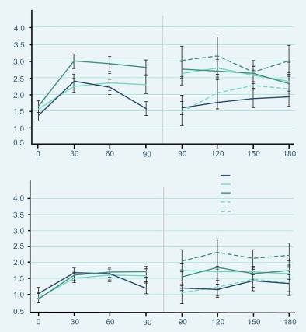
Effects on Sexual Function (6 Months)
  Similar scores at baseline
  Significant improvement compared to baseline in:
    Sexual motivation
    Sexual performance
    Sexual desire
    Satisfaction with erection
    For parameters (p=0.0001)
Motivation (0-7)
T patch
50 mg/day T gel
100 mg/day T gel
50-75 mg/day T gel
100-75 mg/day T gel
Performance (0-7)
Wang C, Swerdloff RS et al. J Clin Endocrinol Metab. 2000; 85:2839-53.
Day
Notes:
At baseline, the sexual motivation and performance scores were similar across groups.
After treatment – all subjects as a group showed significant improvement (p=0.0001).
A significant improvement in sexual function, as assessed by patient-completed questionnaires, was observed during 180 days of treatment with AndroGel® 5 g and 10 g. Patients with a dose adjustment to 7.5 mg at Day 90 had a very similar response to those remaining on their initial dose. Improvements were seen in sexual motivation (sexual day dreams, anticipation of sex, flirting and sexual interaction), sexual performance (orgasm, erection, masturbation, ejaculation and intercourse), sexual desire, sexual enjoyment with and without a partner, satisfaction with erection and the percentage of full erection achieved. These improvements occurred within 30 days and were sustained with continued therapy.

Slide 10
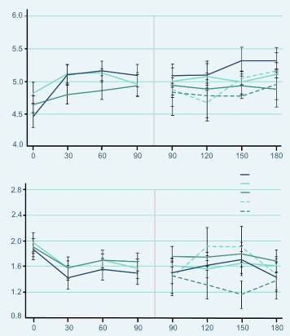
Effects on Mood (6 Months)
  Similar scores at baseline
  Positive Mood
    showed significant improvement (p=0.0001)
  Negative Mood
    showed significant decreases (p=0.0001)
Positive moods (0-7)
T patch
50 mg/day T gel
100 mg/day T gel
50-75 mg/day T gel
100-75 mg/day T gel
Negative moods (0-7)
Wang C, Swerdloff RS et al. J Clin Endocrinol Metab. 2000; 85:2839-53.
Day
Notes:
Parameters of mood were assessed by using questionnaires that the patients answered daily for 7 consecutive days before clinic visits on day 0 and on days 30, 60, 90, 120, 150, and 180 days during gel and patch application.
This chart shows the positive and negative mood summary responses to T replacement therapy.
All three treatment groups had similar scores at baseline, and all subjects as a group showed improvement in positive mood (P=0.0001).
Positive mood parameters included being alert, friendly, full of energy and well/good feelings.
The negative mood summary scores were also similar in the three groups at baseline.
Negative mood parameters were anger, irritable, sad, tired and nervousness.
The responses to transdermal T applications showed significant decreases (P=0.0001) without showing between-group differences.

Slide 11
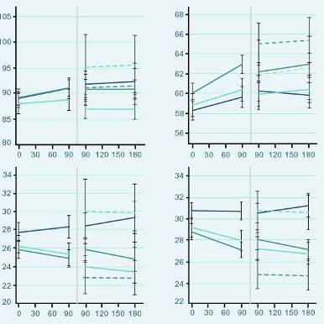
Effects on Body Composition (6 Months)
  Similar scores at baseline
  Increase in body mass
    due to the increase in lean body mass
    positively correlated with the increase in serum T from baseline
  Fat mass and percent body fat significantly decreased with T gel
T patch
50 mg/day T gel
100 mg/day T gel
50-75 mg/day T gel
100-75 mg/day T gel
Total Body Mass
Lean Mass
Total Body Mass (Kg)
Fat Mass
% Fat
Fat Mass (Kg)
Day
Day
Wang C, Swerdloff RS et al. J Clin Endocrinol Metab. 2000; 85:2839-53.
Notes:
Body composition (total body mass, lean body mass, fat mass, and percent fat) was measured by dual x-ray absorptiometry on days 0, 90, and 180.
At baseline there were no significant differences in these body composition parameters in the three treatment groups.
The increase in body mass was mainly due to the increases in lean body mass.
The percent body fat and fat mass decreased in all treatment groups.
AndroGel® 5 g and 10 g treatment for 180 days resulted in statistically significant increases in total body mass and total lean body mass, whereas the total body fat mass and percentage body fat decreased significantly. The changes to lean body mass and total fat mass were significant by Day 90. The total fat mass remained significantly lower until Day 180. Similar changes were seen in patients titrated to the 7.5 g dose. At the end of 180 days of treatment, the increase in lean body mass was positively correlated with the increase in serum testosterone concentrations from baseline.

Slide 12
Effects on Muscle Strength (6 Months)
Increase in arm and leg muscle strength Day 90 compared to baseline | T-gel 5g n = 73 | T-gel 10 g n = 78 | T-patch n = 76
Leg muscle strength with leg press exercises | 13.7 ± 3.4 kg (p=0.0003) | 12.7 ± 2.7 kg (p=0.0001) | 11.6 ± 2-5 kg (p=0.0001)
Arm/chest muscle strength | 2.6 ± 0.7 kg (p=0.0009) | 2.9 ± 0.8 kg (p=0.0004) | 1.5 ± 0.8 kg (p=0.08)
Wang C, Swerdloff RS et al. J Clin Endocrinol Metab. 2000; 85:2839-53.
Notes:
There was an increase in muscle strength in the legs and arm/chest. After 90 days of treatment, the muscle strength in leg press exercises had increased by 13.7 ± 3.4 kg (p=0.0003) and 12.7 ± 2.7 kg (p=0.0001) with 5 g and 10 g AndroGel®, respectively. Somewhat smaller increases were seen in arm/chest muscle strength: 2.6 ± 0.7 kg (p=0.0009) with 5 g and 2.9 ± 0.8 kg (p=0.0004) with 10 g.

Slide 13
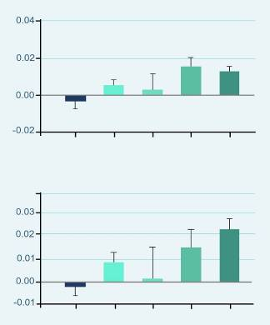
Effects on Bone Mineral Density (6 Months)
  BMD increased with T gel in a dose dependent fashion
  Significant increase in BMD with the 10 g dose at both
    Hip (* p=0.0001)
    Spine (* p=0.0001)
  Significant increase in hip BMD with patients titrated down to 7.5 g after Day 90
    Hip (**p=0.016)
**
*
Change in hip BMD (g/cm²)
Patch
50 mg
50-
75 mg
100-
75 mg
100 mg
T Gel
*
Change in spine BMD (g/cm²)
Patch
50 mg
50-
75 mg
100-
75 mg
100 mg
T Gel
Wang C, Swerdloff RS et al. Clin Endocrinol (Oxf). 2001;54:739-50.
Notes:
Bone mineral density in the hip and spine, as measured by DEXA, increased after 180 days of treatment with 5 g or 10 g AndroGel®. The effect was statistically significant with the 10 g dose. Patients titrated down to 7.5 g after Day 90 also showed a significant increase in hip bone mineral density (p=0.016), whilst no significant change was seen in those titrated up to 7.5 g.
There were also positive changes in urinary markers of bone catabolism. The N-telopeptide:creatine ratio declined within 30 days of treatment with both the 5 g and 10g doses of AndroGel®, and remained below baseline at Day 180.

Slide 14
Wang, C et al.
Long-Term Testosterone Gel Treatment Maintains Beneficial Effects on Sexual Function and Mood, Lean and Fat Mass, and Bone Mineral Density in Hypogonadal Men
J Clin Endocrinol Metab, May 2004, 89(5):2085–2098.

Slide 15
Wang C et al. Long-Term Testosterone Gel (AndroGel*) Treatment Maintains Beneficial Effects on Sexual Function and Mood, Lean and Fat Mass, and Bone Mineral Density in Hypogonadal Men. J Clin Endocrinol Metab 2004;89:2085–98.
Long term open-label efficacy, outcome and safety follow up study of Swerdloff 2000
Study design | 36-month open-label follow-up study of the randomised controlled study, Swerdloff 2000 (42 months total). To evaluate the long term efficacy of T Gel
Study treatment | All patients were treated with T Gel at a dose of either 5g, 7.5g or 10g of gel daily (50mg, 75mg or 100mg testosterone respectively) All subjects previously on the T patch were assigned to 5g AndroGel* Men previously on T gel 5g/day with levels <10.4nmol/L (or T gel 10g/day with levels >34.7nmol/L) were assigned to 7.5g/day gel group. Due to the long duration of the study, the study design allowed dose adjustment in increments of 2.5g/day (range min: 2.5g/day max: 10g/day) throughout the study period, depending on clinical symptoms and serum T levels.
Study population | A total of 163 subjects (aged 19-68 years) participated in the long-term study and were included in the safety analysis 123 subjects were included in the efficacy analysis n=49 (primary hypogonadism), n=27 (secondary hypogonadism), n=47 (age-related/adult-onset hypogonadism)
Notes:
Design:
Subjects were permitted entry into a long-term efficacy study of 24 months (total exposure 30 months), which was further extended for up to 36 months (total exposure 42 months)
40 subjects were excluded from the efficacy analysis:
- If there was an interval of ≥90days between the end of the 6-month study and the long-term study in which the subjects could have received some other treatment (20 subjects)
If the subjects participated for <3 months in the long-term study (9 subjects), or
If the subjects were enrolled in this study without having completed the 6-month study (11 subjects)
In the initial 6-month study, patients randomised to testosterone gel had a single, preapplication serum testosterone measurement on Day 60; if levels were within the normal range (10.4 –34.7 nmol/litre; 300-1000 ng/dl), they remained on their original dose.

Slide 16
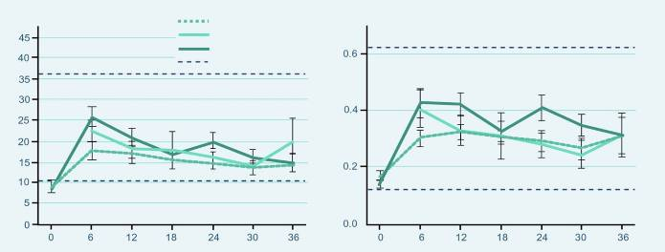
Results of the 3 Year AndroGel® 1% Trial
  Testosterone Levels
5 grams
7.5 grams
10 grams
Normal range
Months
Months
  At 6 months, the beginning of the long-term study, mean serum T levels were at 14.1, 22.4 and 25.6 nmol/L for the 5g, 7.5g and 10g groups, respectively, which were significantly different between the groups (p = 0.012)
  At 12 months the differences in T concentrations between the different dose groups became smaller but remained significant (p= 0.042)
  Thereafter with dose adjustment for the subjects, serum T levels were not different between the three groups.
  Serum free T followed the same pattern as serum T and also showed no significant differences among the dose groups after 12 months.
Wang C, Cunningham G et al. J Clin Endo Metab 2004; 89:2085-98.
Notes:
At 6 months, which is the beginning of the long-term study, mean serum T levels were at 14.1 ± 1.3, 22.4 ±2.7 and 25.6 ± 2.4 nmol/L which was significantly different for the 5, 7.5 and 10g T gel dose group, respectively (p = 0.012). At 12 months the differences in serum T concentrations between the different dose groups became smaller but remained significant (p = 0.042: T gel 5 g/d 16.9 ± 1.9 nmol/L; 7.5 g/d, 17.9 ± 3.9 nmol/L; and 10 g/d, 20.5 ± 1.5 nmol/L). Thereafter with dose adjustment for the subjects, serum T levels were not different between the three groups.
Serum free T followed the same pattern as serum T and also showed no significant differences among the dose groups after 12 months.

Slide 17
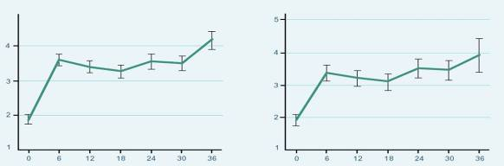
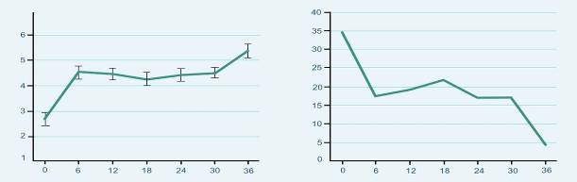
Effects on Sexual Function (3 Years)
  After treatment with T Gel, Sexual Desire, Sexual Enjoyment and Sexual Activity improved, compared with baseline, and were maintained at the same level from 6 months until the end of the treatment period.
Sexual Desire
Sexual Activity
*
*
Sexual activity (0-7)
Sexual desire (0-7)
Satisfaction with Erection
% Without Erections
*
Satisfaction (0-7)
Subjects without erections (%)
Months
Months
Wang C, Cunningham G et al. J Clin Endo Metab 2004; 89:2085-98.
Notes:
After treatment with T gel, as a group sexual desire (P = 0.0001), enjoyment without partner (P = 0.0001), enjoyment with partner (P= 0.0022), percent full erection (P = 0.0001), and self-assessment of satisfaction with erections (P= 0.0001) improved, compared with baseline, and were maintained at the same level from 6 months until the end of the treatment period. Sexual activity scores were also significantly increased and maintained at the same level from 6 months throughout the treatment period (P = 0.0001). The proportion of subjects with erections increased from a baseline of 64.8% to 81.7% at 6 months without subsequent further significant increases.

Slide 18
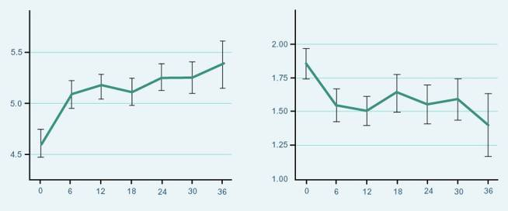
Effects on Mood (3 Years)
  Positive mood improved significantly and changes were sustained from baseline
  Negative mood parameters were decreased and remained significantly lower (p=0.0013) than baseline without further changes after 6 months of T Gel replacement therapy.
Positive Moods
Negative Moods
Positive moods (0-7)
p = 0.0022
p = 0.0013
Months
Months
Wang C, Cunningham G et al. J Clin Endo Metab 2004; 89:2085-98.
Notes:
Positive mood scores improved with treatment and were sustained (P=0.0022), whereas negative mood parameters were decreased and remained significantly lower (P=0.0013) than baseline without further changes after 6 months of T gel replacement. There was overall improvement in psychosexual function in men over 60 yr, but the changes were smaller, compared with those younger than 60 yr of age (e.g. sexual activity P=0.0129 in older men and P= 0.0001 in younger men).

Slide 19
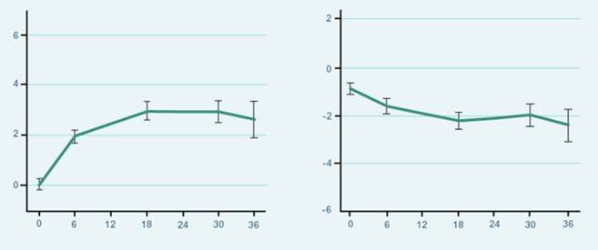
Effects on Body Composition (3 Years)
  Lean and fat body mass changed significantly from baseline
Lean Body Mass Change
Fat Body Mass Change
Fat mass change (kg)
*
Lean mass change (kg)
*
* p = 0.0001
* p = 0.0058
Months
Months
Wang C, Cunningham G et al. J Clin Endo Metab 2004; 89:2085-98.
Notes:
Average total body mass increased by 1.2 ± 0.3 kg at 6 months (P=0.0157) and did not significantly change with continued T gel therapy.
Lean body mass increased significantly (P=0.0001) from baseline and remained increased throughout the study period. The change in lean body mass was 1.97 ± 0.24 kg at 6 months and was further increased to 2.93 ± 0.32 kg at 18 months and 2.89 ± 0.41 kg at 30 months (P=0.0065). The differences in the lean body mass between the dose groups and those over and under age 60 yr were not significant.
Fat mass decreased significantly as a group with T gel replacement (P=0.0058). The decrease in fat mass was 0.8 ± 0.3 kg at 6 months and 1.57 ± 0.38 and 1.30 ± 0.51 kg at 18 and 30 months (P= 0.088 when compared with 6 months), respectively, without significant differences among the different dose groups. The decreases in fat mass (P=0.032) and percent fat (P=0.0001) were observed only in the younger subjects but not in older men. The changes in body composition parameters were not related to the change in serum T concentrations during replacement therapy.

Slide 20
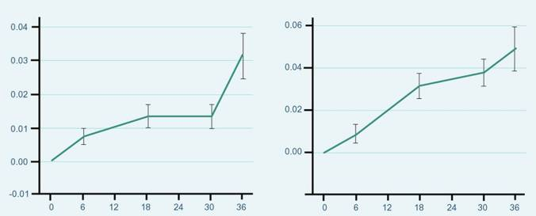
Effects on Body Composition (3 Years)
  BMD showed significant gradual and progressive increase from baseline
Change Hip BMD
Change Spine BMD
Change in hip BMD (g/cm²)
Change in spine BMD (g/cm²)
p = 0.0004
p = 0.0001
Months
Months
Wang C, Cunningham G et al. J Clin Endo Metab 2004; 89:2085-98.
Notes:
BMD of the hip (P = 0.0004) and spine (P= 0.0001) showed a gradual and progressive increase with treatment. The increase in the BMD was more marked in the spine than the hip. Spine BMD increased by 0.031± 0.006 (3.1%) and 0.037 ± 0.006 g/cm2 (3.8%) at 18 and 30 months of treatment, respectively, and was significantly higher than that at 6 months (P =0.0001). There were no significant differences in the improvement in BMD among the three dose groups or between the younger and older age groups. The absolute increase in BMD in the hip and spine was not related to the baseline serum T or the change in serum T levels but was significantly related to baseline BMD (P= 0.0001).

Slide 21
Kaufman JM et al.
Efficacy and Safety Study of 16.2mg/g Testosterone Gel for the Treatment of Hypogonadal Men
J Sex Med 2011;2079-2089
Kaufman JM et al.
One-year efficacy and safety study of a 16.2mg/g testosterone gel in hypogonadal men:
J Sex Med 2012;9:1149–61

Slide 22
Kaufman, JM et al (2011): 82.2% of hypogonadal men achieved T levels within the normal range at Day 182, following treatment with testosterone 16.2mg/g gel
Testosterone 16.2mg/g increases C_{av} testosterone levels to within the normal range in hypogonadal men
Results | Efficacy The success criterion was determined to be ≥75% of subjects achieving testosterone levels within the normal range of 300-1000ng/dL This was met in all population samples on all study days by the testosterone treatment group except on day 14 (65.7%) Significantly more subjects receiving titrated doses of testosterone gel at day 182 had testosterone Cav values within the eugonadal range vs placebo (p<0.0001) After titration, the dose distribution was 1.25g (7.3% n=17/234), 2.5g (25.6% n=60/234), 3.75g (28.2% n=66/234), and 5.0g (38.9% n=91/234).
Number & percentage of subjects achieving C_{av} target range (300-1000ng/dL)* for testosterone on day 182 following dose titration
Study day | 16.2mg/g testosterone gel |  | Placebo |  | P value
 | n/N (%) | 95% Cl | n/N (%) | 95% Cl
182 | 139/169 (82.2) | (75.6, 87.7) | 8/28 (28.6) | (13.2, 48.7) | <0.0001
* This equates to 10.4-34.7nmol/L; C_{av} - serum total testosterone average concentrations; T - Testosterone
Table adapted from Kaufman JM, et al 2011

Slide 23
Kaufman, JM et al (2012): >77% of patients achieved normal T levels after 1 year following dose titration with 16.2mg/g T gel
Testosterone 16.2mg/g gel for up to 1 year is efficacious with >77% of patients achieving normal testosterone levels following dose titration
Results | Efficacy On final visit, day 364, 77.9% and 87.0% of patients previously receiving testosterone gel or placebo gel respectively in the previous 6 month double-blind study had C_{av} values within the eugonadal range (300-1000ng/dL*) Based on the last titrated dose (following day 266), final dose allocation to 16.2mg/g testosterone gel was: 1.25g (7.8% n=15/191), 2.5g (21.5% n=41/191), 3.75g (22.5% n=43/191), and 5.0g (48.2% n=92/191).
Number & percentage of subjects achieving C_{av} target range (300-1000ng/dL)* for testosterone on day 364 following dose titration
Study day | Continuing Active |  | Formerly Placebo |  | Total (Continuing Active + Placebo)
 | n/N (%) | 95% Cl | n/N (%) | 95% Cl | n/N (%) | 95% Cl
364 | 106/136 (77.9) | 70.0, 84.6 | 20/23 (87.0) | 66.4, 97.2 | 126/159 (79.2) | 72.1, 85.3
* This equates to 10.4-34.7nmol/L; C_{av} - serum total testosterone average concentrations; T - Testosterone

Slide 24
Snyder PJ et al.
Effects of Testosterone Treatment in Older Men
N Engl J Med 2016;374:611–24
Walsh JS et al.
Testosterone replacement in young male cancer survivors: A 6-month double-blind randomised placebo-controlled trial
PLoS Med 2019;16:e1002960.

Slide 25




Sexual Function Trial: effect of TTh on sexual activity in older men with low testosterone
To determine if TTh for older men with low testosterone increases sexual activity, assessed by PDQ-Q4
Aim
n=
459
enrolled in the Sexual Function Trial and analysed
n=
771
enrolled in all TTrials and analysed
Selected
baseline characteristics
and demographics
Mean age
Race
PDE-5 inhibitor use
72.2 years
89% White
8.4%
BMI, body mass index; PDE-5, phosphodiesterase type 5; PDQ-Q4, question 4 of the Psychosexual Daily Questionnaire; TTh, testosterone therapy
Snyder PJ et al. N Engl J Med 2016;374:611–24; Snyder PJ et al. Endocr Rev 2018;39:369–86.
Notes:
The PDQ is a 7-day diary used in multiple trials to evaluate both the frequency and intensity of sexual desire and performance across sexual activities.¹
PDQ-Q4 asks participants to list how many of 12 specified activities (sexual daydreams, anticipation of sex, sexual interactions with partner, flirting by you, flirting toward you, orgasm, ejaculation, intercourse, masturbation, night spontaneous erection,
day spontaneous erection, and erection in response to sexual activity) they engaged
in each day of the week, and the daily count is averaged over 7 days for a total score ranging from 0–12 (higher scores indicate more activity).^{1,2}
Previous studies show that in hypogonadal men, sexual activity assessed by the PDQ significantly improved after administration of TTh.¹
In the Sexual Function Trial, sexual activity was assessed by PDQ-Q4, administered by interactive voice response daily for 7 days at baseline and 3, 6, 9 and 12 months. An average of the scores for the 7 days at each time point were taken.³
PDQ-Q4 was also administered to all men in the T Trials; however, the primary outcome was determined only for men who were enrolled in the Sexual Function Trial, and analyses of PDQ-Q4 in the overall T Trial population were exploratory only.^{2,3}
PDQ-Q4, question 4 of the Psychosexual Daily Questionnaire (PDQ); TTh, testosterone therapy
References
1. Wang C et al. J Sex Med 2018;15:997–1009; 2. Snyder PJ et al. N Engl J Med 2016;374:611–24;
3. Snyder PJ et al. Endocr Rev 2018;39:369–86.

Slide 26
Sexual Function Trial: TTh significantly improved sexual function versus placebo in older men with low testosterone
Averaged over all follow-up visits, TTh significantly increased sexual activity versus placebo among hypogonadal men enrolled in both the Sexual Function Trial and across all TTrials^{1,2}
  TTh also substantially increased libido and, to a lesser degree, erectile function²
Association between TTh and increased sexual activity in men with low testosterone
Effect of TTh on sexual activity, assessed by PDQ-Q4, in older men with low testosterone²
Men enrolled
in the Sexual Function Trial (n=459)
All men in the TTrials
(n=771)
1.0
p<0.001
1.0
p<0.001
0.8
0.8
0.6
0.6
0.4
0.4
Change from baseline
in response to PDQ-Q4
Change from baseline
in response to PDQ-Q4
0.2
0.2
0
0
-0.2
-0.2
-0.5
TTh
Placebo
-0.5
0
3
6
9
12
0
3
6
9
12
No. at risk
TTh
Placebo
Month
No. at risk
TTh
Placebo
Month
230
229
206
201
208
191
205
191
193
194
387
384
348
335
349
317
339
314
328
319
PDQ-Q4, question 4 of the Psychosexual Daily Questionnaire; TTh, testosterone therapy
1. Snyder PJ et al. N Engl J Med 2016;374:611–24; 2. Snyder PJ et al. Endocr Rev 2018;39:369–86.
Notes:
TTh, compared with placebo, substantially increased sexual activity, averaged over all follow-up visits, for men enrolled in the Sexual Function Trial (n=459) and also for all men in the TTrials (n=771). This effect was seen for most types of sexual activity assessed, including sexual daydreams, flirting, sexual intercourse, masturbation and spontaneous erections at night.^{1,2}
The treatment effect (defined as the mean difference in the change from baseline between participants assigned to TTh and those assigned to placebo) was 0.58
and 0.62 for men in the Sexual Function Trial and all men in the TTrials, respectively (both p<0.001).³
The clinical significance of this effect can be judged from the effect size of 0.45,
which is close to a ‘moderate’ effect of 0.5, and that TTh increased sexual activity
of all types about four times a week.¹
Elevations in plasma testosterone level during TTh were proportional to increases
in PDQ-Q4 score (p<0.001 by instrumental variable analysis).³
TTh also substantially increased libido and, to a lesser degree, erectile function.¹
Incremental increases in total and free testosterone and oestradiol levels were substantially associated with greater improvements in sexual activity and libido, but not erectile function.¹
CI, confidence interval; OR, odds ratio; PDQ-Q4, question 4 of the Psychosexual Daily Questionnaire; TTh, testosterone therapy
References
1. Snyder PJ et al. Endocr Rev 2018;39:369–86; 2. Matsumoto AM. Curr Opin Endocr Metab Res 2019;6:34–41; 3. Snyder PJ et al. N Engl J Med 2016;374:611–24.

Slide 27
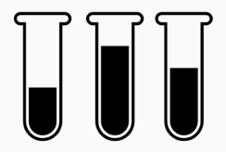
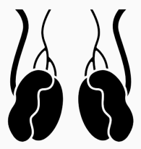
TRYMS Study 2019: TTh is associated with improvement in body composition including reduction in trunk fat mass in young, male cancer survivors
Lower testosterone levels may contribute to the high fat mass and poor QoL seen in young, male cancer survivors
The UK placebo-controlled, double-blind, multicentre TRYMS study examined whether young male cancer survivors (N=136) with borderline low testosterone levels might benefit from TTh
Participants were randomised 1:1 to receive testosterone 2% gel (Tostran®, Fortesta®, Tostrex®, Itnogen®) or placebo for 26 weeks
Selected
baseline characteristics
and demographics
Baseline morning
serum total
testosterone level
Age
88% of
participants had testicular cancer
25–50 years
7–12 nmol/L
BMI, body mass index; QoL, quality of life; TRYMS, Testosterone Replacement in Young Male Cancer Survivors; TTh, testosterone therapy
Walsh JS et al. PLoS Med 2019;16:e1002960.
Notes:
Young male cancer survivors in the UK with borderline low testosterone levels were
enrolled in the placebo-controlled, double-blind TRYMS trial of TTh.
Eligible participants were aged 25–50 years and were ≥12 months from the end of
curative treatment for either testicular cancer, lymphoma or leukaemia, and had a
baseline morning serum total testosterone concentration of 7–12 nmol/L.
Participants were randomised to either active testosterone 2% gel or a placebo (inactive)
gel, applied daily to skin for 6 months.
At baseline and study end, body composition was measured and participants’ quality of
life was assessed using questionnaires.
TRYMS, Testosterone Replacement in Young Male Cancer Survivors; TTh, testosterone therapy
Reference
Walsh JS et al. PLoS Med 2019;16:e1002960.

Slide 28
TRYMS Study 2019: TTh is associated with improvement in body composition including reduction in trunk fat mass in young, male cancer survivors (cont.)
Change in trunk fat mass, whole-body fat mass, and whole-body lean mass at 26 weeks*
At Week 26, TTh was associated with:
  Significant decrease in trunk fat mass
  (−0.9 kg, 95% CI: −1.6, −0.3; p=0.0073)
    25% of men had a decrease >1.5 kg
  Decrease in whole-body fat mass
  (−1.8 kg, 95% CI: −2.9, −0.7; p=0.0016)
  Increase in whole-body lean mass
  (1.5 kg, 95% CI: 0.9, 2.1; p<0.001)
Decrease in fat mass was greatest in men with
a high trunk fat mass at baseline
There was no treatment effect on any QoL scores
Conclusions
In men with low and low-normal fasting morning
total testosterone 7–12 nmol/L, TTh is associated
with improvements in body composition
The reduction in trunk fat mass with TTh is potentially more beneficial in men with an increased trunk fat mass
  In these patients, TTh should be considered alongside other interventions to improve body composition
*
*
*
*
*
Absolute change (kg)
*
*
*
*
*
*
*
*Boxes represent IQR, circles indicate mean, lines inside the box indicate median, whiskers represent range excluding outliers, asterisks indicate outliers.
CI, confidence interval; IQR, interquartile range; QoL, quality of life; TRYMS, Testosterone Replacement in Young Male Cancer Survivors; TTh, testosterone therapy
Adapted from Walsh JS et al. PLoS Med 2019;16:e1002960.
Notes:
Young male cancer survivors in the UK with borderline low testosterone levels were enrolled in the placebo-controlled, double-blind TRYMS trial of TTh.
At Week 26, TTh was associated with a statistically significant:
Decrease in trunk fat mass [treatment effect: -0.9 kg (95% CI: -1.6, -0.3; p=0.0073)];
in the treatment group, 25% of men had a decrease in trunk fat mass of >1.5 kg.
Decrease in whole-body fat mass [treatment effect: -1.8 kg (95% CI: -2.9, -0.7; p=0.0016)].
Increase in lean body mass [treatment effect: 1.5 kg (95% CI: 0.9, 2.1; p<0.001)].
TTh is associated with improvements in body composition in men with low/low-normal fasting morning total testosterone concentrations (7–12 nmol/L).
CI, confidence interval; TRYMS, Testosterone Replacement in Young Male Cancer Survivors; TTh, testosterone therapy
Reference
Walsh JS et al. PLoS Med 2019;16:e1002960.

Slide 29
Primary Clinical Benefits - Summary (1/2)
Pivotal studies on testosterone gel from the early 2000s were designed to demonstrate that a transdermal gel delivery system would be an acceptable route of administration when compared to a testosterone patch.^{1,2}
The landmark pharmacokinetic study by Swerdloff RS et al showed that AndroGel can efficiently elevate serum T and FT levels to the normal range in hypogonadal men whilst also being able to provide dose flexibility. ¹
Wang et al continued the work of Swerdloff to look at the long term efficacy, outcome and safety results of testosterone gel application over a 42 month period. They demonstrated that AndroGel restored and maintained T and FT levels within the normal range and showed sustained benefits on sexual symptoms and body composition parameters. Safety parameters were shown to be comparable to other delivery systems. ²
Wang therefore concluded that AndroGel is effective & well-tolerated when used in the long-term treatment of hypogonadal men. ²
Swerdloff RS, Wang C, Cunningham G, et al. Long-Term Pharmacokinetics of Transdermal Testosterone Gel in Hypogonadal Men. J Clin Endocrinol Metab 2000;85(12):4500–10.
Wang C, Cunningham G, Dobs A, et al. Long-Term Testosterone Gel (AndroGel) Treatment Maintains Beneficial Effects on Sexual Function and Mood, Lean and Fat Mass, and Bone Mineral Density in Hypogonadal Men. J Clin Endocrinol Metab 2004;89:2085–98.

Slide 30
Primary Clinical Benefits - Summary (2/2)
In 2011, Kaufman JM et al demonstrated that 82.2% of subjects achieved C_{av} target range (300-1000ng/dL)* for testosterone on day 182 following dose titration.¹
Kaufman concluded that 16.2mg/g testosterone gel offers an effective, convenient, flexible and well tolerated dosing regimen that achieves eugonadal testosterone levels in hypogonadal men and provides patients the opportunity to reduce the total mass of gel applied vs. 1% testosterone gel products. ¹
Kaufman then extended the original trial by a further 6 months in an open-label phase following which he concluded that 16.2mg/g testosterone gel for up to 1 year was well tolerated and efficacious, with >77% of patients achieving normal serum testosterone levels following dose titration. ²
In 2016, Snyder et al demonstrated that older men with TD achieve significant improvements in sexual function when treated with TTh for 12 months.³
More recently, in 2019 Walsh et al demonstrated that TTh can have significant beneficial improvements in body composition when given to young male cancer survivors for 6 months.⁴
* This equates to 10.4-34.7nmol/L. C_{av} - serum total testosterone average concentrations.
1. Kaufman JM, Miller MG, Garwin JL, et al. Efficacy and safety study of 1.62% testosterone gel for the treatment of hypogonadal men. J Sex Med 2011;8:2079–89.; 2. Kaufman JM, Miller MG, Fitzpatrick S, et al. One-year efficacy and safety study of a 1.62% testosterone gel in hypogonadal men: Results of a 182-day open-label extension of a 6-month double-blind study. J Sex Med 2012;9:1149–61; 3. Snyder PJ et al. N Engl J Med 2016;374:611–24; 4. Walsh JS et al. PLoS Med 2019;16:e1002960.

Slide 31
Secondary Clinical Benefits of Testosterone Therapy (TTh)

Slide 32
Roy CN et al.
Association of Testosterone Levels With Anaemia in Older Men. A Controlled Clinical Trial
JAMA Intern Med 2017;177:480–90
Snyder PJ et al.
Effect of Testosterone Treatment on Volumetric Bone Density and Strength in Older Men With Low Testosterone. A Controlled Clinical Trial
JAMA Intern Med 2017;177:471–9.
Tang-Fui NM et al
Effect of Testosterone treatment on bone microarchitecture and bone mineral density in men: a two-year RCT
The Journal of Clinical Endocrinology & Metabolism, dgab149

Slide 33



Anaemia Trial: relationship between testosterone levels and anaemia, and impact of TTh in older men
To determine if TTh for older men with low testosterone increases haemoglobin concentration and can correct anaemia
Aim
788
n=
n=126 with anaemia (n=62 with unexplained anaemia)
enrolled
Selected
baseline characteristics
and demographics
Mean age
Race
Mean BMI
74.8 years
85% White
30.7 kg/m²
*Haemoglobin concentration <12.7 g/dL; BMI, body mass index; TTh, testosterone therapy; vBMD, volumetric bone mineral density
Roy CN et al. JAMA Intern Med 2017;177:480–90; Snyder PJ et al. Endocr Rev 2018;39:369–86.
Notes:
For the Anaemia Trial, men had baseline haemoglobin levels ≤12.7 g/dL and were classified using family history and blood/laboratory testing into cohorts with either unexplained anaemia (n=62, 49.2%) or anaemia of known cause (n=64, 50.8%):
Myelodysplasia, n=8 (6.3%).
Iron deficiency, n=42 (33.3%).
Vitamin B12 deficiency, n=3 (2.4%).
Anaemia of inflammation/chronic disease, n=10 (7.9%).
Plasma cell dyscrasia, n=1 (0.8%).
No cases of renal insufficiency, folate deficiency, haemolytic anaemia or
monoclonal gammopathy.
TTh, testosterone therapy
Reference
Roy CN et al. JAMA Intern Med 2017;177:480–90.

Slide 34
TTh significantly increased Hb levels in older men with low testosterone and unexplained anaemia
Significantly more men with anaemia of unknown cause had an increase in Hb level ≥1 g/dL from baseline at Month 12 with TTh (54%) than placebo (15%)
  Adjusted OR 31.5, 95% CI: 3.7–277.8; p=0.002
  More men were not anaemic at Month 12 with TTh (58.3%) than placebo (22.2%)
  Adjusted OR 17.0, 95% CI: 2.8–104.0; p=0.002
Association between TTh and Hb concentration in men with unexplained anaemia
Unexplained anaemia at baseline
Change in haemoglobin levels for
unexplained anaemia from baseline
80
Testosterone
Placebo
p=0.002
1.5
p=0.02
60
1.0
Percent of men whose haemoglobin levels increased ≥1 from baseline
Change in haemoglobin levels from baseline
40
0.5
20
0
0
-0.5
0
3
6
9
12
0
3
6
9
12
No. at risk
Testosterone
Placebo
Month
No. at risk
Testosterone
Placebo
Month
27
35
24
32
22
27
24
28
24
27
27
35
24
32
22
27
24
28
24
27
CI, confidence interval; Hb, haemoglobin; OR, odds ratio; TTh, testosterone therapy
Roy CN et al. JAMA Intern Med 2017;177:480–90.
Notes:
In cases of unexplained anaemia, more men receiving TTh achieved improvements in haemoglobin concentration ≥1.0 g/dL at Month 12 versus baseline, compared with placebo treatment (adjusted OR 31.5, 95% CI: 3.7–277.8; p=0.02) (primary outcome).
In total, 54% of TTh-treated men and 15% of placebo-treated men had increases of ≥1.0 g/dL versus baseline.
TTh also increased haemoglobin concentrations by continuous analysis in men with unexplained anaemia (secondary outcome):
Adjusted mean difference 0.83 g/dL, 95% CI: 0.48–1.39; p<0.001.
At Month 12, 58.3% (n=14/24) of TTh-treated men with unexplained anaemia at baseline were no longer anaemic, compared with 22.2% (n=6/27) of placebo-treated men
(OR 17.0, 95% CI: 2.8–104.0; p=0.002).
CI, confidence interval; OR, odds ratio; TTh, testosterone therapy
Reference
Roy CN et al. JAMA Intern Med 2017;177:480–90.

Slide 35
TTh significantly increased Hb levels in older men with low testosterone and anaemia of known cause
Significantly more men with anaemia of known cause had an increase in Hb level ≥1 g/dL from baseline at Month 12 with TTh (52%) than placebo (19%)
  Adjusted OR 8.2, 95% CI: 2.1–31.9; p=0.003
Association between TTh and Hb concentration in men with anaemia of known cause
Anaemia of known cause
at baseline
Change in haemoglobin levels for anaemia of known cause from baseline
80
Testosterone
Placebo
p=0.003
1.5
p=0.02
60
1.0
Percent of men whose haemoglobin levels increased ≥1 from baseline
Change in haemoglobin levels from baseline
40
0.5
20
0
0
-0.5
0
3
6
9
12
0
3
6
9
12
No. at risk
Testosterone
Placebo
Month
No. at risk
Testosterone
Placebo
Month
29
35
25
31
26
25
25
26
25
27
29
35
25
31
26
25
25
26
25
27
CI, confidence interval; Hb, haemoglobin; OR, odds ratio; TTh, testosterone therapy
Roy CN et al. JAMA Intern Med 2017;177:480–90.
Notes:
In cases of anaemia of known cause, more men receiving TTh achieved improvements in haemoglobin concentration ≥1.0 g/dL at Month 12 versus baseline, compared with placebo treatment (adjusted OR 8.2, 95% CI: 2.1–31.9; p=0.003).
In total, 52% of TTh-treated men and 19% of placebo-treated men had increases of ≥1.0 g/dL versus baseline.
TTh also increased haemoglobin concentrations by continuous analysis in men with anaemia of known cause:
Adjusted mean difference 0.64 g/dL, 95% CI: 0.12–1.17; p=0.02.
At Month 12, 60.0% (n=15/25) of TTh-treated men with anaemia of known cause at baseline were no longer anaemic, compared with 14.8% (n=4/27) of placebo-treated men
(OR 9.4, 95% CI: 1.4–60.5; p=0.02).
CI, confidence interval; OR, odds ratio; TTh, testosterone therapy
Reference
Roy CN et al. JAMA Intern Med 2017;177:480–90.

Slide 36
TTh significantly increased Hb levels in older men with low testosterone without anaemia
More men WITHOUT anaemia had a significant increase in Hb level ≥1 g/dL from baseline at Month 12 with TTh than placebo
In men without anaemia at baseline, administration of TTh resulted in an Hb concentration of >17.5 g/dL in 6 older, hypogonadal men without anaemia. Most of these patients had supraphysiological levels of testosterone at the time of measurement
Association between TTh and Hb concentration in men without anaemia
No anaemia at baseline
Change in haemoglobin levels for no anaemia from baseline
80
Testosterone
Placebo
p<0.001
1.5
p<0.001
60
1.0
Percent of men whose haemoglobin levels increased ≥1 from baseline
Change in haemoglobin levels from baseline
40
0.5
20
0
0
-0.5
0
3
6
9
12
0
3
6
9
12
No. at risk
Testosterone
Placebo
Month
No. at risk
Testosterone
Placebo
Month
336
321
323
304
314
298
309
284
305
285
336
321
323
304
314
298
309
284
305
285
CI, confidence interval; Hb, haemoglobin; OR, odds ratio; TTh, testosterone therapy
Roy CN et al. JAMA Intern Med 2017;177:480–90.
Notes:
More men without anaemia receiving TTh achieved improvements in haemoglobin concentration ≥1.0 g/dL at Month 12 versus baseline, compared with those receiving placebo (adjusted OR 20.7, 95% CI: 12.9–33.3; p<0.001).
In total, 38% of TTh-treated men and 4% of placebo-treated men had increases of ≥1.0 g/dL versus baseline.
TTh also increased haemoglobin concentrations by continuous analysis in men without anaemia:
Adjusted mean difference 0.90 g/dL, 95% CI: 0.78–1.03; p<0.001.
Administration of TTh resulted in a haemoglobin concentration of >17.5 g/dL in 6 men who were not anaemic at baseline.
CI, confidence interval; OR, odds ratio; TTh, testosterone therapy
Reference
Roy CN et al. JAMA Intern Med 2017;177:480–90.

Slide 37
Bone Trial: effect of TTh on bone mineral density and strength in older men with low testosterone
To determine if TTh of older men with low testosterone increases vBMD, assessed using quantitative computed tomography
Aim
211
n=
Osteoporosis was not an entry criterion
enrolled
Selected
baseline characteristics
and demographics
Mean age
Race
Mean BMI
72.3 years
86% White
31.2 kg/m²
BMI, body mass index; TTh, testosterone therapy; vBMD, volumetric bone mineral density
Snyder PJ et al. JAMA Intern Med 2017;177:471–9; Snyder PJ et al. Endocr Rev 2018;39:369–86.
Notes:
For the Bone Trial, men were excluded if they were taking a medication known to affect bone, except for calcium and over-the-counter vitamin D preparations; if they did not have
≥1 evaluable lumbar vertebra; and/or if they had a DEXA T-score at any site of less than −3.0.
Osteoporosis was not an entry criterion for the study.
The primary efficacy outcome was percent change from baseline in vBMD of trabecular bone in the lumbar spine, assessed by QCT.
Volumetric BMD was chosen as the main method of assessment rather than aBMD by DEXA because it is not artifactually influenced by osteophytes and aortic calcification, and because it can distinguish between trabecular bone, which testosterone primarily affects, and cortical bone.
Secondary outcomes were vBMD of peripheral bone and whole bone of the lumbar spine and trabecular, peripheral and whole bone of the hip; estimated strength of the same sites by finite element analysis from computed tomographic data; and aBMD of the spine and hip by DEXA.
aBMD, areal bone mineral density; DEXA, dual-energy x-ray absorptiometry; QCT, quantitative computed tomography; TTh, testosterone therapy; vBMD, volumetric bone mineral density
References
Snyder PJ et al. JAMA Intern Med 2017;177:471–9; Snyder PJ et al. Endocr Rev 2018;39:369–86.

Slide 38
Bone Trial: TTh significantly increased vBMD and bone strength versus placebo in older men with low testosterone
In older men with low testosterone, TTh significantly increased vBMD and estimated bone strength, especially in trabecular bone and the spine, but also in peripheral bone and the hip
  TTh increased mean lumbar spine trabecular vBMD by an additional 6.8% (95% CI: 4.8 to 8.7%; p<0.001, r² 0.26) and estimated spine trabecular bone strength by an additional 8.5% (95% CI: 6.0 to 10.9%; p<0.001) versus placebo
Effect of TTh on vBMD and estimated bone strength in older men with low testosterone
vBMD
Estimated bone strength
12
*
16
*
TTh
Placebo
10
14
*
8
*
12
10
*
6
*
8
Change from baseline (%)
Change from baseline (%)
4
*
*
*
6
**
2
4
*
*
0
2
0
-2
-2
Trabecular
Peripheral
Whole
Trabecular
Peripheral
Whole
Trabecular
Peripheral
Whole
Trabecular
Peripheral
Whole
Spine
Hip
Spine
Hip
*p<0.001, **p<0.005 vs placebo; CI, confidence interval; TTh, testosterone therapy; vBMD, volumetric bone mineral density
Snyder PJ et al. JAMA Intern Med 2017;177:471–9.
Notes:
TTh was associated with significantly greater increases versus placebo in mean spine trabecular vBMD [7.5% (95% CI: 4.8% to 10.3%) vs 0.8% (95% CI: −1.9% to 3.4%); treatment effect 6.8% (95% CI: 4.8% to 8.7%; p<0.001)], spine peripheral vBMD, and hip trabecular and peripheral vBMD.
TTh was also associated with significantly greater increases in mean estimated strength of spine trabecular bone [10.8% (95% CI: 7.4% to 14.3%) vs 2.4% (95% CI: −1.0% to 5.7%); treatment effect 8.5% (95% CI: 6.0% to 10.9%; p<0.001)], spine peripheral bone, and hip trabecular and peripheral bone.
The estimated strength increases were greater in trabecular than peripheral bone and greater in the spine than the hip.
CI, confidence interval; TTh, testosterone therapy; vBMD, volumetric bone mineral density
Reference
Snyder PJ et al. JAMA Intern Med 2017;177:471–9.

Slide 39
Effect of Testosterone treatment on bone microarchitecture and bone mineral density in men: a two-year RCT (T4Bone)
Testosterone treatment increases bone mineral density (BMD) in hypogonadal men. Effects on bone microarchitecture, a determinant of fracture risk, are unknown.
Objective:
  Determine the effect of testosterone treatment on bone microarchitecture using high resolution-peripheral quantitative computed tomography (HR-pQCT).
Design, Setting, Participants:
  Men>50 years were recruited from six Australian centres.
Interventions:
  Injectable testosterone undecanoate or placebo over 2 years on the background of a community-based lifestyle program.
Main outcomes:
  Primary endpoint was cortical volumetric BMD (vBMD) at the distal tibia, measured in 177 men
  Secondary endpoints included other HR-pQCT parameters and bone remodelling markers. Areal BMD (aBMD) was measured by dual energy X-ray absorptiometry (DXA) in 601 men (five centres). Using a linear mixed model for repeated measures, the mean adjusted differences (MAD) [95% CI] at 12 and 24 months between groups are reported as treatment effect.
Tang-Fui, NM et al. The Journal of Clinical Endocrinology & Metabolism, dgab149

Slide 40
Effect of Testosterone treatment on bone microarchitecture and bone mineral density in men: a two-year RCT (T4Bone)
Results:
  Over 24 months, testosterone treatment, compared to placebo, significantly increased tibial cortical vBMD, radial cortical vBMD, total tibial vBMD, and total radial vBMD.
  Testosterone also significantly increased cortical area and thickness at both sites.
  Effects on trabecular architecture were minor.
  Testosterone significantly reduced bone remodeling markers.
  Testosterone significantly increased aBMD at the lumbar spine and the total hip.
Conclusions:
  In men>50 years, testosterone treatment for 2 years increased volumetric bone density, predominantly via effects on cortical bone.
  Implications for fracture risk reduction require further study.
Tang-Fui, NM et al. The Journal of Clinical Endocrinology & Metabolism, dgab149

Slide 41
Testosterone Therapy
& Diabetes

Slide 42
Men with T2DM frequently have low testosterone levels
Cross-sectional study to assess the prevalence of clinical hypogonadism in 355 men with T2DM (mean age 58.1 years)
In total, 20% (n=71) and 31% (n=109) of men with T2DM had total testosterone levels <8 nmol/L and 8–12 nmol/L, respectively
  Free testosterone <0.255 nmol/L: 50% (n=179)
Proportion of men with low or borderline low testosterone levels per decade of life (n=180)
Total testosterone <8 nmol/L
Total testosterone <12 nmol/L
Calculated free testosterone <0.255 nmol/L
Patients (%)
Patients (%)
Age (years)
Age (years)
  T2DM, type 2 diabetes mellitus
  Kapoor D et al. Diabetes Care 2007;30:911–17.
Notes:
This cross-sectional study assessed the prevalence of clinical hypogonadism in men with T2DM.
It included 355 men with T2DM (mean age: 58.1 years) who were registered with the Centre for Diabetes and Endocrinology, Barnsley Hospital NHS Foundation Trust, Barnsley, UK. Study participants were recruited from the diabetic clinic and district retinal screening programme.
In total, 70 patients were treated with diet alone, 95 with insulin, and 160 with oral hypoglycaemic agents.
Patients were excluded if they had any inflammatory disease or infection with elevated CRP
>10 mg/L, or were already receiving TTh.
Assessments were always made between 8:00 and 10:00 in the morning.
Total testosterone levels were measured by ELISA, with <8 nmol/L considered ‘low’ and
8–12 nmol/L considered ‘borderline low’.
Age distribution and mean total and free testosterone levels, respectively, were:
<40 years (n=13; 4%): 11.1 and 4.05 nmol/L.
40–49 years (n=60; 17%): 12.3 and 4.34 nmol/L.
50–59 years (n=124; 35%): 12.4 and 4.05 nmol/L.
60–69 years (n=112; 32%): 13.5 and 4.03 nmol/L.
>69 years (n=46; 12%): 12.45 and 3.51 nmol/L.
20% of men (n=71) had total testosterone levels <8 nmol/L.
31% of men (n=109) had total testosterone levels between 8–12 nmol/L.
50% of men (n=179) had free testosterone levels <0.255 nmol/L.
CRP, C-reactive protein; ELISA, enzyme-linked immunosorbent assay; NHS, National Health Service; T2DM, type 2 diabetes mellitus; TTh, testosterone therapy
Reference
Kapoor D et al. Diabetes Care 2007;30:911–7.

Slide 43
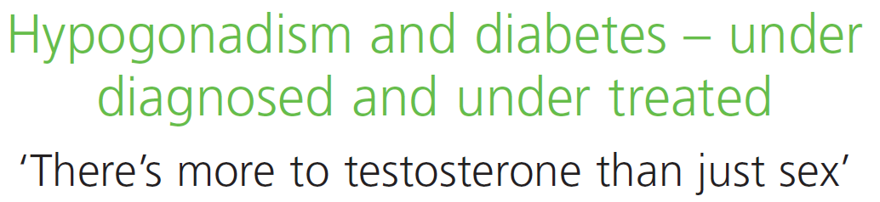
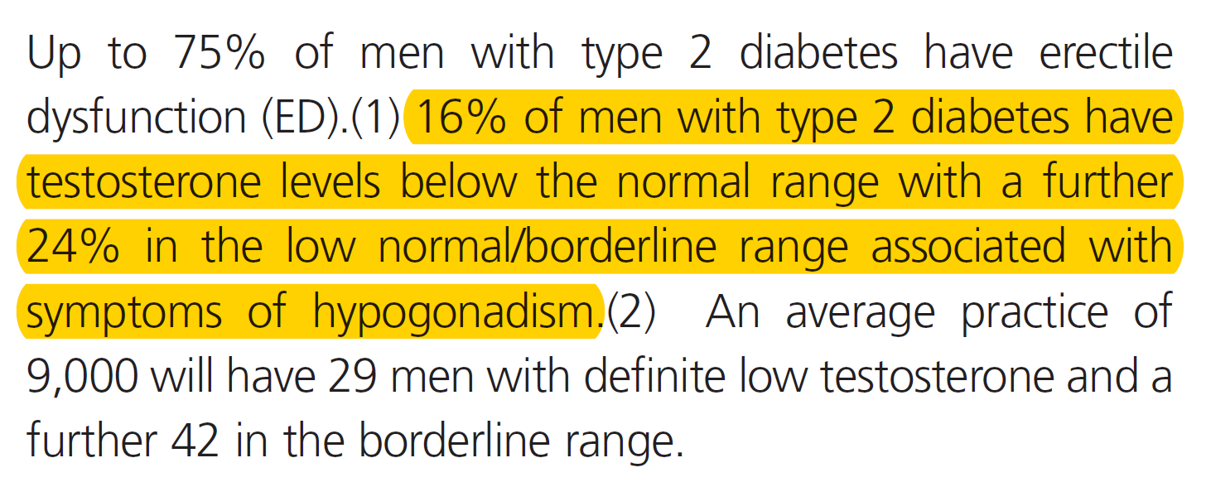

Low testosterone and hypogonadal symptoms are common in men with T2DM
40%
of men with T2DM have testosterone levels <12 nmol/L
NHS, UK National Health Service; T2DM, type 2 diabetes mellitus
Notes:
NHS Factsheet #36
A Factsheet produced in March 2012 (#36) by the NHS highlights the high number of men with T2DM who also have low testosterone and/or hypogonadal symptoms.
Among men with T2DM, 16% are hypogonadal; a further 24% have low-normal/borderline testosterone levels, but present with symptoms of hypogonadism.
Therefore, the prevalence of men with T2DM and testosterone levels <12 nmol/L is ~40%.
NHS, UK National Health Service; T2DM, type 2 diabetes mellitus

Slide 44
Low testosterone and T2DM are linked
In a study of 1,413 men aged ≥20 years in NHANES III, those in the first (lowest) tertiles of low free and total testosterone were four times more likely to have diabetes than those in the third tertiles [OR 4.12 (95% CI: 1.25 to 13.55 and OR 3.93 (95% CI: 1.39 to 11.13), respectively]¹
A meta-analysis of 37 prospective and cross-sectional studies showed that:²
  After adjusting for age and BMI, T2DM was associated with lower total testosterone levels (p<0.0001)
  Analysis of longitudinal studies demonstrated that baseline total testosterone was significantly lower among patients with incident diabetes versus controls [HR -2.08 (95% CI: -3.57 to -0.59); p<0.001]
  Analysis of RCTs showed that TTh was associated with a significant reduction in fasting plasma glucose, HbA_{1c}, fat mass and triglycerides
  BMI, body mass index; CI, confidence interval; HbA_{1c}, glycated haemoglobin; NHANES III, Third National Health and Nutrition Examination Survey; OR, odds ratio;
  RR, relative risk; T2DM, type 2 diabetes mellitus
1. Selvin E et al. Diabetes Care 2007;30:234–8; 2. Corona G et al. J Sex Med 2011;34:528–40.
Notes:
In a study conducted in 1,413 men aged ≥20 years who participated in NHANES III:¹
Low free testosterone concentrations in the normal range were associated with diabetes, independent of adiposity.
In multivariate models adjusted for age, race/ethnicity, and adiposity, men in the first tertile (lowest) of free testosterone level were four times more likely to have prevalent diabetes compared with men in the third tertile [OR 4.12 (95% CI: 1.25
to 13.55)].
These associations persisted even after excluding men with clinically abnormal testosterone concentrations, defined as total testosterone <11.3 mmol/L or free testosterone <0.2 nmol/L.
Corona et al. performed a literature search to identify prospective and cross-sectional studies investigating the relationship between androgen levels and type 2 diabetes mellitus (T2DM).²
A total of 37 studies were included in the meta-analysis.
Patients with T2DM showed significantly lower testosterone plasma levels compared with those without diabetes.
Similar results were obtained when patients with T2DM with and without erectile dysfunction were analysed separately.
In a multiple regression model, after adjusting for age and body mass index (BMI), T2DM was still associated with lower total testosterone levels (adjusted r = -0.568; p<0.0001).
Analysis of longitudinal studies demonstrated that baseline TT was significantly lower in men with incident diabetes compared with controls (hazard ratio = -2.08 [95% CI -3.57;-0.59]; p<0.001).
When combining the RCTs, TRT was associated with a significant reduction in fasting plasma glucose, glycated haemoglobin, fat mass and triglycerides. No significant difference was observed for total and high-density lipoprotein cholesterol, blood pressure or BMI.
These data suggest that T2DM can be considered independently associated with male hypogonadism.
BMI, body mass index; CI, confidence interval; NHANES III, Third National Health and Nutrition Examination Survey;
OR, odds ratio; RCT, randomised controlled trial; T2DM, type 2 diabetes mellitus; TTh, testosterone therapy
References
1. Selvin E et al. Diabetes Care 2007;30:234–8; 2. Corona G et al. J Sex Med 2011;34:528–40.

Slide 45





Guideline recommendations for men with T2DM
Guideline
Recommendation
BSSM¹
Screen for testosterone deficiency in all men with T2DM
AACE/
ACE²
All male patients with T2DM should be evaluated to exclude testosterone deficiency
In men with diabetes and symptoms or signs of testosterone deficiency, e.g. decreased libido or ED, consider screening with a morning serum testosterone level
ADA³
Consider testosterone assessment in men with a disease or treatment in which testosterone deficiency is common and in whom treatment may be indicated, such as T2DM
EAU⁴
  AACE, American Association of Clinical Endocrinologists; ACE, American College of Endocrinology; ADA, American Diabetes Association; BSSM, British Society for Sexual Medicine; EAU, European Associate of Urology; ED, erectile dysfunction; T2DM, type 2 diabetes mellitus
1. Hackett G et al. J Sex Med 2017;14:1504–23; 2. Garvey WT et al. Endocr Pract 2016;22(Suppl. 3):1–203; 3. American Diabetes Association. Diabetes Care 2019;42(Suppl.1):S34–S45; 4. Dohle GR et al. European Association of Urology Guidelines on Male Hypogonadism 2018. Available at: https://uroweb.org/guideline/male-hypogonadism/ (last accessed September 2020).
Notes:
Guidelines from the BSSM, AACE/ACE, ADA and EAU all recognise the link between T2DM and hypogonadism, and recommend screening for low testosterone in this population.
AACE, American Association of Clinical Endocrinologists; ACE, American College of Endocrinology; ADA, American Diabetes Association; BSSM, British Society for Sexual Medicine; EAU, European Associate of Urology; T2DM, type 2 diabetes mellitus
References
1. Hackett G et al. J Sex Med 2017;14:1504–23; 2. Garvey WT et al. Endocr Pract 2016;22(Suppl. 3):1–203; 3. American Diabetes Association. Diabetes Care 2019;42(Suppl.1):S34–S45; 4. Dohle GR et al. European Association of Urology Guidelines on Male Hypogonadism 2018. Available at: https://uroweb.org/guideline/male-hypogonadism/ (last accessed September 2020).

Slide 46
TTh significantly improves glycaemic control in obese, hypogonadal men
Analysis of two prospective, cumulative registry studies including 411 obese, hypogonadal men (mean age: 59.5 years) treated with TTh, of whom 25% had prediabetes, 42% had T2DM and 6% had T1DM
TTh significantly improved glycaemic control at 8 years of follow-up
Association between TTh and increased sexual activity in men with low testosterone
Effect of TTh on glycaemic control in obese, hypogonadal men
  BMI, body mass index; HbA_{1c}, glycated haemoglobin; T1DM, type 1 diabetes mellitus; T2DM, type 2 diabetes mellitus; TTh, testosterone therapy
Saad F et al. Int J Obesity 2016;40:162–70.
BMI 30.0–34.9 kg/m²
HbA_{1c} reduction: 1.15% (p<0.0001)
BMI 35.0–39.9 kg/m²
HbA_{1c} reduction: 1.79% (p<0.0001)
BMI ≥40 kg/m²
HbA_{1c} reduction: 1.87% (p<0.0001)
Notes:
This study investigated the effects of long-term TTh for up to 8 years in obese, hypogonadal men.
From two prospective, cumulative registry studies of 622 hypogonadal men, 411 (66.1% of all patients) with varying classes of obesity were identified:
Class I (BMI 30–34.9 kg/m²): n=214; mean age 58.6 years.
Class II (BMI 35–39.9 kg/m²): n=150; mean age 60.4 years.
Class III (BMI ≥40 kg/m²): n=47; mean age 60.5 years.
Among these obese, hypogonadal men, 72.7% (n=299) had prediabetes or diabetes [prediabetes: 25.1% (n=103), T2DM: 42.1% (n=173), T1DM: 5.6% (n=23)].
All men were treated with TTh (testosterone undecanoate injection) for up to 8 years.
Men were entered into the registry once they had received 1 year of TTh.
Inclusion criteria were two separate morning measures of total testosterone ≤12.1 nmol /L and the presence of hypogonadal symptoms measured by the Aging Males’ symptoms scale.
Exclusion criteria for TTh included previous treatment with androgens, prostate cancer or any suspicion thereof, International Prostate Symptom Score of 419 points, breast cancer, a history of congestive heart failure or recent angina, or severe untreated sleep apnoea.
Significant reductions in HbA_{1c} with long-term TTh were observed (all p<0.0001):
Class I: 6.67% to 5.4% (change from baseline of −1.2%).
Class II: 7.5% to 5.8 (change from baseline of −1.8%).
Class III: 7.6% to 5.7% (change from baseline of −1.9%).
BMI, body mass index; HbA_{1c}, glycated haemoglobin; T1DM, type 1 diabetes mellitus;
T2DM, type 2 diabetes mellitus; TTh, testosterone therapy
Reference
Saad F et al. Int J Obesity 2016;40:162–70.

Slide 47
Significant improvements in glycaemic control with TTh are lost if treatment is interrupted, but reappear when TTh is resumed
Observational registry study including 262 middle-aged and elderly hypogonadal men who received TTh for up to 11 years, representing 2088.5 patient-years
Significant decreases in fasting glucose and HbA_{1c} seen with TTh use were reversed upon withdrawal of TTh, but returned again to pre-interruption values when TTh was restarted
Association between TTh and increased sexual activity in men with low testosterone
Effect of continuous or interrupted TTh on glycaemic control in men with low testosterone
Continuous TTh (n=115) Interrupted TTh (n=147)
Fasting glucose
(mg/dL)
p<0.0001
HbA_{1c} (%)
p<0.0001
p<0.0001
p<0.0001
p=NS
p=NS
p=0.0043
p=0.0012
1
2
3
1
2
3
Period
Period
p values are for comparison of end of period vs beginning of period
HbA_{1c}, glycated haemoglobin; TTh, testosterone therapy
Yassin A et al. Clin Endocrinol 2016;84:107–14.
Notes:
This observational registry study included 262 hypogonadal, middle-aged and elderly men who received TTh for a maximum of 11 years, representing 2088.5 patient-years.
After having been on TTh for a mean duration of 65.5 months, treatment was temporarily interrupted in 147 patients for a mean of 16.9 months due to cost reimbursement issues,
as well as PCa for 7 of these patients. All men resumed TTh for a mean period of 14.5 months.
The other 115 men were treated continuously with TTh.
Serum total and free testosterone levels increased significantly in both groups. In men who received continuous TTh, serum testosterone levels were maintained over the study period, while in men whose TTh was interrupted, testosterone levels returned to baseline but increased to previous levels after treatment was resumed.
In men on continuous TTh, there was a progressive significant improvement in fasting glucose levels and HbA_{1c}. In men on intermittent therapy, there was a similar initial significant improvement in both glycaemic control parameters, which was reversed when TTh was interrupted, but became evident again after TTh was reinstated.
HbA_{1c}, glycated haemoglobin; PCa, prostate cancer; TTh, testosterone therapy
Reference
Yassin A et al. Clin Endocrinol 2016;84:107–14.

Slide 48
TTh is independently associated with reduced mortality in men with T2DM
Prospective study of 857 men with T2DM from 5 UK primary care practices: 320 were eugonadal and 537 were hypogonadal* (n=175 TTh-treated, n=362 did not receive TTh)
Mortality in eugonadal men or hypogonadal/TTh-treated men was significantly reduced versus hypogonadal/TTh-untreated men [HR 0.62 (95% CI: 0.41 to 0.94) and HR 0.38 (95% CI: 0.16 to 0.90), respectively]
Effect of TTh on mortality in men with T2DM with or without hypogonadism (N=857)
*Total testosterone ≤12 nmol/L or free testosterone ≤0.25 nmol/L
CI, confidence interval; HR, hazard ratio; TTh, testosterone therapy; T2DM, type 2 diabetes mellitus
Hackett G et al. Int J Clin Pract 2016;70:244–53.
Notes:
The primary aim of this longitudinal, observational study was to assess the association between mortality, testosterone levels and TTh use in 857 men with T2DM enrolled from 5 primary care practices between April 2007 and April 2009.
Based on early morning serum testosterone levels, men were classified as being eugonadal (total testosterone >12 nmol/L and free testosterone >0.25 nmol/L) or hypogonadal (total testosterone
≤12 nmol/L or free testosterone ≤0.25 nmol/L). In patients with total testosterone ≤12 nmol/L,
a second morning testosterone measurement was taken at ≥2 weeks later, according to European Association of Urology guidelines.
Of these men, 175/637 with serum total testosterone ≤12 nmol/L or free testosterone ≤0.25 nmol/L received TTh for a mean of 3.8 years. PDE-5 inhibitors and statins were prescribed to 175/857 and 662/857 men, respectively.
The primary endpoint of the study was all-cause mortality. Cox regression analysis was used to study the association between TTh and mortality.
Compared with the hypogonadal/TTh-untreated group, mortality in the eugonadal (p=0.023) and hypogonadal/ TTh-treated (p=0.027) groups was significantly reduced.
After repeating the Cox regression analysis in 682/857 men not given a PDE-5 inhibitor (which may
be a confounding factor), mortality in the eugonadal and hypogonadal/TTh-treated groups was significantly lower than in the reference hypogonadal/TTh-untreated group.
Low baseline testosterone is associated with increased all-cause mortality in men with T2DM, and
TTh is independently associated with reduced all-cause mortality, especially in men aged >60 years.
PDE-5, phosphodiesterase type 5; T2DM, type 2 diabetes mellitus; TTh, testosterone therapy
Reference
Hackett G et al. Int J Clin Pract 2016;70:244–53.

Slide 49
TTh is independently associated with reduced mortality in men with T2DM
Effect of TTh on mortality among men with T2DM (N=581)
Study of 581 men with T2DM who had testosterone levels measured during 2002–05 and were followed up for a mean of 5.8 years
  Eugonadal status (total testosterone
  >10.4 nmol/L): n=343
  Hypogonadal status (total testosterone
  ≤10.4 nmol/L): n=238
Mortality was significantly increased in hypogonadal vs eugonadal men (17% vs 9%, respectively; p=0.003), and TTh-untreated vs TTh-treated hypogonadal men (20% vs 9%, respectively; p=0.002)
There was a significant decrease in survival in TTh-untreated men versus TTh-treated and eugonadal men, after controlling for covariates*
1.00
Hypogonadal/TTh-treated
0.95
Eugonadal
0.90
Cumulative survival
0.85
Hypogonadal/TTh-untreated
HR 2.3 (95% CI: 1.3 to 3.9); p=0.004
0.80
0
20
40
60
80
Months of survival
*Age, weight, height, body mass index, glycated haemoglobin, pre-existing cardiovascular disease, smoking, statin and ARB/ACE inhibitor treatment
ACE, angiotensin-converting enzyme; ARB, angiotensin receptor blocker; CI, confidence interval; HR, hazard ratio; TTh, testosterone therapy; T2DM, type 2 diabetes mellitus. Muraleedharan V et al. Eur J Endocrinol 2013;166:725–33.
Notes:
This 6-year follow-up study included 581 men with type 2 diabetes who had testosterone levels measured between 2002–05.
Mortality rates were compared between eugonadal men (total testosterone >10.4 nmol/L; n=343) and hypogonadal men (total testosterone ≤10.4 nmol/L; n=238).
The effect of TTh (as per normal clinical practice: 85.9% testosterone gel and 14.1% intramuscular testosterone undecanoate) was assessed retrospectively in the hypogonadal group.
Kaplan–Meier survival curves showed a significant decrease in survival in the hypogonadal group compared with the eugonadal group (p=0.002).
In the Cox regression model, after adjusting for covariates of age, weight, height, body mass index, glycated haemoglobin, pre-existing cardiovascular disease, smoking, statin and angiotensin receptor blocker/angiotensin-converting enzyme inhibitor therapy) at baseline, the hazard ratio for decreased survival was 2.02 (95% CI: 1.2 to 3.4); p=0.009.
Mean baseline testosterone levels were significantly low in patients who died (10.9 ± 5.2 nmol/L) compared with those who were alive (12.6 ± 5.5 nmol/L; p=0.018). The mortality rate was 17.2% (41/238) in hypogonadal men compared with 9% (31/343; p=0.003) in eugonadal men.
Of the 238 hypogonadal men, 64 (27%) received TTh and 174 did not. A total of 60 hypogonadal men received TTh for ≥12 months and 51 had treatment for ≥2 years.
There was a significant increase in mortality rate in the TTh-untreated group (20.1% [35/174]) compared with the TTh-treated group [9.4% (6/64); p=0.002] and eugonadal men [9.1% (31/340)].
The multivariate-adjusted hazard ratio for decreased survival in TTh-untreated hypogonadal men was
2.3 (95% CI: 1.3 to 3.9; p=0.004).
Low testosterone levels predicted an increase in all-cause mortality during long-term follow-up.
CI, confidence interval; T2DM, type 2 diabetes mellitus; TTh, testosterone therapy
Reference
Muraleedharan V et al. Eur J Endocrinol 2013;166;725–33.

Slide 50

Long-term TTh use in men with hypogonadism prevents progression from prediabetes to T2DM and improves glycaemic control, lipid profile and AMS scale score
Long-term registry study to evaluate whether TTh use in men with hypogonadism and prediabetes prevents progression to T2DM
In total, 316 men with prediabetes (HbA_{1c} 5.7–6.4%) and total testosterone level ≤12.1 nmol/L plus symptoms of hypogonadism were analysed, of whom 229 received TTh, and 87 served as untreated controls
Association between TTh and increased sexual activity in men with low testosterone
Effect of TTh on glycaemic control in men with hypogonadism and T2DM (N=316)
TTh Placebo Difference
1.5
1.0
1.0
0.5
0.5
0
0
Change in fasting glucose (mmol/L)
Change in HbA_{1c} (%)
-0.5
-1.0
-0.5
-1.5
-1.0
0
1
2
3
4
5
6
7
8
0
1
2
3
4
5
6
7
8
Year
Year
AMS, Aging Males’ Symptoms; HbA_{1c}, glycated haemoglobin; T2DM, type 2 diabetes mellitus; TTh, testosterone therapy
Yassin A et al. Diabetes Care 2019;42:1104–11.
Notes:
This registry study analysed 316 men with prediabetes (defined as HbA_{1c} 5.7–6.4%) and total testosterone levels ≤12.1 nmol/L with symptoms of hypogonadism.
Patients in this study were pooled from two ongoing urological registries.
In total, 229 men received parenteral testosterone undecanoate every 12 weeks after an initial 6-week interval and 87 men served as untreated controls.
The following parameters were measured: total testosterone, weight, waist circumference, body weight, haemoglobin, haematocrit, fasting glucose, HbA_{1c}, systolic/diastolic blood pressure, heart rate, and lipids (total cholesterol, low-density lipoprotein cholesterol,
high-density lipoprotein cholesterol, triglycerides).
Metabolic and anthropometric parameters were measured twice-yearly for 8 years.
TTh led to substantial improvements in glycaemic parameters; both fasting blood glucose and HbA_{1c} values were reduced in the TTh-treated group but were increased in the
TTh-untreated group.
HbA_{1c}, glycated haemoglobin; TTh, testosterone therapy
Reference
Yassin A et al. Diabetes Care 2019;42:1104–11.

Slide 51

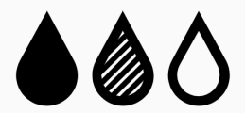



Long-term TTh use in men with hypogonadism prevents progression from prediabetes to T2DM and improves glycaemic control, lipid profile and AMS scale score
TTh-treated group (n=229)
TTh-untreated group (n=87)
HbA_{1c} decreased by 0.39%
Significant improvement in fasting glucose
90% of men achieved normal
glucose regulation (HbA_{1c} <5.7%)
0% of men progressed to T2DM (HbA_{1c} >6.5%)
HbA_{1c} increased by 0.63%
Significant worsening in fasting glucose
1% of men achieved normal
glucose regulation (HbA_{1c} <5.7%)
40% of men progressed to T2DM (HbA_{1c} >6.5%)
Significant improvements in lipid profile and AMS scale score
Significant worsening in lipid profile and AMS scale score
Incidence of non-fatal MI: 0.4%
Incidence of non-fatal MI: 5.7%
Mortality: 7.4%
Mortality: 16.1%
AMS, Aging Males’ Symptoms; HbA_{1c}, glycated haemoglobin; T2DM, type 2 diabetes mellitus; TTh, testosterone therapy
Yassin A et al. Diabetes Care 2019;42:1104–11.
Notes:
HbA_{1c} decreased by 0.39 ± 0.03% (p<0.0001) in the TTh-treated group and increased by
0.63 ± 0.1% (p<0.0001) in the TTh-untreated group.
The differences in glucose concentrations and HbA_{1c} were substantial and significant between the two groups throughout the entire follow-up period, amounting to a difference in HbA_{1c} of 1.02% at 8 years.
In the TTh-treated group, 90% achieved normal glucose regulation (HbA_{1c} <5.7%) versus
1% in the TTh-untreated group.
In the TTh-untreated group, 40.2% of men progressed to T2DM (HbA_{1c} >6.5%), compared with 0% of TTh-treated men.
TTh was also associated with significant improvements in fasting glucose, lipids accumulation product, total cholesterol, low-density lipoprotein cholesterol, high-density lipoprotein cholesterol, non-high-density lipoprotein cholesterol, triglycerides and Aging Males’ Symptoms (AMS) scale scores. Significant deterioration in all these parameters was seen
in the TTh-untreated group.
Mortality was 7.4% in the TTh-treated group and 16.1% in the TTh-untreated group (p<0.05).
The incidence of non-fatal myocardial infarction was 0.4% in the TTh-treated group and 5.7% in the TTh-untreated group (p<0.005).
HbA_{1c}, glycated haemoglobin; T2DM, type 2 diabetes mellitus; TTh, testosterone therapy
Reference
Yassin A et al. Diabetes Care 2019;42:1104–11.

Slide 52
Long-term TTh use in men with hypogonadism and T2DM significantly improves glycaemic control
Prospective, long-term, single-centre registry study in Germany to evaluate the effects of TTh use in men with hypogonadism and T2DM
In total, 356 men with T2DM [HbA_{1c} 62–79 mmol/mol (7.8–9.4%)] and total testosterone level ≤12.1 nmol/L plus symptoms of hypogonadism were analysed, of whom 178 received TTh, and 178 served as untreated controls
Association between TTh and increased sexual activity in men with low testosterone
Effect of TTh on glycaemic control in men with hypogonadism and T2DM (N=356)
TTh Untreated Difference
2
40
1
20
0
0
Change in fasting glucose (mmol/L)
Change in HbA_{1c} (mmol/mol)
-1
-20
-2
-40
-3
-60
-4
-80
0
1
2
3
4
5
6
7
8
9
10
11
0
1
2
3
4
5
6
7
8
9
10
11
Year
Year
p<0.0001 between groups.
HbA_{1c}, glycated haemoglobin; T2DM, type 2 diabetes mellitus; TTh, testosterone therapy
Haider KS et al. Diabetes Obes Metab 2020;doi: 10.1111/dom.14122.
Notes:
This registry study analysed 356 men with diabetes [baseline HbA_{1c} of 62–79 mmol/mol (7.8–9.4%)] and total testosterone levels ≤12.1 nmol/L with symptoms of hypogonadism.
All patients were managed by the same local diabetes centre and received standard diabetes treatment, including mandatory educational courses and materials.
In total, 178 men received parenteral testosterone undecanoate every 12 weeks after an initial 6-week interval and 178 men served as untreated controls.
The following parameters were measured: height, weight, waist circumference, blood pressure, haemoglobin, haematocrit, fasting glucose, HbA_{1c}, insulin, systolic/diastolic blood pressure, heart rate, lipids (total cholesterol, low-density lipoprotein cholesterol,
high-density lipoprotein cholesterol, triglycerides), high-sensitivity C-reactive protein, total testosterone, quality of life (assessed using the Aging Males’ Symptoms scale) and erectile function (assessed using the International Index of Erectile Function – Erectile Function domain).
Clinical variables were assessed at least twice-yearly for 11 years.
TTh led to significant and sustained gradual reductions in fasting blood glucose and HbA_{1c} values in hypogonadal men with T2DM; in contrast, both parameters increased in the
TTh-untreated group.
HbA_{1c}, glycated haemoglobin; T2DM, type 2 diabetes mellitus; TTh, testosterone therapy
Reference
Haider KS et al. Diabetes Obes Metab 2020;doi: 10.1111/dom.14122.

Slide 53

Long-term TTh use in men with hypogonadism and T2DM is associated with disease remission, return to normal glucose control, and decreased all-cause mortality
Effect of TTh on disease parameters and mortality in men with hypogonadism and T2DM (N=356)
HbA_{1c} ≤47.5 mmol/mol
HbA_{1c} ≤53.0 mmol/mol
Men achieving outcome (%)
100
80
TTh
60
Untreated
Survival (%)
40
20
0
0
1
2
3
4
5
6
7
8
9
10
11
12
Patients, n
Year
TTh
Untreated
178 178 178 168 154 125 113 101 86 76 60 55 42
178 178 178 176 165 153 144 134 120 110 86 49 18
HbA_{1c}, glycated haemoglobin; T2DM, type 2 diabetes mellitus; TTh, testosterone therapy
Haider KS et al. Diabetes Obes Metab 2020;doi: 10.1111/dom.14122.
Notes:
This registry study analysed 356 men with diabetes [baseline HbA_{1c} of 62–79 mmol/mol (7.8–9.4%)]
and total testosterone levels ≤12.1 nmol/L with symptoms of hypogonadism.
All patients were managed by the same local diabetes centre and received standard diabetes treatment, including mandatory educational courses and materials.
In total, 178 men received parenteral testosterone undecanoate every 12 weeks after an initial 6-week interval and 178 men served as untreated controls.
The following parameters were measured: height, weight, waist circumference, blood pressure, haemoglobin, haematocrit, fasting glucose, HbA_{1c}, insulin, systolic/diastolic blood pressure, heart rate, lipids (total cholesterol, low-density lipoprotein cholesterol, high-density lipoprotein cholesterol, triglycerides), high-sensitivity
C-reactive protein, total testosterone, quality of life (assessed using the Aging Males’ Symptoms scale) and erectile function (assessed using the International Index of Erectile Function – Erectile Function domain).
Clinical variables were assessed at least twice-yearly for 11 years.
Among men with T2DM receiving TTh:
34.3% and 46.6% achieved remission of T2DM [defined as HbA_{1c} <47.5 mmol/mol (6.5%) and discontinuation of all glucose-lowering agents, including metformin] and normal glucose regulation [defined as HbA_{1c} <39 mmol/mol (5.7%)], respectively. Of the latter, 22 men had been on insulin at baseline. The mean time to discontinuation of glucose-lowering medications was 8.6 ± 2.9 years,
and the mean time following remission was 2.5 ± 2.3 years. There were no relapses.
83.1% and 91.0% achieved HbA_{1c} values of 47.5 mmol/mol and 53.0 mmol/mol, respectively.
In contrast, no remission of T2DM or reduction in glucose or HbA_{1c} levels was noted in the untreated group.
There were fewer all-cause deaths in the TTh group than the untreated group [13 (7.3%) versus 52 (29.2%)].
These observations are consistent with other studies showing reduced mortality in men with hypogonadism and T2DM receiving TTh.
HbA_{1c}, glycated haemoglobin; T2DM, type 2 diabetes mellitus; TTh, testosterone therapy
Reference
Haider KS et al. Diabetes Obes Metab 2020;doi: 10.1111/dom.14122.

Slide 54
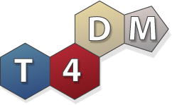
The T4DM study: in high-risk men, TTh decreased the 2-year risk of T2DM by 41% beyond lifestyle interventions alone
Randomised, double-blind, placebo-controlled multicentre Phase 3 trial in men aged 50–74 years (N=1007) with waist circumference >95cm, serum total testosterone ≤14nmol/L and newly diagnosed T2DM
Men were randomised 1:1 to either TTh (1000 mg/4 mL IM) or placebo at baseline, 6 weeks and then 3-monthly for 2 years; all were enrolled in a lifestyle program
Co-primary 2-year endpoints
Proportion of men with OGTT 2-hour glucose ≥11.1 mmol/L at 2 years
Mean change in OGTT 2-hour glucose at 2 years (mmol/L)
IM, intramuscular; OGTT, oral glucose tolerance test; T2DM, type 2 diabetes mellitus; TTh, testosterone therapy Wittert, G et al. Lancet Diabetes Endocrinol 2021; 9: 32–45
Notes:
The primary hypothesis of the T4DM study was that TTh for 2 years will prevent progression to, or reverse, T2DM in high-risk men concurrently enrolled in a community-based lifestyle programme.¹
A key secondary hypothesis was that TTh for 2 years will lead to metabolically favourable changes in body composition, improve sexual function and enhance adherence to the lifestyle programme.¹
This randomised, placebo-controlled, double-blind, 2-year, Phase IIIb trial was conducted at 6 Australian Tertiary Care centres.²
Inclusion criteria were age 50–74 years; waist circumference ≥95 cm; OGTT 2-hour glucose 7.8–15.0 nmol/L (140–270 ng/dL) and serum testosterone concentration ≤14 nmol/L.²
Exclusion criteria were: HPG pathology; TTh in the past 12 months; any prior anabolic steroid abuse; medications affecting testosterone or sex hormone-binding globulin; previously diagnosed T2DM; medication to lower blood glucose; OGTT 2-hour glucose >15 mmol/L;
anti-obesity drugs, prior or planned bariatric surgery; major cardiovascular event in previous 6 months or active cardiac disease; systolic blood pressure ≥160 mmHg, diastolic blood pressure ≥100 mmHg, transient ischaemic attack or stroke within the previous 3 years and significant psychiatric disorder.²
HPG, hypothalamo-pituitary-gonadal; OGTT, oral glucose tolerance test; T2DM, type 2 diabetes mellitus; TTh, testosterone therapy
References
1. Wittert GA et al. Diabetes 2020;69(Suppl 1): https://doi.org/10.2337/db20-274-OR.
2. Wittert G et al. Diabetes Obes Metab 2019;21:772–80.

Slide 55
T4DM Participants n=1007
Parameter | Placebo Group (n=503) | Testosterone Group (n=504)
Age (years) | 59.6 (6.4) | 59.8 (6.3)
BMI kg/m² | 34.6 (5.1) | 34.8 (5.1)
Prediabetes (2-hour glucose 7.8 ≥to <11.1 mmol/L) | 400 (79.5%) | 397 (78.8%)
Diabetes (2-hour glucose ≥11.1-15.0 mmol/L) | 100 (19.9%) | 100 (19.8%)
HbA1c (%) | 5.7 (0.5) | 5.7 (0.5)
Screening Serum Testosterone nmol/L (ECLIA) | 10.0 (2.5) | 9.9 (2.5)
Serum Testosterone nmol/L (LCMS/MS) | 13.9 (4.6) | 13.4 (4.1)
Participants with data for primary endpoint analysis at 2 years | 413 (82.1%) | 443 (87.9%)
Wittert, G et al. Lancet Diabetes Endocrinol 2021; 9: 32–45
Data are mean (SD), or n (%)

Slide 56
The T4DM study: Changes in HPG axis markers over time
Blood trough levels were taken prior to each injection
Sex steroids were assayed using liquid chromatography–mass spectrometry
Placebo
TTh
20
2.0
18
1.6
260
16
1.2
E2 (pg/mL)
Testosterone (nmol/L)
DHT (nmol/L)
220
14
0.8
12
0.4
180
0
6
12
18
24
0
6
12
18
24
0
6
12
18
24
Months from randomisation
Months from randomisation
Months from randomisation
8
10
50
6
8
45
4
6
E2 (pg/mL)
LH (IU/L)
FSH (IU/L)
40
4
2
2
35
0
0
30
0
6
12
18
24
0
6
12
18
24
0
6
12
18
24
Months from randomisation
Months from randomisation
Months from randomisation
DHT, dihydrotestosterone; E2, oestradiol; FSH, follicle-stimulating hormone; HPG, hypothalamo-pituitary-gonadal; LH, luteinising hormone; TTh, testosterone therapy
Wittert GA et al. Diabetes 2020;69(Suppl 1): https://doi.org/10.2337/db20-274-OR.
Notes:
Reference
Wittert GA et al. Diabetes 2020;69(Suppl 1): https://doi.org/10.2337/db20-274-OR.

Slide 57
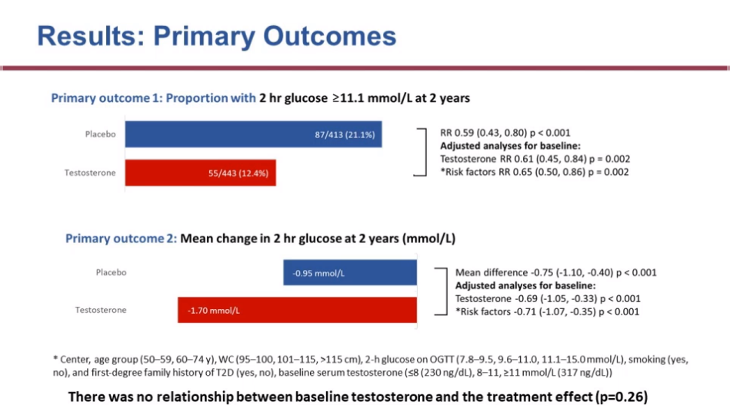
The T4DM study: primary outcomes
Primary outcome 1: proportion of men with OGTT 2-hour glucose ≥11.1 mmol/L at 2 years
Placebo
TTh
87/413 (21.1%)
RR 0.59 (95% CI: 0.43, 080); p<0.001
Adjusted analyses for baseline:
Testosterone RR 0.61 (95% CI: 0.45, 0.84); p=0.002
*Risk factors RR 0.65 (95% CI: 0.50, 0.86); p=0.002
55/443 (12.4%)
Primary outcome 2: mean change in OGTT 2-hour glucose at 2 years (mmol/L)
Mean difference -0.75 (95% CI: 01.10, -0.40); p<0.001
Adjusted analyses for baseline:
Testosterone -0.69 (95% CI: -1.05, -0.33); p<0.001
*Risk factors -0.71 (95% CI: -1.07, -0.35); p<0.001
-0.95 mmol/L
Placebo
TTh
-1.70 mmol/L
TTh decreased RR of T2DM at 2 years by ~40% beyond lifestyle programme alone
There was no relationship between baseline testosterone and the treatment effect (p=0.26)
*Centre, age group (50–59, 60–74 years), WC (95–100, 101–115, >115 cm), 2-hour glucose on OGTT (7.8–9.5, 9.6–11.0, 11.1–15.0 mmol/L), smoking (yes, no),
first-degree family history of T2DM (yes, no), baseline serum testosterone (≤8, 8–11, ≥11 mmol/L)
CI, confidence interval; OGTT, oral glucose tolerance test; T2DM, type 2 diabetes mellitus; TTh, testosterone therapy; WC, waist circumference
Wittert, G et al. Lancet Diabetes Endocrinol 2021; 9: 32–45
Notes:
Reference
Wittert GA et al. Diabetes 2020;69(Suppl 1): https://doi.org/10.2337/db20-274-OR.

Slide 58
The T4DM study: secondary outcomes
Change from baseline in body composition
Change from baseline in sexual function
-8
-6
-4
-2
0
2
-1.0
-0.5
0
0.5
1.0
1.5
p=0.06
Body weight (kg)
Erectile function score
Waist circumference (cm)
Orgasmic function score
Total muscle mass (kg)
Sexual desire score
Total fat mass (kg)
Intercourse
satisfaction score
Abdominal fat (%)
Arm muscle mass (kg)
Overall sexual
satisfaction score
Grip strength (kg)
p=0.14
Total LUTS score
Placebo TTh
Placebo TTh
All p<0.001 unless otherwise stated
LUTS, lower urinary tract symptoms; TTh, testosterone therapy
Wittert, G et al. Lancet Diabetes Endocrinol 2021; 9: 32–45
Notes:
TTh was associated with favourable changes in body composition.
Patients treated with TTh showed greater decreases from baseline in fasting glucose
(-0.17 mmol/L), waist circumference (-2.1 cm), total fat mass (-2.7 kg) and abdominal fat mass (-2.3%), and greater increases in total muscle mass (+1.7 kg), arm muscle mass
(+0.36 kg) and hand grip strength (+2.2 kg) versus those receiving placebo (all p<0.004).
TTh was also associated with small benefits on sexual function.
TTh, testosterone therapy
Reference
Wittert GA et al. Diabetes 2020;69(Suppl 1): https://doi.org/10.2337/db20-274-OR.

Slide 59
The T4DM study: secondary outcomes (cont.)
 | Placebo | TTh | Relative risk (95% CI) |  | p value
 | n/N (%)
Endpoint
Normalised blood glucose (OGTT 2-hour glucose <7.8 mmol/L) | 179/413 (43.3) | 230/443 (51.9) |  | 1.20 (1.04 to 1.38) | 0.012
Reported use of anti-diabetic drugs | 16/503 (3.2) | 20/504 (4.0) |  | 1.25 (0.65 to 2.38) | 0.50
Compliant with lifestyle program | 132/471 (28.0) | 144/480 (30.0) |  | 1.07 (0.88 to 1.31) | 0.50
Achieved sufficient weekly exercise | 280/398 (70.4) | 293/434 (67.5) |  | 0.96 (0.88 to 1.05) | 0.38
0.5
5
Favours placebo
Favours TTh
CI, confidence interval; OGTT, oral glucose tolerance test; TTh, testosterone therapy
Wittert, G et al. Lancet Diabetes Endocrinol 2021; 9: 32–45
Notes:
Reference
Wittert GA at al. Diabetes 2020;69(Suppl 1): https://doi.org/10.2337/db20-274-OR.

Slide 60
The T4DM study: safety
Summary of safety triggers by treatment
Summary of Serious AEs by treatment
 | Placebo | TTh
Participants receiving ≥1 dose of treatment | 503/503 | 504/504
Any trigger | 93/485 (19.2%) | 185/492 (37.6%)
Haematocrit ≥54%* | 6/484 (1.2%) | 106/491 (21.6%)
Increased PSA | 87/468 (18.6%) | 109/480 (22.7%)
25/106 (5% of total) had HCT ≥ 54 on repeat testing and were excluded from the study
 | Placebo | TTh
 | 41 (7%) | 55 (11%)
Arrhythmias | 3 | 8
IHD | 13 | 7
Cerebrovascular disease | 3 | 4
BPH | 3 | 8
Prostate cancer | 5 | 4
Depression | 3 | 1
Venous thrombotic events | 0 | 2
Other cancers | 10 | 4
There were 2 deaths in each group
*Denominators reflect patients with ≥1 haematocrit reading on study
BPH, benign prostatic hyperplasia; IHD, ischaemic heart disease; PSA, prostate-specific antigen; TTh, testosterone therapy
Wittert, G et al. Lancet Diabetes Endocrinol 2021; 9: 32–45
Notes:
Frequent treatment-induced elevations of haematocrit were reported. Risk factors for an increase in haematocrit should be considered before prescribing TTh.
The cardiovascular safety profile of TTh in this patient population was reassuring.
Of the 106 participants who recorded haematocrit ≥54%:
25 ceased study treatment due to confirmed raised haematocrit following hospital pathology service repeat testing
38 had flagged haematocrit occur at weeks 90 or 102 after the final study injection had already been given
5 ceased treatment for another reason prior to the visit with the flagged haematocrit
3 ceased treatment at the same visit as the flagged haematocrit for another reason
40 continued treatment after recording raised haematocrit; according to the protocol, participants should only have continued study injections if a local site (hospital) pathology test returned haematocrit <0.54% on repeat – the men in this group had haematocrit at or just over 0.54% on the core laboratory measurement, but were <0.54 on repeat and did not attract a subsequent flag
TTh, testosterone therapy
Reference Wittert GA et al. Diabetes 2020;69(Suppl 1): https://doi.org/10.2337/db20-274-OR.

Slide 61
Secondary Clinical Benefits - Summary
Whilst not specifically licensed for the treatment of certain conditions, testosterone therapy in men with testosterone deficiency has beneficial impacts on a range of other parameters
TTh significantly increases haemoglobin levels in older men with low testosterone and unexplained anaemia
TTh significantly increases volumetric BMD and bone strength versus placebo in older men with low testosterone
Low testosterone levels occur in over 40% of men with T2DM and have been associated with increased mortality, with testosterone therapy independently associated with reduced mortality in such men.
Guidelines (ADA, AACE, EAU, BSSM) currently recommend screening type 2 diabetic men for testosterone deficiency, especially in the presence of ED
TTh in hypogonadal men with prediabetes and type 2 diabetes improves insulin sensitivity
Improvement in glycaemic control (and reduction in progression of diabetes) is very important for reduction in complications of diabetes including mortality however changes can take time
TTh plus lifestyle program has been shown to decrease the relative risk of type 2 diabetes at 2 years by approximately 40% beyond lifestyle program alone.

Slide 62
Patient Case Studies

Slide 63

Case study – Part 1: Patient Profile
Chris: 54 year old office worker with type 2 diabetes mellitus (T2DM)
He has had erectile dysfunction for several years which is putting a strain on his marriage.
Whilst he was being managed by the secondary care diabetic team he was started on daily sildenafil 50mg for erectile dysfunction which worked on rare occasions.
He didn’t think anymore could be done about it.
* This patient profile is based on a real patient, and has been anonymised and reproduced with permission.

Slide 64
Case study – Part 2: Route to Diagnosis
Chris: 54 year old office worker with type 2 diabetes mellitus (T2DM)
He had his bloods taken in GP diabetic clinic and a testosterone level was added to the screening.
  Total Testosterone (TT) = 5.6nmol/L, Free Testosterone (FT) = 0.125nmol/L
Chris was asked to attend the practice to discuss these results. On further questioning it transpired that he was dissatisfied with his erections and had a low libido.
  His AMS score was 48 (moderate to severe symptoms)
  Waist circumference: 42 inches
  HbA1c: 68mmol/mol
Chris was counselled regarding TD and had no contraindications to testosterone therapy (TTh).
He was started on daily testosterone gel and his PDE5i was changed to a daily dose.

Slide 65
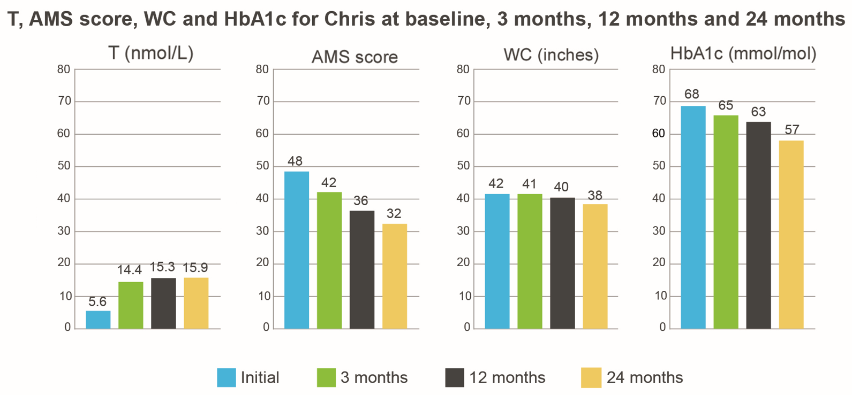
Case study – Part 3: Two years later
Chris: 54 year old office worker with type 2 diabetes mellitus (T2DM)
Following Testogel** treatment for his TD after 24 months:
  Testosterone: 15.9nmol/L
  AMS score: 32
  WC: 38 inches
  HbA1c: 57mmol/mol
Feels much better
His wife said, “Thank you so much for helping Chris. He’s like the man I fell in love with”
This patient profile is based on a real patient and has been anonymised and reproduced with permission.
**This patient started treatment in Sept 2016 on one sachet of Testogel 50mg per day. In February 2018 he was changed to Testogel 16.2mg/g pump (40.5mg/day)
AMS - Ageing Males’ Symptoms; TD - Testosterone Deficiency; WC - Waist Circumference; T - Testosterone

Slide 66

Case study 2: Borderline Total Testosterone
Peter: 60 year old man complaining of ED, low libido, increased anxiety & fatigue
Initial tests done in December 2018:
  1st – TT (11.2nmol/L) SHBG (54nmol/L) FT (0.161) nmol/L
  2nd – TT (11.4nmol/L) SHBG (55nmol/L) FT (0.162) nmol/L
  WC 94cm / BMI 28 / AMS 49
Diagnosed with TD based on symptoms and a low free testosterone. Treatment started with Testogel 16.2mg/g
Follow up appointment October 2019:
  Most recent TT (20.0) FT (0.307) nmol/L
  Doing very well, symptoms have improved, has confidence to meet new people and has started to date again.
  He has increased work capacity, general improvement in quality of life and is very happy with TTh
This patient profile is based on a real patient, and has been anonymised and reproduced with permission.
AMS - Ageing Males’ Symptoms; TD - Testosterone Deficiency; WC - Waist Circumference; TT – Total Testosterone; FT – Free Testosterone; BMI – Body Mass Index; SHBG – Sex Hormone Binding Globulin; TTh – Testosterone Therapy

Slide 67
Benefits of TTh Questions:
1. Which of these can NOT be considered a benefit of testosterone therapy (TTh) in hypogonadal men?
  Increased BMD
  Improved Sexual Function
  Improved Vision
  Improved Body Composition
  Improved Mood
  (choose 1 answer)

Slide 68
Benefits of TTh Questions:
2. According to the 2017 BSSM guidelines, how long should HCPs trial testosterone therapy for in men with testosterone deficiency?
  <12 months
  3-6 months
  2 years
  ≥6 months
  (choose 1 answer)

Slide 69
Benefits of TTh Questions:
3. What is the major goal of testosterone therapy?
  To achieve & maintain normal physiological testosterone levels to relieve symptoms of testosterone deficiency
  To achieve supraphysiological levels of testosterone for the entire dosing interval to generate best patient outcomes
  To alleviate symptoms of TD by using the least amount of TTh possible to achieve physiological levels
  To improve erection quality by combining with a PDE5i
  (choose 1 answer)

Slide 70
Benefits of TTh Questions:
4. Which recent study evaluated the impact of testosterone therapy on body composition in young male cancer survivors? Which product was used in this study?
  TRAMS, 1% gel in sachet
  TRYMS, 2% gel in pump
  TRAVERSE, 1.62% gel in pump
  TERESA, 1% gel in pump
  (choose 1 answer)

Slide 71
Benefits of TTh Questions:
5. What did Wang et al conclude about AndroGel in her 2004 publication in the Journal of Clinical Endocrinology & Metabolism
  AndroGel only improves sexual function and further study is required
  AndroGel is effective & well-tolerated but only in the short-term treatment of hypogonadal men
  AndroGel is effective & well-tolerated when used in the long-term treatment of hypogonadal men.
  AndroGel 1.62% gel achieves significantly better outcomes than 1% gels
  (choose 1 answer)

Slide 72
Benefits of TTh Questions:
6. What study from 2021 demonstrated that TTh decreased the 2-year risk of T2DM by 41% beyond lifestyle interventions alone?
  T2DM
  REDUCE
  T4Bone
  T4DM
  (choose 1 answer)

Slide 73
Benefits of TTh Questions:
7. What was one of the main conclusions from the Roy et al study from JAMA Internal Medicine in 2017?
  TTh significantly increases haemoglobin levels in older men with low testosterone and unexplained anaemia
  TTh significantly increase vBMD in older men
  TTh significantly improves sexual function in all men
  TTh in combination with a PDE5i can improve cardiovascular outcomes
  (choose 1 answer)

Slide 74
Benefits of TTh Questions:
8. Which of these statements is true?
  Testosterone 16.2mg/g gel for up to 2 years is efficacious with >77% of patients achieving normal testosterone levels following dose titration
  Testosterone 16.2mg/g gel for up to 1 year is efficacious with >82.2% of patients achieving normal testosterone levels following dose titration
  Testosterone 16.2mg/g gel for up to 1 year is efficacious with >77% of patients achieving normal testosterone levels following dose titration
  Testosterone 16.2mg/g gel for up to 6 months is efficacious with >91% of patients achieving normal testosterone levels following dose titration
  (choose 1 answer)

Slide 75
Benefits of TTh Questions:
9. According to a 2012 NHS Diabetes Factsheet, what percentage of men with T2DM have testosterone levels <12 nmol/L?
  70%
  40%
  50%
  25%
  (choose 1 answer)

Slide 76
Benefits of TTh Questions:
10. A 2013 paper from which author concluded that TTh in hypogonadal T2DM men is independently associated with reduced mortality versus untreated hypogonadal T2DM men or eugonadal T2DM men?
  Muraleedharan
  Zitzmann
  Morgentaler
  Lipshultz
  (choose 1 answer)

Slide 77
Benefits of TTh Answers:
Q1: Improved Vision
Q2: ≥6 months
Q3: To achieve & maintain normal physiological testosterone levels to relieve symptoms of testosterone deficiency
Q4: TRYMS, 2% gel in pump
Q5: AndroGel is effective & well-tolerated when used in the long-term treatment of hypogonadal men
Q6: T4DM
Q7: TTh significantly increases haemoglobin levels in older men with low testosterone and unexplained anaemia
Q8: Testosterone 16.2mg/g gel for up to 1 year is efficacious with >77% of patients achieving normal testosterone levels following dose titration
Q9: 40%
Q10: Muraleedharan

