Slide 1
Behre, HM et al
A randomized, double-blind, placebo-controlled trial of testosterone gel on body composition and health-related quality-of-life in men with hypogonadal to low-normal levels of serum testosterone and symptoms of androgen deficiency over 6 months with 12 months open-label follow-up (The PADAM Study)
The Aging Male, 2012; 15(4): 198–207
Besins Healthcare
Global Medical Affairs
March 2021

Slide 2
Aims & Objectives
The aim of this randomized, placebo-controlled study was to investigate the efficacy and safety of treatment with a 1% testosterone gel in men aged 50-80 years with hypogonadal to low-normal total serum testosterone (<15.0nmol/l) along with putative symptoms of testosterone deficiency.
The primary objective was the assessment of changes in lean body mass (LBM) after 6 months of treatment with AndroGel compared with placebo.
A secondary study objective was assessment of changes in LBM during open label treatment with AndroGel from study month 6 to 18, and assessment of changes in LBM in subgroups of patients.
Other secondary study objectives were assessment of changes in T serum levels, fat mass, total body mass, bone density, health-related quality of life (HRQoL) as assessed by the Ageing Male Symptoms (AMS) rating scale and monitoring of safety parameters.
Behre, HM et al. The Aging Male, 2012; 15(4): 198–207

Slide 3
Patients & Methods
Phase IV study, randomised, double blind
Efficacy and Safety of Testogel® in Men with Partial Androgen Deficiency of Aging Males (PADAM)
362 men aged
  50 to 80 years
  Total testosterone <15nmol/L
  AMS rating scale total score > 36 with typical symptoms of PADAM
    Total AMS scores and scores for the psychological, somatic, and sexual subscales were calculated
First 6 months: 2 treatment arms (5g Testogel® 1%vs. placebo)
  Depending on clinical response and serum testosterone levels, dose could be increased to 7.5 g after 3 months.
Follow up period: 12 months, open label, active treatment
30 centres in 8 countries
Final analysis after all patients completed 18 months treatment
Behre, HM et al. The Aging Male, 2012; 15(4): 198–207

Slide 4
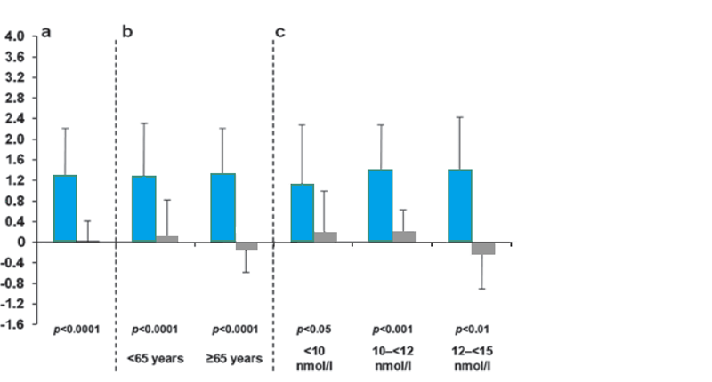
Improvements in LBM independent of age & baseline serum testosterone level
Mean (SD) changes in lean body mass at 6 months with testosterone versus placebo in all patients (a), in patients grouped by age (b) and by baseline serum total testosterone levels (c).
Placebo (6 months)
Transdermal testosterone gel only
Change in lean body mass (kg)
Age group: <65 years: placebo n=121; testosterone gel n=115
≥65 years: placebo n=57; testosterone gel n=68
Behre, HM et al. The Aging Male, 2012; 15(4): 198–207

Slide 5
Improvements in LBM independent of age
<65 years
≥65 years
3.6
Placebo (6 months)
3.2
2.8
Transdermal testosterone
gel only
2.4
Transdermal testosterone gel
following 6 months’ placebo
2.0
*
**
1.6
1.2
* p<0.005
** p<0.0001
Change in lean body mass (kg)
0.8
0.4
0
-0.4
-0.8
-1.2
-1.6
6 months
18 months
6 months
18 months
Age group: <65 years: placebo n=121; testosterone gel n=115
≥65 years: placebo n=57; testosterone gel n=68
Behre, HM et al. The Aging Male, 2012; 15(4): 198–207
Notes:
5

Slide 6
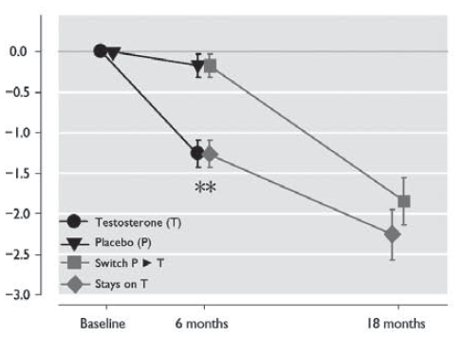
Changes in fat mass, BMD and total body mass
FAT MASS
Change in fat mass from baseline
Significant decreases in fat mass were associated with testosterone therapy.
This decrease in fat mass was similar across subgroups of age, baseline total testosterone & baseline BMI.
The effect on body fat mass was more pronounced in the obese population (i.e. BMI ≥30 kg/m2).
Changes in bone mineral density, bone mass, and total body mass were not significantly different between the randomized groups
Behre, HM et al. The Aging Male, 2012; 15(4): 198–207
Notes:
Significant decreases in fat mass were associated with testosterone therapy; after 6 months, the mean (SD) decrease in fat mass following testosterone and placebo treatment was –1.16 ± 0.16 and – 0.14 ± 0.12 kg, respectively (p < 0.001).
This decrease in fat mass was largely similar across subgroups of age, baseline total testosterone, and baseline BMI.
The effect on body fat mass was somewhat more pronounced in the obese population (i.e. BMI ≥30 kg/m2).
Over the next 12 months of the study there was a statistically significant progressive decrease of fat mass.
In the testosterone treated group at month 18, fat mass had decreased further (by an additional –1.11 ± 0.24 kg to a total of 2.45 ± 0.48 kg. In the placebo group that switched to testosterone after 6 months an almost similar decrease in fat mass was seen at the end of the 18 month study

Slide 7
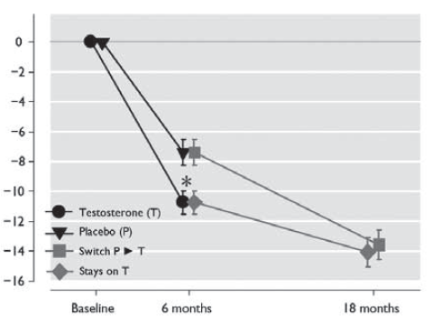
Improvements in Health-Related Quality of Life (AMS)
TOTAL SCORE
Change from baseline in total AMS score
While AMS scale scores improved in both the AndroGel® 1% and the placebo group at 6 months, AndroGel® 1% therapy was associated with significantly greater decreases in the mean AMS total score (p=0.002)
Changes in outcomes during the trial according to treatment status. Error bars represent standard error (SE). *: p < 0.05 for difference between the two groups. **: p < 0.001 for difference between the two groups.

Slide 8
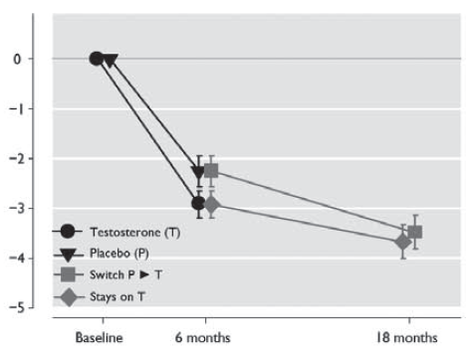
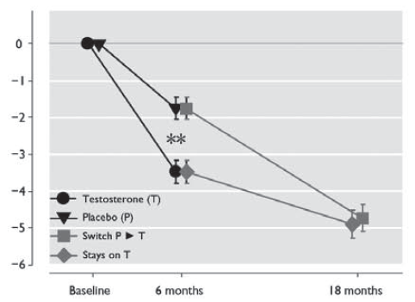
Improvements in Health-Related Quality of Life (AMS)
PSYCHOLOGICAL SCORE
SEXUAL SCORE
Change from baseline in psychological subscale
Change from baseline in sexual subscale
AndroGel® 1% therapy was associated with significantly greater decreases in the mean AMS psychological subscale score (p=0.049), and sexual subscale score (p<0.001)
Changes in outcomes during the trial according to treatment status. Error bars represent standard error (SE). *: p < 0.05 for difference between the two groups. **: p < 0.001 for difference between the two groups.

Slide 9
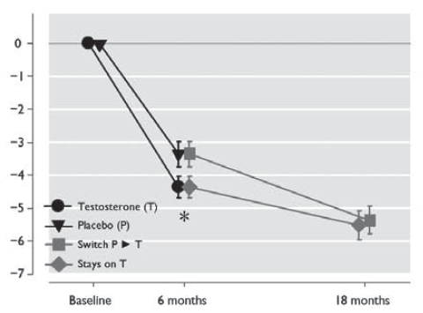
Improvements in Health-Related Quality of Life (AMS)
SOMATIC SCORE
Change from baseline in somatic subscale
AndroGel® 1% therapy was associated with a decrease that approached statistical significance for the somatic subscale score (p=0.053)
Changes in outcomes during the trial according to treatment status. Error bars represent standard error (SE). *: p < 0.05 for difference between the two groups. **: p < 0.001 for difference between the two groups.

Slide 10
Safety Data – Adverse Events
During the double-blind treatment phase, 10/183 (5.5%) and 12/179 (6.7%) patients in the testosterone and placebo groups, respectively, discontinued the study due to adverse events.
Adverse event profiles were similar in the groups receiving testosterone and placebo.
The number of patients experiencing one or more serious adverse events was 7/183 (3.8%) and 6/179 (3.4%) in testosterone and placebo groups, respectively.
Five patients experienced serious adverse events considered to be potentially related to the study medication (testosterone group).
One patient in the testosterone group died of coronary artery disease; this cause of death was not considered related to the study medication.
Behre, HM et al. The Aging Male, 2012; 15(4): 198–207
Notes:
Five patients experienced serious adverse events considered to be potentially related to the study medication (testosterone group). One patient was diagnosed with prostate cancer and subsequently treated with radical prostatectomy. Another underwent a prostate biopsy in which intraepithelial neoplasia was diagnosed, and the third experienced a worsening of prostate-related symptoms which resolved following transurethral resection of the prostate (TURP). A fourth patient had a tendon rupture of the biceps, and a fifth a deep vein thrombosis.

Slide 11
Safety Data – Haematocrit
The number of patients in the testosterone group that discontinued the study due to increased haematocrit (>54%) during the first 6 months of treatment was 2/183 (1.1%).
No patients in the placebo group discontinued due to an increased haematocrit.
In the 12 months extension period 21/249 patients left the study because of elevations of the haematocrit.
Behre, HM et al. The Aging Male, 2012; 15(4): 198–207

Slide 12
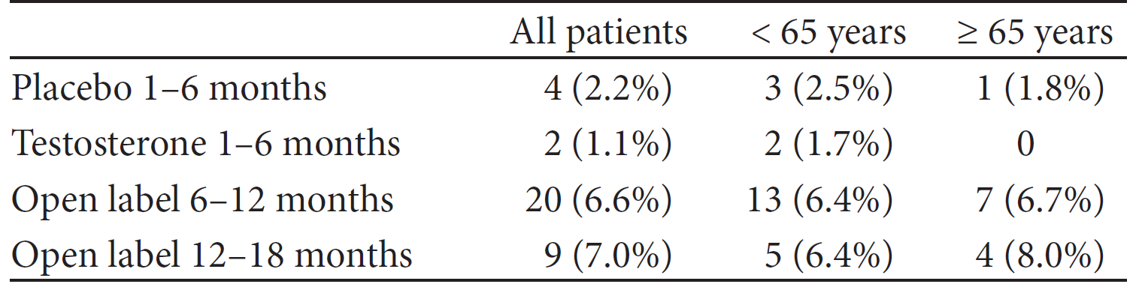
Safety Data – Prostate
Mean International Prostate Symptom Score (IPSS) at baseline and 6 months, respectively, were 7.1 and 6.4 in the testosterone group and 8.1 and 8.7 in the placebo group.
Subsequent treatment with testosterone gel until month 18 resulted in mean values of 6.1.
Abnormal digital rectal examinations at baseline and 6 months were reported in 14.4% and 9.8% of testosterone-treated patients, and 13.6% and 8.5% of patients in the placebo group.
Discontinuations due to increases of serum PSA >1 ng/mL and/or >50% above value at screening
Behre, HM et al. The Aging Male, 2012; 15(4): 198–207

Slide 13
Safety Data – Mean PSA Levels
Placebo/ testosterone gel following 6 months’ placebo
2.0
Transdermal testosterone gel only
1.8
1.6
1.4
1.2
PSA (ng/ml)
1.0
0.8
0.6
0.4
0.2
0.0
Baseline
3
6
9
12
18
Time (months)
Behre, HM et al. The Aging Male, 2012; 15(4): 198–207

Slide 14
SUMMARY
This large, randomized, double-blind, placebo-controlled study demonstrated that 6 months’ treatment with testosterone improves lean body mass and HRQoL and decreases fat mass in men with serum total T < 15.0 nmol/L and symptoms of androgen deficiency.
Treatment increased median testosterone levels by approximately 7 nmol/L
Testosterone therapy was associated with improvements in cardiovascular and metabolic profiles in this population
At the end of the 6-month double-blind study period, 89% of the original 362 patients (i.e. patients from both the AndroGel® 1% and the placebo group) elected to continue with AndroGel® 1% treatment in a 12-month open-label extension phase.
Over this 12-month period there was a progressive decrease in scores on the AMS scale and its subscales indicating progressive improvement of HRQoL.
Transdermal testosterone gel preparation possesses good safety and efficacy profiles when used in the treatment of late-onset hypogonadism
Behre, HM et al. The Aging Male, 2012; 15(4): 198–207
Bouloux PM et al. Results presented at the EAU Congress, Italy 2008.

