Slide 1
Anatomy & Physiology
Besins Healthcare
Global Medical Affairs
March 2021

Slide 2
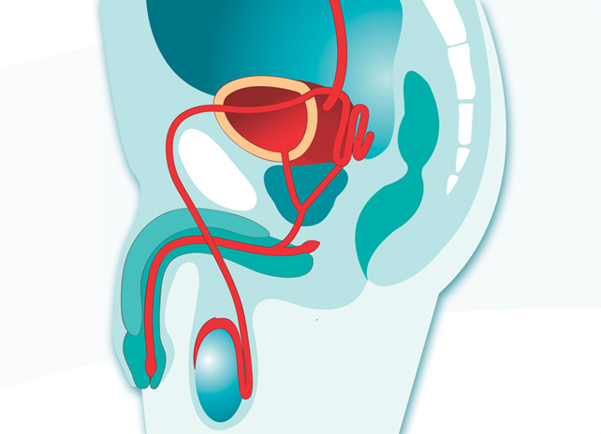
Male Reproductive System
Ureter (from kidney)
Pubic bone
Rectum
Urinary bladder
Seminal vesicle
Erectile tissue
Ejaculatory duct
Urethra
Prostate gland
Accessory gland
Glans penis
Vas deferens
Scrotum
Testis
Epididymis
Notes:
General overview of male reproductive system
Each organ or gland will be discussed in detail with respect to testosterone and spermatogenesis.
Additional information:
Accessory gland = Cowper’s gland or bulbourethral gland
Erectile tissue = corpus cavernosum (above) and corpus spongiosum (surrounding the urethra)
Ejaculatory duct connects the seminal vesicle to the urethra

Slide 3
Scrotum
Sack of skin and smooth muscle
Purpose
Protect testes
Temperature regulation
Scrotum
Notes:
The scrotum is divided intro 2 sacs by a septum of connective tissue. The scrotum not only supports the testes, but by relaxation or contraction of its muscular layer, it helps to regulate the environmental temperature.
When the external temperature is too cold, the scrotum retracts (wrinkles) as the Dartos muscle contracts. The temperature in the human testis is 2-3 degrees C less than that of the core body temperature providing a suitable environment for sperm production. Testicular temperature above 35 degrees C impairs spermatogenesis and the production of viable sperm.

Slide 4
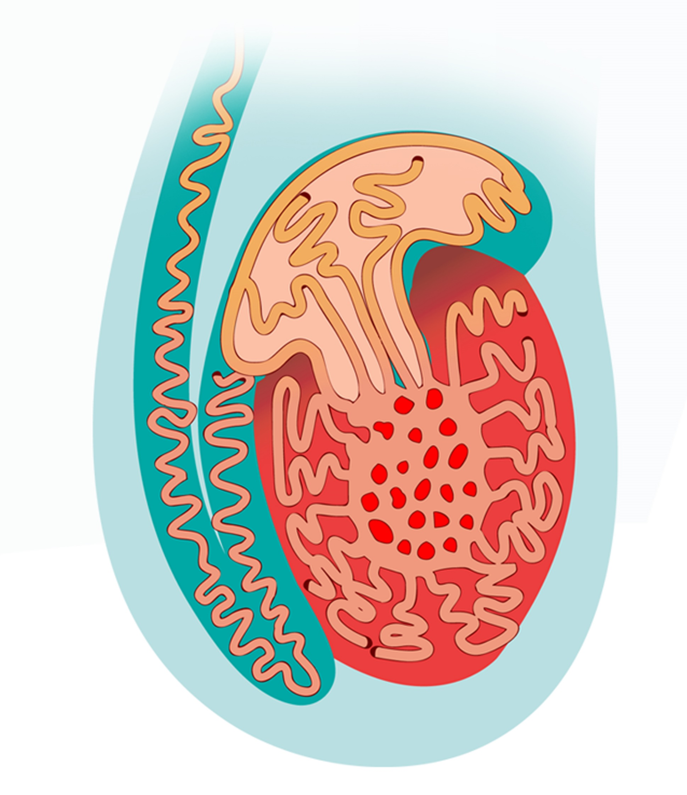
Testes
Testis
Testes, testicles (plural)
On average 4 x 3 x 2.5 cm
Seminiferous tubules
Production and transport of sperm
Leydig cells
Synthesis of androgens
Vas deferens
Epididymis
Seminiferous tubules
Testis
Scrotum
Griffin JE & Wilson JD. In Williams Text book of Endocrinology. 2003: 709-753.
Tanagho EA & McAninch JW. In Smith‘s General Urology. 2003: 1-17, 678-693.

Slide 5
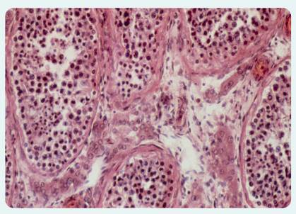
Testes
Interstitial or Leydig cells
Between the seminiferous tubules
Part of endocrine system, having LH receptors
Produce and secrete
testosterone
testosterone precursors (i.e. androstenedione)
estradiol
Interstitial (Leydig) Cells
Photograph courtesy of Astrid & Hanns-Frieder Michler Science Photo Library
Seminiferous tubules
Griffin JE & Wilson JD. In Williams Text book of Endocrinology. 2003: 709-753.
Tanagho EA & McAninch JW. In Smith‘s General Urology. 2003: 1-17, 678-793.
Notes:
The Leydig cells appear foamy because they are composed of esterified cholesterol. This serves as a reservoir of substrate for testosterone synthesis. The conversion of cholesterol to testosterone involves several steps and several other androgens (testosterone precursors) are made during the process: The amount of testosterone stored in the Leydig cells is small because newly synthesized testosterone diffuses promptly into the blood.
The Leydig cells have LH (luteinizing hormone) receptors.
Leydig cells make up 10% of the mass of the adult testes. The Seminiferous tubules and germ cells account for 90%

Slide 6
Testes
Seminiferous tubules
Network of highly convoluted tubules
Sertoli cells (support, FSH receptors)
Germ cells
Functions
Spermatogenesis
Blood-testis barrier
Produce & secrete inhibin / activin
Vas deferens
Epididymis
Seminiferous tubules
Testis
Scrotum
Notes:
The seminiferous tubules comprises 85-90% of testes. Their main function is to produce sperm and so this is why measurement of the testes is critical in the evaluation of infertility.
The seminiferous tubules are lined with Sertoli cells which nurture and control spermatogenesis. They have FSH (follicle stimulating hormone) receptors which allows them to make testosterone available to developing spermatogonia. The Sertoli cells make inhibin (inhibits pituitary FSH production) and activin (activates pituitary FSH production).
Sertoli cells form a tight barrier between the developing spermatozoa and the blood in the capillaries. This prevents penetration of large proteins from the capillaries that surround the tubules and the development of an immune response to the spermatozoa which are considered foreign to the immune system.
The germ cells, spermatogonia, and are inserted within the Sertoli cells forming a very close association. The more mature spermatozoa are closest to the lumen of the tubule.

Slide 7
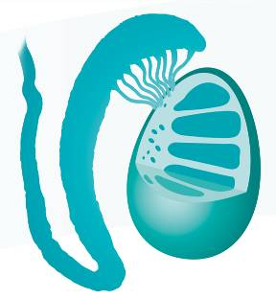
Epididymis
Vas deferens
Purpose
Maturation of sperm
Storage of sperm
Transport of sperm to vas deferens
Epididymis
Seminiferous tubules
Testis
Griffin JE & Wilson JD. In Williams Text book of Endocrinology. 2003: 709-753.
Tanagho EA & McAninch JW. In Smith‘s General Urology. 2003: 1-17, 678-793.
Notes:
The upper portion of the epididymis is connected to the testes by numerous ducts from the testes. The epididymis is a single convoluted tubule 5- 6 meters long that is continuous with the vas deferens at the lower pole.
It has three main functions, maturation, storage and transport of sperm.
Testicular spermatozoa are non-motile and incapable of fertilizing ova when they arrive in the epididymis. Within the epididymis, the spermatozoa mature and gain the ability to swim as the flagellum completes development resulting in progressive motility and fertilizing ability.
440 million sperm are stored outside of the testes with approximately 50% in the tail of the epididymis.
The transit time of sperm through the epididymis is 10-15 days.

Slide 8
Prostate Gland
Fibromuscular and glandular organ
Consists of 5 lobes
anterior, posterior, median, right lateral, left lateral
Contains
Prostatic urethra
Ejaculatory duct
Normal weight is 20g
Prostate gland
Tanagho EA & McAninch JW. In Smith‘s General Urology. 2003: 1-17, 367- 385.
Notes:
The prostate is a fibromuscular and glandular organ lying just inferior to the bladder. The prostate contain abundant amounts of smooth musculature and this represents the true smooth involuntary sphincter of the posterior urethra.
The prostatic urethra runs through the gland and is about 2.5 cm long. The ejaculatory duct which is formed duct from the seminal vesicle enters the vas deferens joins the prostatic urethra in the prostate gland.
The normal prostate weighs 20 g and measures 2-4 cm at the base, 4-6 cm vertically and 2-3 cm horizontally.
The prostate consists of 5 lobes: anterior, posterior, median, right lateral and left lateral. The prostate has a peripheral zone, a central zone and a transitional zone.
Benign prostate hyperplasia is the most common benign tumor in men and its incidence is age related. the prostate becomes enlarged which affects the urination stream.
Prostate cancer is the most common cancer amongst men in the USA and the second most common malignant cause of male death worldwide after lung cancer. The life time risk for a 50 year old man of having:
a) microscopic evidence of prostate cancer is 40%
b) clinically apparent prostate cancer is 9.5%
c) dying from the cancer is 2.9% .
The posterior lobe is prone to cancerous degeneration.

Slide 9
Transporting System
Vas Deferens
From epididymis to ejaculatory duct
Ejaculatory Duct
From the vas deferens and seminal vesicle to the urethra
Urethra
Transports sperm/ejaculate and urine to the outside through the penis
Seminal vesicle
Ejaculatory duct
Prostatic Urethra
Vas deferens
Urethra
Tanagho EA & McAninch JW. In Smith‘s General Urology. 2003: 1-17.
Notes:
The vas deferens or ductus deferens is a narrow, muscular tube that connects the testicles (where sperm is produced) to the urethra.
When the vas deferens is joined by the duct from the seminal vesicles, it becomes the ejaculatory duct and this passes through the prostate to join with the prostatic urethra.
Seminal fluid is mucoid material composed of nutrients, sugars (fructose), citric acid, prostaglandins and fibrinogen.
During ejaculation, the sperm flows out of the testicles, through the vas deferens, and into the urethra that leads outside the body through the penis.
The urethra transports both urine and sperm to outside of the body.
Vasectomy is performed for contraception. in this operation, the vas deferens is blocked (thus sperm has no exit route out of testicles).
Seminal Volume: 10% fluid and sperm from vas deferens
60% fluid from seminal vesicles
30% fluid from prostate gland
~1% fluid from accessory gland (bulbourethral gland)
Semen: Prostaglandins,
Fructose (fuel source),
Neutralizes acidic vagina (pH ~7.5)

Slide 10
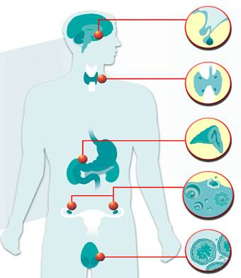
Endocrine System
Pineal body
Pituitary
Anterior lobe
Internal system
Releases hormones into bloodstream
Hormone examples
Testosterone
Progesterone
Estradiol
Cortisol
Posterior lobe
Thyroid
Parathyroid
Stomach
Cortex
Adrenal
Medulla
Duodenum
Ovaries (females)
Follicle
Pancreas
(Islets of Langerhans)
Corpus luteum
Endocrine cells
Testis
(males)
Sperm producing
cells
Griffin JE & Wilson JD. In Williams Text book of Endocrinology. 2003: 1-9.
Notes:
In comparison, the exocrine system excretes outwards, i.e. pancreas enzymes.

Slide 11
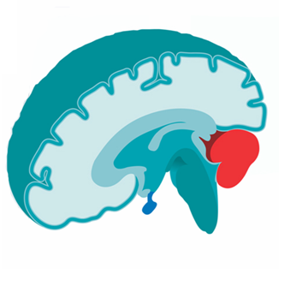
Hypothalamus
Hormone regulator (“Master regulator”)
Signals the brain and nervous system including
the pituitary gland
Produces hormones
e.g. gonadotropin releasing hormone (GnRH)
Hypothalamus
Griffin JE & Wilson JD. In Williams Text book of Endocrinology .2003: 82-92.
Notes:
The Hypothalamus allows mammals to maintain homeostasis and destruction of the hypothalamus is not compatible with life. The hypothalamus receives sensory inputs from the external environment (e.g. light, pain, temperature) and information regarding the internal environment (e.g. blood pressure, blood glucose levels). In additional, hormones exert negative feedback directly on the hypothalamus.
The hypothalamus consists of neuronal tissue.
Control Center/Coordinator of endocrine system and limbic system (emotional behavior & motivational drives)
- Cardiovascular regulation (control HR and BP)
- Thermostat – Temperature control
- Water and electrolyte regulation
- Hunger and GI regulation
- Sleep and wake
- Sexual response
- Emotions
- Endocrinology

Slide 12
Pituitary
Pituitary / Hypophysis
“Master” Gland
Three Sections
Anterior lobe
Intermediate lobe
Posterior lobe
Pituitary gland
Griffin JE & Wilson JD. In Williams Text book of Endocrinology. 2003: 82-92.
Notes:
The pituitary controls functions of all endocrine glands.
The pituitary gland, or hypophysis, is an endocrine gland about the size of a pea that sits in a small, bony cavity (sella turcica) at the base of the brain.
The pituitary gland secretes hormones regulating homeostasis, including tropic hormones that stimulate other endocrine glands.

Slide 13
Pituitary
Anterior Lobe
Prolactin
Luteinizing hormone (LH)
Follicle-stimulating hormone (FSH)
Adrenocorticotropin hormone (ACTH)
Thyroid-stimulating hormone (TSH)
Growth hormone (GH)
Pituitary gland
Griffin JE & Wilson JD. In Williams Text book of Endocrinology. 2003: 82-148.
Notes:
The pituitary is made up of the:
Anterior lobe which secretes the following hormones:
Prolactin – stimulates mammary gland for milk production
LH (Luteinizing Hormone) – stimulates the Leydig cells
FSH (Follicular–Stimulating Hormone) – stimulates the Sertoli cells
ACTH (AdenoCorticoTropin hormone) – stimulates adrenal cortex to produce glucocorticoids (i.e., cortisol) - stress management
TSH – simulates thyroid gland to produce thyroid hormones for cellular differentiation, cell growth and metabolism
– stimulates calcitonin secretion which is involved in calcium and potassium homeostasis – bone physiology
GH (Growth Hormone) – is involved with growth and metabolism
- Stimulates fat cells to break down triglycerides
- Stimulates liver to produce IGF-1 with growth promoting effects on multiple tissues
- Important for controlling background metabolic function of testes, specifically promotes early division of spermatogonia
Intermediate Lobe which secretes: melanocyte-stimulating hormone
Posterior Lobe which secretes the following hormones:
Vasopressin (antidiuretic hormone)
Oxytocin – milk let down & uterine smooth muscle contraction

Slide 14
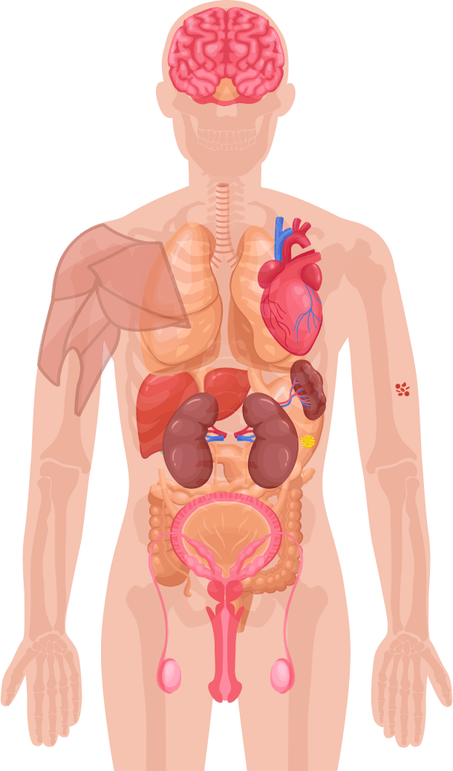
Role of Testosterone in Men’s Health
Mood, Cognitive ability¹
Bone mass¹
Muscle mass, strength¹
Red blood cell production¹
Fat distribution¹
Sexual function, sexual desire and sperm production¹
1. Hackett G, et al. British Society for Sexual Medicine Guidelines on Adult Testosterone Deficiency, With Statements for UK Practice. J Sex Med 2017;14:1504-1523.
Notes:
Testosterone is a sex hormone that is important to health.
In men, testosterone is believed to regulate:¹
Sexual function and sexual desire
Bone mass
Fat distribution
Muscle mass and strength
Production of red blood cells
Production of sperm
Mood
Cognitive ability

Slide 15
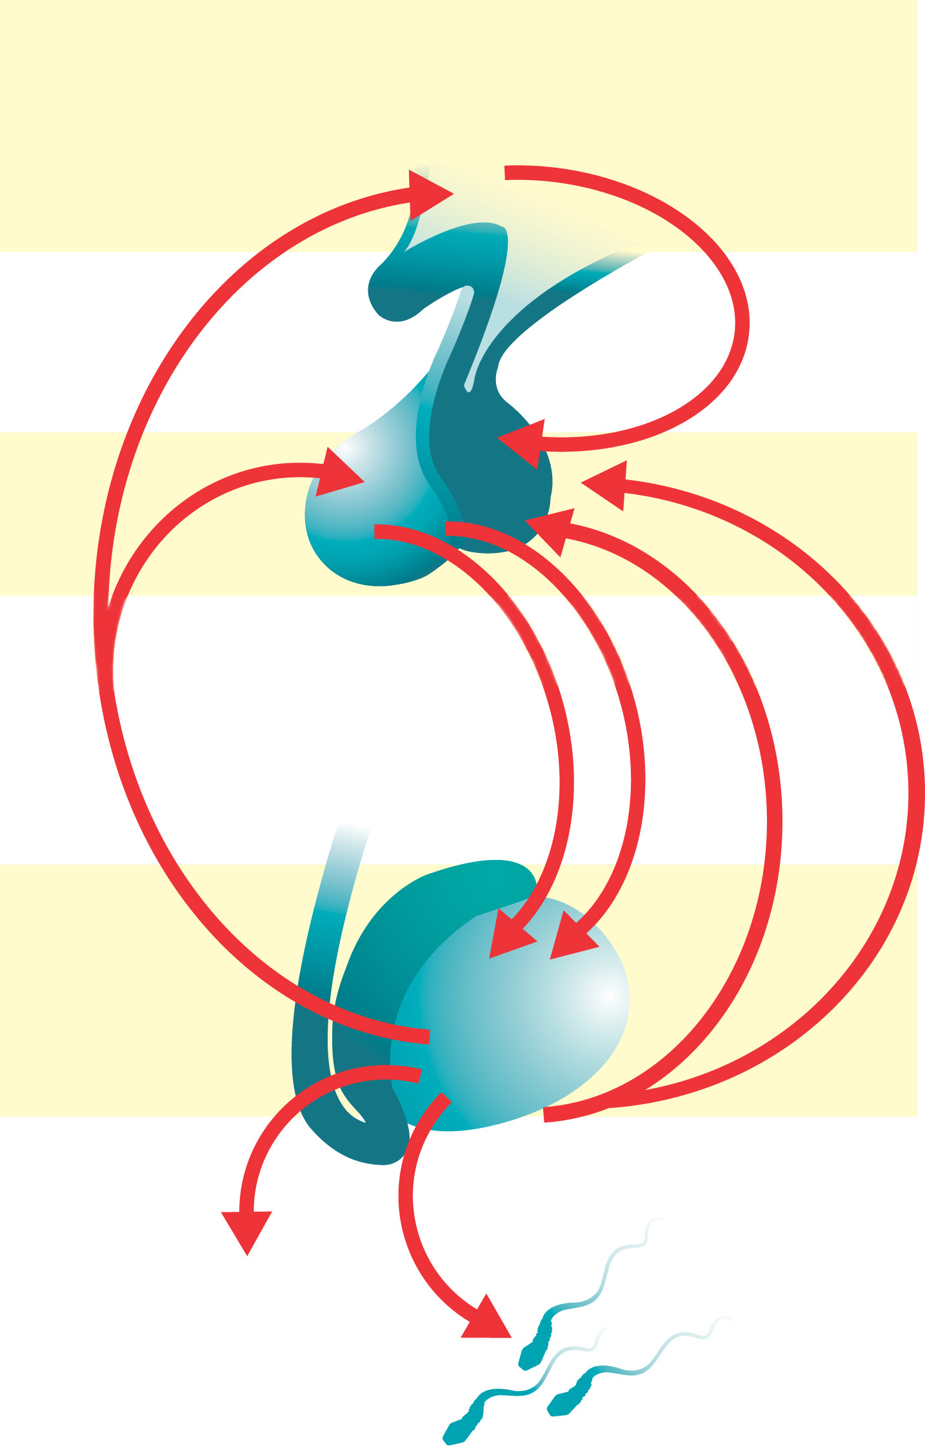
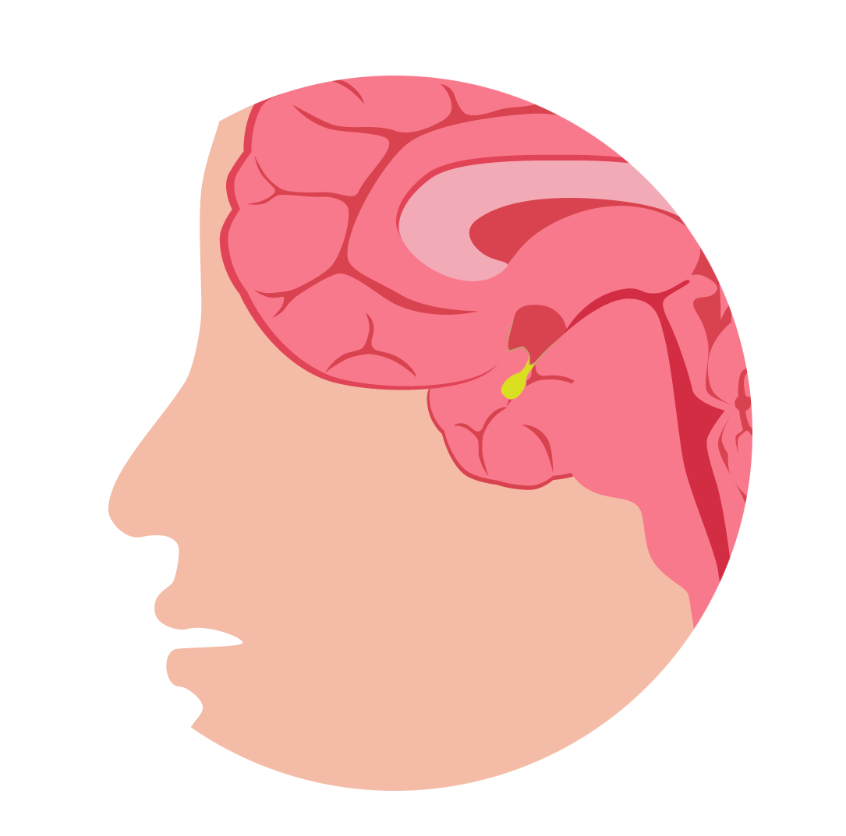
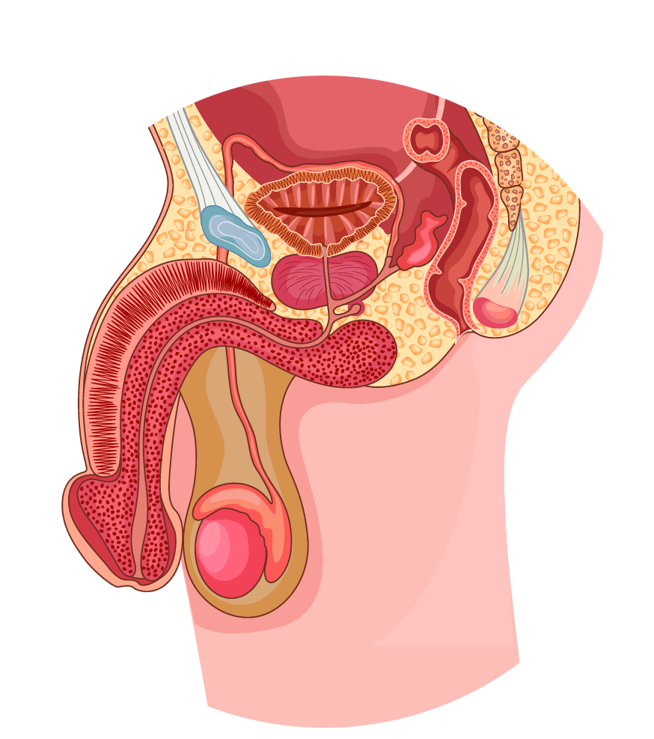
Testosterone Physiology - Production
Hypothalamic–Pituitary–Testicular (HPT) Axis
Hypothalamus
Pituitary gland
GnRH
Anterior pituitary
Prostate gland and gonadal tissue
Activin
Testosterone
LH
FSH
Inhibin
LH receptor¹
Testis
Testosterone
Sperm
Adapted from Dandona P & Rosenberg MT. 2010¹
1. Dandona P & Rosenberg MT. A practical guide to male hypogonadism in the primary care setting. J Clin Pract 2010.64(6):682-696.
Notes:
In the brain, the hypothalamus releases gonadotropin-releasing hormone (GnRH) in a pulsatile manner every 60-90 minutes (for a few minutes at a time), stimulating the release of luteinising hormone (LH) from the pituitary gland into the bloodstream¹
LH binds the LH receptor on the Leydig cells of the testes¹
Leydig cells are composed of cholesterol¹
Via a cascade of events, cholesterol is converted into testosterone¹
Testosterone is then secreted by the testes into the bloodstream to be carried to target tissues to exert its biological effect:¹
- In liver, muscle and adipose tissue, testosterone binds directly to its androgen receptor (AR)
- In skin, hair, prostate gland and gonadal tissue, testosterone is first converted to dihydrotestosterone (DHT)
- In bone and brain, testosterone is first converted to oestradiol
Testosterone has multiple effects on the body. In the brain, it stimulates libido and aggression and aids cognition, memory, and feelings. In the kidneys, it promotes erythropoiesis. In the skin, it supports collagen production and stimulates hair growth and sebum production. Testosterone also affects muscle mass and strength, bone growth, density and erythropoiesis (red blood cell production – think haematocrit/haemoglobin), growth of the sex organs, spermatogenesis, and erectile function.¹
T is a steroid hormone that is produced primarily in the testes (> 95% from Testes) with the remainder being produced from the adrenal cortex
GnRH = Gonadotropin Releasing Hormone.
The plus signs indicate stimulatory effects.
The minus signs indicate inhibitory effects.
As the structure of human chorionic gonadotropin (hCG) and LH are similar, they both have similar effects as LH on Leydig cells and T production

Slide 16
Gonadotropins
FSH
Stimulates Sertoli cells in spermatogenesis
Stimulates ovarian follicle maturation & secretion of estrogens
LH
Stimulates Leydig cells to produce testosterone
Triggers ovulation & indirect secretion of progesterone
Notes:
Sertoli cells produce androgen-binding protein which binds T & E2 to support spermatogenesis

Slide 17
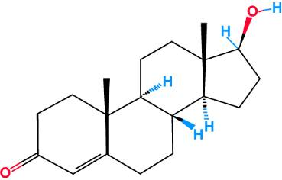
Testosterone
Major androgen in man
95% synthesized by Leydig cells, from cholesterol
Secreted into the bloodstream
Necessary for
fetal male sexual differentiation
puberty
maintenance of secondary male sex characteristics
Notes:
Androgen: substance (endogenous = steroid derivatives of androstane) that stimulates activity of the accessory male sex organs, promotes development of male sex characteristics or prevents changes in the latter that follow castration
95% of the testosterone is synthesized by testes the rest by adrenal gland.
The male fetal testes secrete T at ~9-10th week of embryonic life. Testosterone is important for the development of male genitals, prostate gland, seminal vesicles & male genital ducts. It is needed for decent of testes into scrotum during last 2-3 months gestation. It is important for the developmental changes at puberty and the maintenance of male secondary sex characteristics.

Slide 18
Testosterone fractions in the blood
60% of testosterone in the blood is tightly bound to SHBG
A further 38% is loosely bound to albumin.
Only 2% of the testosterone in the blood is free testosterone
The albumin-bound and the free testosterone portions make up the bio-available testosterone
SHBG, sex hormone-binding globulin; T, testosterone
Figure adapted from Anawalt BD & Braunstein GD. Testes; In Greenspan’s Basic & Clinical Endocrinology 10th Edition. Gardner DG & Shoback D, McGraw-Hill Education, 2018
Notes:
Normal range in men: 300 – 1200 ng/dL
(factor = 0.03467; 10.4 – 41.6 nmol/L),
Normal also reported as 3 – 10 ng/mL
Normal range in women 30 – 95 ng/dL (1.0 – 3.3 nmol/L)
Bilateral orchidectomy reduces T to < 0.3 ng/mL
On average 6mg of testosterone is secreted into the plasma each day and only 25μg is stored in the normal testes.
Reference normal range may vary depending on the laboratory.

Slide 19
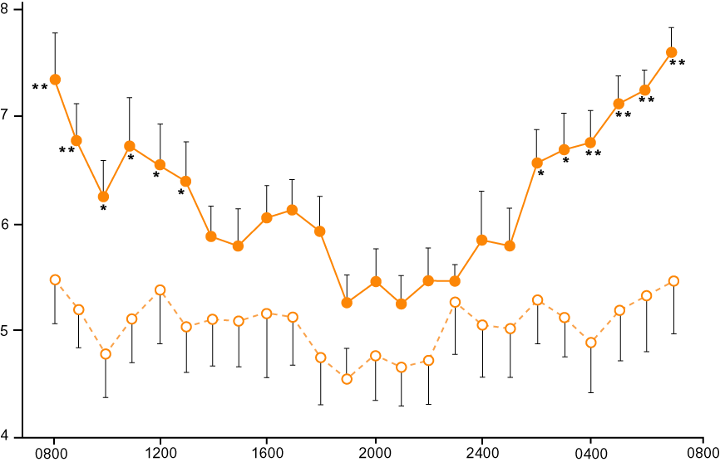
Testosterone Circadian Rhythm in Men
Clock time (Hours)
Notes:
Testosterone levels are determined usually at early morning because circulating levels are at their highest at that time, so the result shows the baseline level of testosterone concentration that can then be used to determine whether the patient is truly hypogonadal or not.
Tenover JS, Matsumoto AM et al.
Age-related alterations in the circadian rhythms of pulsatile luteinizing hormone and testosterone secretion in healthy men.
J Gerontol. 1988 Nov;43(6):M163-9.
Twenty young (average age 30.4 yrs) and 14 elderly (average age 70.4 yrs) men underwent 10 min blood sampling for 25 hrs to evaluate the circadian periodicity of LH, LH pulse frequency, and T. Using cosinor regression analysis, young men were found to have a significant (p less than .05) circadian variation in LH pulse frequency, with slowing of LH pulses during the night (maximum slowing at 2230 hr). There was also a tendency for LH pulse amplitude to increase at night (p = .06) in young men. However, no significant circadian pattern in LH pulse frequency or amplitude was detected in the elderly men. Mean LH by radioimmunoassay (RIA) and bioassay did not vary over the 24-hr period in either age group. Both young and elderly men had significant circadian rhythms in serum T, although the rhythm in elderly men was considerably blunted and was shifted in time compared to the young. These data provide evidence for age-related changes in the circadian rhythms of LH pulse frequency and T secretion and suggest that the LHRH pulse generator loses its circadian rhythmicity with normal aging in men.

Slide 20
Testosterone Physiology - Metabolism
Primarily by the liver
Two active metabolites
Dihydrotestosterone
(via 5 alpha-reductase)
Estradiol
(via aromatase)
Figure adapted from Molina PE. Male Reproductive System. In: Raff H, Levitzky M, eds. Medical Physiology: A Systems Approach: The McGraw-Hill Companies; 2011: 683-694.
Notes:
At its target cells testosterone can have a direct androgen receptor-mediated effect, or alternatively it may be metabolized to 17β-estradiol through the action of aromatase or to 5α-dihydrotestosterone (DHT) through the action of 5α-reductase.¹
Aromatase is expressed in Sertoli cells as well as in extragonadal tissues including the brain and adipose tissue; the majority of estradiol in males is produced in adipose tissue through the aromatisation of testosterone.
Testosterone is converted to DHT in many target organs including the skin, liver, brain, prostate, testes, hair follicles, epididymis, and seminal vesicle.
DHT is highly biologically active – three- to six-fold compared to testosterone.²
In many tissues, the activity of testosterone depends on its conversion to DHT, which also binds to the cytosolic androgen receptor. Subsequently, the steroid-receptor complex is translocated to the nucleus where it initiates the transcription and cellular changes related to androgen action.³
The major route of testosterone metabolism is in the liver. Testosterone is converted into androsterone & dehydroepiandrosterone which are then conjugated into glucuronides and sulfates and excreted in liver bile (gut, 6%) or urine (90%).
References: 1. Molina PE. Male Reproductive System. In: Raff H, Levitzky M, eds. Medical Physiology: A Systems Approach: The McGraw-Hill Companies; 2011: 683-694. 2. Weinbauer G, Luetjens C, Simoni M, Nieschlag E. Physiology of Testicular Function. In: Nieschlag E, Behre H, Nieschlag S, eds. Andrology: Springer Berlin Heidelberg; 2010: 11-59. 3. Griffin JE, Wilson JD. Disorders of the testes and the male reproductive tract. In: Larson PR, Kronenberg HM, Melmed S, Polonsky KS, eds. Williams Textbook of Endocrinology. Philadelphia: W. B. Saunders; 2003: 709-769.

Slide 21
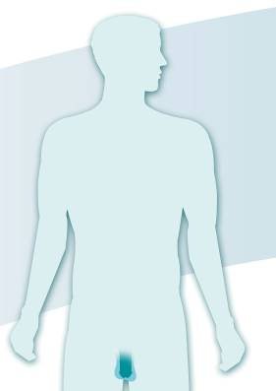
Primary Androgen Effects
Puberty / virilization
Sexual function and behavior
Build protein
Metabolic activities
Facial hair appears and acne may develop
Larynx enlarges and voice deepens
Axillary hair appears
Musculature develops
Pubic hair grows
Penis, seminal vesicles and prostate enlarge
Notes:
Virilization – the development of secondary sexual male characteristics
Primary androgen effects include primary & secondary sexual characteristics:
Primary sexual characteristics: enlargement of penis, scrotum, testes and prostate
Secondary sexual characteristics: pubic hair, increased muscular development, facial hair, etc.

Slide 22
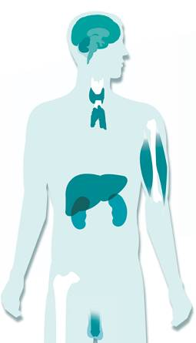
Other Androgen Effects
Brain - libido, mood
Skin - hair growth, balding, sebum production
Muscle - increase in strength and volume
Liver - synthesis of serum proteins, lipids, cholesterol
Kidney - stimulation of erythropoietin production
Synovial Tissue - modulation of the immune response
Bone marrow - stimulation of stem cells
Bone - increase bone density, accelerate linear growth
Male sexual organs - penile, testicular & prostate growth and function
Bagatell CJ, Bremner WJ. N Eng J Med 1996; 334: 707-714.
Griffin JE & Wilson JD. In Williams Text book of Endocrinology. 2003: 709-753.
Notes:
Brain – Androgens have a key role in stimulating and maintaining sexual function in men. Most men notice increased libido, energy and strength within days after starting androgen therapy.
Skin – Axillary and pubic hair respond to low levels of androgens. Hair on the face, and chest require higher concentrations. Sebum production is androgen dependent.
Liver- Androgens increase the synthesis of clotting factors and decrease the synthesis of sex hormone binding globulin and fibrinogen. Men generally have a lower plasma concentration of HDL cholesterol and higher triglycerides, LDL cholesterol compared to premenopausal women.
Hematogologic and immunologic effects – Androgens stimulate the production of erythropoietin in the kidneys , thereby increasing the hemoglobin concentrations. Previously before use of synthetic erythropoietin, androgens were frequently used for anemia and other chronic diseases. The incidence of autoimmune disease is higher in women than men. Men with Kleinfelter’s syndrome have a higher incidence of autoimmune disease compared to men with normal gonadal function.
Bone – A growth spurt and an increase in bone density occurs during puberty in boys. Hypogonadism is an important risk factor for osteoporosis. The benefits on bone are probably from conversion to estrogen.

Slide 23
Anatomy & Physiology Questions
1. Testosterone is mainly produced in:
Ovary
Leydig cells
Sertoli cells
Prostate
Human brain
(choose 1 answer)

Slide 24
Anatomy & Physiology Questions
2. Spermatogenesis takes place in the:
Ovary
Leydig cells
Uterus
Seminiferous tubules
Epididymis
(choose 1 answer)

Slide 25
Anatomy & Physiology Questions
3. Hypothalamus secretes:
FSH and LH
Testosterone
GnRH in pulses
GnRH continuously
Electrical pulses
(choose 1 answer)

Slide 26
Anatomy & Physiology Questions
4. What is the purpose of the scrotum?
Secretes LH
Protects the testes
Maintains testicular temperature below body temperature
Keeps the testes at above body temperature
(choose >1 answer)

Slide 27
Anatomy & Physiology Questions
5. What gives NEGATIVE FEEDBACK to the hypothalamus and pituitary gland?
Both Testosterone and Inhibin
Inhibin but not Testosterone
Gonadotropin releasing hormone
Luteinizing hormone
(choose 1 answer)

Slide 28
Anatomy & Physiology Questions
6. Testosterone is mainly metabolized?
In the kidneys
To estradiol & dydrogesterone
In the liver
To estradiol & dihydrotestosterone
To cholesterol
(choose 1 answer)

Slide 29
Anatomy & Physiology Questions
7. Testosterone is RESPONSIBLE for?
Virilization
Sexual behavior
Muscle development
Higher voice
Acne
Auxillary & pubic hair growth
(choose >1 answer)

Slide 30
Anatomy & Physiology Questions
8. Which are the main cells that FSH stimulates?
Leydig Cells
Spermatozoa
Sertoli cells
Erythrocytes
(choose 1 answer)

Slide 31
Anatomy & Physiology Questions
9. Which cells does LH stimulate?
Leydig Cells
Spermatozoa
Sertoli cells
Erythrocytes
(choose 1 answer)

Slide 32
Anatomy & Physiology Questions
10. Which enzyme converts testosterone to estradiol?
Lipase
Aromatase
5-alpha reductase
Amylase
(choose 1 answer)

Slide 33
Anatomy & Physiology Answers
Q1: Leydig cells
Q2: Seminiferous tubules
Q3: GnRH in pulses
Q4: Protects the testes & maintains them below body temperature
Q5: Testosterone and inhibin
Q6: In the liver
Q7: Virilization, muscle development, acne, auxiliary and pubic hair growth, sexual behaviour
Q8: Sertoli cells
Q9: Leydig cells
Q10: Aromatase

